Slide 1
Georgia School Superintendents Association
April 16, 2025

Slide 2
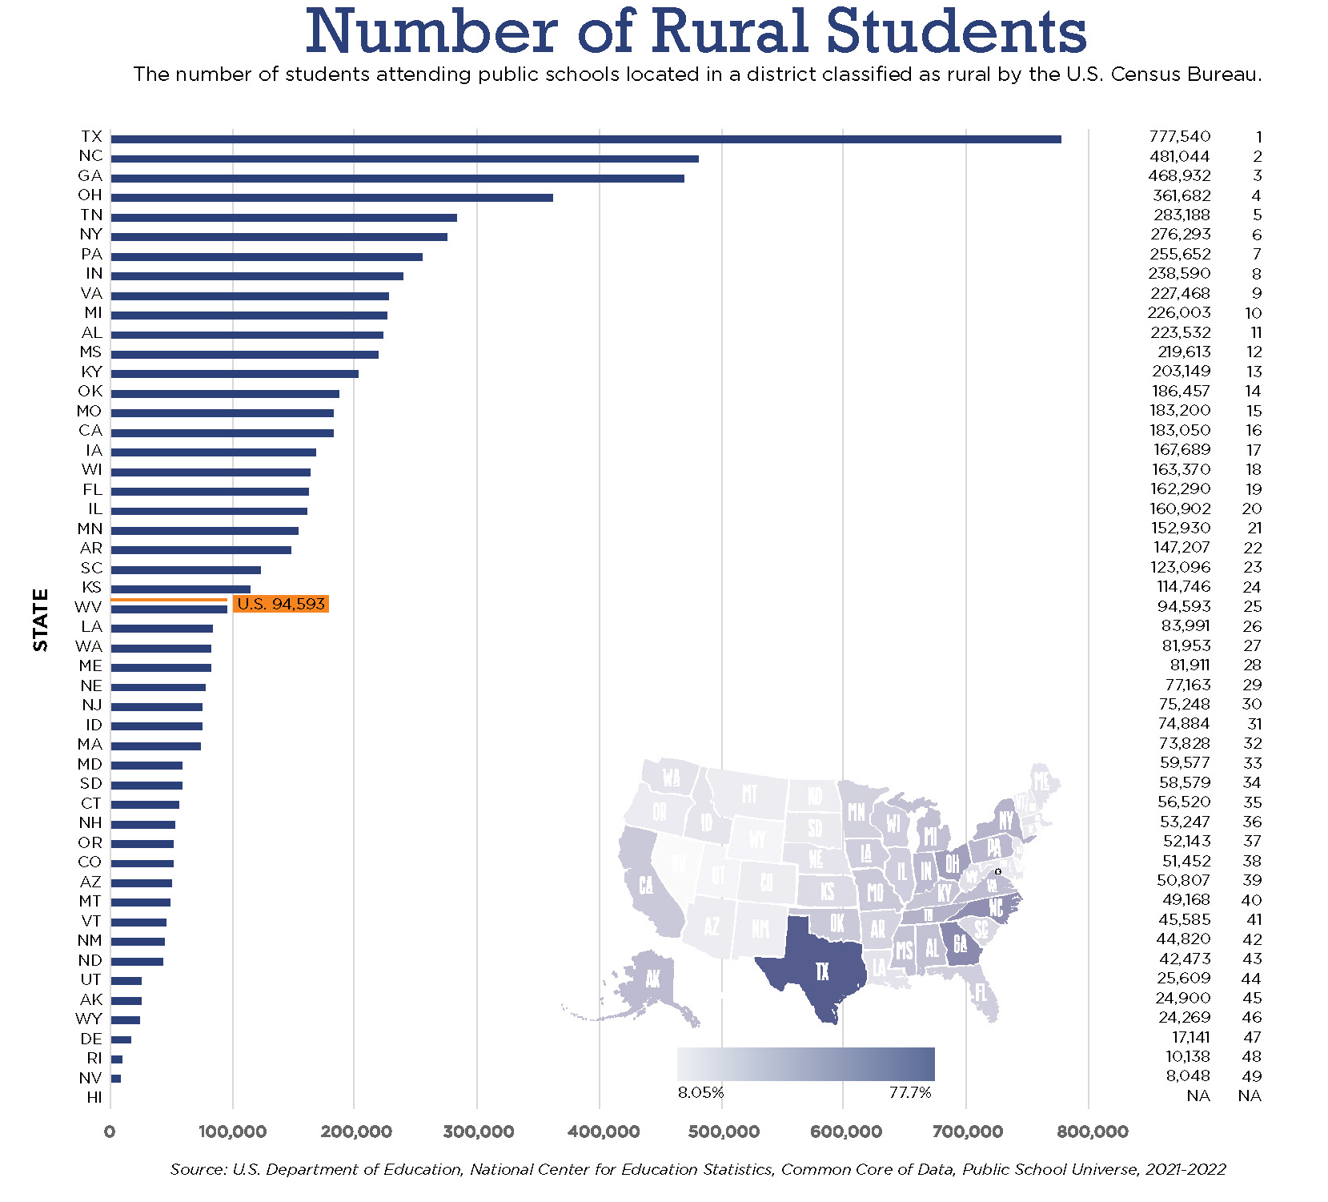
Number of Rural Students
The number of students attending public schools located in a district classified as rural by the U.S. Census Bureau.
TX
777,540
1
NC
481,044
2
GA
468,932
3
100,000
200,000
300,000
400,000
500,000
600,000
700,000
Image from Why Rural Matters 2023 by The National Rural Education Association
Notes:
Why Rural Matters Source: U.S. Department of Education, National Center for Education Statistics, Common Core of Data, Public School Universe, 2021-2022

Slide 3

Politics
Politics is who gets what, when, and how.
Dr. Harold Lasswell
Political Scientist and Communications Theorist

Slide 4
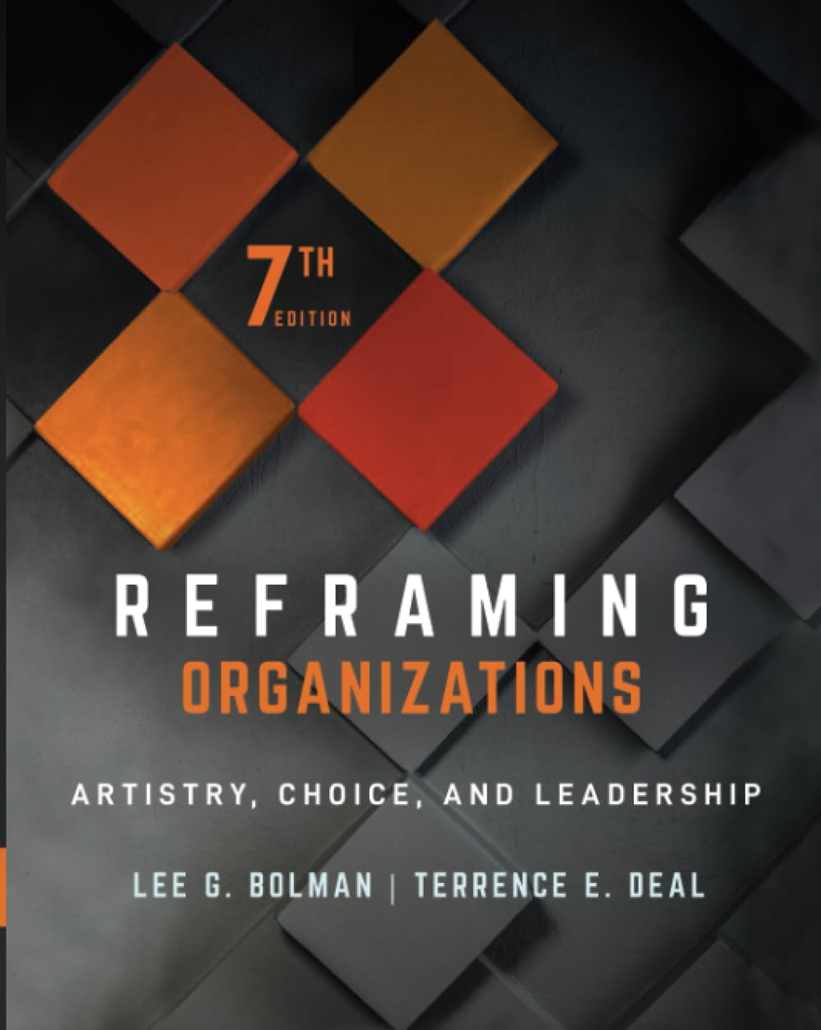
The traditional view sees organizations as created and controlled by legitimate authorities who set goals, design structure, hire and manage employees, and ensure pursuit of the right objectives.
The political view frames a different world: Organizations are coalitions composed of individuals and groups with enduring differences who live in a world of scarce resources. That puts power and conflict at the center of organizational decision making.
Reframing Organizations: Artistry, Choice, and Leadership
Lee G. Bolman and Terrence E. Deal, 2021, p. 209

Slide 5
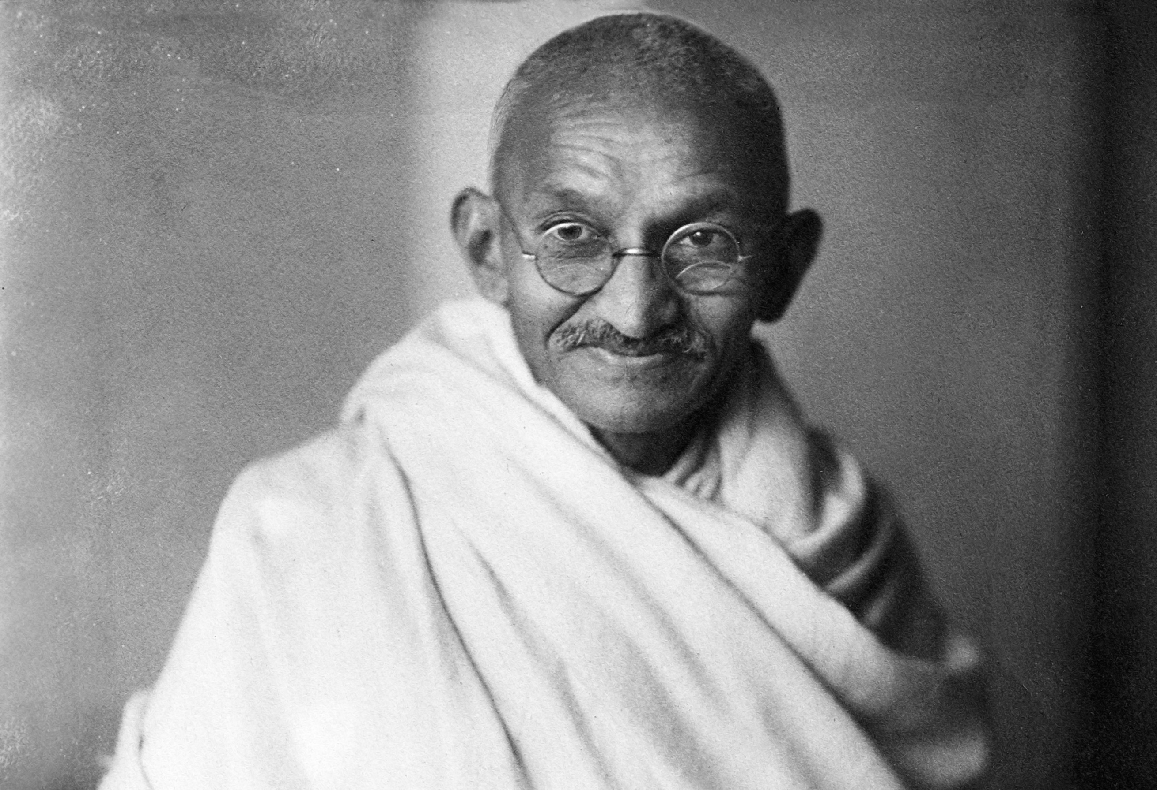
Seven Deadly Sins
Wealth without work
Pleasure without conscience
Science without humanity
Knowledge without character
Politics without principle
Commerce without morality
Worship without sacrifice
Mahatma Gandhi
Gandhi image royalty free / copyright expired

Slide 6
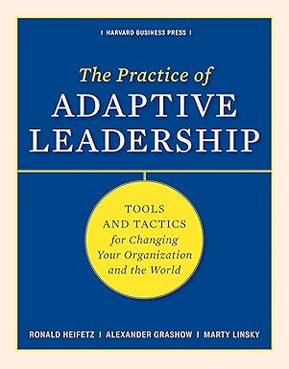
The most common cause of failure in leadership is produced by treating adaptive challenges as if they were technical problems.
The Practice of Adaptive Leadership:
Tools and Tactics for Changing Your Organization and the World
Ronald Heifetz, Alexander Grashow, and Marty Linsky, 2009, p. 19

Slide 7
Technical problems … have known solutions.
Adaptive challenges can only be addressed through changes in people’s priorities, beliefs, habits, and loyalties.
The Practice of Adaptive Leadership, p. 19

Slide 8

The Climate of Complaint
Taking a romantic view of the past in relation to the present often translates into misguided policies and acerbic commentary, summed up in the battle cry “back to the basics.” But how, it should be asked, can we go back to where we have never been.
Shaking Up the Schoolhouse: How to Support and Sustain Educational Innovation
Phillip C. Schlechty, 2001, p. 7

Slide 9
Educational Attainment (percentage of persons 25 years and older)
Source: U.S. Census Bureau

Slide 10
The Problem Defined
Expectations
Performance
1900
1950
2000
Present

Slide 11
What is different today?
National politics is now local
Legislators are usurping the authority of local school boards
School leaders are confronted with more issues of morality
Church-state boundaries are being challenged
Privatization has more political and financial support (although I am not sure it has more public support)
Funding cuts are more about sending a message than about fiscal responsibility

Slide 12
Politics
Partisanship

Slide 13
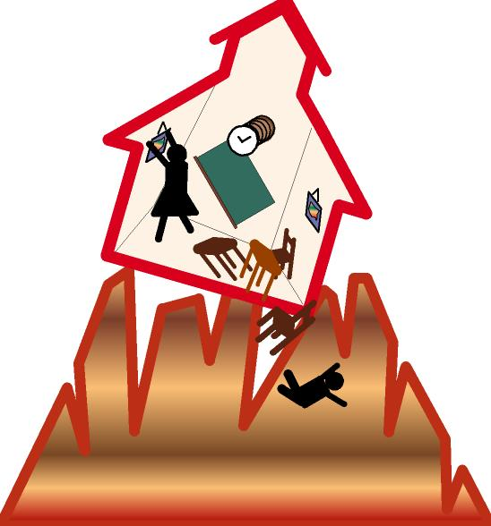
Seismic Shifts

Slide 14
Competition for Hearts and Minds of Children
Social Media
Attention—Screens vs. Schoolwork
Artificial Intelligence
Virtual School
Homeschool
Privatization, Including Vouchers

Slide 15
Common Good
Particular Interests

Slide 16
Our Tax Dollars
My Tax Dollars

Slide 17
Parents as Shrinking Majority
Much of the rhetoric surrounding the voucher movement is based on “the rights of parents to choose.” What is overlooked is that when the right of parents to unfettered choice is guaranteed then the nonparents, who now pay the majority of the taxes, lose even the semblance of control over the way their money is to be spent. Education under these circumstances becomes an entitlement and a private right rather than a civic duty and a public good . … In the long run, this condition can serve only to further estrange senior citizens and nonparent taxpayers from the schools.
Shaking Up the Schoolhouse: How to Support and Sustain Educational Innovation
Phillip C. Schlechty, 2001, p. 13

Slide 18

In the short term, what individual parents want for their children may not be in the general interest or promote the common good. For example, in 1945, few white parents in the South were demanding that schools be desegregated. Today, few Americans, including those from the South, would publicly defend separate but equal as anything other than separate and evil.
Inventing Better Schools: An Action Plan for Educational Reform
Phillip C. Schlechty, 1997, p. 80

Slide 19
Community
Groups

Slide 20
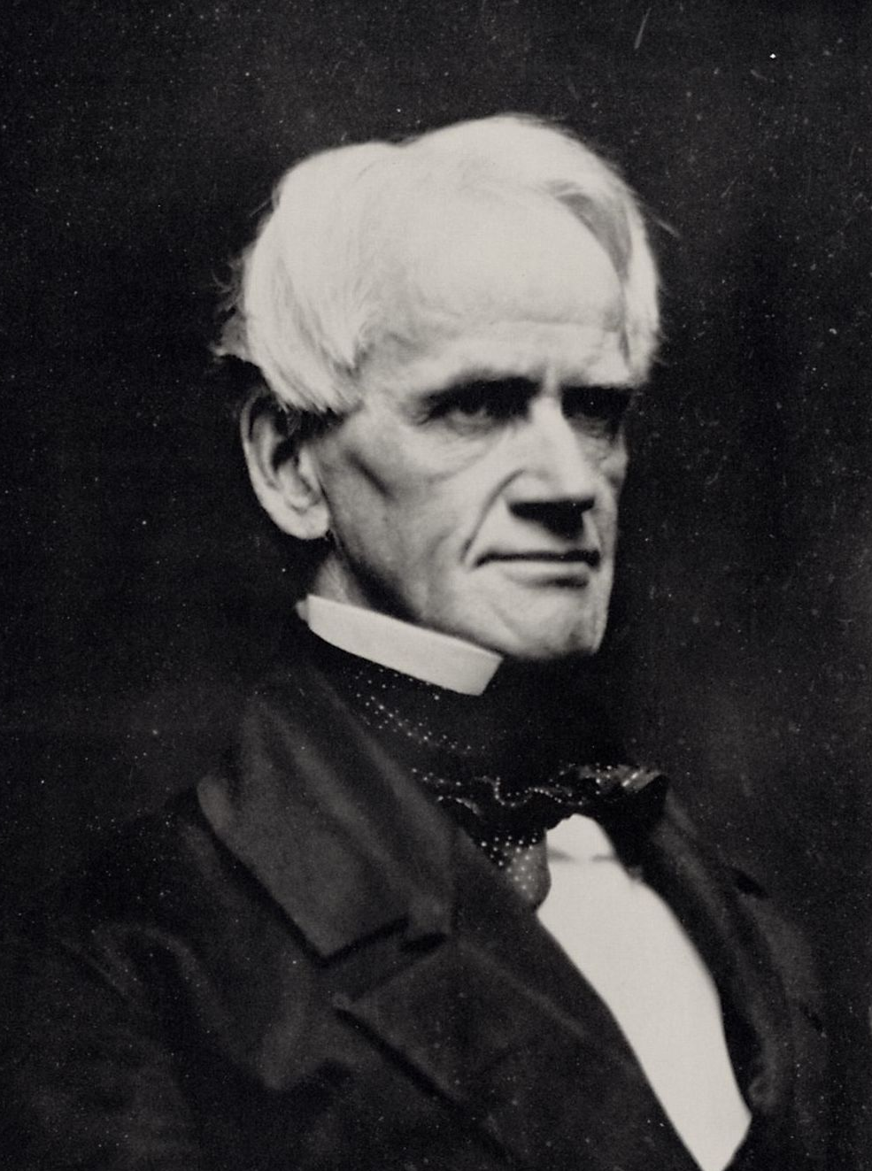
[Horace Mann] spearheaded the Common School Movement, ensuring that every child could receive a basic education funded by local taxes. His influence soon spread beyond Massachusetts as more states took up the idea of universal schooling.
Mann's commitment to the Common School sprang from his belief that political stability and social harmony depended on education: a basic level of literacy and the inculcation of common public ideals.
Southworth & Hawes
https://www.pbs.org/onlyateacher/horace

Slide 21
Community Schools
Government Schools

Slide 22
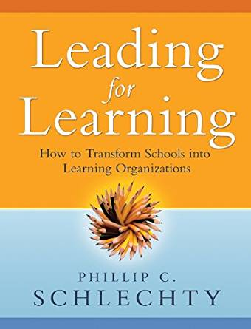
Shared Ordeals
… an experience that would be debilitating if borne alone but can be exhilarating when shared with others who have the same risks and feelings of uncertainty. Such an experience can build a sense of community and purpose beyond oneself and beyond the immediate milieu in which one is currently operating.
Leading for Learning: How to Transform Schools into Learning Organizations
Phillip C. Schlechty, 2009, p. 267

Slide 23
Position Schools as Community Institutions as Opposed to Governmental Agencies

Slide 24
Schools as Governmental Agencies Enforcing Policies and Implementing Programs vs. Schools as Community Institutions Serving Children and Families
Creating Common Understandings
ESSER
HRS
LEA
PBL
AT
DBL
CCSS
SIPPS
Title I
NOREP
SBA
MAP
ADA
OT
IEP
NAEP
TESOL
AAC
NCLB
PT
IM
NGSS
OG
STEM
ID
PBIS
FAPE
IEE
OER
RTI
ELA
ELAC
OHI
Title IX
ELD
ASD
504
UDL
SLP
DIBELS
SIP
SMP
TBI
ED
LMS
DEI
EL
WIDA
BIP
IDEA
ESY
SEL
MTSS
F&B
VI
AI
FBA
Instruction Acronyms
STEAM
LRE
Special Education (not including those already mentioned)
HI

Slide 25
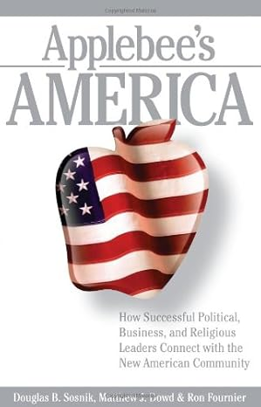
Needs and Wants
Two Gut Values have emerged as the most important from today forward: authenticity and community. People are starved for belonging and will pay special heed to leaders who unite them and rally them to a great or common cause. They are tired of phoniness and failure in politics, business, and religion, and, with their emerging power, can find or create alternatives to the institutions that fail them.
Applebee’s America:
How Successful Political, Business, and Religious Leaders Connect with the New American Community
Ron Fournier, Douglas B. Sosnik, and Matthew J. Dowd, 2006, p. 220

Slide 26

Get in Your Fans’ Shoes.
Everything that a fan would notice, we want to notice—because it’s those little things they’ll tell their friends and family about.
Fans First: Change the Game, Break the Rules, & Create an Unforgettable Experience
Jesse Cole, 2022, p. 334

Slide 27
Navigators
Americans are actually more dependent on people they know and trust to guide them through the treacherous tides of change—people we call Navigators.
A Navigator is anybody who influences an opinion in peer-to-peer conversation.
Applebee’s America:
How Successful Political, Business, and Religious Leaders Connect with the New American Community
Ron Fournier, Douglas B. Sosnik, and Matthew J. Dowd, 2006, p. 181

Slide 28
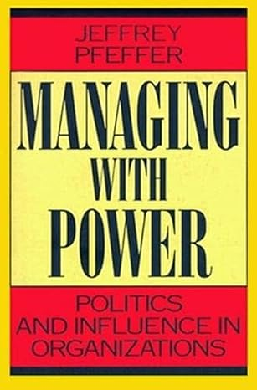
In Jeffrey Pfeffer’s book, Managing with Power: Politics and Influence in Organizations, he stressed the importance of “… knowing how others think and what they care about so that your agenda responds to their concerns.”
Managing with Power: Politics and Influence in Organizations
Jeffrey Pfeffer, 1992

Slide 29
Superintendent as Moral and Intellectual Leader
What does this mean?
What do you believe?
What are you for?

Slide 30
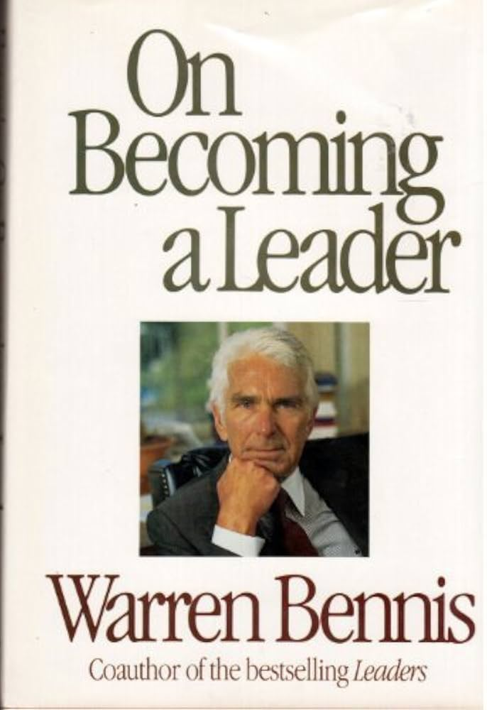
Reflection from Warren Bennis on his role as a university president: “It struck me that I was effective when I knew what I wanted.”
On Becoming a Leader
Warren Bennis, 1989, p. 20

Slide 31
The Problem Defined
Expectations
Performance
1900
1950
2000
Present

Slide 32
Develop a Process and Follow It

Slide 33
Establish Authentic Relationships
Especially with the Board
Board’s Role
Superintendent’s Role

Slide 34
Leadership and Authentic Relationships
… political, business, and religious leaders don't need our help in fooling the public. But they do need to be reminded that the road to success in politics, products, and pews is to build authentic relationships with the people they serve.
Applebee’s America:
How Successful Political, Business, and Religious Leaders Connect with the New American Community
Ron Fournier, Douglas B. Sosnik, and Matthew J. Dowd, 2006, p. 218

Slide 35
Which of the statements below best describes our board?
 | The board as community leaders | The board as managers | The board as partisans
Leadership | sets and articulates the direction of the school district and consistently behaves in ways that provide leadership to the school district and to the community. | gives priority to compliance with state and national mandates and accepts these as statements of its primary source of direction. | becomes a forum for individual board members to advocate for agendas of special interest groups or factions.
 | The board as community leaders | The board as managers | The board as partisans
Leadership | sets and articulates the direction of the school district and consistently behaves in ways that provide leadership to the school district and to the community. | gives priority to compliance with state and national mandates and accepts these as statements of its primary source of direction. | becomes a forum for individual board members to advocate for agendas of special interest groups or factions.
Core Business | is focused on making proactive contributions to the core business of the school district. | is focused on monitoring to ensure that programs and projects are implemented. | is focused on exercising direct control over programs and the people who manage them.
 | The board as community leaders | The board as managers | The board as partisans
Leadership | sets and articulates the direction of the school district and consistently behaves in ways that provide leadership to the school district and to the community. | gives priority to compliance with state and national mandates and accepts these as statements of its primary source of direction. | becomes a forum for individual board members to advocate for agendas of special interest groups or factions.
Core Business | is focused on making proactive contributions to the core business of the school district. | is focused on monitoring to ensure that programs and projects are implemented. | is focused on exercising direct control over programs and the people who manage them.
Responsiveness | develops policies that ensure the district is responsive to the needs of parents and students and accountable to all taxpayers in the community. | develops policies needed to comply with state or federal regulations. | develops policies that reflect individual agendas of board members.
 | The board as community leaders | The board as managers | The board as partisans
Leadership | sets and articulates the direction of the school district and consistently behaves in ways that provide leadership to the school district and to the community. | gives priority to compliance with state and national mandates and accepts these as statements of its primary source of direction. | becomes a forum for individual board members to advocate for agendas of special interest groups or factions.
Core Business | is focused on making proactive contributions to the core business of the school district. | is focused on monitoring to ensure that programs and projects are implemented. | is focused on exercising direct control over programs and the people who manage them.
Responsiveness | develops policies that ensure the district is responsive to the needs of parents and students and accountable to all taxpayers in the community. | develops policies needed to comply with state or federal regulations. | develops policies that reflect individual agendas of board members.
Advocacy | views itself as a leading advocate for youth in the community. | views itself as a leading advocate for externally mandated programs and compliance concerns. | advances various special interests and views itself as a vehicle for advancing and advocating the views of special interests.
 | The board as community leaders | The board as managers | The board as partisans
Leadership | sets and articulates the direction of the school district and consistently behaves in ways that provide leadership to the school district and to the community. | gives priority to compliance with state and national mandates and accepts these as statements of its primary source of direction. | becomes a forum for individual board members to advocate for agendas of special interest groups or factions.
Core Business | is focused on making proactive contributions to the core business of the school district. | is focused on monitoring to ensure that programs and projects are implemented. | is focused on exercising direct control over programs and the people who manage them.
Responsiveness | develops policies that ensure the district is responsive to the needs of parents and students and accountable to all taxpayers in the community. | develops policies needed to comply with state or federal regulations. | develops policies that reflect individual agendas of board members.
Advocacy | views itself as a leading advocate for youth in the community. | views itself as a leading advocate for externally mandated programs and compliance concerns. | advances various special interests and views itself as a vehicle for advancing and advocating the views of special interests.
Norms | has established operating norms that result in higher levels of trust between and among the members and the superintendent. | depends on formal rules to promote order and decorum. | operates without operational norms or principles.
 | The board as community leaders | The board as managers | The board as partisans

Slide 36

Board as Leaders
Board as Partisans
Building Community
Effective Management
Advocating for Youth
Faction Building
Building Community
Effective Management
Advocating for Youth

Slide 37
Be the Best You Can Be

Slide 38

Images of School
Core
Business
Student
as:
Parent
as:
Teacher
as:
Principal
as:
Supt. &
CO
as:
School
Board
as:
Likely
Classroom
Profiles
Level of
Student
Learning
Bloom’s
Taxonomy
Guiding
Metaphor
Designing
Engaging
Academic Work
for Students &
Leading Them to
Success
in That Work
Volunteer &
Knowledge
Worker
Partner &
Member of
the School
Community
Leader,
Designer, &
Guide to
Instruction
Leader of
Leaders
Moral and
Intellectual
Leader &
Capacity
Builders
Community
Builders &
Advocates
for Schools
Highly
Engaged
Create,
Evaluate,
Analyze,
Apply,
Understand,
Remember
Learning
Organization
Diagnosis,
Prescription,
&
Treatment
Client
Guarantor
&
Questionable
Ally
Professional
Performer &
Presenter, or
Clinician &
Diagnostician
Chief of
Staff
CEO &
Technicians
and Support
Staff
Board of
Directors
Well
Managed
Analyze,
Apply,
Understand,
& Sometimes
Remember
Long Term
Professional
Service
Delivery
Organization
Testing,
Remediation,
&
Reporting
Raw Material
& Product
Supply
Source &
Determinant
of Product
Quality
Skilled
Worker
Shop
Foreman
Plant
Manager &
Inspectors
and
Supervisors
Owners &
Advocates
Passive
Congenial
Understand,
but
Unlikely
to Remember
Long Term
Factory
Labeling,
Categorizing,
Placement,
& Recording
Excess
Inventory
Primary
Shipper &
Receiver
Clerk &
Keeper
of Records
Midlevel
Bureaucrat
& Keeper
of the Keys
Property
Manager &
Directors of
Maintenance,
Shipping, and
Personnel
Safety
Inspectors
&
Fire Marshals
Threatened
Learn Little
Warehouse
Containment,
Monitoring,
Corrective Action,
& Punishment
Inmate
Distrusted
Visitor
Guard
Warden
Bureau Chief &
Department
Directors,
Hearing
Officers, and
Parole Officers
Hearing
Officers
&
Parole Board
Conflict
Habituated
Students
Develop
Negative
Attitudes
Toward
Disciplined
Learning
Prison
© 2005 Phillip C. Schlechty. All rights reserved.
Notes:
Thinglink: https://www.thinglink.com/card/1619437079349952515

Slide 39
Politics
Partisanship
Community Schools
Government Schools
Community
Groups
Common Interests
Particular Interests
Our Tax Dollars
My Tax Dollars

