Slide 1


Georgia
Safety Fire Marshal

Slide 2

Amanda Jones
Lead Fire and Life Safety Educator and Reporting Supervisor
Fire and Life Safety Education
Fire Incident Reporting
Emergency Drill Reporting
Assisting Fire Departments and Communities across the State with Fire and Life Safety Programs.
We Team with agencies such as GEMA, DOE, GFSTC, and School Resource Officers.

Slide 3
School Emergency Drill

Slide 4
School Emergency Drill Code
Based upon the provisions and charge of Code Section 25-2-31 of the official Code of Georgia the State Fire Marshal’s Office is charged with the responsibility to carry on a statewide program of fire prevention education in the schools of this state and to establish fire drills therein.
International Fire Code under Section 404.2 to require an approved Fire Safety and Evacuation Plan, shall be prepared and maintained for educational occupancies and buildings. Fire evacuation drills must be conducted monthly with all occupants participating. Reporting of all drills must be submitted electronically to the Office of the Safety Fire Commissioner.

Slide 5
What is required?
Within the first 10 days of School a Fire Drill must be completed
Within the first 30 days of School a Second Fire Drill must be completed.
A Fire Drill must be completed every month that the school is in session.
During the months of February and November Fire Drills can be substituted for a Severe Weather Drill or a Lockdown Drill.
All Drills must be reported on the online state portal. SCHOOL FIRE DRILL REPORTING

Slide 6
Statewide
Sever Weather (NOAA schedules dates)
  February
  November
Lockdown Drills
  TBD
Fire Drills
  October – Fire Prevention Week

Slide 7
    Do you want to receive a report for your entire school system?
    Report can be sent to you that provides a list of schools that have reported drills for you school system.

Slide 8
    Recommendations
    Call your local Fire Department out at least once a year to take part in your Fire Drill.
    Report all drills in the system?
    Unplanned drills can be used as your drill for the month.
    Conduct the drills at different times during the day.

Slide 9

Do you have any questions?
Thank you!
Phone Number
(470) 725-5722
Email Address
ajones@oci.ga.gov
Website
www.oci.georgia.gov
Notes:
This page will be changed to who ever is speaking.

Slide 10
Craig Landolt
State Fire Marshal
Hazardous Materials
Manufactured Housing
License under Fire Marshal
Building Inspections
Inspection of schools
Review of construction plans
Investigate complaints
Consultation visits

Slide 11
    NFPA issued a Tentative Interim Amendment (TIA) for 2018 NFPA 101 Section 15.2.2.4 for Existing Educational occupancies
In response to educational occupancies using dangerous / unapproved methods for door locking.
15.2.2.2.4 Classroom Door Locking to Prevent Unwanted Entry
Added a new item to allow 2 non-simultaneous releasing operations on doors.
TIA 18-20 was effective August 26, 2019.

Slide 12
    TIA 18-20
February 16, 2022, a letter was issued by State Fire Marshal Landolt recognizing TIA 18-20 as part of the 2018 LSC.
The State Fire Marshal’s Office does not recommend or endorse any product or devices.
Each case will be reviewed on a case-by-case situation.
The Chief Fire Official of the local responding fire department must approve the locking device.

Slide 13
    2021 NFPA 101 incorporated the language of the TIA into the code
15.2.2.2.4 Existing Educational Occupancies.
17.2.2.2.6 Existing Daycare occupancies.
Requirements are the same for both Existing Educational and Daycare.
120-3-3 modified to include the 2021 code language.

Slide 14
    15.2.2.2.4.1 and 17.2.2.26.1 both allow doors to classrooms and other instructional spaces/client spaces to be locked provided that:
Locking means is approved.
All the following conditions are met.

Slide 15
(4) The releasing mechanism for unlocking and unlatching shall be located at a height not less than 34 in. (865 mm) and not exceeding 48 in. (1220 mm) above the finished floor.
(5) Locks, if remotely engaged, shall be unlockable from the egress side of the door without the use of a key, tool, or special knowledge or effort.
(6) The door shall be capable of being unlocked and opened from outside the room with the necessary key or other credential.

Slide 16
(7) The locking means shall not modify the door closer, panic hardware, or fire exit hardware or impair their operation.
(8) Modifications to fire door assemblies, including door hardware, shall be in accordance with NFPA 80.
(9) The emergency action plan, required by 17.7.1 / 15.7.1, shall address the use of the locking and unlocking means from both sides of the door.
(10) Staff shall be drilled in the engagement and release of the locking means, from both sides of the door, as part of the emergency egress drills required by 17.7.2 / 15.7.2.

Slide 17
15.2.2.2.4.2
Where existing classroom doors and doors to instructional spaces are replaced, they shall comply with the provisions of 14.2.2.2.4.
17.2.2.2.6.2
Where existing classroom doors and doors to client care spaces are replaced, they shall comply with the provisions of 16.2.2.2.6.

Slide 18
The 2018 Edition of NFPA 101 Life Safety Code incorporated major changes in the requirements for automatic sprinkler protection in new educational occupancies.
Paragraph 14.3.5.1 requires education occupancy buildings to be protected throughout by an approved, supervised automatic sprinkler system.
This applies to all new schools with very few exceptions.

Slide 19
    NFPA 101Paragraph 14.3.5.2 exempts the requirements for an automatic sprinkler system in new schools under certain conditions
(1) Non-relocatable buildings having an area not exceeding 1000 ft²
(2) Non-relocatable buildings containing a single classroom
(3) Relocatable buildings (portable classrooms) complying with all of the following:
(a) Building area does not exceed 1000 ft²
(b) Building contains a single classroom
(c) Building is located not less than 30 ft from another building

Slide 20
Recognizing the financial burden requiring school systems to install automatic sprinkler systems in portable classrooms for short term durations a proposed modification to paragraph 14.3.5.2 item (3) has been proposed.
A hearing was held on August 5, 2022, on the proposed change
The proposed change deletes the current paragraph 14.3.5.2 item (3) and replaces it with a new 14.3.5.2 item (3)
The change gives more flexibility on not requiring automatic sprinklers portable classrooms

Slide 21
New paragraph 14.3.5.2 item (3) to omit automatic sprinkler system in portable classrooms
(3) Relocatable buildings complying with all of the following:
  Building contains a maximum of 2 classrooms.
(b) Each classroom has 2 independent doors remotely located in accordance with 7.5.1.3 of this code leading directly to the outside of the building.
(c) Building is located not less than 30 feet (9.1 m) from another building or other relocatable building.
(d) Building has a fire alarm system connected to the main school building fire alarm.

Slide 22
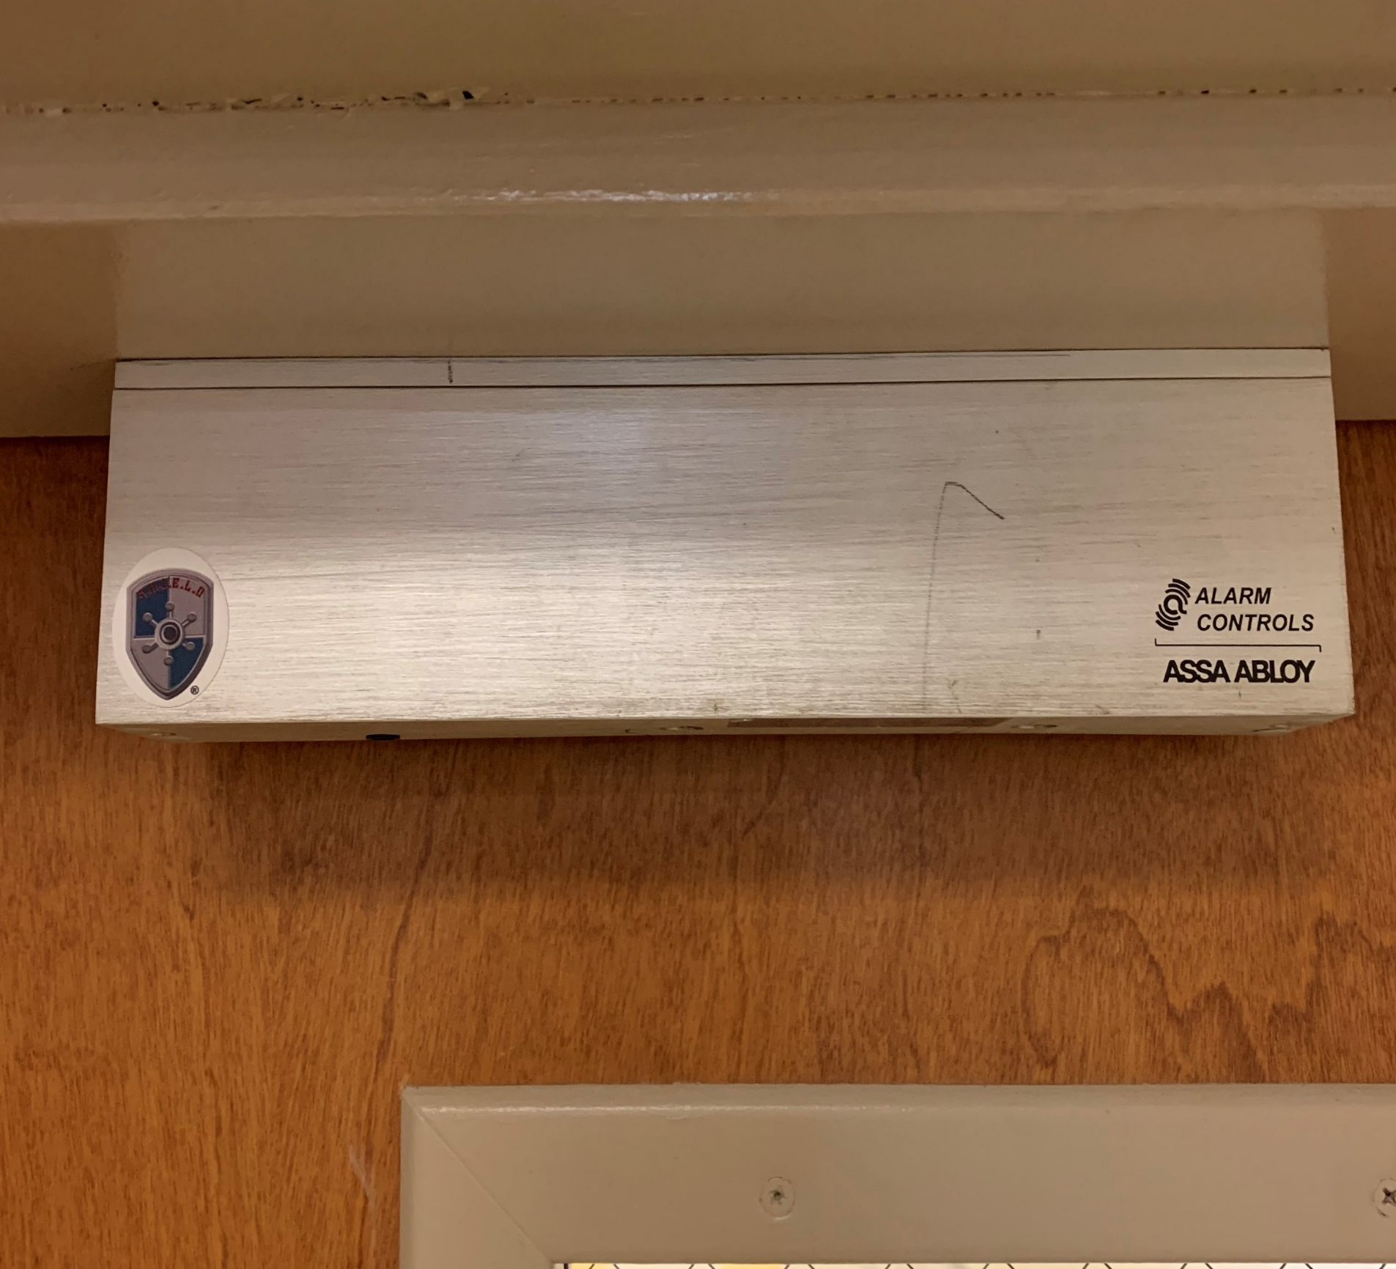
SHIELD
School
Hallway
Interior
Emergency
Lockdown
Defense

Slide 23
Do you have any questions?
Thank you!
Phone Number
(470) 270-6499
Email Address
clandolt@oci.ga.gov
Website
www.oci.georgia.gov
Notes:
This page will be changed to who ever is speaking.

