Slide 1
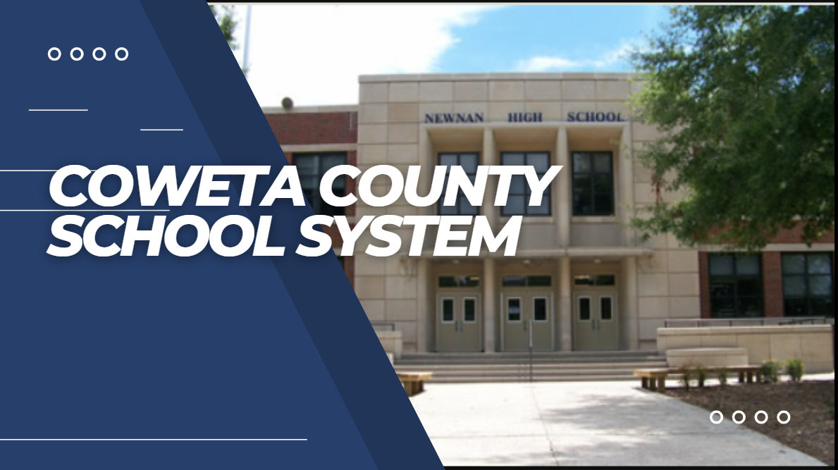
Tornado Response
Lessons Learned
GSSA Bootstrap October 19, 2022

Slide 2
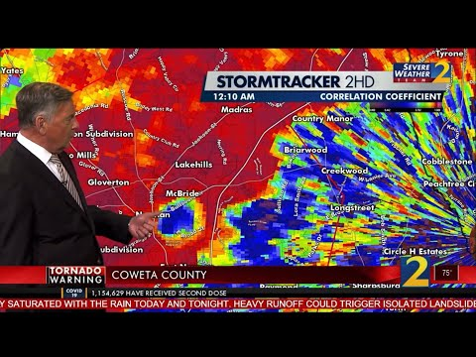
A Day We Will Never Forget...
MARCH 26,
2021

Slide 3
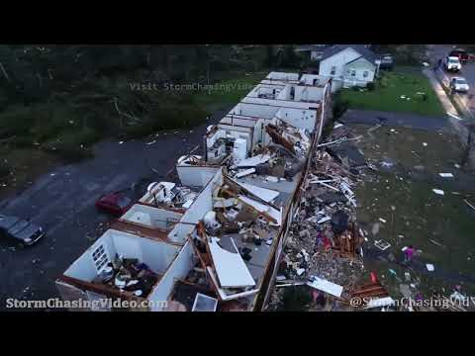
A look at the damage
MARCH 26,
2021

Slide 4
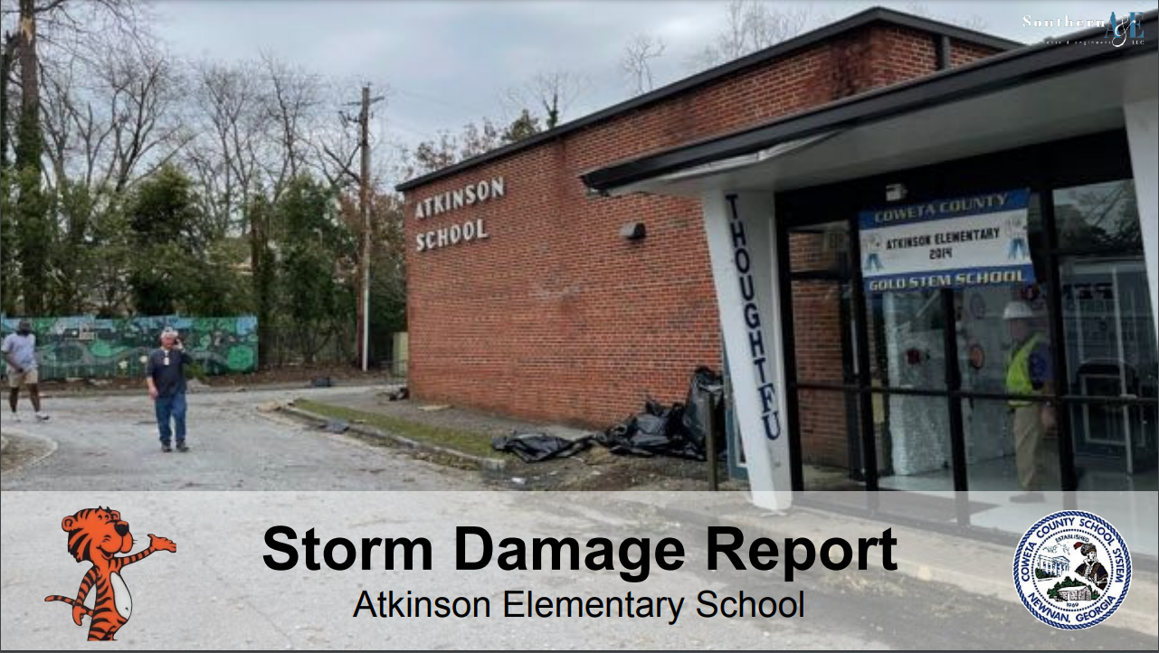
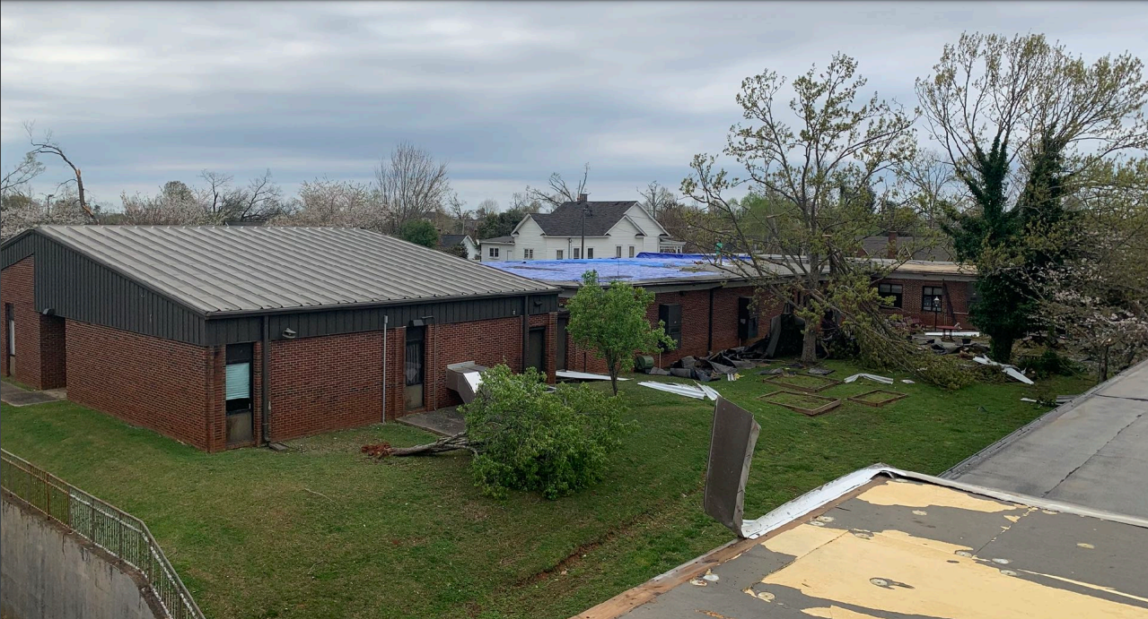
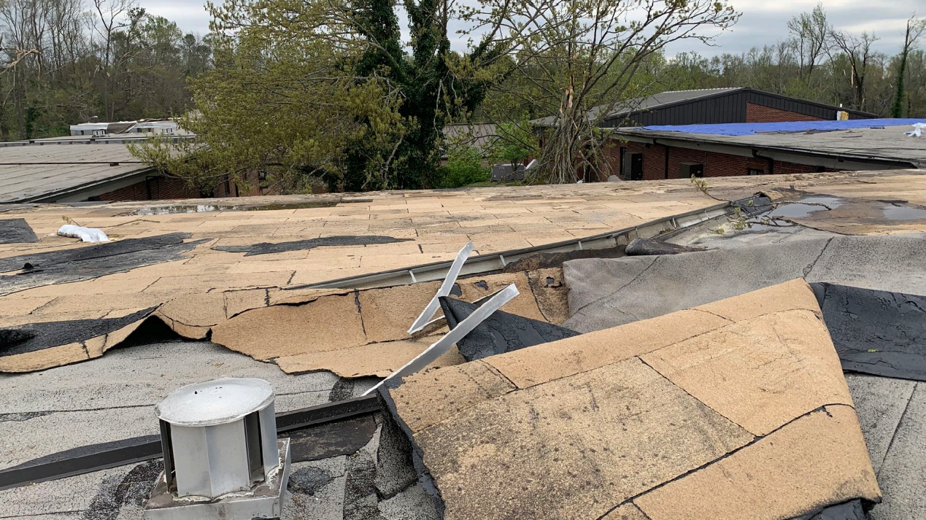
A look at the damage

Slide 5
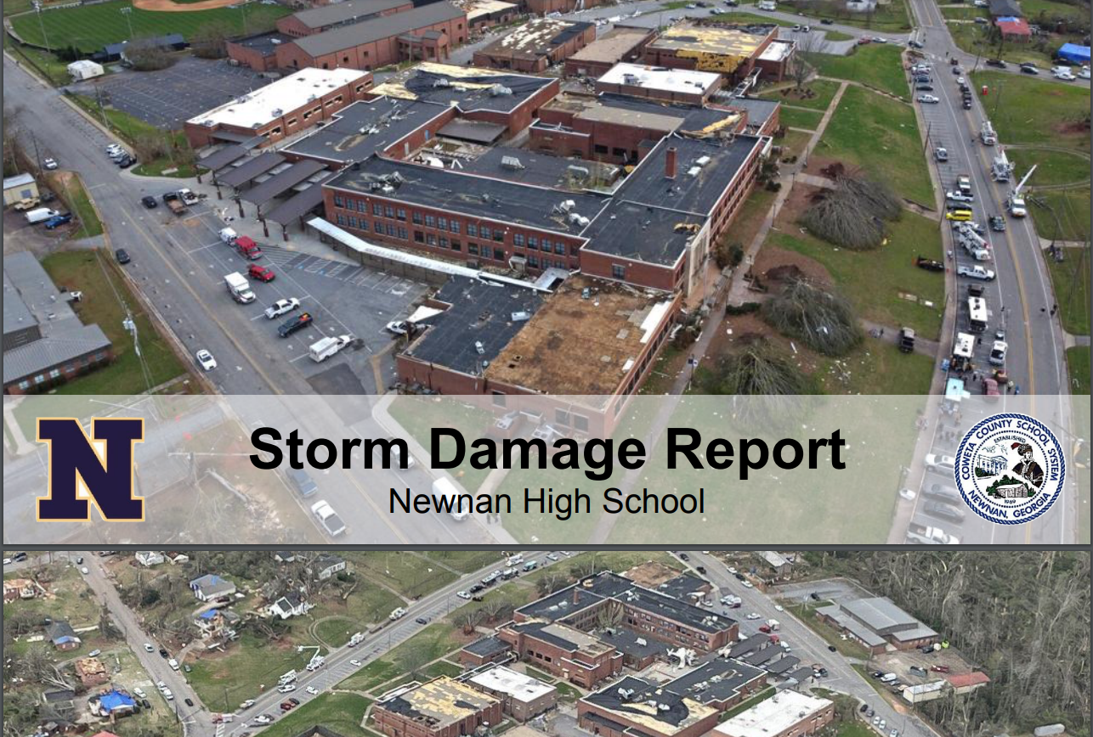
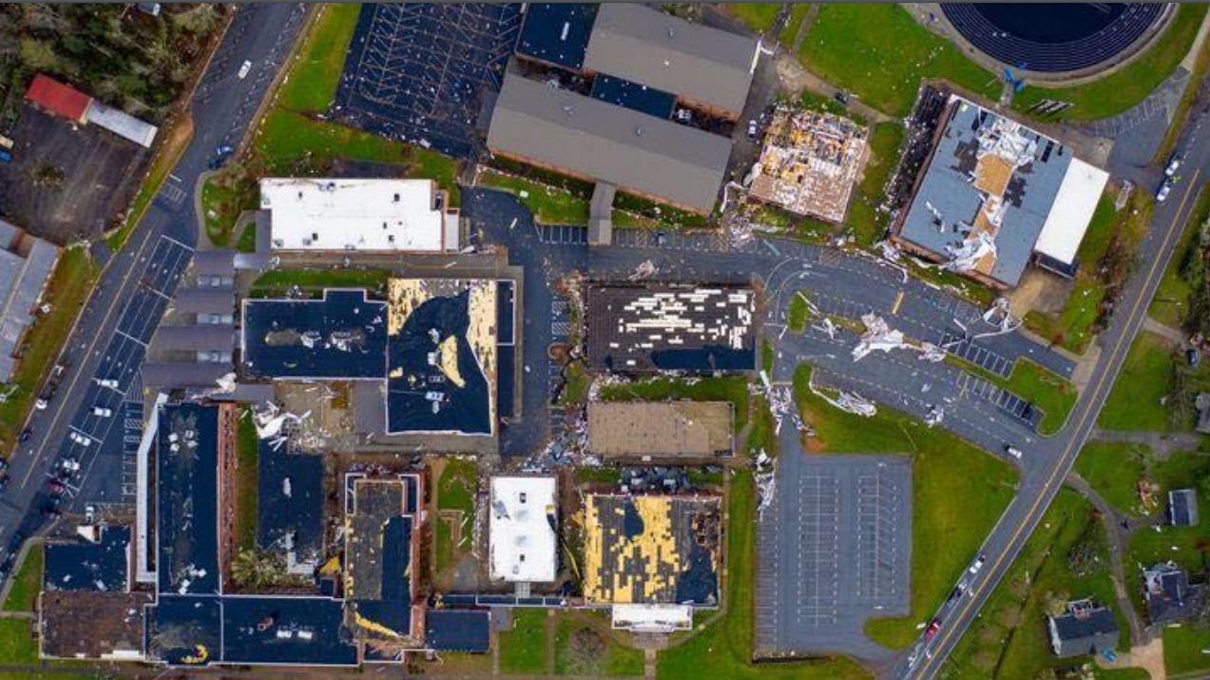
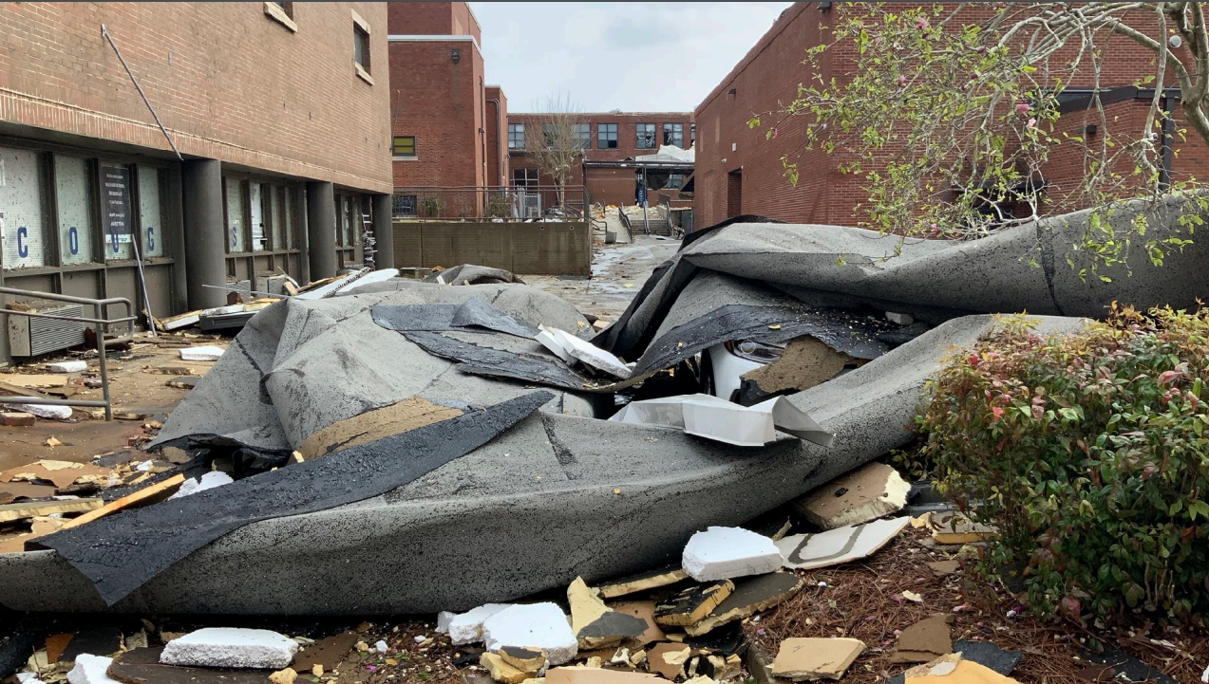
A Day We Will Never Forget

Slide 6
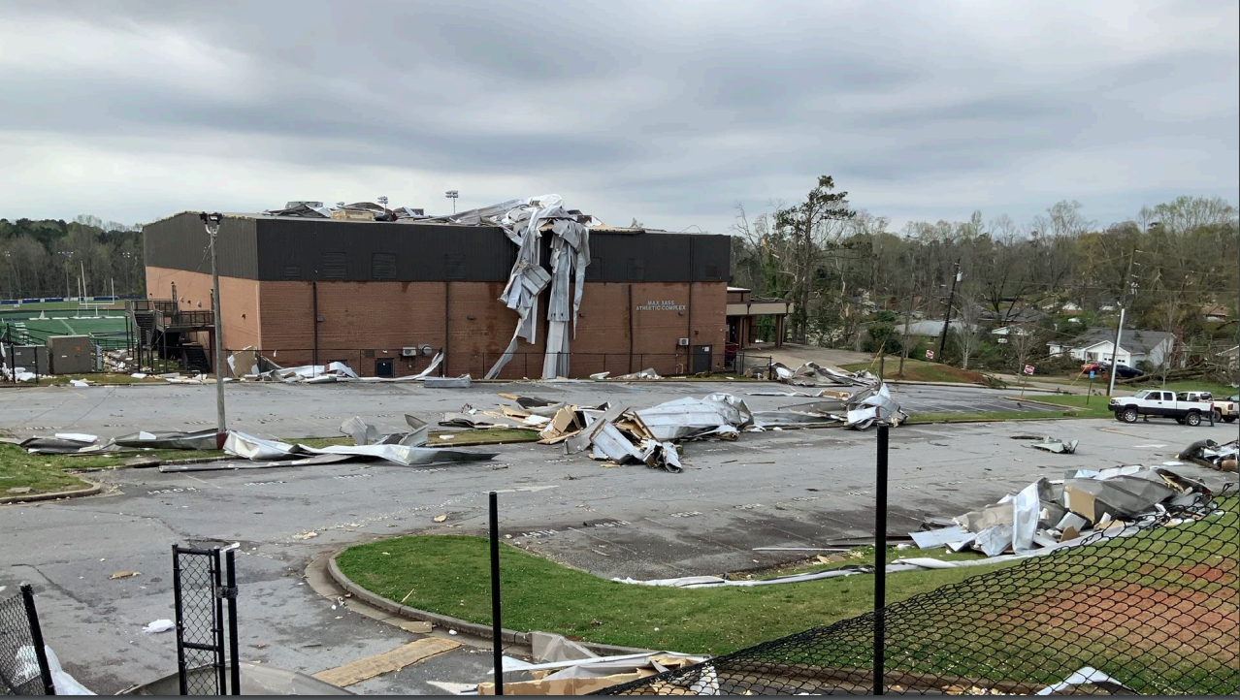
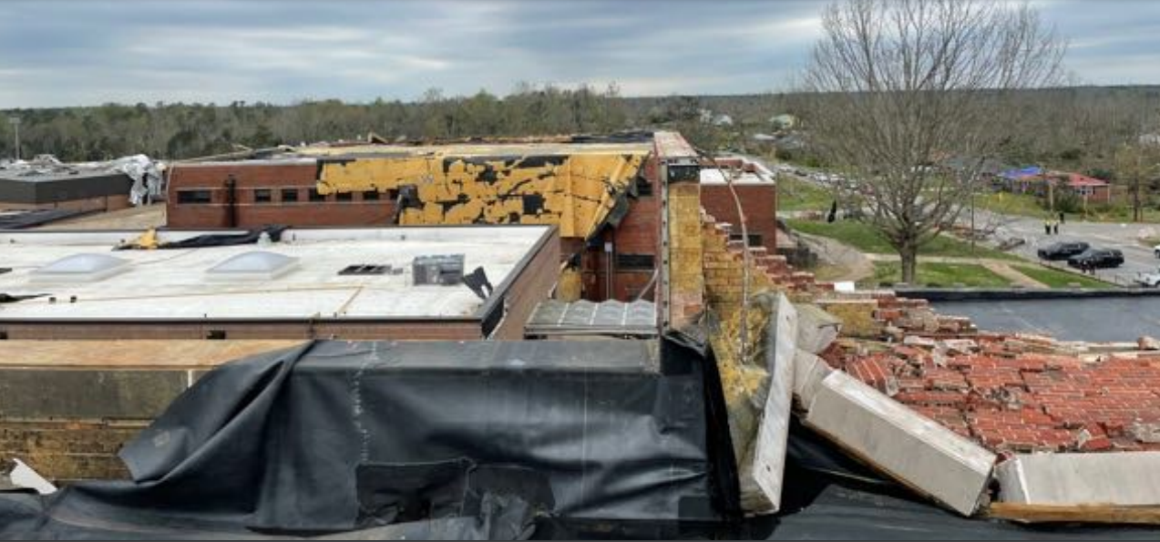
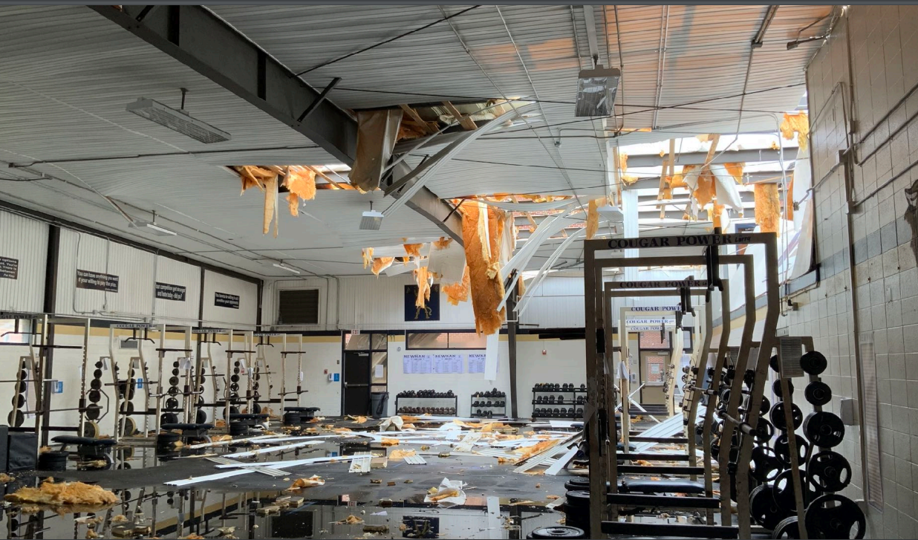
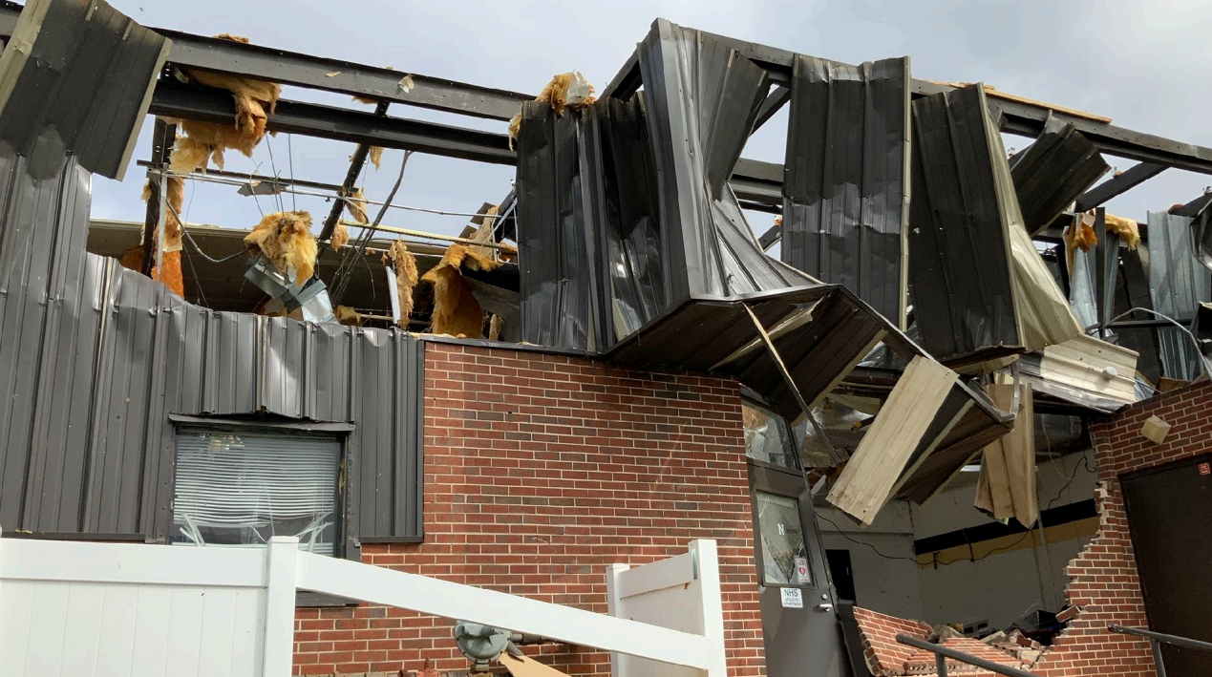
NHS

Slide 7
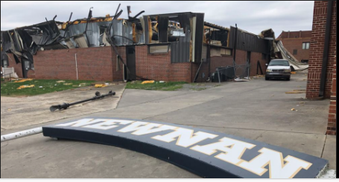
WHAT HAVE WE LEARNED?
Nothing prepares you for what you will see and feel.
First priority=Make sure everyone is okay. (Nothing else matters)
Secure the facility ASAP.
Be intentional about communicating from the beginning.
Plan for scenarios and hope you never need them. (Paying employees with no power or internet)
Purchasing policies and procedures are important in the aftermath.
Notes:
You are going to need to process emotions. I never took this into consideration.
People want answers.
So many things to consider. It is overwhelming.
Emergency purchasing policies are vital. Mistakes are made in chaos. They help to prevent them.
Communication plans for employees and community. Short and long term. They need to hear something. We used video a lot. Connection.
Internet and transportation communication a vital to your ability to have school. Internet was a new consideration for me.
Tabletop drills are important because they stretch your thinking. (payroll example)
There are steps that you can take now that I wish I had taken. (Scout potential sites in your community, Contacts to outsource certain activities)

Slide 8
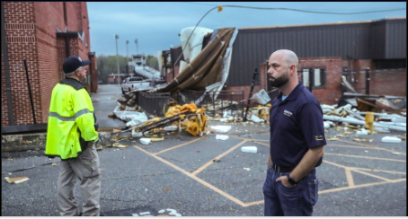
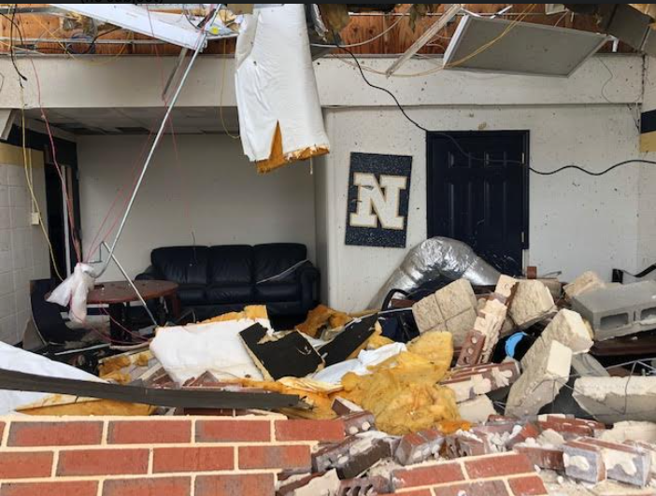
A Few More...
Teachers’ personal items are very important to them. (Have a plan)
Offers of help will come from many directions.
Partnerships sustain your district.
That quarterly property inventory that everyone thinks is silly is very important.
Be mindful of the emotional impact.
It’s a marathon; not a sprint.
Notes:
We are so fortunate to live in a community where partnerships between our system and first responders have been cultivated for decades. Long before my time.
Me and my staff had a seat at the table in the EOC in the hours and days after the storm. Also before the storm.
We actually drilled for this exact scenario about four years ago. We had practiced. Preparation created a little bit of luck here.
Very thankful that this storm came through after school hours.

Slide 9
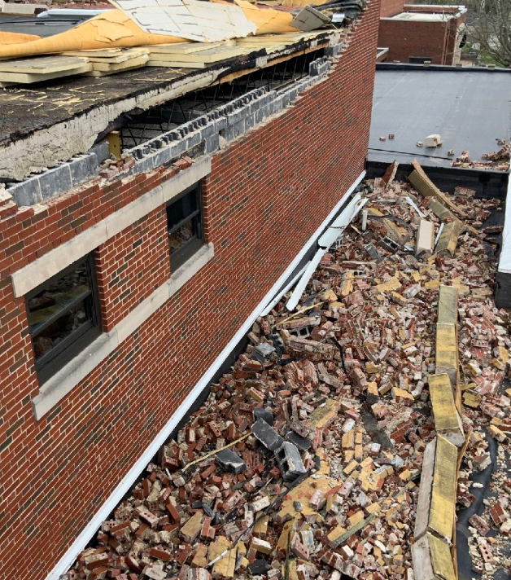
And Finally…..
Financial planning matters.
A long-term relationship with our insurance company
Establish your priorities as soon as you can clear your head.
Bite the apple one piece at a time.
Don’t be afraid to ask for help. It is available.
Notes:
The Board has planned financially for such a scenario.
Look closely at your insurance policies.
You can think about priorities ahead of time. 1. Account for everyone 2. Security 3. Condition of facilities 3. Relocation 4. Instruction 5. Long term plans

Slide 10
REFLECTIONS
This has caused me to think differently about daytime scenarios.
Can’t emphasize communication and transportation enough.
Our buildings performed exceptionally well.
Someone has to begin thinking about possible solutions to long-term problems quickly.
Notes:
We are still in the middle of it. 3 to 5 year recovery.
The storm went right through the heart of our community. Perfectly dissected the county.
Divide your people up. Fog of war is real. You can get caught spinning your wheels if you’re not careful. Who is really good at thinking beyond the horizon. Can’t just be you.
Re examine where you put students and staff during weather events. (Vehicles)
I can promise you that I won’t be the lone ranger.

Slide 11
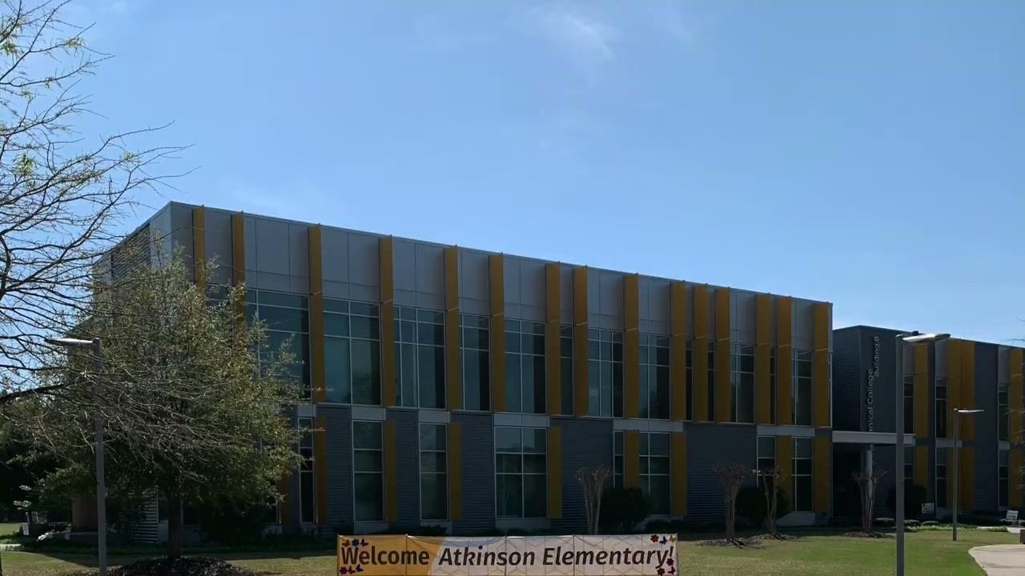
Continuing Instruction
How did we navigate this aspect of recovery?
Identified highest needs:
Students with special needs
Elementary students who had struggled with virtual instruction
Students who could not access virtual instruction
Individuals who did not have internet access (NHS teachers placed across the district to utilize internet)
Notes:
COVID helped to prepare us to navigate the tornado; especially at Newnan High. Without the pandemic the tornado would have had us starting at March 2020.
Had to find a physical facility for the elementary school students.

Slide 12
We continued to have school
The role of the Board
Our responsibilities to the community and to each other.
The expectations of our community
Notes:
We are still in the middle of it. 3 to 5 year recovery.
The storm went right through the heart of our community. Perfectly dissected the county.
Divide your people up. Fog of war is real. You can get caught spinning your wheels if you’re not careful. Who is really good at thinking beyond the horizon. Can’t just be you.
Re examine where you put students and staff during weather events. (Vehicles)
I can promise you that I won’t be the lone ranger.

Slide 13
Funding Sources/Financial
Considerations
Insurance Proceeds $15,870,635
SPLOST V $27,943,857
GADOE $14,967,660
Local Construction $7,000,000
FEMA will reimburse up to 75% of allowable expenses not covered by insurance. We would have to pay these expenses upfront and be reimbursed.
Notes:
These are not final numbers. Long term relationship with our insurance company.

Slide 14
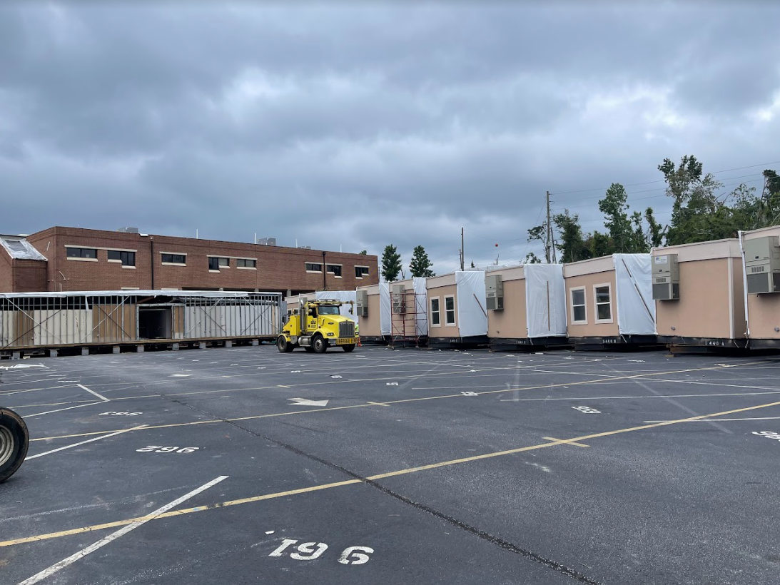
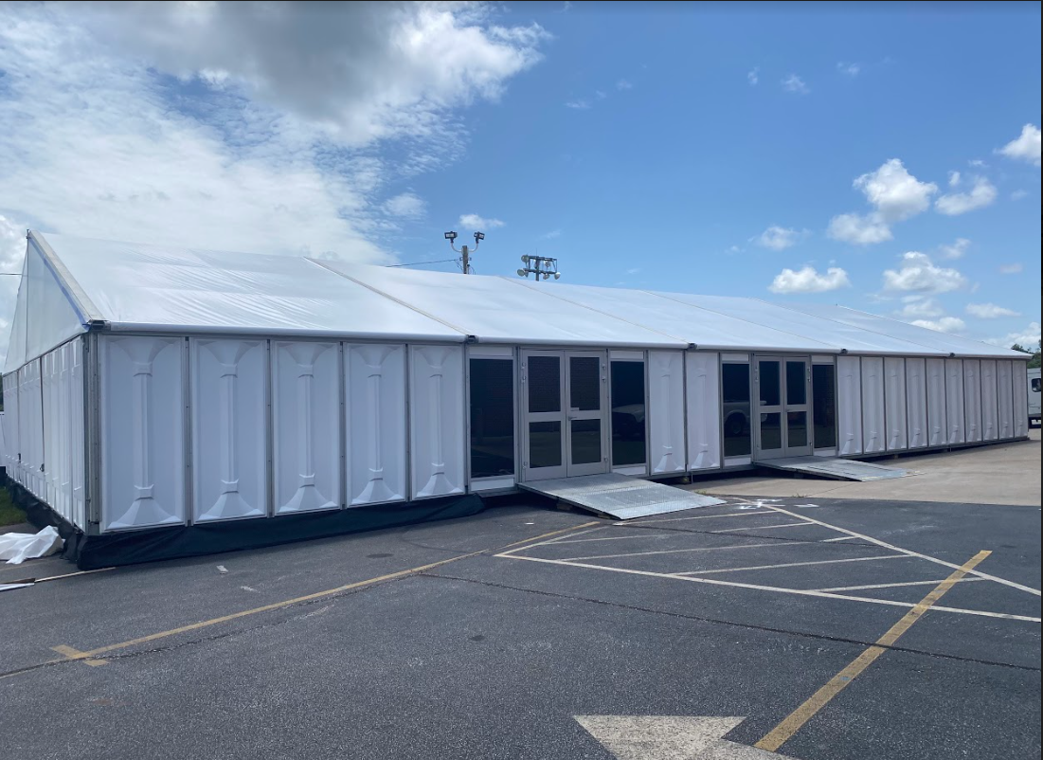
We Have Adapted….
NHS Temporary Classrooms and Offices
Classrooms
Cafeteria

Slide 15
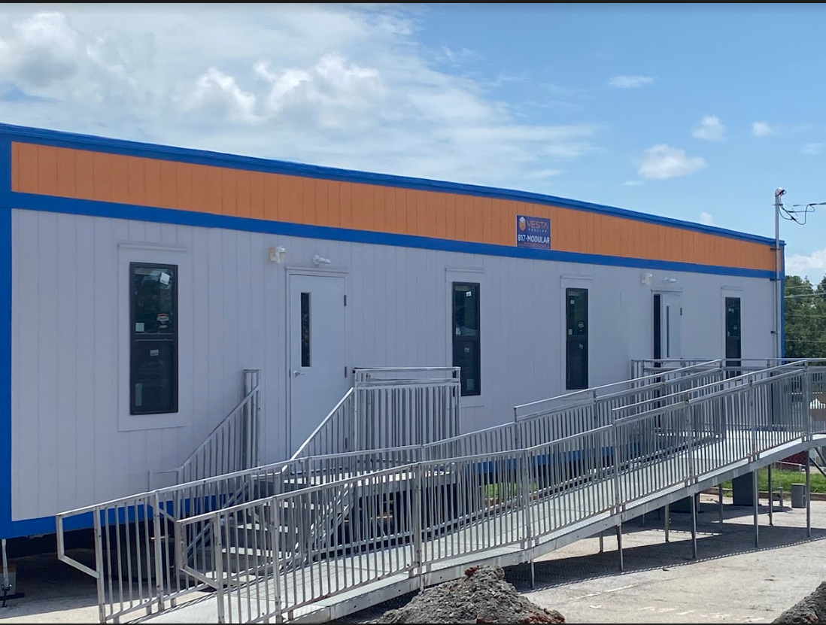
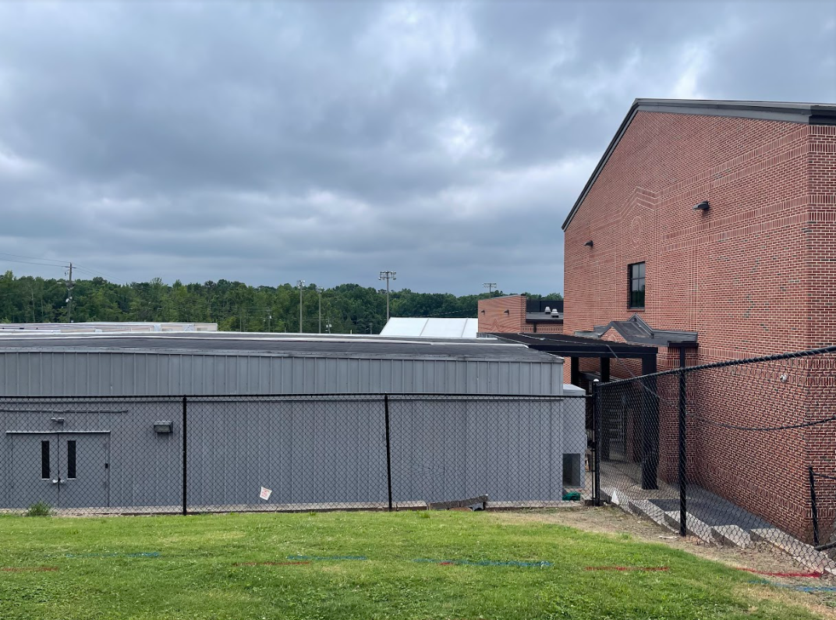
We Have Adapted….
NHS Temporary Classrooms and Offices
Front Office
More classrooms

Slide 16
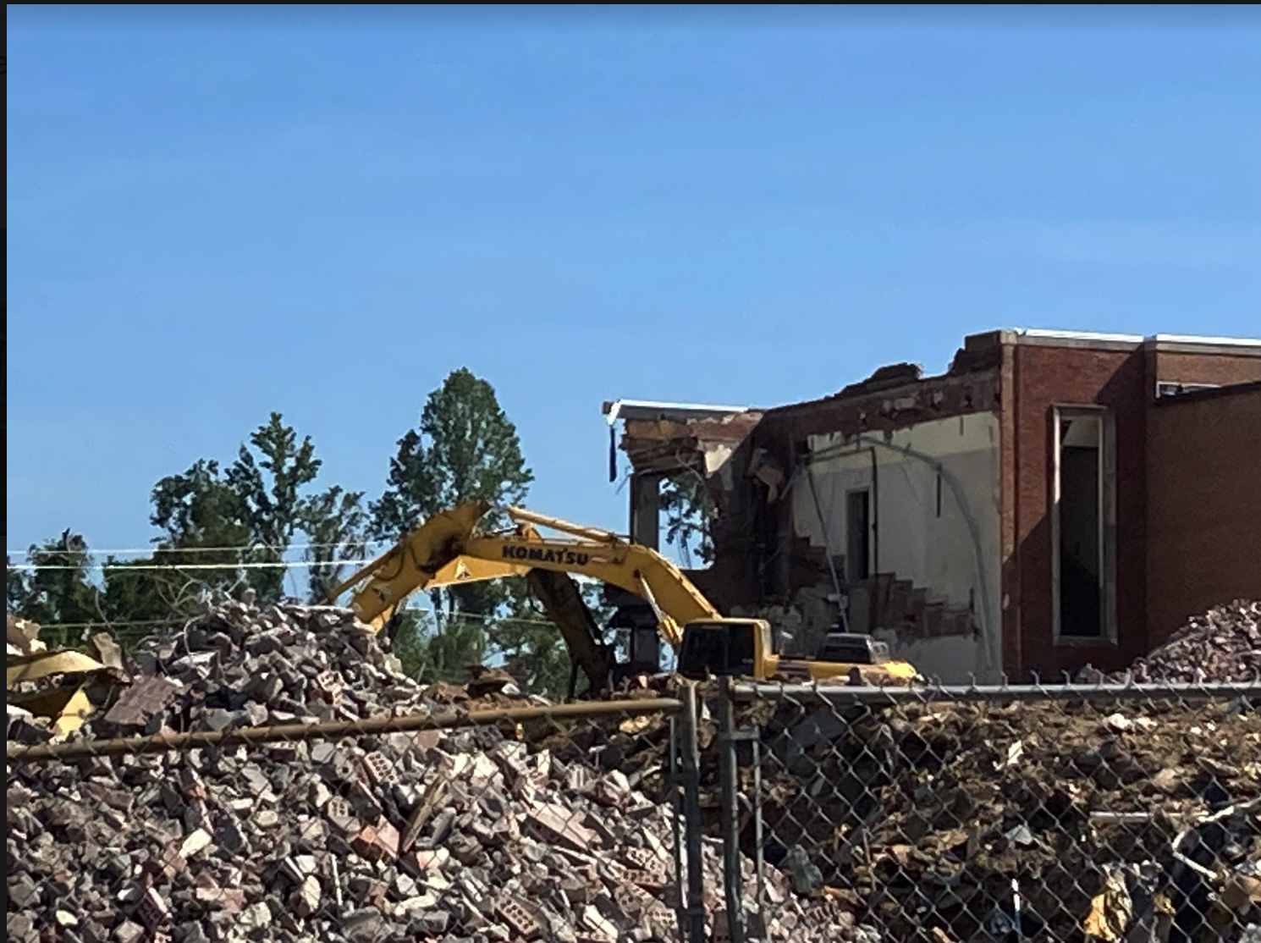
Where We Are Today…
6/22/22 Update
Video Update

Slide 17
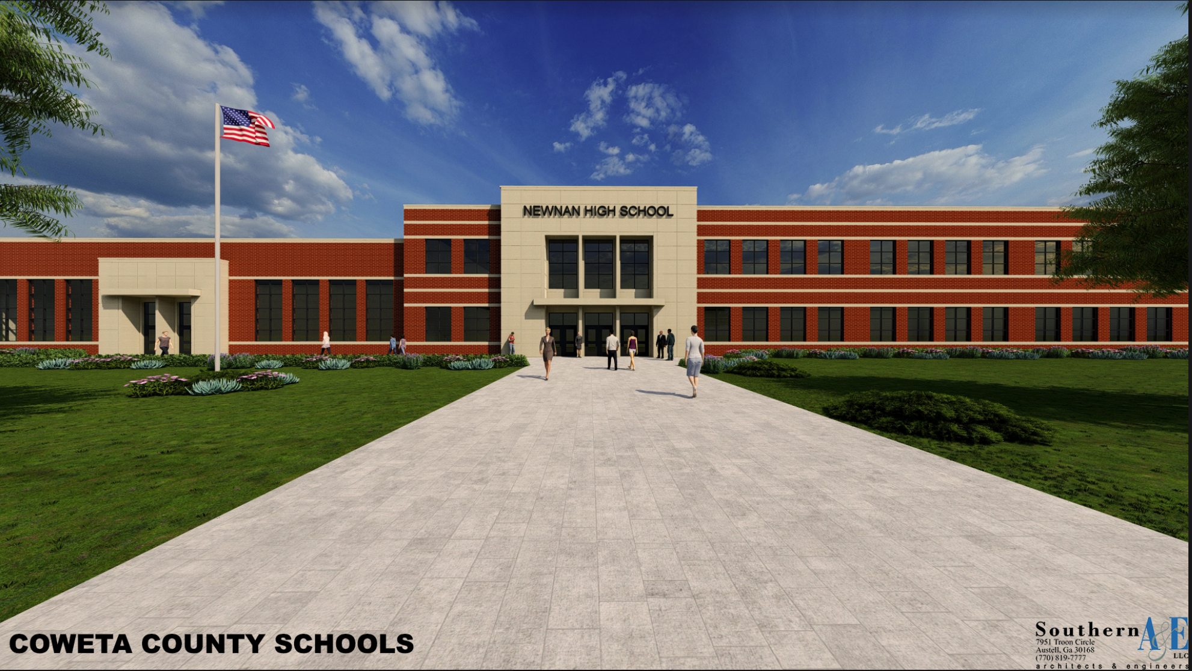
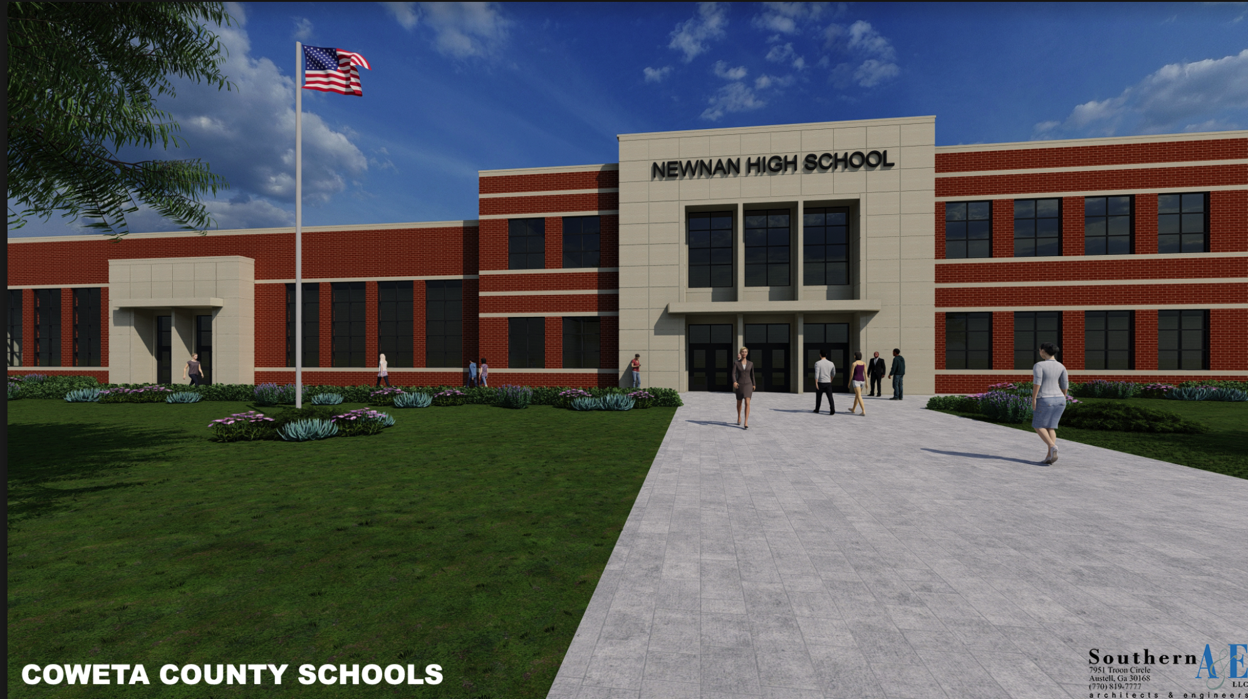
Where We Are Headed…
Notes:
3 to 5 years. We are still dealing with it. Academically, emotionally and physically, financially.

Slide 18
March 26, 2021, A Day We Will Never Forget...
Links for more footage…
In Real Time - video
A Look at the Damage - video
Damage Photos - photographs

