Slide 1
Georgia School Superintendents Association Fall Bootstrap Conference Legal Issues Update October 20, 2022
Phil Hartley
Harben, Hartley & Hawkins, LLP
770-534-7341
770-654-3616 (cell)
phartley@hhhlawyers.com

Slide 2
HOW DID YOUR SCHOOL YEAR BEGIN?

Slide 3
HAVE YOU HAD YOUR CONSTITUTIONAL?
Audit I mean…
What Does The First Amendment Say About People Wandering Around in Your Central Office with Their Cell Camera/Recorder?
Politics or Money?
How Do You Prepare?

Slide 4
O.C.G.A. § 20-2-786 – HB 1178 Parents’ Bill of Rights
“Unless such rights have been waived or terminated as provided by law, parents have inalienable rights that are more comprehensive than listed. . . . This Code Section does not prescribe all rights of parents. Unless otherwise required by law, the rights of a parent of a minor child shall not be limited or denied.”

Slide 5
PARENTAL RIGHTS ON STEROIDS
Letters stating “strongly held religious beliefs” in students not being disciplined in certain ways
Protect Children Project (PCP)
https://thesatanictemple.com/pages/protect-children-project

Slide 6
PARENTAL RIGHTS ON STEROIDS
The sovereign citizen movement is a loose grouping of litigants, activists, tax protesters, financial scheme promoters and conspiracy theorists, who claim to be answerable only to their particular interpretations of the commone law and to not be subject to any government statutes or proceedings, unless they consent to them.
So what does this mean for schools? Think
Enrollment
Attendance
Discipline
Curriculum

Slide 7
ISSUES FROM THE GENERAL ASSEMBLY

Slide 8
Clearer Issues of Parental Rights from Last Year’s Legislature O.C.G.A. §20-2-324.6 Policy Due by January 1, 2023
(a) As used in this Code section, “harmful to minors” means that quality of description or representation, in whatever form, of nudity, sexual conduct, sexual excitement, or sadomasochistic abuse, when it:
(1) Taken as a whole, predominantly appeals to the prurient, shameful, or morbid interest of minors:
(2) Is patently offensive to prevailing standards in the adult community as a whole with respect to what is suitable material for minors: and
(3) Is, when taken as a whole, lacking in serious literary, artistic, political, or scientific value for minors.

Slide 9
Practical Guidance
The definition provides opportunity to reassess how to evaluate objections to material that deals with sexual issue
The process, while very streamlined, provides a means of focusing these objections
Difference between responding to challenges from an individual and school, administration, or BOE making decision on its own to remove material already placed
“Local school boards have broad discretion in the management of school affairs, but such discretion must be exercised in a manner that comports with the transcendent imperatives of the First Amendment. Students do not "shed their constitutional rights to freedom of speech or expression at the schoolhouse gate," and such rights may be directly and sharply implicated by the removal of books from the shelves of a school library.” Island Trees School District v. Pico (1982)
Get help and a plan when a complaint is filed. Remember that these cases go directly from principal to BOE, directly from instructional analysis to political division.

Slide 10
O.C.G.A §20-1-11 – HB 1084 Divisive Concepts
One race is inherently superior to another
USA is fundamentally racist
An individual, by virtue of race, is inherently or consciously racist or oppressive toward individuals of other race
An individual should be discriminated against or receive adverse treatment solely or partly because or race
Moral character is inherently determined by race
An individual, solely by virtue of race, bears individual responsibility for actions committed in the past by others of the same race
An individual, solely by virtue of race, should feel anguish, guilt, or other psychological distress
Performance-based recognition and character traits such as a hard work ethic are racist or have been advocated by one race to oppress another race
Race scapegoating or race stereotyping

Slide 11
PRACTICAL GUIDANCE POLICIES ALREADY IN PLACE
Lack of clear definition and disagreement among school community and professionals as to interpretation
Nevertheless, carefully review the actual words in the list and what they logically mean to the objective person
Any challenge, by its very nature, could lead to a Title VI or 14 A. claim by someone
The statue does not prohibit teaching history and the divisive concepts that are part of it, it prohibits advocating for a divisive concept by a school employee
The racist incidents by students or staff are not a part of this legislation

Slide 12
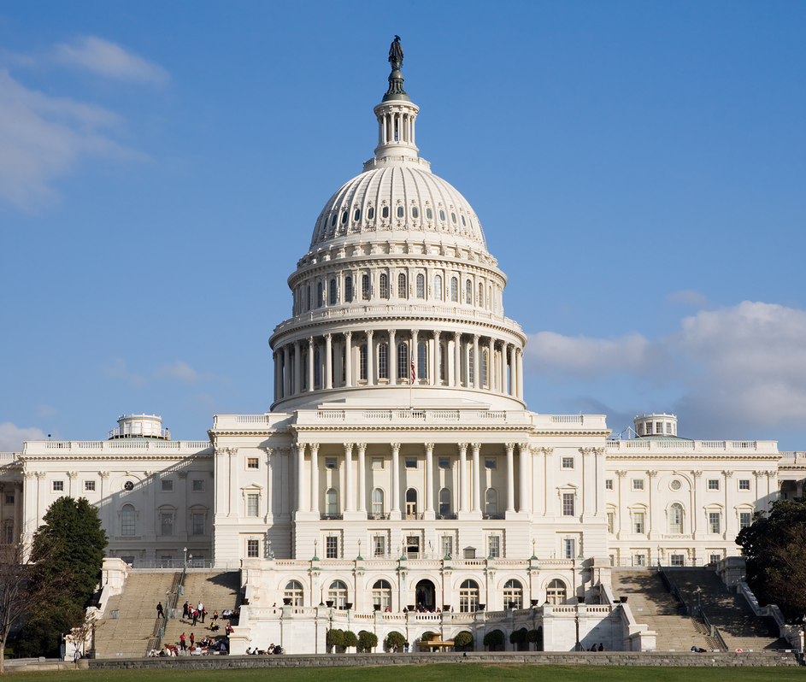
FEDERAL CASES

Slide 13
RESPONDING TO RACIST INCIDENTS UNHEALTHY OR UNSAFE
“[W]e note that this First Amendment freedom of expression case stands against the unique backdrop of a public school. Although public school students' First Amendment rights are not forfeited at the school door, those rights should not interfere with a school administrator's professional observation that certain expressions have led to, and therefore could lead to, an unhealthy and potentially unsafe learning environment for the children they serve.”
Scott v. Sch. Bd. of Alachua Cty., 324 F.3d 1246, 1247 (11th Cir. 2003)

Slide 14
RESPONSE TO RACIST INCIDENTS
“It is not only constitutionally allowable for school officials to closely contour the range of expression children are permitted regarding such volatile issues, it is their duty to do so.”
“One only needs to consult the evening news to understand the concern school administrators had regarding the disruption, hurt feelings, emotional trauma and outright violence which the display of the symbols involved in this case could provoke.”
Scott v. Sch. Bd. of Alachua Cty., 324 F.3d 1246 (11th Cir. 2003)

Slide 15
Kennedy v. Bremerton School District The Supreme Court Addresses School Prayer What Are the Facts?
“Joseph Kennedy lost his job as a high school football coach because he knelt at midfield after games to offer a quiet prayer of thanks.”
OR
“This case is about whether a public school must permit a school official to kneel, bow his head, and say a prayer at the center of a school event.”

Slide 16
Important facts according to the Court
Students were otherwise occupied
Coach Kennedy was not required to supervise students
The prayer was offered quietly
The School District disciplined him because it thought the Establishment Clause of the Constitution made the coach’s prayer a “public prayer” prohibited and not a “private prayer” allowed.
At first the coach prayed alone for “about 30 seconds,” over time players joined him until most of the team and sometimes players from the other team knelt and joined his prayer.
At some point, the gathering began to include a “motivational” speech from the coach and in the locker room, separate from the event after the game, the team would engage in a pregame or postgame prayer described by the Court as a “school tradition.”

Slide 17
Important facts according to the dissent
Diversity of religions within the student body
Job description that required the coach to supervise the students immediately after the game
Handbook specifically addressed avoiding “religious programs” at school or during any “school activity”
The coach was warned verbally and in writing against continuing the activity, he stopped praying on the field and returned to the locker room after all the players had left to have his prayer
Even though no one objected to this practice he then consulted a lawyer who wrote a letter that the prayer, even on the field, was private, and not public prayer
Coach returned to his former practice, made multiple media appearances, and was surrounded by members of the public, television cameras and at least one state politician during his “private” prayer

Slide 18
So what did we learn?
That the Current Court Leans Strongly Toward Freedom of Religion (and Speech) and Not So Much Toward Worries About the Establishment Clause
For Lawyers There is a Pretty Clear Reversal of Years Of Precedent
But It Is Not Clear There Is a Rule

Slide 19
So what do we do to avoid lawsuits?
1 – Try to avoid an overreaction that either side might view as grounds for litigation.
2- Continue to emphasize that it is not the role of educators to proselytize or preach their religious beliefs to their students, thus keeping any expression of those beliefs in the school setting as private as possible.
3 – Consult legal advice before taking any action, but know the facts when you do so.

Slide 20
MISCELLANEOUS ISSUES
UPDATE ON USDOE
JUUL LITIGATION
WHY YOU MIGHT WORRY ABOUT THE CELL PHONE IN YOUR POCKET

Slide 21
JUUL LITIGATION
Civil Class Action Suits by Users
Civil Class Action Suits by School Districts
Suits on Behalf of States by Attorneys General
Food & Drug Administration

Slide 22
Food & Drug Administration
June 23, 2022 – FDA Issues Market Denial as to JUUL, effectively stopping the sale
June 25, 2022 – USCOADC issued emergency stay to consider case on the merits
July 5, 2022 – FDA Stays its Market Denial
September 20, 2022 – JUUL Sues Seeking Documents from FDA

Slide 23
States, including Georgia, settle suit with JUUL
33 States settle for $440 million ending suit filed in 2020
Georgia gets more than $19 million, also addresses marketing and some composition issues
How will that money be used and distributed?

Slide 24
Private Suit for School Districts
Being treated as a mass tort claim with control by California court
What might be recovered?
Equipment to detect
Personnel directed to the issue
Reimbursement of expenses on such items in the past
Political (PR) statement or expectation of money
Pros
Cons

Slide 25
WHAT’S NEXT FOR USDOE?
TITLE IX REGULATIONS ARE OUT, HAVE BEEN COMMENTED UPON AND ARE UNDER REVIEW, WHEN WILL THE BE FINAL?
USDOE HAS INDICATED THAT A REVIEW AND REWRITE OF SECTION 504 REGULATIONS IS NEXT ON THE AGENDA
NO DOUBT THEY WILL LOOK MORE LIKE IDEA THAN THE CURRENT REGULATIONS
WHAT ABOUT INVESTIGATIONS?

Slide 26
OPEN RECORDS ACT – PROTECT YOURSELF!
“Public record” means all documents, papers, letters, maps, books, tapes, photographs, computer based or generated information, data, data fields, or similar material prepared and maintained or received by an agency or by a private person or entity in the performance of a service or function for or on behalf of an agency or when such documents have been transferred to a private person or entity by an agency for storage or future governmental use.
What about the District’s cell phones or computers given to Board members? What about a personal cellphone or computer?
What about discovery in litigation?

Slide 27
Fall Legal Issues Workshop November 2, 3, and 4, 2022
Classic Center
Athens, Georgia
ONLY LEGAL ISSUES WORKSHOP THIS SCHOOL YEAR
Save the Date!
Save the Date!

Slide 28
BELIEVE IN PUBLIC EDUCATION

