Slide 1
GSSA 2022

Slide 2
Your Partner in
Fleet Electrification

Slide 3
More affordable, cleaner student transportation
10% savings vs your diesel fleet
Cleaner buses, healthier kids
A guaranteed reliable electric fleet - without the headaches
Notes:
Focus on the result or output of what they get by working with us
Stress-free EV fleet
- Guaranteed vehicle uptime (reliability)
- Includes depot

Slide 4
10% Savings, Guaranteed
Highland extends your transportation budget
Buses
Fuel
Maintenance & repairs
Diesel Fleet
Market Rate
Market Rate
Market Rate
Highland Electric Fleet
Highland discounted bus pricing
Electricity capped at 90% of current fuel costs
Extended warranty + maintenance reimbursement
How?
A long-term Highland contract
Asset depreciation
State & federal grants
Bulk orders & contracts
Energy cost modeling
Managed charging software
Scalable depot construction & operation
EV technology expertise
Lower cost of EV operation

Slide 5
Health issues associated with diesel buses
Student Health Benefit of Going Electric
Children who ride a diesel bus have a
Riding a diesel bus is equivalent to smoking
Exposure to toxic particulate matter
12%
Higher Risk
OF DEVELOPING PEDIATRIC ASTHMA¹
12–14
Cigarettes
A YEAR²
50%
Higher
THAN ELECTRIC³
Exposure to air pollution is linked to impaired cognitive development & lower academic performance ⁴
American Journal of Respiratory and Critical Care Medicine. Available at: https://www.atsjournals.org/doi/10.1164/rccm.201706-1267OC
EPA Greenhouse Gas Equivalencies Calculator. Available at: https://www.epa.gov/energy/greenhouse-gas-equivalencies-calculator
American Journal of Respiratory and Critical Care Medicine. Available at: https://www.atsjournals.org/doi/full/10.1164/rccm.201410-1924OC#.VTVtZK1Vikp
Environmental Epidemiology. Available at: https://www.ncbi.nlm.nih.gov/pmc/articles/PMC8663889/

Slide 6
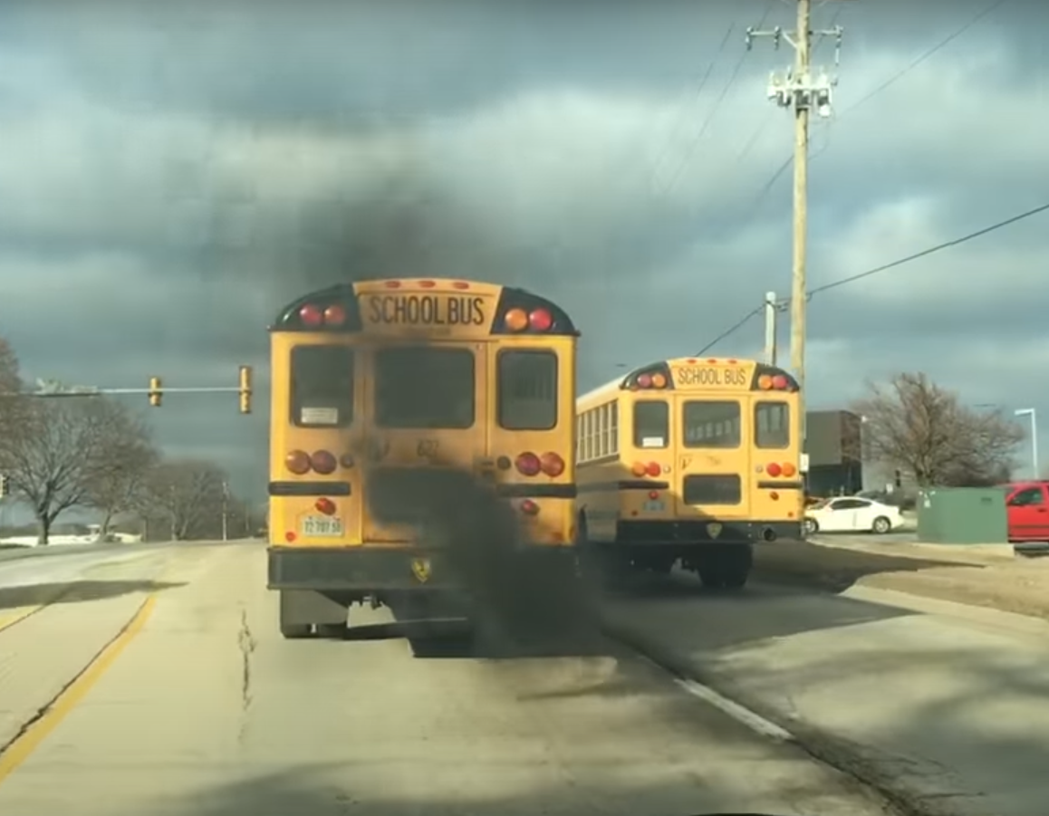
Pediatric Asthma rates in US
8.8%
CDC: Percentage of children with current asthma by state/territory. Available at: https://www.cdc.gov/asthma/asthmadata/Child_prevalence_state.html
Image: Q98.5 Rockford, Youtube

Slide 7
Implementing an electric fleet is complex
Project development must begin at least 12-18 months before buses arrive.
Activity
Kick-off
Bus Delivery
Feasibility &
Initial Design
Site visits, contractor bids, pricing
Ongoing Project Operation
Utility Engagement
Outreach & planning
Design, application, & implementation
Design & Engineering
Electrical & civil engineering planning & implementation
Permitting
Permitting scope
Environmental, building, & electrical permit applications
Construction
Management
Contractor engagement & selection
Contracting
Construction
EV Chargers
Scope & design
Charger procurement
Delivery, installation, & commissioning
Legal
Compliance review
Budget
Budget tracking & review
Electric Buses
Scope & procurement
Vehicle Registration
Training
Training scope
Driver & mechanic training

Slide 8
Don’t forget ongoing electric fleet operations
There’s a lot involved in keeping the buses on the road.
Activity
Contract length or bus useful life
1st depot electrification
Phased fleet
delivery
2nd fleet delivery
3rd fleet delivery
4th fleet delivery
Phased depot
electrification*
2nd depot electrification
3rd depot electrification
4th depot electrification
Fueling
10k miles/year included fueling
Managed Charging
Charge optimization, energy management, V2G technology
Charger Maintenance
Charger software and firmware updates & scheduled maintenance
Vehicle Maintenance
Ongoing bumper-to-bumper warranty
Software Access
Live and historical route data, vehicle telemetry, performance metrics, reporting
Budget Neutrality
Budget tracking & review
*Additional depot construction or existing depot expansion

Slide 9
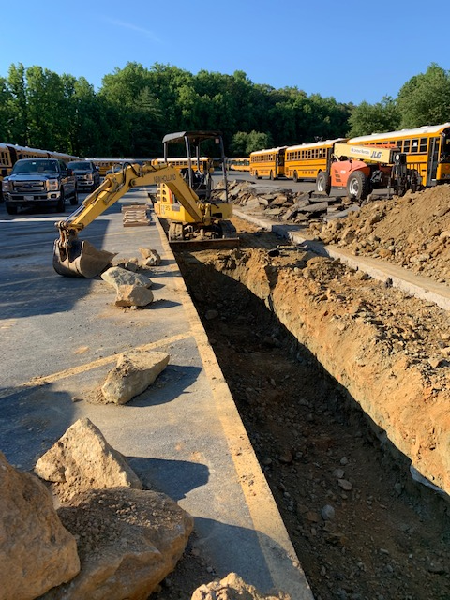
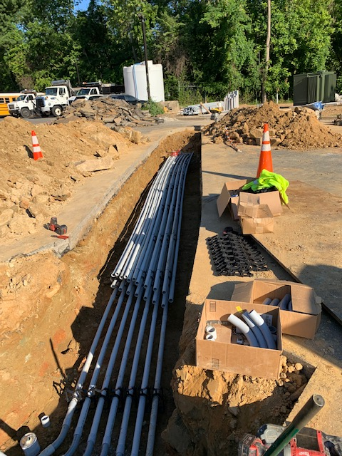
Before
MCPS
Bethesda Depot

Slide 10
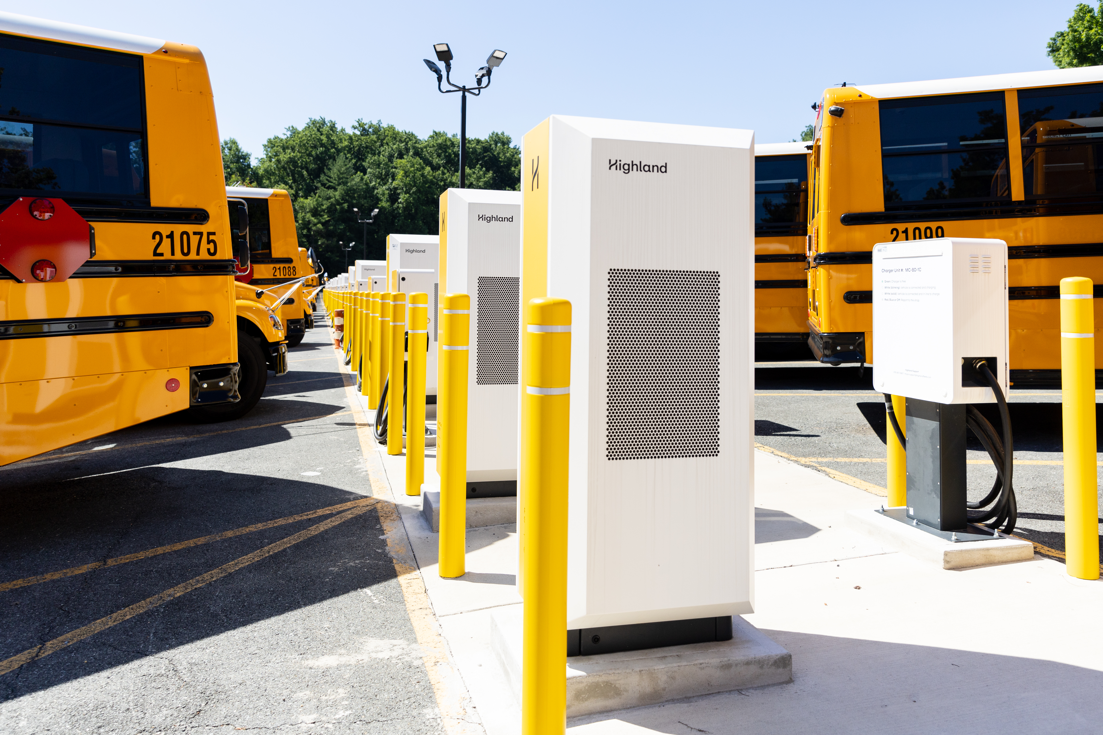
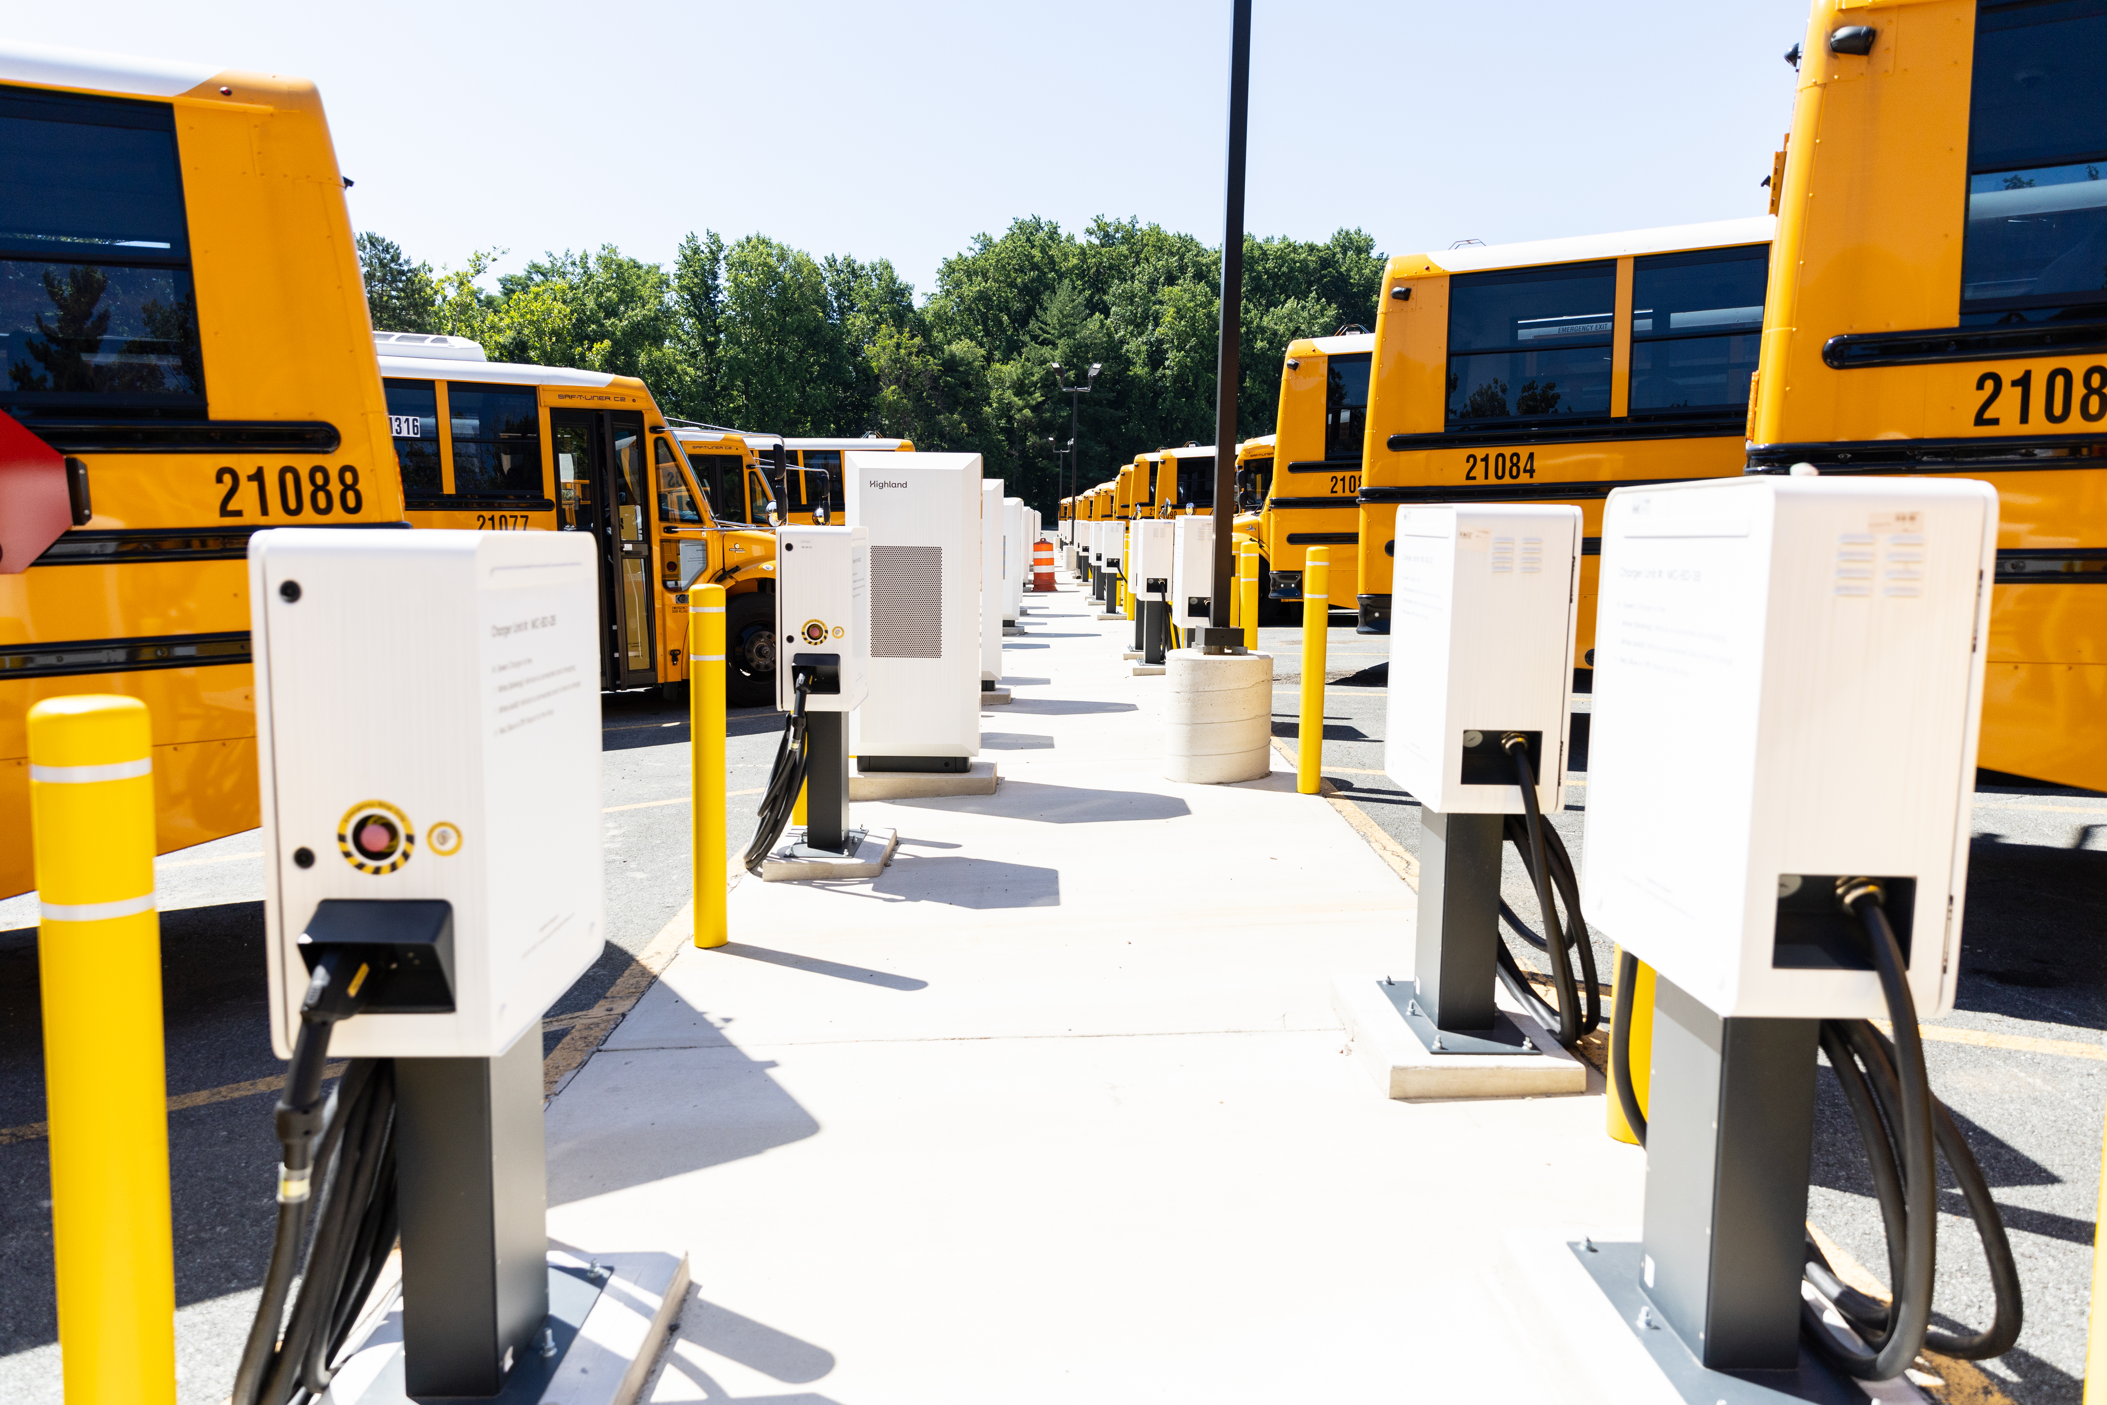
After
MCPS
Bethesda Depot

Slide 11
Highland turns 10 buses into 20
EPA Clean School Bus Program Pricing Example*
10 buses: Highland + EPA grant
10 buses: Highland
20 buses
Dealer Base Bus Cost ($395k)
Dealer Base Bus Cost ($395k)
Dealer: Sells 20 buses vs 10 EPA awarded, plus 10-15-year sales agreement
-
EPA Grant ($190k)
-
Tax Credits ($40k)
-
-
Asset Depreciation ($40k)
Asset Depreciation ($23k)
-
V2G Discount ($28k)
+
-
V2G Discount ($28k)
-
Highland: Provides full electrification infrastructure, services & maintenance
-
Fuel Discount ($22k)
Fuel Discount ($22k)
-
B-to-B† Discount ($22k)
-
B-to-B† Discount ($22k)
Subsidized bus cost
($110k)
Subsidized bus cost
($243k)
School District: Receives 20 buses, fuel, & maintenance for 10-15 years at reduced cost
Average: $176k per bus cost to district
*Quantity & dollar amounts are illustrative – detailed model & partnership agreements available upon request
† Bumper-to-bumper

Slide 12
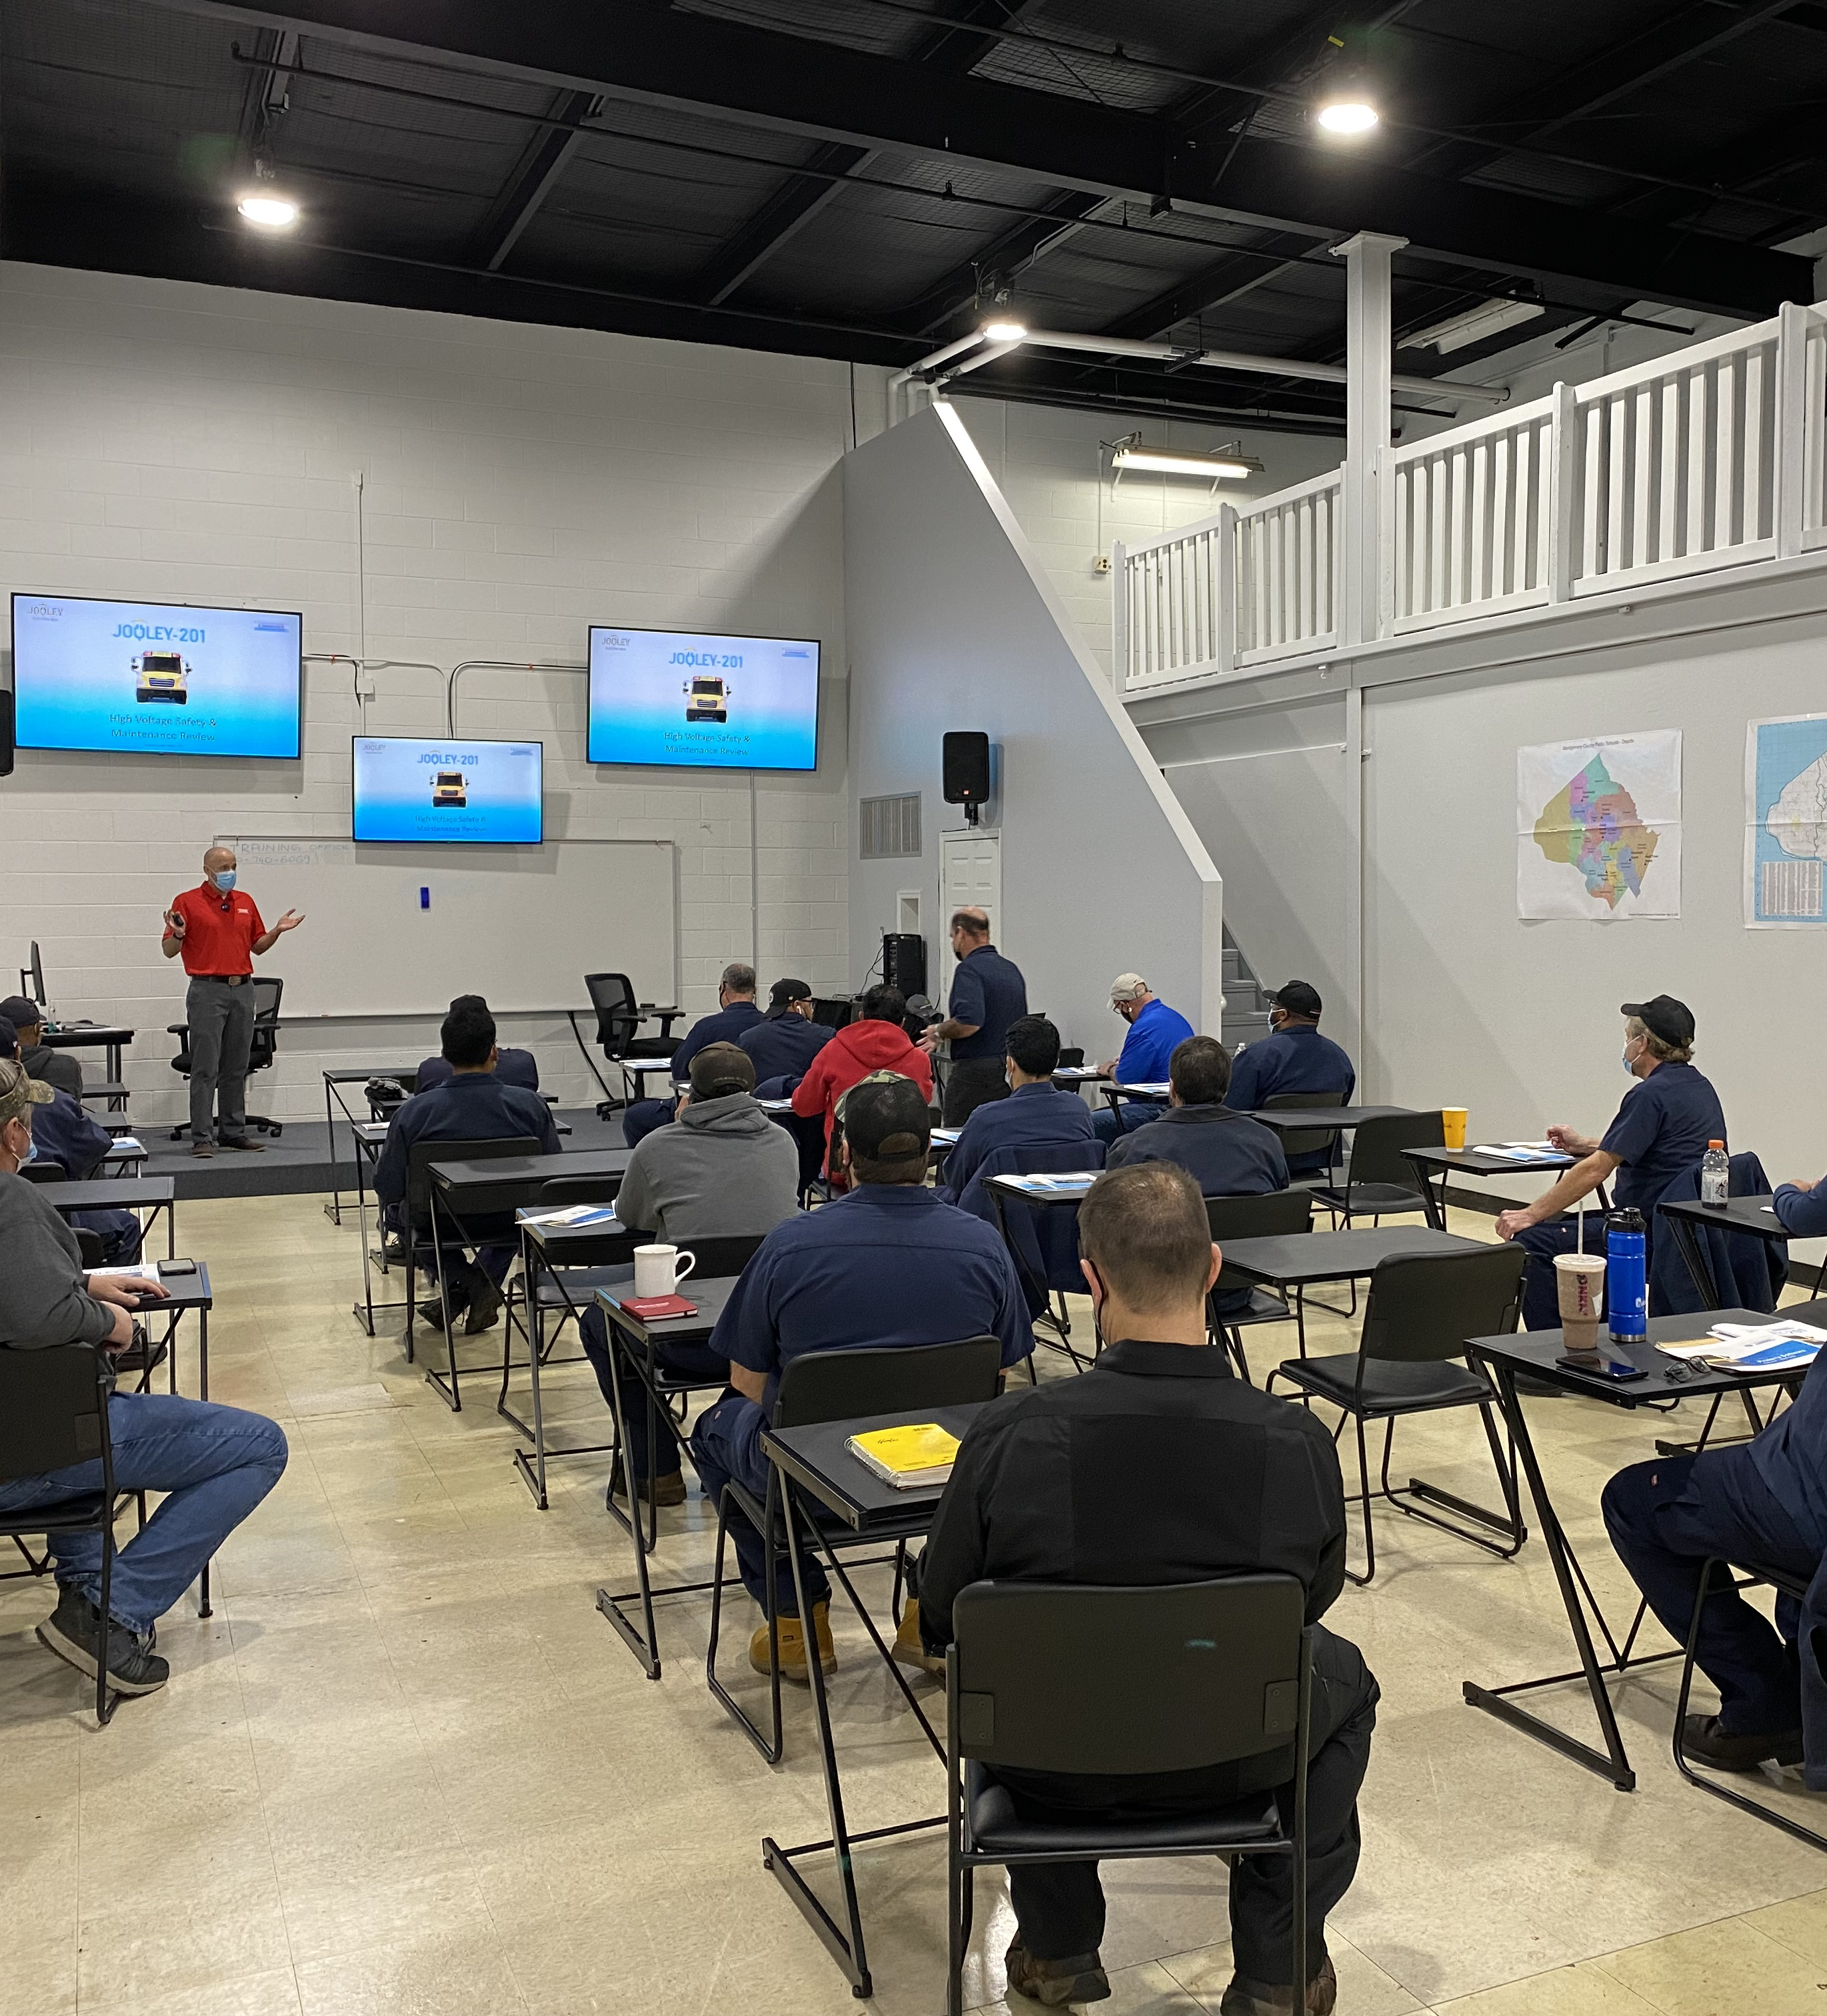
Your drivers. Your mechanics. Your depot.
Each electrification project is unique and place-based.
We work with the local dealer, contractors, utility, and community to deliver your project.
We also train your drivers and mechanics to participate in the electric economy.

Slide 13
Congratulations!
The South is a magnet for EV business – connecting school bus/education and EV business – Congrats Georgia, Rivian, Hyundai, Kia, SKG, and Blue Bird
Don’t disappoint parents with dirty diesel buses!

Slide 14
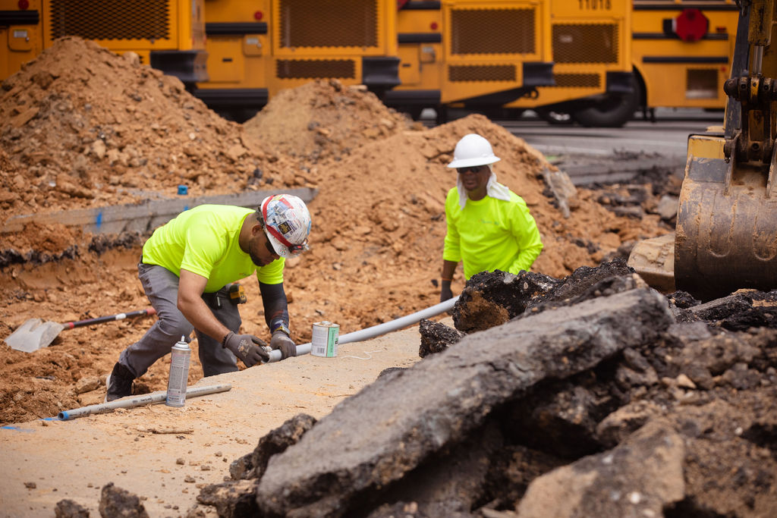
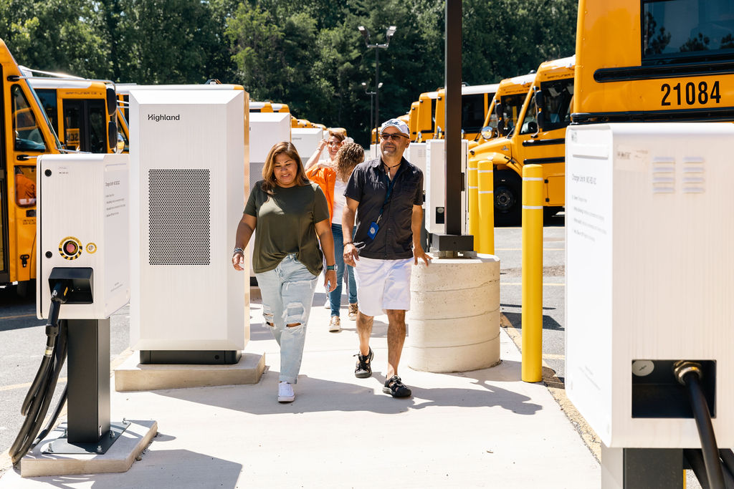
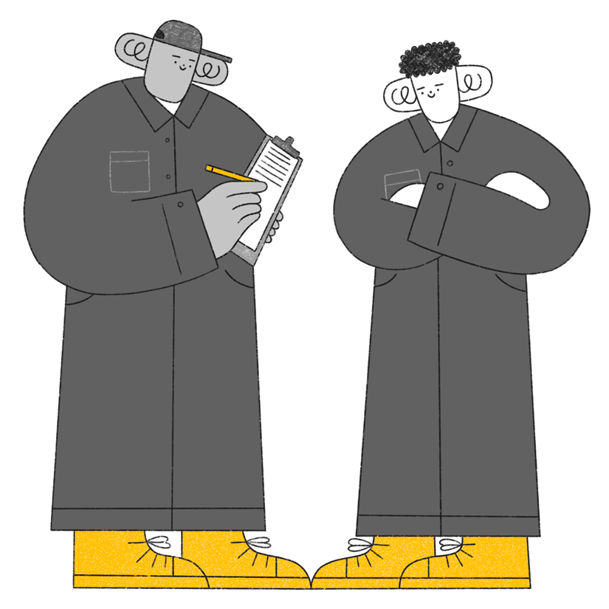
Electrification that works for you
We work with you to deliver the right equipment for the right routes, and provide the depot/electrification solution you want

Slide 15
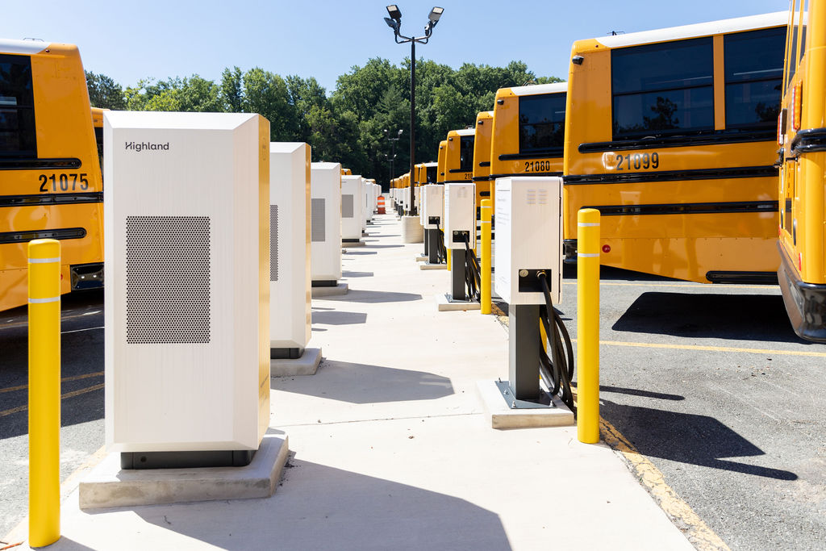
Highland makes upgrading to electric simple and affordable.
No upfront cost
No complexity
10% savings*
Performance guarantee
*Over current diesel costs on a per bus basis

Slide 16
Thank You
Richard DiMatteo
617.543.2775 | Richard@highlandfleets.com

