Slide 1
Georgia Public Schools Succeeding
Supporting Those Who Make Success Happen
Employee Assistance Program
Available to all full-time, K-12 public education employees + Pre-K teachers. Visit www.EAPHelpLink.com and enter code GADOE.
Investing in academic recovery
Dedicated Academic Recovery Specialists, expanded, afterschool & summer learning, free formative assessments, & more.
SAT & ACT beating the nation again
All-time-high graduation rate in 2022

Slide 2
Joyce Bearden
Director of Knowledge and Resource Management
October 20, 2022
Notes:
Good morning! My name is Joyce Bearden, Director of Knowledge and Resource Management in Technology Services. I am delighted to have the opportunity to share updates from our department today on behalf of Dr. Keith Osburn, our Chief Information Officer and the Technology Services team. Dr. Osburn regrets not being able to be here today with us. I'd also like to thank Mr. Josh Hooper for the invitation to share. I'd also like to thank Superintendent Woods for his leadership, ongoing support, and dedication to Georgia's education community.

Slide 3
Technology Services Projects
Governed by Superintendent Woods’ A Roadmap to Reimagining K-12 Education document and GaDOE’s strategic plan, current projects include:
Ensuring adequate connectivity for K-12 students both on campus and off campus
Modernizing GaDOE’s data centers and data collections processes to ensure we can answer 21st Century questions
Providing access to cybersecurity tools and training for all districts
Streamlining access to professional learning and access to high-quality digital resources to support teachers and students
Notes:
Our work in Technology Services is governed by Superintendent Wood's Roadmap to Reimagining K12 Education document and our strategic plan. We endeavor to deliver on the mission and vision outlined by Mr. Woods and to offer high quality service and support to districts and schools. So what are our current projects? They are connectivity, data modernization, cybersecurity awareness, professional learning and high quality digital resources. First we are ensuring adequate connectivity for Georgia's students both on and off campus. We are also modernizing our data centers and data collections processes. Next we are providing cybersecurity tools and training for all districts. Finally, we are streamlining access to professional learning courses/events and high quality digital instructional resources to support teachers and students in the classroom. I'm delighted to share more about each of these projects today.

Slide 4
Connectivity
Peachnet Upgrade - Amount of Peachnet bandwidth to each school has quadrupled since 2019 to now 400Mpbs per school.
Bandwidth dashboard has been made available for technology directors to monitor bandwidth usage.
An external antenna for each school that requested one has been installed. 1,607 Wi-Fi antennas were requested and installed.
Over 155,000 hotspots have been made accessible to economically disadvantaged students.
Notes:
Thank you Governor Kemp, Superintendent Woods and the State Board of Education for approving connectivity projects to help all districts ensure students have access to ample bandwidth to support multimedia rich digital curriculums. We know that bandwidth matters and for that reason we are continuing to work to upgrade Peachnet. In 2021 the bandwidth was doubled from 100 megs to 200 megs. We built a dashboard to help your technology leaders monitor your bandwidth usage. This tool helped us to recognize the need for additional bandwidth. The bandwidth dashboard was released this past summer to your technology leadership. Let's take a quick look at the dashboard. (advance to next slide, then come back)
To promote open classroom learning spaces and help address the homework gap, we worked to install external antenna for each school that requested one – that's 1607 WiFi antennas. This project is nearly completed. Lastly, over 155,000 hotspots have been made accessible to economically disadvantaged students.

Slide 5
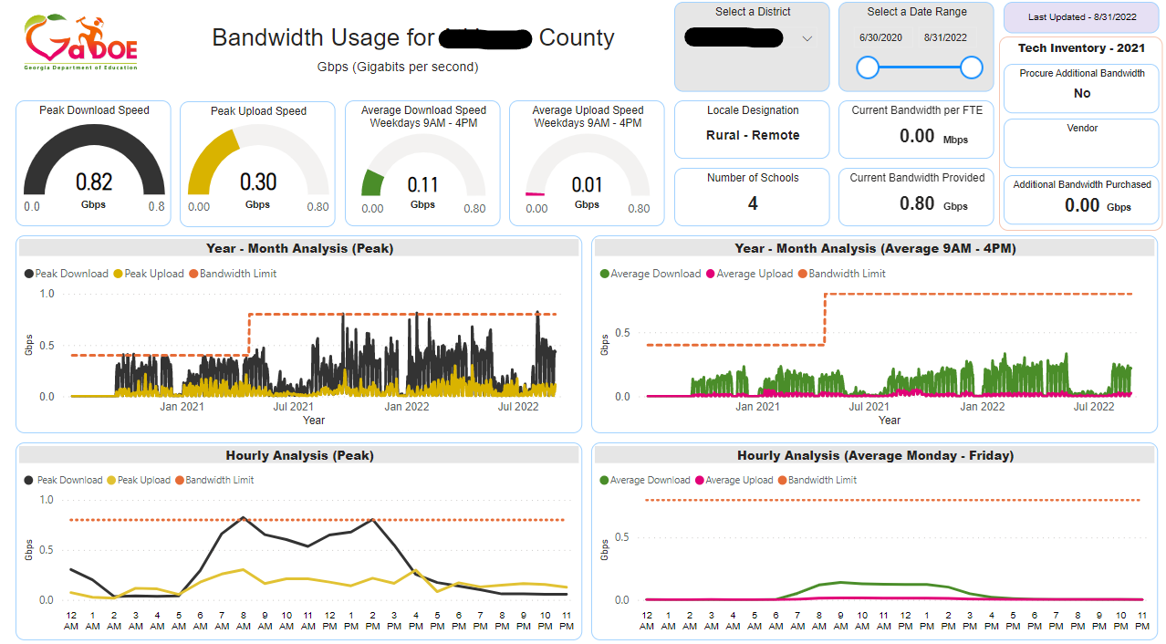
Notes:
Here is an example dashboard. I want to draw your attention to the center of the dashboard – the year to month analysis visualization. The orange line indicates the available bandwidth limit. The dark grey and orange bar graphs show peak usage. The data indicates that districts are utilizing all bandwidth currently available. Great news! - We are currently in the process of adding additional bandwidth – increasing to 400 megs this school year.

Slide 6
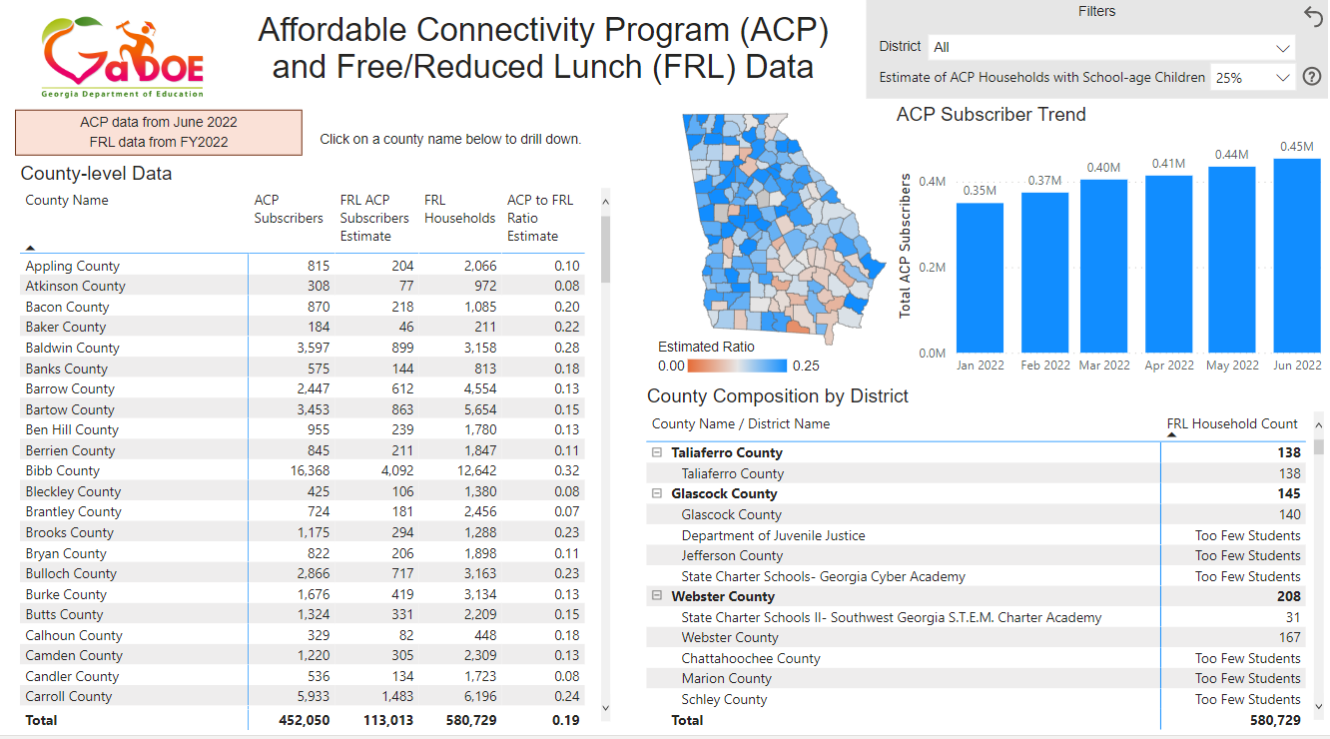
Promoting Affordable Connectivity Program (ACP)
Created ACP dashboard to help districts understand opportunity gap https://www.georgiainsights.com/affordable-connectivity-program.html
Notes:
Since we are talking about connectivity, I don't want to miss an opportunity to share with you about the Affordable Connectivity Program. ACP is a federal program offered through the FCC for families and students that meet an income threshold and other criteria. ACP enables a family to off-set the cost of their bandwidth by $30 a month and provides a one time $100 allotment towards a device.
This ACP dashboard is available now at Georgia Insights. It is intended to provide an opportunity for you to see progress towards helping families signing up. The Department of Education has committed resources to help you promote this program as well support families in completing the sign up process. Please reference the flyer provided today for more information about the Affordable Connectivity Program.

Slide 7
Modernization Efforts
A multi-year project to modernize technology systems
Supports a “digital first” culture
Shifting “on premise” resources and applications to become “cloud native”
Increasing the security of and ability to govern the use of stored data
Improving ability to rapidly analyze and report data
Notes:
We believe in a digital first culture and recognize that technology is mission critical. That brings me to our next project – a Modernization effort. This multi-year project will result in the modernizing our systems with goals of
1. reducing work and effort of your staff
2. developing a more efficient data collections and reporting processes
3. providing meaningful data sets to you
We will update our systems to the cloud, increase the security and governance of stored data and improve the ability to analyze and report data.

Slide 8
Cybersecurity Awareness
Notes:
Next, we recognize that cybersecurity awareness is everyone's responsibility. Ensuring good cybersecurity practices for all districts remains the highest priority of our Chief Information Officer, Dr. Osburn. We would like to thank Mr. Woods and the State Board of Education for providing resources to enable helping our districts improve their cybersecurity posture. We have done that at no cost to the district for the next several years.

Slide 9
Cybersecurity Vulnerability Assessment Tool
GaDOE has provided a cybersecurity vulnerability assessment tool to each district that has requested access.
The tool scans your organization's technology infrastructure to identify weaknesses and vulnerabilities that might be exploited by bad actors.​
GaDOE, in partnership with GTA, is providing access to this tool to every district.
If you have not received an enrollment invitation, email Nathan Miller, GaDOE’s Chief Information Security Officer at:​
nathan.miller@doe.k12.ga.us​
Notes:
One such tool provided at no cost to your district includes the cybersecurity vulnerability assessment tool that scans your organization's technology infrastructure to identify weaknesses and potential vulnerabilities. If you would like more information about this initiative, please contact our Chief Information Security Officer, Nathan Miller. His email address is provided here.

Slide 10
KnowBe4 Phishing and Cybersecurity Training licenses have been purchased for every district in Georgia.​
License term will be through August 31, 2026​.
Districts who are existing KnowBe4 customers should have already received an email​.
New districts will receive their account information as KnowBe4 gets the accounts provisioned.
Notes:
KnowBe4 is a phishing and cybersecurity training tool. Licenses have been purchased for every district in Georgia and will be active through August 2026. The phishing tool will help you check awareness and provide ongoing training when needed. We are currently rolling out KnowBe4 and offering onboarding training and support. Additionally, we have utilized many of the KnowBe4 training resources to support of Cybersecurity Awareness Month this month.

Slide 11
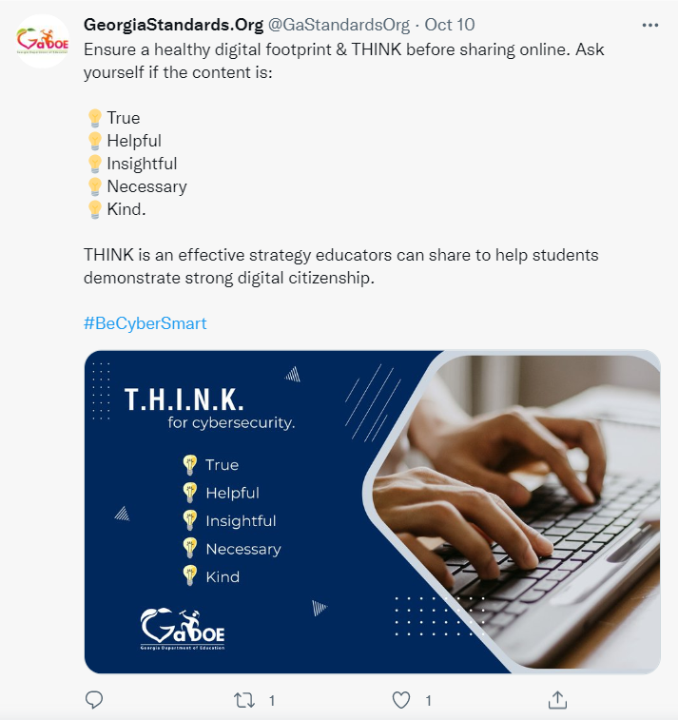
Cybersecurity Awareness Month
Weekly presentations including guest experts for technology staff
Sharing cybersecurity awareness training, tips and resources
Social media campaign
Notes:
Indeed October is Cybersecurity Awareness Month. The Georgia Department of Education is committed to educating stakeholders about cybersecurity awareness. This October, we are focusing on the people part of cybersecurity, providing information and resources to help you make smart decisions on the job, at home, or at school. We are hosting weekly presentations with guest experts, sharing daily training resources and tips for your technology staff. We are also sharing best practices through social media. The theme for 2022 is See Yourself in Cyber. We invite you to join us in cybersecurity awareness month activities.

Slide 12
Cybersecurity Training with RESAs
Partnering with RESAs around the state to help increase awareness around cybersecurity to help you and your district leaders plan for good cybersecurity posture.
Second cohort is planned for January 2023 and includes:
Series of face-to-face trainings
Sharing of planning resources and templates
Self-paced online training course
Notes:
This last cybersecurity update is another way we are supporting your technology workforce by partnering with RESAs – currently we are implementing our second cohort with RESAs across the state to help increase awareness around cybersecurity and to help you and your district leaders plan for good cybersecurity posture. Our RESA cybersecurity cohorts will attend a series of face-to-face trainings co-hosted by our chief information security officer and industry experts. Resources, templates and a self-paced online course will be included. We even provide a practice incident response scenario as part of the cohort training. Superintendents, we would like to invite you, your finance officer, your academic officer and your technology leadership to participate in this training. I do hope you will join us! Thank you to our RESA partners!

Slide 13
Supporting the 21st Century Learner
Task force of superintendents, chief information officers, and technology experts convened to recommend technology standards to:
promote a 21st-century learning environment in classrooms and media centers
provide uniform recommendations for devices, networks, technology structure, bandwidth, and more
Notes:
Here is our final project update where Mr. Woods tasked us with beginning to plan for the 21st century classroom and media center. We initiated a task force of district and technology leaders. The group created technology standards recommended by your district technology leaders – this was the launch point for our 21st century work. This framework of standards offers district, school and classroom recommendations to support technological and pedagogical strategic planning. Look for this report for when it is released later this year.

Slide 14
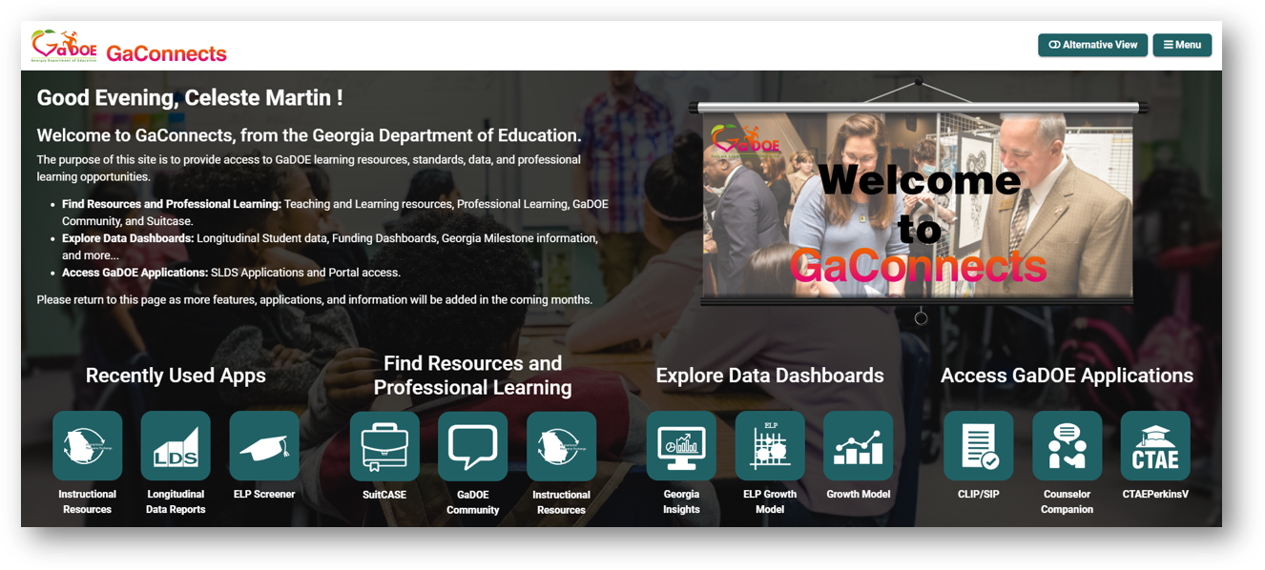
Applications and Tools
Notes:
In my opinion, I have saved the best updates for last. We are excited to announce the release of several applications and tools to support teachers and leaders. GaConnects is our one stop shop for teachers and staff to gain immediate access to DOE provided resources to help your district and schools. By better organizing information and resources into three areas: learning resources, data dashboard, and DOE applications, we are working to ensure that we efficiently provide access to these resources immediately when you need them. GaConnects is currently available through SLDS.

Slide 15
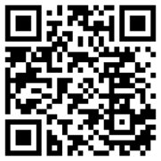
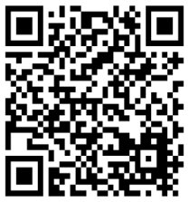
Tools for Professional Learning
GaDOE Community
Collaborative Discussion Platform
Georgia Learns
Professional Learning Courses
Notes:
Two new applications includes the GaDOE Community project and Galearns, our enterprise professional learning platform. Both of these resources are available for all school staff…. Currently we have over 100K users accessing high quality resources. On the left, GaDOE Community is a collaborative discussion platform built to facilitate ongoing discussions and collaboration for school and district staff. You can find a variety of GaDOE hosted groups: STEM/STEAM, Fine Arts, School Nutrition, Library Media Specialists, and more. There is a group for everyone and some have virtual specialists who offer digital professional learning communities. I hope you will join GaDOE Community by clicking "create an account". Also you can access our Professional learning events by clicking "professional learning" in the upper right corner of the GaDOE Community log in screen. This will provide you access to our virtual and live events as well as recorded webinars from across the Georgia Department of Education. On the right, is the Georgia Learns course catalog. This is available through the SLDS or GaConnects applications. There are over 100 courses available on topics like Suicide Prevention, Cybersecurity Awareness, as well as content specific courses. Continue to check back as we publish courses weekly and there are another 100 courses in development.

Slide 16
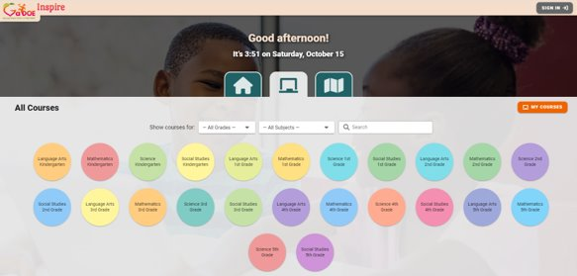
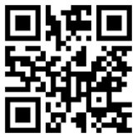
Tools for Standards and Resources
GaDOE SuitCASE
Georgia Standards of Excellence
GaDOE Inspire
New Instructional Resources Platform
Notes:
We continue to see an increase in the use of digital platforms and resources by your teachers. To better support their use of these resources we have partnered with DOE’s Teaching and Learning team to develop two new tools: GaDOE SuitCASE and GaDOE Inspire. On the left is GaDOE SuitCASE which now provides educators access to Georgia's Standards of Excellence in digital format. Teachers can search a framework by key words, pin standards and elements for quick reference and copy/paste standards easily from SuitCASE to another application. On the right, GaDOE Inspire is a first of its kind platform designed to provide an access to DOE resources organized by content and grade for immediate access by your teachers. Here teachers can access K-5 curriculum maps, unit plans, and lessons with high quality resources. I invite you to explore there new tools.

Slide 17
Contact Information
Technology Services Team​
Keith Osburn​ | Chief Information Officer​ | keith.osburn@doe.k12.ga.us​
Nathan Miller​ | Chief Privacy & Information Security Officer​ | nathan.miller@doe.k12.ga.us​
Joyce Bearden​ | Director of Knowledge & Resource Management​ | jbearden@doe.k12.ga.us​
Nicholas Handville​ | Chief Data Officer​ | nhandville@doe.k12.ga.us​
Chris Shealy​ | Director of IT Strategy & Enterprise Services​ | cshealy@doe.k12.ga.us​
Amanda Williamson​ | Director of Virtual Learning​ | awilliamson@doe.k12.ga.us​
Jay Heap​ | Associate Superintendent, Enterprise Services & Applications​ | jheap@doe.k12.ga.us​
Bob Swiggum​ | K12 Connectivity Officer​ | rswiggum@doe.k12.ga.us​
Notes:
I have shared a lot of information today about our Technology Services projects. It may feel a little like information overload. Please know that Dr. Osburn and our team prioritize service and support of your district and schools. It is a great honor and privilege support your work. If we can be of assistance in answering questions or even offering a demonstration of these new tools, please contact us. We are happy to assist. Thank you again Mr. Woods for the opportunity to share.

