Slide 1
Georgia School Superintendents Association Spring Bootstrap Conference Legal Issues Update April 21, 2022
Phil Hartley
Harben, Hartley & Hawkins, LLP
770-534-7341
770-654-3616
phartley@hhhlawyers.com

Slide 2
ISSUES FROM THE GENERAL ASSEMBLY

Slide 3
O.C.G.A. § 20-2-786 - HB 1178 PARENTS’ BILL OF RIGHTS
“….a fundamental right of parents to direct the upbringing and education of their minor children….important information shall not be withheld, either inadvertently or purposefully” from parent regarding child’s education.
Parental rights include:
direct the upbringing and moral or religious training
review all instructional materials (as defined by 20-2-1010 & 1017) intended for classroom instruction, to be available during first 2 weeks of each grading period
enroll child in public or private school, including religious school or home study program
access/review all records including grades and attendance
access to promotion/retention policies and high school graduation requirements

Slide 4
O.C.G.A. § 20-2-786 HB 1178 continued
right to prohibit photographs, video or audio recordings of children by written notice
right to request in writing from principal or superintendent any of the above-mentioned information
-must provide information within 3 business days of receipt of request
-if information will take longer, must provide a written description of information and timeline, not to exceed 30 days
-if denied, a parent can appeal to BOE at next public meeting and it must be on agenda
-parent can appeal to SBOE

Slide 5
O.C.G.A. § 20-2-786 HB 1178 cont’d
“…parents have inalienable rights that are more comprehensive than listed. [this] does not prescribe all rights of parents … rights of parents shall not be limited or denied.”
Each local District must adopt a policy/regulation to “promote parental involvement”
must include “process for parents to enact each enumerated right above”
object to instructional materials
withdraw from sex ed after getting notice of content
Cannot be waived

Slide 6
O.C.G.A §20-1-11 – HB 1084 Divisive Concepts
One race is inherently superior to another
USA is fundamentally racist
An individual, by virtue of race, is inherently or consciously racist or oppressive toward individuals of other race
An individual should be discriminated against or receive adverse treatment solely or partly because or race
Moral character is inherently determined by race
An individual, solely by virtue of race, bears individual responsibility for actions committed in the past by others of the same race
An individual, solely by virtue of race, should feel anguish, guilt, or other psychological distress
Performance-based recognition and character traits such as a hard work ethic are racist or have been advocated by one race to oppress another race
Race scapegoating or race stereotyping

Slide 7
O.C.G.A. §20-1-11 – HB 1084 cont’d
LOA shall prohibit employees from discriminating against students and other employees based on race
LOA shall ensure curricula encourage employees and students to practice tolerance and mutual respect and to refrain from judging based on race
LOA may provide curricula fostering environments where all are respected; but any curriculum, instruction or mandatory training program whether by District or third party shall not advocate for divisive concepts

Slide 8
O.C.G.A. §20-1-11 – HB 1084 cont’d
Law Not Intended to
Violate rights or undermine intellectual freedom and free expression
Infringe on intellectual vitality
Prohibit tolerance, mutual respect, cultural sensitivity, or cultural competency, as long as not inconsistent with this law
Prohibit responding to questions regarding divisive concepts in professionally or academically appropriate manner and without espousing personal political beliefs
Prohibit discussion of divisive concepts, as part of larger course of instruction, in professional and academically appropriate manner, w/o espousing personal political beliefs

Slide 9
O.C.G.A. §20-1-11 – HB 1084 cont’d
Prohibit full and rigorous implementation of AP, IB, and DE coursework, professionally, academically appropriate and not personal beliefs
Prohibit discussion of slavery, racial oppression, racial segregation, or racial discrimination, professionally, academically appropriate and no personal beliefs
Create any right or benefit enforceable in law or equity
Prohibit a court from ordering training due to a finding of discrimination

Slide 10
O.C.G.A. §20-1-11 – HB 1084 cont’d
By 8/1/22 must have complaint resolution policy to address violations
Must be made by parent, student or staff
Submitted in writing to the principal, with reasonably detailed description of violation
Within 5 days, principal must take reasonable steps to investigate
Within 10 days, unless mutually agreed, confer with complainant and inform if a violation, what is to be done, student and personnel information confidential
Within 3 days of request, put decision in writing

Slide 11
O.C.G.A. §20-1-11 – HB 1084 cont’d
Principal’s determination shall be reviewed by Supt. w/in 10 days of written request
Supt’s decision subject to review by BOE under 20-2-1160 w/right to appeal to SBOE
SBOE shall make written findings regarding whether any violations occurred
If so, SDOE develops corrective action plan w/in 10 days and LOA has 30 days to implement
If not, SBOE shall suspend one or more waivers
By 7/1/22, SBOE shall develop model policy; SDOE shall develop guidance as to whether violations have occured

Slide 12
O.C.G.A. §20-1-11 – HB 1084 And that’s not all….
Nothing…shall be construed to prohibit any cause of action… to complainant who is aggrieved by a decision of LBOE or SBOE
Right of individual to request nonconfidential records that may substantiate complaint
Three days, not more than 30 days
If request denied or more than 30 days passes, appeal to LBOE at its next meeting
Can’t be waived

Slide 13
O.C.G.A. §20-2-324.6 SB 226 Book Banning Bill
(a) As used in this Code section, “harmful to minors” means that quality of description or representation, in whatever form, of nudity, sexual conduct, sexual excitement, or sadomasochistic abuse, when it:
(1) Taken as a whole, predominantly appeals to the prurient, shameful, or morbid interest of minors:
(2) Is patently offensive to prevailing standards in the adult community as a whole with respect to what is suitable material for minors: and
(3) Is, when taken as a whole, lacking in serious literary, artistic, political, or scientific value for minors.

Slide 14
SB 226
By January 1, 2023:
BOE must adopt a complaint resolution policy for complaints by parents that “materials” provided/available to student is “harmful to minors”
By September 1, 2022
SDOE shall have model policy for complaints procedure

Slide 15
SB 226
Complaint must be in writing to the Principal
Must be “reasonably detailed description” of what is “harmful”
Principal must review/investigate complaint within 7 business days
Within 10 business days of Complaint:
Principal/designee determines if material is, in fact, “harmful to minors”
Remove material?
Restrict access?

Slide 16
Appeal of Principal’s decision to “full administrative and substantive review by Board of Education”
Must include right of parent to provide public comment
Appeal must be decided w/in 30 days
Titles deemed not harmful must be listed on website w/in 15 days and stay for 12 months

Slide 17
O.C.G.A. § 20-2-59 - SB 588
Requires BOE meeting to comply with provision of the Open Meetings Act, that were already required
BOE must provide for public comment at regular monthly meeting
Public comment must be included on each regular monthly meeting agenda
Agenda must be posted prior to meeting
Cannot require more than 24 hours notice prior to participation in public comment
Can limit time for each participant and number of participants on a particular topic
All meetings are to be open to the public
Recording (visual/audio) permitted
BOE to adopt rules of conduct at meeting for public by 10/1/22 and 8/1 hereafter
- Post in a prominent manner on website
- Include provision for removal of member of the public for an actual disruption of a meeting

Slide 18
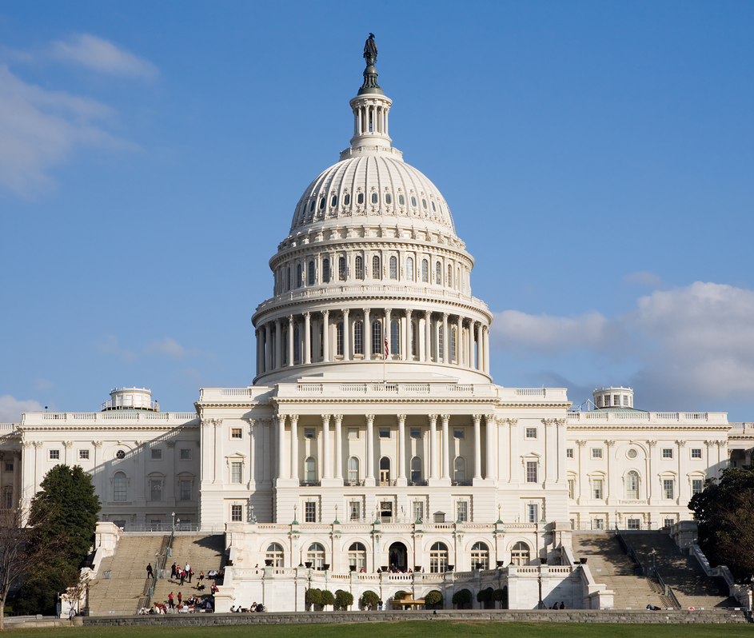
FEDERAL ISSUES

Slide 19
Department of Education (OCR) Notice of Interpretation in Light of Bostock v. Clayton County
“Consistent with the Supreme Court’s ruling and analysis in Bostock, the Department interprets Title IX’s prohibition or discrimination “on the basis of sex” to encompass discrimination on the basis of sexual orientation and gender identity.”
OCR will fully enforce Title IX to prohibit discrimination based on sexual orientation and gender identity in education programs and activities that receive Federal financial assistance from the department.
New Title IX regulations have been drafted and will soon (maybe April) be published for comment – will include gender identity and sexual orientation; will also rewrite the Devos sexual harassment regulations

Slide 20
U.S. Department of Education, Office of Civil Rights and Department of Justice Title VI guidance
Dear Colleague Letter originally issued January 8, 2014
Withdrawn December 1, 2018
Federal Commission on School Safety recommended withdrawal – “guidance advance(s) policy preferences and position not required or contemplated by… Title VI”
June 2021 – Federal Discipline and School Climate Coalition recommended:
Rescind withdrawal
Reassert the principle of disparate impact
Reinstate Civil Rights Data Collection
OCR awaiting first new data collection

Slide 21
Title VI, Discipline, and the New/Old OCR
The Return of Civil Rights Data Collection
Know What Your Data Shows
Any Incident with Racial/Cultural Implications Could Turn Into a System-Wide Investigation
Proactive Training for Everyone

Slide 22
Fact Sheet: Providing Students with Disabilities Free Appropriate Public Education During the COVID-19 Pandemic and Addressing the Need for Compensatory Services Under Section 504 (OCR 2/17/22)
Although the COVID-19 pandemic has created unique challenges for schools, students, and parents, the responsibility for schools to comply with Section 504 continues regardless of how schools provide education: virtually, in-person, or with a hybrid learning model. In ensuring eligible students with disabilities receive FAPE under Section 504, schools must make decisions that consider students' health, safety, and well-being….Regardless of the challenges schools face during the pandemic, students with disabilities retain their right to FAPE under Section 504.

Slide 23
Fact Sheet Compensatory Services
Unlike the FAPE inquiry, which requires the group to determine appropriate services going forward, the compensatory services inquiry requires looking backwards to determine the educational and other benefits that likely would have accrued from services the student should have received in the first place.
Providing compensatory services to a student does not draw into question a school’s good faith efforts during these difficult circumstances. It is a remedy that recognizes the reality that students experience injury when they do not receive appropriate and timely initial evaluations, re-evaluations, or services, including the services that the school had previously determined they were entitled to, regardless of the reason.

Slide 24
Fact Sheet Compensatory Services - Factors
In general, the individualized determinations of whether, and to what extent, compensatory services are required must be made by a group of persons knowledgeable about the student, including for example, school nurses, teachers, counselors, psychologists, school administrators, social workers, doctors and/or family members. The following factors may be relevant for the group of knowledgeable persons to consider in determining the appropriate type and amount of compensatory services:
the frequency and duration of missed instruction and related services;
whether special education and/or related services that were provided during the pandemic were appropriate based on the student’s individual needs;
a student’s present level of performance;
previous rates of progress;
the results of updated evaluations;
whether evaluations were delayed; and
any other relevant information.

Slide 25
J.N. v. Jefferson County Board of Education, 11th Cir., Sept. 10, 2021
Is compensatory education an automatic remedy for child-find violation?
“IT IS NOT.”
“Fact intensive analysis,” varies from case to case
For example, in this case:
ADHD student – mother took her off medication
Behavioral problems increased “when she was in the same class as her [twin] sister”
Remedial services provided
She was in middle school

Slide 26
J.N. v. Jefferson County BOE
“As a result of [IDEA’s design], the remedy for a procedural failing is generally to require that the procedure be followed. And where the IDEA’s educational guarantee itself is violated, substantive remedies like compensatory education may be available.”
“Low grades and behavioral incidents may show that Molly suffered from ADHD and that she struggled in the classroom – probably even more than most. But that is not enough to show that the educational opportunity Molly received was substantively different than what she would have gotten with a more timely IEP, or that her education was otherwise deficient. “

Slide 27
BELIEVE
IN
PUBLIC
EDUCATION

