Slide 1
TRS Updates!
GSSA Bootstrap
TRS Update
April 20, 2022
L. C. (Buster) Evans, Ed.D.
Executive Director

Slide 2
TRS Overview
Founded in 1943 operational in 1945
We serve: K-12, Most College and University, Technical Colleges, County Extension Agents, and Public Libraries
Over 400,000 Members (140,000 retired; 240,000 active; 30,000+ active non-contributing/other)
23rd largest pension system in nation
Assets over $100 billion
Funded at 77%
$5.5 billion annual payroll

Slide 3
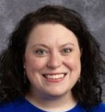
Board of Trustees
Ms. Deborah K. Simonds Chair
Elected by the Board of Trustees
Mr. Thomas W. Norwood Vice Chair
Elected by the Board of Trustees
3-Year Term Expiring
06/30/24
3-Year Term Expiring 06/30/23
Ms. Miriam Shook
Appointed by the Governor
Ms. Marion R. Fedrick
Appointed by the Board of Regents
Mr. Greg S. Griffin
State Auditor
Mr. Steven N. McCoy
State Treasurer
3-Year Term Expiring 06/30/23
3-Year Term Expiring
06/30/24
Ex-Oﬃcio Member
Ex-Officio Member
Dr. William G. Sloan
Appointed by the Governor
Mr. Christopher M. Swanson
Appointed by the Governor
Dr. Jason L. Branch
Appointed by the Governor
Mr. Kenneth Dyer
Appointed by the Governor
3-Year Term Expiring 06/30/23
3-Year Term Expiring 06/30/24
3-Year Term Expiring 06/30/24
3-Year Term Expiring 06/30/23

Slide 4
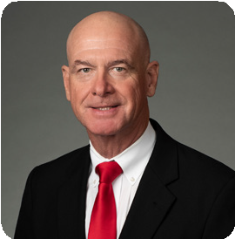
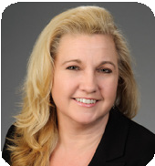
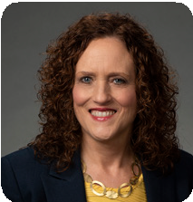
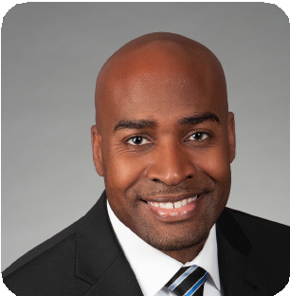
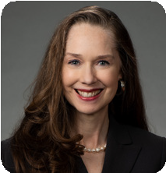
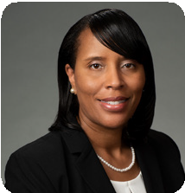
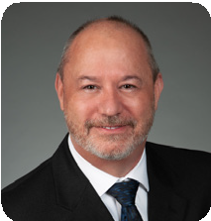
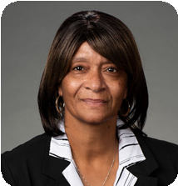
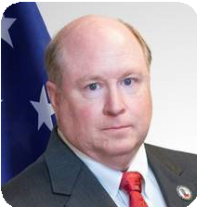
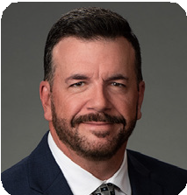
Administration
L. C. (Buster) Evans
Executive Director
Vonnie Stewart Executive Assistant
Laura Lanier Chief Financial Officer
Winston Buckley Communications & Outreach Director
Paige Donaldson Contact Management &
E
Employer Services Director
Sonya Kinley
Chief Human Resources Director
Eddy Hicks Controller
Dina Jones
Member Services Director
Thomas W. McMurry Chief Information Officer
Cory Buice Retirement Services Director

Slide 5
TRS Update
Over 400,00 Members

Slide 6
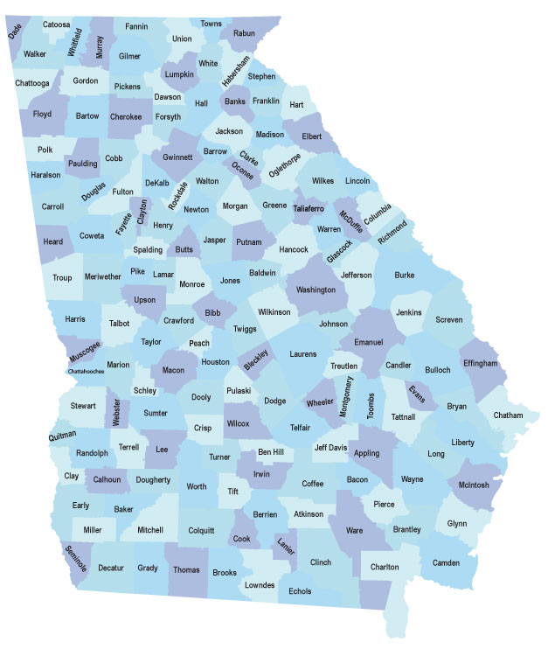
TRS Membership
Analysis – Retiree Annual Benefit - FY20 Year End Tabulation
Residency Maps:
Where Our TRS
Members Retirees Reside
https://www.trsga.com/residency-maps/

Slide 7
Plan & Retirement Information
 | March 1, 2021 | March 1, 2022
Service Retirees | 123,064 | 126,636
Avg. Monthly Benefit | $3,430 | $3,487
Avg. Service Credit | 25.70 | 25.63
Avg. Age at Retirement | 59 | 59
Avg. Age at Payment | 71 | 71
Total Benefit Payroll | $452.0 Million | $473.5 Million
EFT | 99% | 99%
March 1, 2022
141,148
Total
Payees

Slide 8
TRS Update
Fewer Retirements?

Slide 9
TRS Update
FY 2022 Retirements

Slide 10
Legislative Update
What happened?
Pension reform? Not a topic this session
HB 385 return to work…passed and awaits Governor’s signature!
SB 267 beneficiary change bill heard but no action
$2,000 bonuses:
Not subject to TRS contributions
Local decision to pay to retired personnel returning to work. TRS will not count it toward maximum earnings for retirees

Slide 11
House Bill 385 Return to Work
Must have 30 years of service
Critical needs teaching field identified for each RESA district by DOE in consultation with PSC
Must have been retired for 12 months
Can draw full salary AND TRS retirement benefit
District pays employer and employee contribution
Beneficiary notify the employer of their status as beneficiary
Employer notify TRS of employee’s earnable compensation
Beneficiary shall not receive additional creditable service
Effective date of July 1, 2022 until June 30, 2026

Slide 12
My Favorite Stat!!!
As of March 31, 2022, 71 of our beneficiaries are over 100… and 7 of them are men!

Slide 13
Thank You!
Questions?

