Slide 1
The Georgia General Assembly Legislative Overview
The Georgia General Assembly Legislative Overview
Spring Bootstrap
April 2022
Dr. John Zauner
Executive Director, GSSA
Dr. Joseph “Jody” Barrow
Deputy Director, GSSA

Slide 2
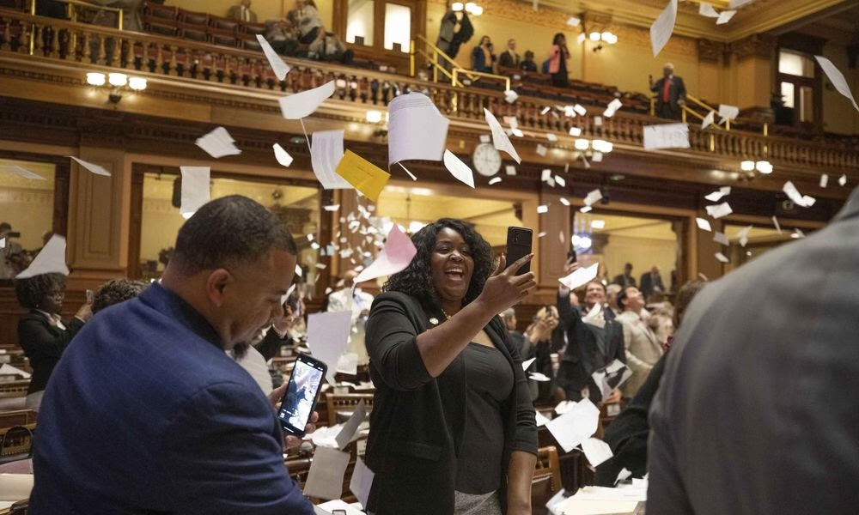
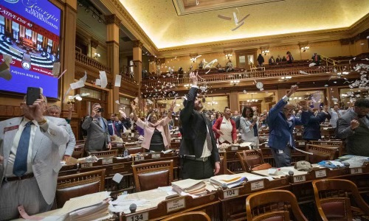
What is the best part of the annual legislative session??
Sine Die!

Slide 3
Seriously, a large number of education related bills were proposed. Many were addressed and we hope to hit on the most significant
GOOD, BAD, UGLY
and those
“Yet To Be Determined!”

Slide 4
“Where you stand on these issues depends on where you sit!”
First, we’ll start with the GOOD:
HB 385 Return to Work Bill (Determined by RESA need)
HB 1292 4-H Activities can not be counted as absences
HB 1004 Police powers for campus security
HB 1303 Elementary Ag Program (optional)
HB 911 Budget Picture is the strongest we have had in years! Mid- term funding is restored with retention compensation ($2000 for certified and for classified) FY23 QBE fully funded with $2,000 for teacher raises (restored GNETS funding, but work to be done!)

Slide 5
HB 910
FY22 Amended:
Added back $382,696,501 to restore austerity cuts to K-12 (QBE)
Restored $5,576,587 austerity to other support programs in K-12
One time salary supplement for $2,000 (full-time) $1,000 (part- time) that covers QBE-funded instructional staff, school support staff, school administration, and central administration ($346,202,968)
Over $93M for midterm adjustment in QBE
Over $18M for State Commission Charter School supplement for 4.54% enrollment growth
$188M to replace over 17 hundred school buses (over 3 years)

Slide 6
HB 911 (Continued)
FY23
Public K-12 schools receiving $382,696,501 restoring austerity to QBE
Restoring $5,576,587 to other support programs in K-12
DOE using $287,136,600 to adjust state base salary schedule (certified personnel by $2,000)
Adding $42,983,562 for enrollment growth and T&E (1.73 million students and 132,000 teachers and administrators)
Providing $35,338,833 for State Commission Charter Schools
Bonds for construction and renovation projects $291,495,000

Slide 7
Next, we have the BAD:
HB 517 Raises cap on SSO’s to 120 million (Could have been ugly if the proposal to 200 million had been agreed on)
HB 1178 Parental Bill of Rights (this may better fall into the “Yet to be Determined” category.) Most of the rights found in this bill are already found in federal and state statue SDOE and local BOE rules, but we placed it in the bad category because of the “lack of trust message” it potentially sends to public educators.
HB 1215 Eliminates restriction on virtual school funding and allows mid-term transfers
SB 588 Open School Board Meetings/Public Participation, already in state statute but a complaint process will now have to be developed if unruly constituents are removed from a meeting due to their behavior.

Slide 8
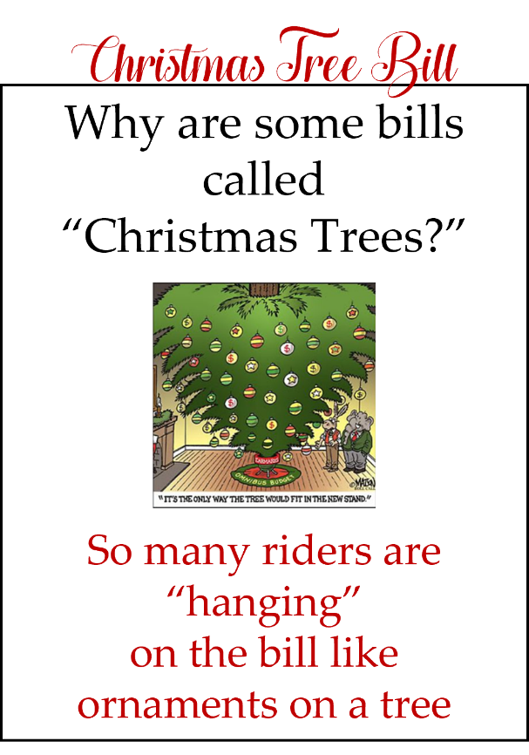
And now…the UGLY:
HB 1084 Divisive Curricula, GHSA Oversight, Optional Transgender Rule a true “Christmas Tree” bill
SB 226 Allows parents status regarding library content challenges (“the devil will be in the details”)

Slide 9
Yet to be Determined:
HB 1283 Recess for grades K-5 (much of the problematic language has been removed but another compliance issue that potentially impacts local control.)
HR 881 Encourages study of civil rights era
SB 220 Civics removal act and HB 681 (financial literacy)
SB 514 Unmask Georgia Student Act (sunsets in 2027)
SR 650 Study of System/School Accreditation process

Slide 10
Higher Education Issues:
SB 333 Private school agents updated; revises certain statutes and rules
SB 379 Expands apprenticeship programs (TCSG)
SB 397 Updated GED language to HSE (high school equivalency)
HB 1435 Higher education financial aid for students in “gaps” to finish

Slide 11
The Governor now has until May 14 to sign his approval or to veto each of the bills that come to his desk. We will continue to watch the process and communicate the bills that continue to law.

Slide 12
For those bills that become law, the State Department of Education may develop rules and/or policies that will provide guidance going forward. If no such guidance is established each local system will want to review the laws and implement their own local policies with their legal council and Boards of Education.

Slide 13
As always GSSA will work to provide support as requested.

