Slide 1
A Golden Opportunity
Cherie Goldman 2022 Georgia Teacher of the Year
(Tavani, n.d.)

Slide 2
Welcome to Savannah!!!
(Clarkson, n.d.)
(UGA Marine Extension and Georgia Sea Grant, n.d.)
(Visit Savannah, n.d.)
Notes:
Good Morning! It is so wonderful to be with GSSA again, and this time, to welcome you all to my hometown of Savannah. I hope that, in addition to being able to soak up this opportunity to be together with each other in person, you have been able carve out a bit of time to enjoy the beauty of our coast and marshes, the charm of our squares, or the energy of the riverfront. As our Savannah-Chatham County superintendent, Dr. Levett shared with you yesterday, Savannah really is quite an amazing place.
I would also like to welcome a couple of special guests today. My father, Michael Bonder, and his girlfriend, Toby Hollenberg. I am so thankful that, by virtue of the fact that we are meeting here in Savannah, they are able to join me for this piece of my journey as Georgia Teacher of the Year. And of course, I would also like to extend an extra shout out to Dr. Levett who has been so incredibly supportive of me in this role. Because of COVID, I had the privilege of serving as our district teacher of the year for two years in a row, and during that time, I was able to work with her so closely as the leader of our Professional Senate, our local Superintendent’s Teacher Advisory Council. She has been a mentor and a guide and an ear, and I am just so eternally grateful for what she has done for me personally and professionally and for what she does every day for our students here in Savannah-Chatham County.

Slide 3
(B., Krissy, n.d.)
Notes:
We’re all about to cross over the finish line. This school year is almost in the rearview mirror, and I’m going to guess….

Slide 4
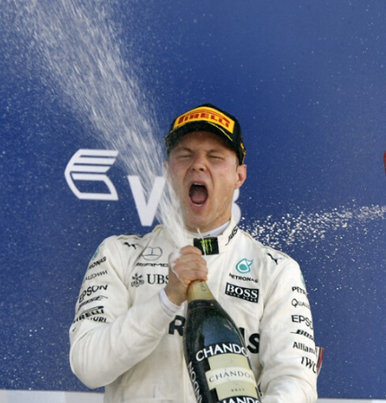
(Rodriguez, n.d.)
(Photograph of Race Car Driver, n.d.)
Notes:
that many of you would not mind if I passed you a glass (or two) of champagne right now. Some of you might dream of just sinking into your most comfortable couch at home with that glass and not moving for hours, even days. And then again some of you might imagine yourself crossing the finish line like this guy with that champagne. Either way…completely justified. It was a HARD year. A lot harder than many anticipated. In so many respects, we thought that the difficulties of LAST school year would be behind us if we could just get everyone back in the buildings. But it wasn’t that easy, was it? Education never is.

Slide 5
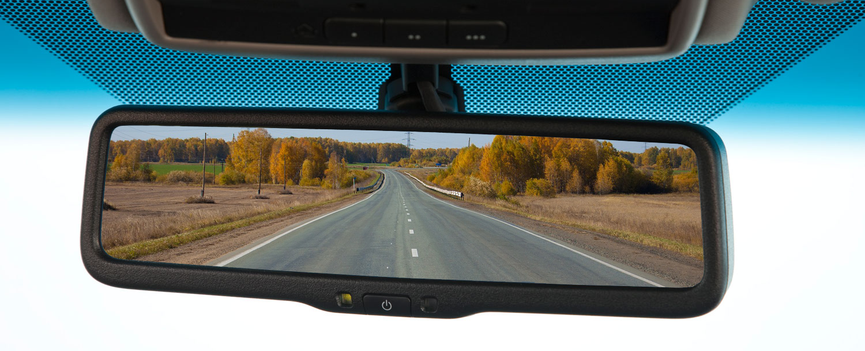
(Photograph of Rearview Mirror, n.d.)
Notes:
But if we really think about it, we can’t truly put this school year, or last year, or any school year for that matter, in the rearview mirror, nor should we. Each year of education is not like a book that you read and when you close it, you just file it on the shelf. Each year builds on the next, it informs the next. A year prior or a series of years prior reveal for us the successes we need to build upon, the directions to be taken, or the challenges that are ahead.

Slide 6
Knowledge
Circumstances
Perspective
Notes:
And we KNOW that knowledge (past and present) is power, so with knowledge as power, then circumstances (past and present) are power too because of how much knowledge we DO gain from circumstances! Even the terrible ones.
As Dr. Jones touched upon yesterday, there is power in knowledge and in circumstances, but there is also undeniable power in perspective. The perspective we take when we come up against challenging circumstances is as much responsible for the actions we take and thus the outcomes as the knowledge we use for our decisions in those circumstances because perspective does drive our decisions. So do we operate from the perspective that a given challenge is a roadblock? Or do we operate from the perspective that a given challenge is an opportunity?
As I come into the last few months of my tenure in this role, I would like to ask all of us to collectively rise together to the challenge before us in…..

Slide 7
Teacher Burnout
(Nieves, 2012)
Notes:
Teacher burnout.
I do not need to throw out reems of statistics for you to understand the extent to which this challenge is impacting teacher retention and recruitment. You are experiencing it firsthand as you plan for next year.
And Please know that I am not going to share with you about this today to take everyone down some sort of rabbit hole. That wouldn’t solve anything. Rather, I have chosen to go down this very real and present path because my lens…..

Slide 8
Teacher Burnout
Notes:
is that of tremendous opportunity in these circumstances. In this challenge.
I see an opportunity for us, together, to create an environment in education where everyone (students, teachers, school staff, administrators, superintendents!) thrive. An environment that connects everyone to the shared dream that we all have of what education should be and could be. I see an opportunity for us to be agents for positive change, agents in touch with the heart of our humanity invested in the success of all. And it is my belief that the commonality of a dream combined with the commonality of humanity presents the greatest, richest opportunity to address this challenge of teacher burnout.
We cannot change how we got here, but we can change how we go forward, and that begins with understanding just what is happening. To move forward together, we need a collective understanding of what burnout is and what its root causes are as the foundation for the positive momentum we want to build and for a united, strategic response.

Slide 9
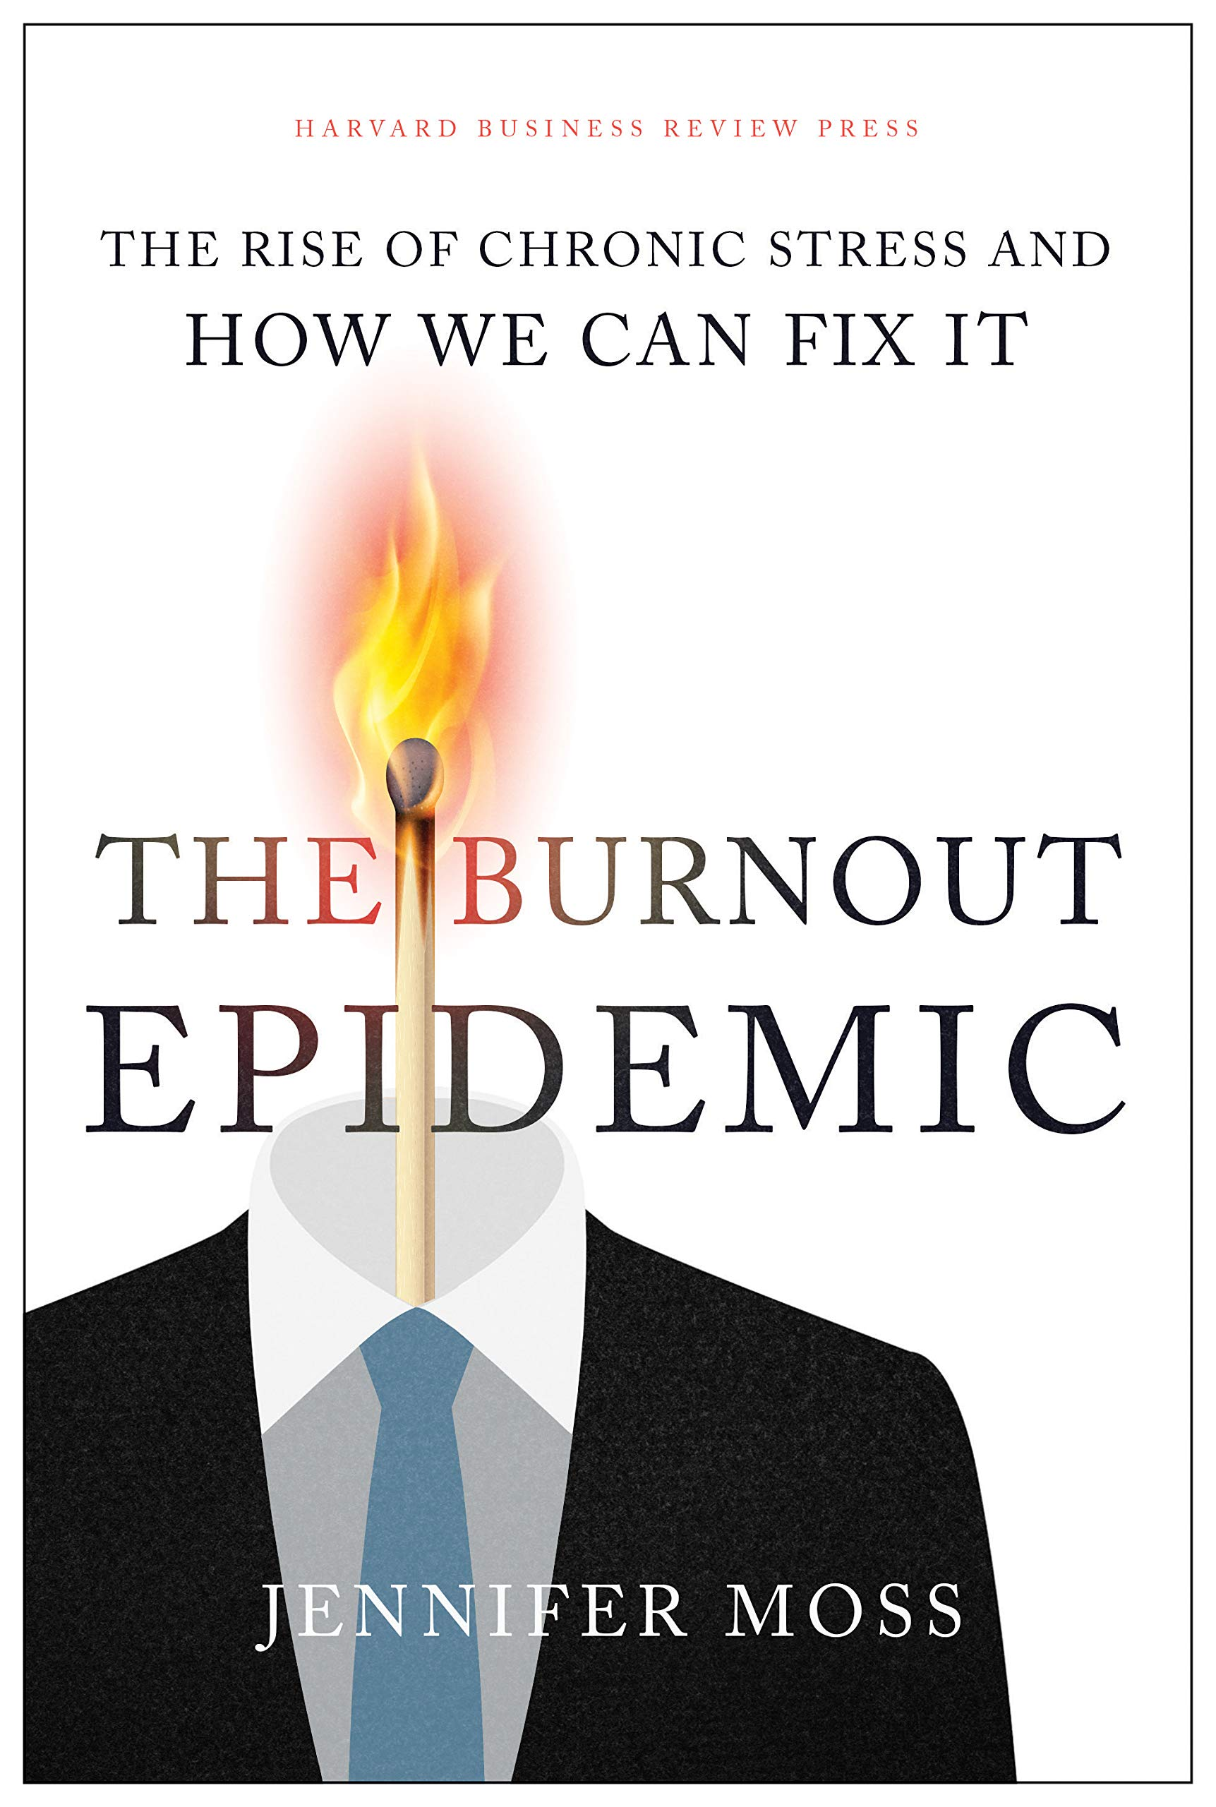
(Moss, 2021)
Notes:
And the best exposition of burnout that has come across my path in the past several months is found in this powerfully, insightful book written by Jennifer Moss and published just last September by the Harvard Business Review Press called “The Burnout Epidemic: The Rise of Chronic Stress and How We Can Fix It.” And I am so thankful to Rebecca Carlisle one of the finalists for 2022 Georgia Teacher of the Year for sharing it with me.
The first thing that jumped out at me in the book was that the term burnout is not just metaphorical jargon.

Slide 10
“A syndrome conceptualized as resulting from chronic workplace stress that has not been successfully managed.”
Feelings of energy depletion or exhaustion
Increased mental distance from one’s job, or feelings of negativism or cynicism related to one’s job
Reduced professional efficacy
(Moss, 2021)
Notes:
Burnout has ACTUALLY been recognized by the World Health Organization, officially included in its International Classification of Diseases (ICD-10).
The definition: “a syndrome conceptualized as resulting from chronic workplace stress that has not been successfully managed.” And it presents as - Feelings of energy depletion or exhaustion - Increased mental distance from one’s job, or feelings of negativism or cynicism related to one’s job - Reduced professional efficacy
Now I’m no doctor, and y’all can correct me if I am wrong, but sadly, that definition and those presentations sound just like so very many of the teachers that I know and have met. And I am going to be so bold as to say that y’all know and have met too. You may even find yourself feeling that way because this is not just impacting the teachers. And doesn’t that break your heart?

Slide 11
“A syndrome conceptualized as resulting from chronic workplace stress that has not been successfully managed.”
Feelings of energy depletion or exhaustion
Increased mental distance from one’s job, or feelings of negativism or cynicism related to one’s job
Reduced professional efficacy
(Moss, 2021)
Notes:
Depleted, exhausted, mentally distant, negative, cynical and ineffective. Those are not the kind of teachers we want our teachers to be. Those are not the kind of teachers our students and families and community partners want our teachers to be. Those are not the kind of teachers our teachers want to be.
The importance of sharing the fact that the WHO has an official definition for burnout is not just found in the fact that there is a definition, but rather its importance is also in the fact that….

Slide 12
“It’s an organizational problem that requires an organizational solution.”
(Moss, 2021)
Notes:
The definition establishes that “it’s an ORGANIZATIONAL problem that requires an ORGANIZATIONAL solution.” It is beyond the employees themselves as individuals.
So while wellness strategies like afterschool yoga and jeans on Friday and even personal days are well-intentioned and greatly appreciated and can contribute to feelings of health and can serve as pieces of the overall culture we would like to create or should create for the workplace in totality, we cannot look to those wellness strategies as the CURE we desperately need. Burnout goes deeper. It remains after you leave yoga, it remains while you are wearing your jeans and it remains when you return from a personal day. Tackling burnout requires organizational proactivity. It requires intentional preventative measures and strategies implemented by organizations to avert the burnout to begin with.

Slide 13
We need to stop just pulling people out of the river.
We need to go upstream and find out why they’re falling in.
Notes:
Desmond Tutu said best: “We need to stop just pulling people out of the river. We need to go upstream and find out why they’re falling in.”

Slide 14
Why They Are Falling In
🔥 Workload
🔥 Perceived Lack of Control
🔥 Lack of Reward or Recognition
🔥 Poor Relationships
🔥 Lack of Fairness
🔥 Values Mismatch
(Moss, 2021)
Notes:
Jennifer Moss further explains in her book that the preventative measures and strategies that organizations take need to address what have been identified by research as….the six main causes of burnout. We could call these six causes the “Why They Are Falling In”:
Workload - Perceived Lack of Control - Lack of Reward or Recognition - Poor Relationships - Lack of Fairness - Values Mismatch
Very clearly, all six of these causes speak to workplace culture. Taken collectively, the six causes of burnout manifest debilitating, demoralizing feelings of irrelevance and incompatibility. And when I think about the teachers who have shared with me about their personal experience with burnout or why they are leaving the profession, I unfortunately can hear voices representing every one of these six causes as they share about their organizational stressors. For Workload it might be excessive paperwork For Perceived Lack of Control – Lack of planning time because of excessive meetings For Lack of Reward or Recognition – Observations or evaluations performed by administrators with a deficit mindset For Poor Relationships – Non-existent or ineffective mentorships, lack of respect from parents For Lack of Fairness – High expectations for the implementation of multiple initiatives without the proper training And for Values Mismatch – Over reliance on quantitative accountability measures
You can testify to the fact that teaching has always been a lot of work and teachers have always been ready and willing to go to incredible lengths for their students, their families, and their school communities…because they both believed so very deeply in their purpose and because they felt trusted and valued. But now…..as one of the finalists for 2023 Georgia Teacher of the Year said recently in her interview, “Teachers feel like things are done to them rather than with them.”

Slide 15
Notes:
Again I am absolutely not sharing this information with you because I want to take you to dark places, but because understanding helps us see the light at the end of a tunnel. And in all of this I see light. I see opportunity. An opportunity for healing and growth. An opportunity to unleash all of the tremendous potential in our teachers and administrators and schools that we can pour right into our students and our families so that it overflows into our communities fulfilling the commitment of and reinvigorating the belief in public education which I have spoken to you all about before. (pause)

Slide 16
Collective Efficacy
“A group’s shared belief in its conjoint capability to organize and execute the courses of action required to produce given levels of attainment.”
(Donohoo, et.al., 2018)
Notes:
The widely applicable research about burnout in the workplace dovetails right into research about education….
In the 1970’s a Stanford University psychologist Albert Bandura identified a pattern in human behavior, more specifically in working-group dynamics, that he termed “Collective Efficacy.” He defined collective efficacy as “a group’s shared belief in its conjoint capability to organize and execute the courses of action required to produce given levels of attainment.”

Slide 17
Collective Efficacy
“The assurance a person places in her or her team affects the team’s overall performance.”
(Donohoo, et.al., 2018)
Notes:
Meaning that “the assurance a person places in his or her team affects the team’s overall performance.”

Slide 18
Collective Efficacy
“When a team of individuals share the belief that through their united efforts they can overcome challenges and produce intended results, groups are more effective.”
(Donohoo, et.al., 2018)
Notes:
“When a team of individuals share the belief that through their unified efforts they can overcome challenges and produce intended results, groups are more effective.”
In other words, assurance, shared belief and united efforts taken together produce performance.
Fast forward to 2009, when Australian researcher John Hattie, whom many of you all are most likely familiar with, began his attempt to understand what impacts student achievement.

Slide 19
What Works Best?
1,800+ meta-analyses of 320+ factors
Each factor ascribed an “Effect Size”
Hinge Point = 0.4
(Corwin, 2022; Waack, 2015)
Notes:
In other words, Hattie was looking for “What works best?” Since that time, to-date, he has performed 1,800 meta-analyses of over 320 interventions, techniques, and factors that might impact student achievement. To each factor, Hattie ascribes what is called an “effect size” in order to rank them. Taking all of the factors together, Hattie found that the “hinge point” or average effect size was 0.4.

Slide 20
The Current Top 21
(Corwin, 2022)
Notes:
Here is a list of the current top 21 factors (I did 21, not 20, because of a tie.)

Slide 21
The Current Top 21
(Corwin, 2022)
Notes:
And if you look very carefully, you will notice that only the top nine of 320 factors considered to impact student achievement even break an effect size of 1.

Slide 22
Collective Teacher Efficacy
“The shared belief by a group of teachers in a particular educational environment that they have the skills to positively impact student outcomes.”
(Corwin, 2022)
Notes:
And Collective Teacher Efficacy which is defined by Hattie as “The shared belief by a group of teachers in a particular educational environment that they have the skills to positively impact student outcomes.” Has Consistently been at the top or next to the top of his effect size rankings since the beginning of his research with a current efficacy size of 1.36.
In the context of our present challenge of teacher burnout, in the context of our now shared understanding of what burnout is and what causes it, this remarkable statistic calls out tremendous opportunity to me, and I hope it does you too, that prioritizing the construction of and commitment to educational environments that promote and value collective teacher efficacy is foundational to battling burnout, stemming the detrimental tide of retention and recruitment issues, and ensuring that our schools are everything that we hope them to be for our students, teachers, and families. (pause)

Slide 23
Teacher Burnout Task Force
Identify the major contributing factors
Determine possible solutions and strategies that can
Be implemented on the school, district, and state levels to increase teacher retention
Provide teaches with the support they need and deserve
Elevate the level of recognition for the professionalism of teachers.
(Nieves, 2012)
Notes:
Matt Jones shared with you just a bit ago that Superintendent Woods and I have worked over the past few months with a task force of teachers to help us identify the major factors contributing to teacher burnout in our state and to determine possible solutions and strategies that can - be implemented on the school, district, and state levels to increase teacher retention - provide teachers with the support they need and deserve, and - elevate the level of recognition for the professionalism of teachers.
When the task force’s report is finalized and released, I believe it could be said that, in many respects, it is a report that speaks in so many ways to the importance of and power of the collective efficacy that Bandura and Hattie have recognized in their research and to the themes of trust and relationships that we have heard about consistently over the past two days in the presentations and panels here at GSSA.

Slide 24
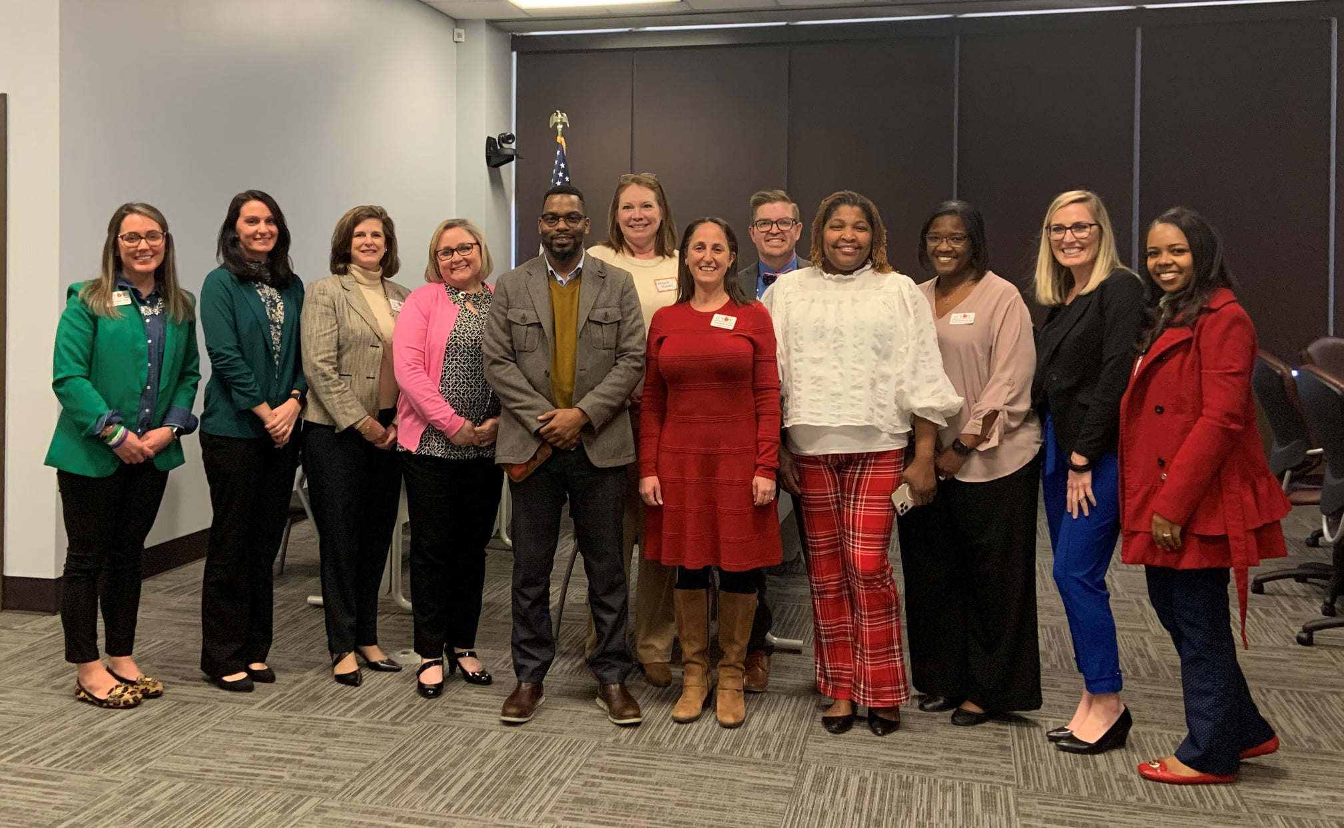
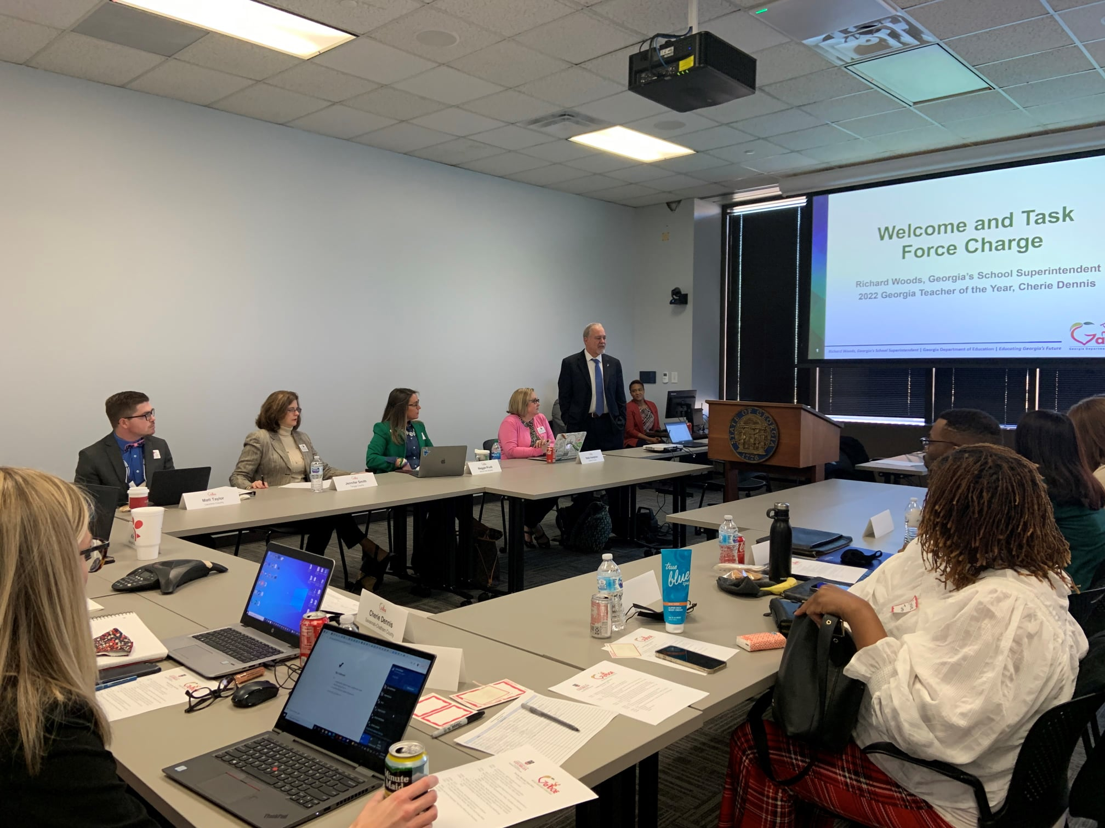
Notes:
The teachers on this task force included me and the other nine finalists for Georgia Teacher of the Year from my 2022 cohort, in addition to a teacher representative each from PAGE, GAE, Educators First, and the Department of Education. These teachers were selected to participate because of their recognition by peers as teacher leaders with a passion for the profession, a commitment to the well-being of the students and families whom they serve, and their ability to articulate and represent the needs of their entire community. Additionally, they were selected because, as a group, they were determined to represent all levels of education (elementary, middle, and high), a variety of content areas and classroom configurations, and both rural and non-rural districts.

Slide 25
What Factors Are Contributing to Teacher Burnout in Georgia:
As a result of the pandemic?
As a result of policies and procedures initiated at the school level?
As a result of policies and procedures initiated at the system level?
As a result of policies and procedures initiated at the state level?
Notes:
Our first meeting in February was a focus group facilitated by members of the education policy team from the Carl Vinson Institute of Government at the University of Georgia. In small groups, participants shared their observations, their knowledge, and their experience about:
What they believed are factors contributing to teacher burnout in Georgia:
As a result of the pandemic?
As a result of policies and procedures initiated at the school level?
As a result of policies and procedures initiated at the system level?
As a result of policies and procedures initiated at the state level?
They further identified the top 3 factors at each of those levels (school, system, and state) and made suggestions for how those factors might be minimized or eliminated.

Slide 26
Additional Small Group Questions
What are the consequences of teacher burnout for students?
What are the consequences of teacher burnout for the teaching profession and teacher preparation?
What are the consequences of teacher burnout on the day-to-day operation of schools?
Notes:
Additionally, the small groups were asked to respond to the following questions:
What are the consequences of teacher burnout for students?
What are the consequences of teacher burnout for the teaching profession and teacher preparation?
What are the consequences of teacher burnout on the day-to-day operation of schools?

Slide 27
Whole Group Discussion
What is making you stay in education?
If you are thinking about walking away from education, why?
Would you encourage others to enter the profession of teaching? If yes, why? If not, why not?
Notes:
In whole group discussion, task force members considered:
What is making you stay in education?
If you are thinking of walking away from education, why?
Would you encourage others to enter the profession of teaching? If yes, why? If no, why not?
These discussions were incredibly raw, honest, and insightful.
Following the first meeting, I worked with the Carl Vinson facilitators to analyze the feedback. We pulled out the issues that were related very specifically to COVID because it was our hope that these issues (like contact tracing or social distancing) would resolve themselves naturally with the departure of COVID (Please, dear Lord!). Then we took the remaining feedback which was now focused on the more institutional factors contributing to teacher burnout, and we were able organize it into 5 overarching themes/threads:

Slide 28
5 Themes/Threads
Assessment
Preserving and Protecting Time
Pressures/Unrealistic Expectations
Teacher Voice and Professional Growth
Mental Health and Wellness
Notes:
Assessment
Preserving and Protecting Time
Pressures/Unrealistic Expectations
Teacher Voice and Professional Growth
Mental Health and Wellness
And for each of these themes, we assigned the related school, system, and state level feedback that had been identified in the focus group.
In March, the task force met again with the goal of developing actionable solutions for each of the five themes/threads, again with the help of the team from Carl Vinson. Once again, our participants were passionate, shot straight from the hip, and were remarkably insightful.
The suggestions that we gathered are now being organized into a formal report that we hope to present to the State Board of Education in the very near future.

Slide 29
Why They Are Falling In
🔥 Workload
🔥 Perceived Lack of Control
🔥 Lack of Reward or Recognition
🔥 Poor Relationships
🔥 Lack of Fairness
🔥 Values Mismatch
(Moss, 2021)
Notes:
To go back to where I started with you all today, in these focus groups, we heard loud and clear the reasons why teachers are falling in the river. We heard about each one of those six causes of burnout: - Workload - Perceived Lack of Control - Lack of Reward or Recognition - Poor Relationships - Lack of Fairness - Values Mismatch
So when the report is finally released, we need to listen to these voices together. Not in silos of teachers and administrators, but together. We need to listen to them very, very hard. We need to understand them. We need to internalize them. We need to empathize with them. And we need to act on the tremendous opportunities they offer us for bringing our colleagues back from burnout so that they can once again experience the joy and the passion that comes from the privilege that we have in being teachers.

Slide 30
(Nieves, 2012)
Notes:
Clearly, the causes for teacher burnout and the degree of burnout manifest differently in different people depending upon the school they are in, the district they are in, and the state they are in. So I am hopeful that the release of the state report will encourage your schools and districts to perform their own reflective, intentional localized analyses of the factors contributing to burnout and the solutions that could be offered. Together with the knowledge from the state report, burnout can be addressed that much more strategically, thoroughly, and effectively. Some of the strategies and solutions identified in the state report and in your own discoveries will be easy to implement immediately and others might not be as easy to implement either due to things like logistics or due process or funding or the hurdles that come with shifting from bad habits to best practices,

Slide 31
(Tavani, n.d.)
Notes:
but none of those should deter any of us from the opportunity in front of us to turn the corner or from the obligation to function with a long-term vision for what all of us want for our schools – for our students, our teachers, our staff, our families, our communities.
Teachers don’t want to walk away. Their motivation for why they originally became a teacher; their aspiration to make that dream come true; their heartfelt passion for making a difference in the lives of students and families and communities – they are the same motivations and aspirations and passion that you hold in your hearts. But too many of our teachers are on empty, so I say again that we must take a hold of this opportunity we have to pour into them so that they can pour into our children until they overflow. We must take hold of this opportunity to focus in on and tap into the power and resources that come with the cohesion and expertise found in collective teacher efficacy. We must take hold of this opportunity to foster a culture in education that consistently ensures everyone is successful, everyone feels heard, and everyone feels valued. Because when we elevate and take care of our teachers, we elevate and take care of our students. And that is what it’s all about.
Thank you for listening. And thank you for joining me in this chance to turn the page to a new beginning.

Slide 32
References
B., Krissy. (Photographer). (n.d.). [Digital Image] Retrieved from https://stockfreedom.com/downloads/checkered-flag-waving-sky/
Clarkson, E. (Photographer). (n.d.). [Digital Image] Retrieved from https://savannahfirsttimer.com/best-time-to-visit-savannah-ga/
Corwin. (2022, March 10). The Visible Learning Research. Visible Learning. Retrieved April 7, 2022, from https://www.visiblelearning.com/content/visible-learning-research
Donohoo, J., Hattie, J., & Eells, R. (2018, March 1). The power of collective efficacy. ASCD. Retrieved April 7, 2022, from https://www.ascd.org/el/articles/the-power-of-collective-efficacy
Froehlich, M. (2022, April 4). Dear Districts: Time to Wake Up, The Teachers Aren't Coming [web log]. Retrieved April 6, 2022, from https://www.mandyfroehlich.com/post/dear-districts-time-to-wake-up-the-teachers-aren-t-coming.
Jensen, T., & Kelly, C. (2019, June 4). Collective Teacher Efficacy [web log]. Retrieved April 7, 2022, from https://www.teachingchannel.com/blog/collective-teacher-efficacy#:~:text=For%20all%20the%20non%2Dscientists,size%20of%20socio%2Deconomic%20status.

Slide 33
References
Loftus, M. (2021, June 9). Collective teacher efficacy. CT3. Retrieved April 7, 2022, from https://www.ct3education.com/2021/06/09/collective-teacher-efficacy/#:~:text=Collective%20Teacher%20Efficacy%20is%20ranked,1.57%20(Hattie%2C%202016).
Moss, J. (2021). The burnout epidemic: The rise of chronic stress and how we can fix it. Harvard Business Review Press.
Nieves, M. (Photographer). (2012, July 12). [Digital Image] Retrieved from https://unsplash.com/s/photos/apple-desk
[Photograph of Race Car Driver]. (n.d.). [Digital Image] Retrieved from https://thesportsrush.com/f1-news-f1-champagne-2020-formula-1-champagne-supplier-price-and-size-for-the-grand-prix-podium-ceremony/
[Photograph of Rearview Mirror]. (n.d.). [Digital Image] Retrieved from https://mailninjas.com/automotive-direct-mail/is-the-key-to-the-future-in-the-rearview-mirror/
Rodriguez, V. (Photographer). (n.d.) [Digital Image] Retrieved from https://www.countryliving.com/uk/create/food-and-drink/news/a2675/why-first-glass-champagne-gets-you-drunker/

Slide 34
References
Tavani, R. (Photographer). (n.d.) [Digital Image] Retrieved from https://unsplash.com/s/photos/growing
UGA Marine Extension and Georgia Sea Grant. (Photographer). (n.d.) [Digital Image] Retrieved from https://www.savannahnow.com/story/lifestyle/2020/12/04/georgias-coastal-marshlands-protection-act-legacy-50/3814587001/
Visit Savannah. (Photographer). (n.d.). [Digital Image] Retrieved from https://www.visitsavannah.com/list/things-to-do-river-street
Waack, S. (2015, October 27). Hattie Effect Size List - 256 influences related to achievement . VISIBLE LEARNING. Retrieved April 7, 2022, from https://visible-learning.org/hattie-ranking-influences-effect-sizes-learning-achievement/

Slide 35
Credits
Special thanks to all the people who made and released these awesome resources for free:
Presentation template by SlidesCarnival
Photographs by Unsplash

Slide 36
Presentation design
This presentation uses the following typographies:
Titles: Playfair Display
Body copy: Inria Serif
Download for free at: https://www.fontsquirrel.com/fonts/playfair-display
https://www.fontsquirrel.com/fonts/inria-serif
You don’t need to keep this slide in your presentation. It’s only here to serve you as a design guide if you need to create new slides or download the fonts to edit the presentation in PowerPoint®

Slide 37
SlidesCarnival icons are editable shapes. This means that you can:
Resize them without losing quality.
Change fill color and opacity.
Change line color, width and style.
Isn’t that nice? :) Examples:
Find more icons at slidescarnival.com/extra-free-resources-icons-and-maps

