Slide 1
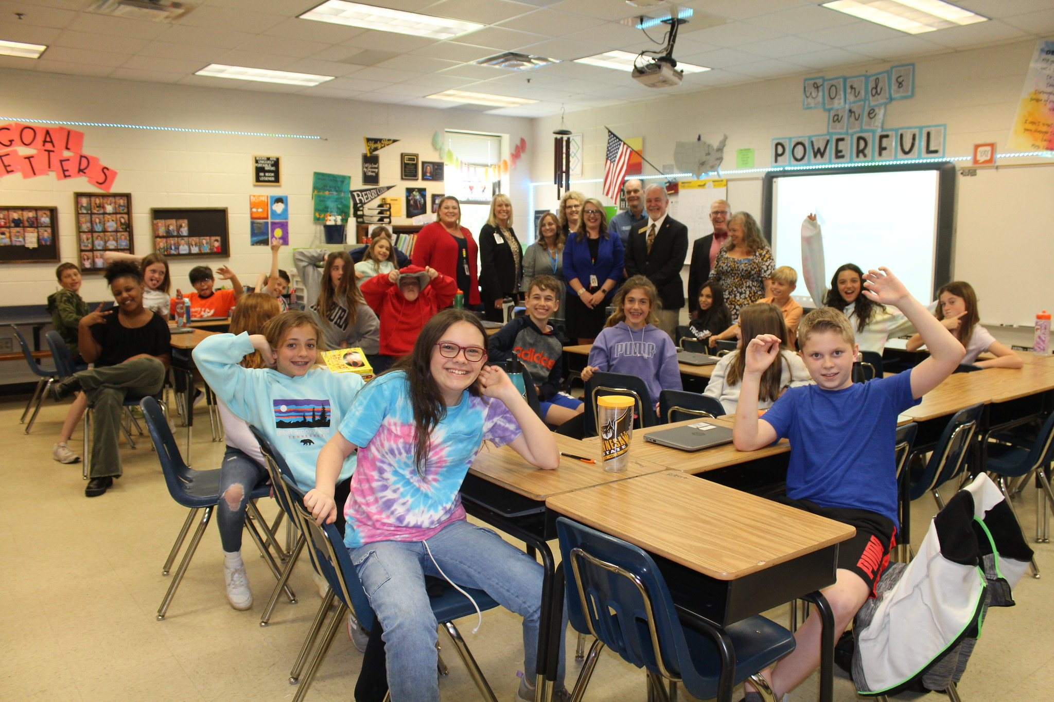
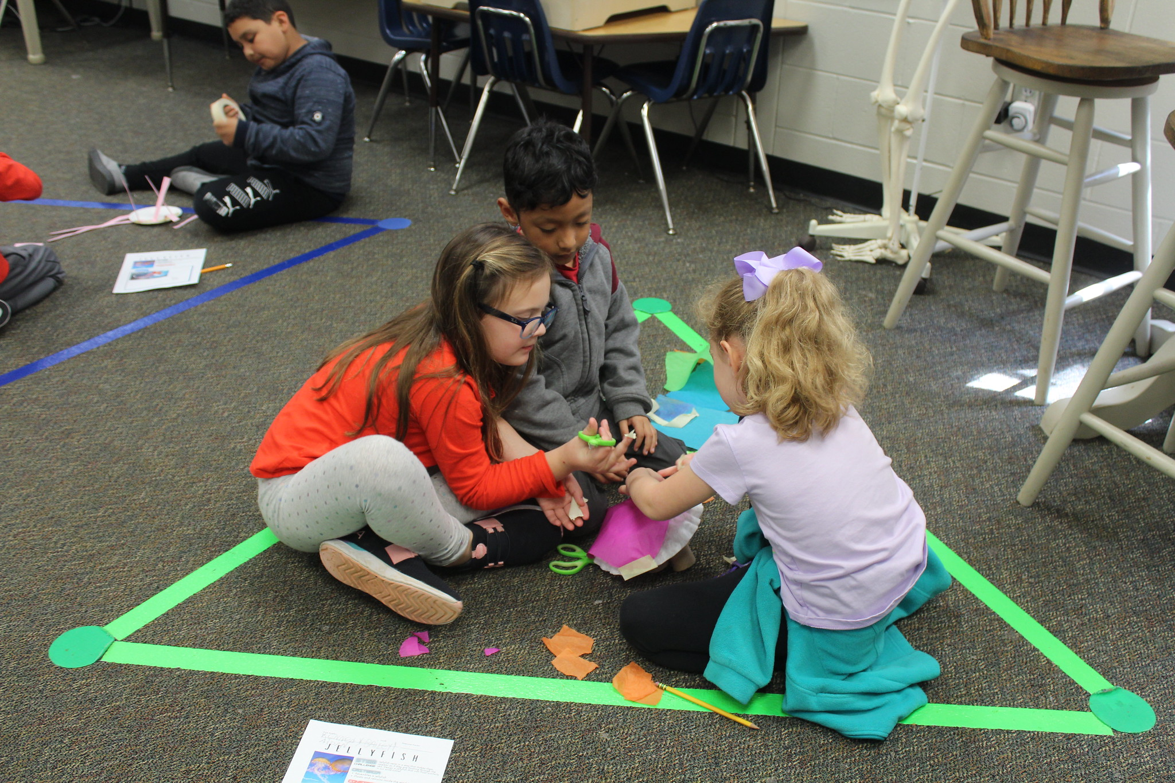
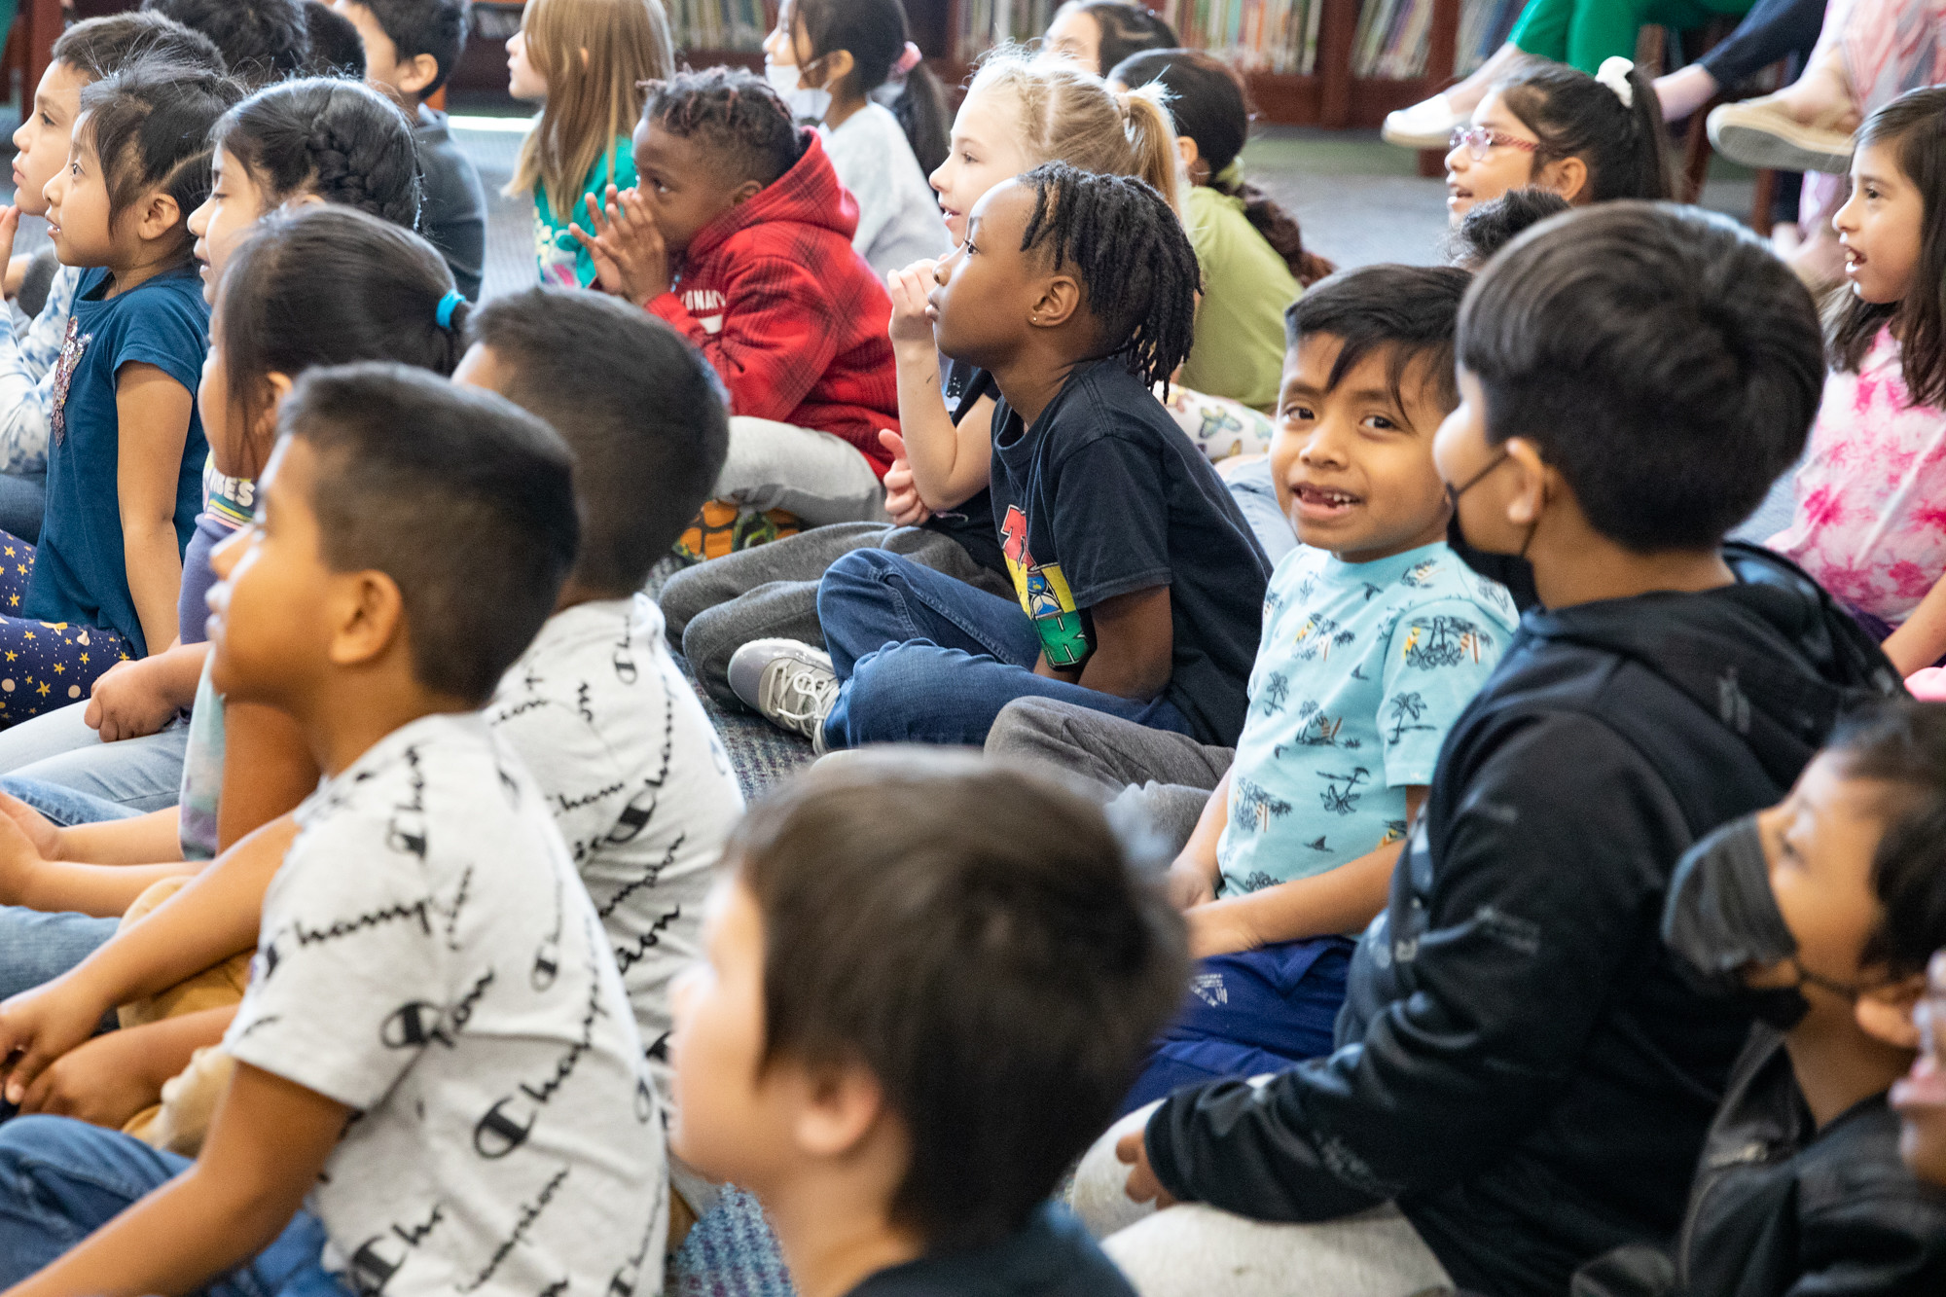
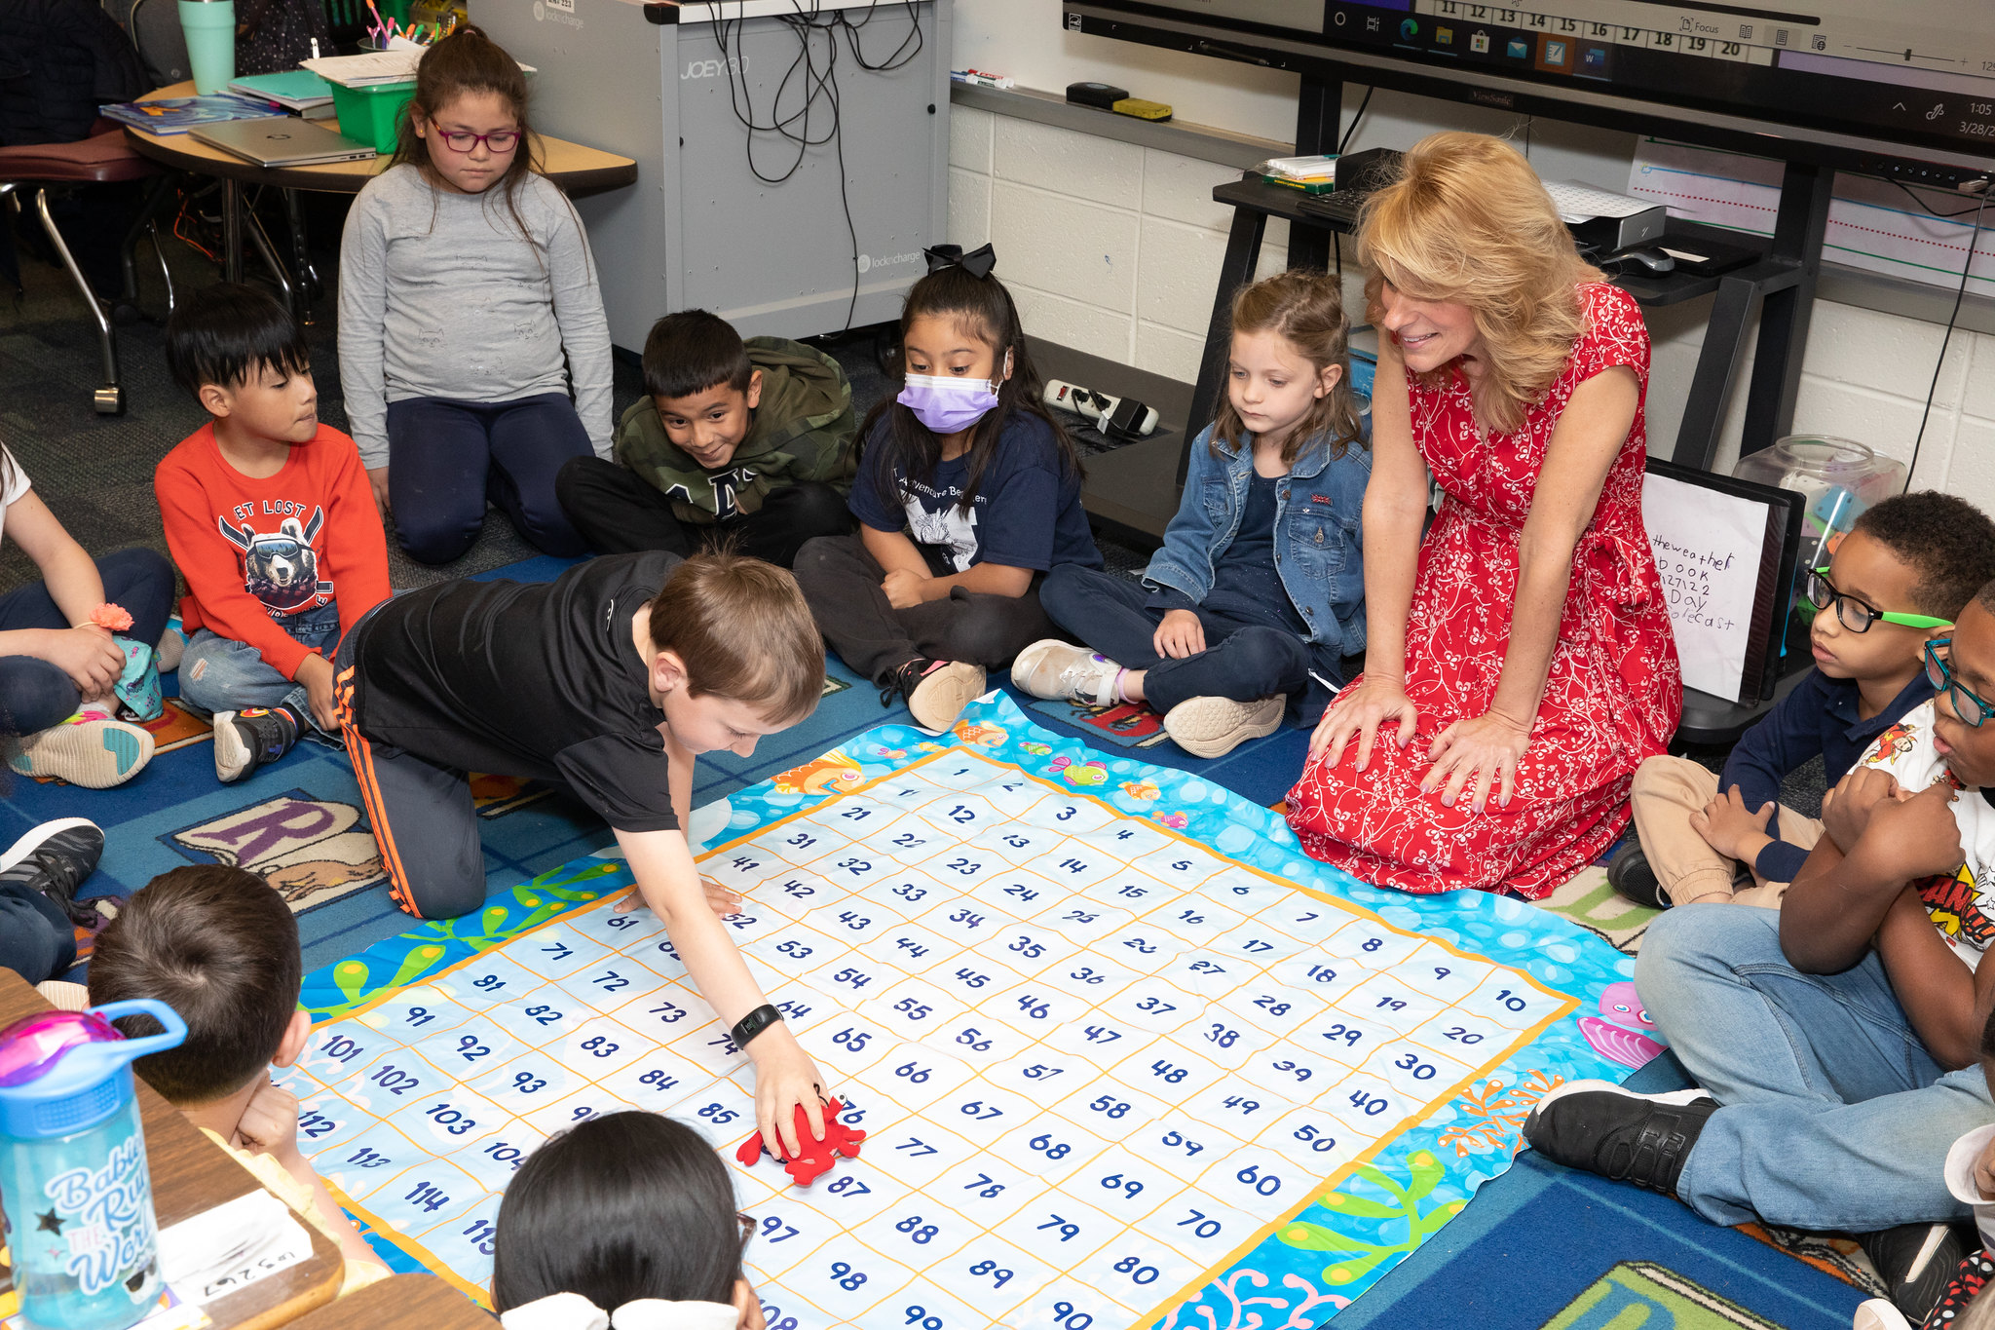
Spring Bootstrap 2022
Richard Woods
State School Superintendent

Slide 2
Good News in Georgia Education (Despite the pandemic)

Slide 3
2022 Legislative Session
PASSED: $2,000 completion of Governor Kemp’s $5,000 teacher pay raise, $2,000 supplement for FY22
PASSED: Allowing districts to utilize retired educators full-time to fill high-need teaching positions
PASSED: Full funding of QBE
PASSED: Elimination of COVID-era austerity cuts
PASSED: Parent’s Bill of Rights
PASSED: Removing divisive concepts and obscene materials
PASSED: Mental health funding and resources

Slide 4
USED Waiver Update: 2022 CCRPI
No summative rating (100 point) for districts and schools
Temporarily suspending indicators impacted by the pandemic
(ex: Attendance & SAT/ACT rates)
Establishing new,
post-pandemic baselines for performance
(ex: Closing Gaps &
Student Growth in ELA & Math)

Slide 5
Taking things off your plates…
Compassion Over Compliance
Fought for maximum testing and accountability flexibility and relief
Granted maximum flexibility to districts
Extended performance contracts
Fought for maximum flexibility for the use of federal ESSER funds
Staff bonuses and full education funding

Slide 6
What are we taking off our teachers’ plates?
Invest in People
We are not going to program our way out of the pandemic.
Districts have record flexibility – how much is reaching the classroom?
Districts have record funding and resources – how much is reaching the classroom?
What are we rolling off?

