Slide 1
2021 Fall Bootstrap Conference
Matt Arthur – Executive Secretary, GaPSC

Slide 2
Working Together to Support the Pipeline
Support Across the Continuum
Recruitment
Preparation
Certification
Induction
Retention
Renewal
Induction

Slide 3
Working Together to Support the Pipeline
Induction

Slide 4
Supporting the Pipeline: Recruitment
Recruitment
Military Veterans and Spouses
HBCU Collaborative
Paraprofessional “At Home”
Testing Option
New PAA Composite Score Policy
Limited Flexibility Option
Recruitment Webcasts

Slide 5
Supporting the Pipeline: Preparation
Recruitment
Program Reviews
Preparation Program
Effectiveness Measures (PPEMs)
Preparation
P20 Collaboratives
Advanced Degrees
and Endorsements

Slide 6
Supporting the Pipeline: Certification
Recruitment
Recruitment
Paperless Certification
Certificate Renewals
Conversion of Induction
Certificates
Certificate Upgrades
Preparation
Preparation
Licensure
Licensure

Slide 7
Supporting the Pipeline: Induction & Retention
Recruitment
Recruitment
Paraprofessional Ethics Modules
Guidelines for Appropriate Use of Social Media and in Remote Learning Environments
Preparation
Preparation
Retention
Licensure
Licensure
Induction
Professional Learning
Events
Induction

Slide 8
AGENCY IMPACT
Recruitment
Recruitment
Maximizing the Role of
Teacher Leaders
VPLCs
P20 Collaboratives
Renewal
Preparation
Preparation
Licensure
Retention
Licensure
Retention
Induction
Induction

Slide 9
Supporting the Pipeline
Recruitment
Recruitment
Renewal
Preparation
Preparation
Partnerships
Licensure
Retention
Licensure
Retention
Induction
Induction

Slide 10
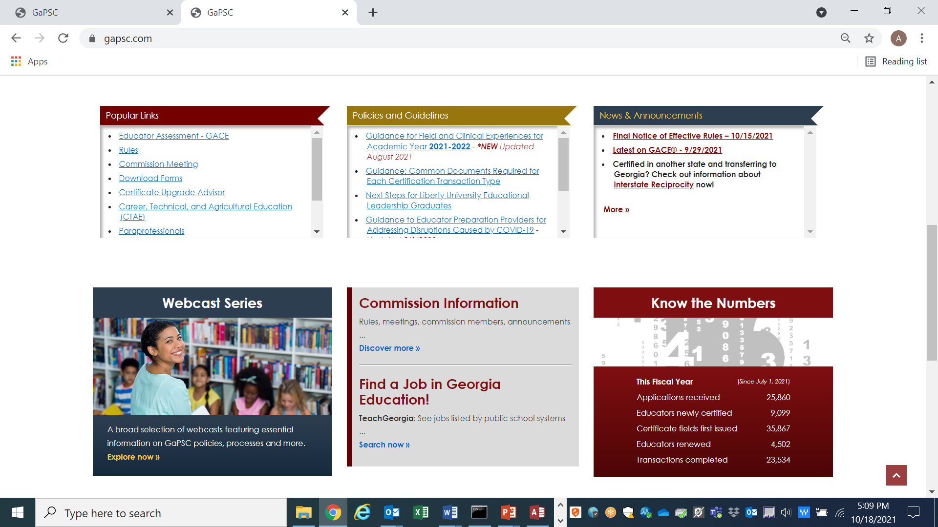
Supporting the Pipeline
GaPSC Webcast Series; News and Announcements
Enhanced Website - www.gapsc.com

Slide 11
2021 Fall Bootstrap Conference
Matt Arthur – Executive Secretary, GaPSC

