Slide 1
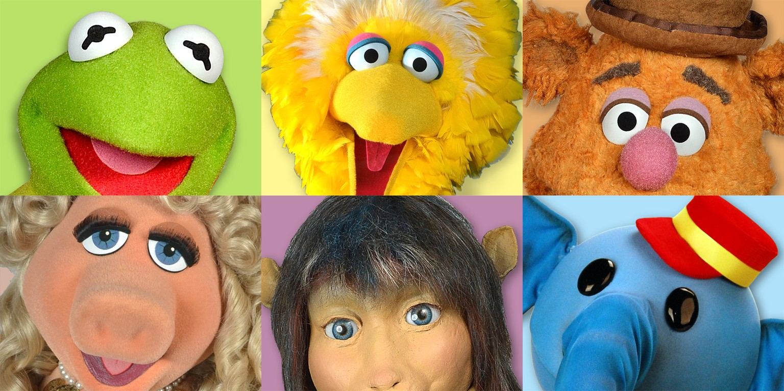
Center for Puppetry Arts

Slide 2
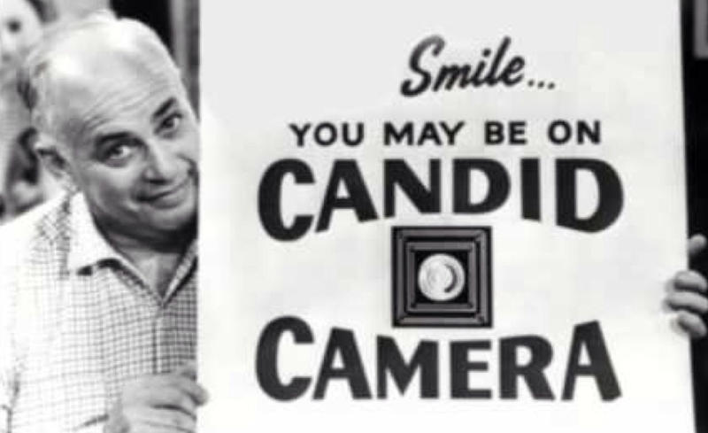
SURPRISE!

Slide 3
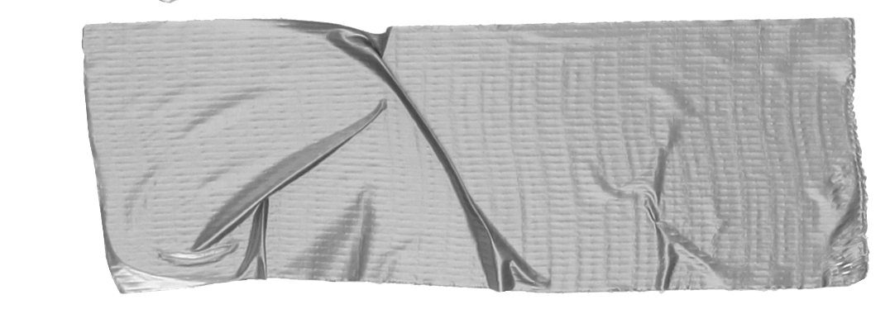

Slide 5
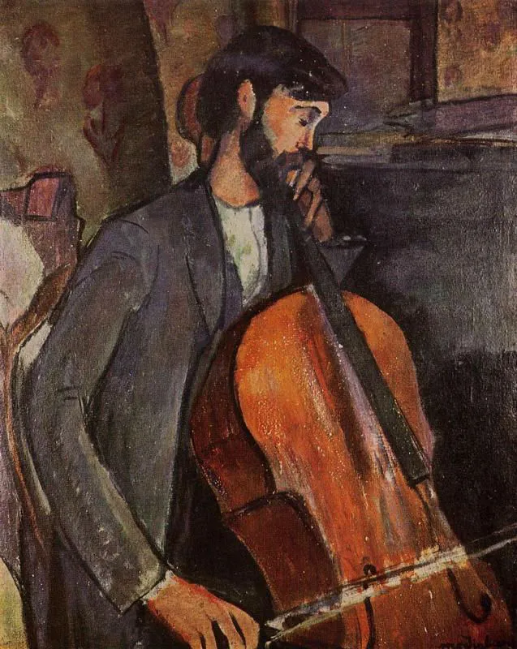
Study for The Cellist
Artist:Amedeo Modigliani

Slide 6
The benefits of field trips
Tip
Academic Growth.
Deepened Engagement.
Real-World Experiences and Cultural Growth. ...
Enhanced Critical Thinking.

Slide 7
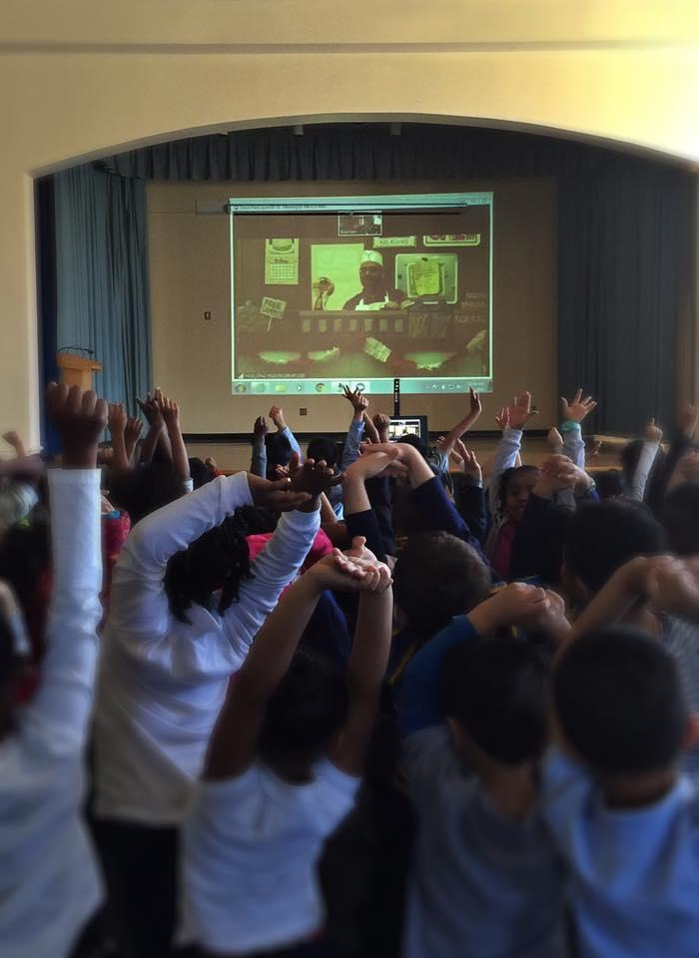
to VIRTUAL
FIELD TRIPS

Slide 8
Virtual Field trips
Give students the ability to connect to experts in the field they are studying no matter where in the world they are.

Slide 9
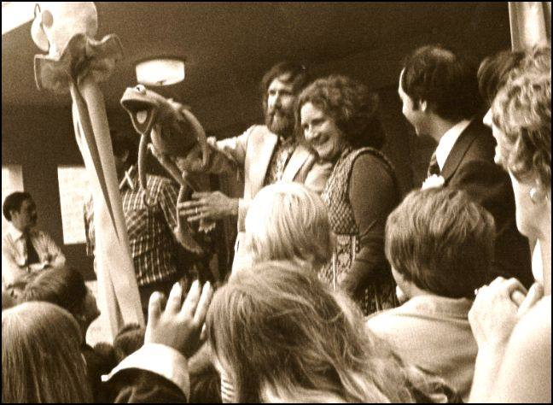
1978
Jim and Kermit at the ribbon ceremony

Slide 10
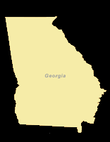
The Center has been doing virtual field trips since 1998

Slide 11
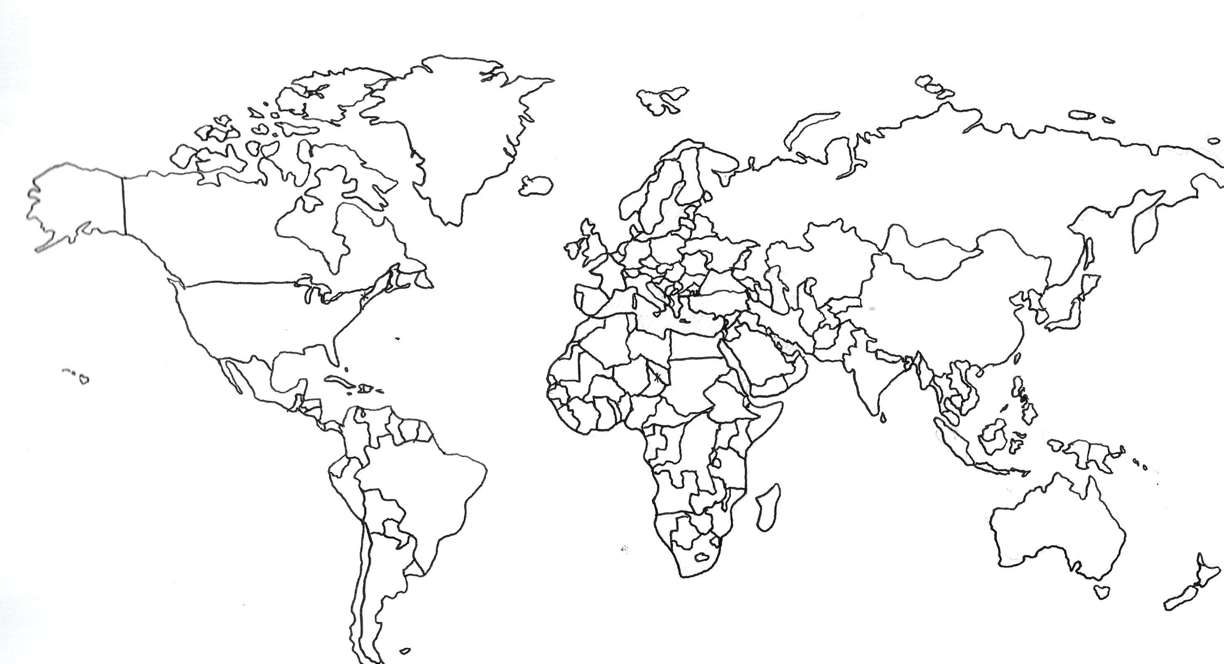
50 States
94 Countries

Slide 12
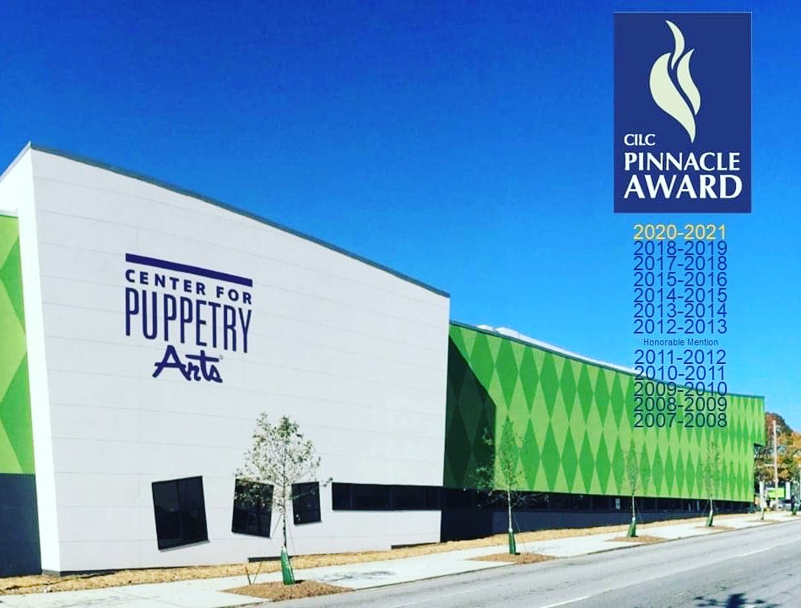

Slide 13
Teaching in-person uses a different skill set than teaching online.

Slide 14
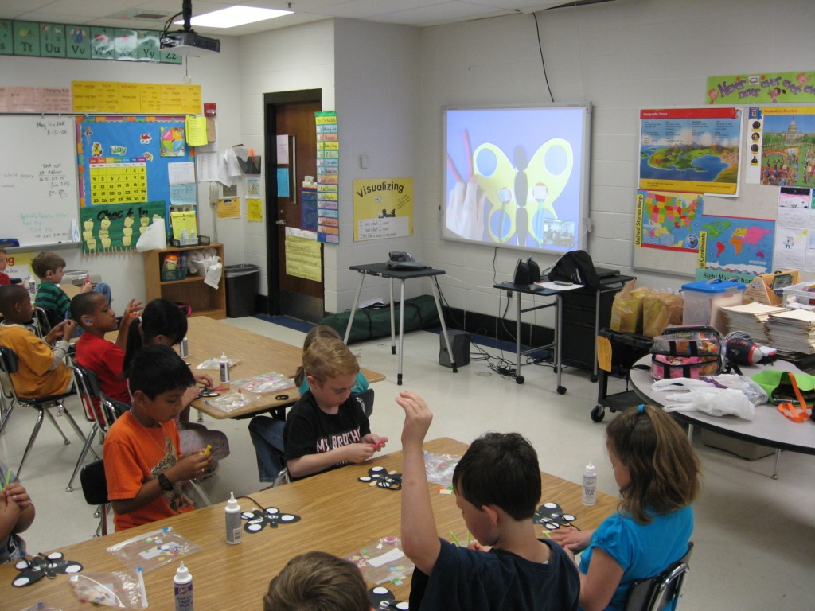
Hands on learning
Tip
If one example isn’t sufficient to help people understand the breadth of your idea, pick a couple of examples.

Slide 15
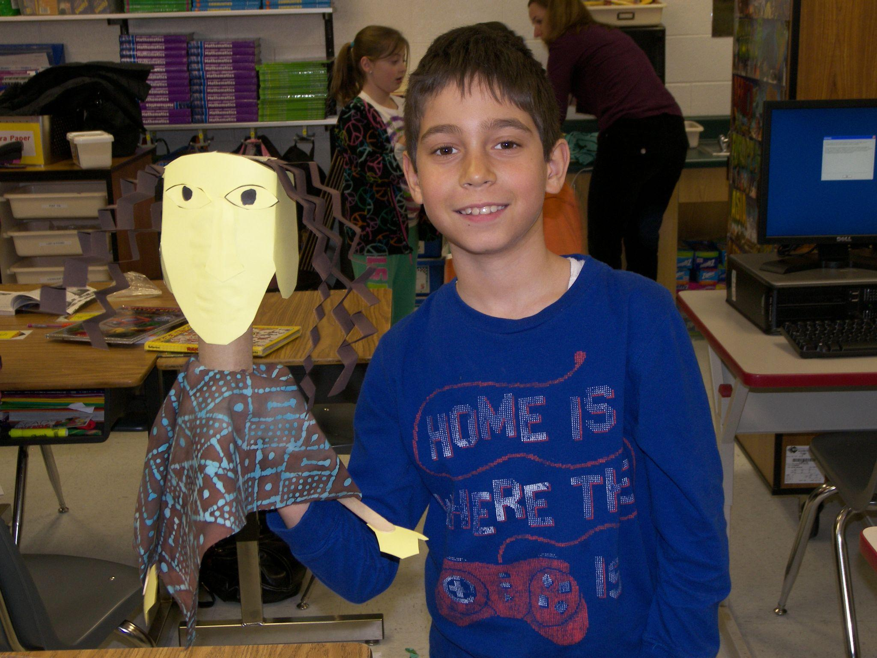
Puppet Building
Tip
Learning about rod puppets and a tradition called Sogobo in Mali Africa

Slide 16
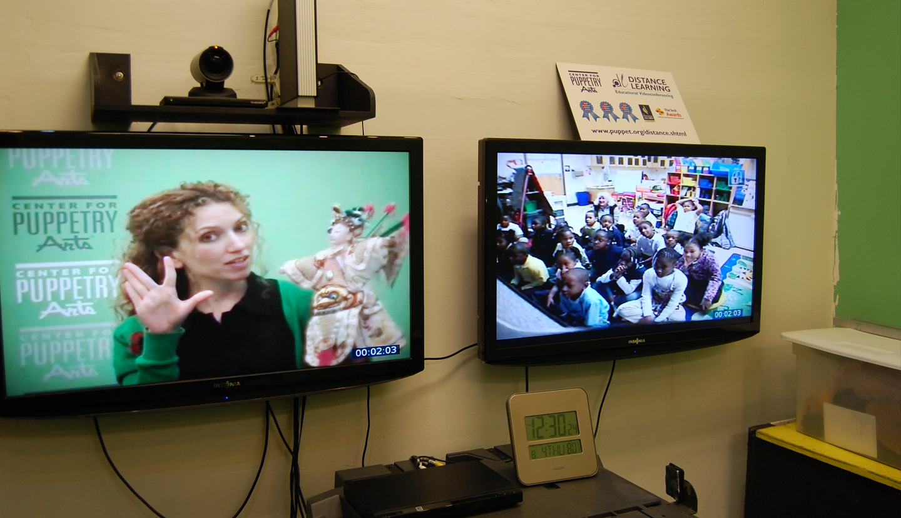
Good luck!
We hope you’ll use these tips to go out and deliver a memorable pitch for your product or service!
For more (free) presentation tips relevant to other types of messages, go to heathbrothers.com/presentations
For more about making your ideas stick with others, check out our book!

Slide 17
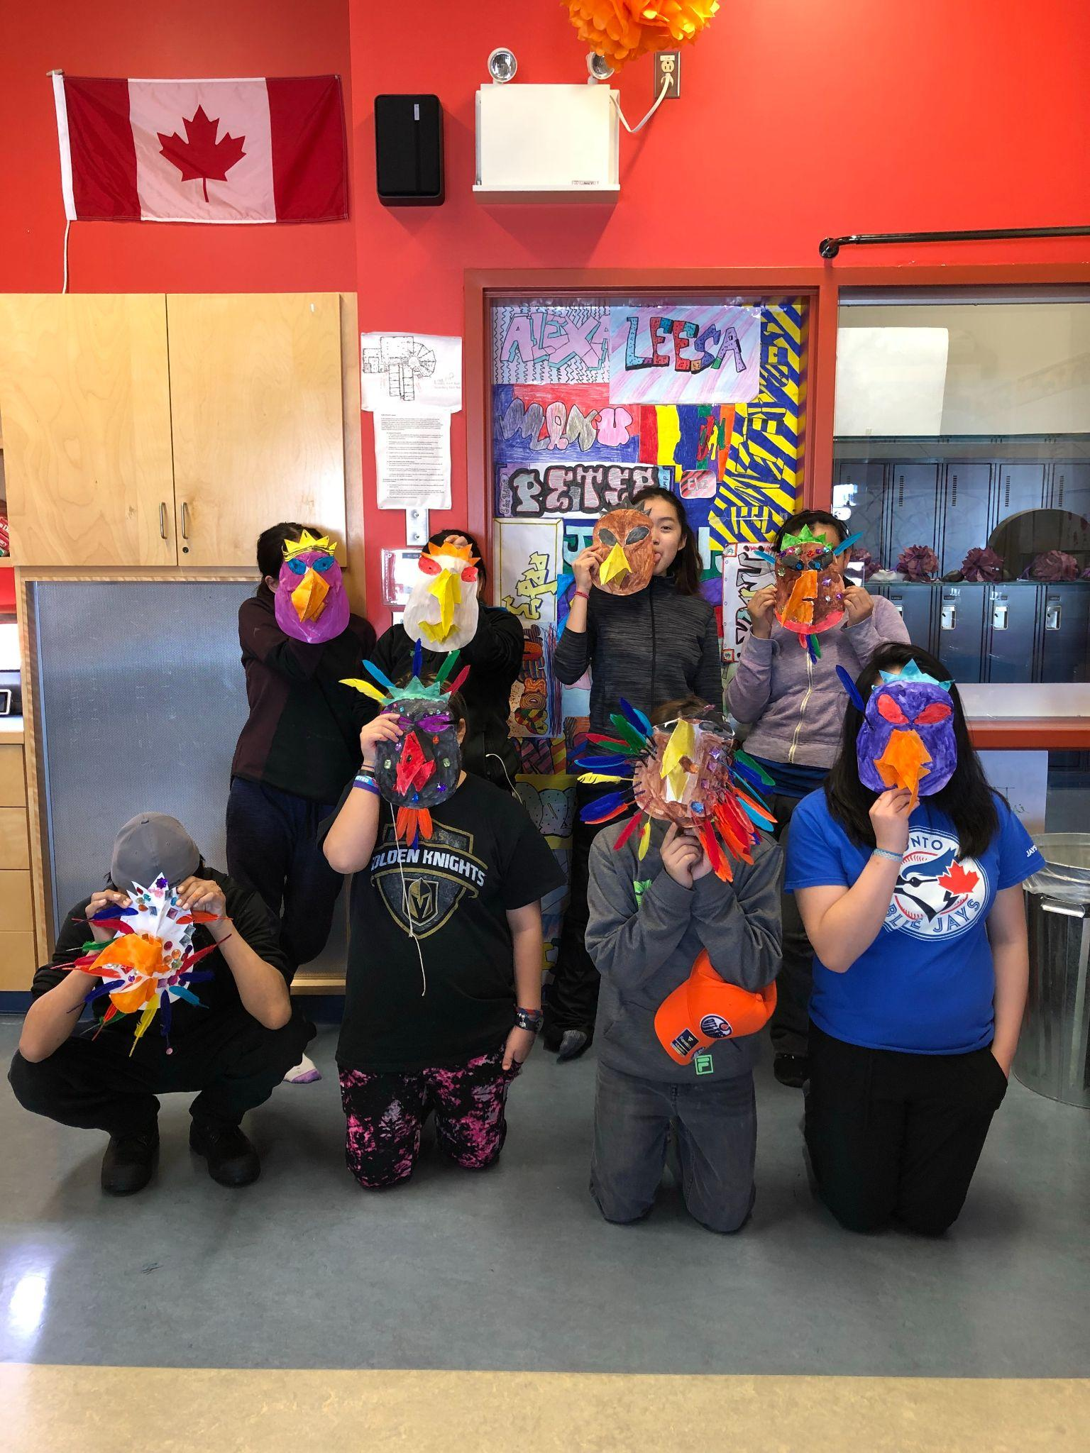
Inuit Students in rural Canada showing their Eagle Mask

Slide 18
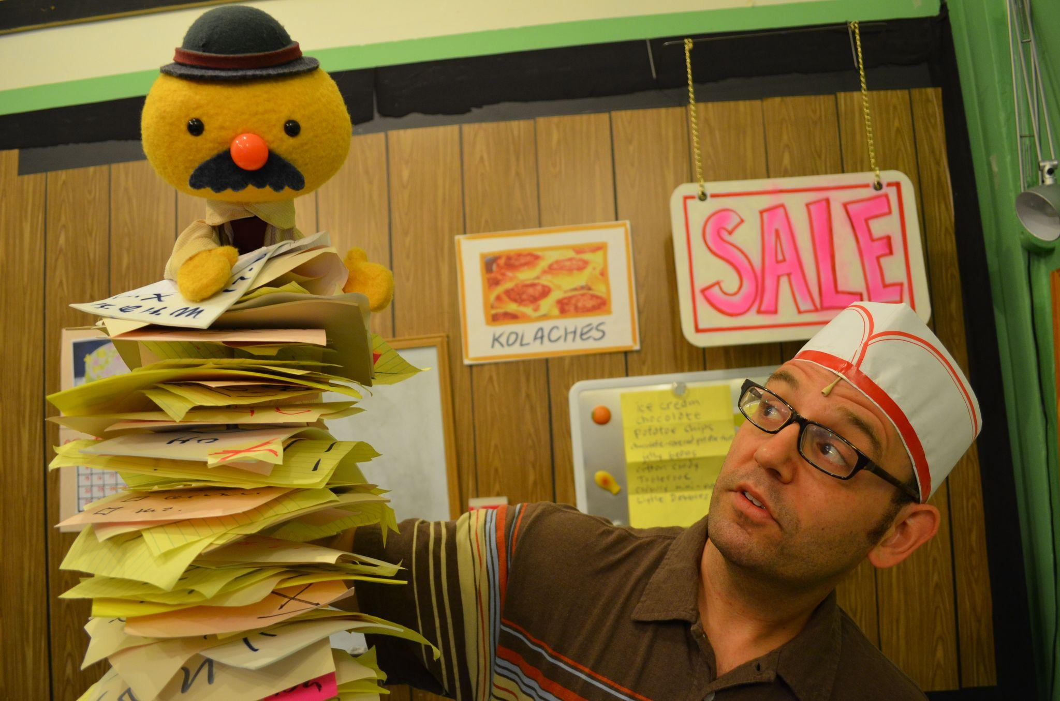
Mr. Kolache’s Long List
Health and Nutrition Puppet Show

Slide 19
Virtual Field Trips are accessible and cost effective
Tip
We bring the Center to you...Virtually!

Slide 20
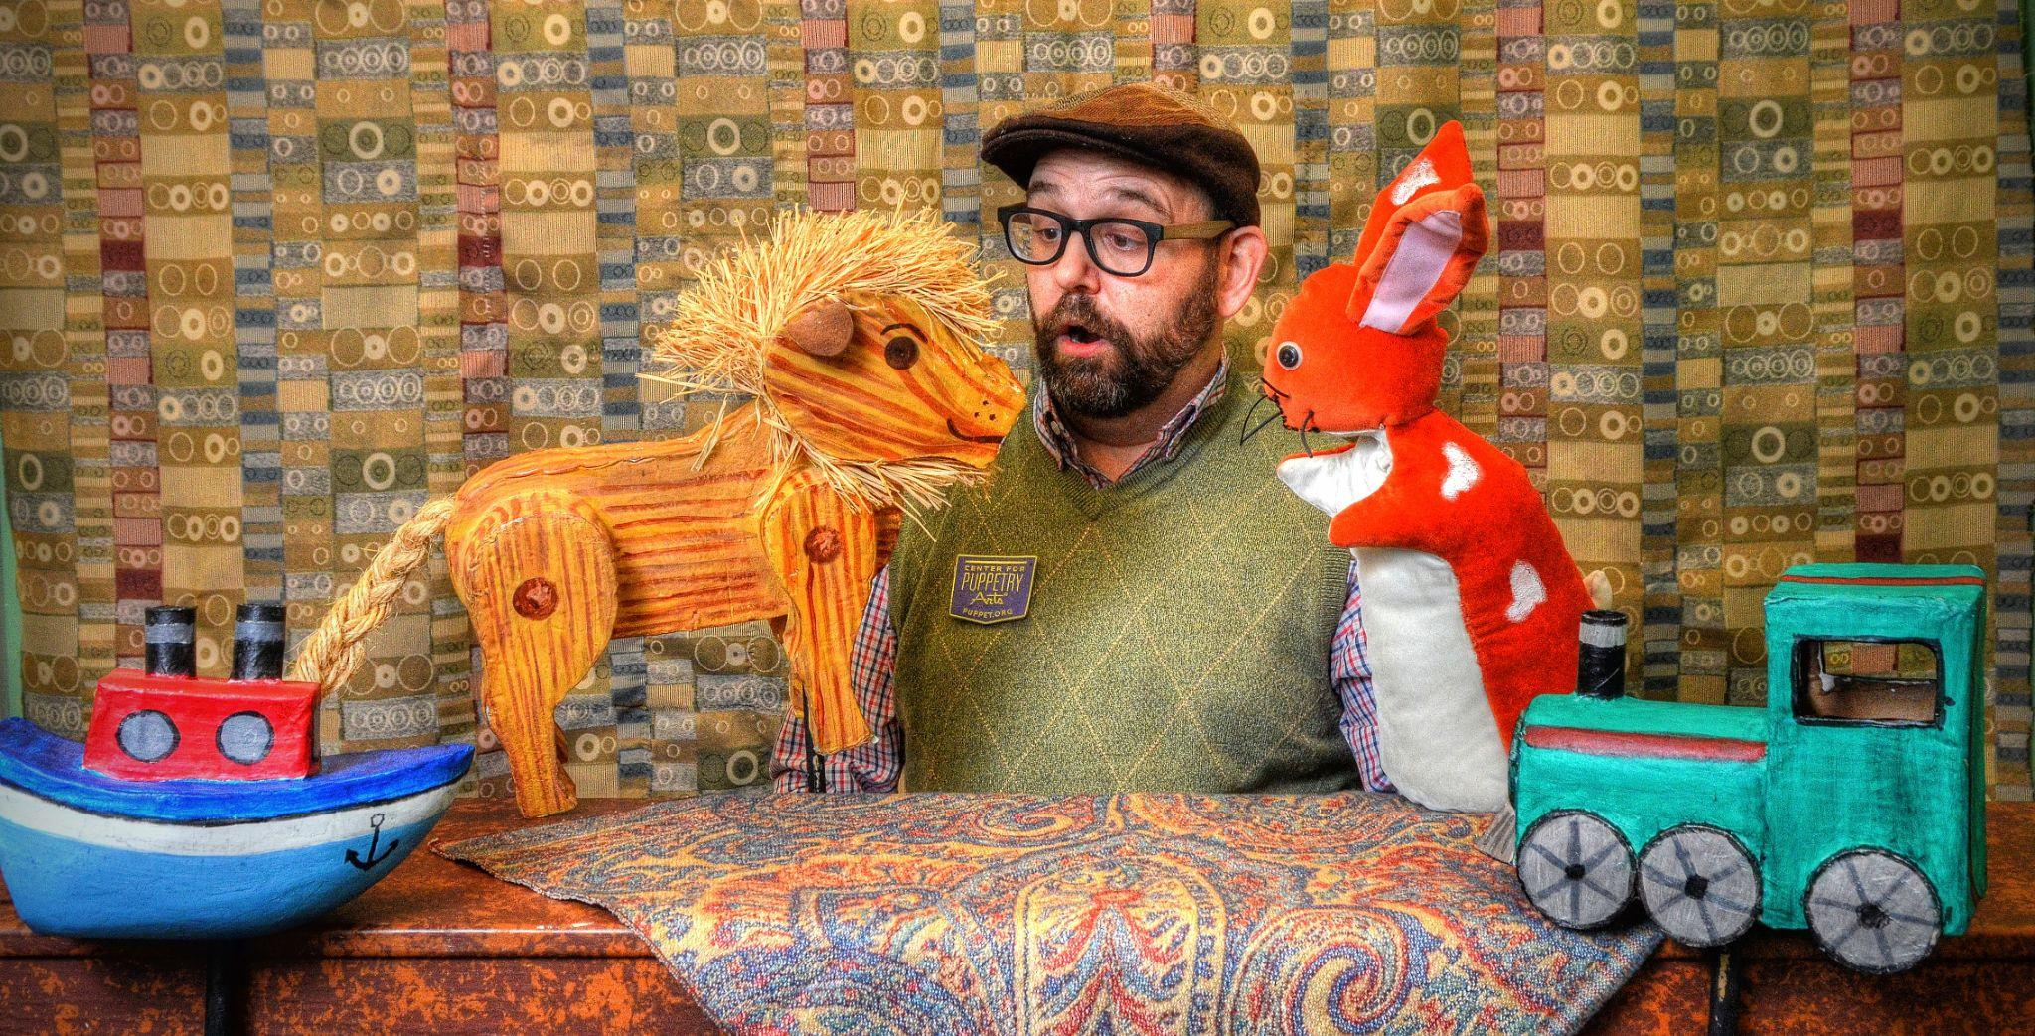
Then, Marcos discovered Google Translate
He has his visiting customers speak their camera issues into the app.
He’s able to give them a friendly, personalized experience by understanding exactly what they need.
Tip
Mr. Jeffery
DL Creative Lead

