Slide 1



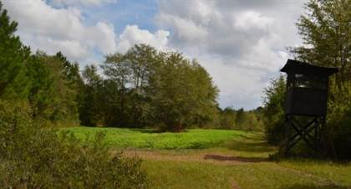

From the COUNTRY to the COAST

Slide 2
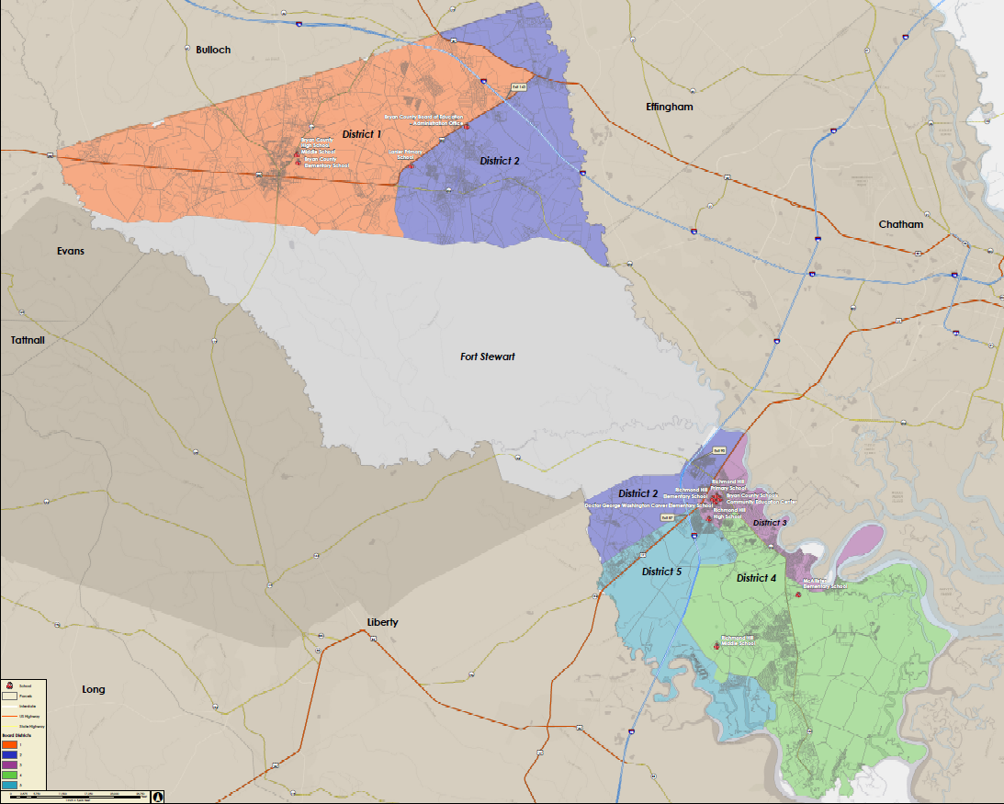
Financial Efficiency
4.5 STARS
CCRPI - 85.4
Fort Stewart makes up 39% of Bryan County with 109,050 acres
Bryan County 282,752 total acres
Growth - 3% to 5%
Students - 10,000

Slide 3
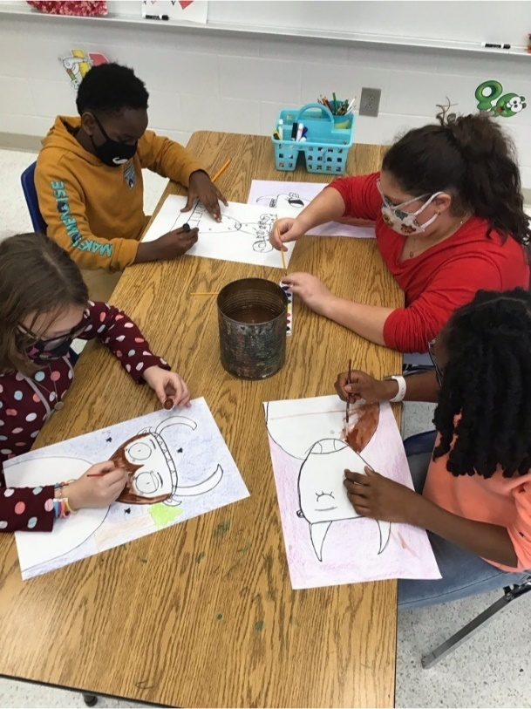

THE IMPERFECT STORM:
Pandemic, Politics, and Public Schools
Steadily Leading in an Uncertain Environment

Slide 4
The Calm Before the Storm
2019–2020 School Year
March 5 - 7th 2020 – Board retreat
Outstanding plan for 2020-2021
Strong budget
Looking forward to:
  Graduation
  Prom
  Spring break
  Summer vacations
Performance – historical highs
March 18, 2020
Reinvent public education

Slide 5

Guidance, Politics, and Science
Center for Disease Control and Prevention (CDC)
Department of Public Health (DPH)
Georgia Department of Education (DOE)
Governors Office of Student Achievement (GOSA)
Governors Office
US Department of Education
White House
Memorandums
Executive Orders
Georgia’s K-12 Restart Working Group
Georgia’s Path to Recovery
National Medical groups
Local Doctors
Symptoms
Close contact
Six feet
15 cumulative minutes
Quarantining
Isolation
Phased mitigation
COVID Testing
Community Spread
14-Day
7-Day
Families First Coronavirus Response Act
Emergency Paid Sick Leave Act
CARES I, II, and III
Masks
PPE
Social Distancing
Cleaning
Ventilation
The COVID 1,000-piece puzzle

Slide 6











Slide 7
Navigating a 100-year storm
Study, Study and Study Again
Communication, Communication and More Communication
The PLAN
The OPENING
First Semester
Second Semester
A Vaccine and a Variant
Finishing Strong
1st Day of School 2021
The Accountability Challenge

Slide 8
Winter MAP Reading (3-year Comparison)

Slide 9
Winter MAP Math (3-year Comparison)

Slide 10
Additional Opportunities vs. Challenges
Austerity reduction
High growth
Redistricting four elementary schools to open new 1,250 student school
Design and construct a new 3,000+ student high school
Guaranteed Viable Curriculum
Standards Based Report Card
Employer-supported childcare

Slide 11
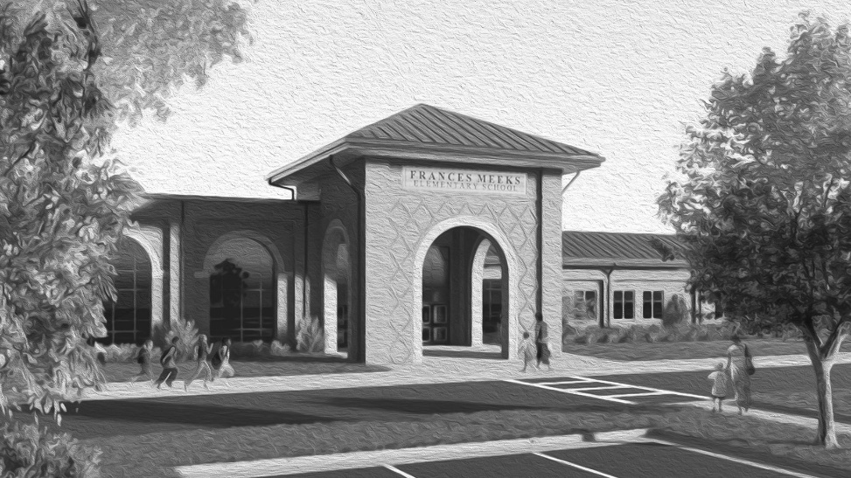
Frances Meeks Elementary School

Slide 12
Richmond Hill High School

Slide 13
Leadership Takeaways
The principalship is the most important position in your school system
Grow your own
The leadership screening process is paramount – the fit and match challenge
Continuous improvement
Plan, evaluate, analyze and plan some more
Do not react – you are not a puppet
Support, support, and more support
Climate, culture, and people
The questions you ask are many times more important than the statements you make
Never use the word because
Your RESA does matter
School Board effectiveness has never been more important!
“Any business that doesn't create value for those it touches, even if it appears successful on the surface, isn't long for this world," Jeff Bezos - Amazon

Slide 14
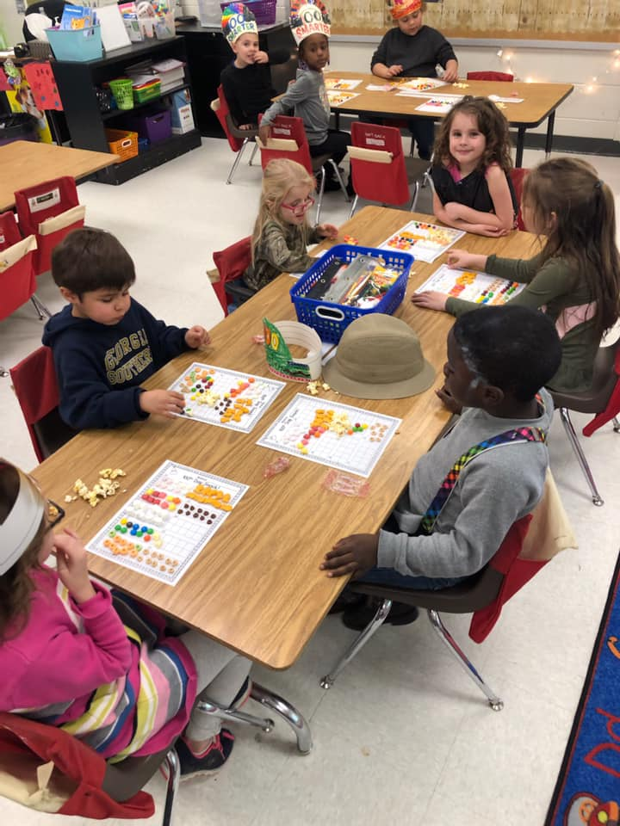
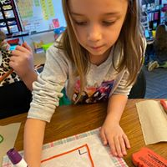

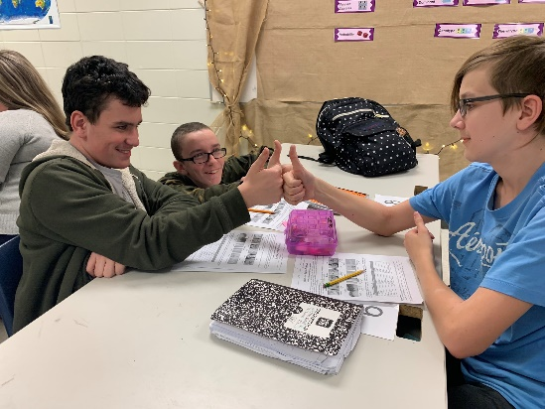
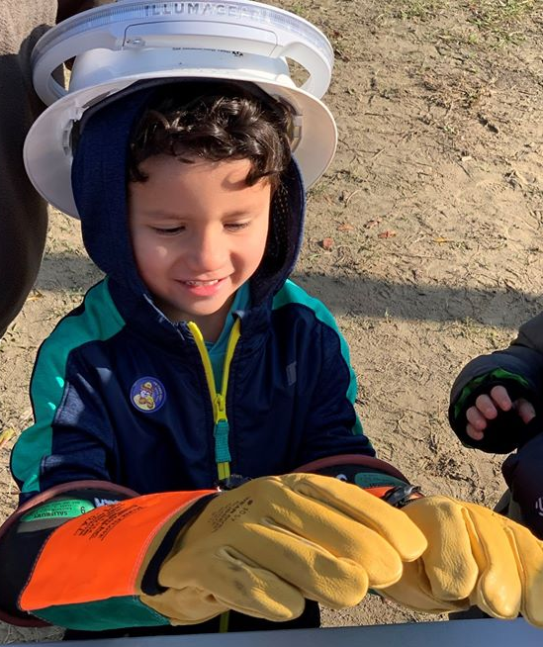
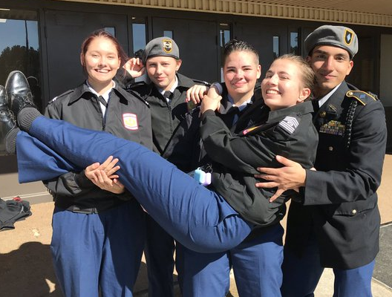

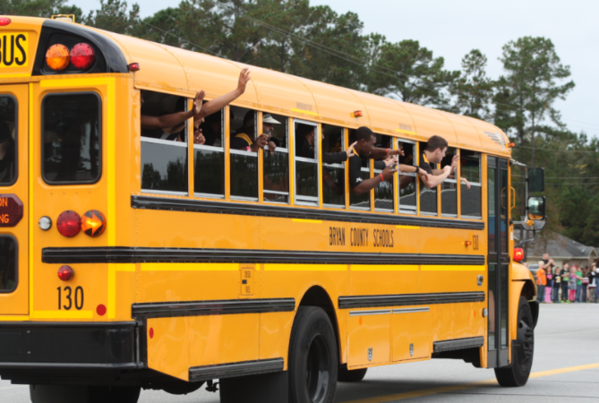
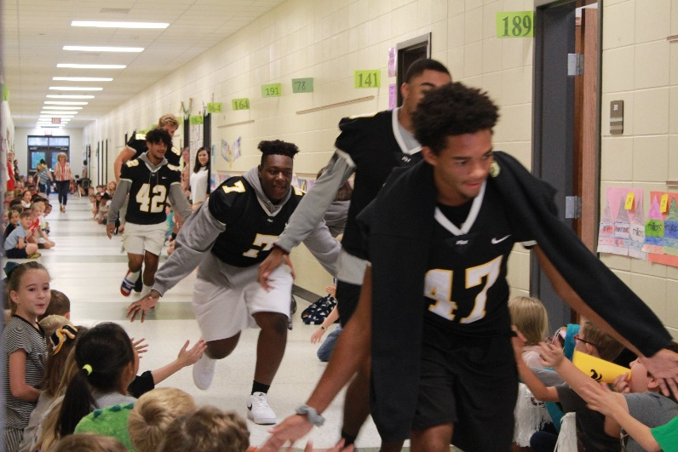

Everything does rise and fall on leadership!

