Slide 1
Test Design and Comparability
Michael Huneke, Marietta Schools
Garron Gianopulos, NWEA
April 21st at 1:30

Slide 2
GMAP: What & why
We are piloting an innovative assessment from NWEA with the goal of:
Creating cohesion across interim assessments administered for teaching and learning and the annual summative test required as part of accountability
Streamlining testing, eliminating the need to administer the Milestones summative test in the spring and potentially reducing the need for other interim tests districts are currently administering

Slide 3
Overview
Who is GMAP?
What is the Innovative Assessment Demonstration Authority (IADA)?
How will the GMAP Through-Year Assessment work?
How will GMAP address the requirements of comparability?
Questions?
Notes:
Comparability in the world of assessment goes well beyond the question of “What percentage of students are passing this exam” down to the design of the assessment and items themselves. Learn about how the GMAP consortium is working to design an assessment that allows students to demonstrate how they are moving from less sophisticated to more sophisticated levels of understanding with respect to the Georgia Standards for Excellence using Range-ALDs. Explore what this means for understanding student growth throughout the year, and develop an understanding of how this helps inform comparability that will eventually allow a new, adaptive through-year model to eliminate the need to take a separate end of year Georgia Milestones Assessment.

Slide 4
How we got here
May 2018 – SB 362: Decrees that the State Board shall establish an innovative assessment pilot
Aug. and Sept. 2018 – State Board approves three applications for the state innovative pilot program (GMAP, Cobb, Putnam)
Dec. 2018 – Georgia application for federal innovative assessment program (IADA) includes GMAP, Putnam, & Cobb Co.
July 2019 – GMAP is approved; Putnam (Navvy) is approved with conditions
August 2020 – GMAP Annual Review for IADA is submitted

Slide 5
GMAP: Who we are
We are a group of districts committed to making assessment more relevant to teaching and learning.
Collaborating partners:
Barrow County School System (~14,000 students)
Clayton County School System (~55,000 students)
Dalton City Schools (~8,000 students)
Floyd County Schools (~9,400 students)
Haralson County Schools (~3,500 students)
Jackson County Schools (~8,565 students)
Jasper County Schools (~3.500 students)
Marietta City Schools (~8,900 students)
Affiliate partners:
Calhoun City Schools (~4,200 students)
Chattooga County Schools (~2,700 students)
Evans County School System (~1,975 students)
Oglethorpe County Schools (~2,225 students)
Social Circle City Schools (~1,800 students)
Trion City Schools (~1,400 students)
Participating partners:
Georgia Cyber Academy (~11,300 students)
Chattahoochee County School District (~918 students)
Notes:
Narrator should define collaborating vs. affiliate vs. participating
Collaborating Partner—Lead Districts are full members participating immediately in the decision-making, design, and development process. These districts have been MAP Growth interim assessment users for a minimum of one school year prior to becoming a lead district and are versed in using growth data throughout the year to inform instruction. These districts may have served as affiliate partners for one school year prior to becoming a lead district and having voting rights. Lead districts contribute to all meetings and send a representative who can make decisions for the district
Affiliate Partner District—Affiliate Partner Districts remain informed about the development process and will give the assessments but do not participate in the decision-making, design, and development process. Affiliate partners do not have voting rights. These districts are invited to all meetings to remain informed of the status. Educators from these districts are invited to participate in development activities. These districts use MAP Growth interim assessments at minimum in Grades 3–8. It is anticipated that affiliate partners will transition to collaborating partners in future years.
Participating Partner District—Participating Partner Districts support the pilot by participating in the assessment but do not participate in the regular informational meetings or in any of the decision-making, design, and development processes. Participating partners do not have voting rights. These districts are invited to meetings/trainings that provide information about piloting the solution being developed by GMAP and NWEA. Districts use MAP Growth interim assessments at minimum in Grades 3–8.

Slide 6
Overview
Who is GMAP?
What is the Innovative Assessment Demonstration Authority (IADA)?
How will the GMAP Through-Year Assessment work?
How will GMAP address the requirements of comparability?
Questions?

Slide 7
The Innovative Assessment Demonstration Authority (IADA)
The IADA was created as part of the Every Student Succeeds Act (ESSA)
It enables an SEA or consortium of SEAs that meets certain application requirements to establish, operate, and evaluate an innovative assessment system (i.e. IADA pilot)
The goal is for the SEA to scale the innovative assessment system after the demonstration authority ends for use statewide to meet academic assessment and accountability system requirements
Our Interpretation:
The primary goal of IADA is to allow us to create innovative assessments that improve existing assessments for accountability and that support differentiated learning in new & improved ways.
A secondary goal of IADA, is to demonstrate just enough comparability to Milestones so that highly similar classification decisions and score interpretations can be made with the GMAP IADA assessment when compared to Milestones.
Notes:
Window of time (5 years). FY20 – FY24 with two years to transition state wide FY25 & FY26.
Claim: The primary goal of the GMAP test design should be to create innovative assessments that improve existing assessments for accountability and that support differentiated learning in new and improved ways.
Grounds: The primary purpose of IADA is to allow districts to create and test out new and improved assessment systems for accountability purposes. By definition, innovation is “a new idea, method, or device”. Also it is defined as, “the introduction of something new.” Merriam‐Webster
If the primary purpose is not INNOVATION, then why did the US dept. Of Ed. Name the program "INNOVATIVE Asssessment Demonstration Authority"?
Warrant: Change for the sake of change, is not sufficient justification for participation in IADA. The innovation‐‐the change, the new idea, method, or device‐‐ must produce positive change, or an improvement to the assessment system in order to be worthwhile.
Warrant: Innovation should be constrained but not hampered by the ongoing need for comparable classification decisions between Milestones and the IADA GMAP assessment.
From the IADA application:
The Elementary and Secondary Education Act (ESEA) as amended by the Every Student Succeeds Act (ESSA) includes in title I, part B of the ESEA a new demonstration authority under which an SEA or consortium of SEAs that meets certain application requirements may establish, operate, and evaluate an innovative assessment system, including for use in the statewide accountability system, with the goal of using the innovative assessment system after the demonstration authority ends to meet the academic assessment and statewide accountability system requirements under title I, part A of the ESEA.

Slide 8
.
Partnering to pilot a solution that:
Helps inform next steps/actions in learning
Is aligned to the GA Standards of Excellence and Milestones blueprint
Adapts to efficiently and accurately measure student learning
Measures growth within and across years
Tells a longitudinal story
Provides RIT information (RIT = indicator of student learning level)
Provides access to NWEA’s national norms (can be used for gifted screening)
Allows for freedom in curriculum and pacing
Determine if students are on pace to reach proficiency by year-end
Determine if the student is below-grade, on-grade, or above-grade
Notes:
Note to help describe a RIT score:
As mentioned earlier, a good number of districts in GMAP use MAP Growth to measure growth and inform instruction and as part of the innovative pilot, we’re moving toward a solution that is different but holds some similarities to MAP Growth.
MAP Growth produces a RIT score, which is a number produced by each MAP assessment (for each content area -- reading, language usage, math, or science). This score represents a student’s achievement level at any given moment and helps measure their academic growth over time. The RIT scale is a stable scale, like feet and inches, that accurately measures student performance, regardless of age, grades, or grade level. Like marking height on a growth chart and being able to see how tall a child is at various points in time, you can also see how much they have grown between tests.
While through-year assessment is different from MAP Growth, it will provide RIT information to maintain the “longitudinal story” for each student as GMAP districts transition their students from taking MAP Growth to taking through-year assessment. This also helps maintain longitudinal continuity with grades K-2 in districts using MAP Growth in those grades.

Slide 9
Innovative solution: Through-year assessment
FALL
WINTER
SPRING
Through-year assessment
Produces grade-level performance and RIT information
Through-year assessment
Produces grade-level performance and RIT information
Through-year assessment Yields summative proficiency and RIT information
RIT = Numerical indicator of student learning level; based on RIT scale, which uses individual item difficulty values to measure student achievement independent of grade level.
Notes:
Three assessments administered fall, winter, and spring
JUST ONE TEST IN SPRING!
Each assessment produces information on student learning level to support differentiated instruction and foster academic growth
The spring test also produces summative proficiency information

Slide 10
Pathway for ELA & mathematics
Year
2021-2022 Field Test
2022-2023 Pilot
Fall
MAP Growth
Through-year Pilot
Winter
MAP Growth
Through-year Pilot
Spring
2023-2024 Demonstration
Through-year Demonstration
Through-year Field Test + Milestones
Through-year Pilot + Milestones?*
Through-year Demonstration + Milestones?*
Through-year Demonstration
*Milestones may or may not be necessary depending on outcomes of comparability studies and State Board of Education approval.
Science will follow the same pattern. GMAP will explore options for assessment in high school if the innovative solution is adopted statewide.

Slide 11
Overview
Who is GMAP?
What is the Innovative Assessment Demonstration Authority (IADA)?
How will the GMAP Through-Year Assessment work?
How will GMAP address the requirements of comparability?
Questions?

Slide 12
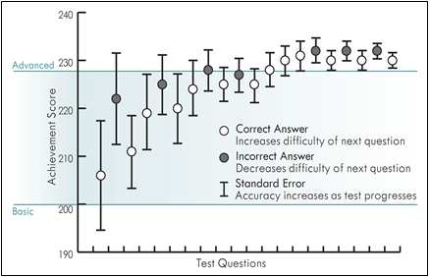
How do computer adaptive tests (CAT) work?
CAT engine selects the most informative items
Blueprint constrains item selection
Items are personalized to the student's learning level
More precise score with fewer questions
Notes:
Test Design and Comparability
Comparability in the world of assessment goes well beyond the question of “What percentage of students are passing this exam” down to the design of the assessment and items themselves. Learn about how the GMAP consortium is working to design an assessment that allows students to demonstrate how they are moving from less sophisticated to more sophisticated levels of understanding with respect to the Georgia Standards for Excellence using Range-ALDs. Explore what this means for understanding student growth throughout the year, and develop an understanding of how this helps inform comparability that will eventually allow a new, adaptive through-year model to eliminate the need to take a separate end of year Georgia Milestones Assessment.

Slide 13
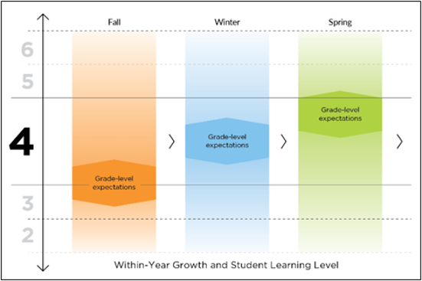
How does a through-year CAT work?
The TY CAT is given in Fall, Winter, and Spring
Achievement level from last CAT informs the starting location of the next CAT
Allows off-grade adaptivity
Yields instructionally useful information

Slide 14
Value provided by through-year reports
Score indicating each student’s learning level, whether on or off grade level (RIT score) – available in fall, winter, and spring
Grade-level performance information in fall, winter, and spring
Norm-referenced information such as achievement and growth percentiles in fall, winter, and spring (via NWEA industry-leading national norms)
Summative proficiency scores in the spring
Growth within and across years based on student learning level
Fall to winter, winter to spring, fall to spring, fall to fall
Growth information based on summative performance
Based on changes in summative performance from spring to spring
Instructional guidance based on students’ performance

Slide 15
Overview
Who is GMAP?
What is the Innovative Assessment Demonstration Authority (IADA)?
How will the GMAP Through-Year Assessment work?
How will GMAP address the requirements of comparability?
Questions?

Slide 16
What is Comparability?
Comparable tests are both very high in quality
Comparable tests measure the same knowledge, skills, and abilities
Comparable tests are aligned to the same content standards
Comparable tests produce consistent score interpretations and classification decisions
Comparable tests have the same purpose
Notes:
Approach to Comparability (Garron?) 15-20 minutes
5 – 6 slides covering test design
Q and A (Michael and Garron) 10 – 15 minutes
Examples:
Same test, different modes (Paper-pencil versus CAT with technology enhanced items)
Translated versions of a test (English versus Spanish translation)
Similar tests (GMAP versus Milestones)
Non-example:
Farenheit-to-celsius (one-to-one scale relationship—too strict)
ACT-to-SAT (Constructs are very similar, but probably not close enough to qualify)
Two forms of the same test (All scale scores are interchangeable—too strict)

Slide 17
Types of Achievement Level Descriptors (ALDs)
Policy ALDs: High-level expectations of student achievement within each achievement level across grades, often defined by the state
Range ALDs: Observable evidence of achievement, demonstrating how the skill changes and becomes more sophisticated for a content standard across achievement levels
Reporting ALDs: Reflect student performance based on the final approved cut scores
Notes:
Egan, Schneider, & Ferrara, 2012
First, Policy ALDs are developed to communicate the vision of what a test score is intended to represent, such as where a student is in their learning regarding the state content standards. For example, Policy ALDs for an ELA assessment provide a minimal description of what a student at different achievement levels in ELA at all grade levels should know and be able to do. When carefully crafted, Policy ALDs can be viewed as the assessment claim because they set the tone for how the content and cognitive demand is intended to be articulated along the test scale.
Next, Range ALDs should explicate observable evidence of achievement, demonstrating how the skill changes and becomes more sophisticated for a standard across achievement levels for each standard and achievement level on an assessment. For ALDs to be the foundation of test score interpretation, they should reflect more complex knowledge, skills, and abilities (KSAs) as the achievement levels increase (e.g., more complex KSAs should be expected for Level 4 than for Level 3) (Schneider, Huff, Egan, Gaines, & Ferrara, 2013).
Range ALDs provide the intended content-based interpretations of what scale scores within a particular achievement level represent. Teachers can use the Range ALDs to determine how students with different scale scores within the different achievement levels may differ in their abilities. The Range ALDs can provide teachers much-needed information on ranges of content- and thinking-skill difficulty that can be found within a single standard and, at times, across standards. Range ALDs have the opportunity to drive item development and test construction as test developers determine the item types that are optimally developed to support the intended score interpretations. As Range ALDs describe increases in student thinking and reasoning, test developers have a rationale regarding why a percentage of particular item types are necessary and the percentage of items that should be developed to particular levels of cognitive complexity within an item bank. Those decisions are driven based on the construct-based evidence that should be collected. The number of concepts and processes that students must integrate to respond to tasks must be monitored and made explicit in ALDs because this affects the difficulty of the tasks and the state-developed notions of mastery (Ferrara & Steedle, 2015; Schneider & Johnson, 2018).
Reporting ALDs are provided at the overall score level and are optimally created after final cut scores are adopted following the standard setting procedure. Reporting ALDs represent the reconciliation of the Range ALDs with the final cut scores. The Range ALDs reflect a state’s initial expectation for student performance within an achievement level, whereas the Reporting ALDs reflect actual student performance based on the final approved cut scores. The Reporting ALDs define the appropriate inferences stakeholders may make based on the student’s test score in relation to the final approved cut scores. Teachers are optimally given supportive information regarding how to interpret them to support formative practice.
ALD Development for the Through-Year Solution
The Range ALDs for the Common Core State Standards (CCSS; National Governors Association Center for Best Practices & Council of Chief State School Officers [CCSSO], 2010)¹) in ELA and mathematics were developed with a committee of educators and subject matter experts and will form the starting point for the through-year assessment. These will be adapted for state partners already using the CCSS as the basis for their standards. States not using the CCSS will require developing new ALDs.
The Range ALDs allow focused item development to specific levels at each standard, resulting in an item pool that represents the test blueprint with a greater range of items within each standard. The greater range of items provides more engagement opportunities for the student by meeting the student at the appropriate content difficulty, reasoning complexity, and supports. The ALDs also influence how items are designed. In some cases, this leads to a natural selection of preferred item types for not only certain standards but also specific levels (multiple choice for identification at a lower level vs gap match for creating at a higher level). The item types section includes more information regarding this topic. For passages, per the CCSS, students are expected to read and respond to a variety of texts at a range of complexity by the end of the school year. NWEA plans to present a variety of texts that demonstrate a range of genres and complexity at each grade, with the items being developed based on the ALDs.
The ALDs also provide a way to communicate a progression that is visible and usable to all stakeholders while also providing a foundation for a robust bank of items that meets the needs of all students. The ALDs provide teachers with ideas and examples of how to increase or decrease complexity with more on-grade access points (four levels within each standard) to help find the point of productive struggle for students across a range of achievement.

Slide 18
Range ALD Example
Notes:
Note: The ALDs may have changed from the exact progressions shown in the training.
All of the ALDs begin with the MGSE as the base.
ALDs progress in difficulty, complexity, and/or both as we move from beginning to distinguished.
GSE
Indicates what students are expected to be able to do at the end of the year (proficiency).
Demonstrates the difference in content between grades while still showing coherence across grades.
RALDS
Indicates what students are likely able to do along the path to proficiency.
Demonstrates coherence within an individual standard and within the grade, in addition to coherence across grades.

Slide 19
Intended Uses of Range ALDs
Range ALDs provide the intended content-based interpretations of what scale scores within a particular achievement level represent.
Teachers can use the Range ALDs to determine how students with different scale scores within the different achievement levels may differ in their abilities.
The Range ALDs can provide teachers much-needed information on ranges of content- and thinking-skill difficulty that can be found within a single standard and, at times, across standards.
Range ALDs drive item development and test construction as test developers determine the content of items and tasks that are optimally developed to support the intended score interpretations.
Range ALDs expand the on-grade item pool to support deeper on-grade adaptivity before moving off-grade
Notes:
ALDs play a central role in item development, score reporting, and score interpretation.
Valid score inferences require quality ALDs.
ALDs represent intended interpretations, and therefore should be validated.
It is not enough for the interpretations to be valid, they also need to be specific and actionable enough to be useful.

Slide 20
Differences Between GMAP and MAP Growth
MAP Growth Assessment | GMAP Through-Year Assessment
Less constrained CAT | Heavily constrained CAT
Grade-agnostic blueprint | Grade-specific blueprint
Items aligned to Georgia Standards of Excellence | Items aligned to Georgia Standards of Excellence and range achievement level descriptors
MAP Growth will adapt more freely to off-grade items | GMAP's item pool will adapt more deeply within grade, before adapting off-grade
Provides proficiency predictions and normative growth measures | Provides proficiency predictions (fall and winter), summative determinations (spring), and links to MAP's normative growth measures

Slide 21
How will GMAP achieve comparability?
Parallel Content
Same content standards
Same achievement level descriptors (ALD)
Highly similar test blueprints
Highly similar item types
Item Development centered around Range ALDs
Notes:
Both assessments follow the same or nearly identical testing conditions, procedures, and policies
Present evidence: test/retest policy is the same,
Both assessments measure the same constructs with highly similar content
Present evidence: Both tests share same policy ALDs and content standards
Present evidence: TY Range ALDs agree with GA policy ALDs
Present evidence: Milestones Blueprints and TY Blueprints are highly similar
Present evidence: First alignment study demonstrated that a large portion of our current item pool aligned to GSE in terms of content and DOK alignment (?), but also highlighted some gaps we will need to fill in upcoming item development.
Present evidence: Similar item types measure similar content in similar ways
Present evidence: TY item bank includes TE item types in ELA and Math and CR ELA item types. Recent changes to Milestones will increase similarity of the two assessments.
Future evidence: Additional alignment studies, including evidence that the CAT selects items that conform to the TY blueprint
Blueprint rules will increase comparability in spring, but in fall and winter, off-grade adaptivity will be allowed to improve measurement precision and qualitative feedback.
Future evidence: High correlations between scores.
Correlations of TY to Milestones is similar to other external benchmarks (e.g. ACT/SAT to summative scores, etc.)
This correlation is driven by many factors, most significantly is similarity of content.
Correlations at total score and at level of subgroups
Cut scores at achievement levels will be defined to maximize classification agreement between Milestones and the TY scale, beginning in spring 2022 and repeating each spring thereafter.
Cut scores on the TY scale will be established using signal detection theory (VanDerHeyden 2010) and logistic regression (the state of Michigan, 2011)
Logistic regression is a type of projection
Signal detection theory
Receive Operating Characteristics (ROC)
What contributes to classification inconsistency?
Testing conditions and timing contribute to classification inconsistency
Example: If one test is very long compared to another test, test taker fatigue may contribute to differences in performance which can increase classification inconsistency
Measurement imprecision contributes to classification inconsistency
Example: Retesting with the same test will produce classification disagreements proportional to the imprecision of the score
Construct differences contribute to classification inconsistency
Example: Milestones versus TY will produce classification disagreements proportional to differences in blueprint, content standards measured, and item types.
Present evidence: Recent linking study between MAP and Milestones shows strong correlation. This is like an external benchmark for comparison. The actual TY to Milestones results should be much improved.
Future evidence: Spring 2022 will give us a first glance at agreement in classification between Milestones and the TY scale
Spring 2022 is a field test, and so the TY test will not be a fully adaptive test; however, the TY scale will not be vertically scaled yet and will not be fully adaptive during the first field test. These factors may contribute to differences in classification.
Fall 2022-Spring 2023will be the TY prototype, an adaptive test
Fall 2023-Spring 2024 will be a demonstration year … fully adaptive and vertically scaled
Classification consistency should be the highest as this point

Slide 22
How will evidence be collected?
Linking Study
Representative sample of Georgia students will be taken from the GMAP districts
The sample of students will take both the Milestones and GMAP TY CAT
Scores are linked statistically to produce a conversion table
Students will be classified into achievement levels according to both tests
Agreement statistics will be examined by GaDOE and GMAP TAC

Slide 23
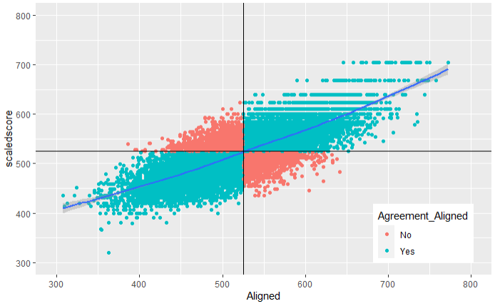
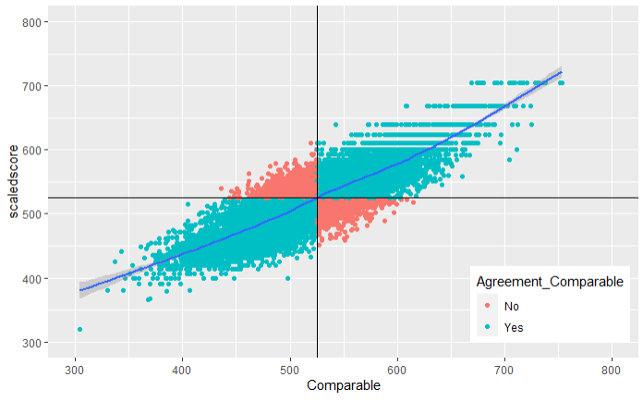
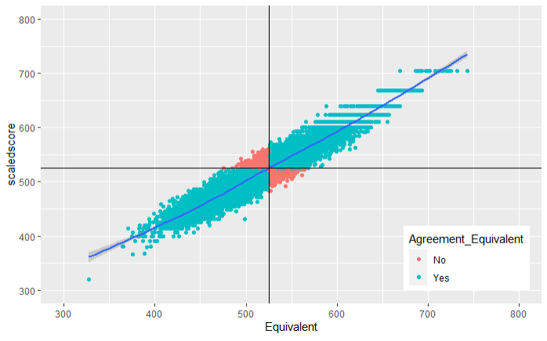
What does comparability look like statistically?
Too Little
Just Right
Too Much
Correlation = 0.77
78% agreement
Correlation = 0.86​
86% agreement
Correlation = 0.96​
91% agreement in proficiency classification
Examples
ACT-to-SAT
Math-to-Science
Examples
CAT-to-Paper
CAT-to-Online Fixed
GMAP-to-Milestones?
Examples
Form-to-Form
Online to paper
Test/Retest
Hypothetical Scatter Plots Showing Degrees of Comparability
Notes:
Note to self: R code:”ROC log regression example.Rmd” was used to make these graphs
Dot = a student (12,877 students)
Milestones (Y axis)
Simulated (X axis)
Blue = Agreement
Red = Disagreement
Correlation = 0.96
91% agreement in proficiency classification
Difference in testing window
Comparable
MAP to Milestones (Math) linking study
Correlation = 0.86
86% agreement in proficiency classifications
MAP Growth not GMAP
Difference in testing window
GMAP should only improve
Aligned
Simulated (X axis)
Correlation = 0.77
78% agreement in proficiency classifications

Slide 24
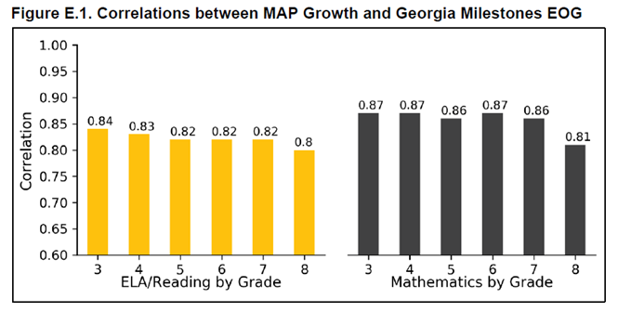
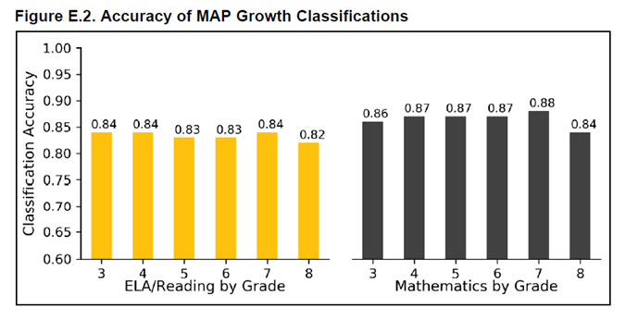
What Does Comparability Look Like Statistically?
High correlations produce consistent proficiency classifications
Even the same test administered twice will not produce perfect consistency
It's important not to require a higher correlation than what Milestones forms can generate
The correlations shown below are between preliminary item pool and Milestones
These should only improve when GMAP is implemented
GMAP TAC and GaDOE ultimately set the bar for comparability
Preliminary item bank
Notes:
Preview
Our best available prediction, and we know it is an underestimate.
Numbers are lower bound
GMAP will have better alignment, same purpose, etc.

Slide 25
Overview
Who is GMAP?
What is the Innovative Assessment Demonstration Authority (IADA)?
How will the GMAP Through-Year Assessment work?
How will GMAP address the requirements of comparability?
Questions?

Slide 26
questions?
Please send us your feedback on the GMAP Innovative Pilot Program at:
nwea.us/gmap
Garron Gianopulos Senior Research Scientist NWEA 503-548-5321 garron.gianopulos@nwea.org
Michael Huneke Director of Assessment Marietta City Schools 678-695-7277 mhuneke@marietta-city.k12.ga.us

Slide 27
Join us in innovating to improve learning
Collaborating partner –voting member; expert in using growth data (MAP Growth partner for at least one year); send representative to all GMAP meetings
Affiliate partner – non-voting member; invited to all GMAP meetings; after one year can become collaborating partner
Participating partner –non-voting member; support the effort by piloting the new assessment; attend trainings re: piloting the solution
CONTACT: Michael Huneke Director of Assessment Marietta City Schools 678-695-7277 mhuneke@marietta-city.k12.ga.us
Please send us your feedback on the GMAP Innovative Pilot Program at:
nwea.us/gmap
Notes:
Collaborating Partner—Lead Districts are full members participating immediately in the decision-making, design, and development process. These districts have been MAP Growth interim assessment users for a minimum of one school year prior to becoming a lead district and are versed in using growth data throughout the year to inform instruction. These districts may have served as affiliate partners for one school year prior to becoming a lead district and having voting rights. Lead districts contribute to all meetings and send a representative who can make decisions for the district
Affiliate Partner District—Affiliate Partner Districts remain informed about the development process and will give the assessments but do not participate in the decision-making, design, and development process. Affiliate partners do not have voting rights. These districts are invited to all meetings to remain informed of the status. Educators from these districts are invited to participate in development activities. These districts use MAP Growth interim assessments at minimum in Grades 3–8. It is anticipated that affiliate partners will transition to collaborating partners in future years.
Participating Partner District—Participating Partner Districts support the pilot by participating in the assessment but do not participate in the regular informational meetings or in any of the decision-making, design, and development processes. Participating partners do not have voting rights. These districts are invited to meetings/trainings that provide information about piloting the solution being developed by GMAP and NWEA. Districts use MAP Growth interim assessments at minimum in Grades 3–8.

Slide 28
Pathway for ELA, mathematics, science
 | Fall | Winter | Spring
2021-2022 | MAP Growth (reading, language, math, science) | MAP Growth (reading, language, math, science) | Through-year field test (ELA, math); MAP Growth (science) Milestones (ELA, math, science) Comparability studies (ELA, math)
2022-2023 | Through-year pilot (ELA, math) MAP Growth (science ) | Through-year pilot (ELA, math) MAP Growth (science) | Through-year pilot (ELA, math); TY field test (science) Milestones for science and potentially for ELA and math (depending on spring 2022 comparability outcomes, SBOE) Comparability studies (science; potentially ELA and math)
2023-2024 | Through-year demonstration (ELA, math) Through-year pilot (science) | Through-year demonstration (ELA, math) Through-year pilot (science) | Through-year demonstration (ELA, math) Through-year pilot (science) Potentially Milestones for the three subject areas but most likely for science (depending on comparability outcomes, SBOE)
Notes:
Milestones may be necessary in spring 2023 depending on outcomes and whether the April deadline for the state DOE to receive the spring 2022 comparability studies can be moved out (comparability data will not be available until late summer)
Milestones may be necessary in 2024 depending on the outcomes of comparability studies but the intent is that by then, Milestones will not be needed. If it *is* needed, it is more likely it will be needed for science than for other subject areas because the development of the through-year solution for science is trailing that of ELA and math by a year.

Slide 29
How do “equivalent scores” differ from “comparable scores”?
Equivalent scores
Alternate forms of the same test
Forms of the test and resulting scale scores are interchangeable
Should not matter what form of the test the student receives
Analog: Comparing apple pies made from exact same process
Objective: Make each pie exactly the same to the greatest extent possible
Comparable scores
Alternate tests of the same subject
Slightly different interpretation of the same content standards
User experience should be improved upon
Analog: Comparing apple pies when one pie was made with new-and-improved ingredients, recipe, or baking process
Objective: Improve upon the recipe, ingredients, or baking process to improve the quality of the apple pie, while still keeping the pie an apple pie
Notes:
If judges in a pie baking contest were told that the objective of the contestant is to produce equivalent pies to the prior year's winning pie, then any new-and-improved pie would receive low marks.
However, if the judges were told the objective is to identify the pie that gives the best apple flavor, then there is an opportunity for improving upon the prior best recipe.
In like manner, if the objective of the IADA is to produce equivalent tests to Milestones, then no improvements can be realized.
However, if the objective of the IADA is to create room for improving the current summative assessment, then GMAP has a chance to improve the summative system for the benefit of all Georgia students and educators.

Slide 30
Equivalent
Simulated (X axis)
Milestones (Y axis)
Dot = a student
12,877 students
Blue = Agreement
Red = Disagreement
Correlation = 0.96
91% agreement in proficiency classification
Difference in testing window
Notes:
Note to self: R code:”ROC log regression example.Rmd” was used to make these graphs

Slide 31
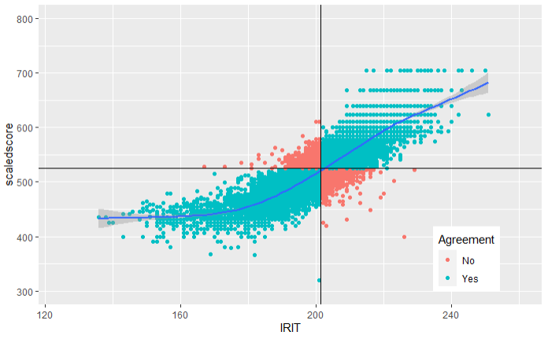
Comparable
MAP Growth (X axis)
Milestones (Y axis)
Correlation = 0.86
86% agreement in proficiency classifications
MAP Growth not GMAP
Difference in testing window
GMAP should only improve
Notes:
Note to self: R code:”ROC log regression example.Rmd” was used to make these graphs

Slide 32
Aligned
Simulated (X axis)
Correlation = 0.77
78% agreement in proficiency classifications
Notes:
Note to self: R code:”ROC log regression example.Rmd” was used to make these graphs

Slide 33
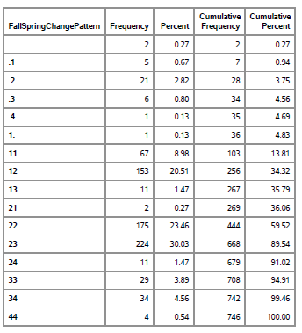
Example: The Iceberg Problem in Math Grade 4
8.98% of students started and ended at Beginning Level.
23.46% of students started and ended as Developing.
RIT

Slide 34
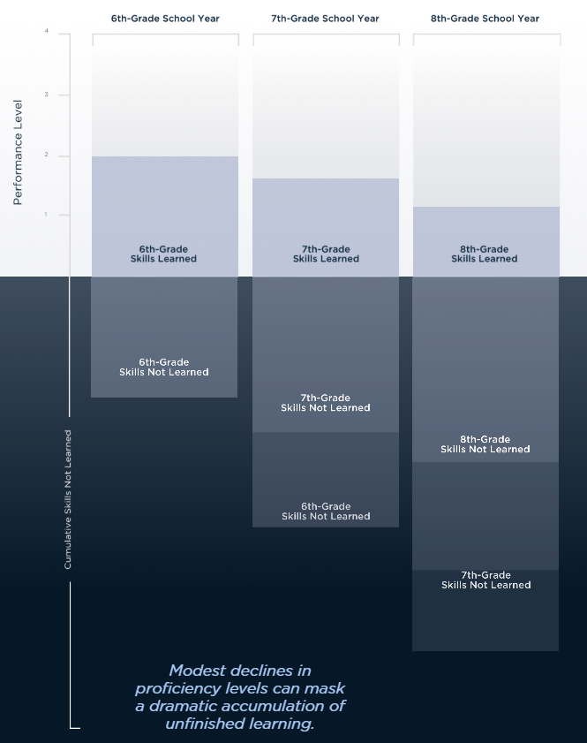
Why off-grade adaptivity?
“Iceberg” problem: Unfinished learning accumulates and persists, hindering the ability for many students to become ready for college and career.
Solution: A constrained CAT that classifies students into on-grade achievement levels, and off-grade levels if needed.
Source: https://assets.website-files.com/5d50257d8e83094ec174b9e3/5d7be52f8fb91d3cd89b5957_Executive%20Summary.pdf
Notes:
Need to cover how it predicts at the standard level what is learned and not learned. Below, on, and above grade level predictions at the standard level.
From page 5 of the white paper:
To accelerate math achievement, opportunity, and equity, this paper urges federal, state, and local education leaders to:
✓ Measure learning growth through the use of assessments that cover standards from across multiple grade levels.
✓ Modify accountability systems in order to incentivize instructional practices that best support each student’s ability to accelerate to grade level and beyond.
✓ Launch Math Innovation Zones.
✓ Make available high-quality instructional supports and strategies that account for unfinished learning from prior school years.
✓ Advance a future vision for assessment and accountability that incorporates more precise measures of student learning growth.
This paper is NOT arguing:
that high expectations and academic rigor are unimportant. They are essential.
2. that our nation’s system of schooling is free from systemic biases. These biases are pervasive, and our educational policies must target overcoming them.
3. that standards-based reform and related accountabilities should be eliminated. They are key building blocks to future progress.
4. that proficiency doesn’t matter. It does. However, for some, achieving college and career readiness in the long term requires building key foundational skills in order to get there.
5. that students should not learn any gradelevel content. Grade-level exposure matters, but an exclusive focus on grade-level material can keep some students from filling critical pre-grade gaps and others from accelerating beyond grade-level expectations.
6. that the recommendations in this paper apply to anything other than middle grade math. That’s just what we know best.

