Slide 1
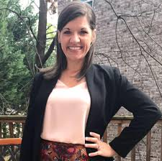
Tracey Nance Pendley 2020 Georgia Teacher of the Year 4th Grade Teacher & Instructional Mentor
Celebrating Teacher Impact
Spring Bootstrap Conference
April 22, 2021
2020gatoty@gmail.com
@2020GaTOTY
Georgia Teacher of the Year

Slide 2
A Little About My Professional Background:
Furman University
Urban Teacher Education Program at the University of Chicago
Turnaround School Success
Teacher Residency Mentor
SEL, Orton-Gillingham, and Social Studies Teacher Leader
Community Partnerships
4-H Club Advisor
Community Engagement, Social Justice
Freddie the Falcon visited our class in May 2019. My students had just finished cleaning out our desks and the floor, when this wild falcon threw confetti everywhere! LOL!

Slide 3
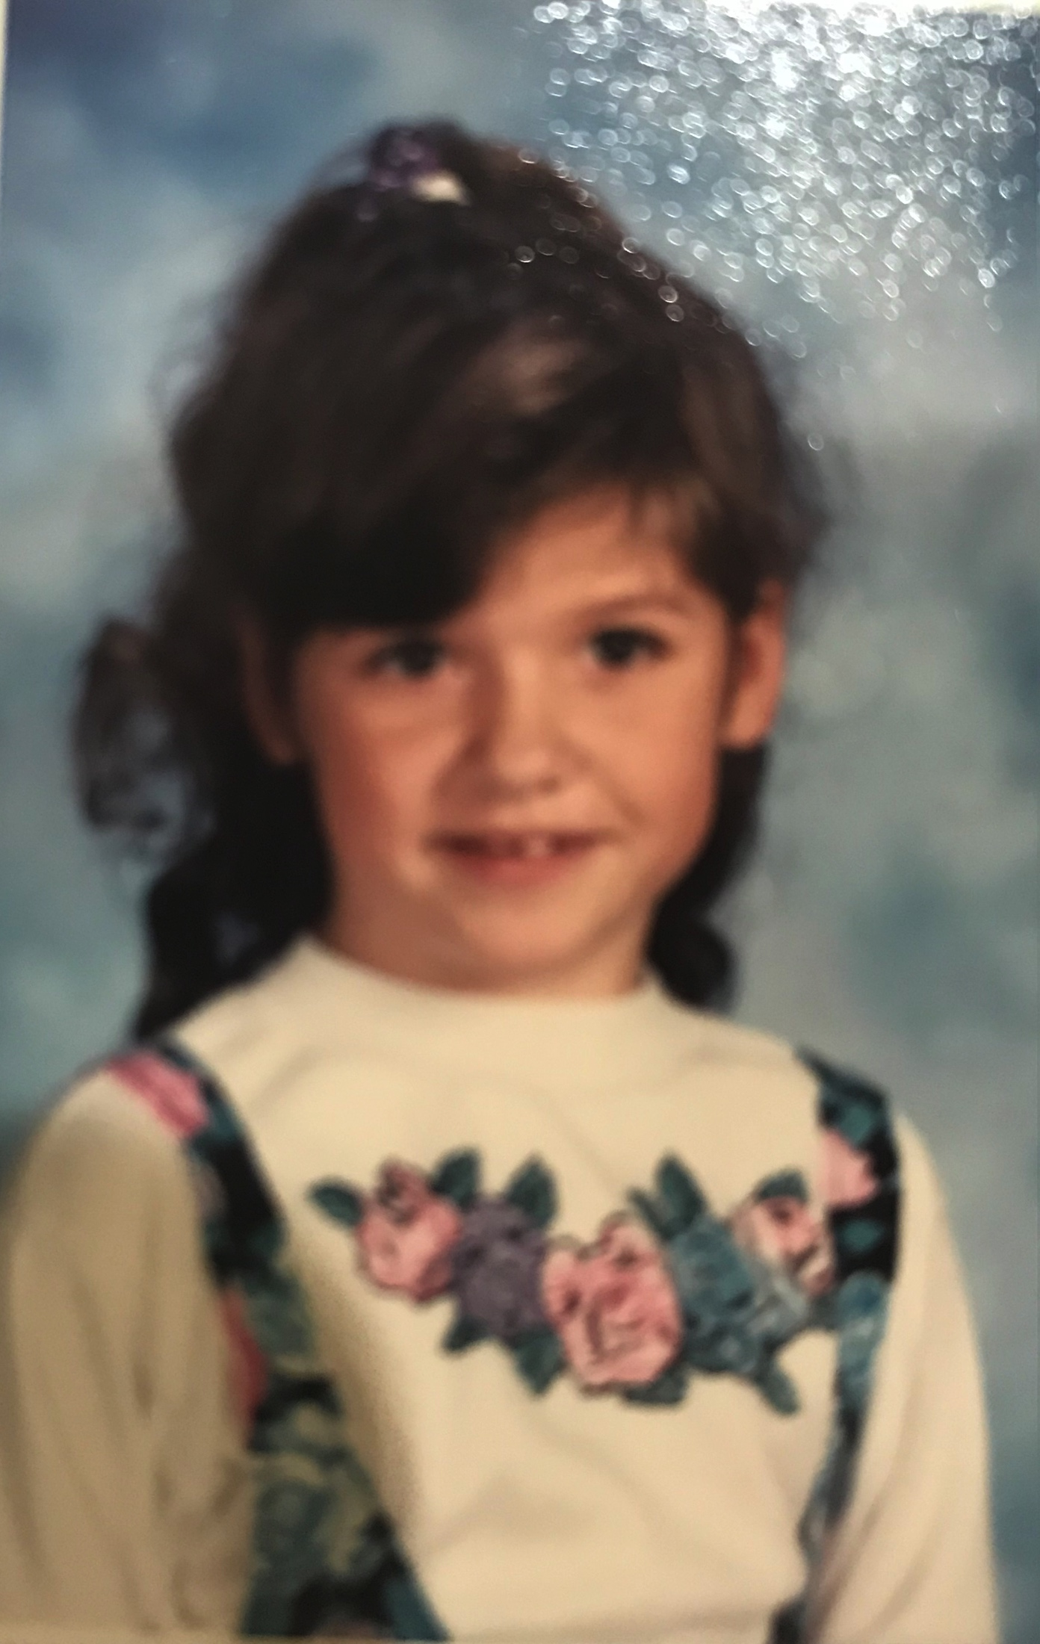
My Story is the story of the impact that great teachers have on their students
Notes:
My own story is the story of the incredible impact that great Georgia educators have on their students. I became a civic-minded, responsible, and educated adult not because of anything my single mom did – I had a tumultuous home life, including 9 different parents, food stamps, and 9 different schools. I took care of my mother’s illness and addiction when she wasn’t in prison. Addicted to crack for as long as I can remember, which caused me to grow up rather quickly, I grew up keenly aware that my mom was choosing her addiction over my brother and I.
-- At age 6, my mom put my brother and I in the car early in the morning to go score her next high. It was raining by the time she returned to the car where she had left us sleeping. On the way home, we were in a terrible car crash. I just remember the car spinning repeatedly. When we finally stopped, I looked into the mirror to see my face covered in blood. I wear the scar from that morning to this very day – prominently on my face. While I don’t see it in the mirror every time I look now, it is a constant reminder of the circumstances I grew out of, and how powerful my mission is today.
** Click for PIC**-- Not long after that, mom bought drugs from an undercover cop and spent 13 months in prison. During that time, my brother and I lived with an uncle ( we were incredibly fortunate that mom was the baby of 11 kids, so we had several relatives who would take us in temporarily). When she returned and not soon after was diagnosed with COPD, I was sure that things would be different. Surely she had conquered her addiction and would choose us – but that wasn’t the case. I was beginning to see, even as a 9 and 10 year old, that her addiction was a disease the same as her lung disease, except that her addiction was the solution she had chosen for her own problems ---- You see, we know now that the addiction isn’t the problem. It’s the solution that people choose to deal with their problems. I was 10 when I realized that my hopes for any semblance of a normal childhood was not going to be found in her or my absent father.
I was on crutches at the time, and wearing one of two church dresses that I alternated between every Sunday. You see, I would get on the Sunday School bus when it came by the apartment complex every week. It was something that was mine – a break from the chaos. When I returned from church, my brother was with a friend so my mom took me out to score. She dropped me off at a Dairy Queen and gave me $2 for an ice creamk cone, telling me she would return in 10 minutes. I’ll never forget sitting outside at a picnic table, holding my ice cream, waiting on mom to return. The ice cream dripped down my hand as I realized that she had lied to me again. As I sat there waiting for her – it took her 2.5 hours to return for me – I decided that I was going to have to make my own way, because my mom was too sick to help make a way for me. I turned to my teachers.

Slide 4
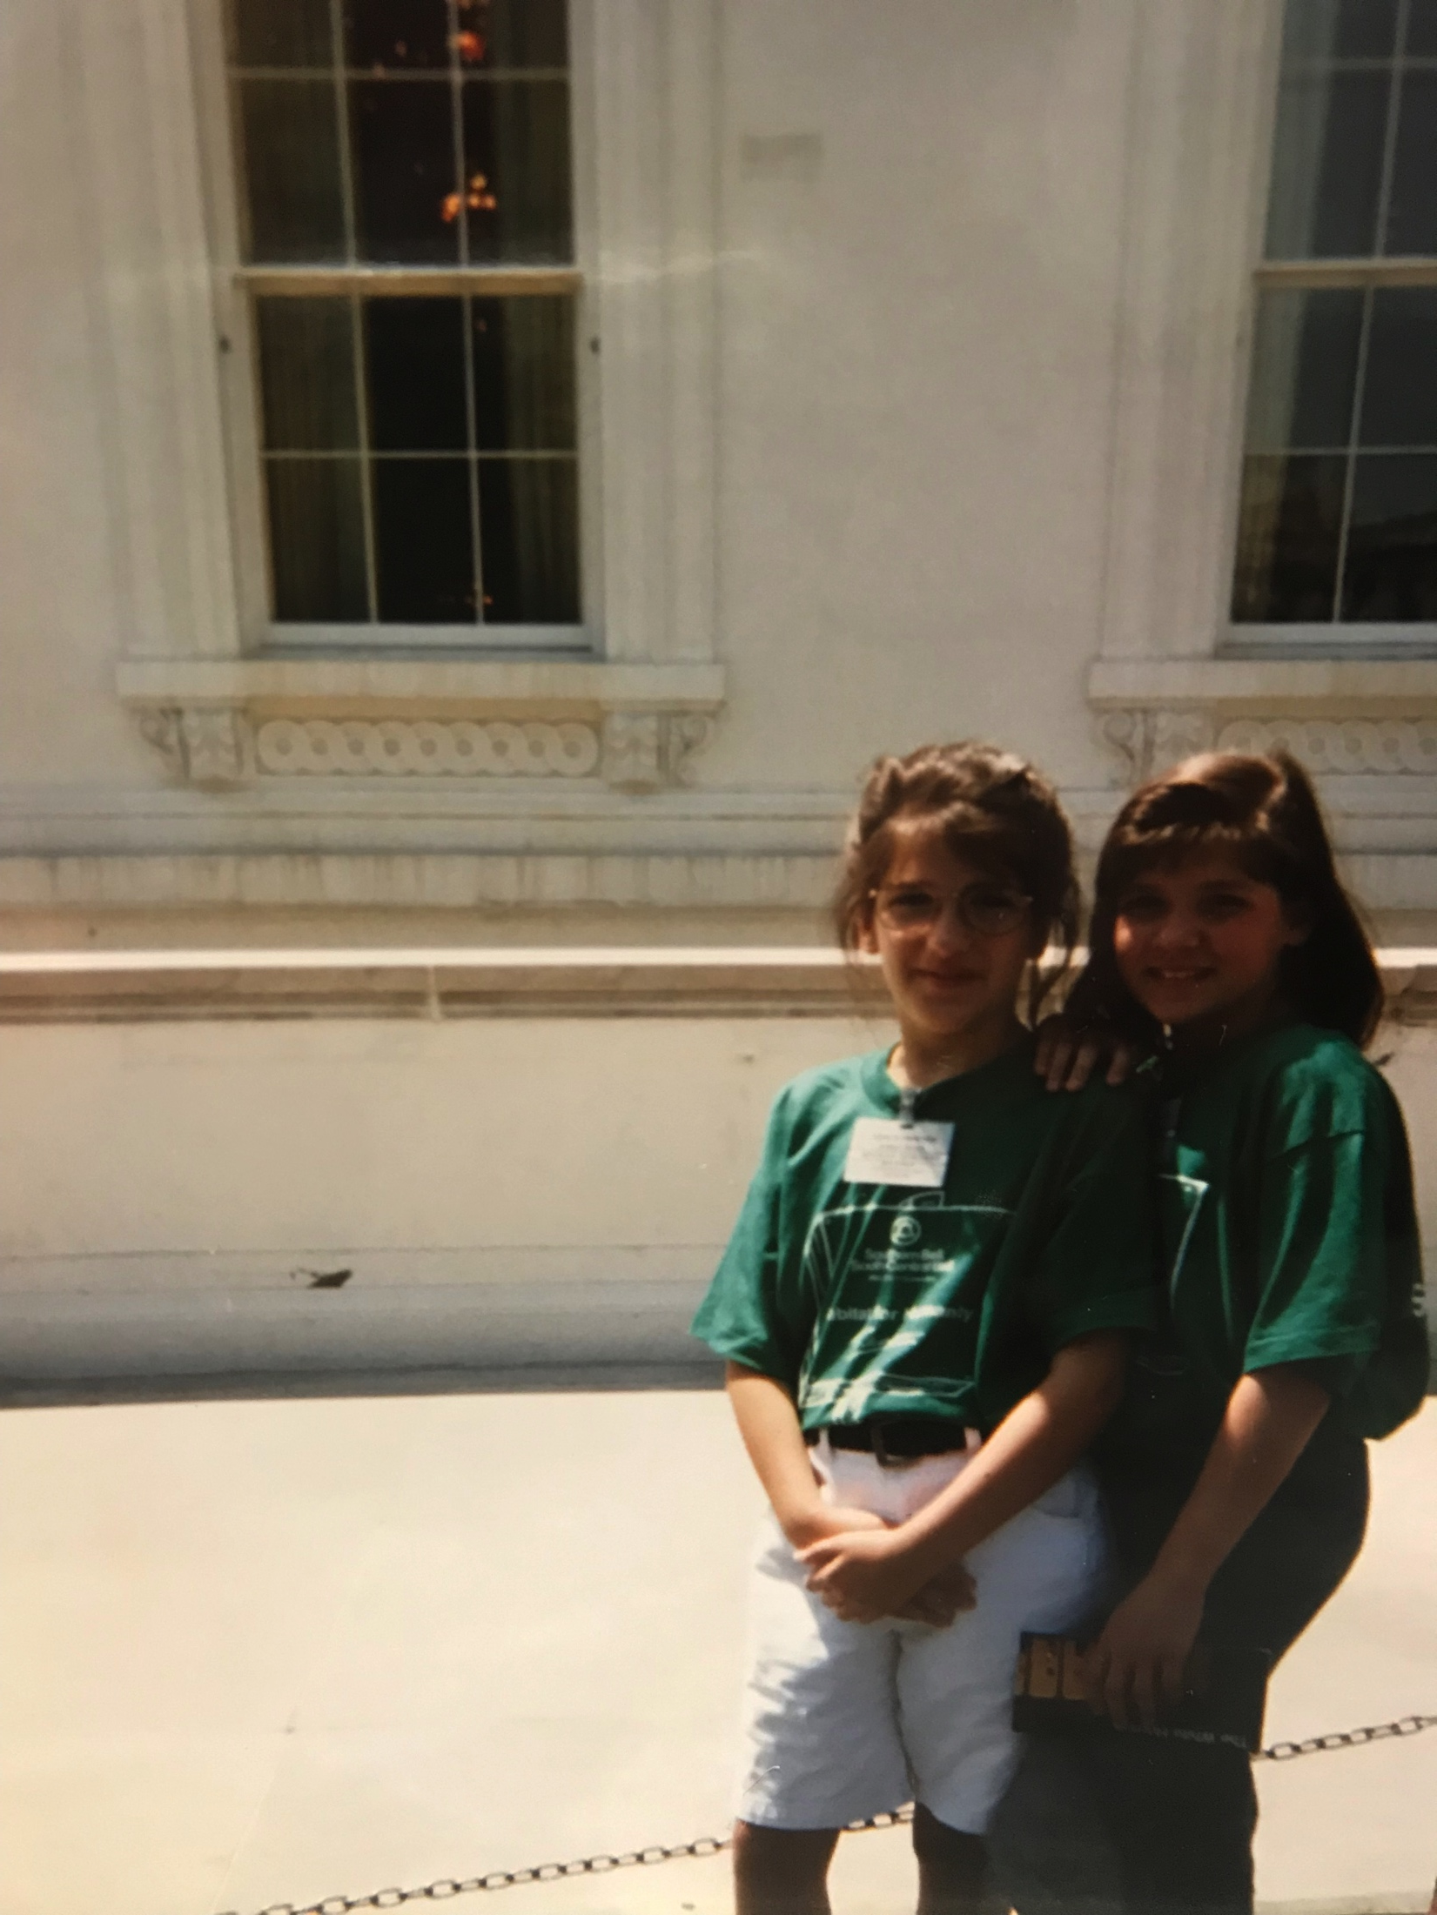
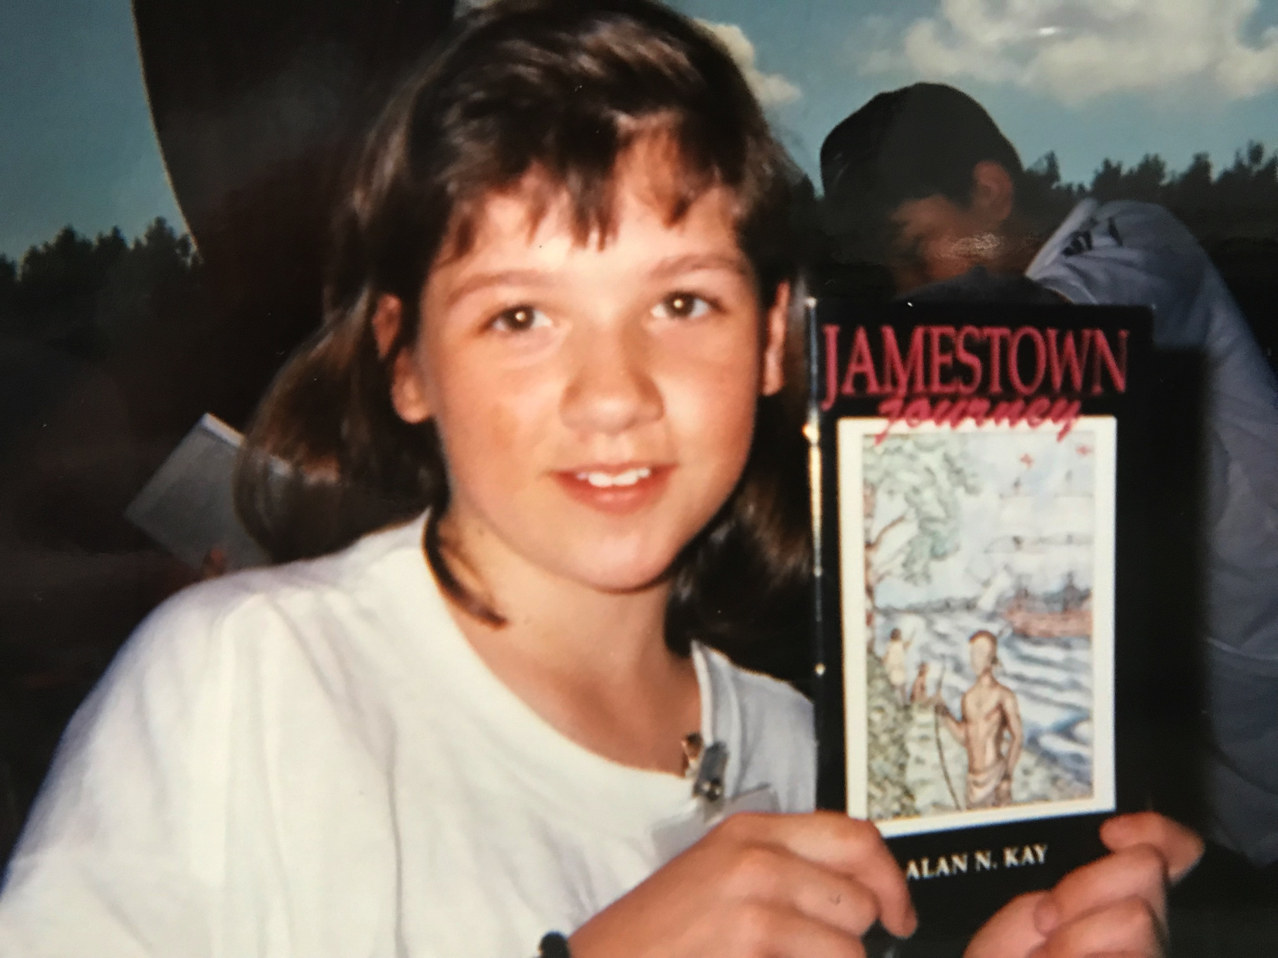
A Teacher’s Impact – My Educators Were EVERYTHING
Hand me-downs, holiday food baskets, trips to the movies, camp
Daily reading adventures
Hands-on & Choice
Real Life, Extended Learning Engagements
Washington, D.C.
Above and Beyond!
Notes:
Dr. Ford’s impact on me!
Boy was I lucky! That school year, Dr. Bobbi Ford – then Mrs. Ford – was my 5th grade teacher.
My experiences with Dr. Bobbi Ford is an especially cool and special story, so I thought I’d share it with you.
Dr. Ford brought life to everything in the classroom, and helped me to become the avid learner that I am today. She was the perfect mix of warm and demanding, and encouraged me in so many ways. She was a constant source of creativity, stability, and nurturing for every kid in her class, and it was especially powerful for me - a kid with a chaotic and unpredictable home life.
In the classroom, I fondly remember her reading to us every single morning from her rocking chair. It’s how we started our day. We read the entire Indian and the Cupboard series that year. I’ll never forget the feeling of the adventure, and the pride that came with having finished a series as a community.
In Dr. Ford’s classroom, we didn’t color maps of the world, we created and painted giant papier mâché globes that hung from the ceiling. When we wrote state reports, we chose how we created our model (I made a giant clay map of Maine, lol). We did not just learn about the explorers, we wrote essays from varying perspectives.
She also constantly advocated for us. In addition to helping us see different perspectives, I remember Dr. Ford ALWAYS entered our essays into contests! Whether the theme was fiction, opinion, historical, etc., she found opportunities for us to write for a real audience and purpose, and then submitted them. When I look back at my elementary portfolio now, it is full of narratives, essays, and reports that Dr. Ford neatly mounted onto construction paper and added to my student work file for safe keeping.
We were also a part of several REAL WORLD extended learning engagements! For the Colonial Fair, we churned butter, sewed dolls, braided and sewed rugs, and made candles. We proudly showed off our “expertise” and colonial garb at a fair outside with lots of visitors! When we studied economics, Dr. Ford conducted true bartering (with things we were willing to part with) and created a classroom business. Students bought shares in the company by submitting whatever $5-$20 we could scrape up on our own at home. We stamped painted designs onto carpet squares donated by a local company, and we sold the beautiful mats as Mother’s Day gifts at Morrow Elementary. I put in $7.12, and got back $21.50. I thought I was rich! I never forgot that economics lesson.
Dr. Ford won the National Miliken Educator Award, a $25,000 prize to do as you wish - no strings attached for how the money is spent, and she took our entire class to Washington, D.C. for a week in the Spring!!! (Boy was my twin brother annoyed with me! Lol) We took a charter bus, wore matching t-shirts donated from local companies each day, and toured every major monument, museum, and building, and visited Jamestown and Williamsburg in between! It was the furthest I had ever been from home. Dr. Ford opened my eyes in so many ways.
Dr. Ford’s heart is huge. In 5th grade, I won an art competition for welcoming the world to Atlanta for the 1996 Summer Olympics. My art was on display at the Twin Towers in downtown Atlanta and there was a reception for the contest winners, but I was unable to go because we didn’t have the money to get down there, mom was sick (she had been on a steady oxygen regimen since 1993), and we didn’t have a car anyway. Dr. Ford picked up me, my mom, and my brother and took us out to eat at Steak n’ Shake, and then to the reception downtown. I felt like a SUPER STAR! Then my mom had a panic attack and needed more oxygen. Again, Dr. Ford was there to save the day. She rushed down to the car in the far away garage to get the extra O2 tank for my mom. All was well. It was one of the first times I received special recognition, and it felt great. I learned that with hard work, and some help from those advocating for you, success was possible.

Slide 5
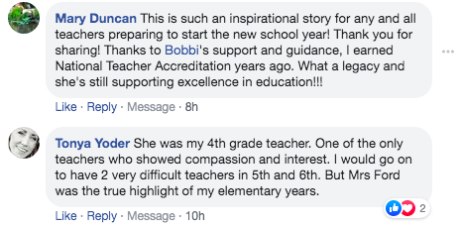
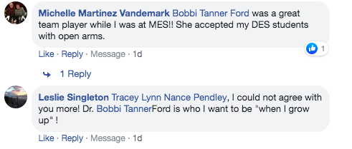
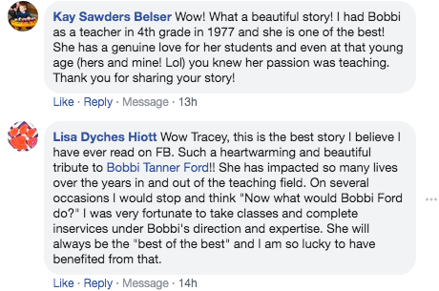
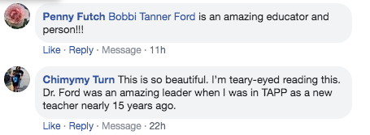
Dr. Bobbi Ford’s Seeds
Notes:
Ready for the even cooler part? Dr. Ford was named Georgia Teacher of the Year the year that I was in her 5th grade class. When I left the Sociology PhD program at the University of Chicago (and my $17,000 stipend & full scholarship) in 2007 to follow my heart into teaching for social justice, I wrote a letter to her to let her know how she had inspired me. Years later, I reconnected with her and presented her with flowers and a personalized super teacher cape at the Atlanta Teacher of the Year Banquet in November 2018. Twenty-four years after being in her class, she introduced me onto the stage, read my biography, and was there when I was named the 2020 Georgia Teacher of the Year. She is truly an inspiration, and the teacher exemplar I aim to model every day that I walk into my classroom. I want to bring MAGIC to my students the same way Dr. Ford did for me. I love that we are now in the Georgia Teacher of the Year Association together, a professional group that each year’s top 10 finalists join. I get to see her rather frequently! I love her to the moon and back. Thank you, Dr. Ford.
----- You can count the number of seeds in an apple, but you can’t count the number of apples in a seed!!!!!
Like many of the students we teach today, my twin brother and I relied heavily on our teachers and the stability that school provided. My teachers helped me strive for the top, modeled good character, and filled a myriad of other needs as well –
Taking me and my brother to the movies, providing hand-me downs, and event food baskets and gifts for us at holidays. They showed up for me – educationally – but in so many other ways as well.

Slide 6
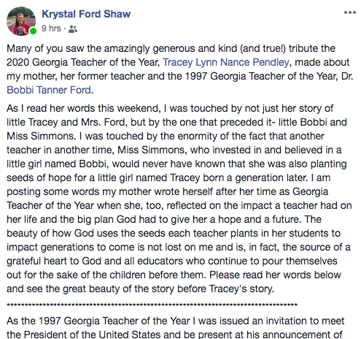
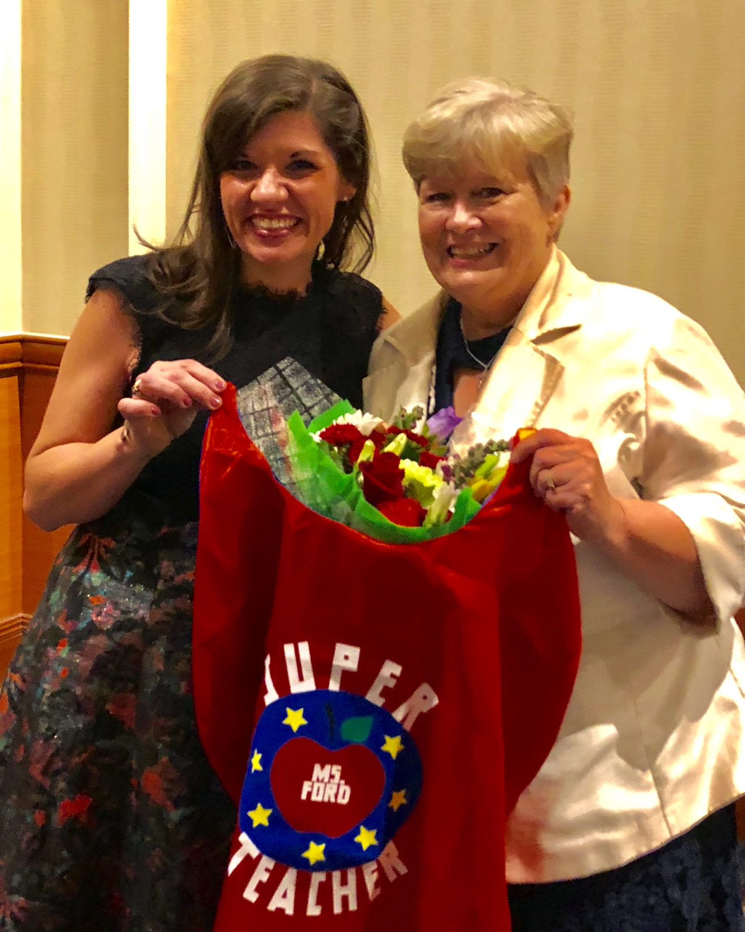
Thank You, Ms. Simmons

Slide 7
“You can count the number of seeds in an apple, but you can’t count the number of apples in a seed.”
- Karen Jenson
Notes:
I was an equity based training called iGroup recently, thinking about the students at school and my ability to reach my hardest to reach students. A new friend shared this quote with me. I think it captures the impact of our chosen career path and certainly, MY WHY.
I bet each one of us can think of an educator who made a positive impact in your life – whether as a student or as a teacher; When I count to three- let’s all speak their names into this space. The impact that the people in our lives have on us, stays with us.
And now here you are. Impacting the lives of countless students, families, and teachers. I’ve directly taught approximately 270 students during my last 10 years in the classroom, and about 400 students if we include my work with The Clubhouse Gang. But my impact doesn’t stop with those 400 --- It doesn’t even stop with the impact that those 400 students have on the people around them – it never stops. Our profession, our mission, our vision and our ability to make REAL POSITIVE CHANGE ----- is POWERFUL!!!!

Slide 8
EDUCATORS ARE
ESSENTIAL HEROES.

Slide 9
What do teachers need from leaders in this uncertain environment?
Lead the way you
want teachers to teach!
Notes:
I’m not a principal – I’m not an assistant principal - I’m a teacher, but we’ve all experienced a variety of leadership styles. We all know the principal who…..
--- keeps their door shut at all times
-- the one who doesn’t back their teachers up with parents
-- gives the same performance evaluations without ever having been in the room --- or worse, just copies and pastes the standard from the TKES rubric.
How do we take this impact that we know teachers have and expand it? How do we elevate teacher effectiveness in our classrooms, buildings, and districts? I’ve told you – I didn’t get here alone. There are key individuals who advocated for me along the way, and the my current leadership and Atlanta Public Schools has been a big part of my ability to impact students and teachers. The people in the room – your impact stretches far and wide, it is an awesome and humbling responsibility. I’ve learned 4 big takeaways, from a teacher’s perspective of course, that I hope will inspire you as you enter your new year!

Slide 10
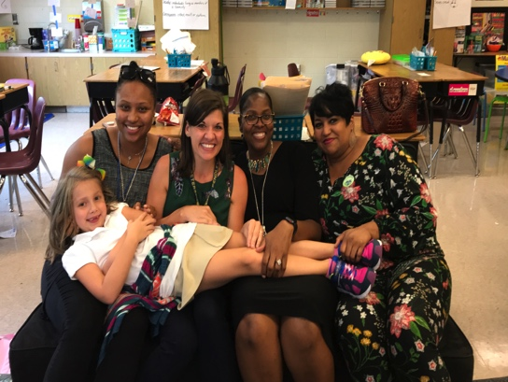
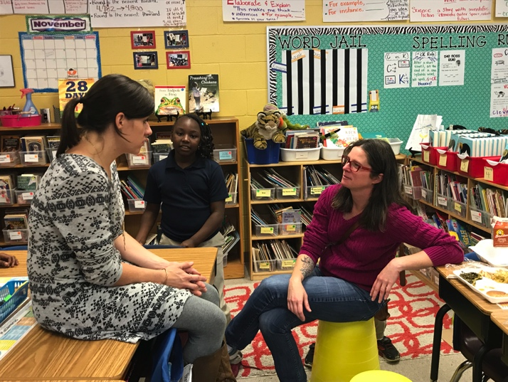
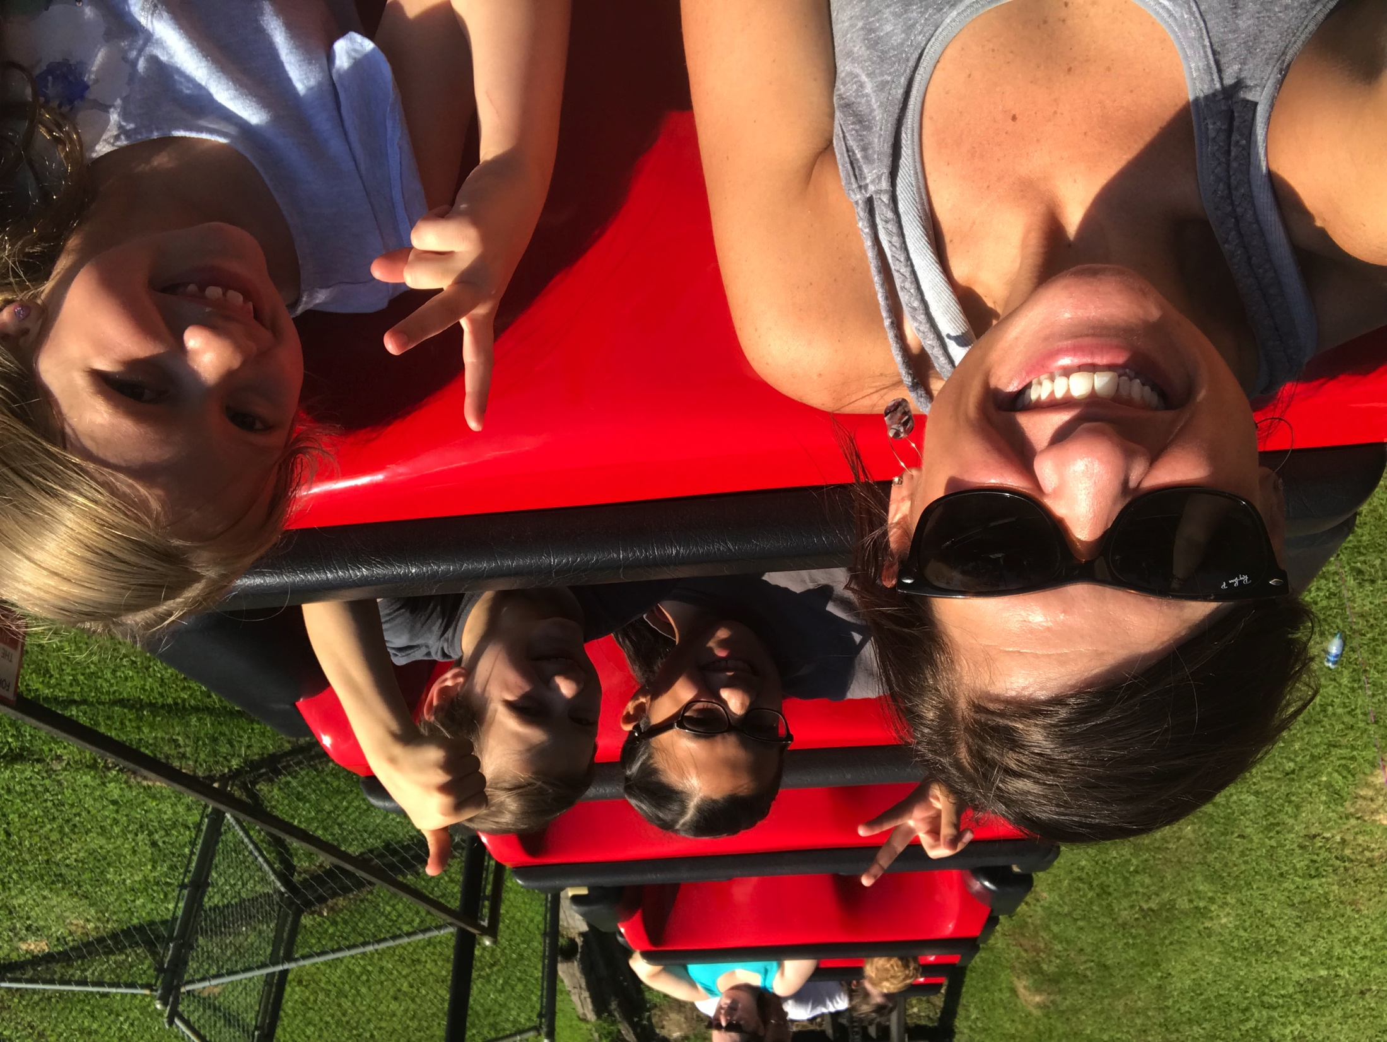
1) Think about how you SHOW UP
Relationships matter!
Teacher relationships: Connect!
Lead with your story, Lose the script
Be visible and vulnerable
Have an open door
Notes:
We know this. We as educators know that relationships are key – but we often don’t know how.
Lead with your story, and get to know their’s
Connect with your people! One of my goals in the morning is to check in with each kid before they get to the rug, and to high five them on their way out. My principal does this in a few ways.
Make your teachers feel heard and valued. People leave our presence either feeling better or worse. Think about it! It’s true.
Have your teachers’ back. “Michael” story if time

Slide 11
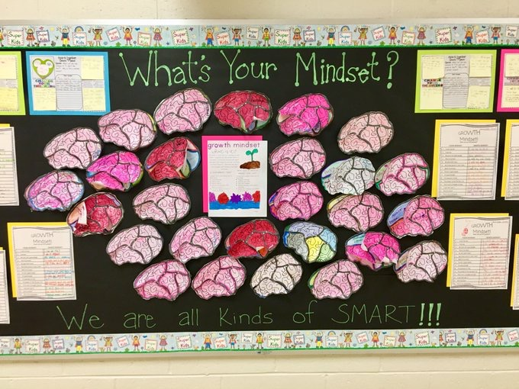
2) Focus on GROWTH
Specific and timely feedback builds trust – academics & behavior
Love your mistakes!
Get YOUR learning too!
“Ownership” vs. “Management”
What does “student-centered” actually mean?
Notes:
In my classroom, I want students to celebrate and learn from their mistakes.
What do we do when a baby falls down? We don’t scold them! We go yayyyyyyyy and encourage them to try again! Our students and teachers are no different.
-- Symone story: I had a student named Symone

Slide 12
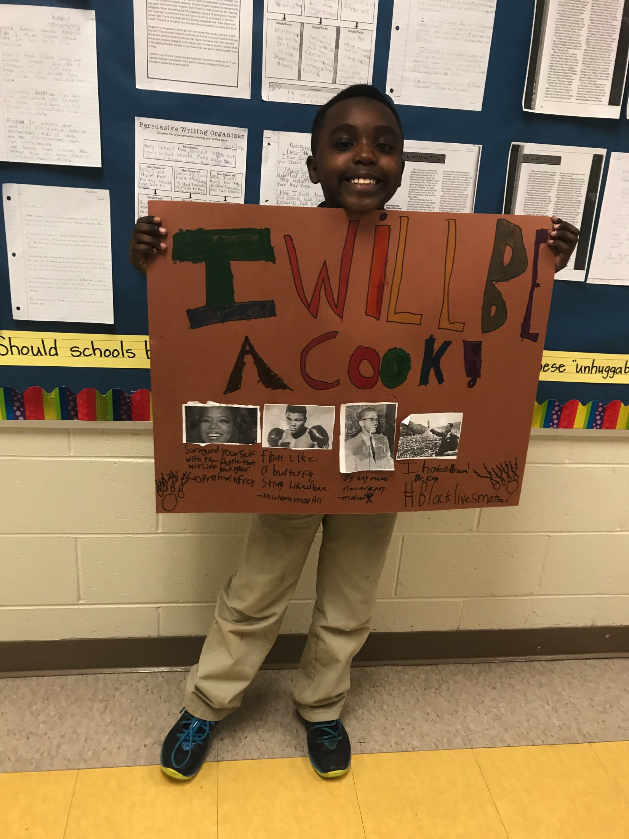
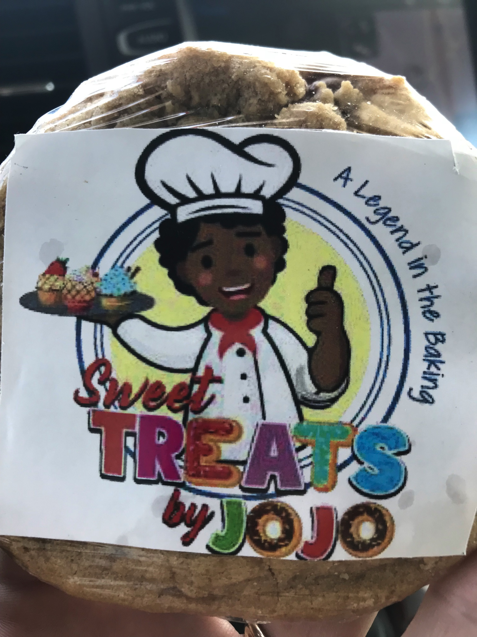
Focus on Growth!

Slide 13
3) Empower Teachers
Teacher-Buy-in & Trust – Include Them
Let data drive Professional Development/ PLCs
Training, Training, and Training!
Establish a clear vision for district/school-wide data use
School-wide discipline policy
Who’s at your table?
Notes:
In order to use data effectively in schools, we must be intentional about creating the right culture around it.
A no blame data culture that emphasizes safety and collaboration requires a growth mindset and relational trust.

Slide 14
GEORGIA’S TEACHERS WANT YOU TO KNOW…
We love our job!
The pay can make it hard.
We would all benefit from small class sizes.
We want to feel appreciated.
We want our expertise to be trusted.
We need more PD opportunities outside of our district.
We want to feel heard.
Our students mean the world to us.

Slide 15
Steadily Leading in an Uncertain Environment
“You can count the number of seeds in an apple, but you can’t count the number of apples in a seed.”
– Karen Jensen
Notes:
Like many of the students we teach today, my twin brother and I relied heavily on our teachers and the stability that school provided. My teachers helped me strive for the top, modeled good character, and filled a myriad of other needs as well –
Taking me and my brother to the movies, providing hand-me downs, and event food baskets and gifts for us at holidays. They showed up for me – educationally – but in so many other ways as well.

Slide 16
Tracey Nance Pendley 2020 Georgia Teacher of the Year 4th Grade Teacher & Instructional Mentor
2020gatoty@gmail.com
@2020GaTOTY
Georgia Teacher of the Year

