Slide 1
How Will History Judge Us?
Notes:
History is ripe with examples of companies that ignored the future.
Many of us forget that Kodiak developed a digital camera in the 70s or that Yahoo decided not to purchase Google or Facebook, instead deciding to be a media company.

Slide 2
Notes:
It almost goes without saying that the events of the past year will only accelerate the pace of change in the economy and civic life.

Slide 3
Notes:
Briefly, I want to speak today about the future in terms of systems.
What do our current systems incentive and why does it matter.
system is perfectly designed to get the results it gets. Demming

Slide 4
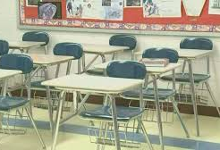
System Incentives
Coverage over Depth
Remediation over Mastery
Compliance over Creativity
Memorization over Transfer
Notes:
Read.
In education we are sometimes complicit being in love with the problem.
What does the future hold?

Slide 5
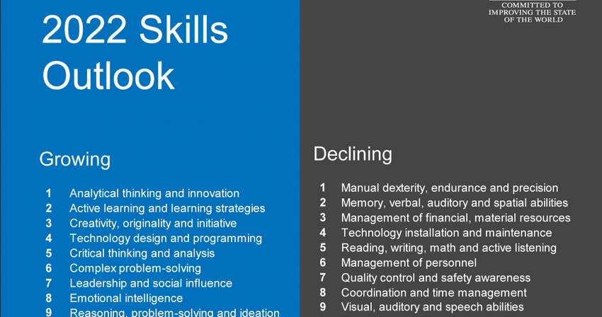
Notes:
Annually, the world economic forum publishes a skills outlook. Here is the skills outlook for 2022.
Let me drill down in to this a little.

Slide 6
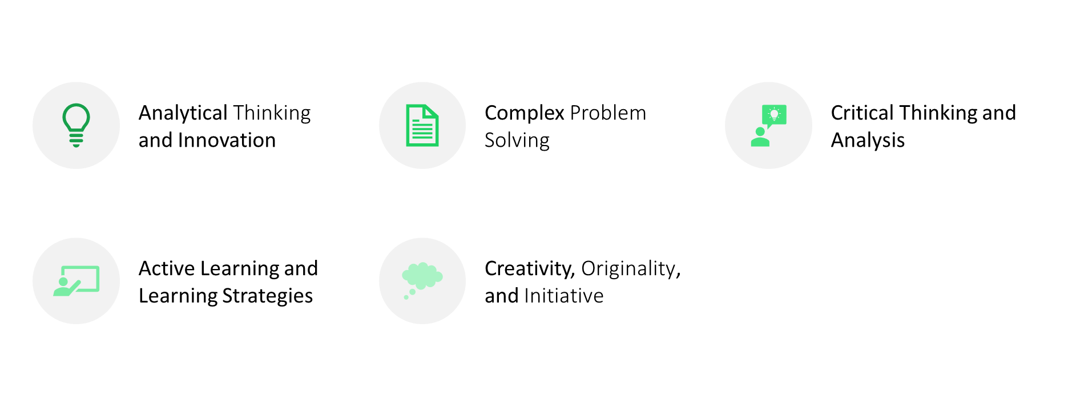
Growing
Notes:
Growing skills include complex problem solving, creativity and initiative.

Slide 7
Declining
Manual Dexerity, Precision, and Endurance
Memory, Verbal, Auditory, and Spatial Abilities
Reading, Writing, Math, and Active Listening
Notes:
Declining are skills that require physical attributes and most surprising is they suggest declining skills include reading, writing and math.
This sounds mad!
Lets explore why?

Slide 8
Notes:
Here's WHY

Slide 9
"In purely quantitative terms, 75 million current job roles may be displaced by the shift in the division of labor between humans, machines and algorithms, while 133 million new job roles may emerge at the same time."
https://www.weforum.org/agenda/2018/09/future-of-jobs-2018-things-to-know/
Notes:
As Thomas Friedman said at the turn of the century, if it can be automated it will.
Are we preparing students for the 133 million jobs created by the robot revolution?

Slide 10
The Growing Gig Economy
An estimated 35% of US workers
https://www.thimble.com/blog/gig-worker
Notes:
Notwithstanding the great wave of automation, now 35% of all workers are Gig workers, free-lancers, private contractors.
What skills and dispositions must students possess to successfully be their own bosses?
Are we designing learning experiences to develop them?

Slide 11
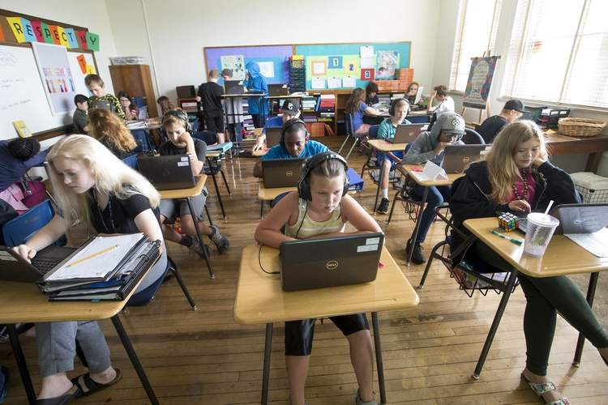
Math
Science
Social Studies
English
Content Mastery
Collaboration
Communication
Self-Direction
Creators/Producers
Notes:
Who is better prepared for the robot revolution and the gig economy.
How might we institute incremental changes to our instructional systems that have systemic impacts.

Slide 12
Ripple Effects
Capstone Experiences
Mastery Transcripts
Digital Portfolios and Badging
Graduate Profiles
Tyler Thigpin, The Institute for Self-Directed Learning
Notes:
I propose a few ideas that have ripple effects across all internal instruction systems and can fundamentally and incrementally transform teaching and learning.
The However to this is that there will come a time when your internal transformation efforts will stall because the system is not designed for deeper learning, thus we much change the external systems.
What are some of these systems?

Slide 13
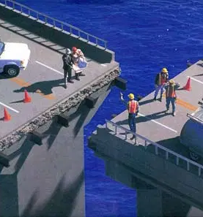
Challenging The Systems
Accountability System
Teacher Evaluation System
Teacher Preparation System
Notes:
If we think of these systems in terms of the incentives and consequences they explicitly or implicitly create, we are reminded that these are the very systems that stifle innovation. Please don't misunderstand me, we need these systems, but they must be designed for 2030, not 1930.
By design, for half of us in the room, the question is why change a system in which we are the winners?

Slide 14
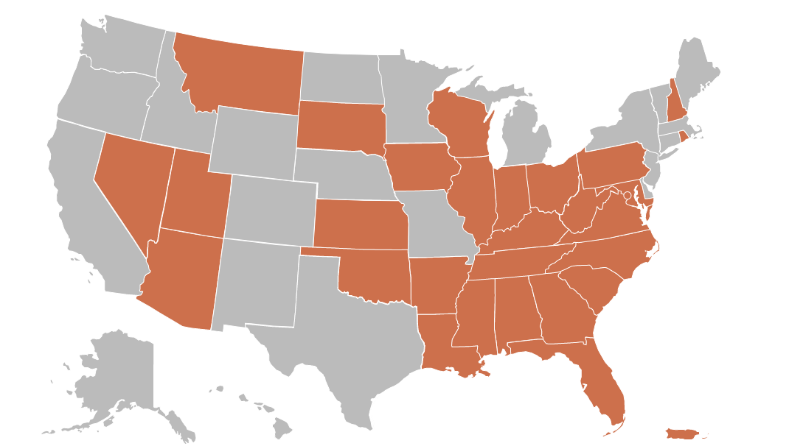
Notes:
Our ability or willingness to respond in a timely and meaningful way to changes to the demands of work and civic life is our greatest weapon against the ever increasing support for public money flowing to choice institutions.

Slide 15
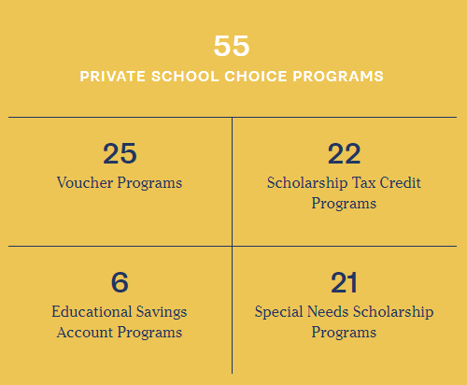
Notes:
ON both sides of the isle choice is gaining momentum.
Yet, we fight these annually by arguing choice schools don't play by the same rules established by the very systems that fail to meet the demands of work and civic life.
And, if you are wondering if this is so, ask your regional employers.

Slide 16
Notes:
So today I offer a call to action. But not the platitudes we have grown accustomed to but a call to begin the work. And it starts here.

Slide 17
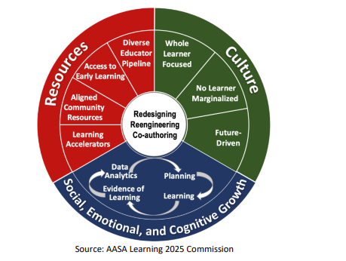
April 8, 2021

Slide 18
"We have an opportunity to finally bring our schools in to the future and transform them into nimble systems that can personalize and customize instruction and supports for ALL learners, while simultaneously restoring dignity and honor to teaching and reigniting the joy of learning for all."
AASA National Commission on Student-Centered, Equity-Focused Education
Notes:
I hope you will join me. It is my honor to have this opportunity.

