Slide 1
Georgia School superintendents’ association spring Bootstrap Conference legal issues update April 21, 2021
Phil Hartley
Harben, Hartley & Hawkins, LLp
340 jesse jewell parkway, suite 750
Gainesville, ga 30501
770-534-7341
770-654-3616
phartley@hhhlawyers.com

Slide 2
WHEN THE PANDEMIC IS OVER, WHAT WILL WE HAVE LEARNED?

Slide 3
Increased/Exacerbated Challenges for Schools*
Expanded decentralized adoption of noncompliant and non-privacy protective technologies
Expanded use of non-education products
Even more difficult to track adoption and use
Video and video recording issues
More monitoring of students
Health tracking
*Future of Privacy Forum
Notes:
DAVID

Slide 4
Increased/Exacerbated Potential Harms*
Amplifying the accessibility of information
Revelation of information that impacts how others see students/staff/
families
Information shared for an educational purpose and used for another purpose
Surveillance effects on learning and SEL
Invasion into the solitude of the home
*Future of Privacy Forum
Notes:
PHIL

Slide 5
FERPA -- The school official exception
School Official Exception – student personally identifiable information (PII) may be disclosed without consent to…
(1)(i)(A) … other school officials, … whom the agency or institution has determined to have legitimate educational interests.
(B) A contractor, consultant, volunteer, or other party to whom an agency or institution has outsourced institutional services or functions may be considered a school official under this paragraph provided that the outside party—
(1) Performs an institutional service or function for which the agency or institution would otherwise use employees;
(2) Is under the direct control of the agency or institution with respect to the use and maintenance of education records; and
(3) Is subject to the requirements of § 99.33(a) governing the use and redisclosure of personally identifiable information from education records.
(ii) An educational agency or institution must use reasonable methods to ensure that school officials obtain access to only those education records in which they have legitimate educational interests. An educational agency or institution that does not use physical or technological access controls must ensure that its administrative policy for controlling access to education records is effective and that it remains in compliance with the legitimate educational interest requirement in paragraph (a)(1)(i)(A) of this section.
34 CFR §99.31(1)(i)(A)
Notes:
PHIL

Slide 6
“ Direct control” may not exist if the vendor:*
Defines the data protected narrowly;
May share de-identified information;
May use student data to market or advertise to students or their parents;
May modify the terms of agreement at any time without notice or consent;
May collect or use data about the student beyond what is needed to fulfill the educational purpose;
May use student’s PII after it is no longer needed or after the district requires that it be deleted;
May not require their subcontractors to adhere to the terms of service;
May limit the district’s access to student information when requested;
May not mention security protections.
Notes:
PHIL
Narrowly defines the data protected by the policy, or retains the right to share protected data that the user is not knowingly providing to the service, such as metadata that may be personally identifiable;
May share de-identified information and has a broad definition of what constitutes de-identified information that would easily allow for re-identification;
May use student data to market or advertise to students or their parents or mine or scan data and user content for the purpose of advertising or marketing to students or their parents;
May modify the terms of agreement at any time without notice or consent from the school or district;
May collect data about the student beyond what is needed to fulfill the educational purpose (also a red flag if provider collects data from a third-party source if the student logs into the service through a third-party website, such as a social networking site);
May use data for any purpose other than the purpose for which the data was originally provided to the service provider without notice to users;
May use student personally identifiable information after it is no longer needed or after the school or district requires that that information be deleted;
May not require their subcontractors to adhere to the service provider’s terms of service;
Is claiming ownership over the student data or copyright or an irrevocable license to use student data or uploaded school or student user content;
May in any way limit the school or district’s access to student information when requested; and
May not mention security protections.

Slide 7
Covid leave in 2021
From January 1 through March 31Mandated Covid Leave Not Continued
Employers Are Allowed to Voluntarily Continue Covid Leave
Private Employers Are Entitled To Tax Credit to Reimburse for Decision to Keep Paying Leave
Public Entities (School Districts) Not Included in Tax Credit Entitlement

Slide 8
American rescue plan – 4/1/21 – 9/30/21?
Continues the Voluntary Extension of EPSLA and EFMLA and Tax Credits
Adds Additional Reasons for EPSLA
Awaiting Results of Covid Test
Getting a Covid Vaccination
Recovering from Condition Related to Vaccination
Any of the EPSLA reasons now qualify for EFMLA, and EPSLA 80 Hours Starts Over
Removes the Exclusion of Governmental Entities
So What Would a Tax Credit Mean?

Slide 9
Covid 19 and the ada/section 504
Like All Issues Dealing with Disabilities in the Workplace, Many Have to Be Analyzed on an Individualized Basis
In General, Having COVID 19 or Being Exposed to It Are Probably Not Qualifying Conditions under ADA, but having a condition that puts an employee at Greater Risk for COVID probably is, either ADA or ADEA
But Being Afraid of COVID 19 Probably is Not a Qualifying Condition
Retaliation for Taking Leave Under the New Acts is Prohibited
When is Teleworking a Required Accommodation? An Acceptable Accommodation? How Is That Going to Change Over Time?

Slide 10
Disabled students: virtual or in person?

Slide 11
Tech access – Us DOE q&a, 3/20
If an LEA closes its schools to slow or stop the spread of COVID-19, and does not provide any educational services to the general student population, then an LEA would not be required to provide services to students with disabilities during that same period of time. Once school resumes, the LEA must make every effort to provide special education and related services to the child in accordance with the child’s individualized education program (IEP) or, for students entitled to FAPE under Section 504, consistent with a plan developed to meet the requirements of Section 504.
If an LEA continues to provide educational opportunities to the general student population during a school closure, the school must ensure that students with disabilities also have equal access to the same opportunities, including the provision of FAPE.
If a public school for children with disabilities is closed solely because the children are at high risk of severe illness and death, the LEA must determine whether each dismissed child could benefit from online or virtual instruction, instructional telephone calls, and other curriculum-based instructional activities, to the extent available. In so doing, school personnel should follow appropriate health guidelines to assess and address the risk of transmission in the provision of such services. The Department understands there may be exceptional circumstances that could affect how a particular service is provided.
If a child does not receive services during a closure, a child’s IEP team (or appropriate personnel under Section 504) must make an individualized determination whether and to what extent compensatory services may be needed, consistent with applicable requirements, including to make up for any skills that may have been lost.
Notes:
SONJA

Slide 12
Is remote learning necessarily an infringement of an in-person IEP?
U.S. Department of Education (March 21, 2020):
To be clear: ensuring compliance with the Individuals with Disabilities Education Act (IDEA), Section 504 of the Rehabilitation Act (Section 504), and Title II of the Americans with Disabilities Act should not prevent any school from offering educational programs through distance instruction.
School districts must provide a free and appropriate public education (FAPE) consistent with the need to protect the health and safety of students with disabilities and those individuals providing education, specialized instruction, and related services to these students. In this unique and ever-changing environment, OCR and OSERS recognize that these exceptional circumstances may affect how all educational and related services and supports are provided, and the Department will offer flexibility where possible.
However, school districts must remember that the provision of FAPE may include, as appropriate, special education and related services provided through distance instruction provided virtually, online, or telephonically.
Notes:
SONJA

Slide 13
Endrew F. v. douglas county school district – USSC (2017)
“To meet its substantive obligation under the IDEA, a school must offer an IEP reasonably calculated to enable a child to make progress appropriate in light of the child’s circumstances.”

Slide 14
Virtual Instruction
Where the school building is closed and virtual education is only option, fape must still be provided and discussion should be about how to implement the IEP in the virtual setting; to the extent some services are simply not possible, document that fape is still being provided and how to account for services not provided at current time
Develop a virtual plan (digital learning plan, etc.) which describes how the implementation will be carried out
Where the school is offering a virtual option to all students, must offer the same to disabled students; but part of the circumstances is now the parent’s request for virtual option
If the virtual instruction does not provide FAPE as it would in the brick-and-mortar setting, document that as well – provide notice that this is only FAPE to the extent possible in this setting given the circumstances and the parent’s request; where there is this disagreement hold meeting and probably provide pwn

Slide 15
Compensatory services: disabled students and regressing students

Slide 16
Compensatory or remedial Educational Services
Remedial programs generally offered based on academic regression and available to all students meeting criteria
Supplemental (i.e., summer) programs often available without qualifying criteria
Look at whether a student’s disability prevented him/her from accessing virtual services during school closure and whether a student’s disability prevented him/her from making progress – if so, individualized compensatory services required
Conduct benchmark assessments or progress monitoring to determine where students stand currently; necessary for disabled students, useful for all

Slide 17
ISSUES FROM THE GENERAL ASSEMBLY

Slide 18
Important Changes Beginning July 1, 2021 O.C.G.A. §20-2-51(E)
Adds to eligibility requirements:
Has completed all prior annual training requirement established by the local board of education and the State Board of Education pursuant to Code Section 20-2-230 if such person is eligible for reelection as a member of the local board of education.

Slide 19
Important Changes Beginning July 1, 2021 O.C.G.A. § 20-2-58
It shall be the duty of each local board of education to hold a regular meeting during each calendar month for the transaction of business pertaining to the public schools and to review the financial status of the local school system….
The State Board of Education shall create a template for local boards of education to use to review the financial status of their local school systems, which shall include at a minimum, a statement of revenues, expenditures, and encumbrances.

Slide 20
Important Changes Beginning July 1, 2021 O.C.G.A. §20-2-103
Before entering upon the discharge of his or her duties, the local school superintendent shall take and subscribe to the following oath of office:
>>>
That I am not the holder of any unaccounted for public money due this state or any political subdivision or authority thereof and that I will manage the finances of the local school system in compliance with all applicable laws and regulations.
>>>

Slide 21
Important Changes Beginning July 1, 2021 O.C.G.A. § 20-2-67
… The Department of Audits and Accounts shall designate local school system that had had reported irregularities or budget deficits for three or more consecutive years as high-risk local school systems and … for one year or two consecutive years as moderate risk local school systems.
… The superintendent shall submit to the DOE a response to the findings and a corrective action plan approved by the local board of education at a board meeting within 120 days of receiving notice of designation…
Must be addressed in flexibility contract
SDOE shall monitor and provide support and guidance.
Superintendent has to complete training

Slide 22
Important Changes Beginning July 1, 2021 O.C.G.A. § 20-2-61
… It shall not be the role of the local board of education or individual members of such board to micromanage the superintendent in executing his or her duties, but it shall be the duty of the local board to hold the local school superintendent accountable in the performance of his or her duties;
Provided, however, that requesting and reviewing financial data and documents shall not constitute micromanagement.

Slide 23
Important Changes Beginning July 1, 2021 O.C.G.A. § 20-2-58
(b) Each local board of education shall provide a public comment period during every regular monthly meeting. Such public comment period shall be included on the agenda required to be made available and posted prior to the meeting pursuant to paragraph (1) of subsection (e) of Code Section 50-14-1. A local board of education shall not require notice by an individual more than 24 hours prior to the meeting as a condition of addressing the local board during such public comment period. The chairperson of the local board of education shall have the discretion to limit the length of time for individual comments and the number of individuals speaking for or against a specific issue.

Slide 24
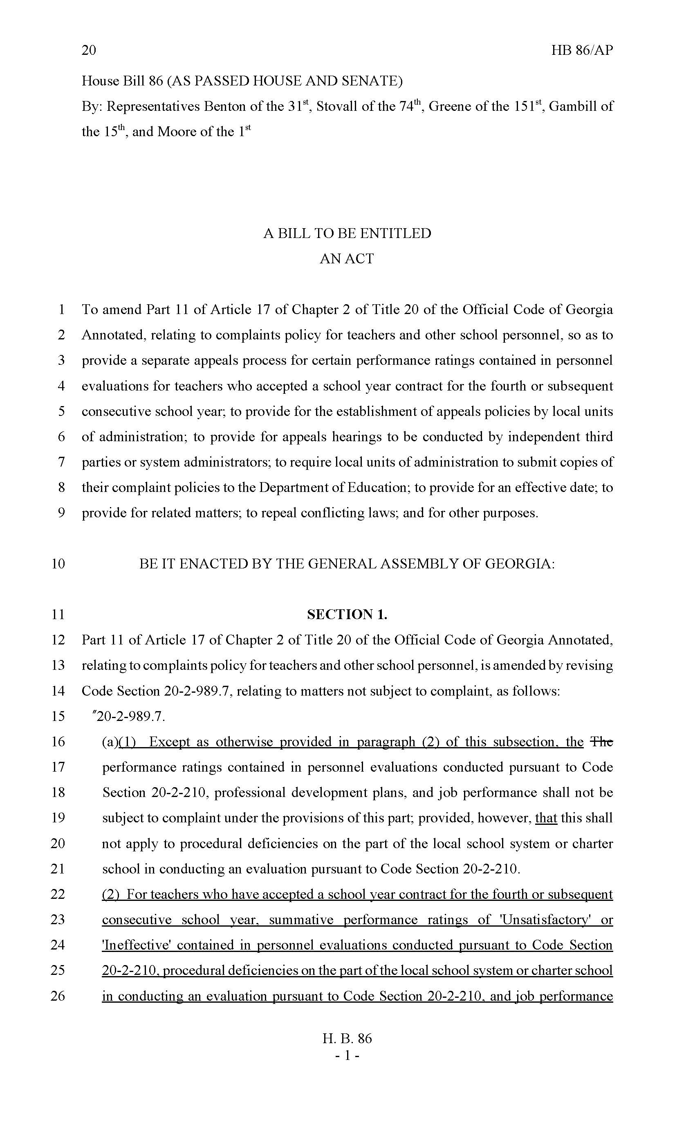
O. C. G. A. § 20-2-989.7 H. B. 86 (2020)
Adds to the State Mandated Grievance Statute a “tenure lite” provision
After 4 contracts can appeal summative ratings of U or I, procedural deficiencies and “job performance”
LUA shall establish appeals policy and submit to SDOE by 7/1/21

Slide 25
This year’s general assembly: the good, the Bad and the ugly

Slide 26
Amends Existing Georgia Special Needs Scholarship Act – SB 47
One year attendance requirement waived if Student qualifies for scholarship if:
Parent is Active Military
Adopted from foster care
Previously qualified
Special Rules for 19-20 and 20-21
Eligibility based on Student having an
IEP
Section 504 Plan for 21 specific conditions or others as determined by SBOE
Parents must receive notice of “Scholarship” when child’s eligibility for IEP/Section 504 Plan is determined
Right to Public School Choice where there is Space or Appropriate Program
Parents waive rights under IDEA and section 504 by accepting Scholarship

Slide 27
SB 51- Dexter Mosley Act
Home Study students grades 6-12 are eligible to participate in “extracurricular or interscholastic activities”:
Parent/guardian provides written notice, at least 30 calendar days before first school day of semester
Must state intent of student to participate in specific activities
Include student’s annual progress assessment report and written verification of academic progress
Home Study student enrolls and attempts to complete one course (virtual, dual-enrollment, onsite)
Must meet all eligibility requirements that public school students do: age, physical, residence, academics
Must comply with code of conduct
Must participate in tryouts and if competitive be selected
A student who withdraws from a public school to participate in home study program shall be ineligible for participation in any extracurricular or interscholastic activity for 12 months from the date of the declaration of intent to utilize a home study program provided to the Department of Education as provided under paragraph (2) of subsection (c) of Code Section 20-2-690; provided, however, that such 12 month restriction on eligibility may be waived due to hardship according to the same rules and procedures applied by a resident school, a resident school system, or an athletic association to receive, review, and grant or deny hardship waiver applications on behalf of students who attend public or private schools.

Slide 28
HB 146 Paid Parental Leave
A full time certified or classified employee may get a maximum of 15 paid school days of parental leave for:
Birth of a child
Placement of child for adoption
Placement of foster child
Must have worked 700 hours over the preceding 6-month period
15 days total during a rolling 12-month period
Available to each parent
Cannot be paid for unused leave

Slide 29
Parental Leave
Each Board of Education shall create rules governing the leave
Can run concurrent with other Federally required leave – think FMLA
What kinds of documentation will the District require?
Incremental leave

Slide 30
HB 32 – teacher recruitment and retention
Qualifying teachers eligible for $3,000 tax credit for no more than 5 consecutive years
SBOE to establish program to recruit and retain teachers in high need subject areas in qualifying schools
100 participating schools from lowest 5% schools in rural territory, up to 1000 participating teachers
High need subject area to be established within resa areas based on specific criteria
Applications to DOE and local schools may access those, documentation required for tax credits

Slide 31
SB 159
Local Board of Education may use a motor vehicle with a capacity of eight persons or less operated and marked for the transportation of special education or homeless school children to and from school and school related activities
Federal and state prohibitions against 15 person vans still apply

Slide 32
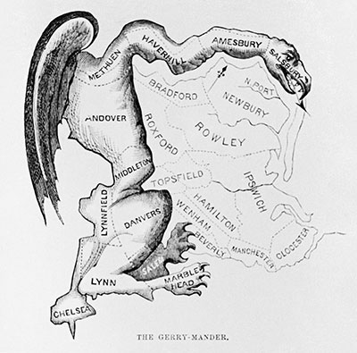
O.C.G.A. § 20-2-690
Local reapportionment legislation must be drawn or approved by the Legislative and Congressional Reapportionment Office
Member of local delegation must provide letter of sponsorship authorizing Office staff to work with local government entity to prepare plan or to review plan created separately
Otherwise, bill must have letter attached stating it cannot be certified and why
Redistricting predictions and plans: State and Local

Slide 33
Questions?!

