Slide 1
Georgia School Superintendents Association Spring Bootstrap Conference Legal Issues Update April 18, 2019
Phillip L. Hartley Harben, Hartley & Hawkins, LLP
340 Jesse Jewell Parkway, Suite 750
Gainesville, GA 30501
Telephone: (770) 534-7341
phartley@hhhlawyers.com

Slide 2
ISSUES FROM THE GENERAL ASSEMBLY

Slide 3
SB 15 Keeping Georgia’s Schools Safe Act
Site Assessments each 5 years by trained individuals or government agencies
Safety plans reviewed and updated annually “as necessary,” submitted to SDOE after approval by law enforcement “designated as having approval authority by LBOE.” List of approved plans posted online
Mass casualty drills at least once a year, student participation discretionary
LBOE annual report to the public, including funding
Principal or designee serves as school safety coordinator who shall issue report, coordinate, “when reasonable suspicion of violent criminal activity exists, report to law enforcement”
Post paper and website display of GBI reporting app; GBI with enhanced role in these emergencies
3

Slide 4
SB 60 Sudden Cardiac Arrest
SDOE or GHSA to develop and post educational guidelines and videos
School shall hold informational meeting twice per year, information sheet shall be provided
Student who faints shall be removed, shortness of breath, dizziness, racing heart, fatigue may be removed, shall notify parents
Coaches must review guidelines and videos once a year
Shall not create liability
3

Slide 5
HB 530 Home School Reporting
SDOE now providing declarations to local system
If withdrawn for 45 days without declaration, local system notifies DFACS
3

Slide 6
SB 48 Dyslexia
12/1/19 – SDOE prepare information handbook
7/1/20 - SBOE policies that provide screening “in collaboration” with RTI
20-21 – 3 year pilot program for at least 3 systems
24-25 – LEA shall screen all K students for dyslexia, may screen for other disorders; shall screen all 1-3 students id’d through RTI; report data each year
SDOE and PSC to update professional development and provide endorsement
3

Slide 7
HB 478 Child Abuse Registry
Now involves notice and right to hearing before placement on registry
Notice to D.A. to protect criminal cases pending
Procedure to seek expungement three years or more after listing
3

Slide 8
HB 459 Bus Driver’s Data Base
LBOE shall furnish names and driver’s license numbers of all bus drivers, twice a year; DPS maintain data base on status of license and immediately notify LBOE when suspended or revoked
Also allows nonsworn law enforcement employees to do traffic control with one hour of training
3

Slide 9
HB 311 Immunity
Waives immunity as to constitutional claims against the state
Waives immunity as to nonmonetary claims against cities and counties but not school districts
3

Slide 10
SB 177 Redistricting
Formalizes process anticipating 2020 Census
Plan must be drawn or approved by Reapportionment Office
Board must have letter of endorsement from local legislator to submit to Reapportionment Office
Statute suggests Board must vote to accept plan
Legislative passage and Governor’s signature

Slide 12
Title ix: sexual harassment regulations
Comment period over – Regulations Not Final
More limited definition of sexual harassment consistent with court cases, but not consistent with state law
Limits school Title IX responsibility to incidents on campus, bus or during a school program
Give both “parties” access to evidence
Presumption of innocence for the accused
Emphasis on fairness and due process for both sides

Slide 13
Practical effect of regulations
Fewer Title IX investigations, but investigations will be more complicated and “legal”
Rewriting of Code of Conduct and difficulty dealing with language in state law on sexual harassment and Title IX
What will be the effect on student discipline decisions and need to clarify specific charges
What effect does this have on Title VI and 504 harassment claims?

Slide 14
Practical effect of regulations
Fewer Title IX investigations, but investigations will be more complicated and “legal”
Rewriting of Code of Conduct and difficulty dealing with language in state law on sexual harassment and Title IX
What will be the effect on student discipline decisions and need to clarify specific charges
What effect does this have on Title VI and 504 harassment claims?

Slide 15
A New Approach to OCR Complaints
Resolution over investigation
Addressing issues rather than punishment
Some argue no emphasis on enforcement
Clearly less emphasis on advocacy of specific issues
Notes:
Focus on new OCR here

Slide 16
March 2018
Appeals reinstated
Pattern complaints reinstated
Copy of the complaint will be provided with complaint
Introduces First Amendment principles
Appeals eliminated
Will not accept complaints that are part of a pattern
Gave OCR greater authority to dismiss complaints
Copy of the complaint provided upon request
November 2018

Slide 17
What Can Be Disclosed under FERPA now?
Health Emergency
&
Safety Emergency
Law Enforcement Records
Personal Knowledge or Observation
“If the educational agency or institution determines that there is an articulable and significant threat to the health or safety of a student or other individuals…”
“it may disclose information from education records to any person whose knowledge of the information is necessary to protect the health or safety of the student or other individuals.”
Investigative reports and records that are created and maintained by law enforcement units
Information learned through personal knowledge or observation
34 CFR § 99.36(c)
34 CFR § 99.36(c)
34 CFR § 99.8
FERPA only applies to educational records

Slide 18
Other FERPA provisions that relate to safety and sharing of information
Directory Information
Who is a School Official and What is Their Role?
WORK IT OUT IN ADVANCE!

Slide 19
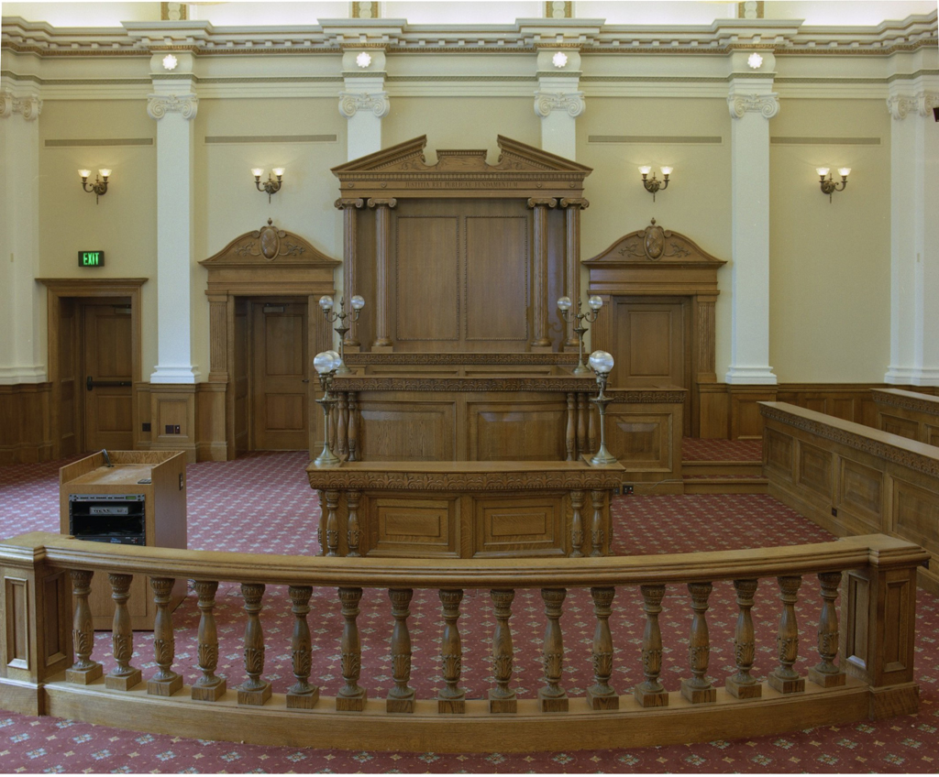

Slide 20
Friedenberg v. school board of palm beach county – 11th circuit (2018)
Requirement that all applicants for substitute teaching positions have to pass a drug test before being hired
Says that T.L.O. establishes that public schools are unique and this case lies at the intersection of student search cases and safety sensitive position cases
“Suspicionless searches are permissible in a narrow band of cases where they serve sufficiently powerful and unique public needs. The force of these needs depends heavily on the context in which the search takes place.”
Only applies to substitute teachers, but……

Slide 21
GAEL Fall Legal Issues Workshop
November 4, 5 and 6, 2019
Georgia Center
Athens, Georgia
ONLY ONE OF THE YEAR!

