Slide 1
GEORGIA BUREAU OF INVESTIGATION
GEORGIA INFORMATION SHARING
& ANALYSIS CENTER
Multi-Disciplinary Threat Assessment Teams
Presented by:
Andy Mossman, Assistant Special Agent in Charge
April 17, 2019

Slide 2
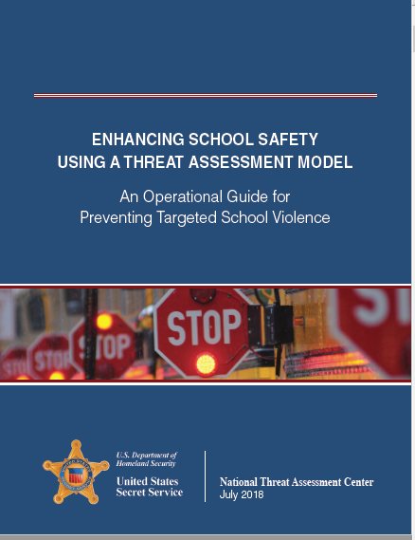
The Secret Service Approach to school safety
Establish a multi-disciplinary team
Define concerning and prohibited behaviors
Create a central reporting mechanism
Determine the threshold for law enforcement intervention
Establish assessment procedures
Develop risk management options
Create and promote safe school climates
Conduct training for all stakeholders

Slide 3
Step 1A: Establish a system-wide oversight board
Utilize an oversight board (Threat Assessment Review Board) consisting of those who have a stake in critical incident response
Using a board engenders transparency, collaboration, and partnerships while minimizing liability by encouraging objectivity
The Board is responsible for:
Establishing school safety policies and procedures
Conducting objective quarterly reviews of system-wide threat assessments
Reviewing and approving school safety plans, site evaluation results, and climate surveys
Reporting and maintaining school safety data in accordance with all applicable laws
Providing system-wide oversight of school safety matters
Reporting threats to Department of Education
At a minimum, the Board should consist of:
Superintendent (board chairperson)
Sheriff or Chief of police
Counselor or community services representative
School board representative,
Fire/Emergency Services representative
***Or use School Climate Board as defined under O.C.G.A. §20-2-690.2

Slide 4
Step 1B: Establish a multi-disciplinary threat assessment team
At a minimum, a school, threat assessment team (aka “Action Team”) should be comprised of the principal, a law enforcement officer with jurisdiction over the school, and a mental health or community services professional.
School principals or their designee should serve as the safety coordinator for the Action Team at their respective schools (Senate Bill 15)
At-large members should be involved in the threat assessment process when and as appropriate
The Action Team is responsible for school-threat detection, assessment, and response based on clearly established system-wide protocols

Slide 5
Step 2: Define concerning and prohibited/risk behaviors
The focus of all threat assessments should be protecting human life and promoting the education and wellness of the school family.
Threat assessments should not be utilized merely for absenteeism, poor academic performance, or routine/minor disciplinary issues.
Threat assessment can be applied to anyone who engages in or is impacted by a prohibited behavior
Consider the following for inclusion in your list of prohibited behaviors requiring a threat assessment:
An individual has expressed or implied a threat of violence to themselves or others
An individual has exhibited significantly disruptive or potentially criminal behavior or has been expelled
An individual has demonstrated or expressed a need for assistance or intervention for health, wellness, or safety reasons (i.e. family crisis, bullied/bully)

Slide 6
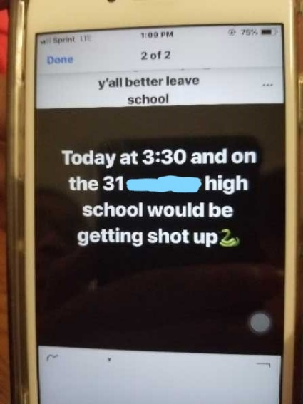
Step 3: Create a central reporting mechanism
Define the technologies that will be utilized
Establish protocols governing how the information is processed, documented, disseminated, and retained*
Consider legal requirements for reporting and the stakeholders who may have a need/right to know.
The See Something, Send Something mobile application supports school threat reporting in Georgia and is available at NO COST.

Slide 7
Steps 4-6: Building threat assessment protocols
Develop and utilize a threat assessment tool (i.e. GBI Violence Risk Appraisal)
Include a scoring component to establish behavioral-based risk levels, as well thresholds for intervention, protective, and law enforcement actions
Include risk-based response protocols and intervention options governed by those pre-defined threshold scores
Establish record retention, dissemination, and review protocols to limit liability and enhance mitigation strategies

Slide 8
Steps 4-6: Building threat assessment protocols
Consider how the tool balances risk-mitigation with student-wellness
Does the tool memorialize the risk-factors that were observed and considered at the time the assessment was completed?
Does the tool establish thresholds for required action based upon observed risk factors?
Does the tool memorialize the available risk-based intervention options that were considered?
Does the tool memorialize the decisions and actions that were implemented as a result of the assessment?
Does the tool specify how and when threat assessment information should be retained and establish clear dissemination protocols?
Notes:
-Again, the focus of all threat assessments should be protecting human life and promoting the education and wellness of the school family. Therefore, your threat assessment tool should be carefully constructed to balance the need to help and protect an at-risk student with the need to help and protect the school family as a whole.
-The threat assessment tool or document is an effective means to objectively assess risk and guide consistent decision-making with regard to the implementation of appropriate intervention strategies.
-The tool should direct specific proscribed action by school safety stakeholders when certain conditions have been met.
-All factors included in the tool to assess risk should be based upon behaviors, which extensive research has shown to be present in a multitude of incidents of Targeted School Violence, as well as behaviors evidencing a serious and significant risk to student health, safety, or wellness. The factors under consideration should not change from person to person or incident to incident and should NEVER be based exclusively on race, religion, ethnicity, gender, sexual orientation, or age.
-Potential intervention thresholds and options should be listed on the form, and the form should clearly denote which options were selected and implemented as a result of the assessment. The tool serves to memorialize those intervention efforts and minimize the school’s liability by ensuring that appropriate intervention actions have been implemented.
-The tool should identify who must be notified of a particular threat, the conditions requiring notification, and denote the date/time and details concerning when and to whom the notification was made. It should also denote when, what, and to whom information regarding the threat may be released, as well as where the completed threat assessment tool or document should be maintained following completion.

Slide 9
Steps 7-8: School climate & safety training
Use your oversight board to evaluate climate surveys and develop solutions to improve school climate
Use completed threat assessment tools to identify patterns of behavior affecting multiple schools system-wide to identify programmatic needs
Use feedback from your Threat Assessment/Action Teams to assess gaps in your safety plan and improve training
Consider future training, facility, personnel, and equipment allocations in light of past incidents
Solicit input from the student body (survey vs. assigned task/project)
Notes:
-Again, the focus of all threat assessments should be protecting human life and promoting the education and wellness of the school family. Therefore, your threat assessment tool should be carefully constructed to balance the need to help and protect an at-risk student with the need to help and protect the school family as a whole.
-The threat assessment tool or document is an effective means to objectively assess risk and guide consistent decision-making with regard to the implementation of appropriate intervention strategies.
-The tool should direct specific proscribed action by school safety stakeholders when certain conditions have been met.
-All factors included in the tool to assess risk should be based upon behaviors, which extensive research has shown to be present in a multitude of incidents of Targeted School Violence, as well as behaviors evidencing a serious and significant risk to student health, safety, or wellness. The factors under consideration should not change from person to person or incident to incident and should NEVER be based exclusively on race, religion, ethnicity, gender, sexual orientation, or age.
-Potential intervention thresholds and options should be listed on the form, and the form should clearly denote which options were selected and implemented as a result of the assessment. The tool serves to memorialize those intervention efforts and minimize the school’s liability by ensuring that appropriate intervention actions have been implemented.
-The tool should identify who must be notified of a particular threat, the conditions requiring notification, and denote the date/time and details concerning when and to whom the notification was made. It should also denote when, what, and to whom information regarding the threat may be released, as well as where the completed threat assessment tool or document should be maintained following completion.

Slide 10
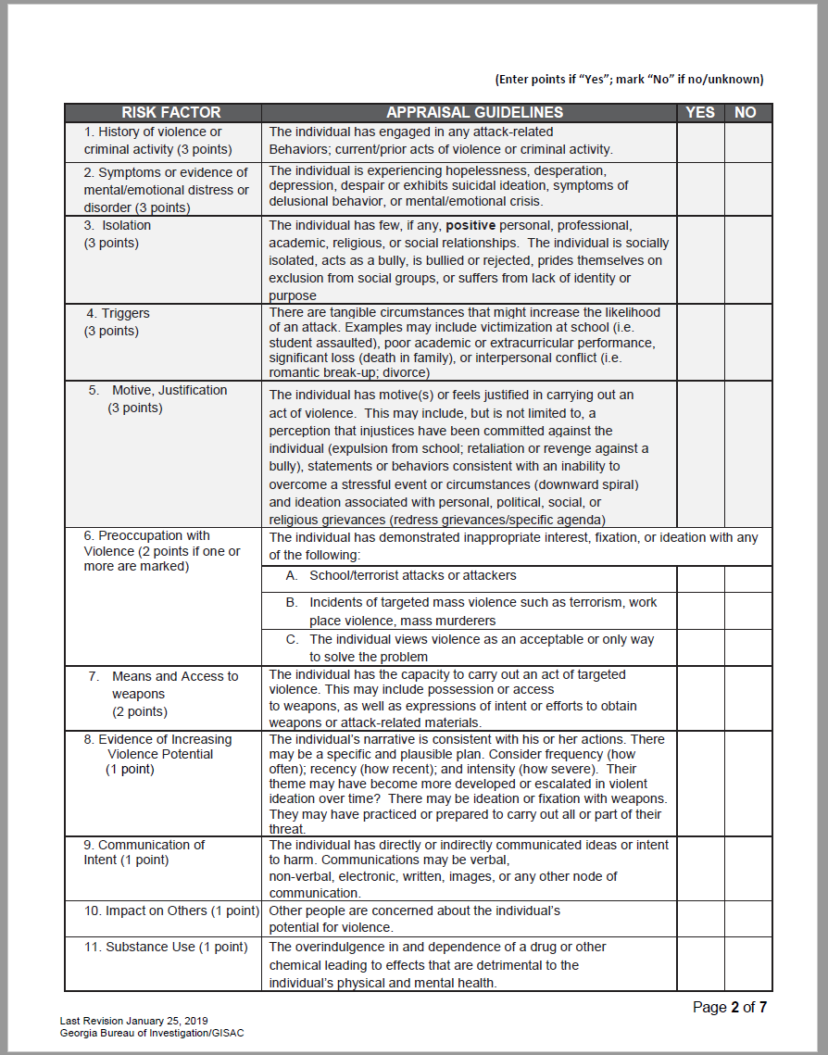
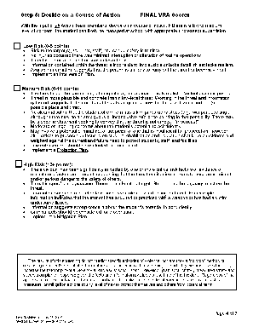
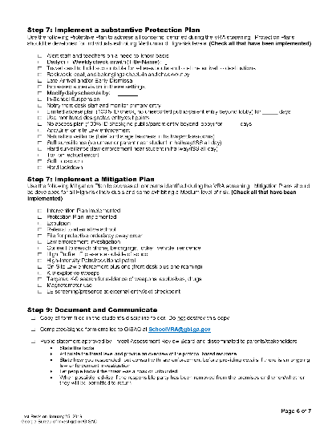
The GBI School VRA: A threat assessment tool
The GBI has developed a School Violence Risk Appraisal tool, which is intended to offer guidance to multi-disciplinary school threat assessment teams in selecting appropriate risk-based intervention strategies in response to school threats:
Uses a behavior-based approach to threat assessment
Utilizes a defensible scored evaluation of risk
Risk-based decision matrix with pre-defined response strategies
Notes:
The creation of the GBI School Violence Risk Appraisal was guided by findings and recommendations published in the Safe School Initiative, Threat Assessment in Schools (U.S. Department of Education, U.S. Secret Service, 2002), Threat Assessment: An Approach to Prevent Targeted Violence (National Institute of Justice, l995), and The School Shooter: A Threat Assessment Perspective (Federal Bureau of Investigation, U.S. Department of Justice, 1999), as well as the Threat Assessment Screening tool developed by Christopher Saiz, Ph.D., School Psychologist, Denver Public Schools; the Indiana Department of Education Threat Assessment Template; and the Los Angeles Unified School District Workplace Violence Prevention Policy Bulletin BUL-5798. It is just one example of a tool that multi-disciplinary threat assessment teams can use to complete and document behavioral-based threat assessments.
The biggest problem we deal with as school safety professionals is triaging threats to life based on very limited information. In this business we often deal with the “Goldilocks Conundrum” of having to determine weather our response is too much, too little, or just right; deciding whether the deployment of manpower and resources is warranted given the available facts, yet knowing that if we are wrong, people could get hurt. As such, we often tend to err on the side of caution and do to little to ensure the health and welfare of an at-risk student or we deploy significant personnel and resources that were not really needed in the first place and were more detrimental than helpful. Scorable, risk-based threat assessments offer a reasoned approach to guiding resource allocation and threat response implementation by establishing pre-defined response strategies associated with threshold scoring values.

Slide 11
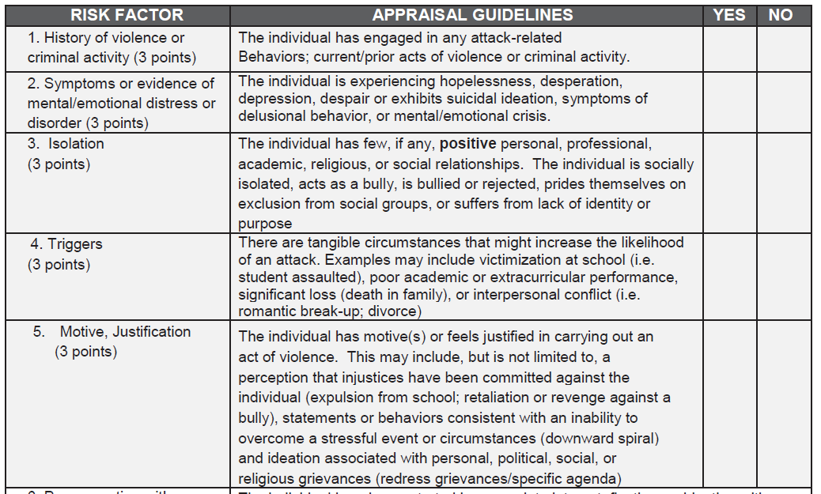
GBI Violence Risk Appraisal
Comprised of 11 core risk factors and 3 enhancement factors
Scoring of Risk Factors is weighted based upon the frequency that they have appeared in prior acts of Targeted Violence

Slide 12
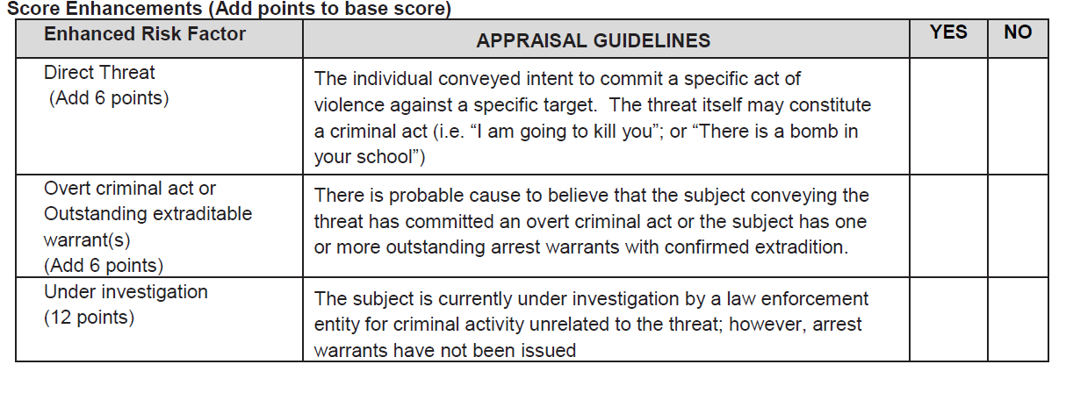
GBI Violence Risk Appraisal
Risk Enhancement Factors impact the necessity of law enforcement intervention

Slide 13
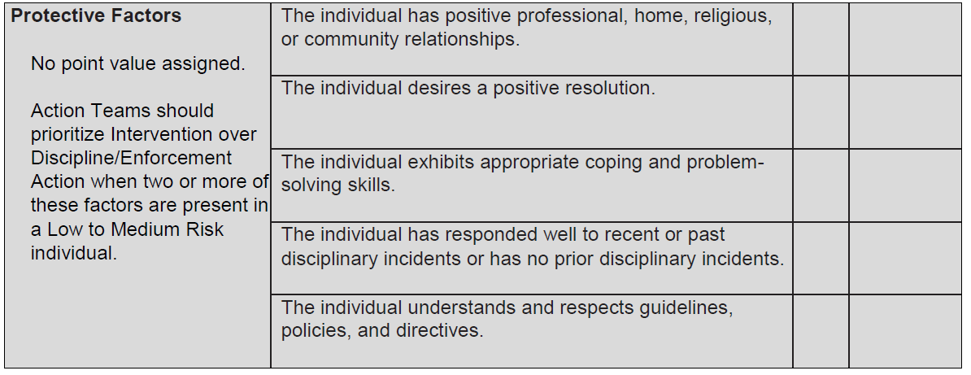
GBI Violence Risk Appraisal
Protective Factors influence the use of internal intervention methodologies in low to moderate risk individuals

Slide 14
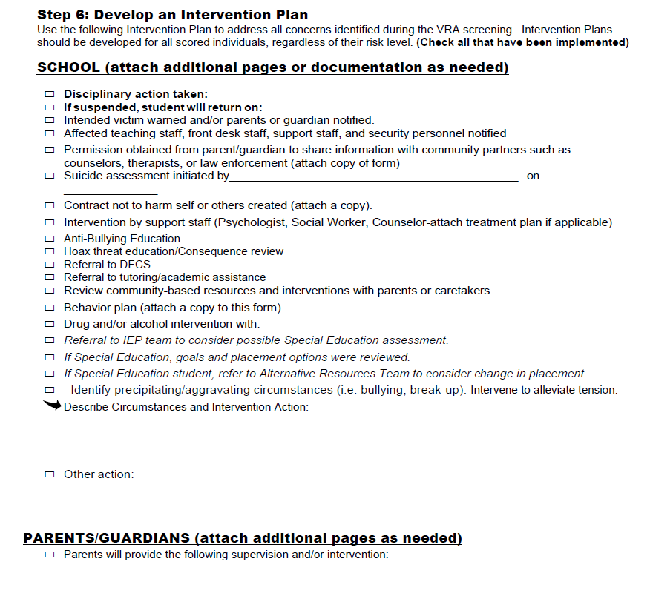
GBI Violence Risk Appraisal
Low Risk = 0 to 5 Points
Risk to the target(s), students, staff, and school safety is minimal.
No injuries occurred there was minimal interruption or alteration of routine operations.
Threat is vague or indirect or constitutes a hoax.
Information contained within the threat is inconsistent, implausible or lacks detail; threat lacks realism.
Available information suggests that the person is unlikely to carry out the threat or become violent.
Implement an Intervention Plan.

Slide 15
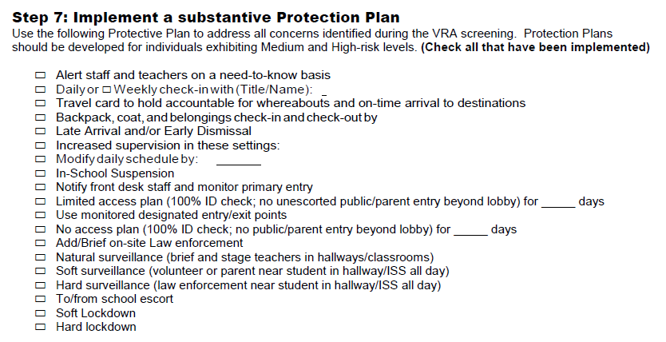
GBI Violence Risk Appraisal
Medium Risk = 6 to 11 Points
The threat could be carried out, although it may not appear entirely realistic. Violent action is possible.
Threat is more plausible and concrete than a low-level threat. Wording in the threat and information gathered suggests that some thought has been given to how the threat will be carried out (e.g., possible place and time).
No clear indication that the student of concern has taken preparatory steps (e.g., weapon, seeking), although there may be an ambiguous or inconclusive reference pointing to that possibility. There may be a specific statement seeking to convey that the threat is not empty: "I'm serious!"
Moderate or lingering concerns about the student's potential to act violently.
May involve a potential criminal act or suspicion of one that is insufficient for prosecution; however, alternatives to prosecution focused on student rehabilitation and education should be considered and weighed against the current and future need to protect students, staff, and facilities.
Law enforcement should be contacted and consulted.
Implement a Protection Plan, inclusive of an intervention plan, as appropriate.

Slide 16
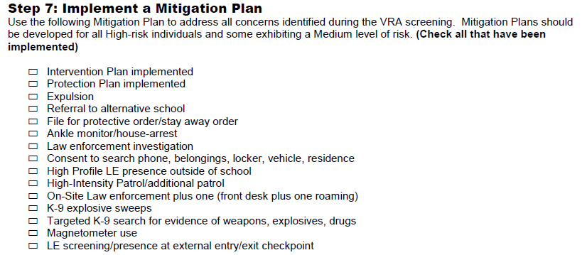
GBI Violence Risk Appraisal
High Risk = 12+Points
The individual has been significantly impacted by one or more critical risk factors or evidence of multiple risk factors are present suggesting that the threat or situation appears to pose an imminent and/or serious danger to the safety of others.
The threat is specific and plausible. There is an identified target. Individual has the capacity to act on the threat or their capacity cannot be discounted.
Information suggests concrete steps have been taken toward acting on threat. For example, information indicates that the student has acquired or practiced with a weapon or has had a victim under surveillance.
Information suggests strong concern about the student's potential to act violently.
Criminal acts should be considered for prosecution.
Implement a Mitigation Plan, inclusive of an intervention plan and a protection plan, as appropriate.

Slide 17
Advantages/disadvantages of threat assessment
Pros:
No cost/low cost
Student-centered
Demonstrative effort to protect children
Cons:
Preventative ONLY
Time consuming
Effectiveness not guaranteed and is dependent upon available resources/ physical security measures
Notes:
TAT is a no cost/low cost school safety measure that can work in all of Georgia’s 2294 schools.

Slide 18
Questions?
Andy Mossman
Assistant Special Agent in Charge
Georgia Bureau of Investigation
Georgia Information Sharing and Analysis Center
(770) 234-3102
3000 Flowers Rd South
Atlanta, GA 30341

