Slide 2
Our Partners
02 | 14

Slide 3
Our DNA
35
States
Our Team
Our Technology
Majority of our investments are
in service and technology
Proprietary cutting-edge machine learning technology
>3,500
Your Students
You & Your Team
Schools
Protecting students for 6 years
Allowing you to be proactive
and save time
~4.5M
The Experts
Our Partners
Subject matter experts in sociolinguistics, safety, wellness and school administration
Long-standing certified integrations with our partners
Students
& Staff
Notes:
Thank you and good morning! I’m Gary Margolis, Founder & CEO of Social Sentinel. On behalf of our team, it's been our privilege to be here with you at NSBA and to support you and your schools.
Serving more than 3,500 schools in 35 states, we exist for three simple reasons… the SAFETY, SECURITY, and WELLNESS of your students and schools.
Using our combined expertise in school safety and artificial intelligence, we’ve built a solution that gives you RESPECTFUL access to the digital conversations happening every day and all day in your schools.

Slide 4
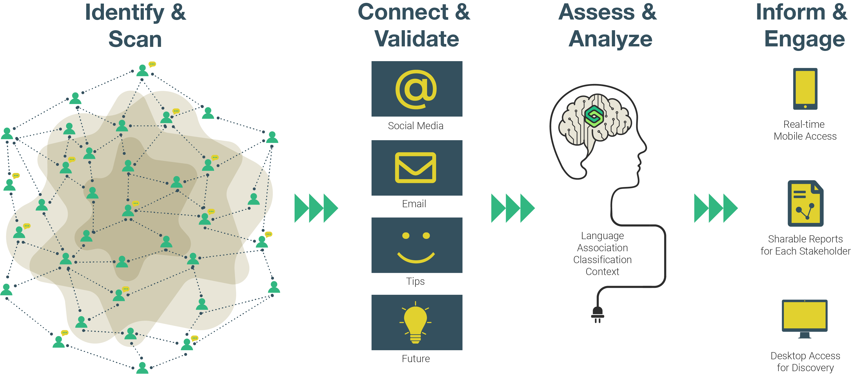
A Culture of Prevention
Notes:
Never in history have we been more connected and yet more alone. As you know all too well, mental health issues for our children have increased sharply in the last 10 years. Not a surprise... this rise correlates with the growth of the Internet and social media.
Our students, faculty, and staff engage their worlds digitally. Our students check their social media accounts 100-125 times per day… They manage 3 to 5 accounts each… They post that many times per hour. In just one week, 1000 of your students will generate more than 450,000 social media posts…
Through these digital conversations, they leak their intentions for harm against others or themselves… they talk about what makes them happy, sad and stressed. Between 2014-2016, 40% of school violence was foreshadowed in these online conversations.
We do what you can’t.... We scan 1b digital conversations every day… and we find the needle in the digital haystack on your behalf. We find those indications of harm so you can help… and we do it all with a deep respect for privacy… we don’t surveil or monitor. We scan content… and like a smoke detector in a classroom, when we find smoke we sound off.
Your students are crying out for help… and with Social Sentinel, now you can hear them.

Slide 5
The Platform
Language
Classification
We study and understand the language of harm and violence. We deploy advanced technology and work with subject matter experts to constantly evolve Social Sentinel’s proprietary machine learning methodologies.
Machine learning (AI) algorithms classify data into alerts for immediate attention and insights for greater understanding.
Associations
Context
We built technology that searches worldwide to make local connections beyond a geo-fence.
We create context by highlighting discussions and trends relevant to our clients’ communities right now.
Unlimited Data → One Method → All Products → Powered by SME & Tech
Notes:
We study language. We understand how violence and harm are foreshadowed on digital platforms. We deploy advanced technologies and work with linguists, data scientists and subject matter experts just like you to scan globally and connect locally. We’re able to classify data so that you can act quickly when needed… and at the same time understand the safety context of the district.

Slide 6
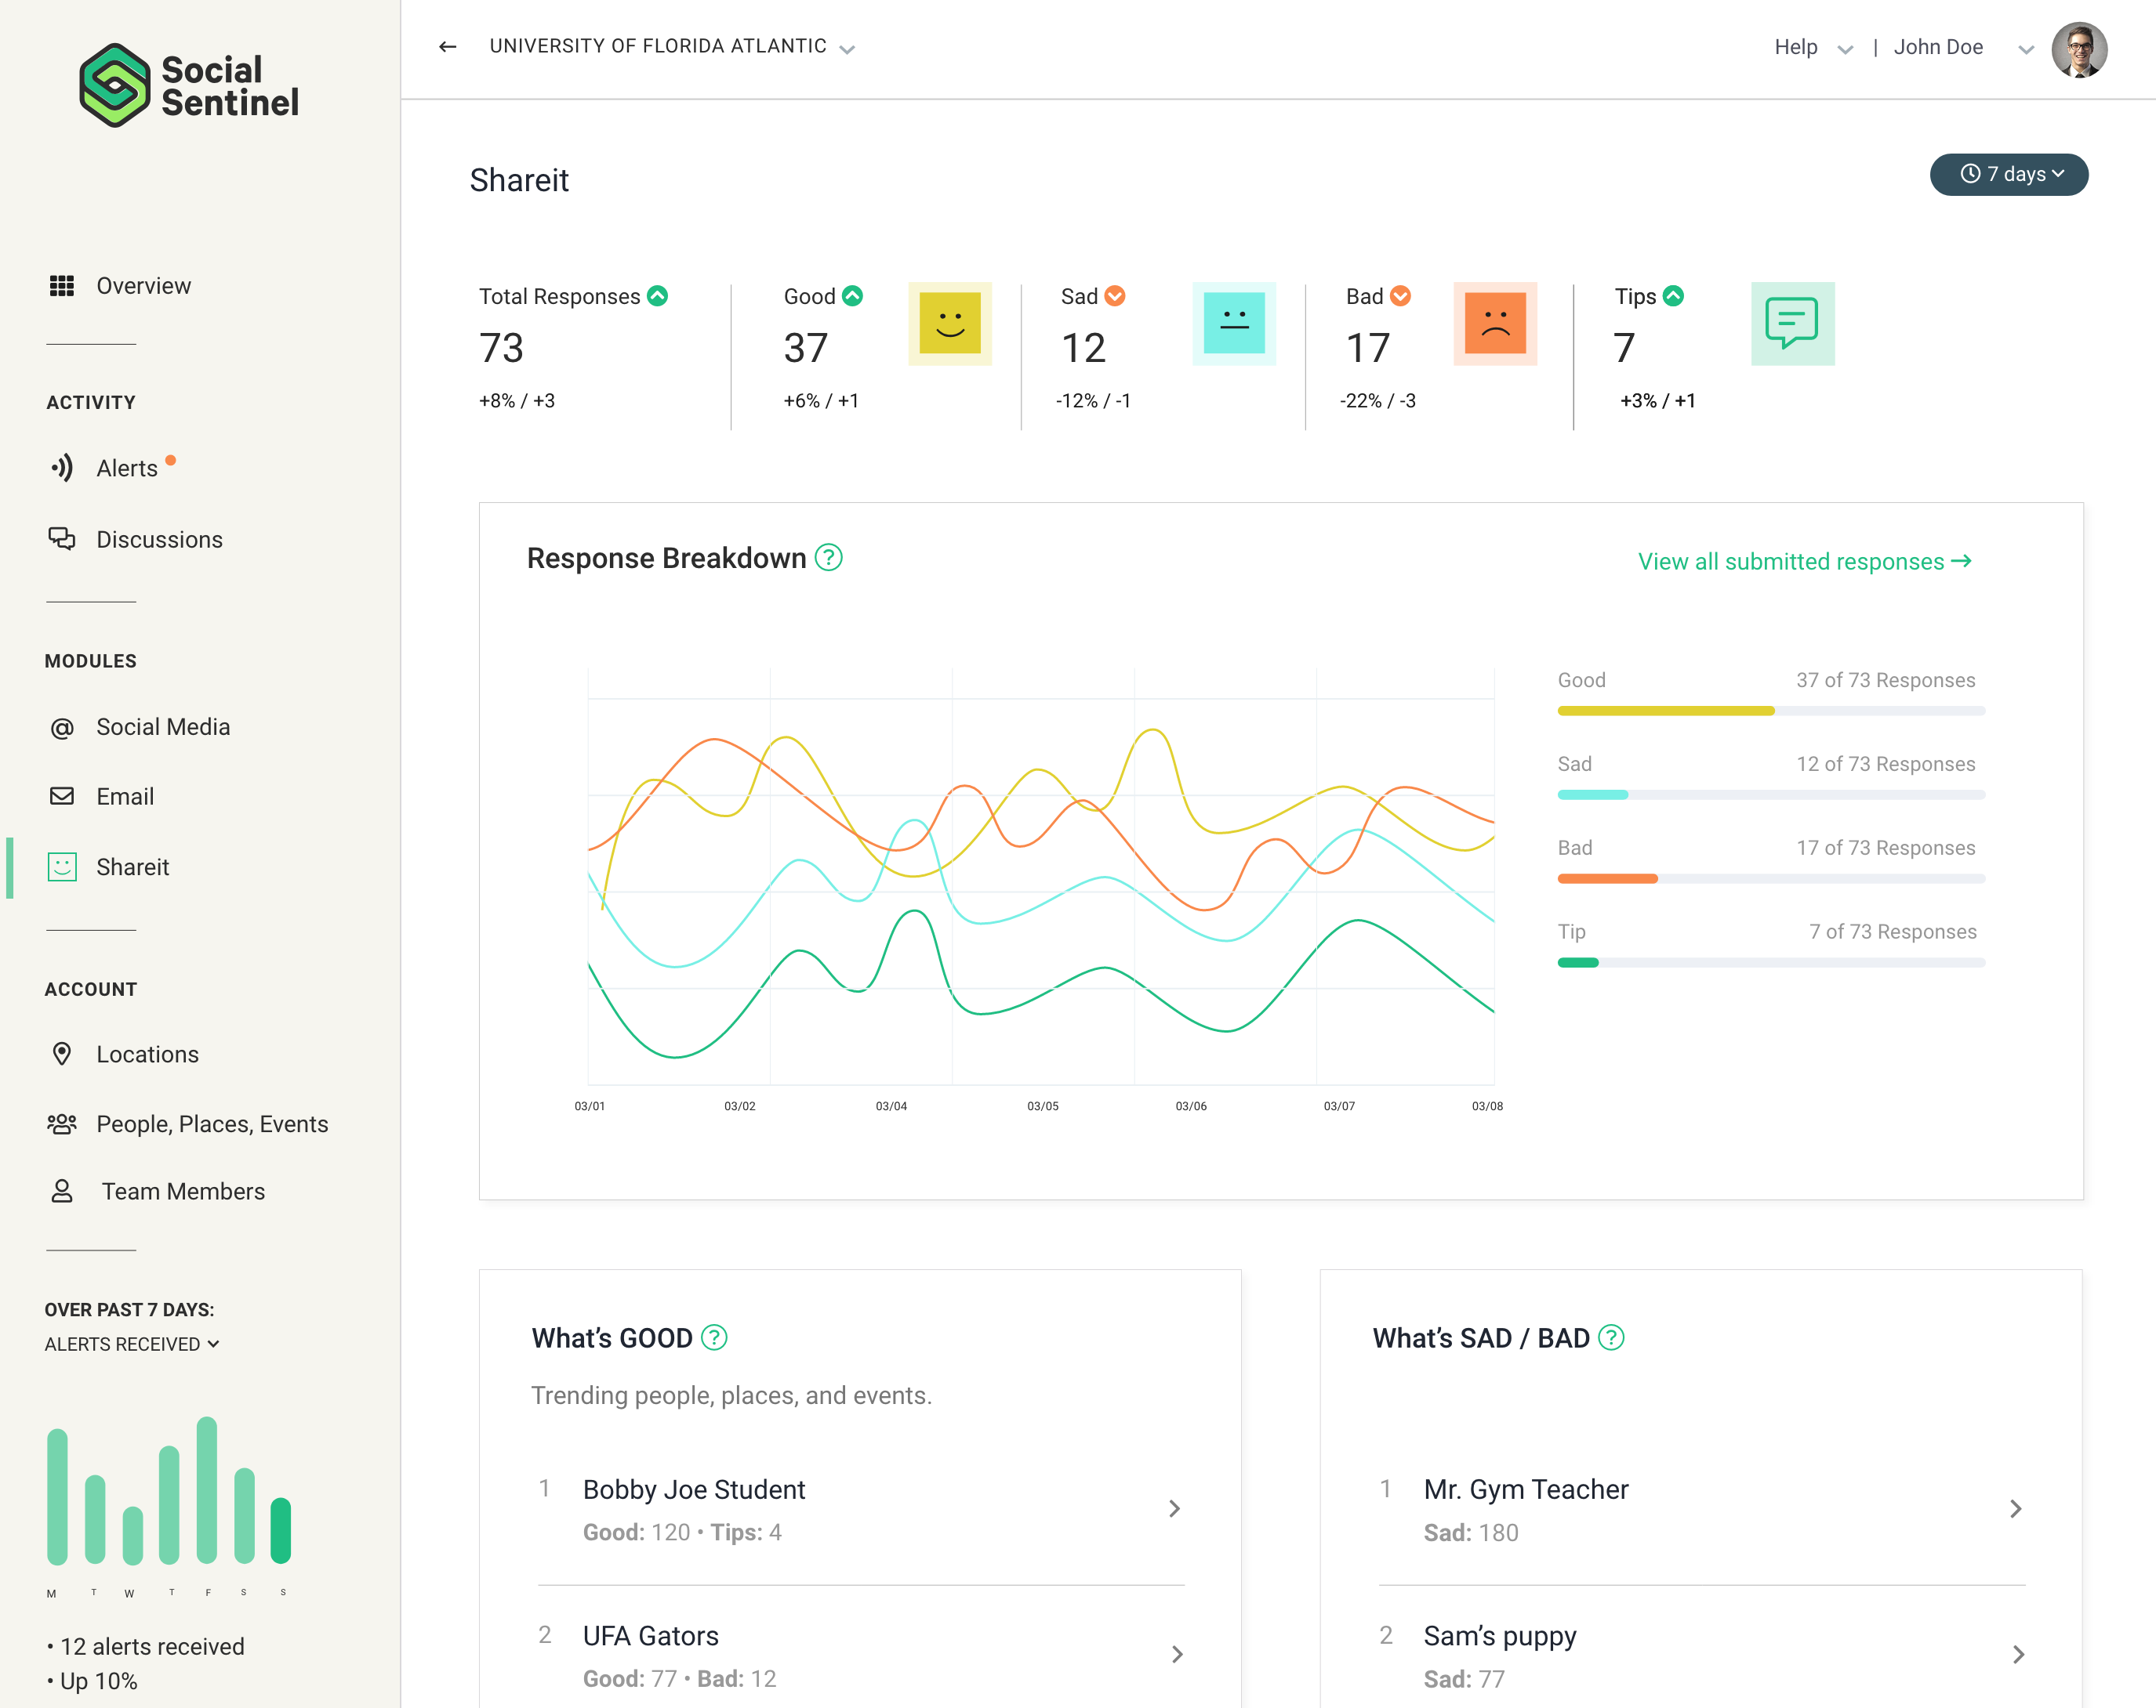
Enhanced!
New!
New!
Social Media Scanning
Integration with Gmail
Shareit
Help keep your students safer by respectfully accessing the digital conversations happening publicly on social media. We help you weed out
the noise and connect with the posts that matter most to your schools’ well-being.
Expand your awareness around conversations that are happening within your school and identify
safety and behavioral patterns, while respecting individual privacy.
Speaking up to share something can be overwhelming, regardless of whether it's good
or bad news. Give students, faculty, and staff
a safe and simple way to speak up and
share their story, anonymously.
Notes:
We offer a proven and comprehensive solution… the only one in the marketplace… that ensures your respectful access to the digital conversation for the safety of your community.
Our social media threat alert service scans on billion conversations each day... we’re proud to introduce the next generation of our alert service today. Using our proprietary Sentinel Search Library, containing hundreds of thousands of behavioral threat indicators, we identify safety concerns where you need us. Not just the text, but images and videos. Removing more than 90% of the false positives and all the irrelevant information, our automated service gives you what you need when you need it… saving you time and money… and saving you a life.
It’s not just social media… your community uses email. 70% of schools use the Google Suite for productivity. Bullying, suicidal ideation, self-harm and the like are shared there as well. We’re proud to introduce our integration for Gmail. You already have responsibility for what’s happening on email… our powerful Sentinel Search Library now makes it easy for you to pay attention respectfully and efficiently here, as well.
Across the country, leaders like you are realizing how important it is for students, faculty, and staff to easily, and anonymously, share their thoughts. The good… and the bad. We’re proud to introduce ShareIt… a revolutionary communication tool backed by the power and insights of the Social Sentinel platform...
We make it easy by giving you one login and one view of your account’s insights.

Slide 7
Giving You
One View of
Everything
Notes:
With the digital conversation so disperse, why install multiple tools when you can have one consistent experience… where the zeitgeist of the safety, security and wellness of your schools is easily accessible in one location.
This is the Social Sentinel platform… and we are pleased to share it with you.

