Slide 1
The Power of
EMPOWERMENT
Allison Townsend
2019 Georgia
Teacher of the Year
Email: 2019toty@gmail.com
Facebook: Georgia Teacher of the Year
Twitter: @Ga2019TOTY

Slide 2
Nice to meet you.
Where are you from?
@Ga2019TOTY

Slide 3
HELLO, I’M
Invisible
@Ga2019TOTY

Slide 4
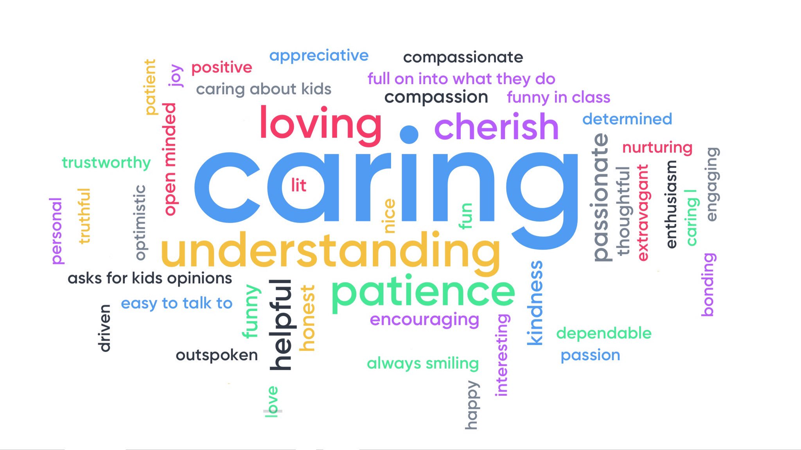
@Ga2019TOTY

Slide 5
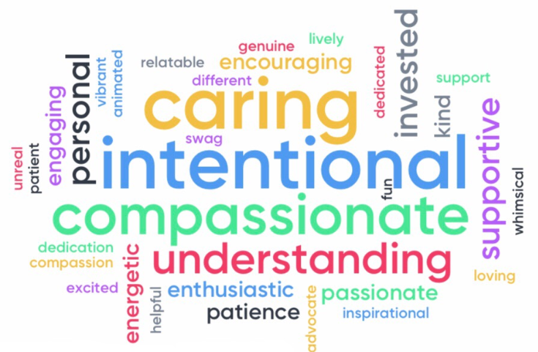
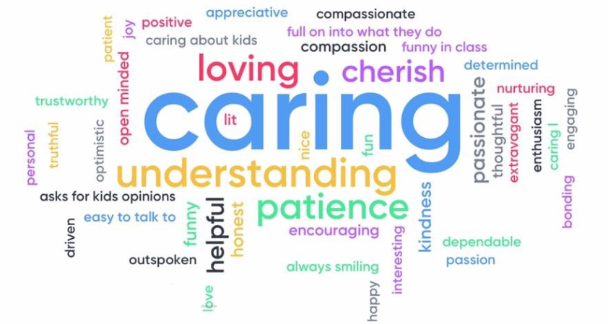
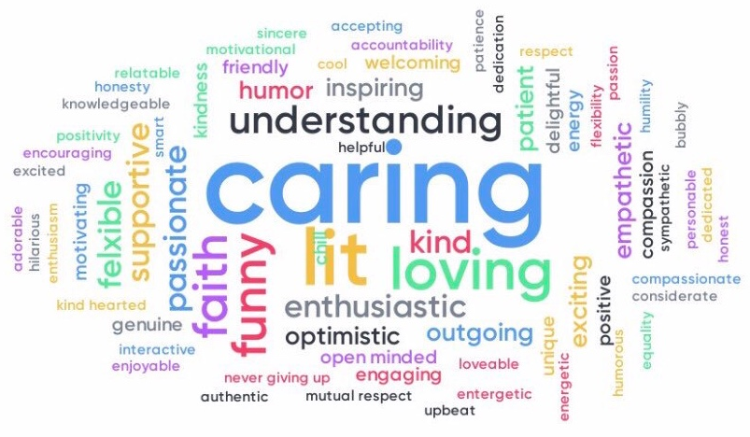
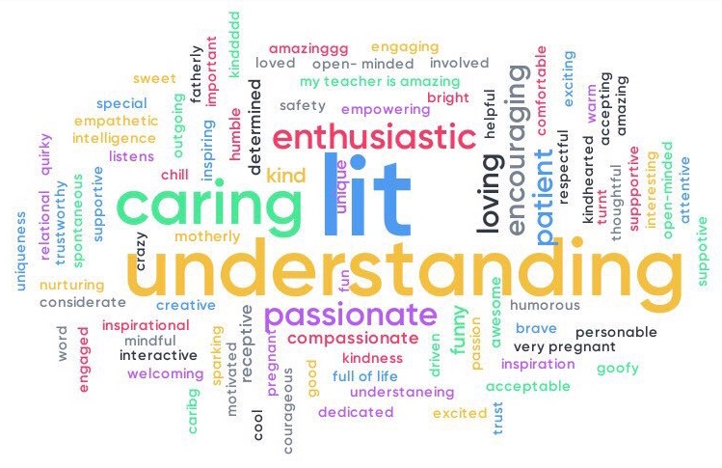
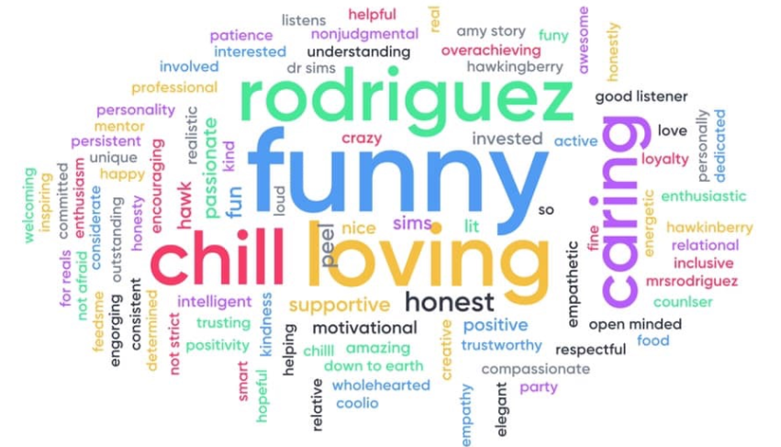
Kids learn from teachers who care.
@Ga2019TOTY

Slide 6
Empowerment
Engagement
“…because of my PURPOSE.”
Entertainment
“…because it’s fun.”
Compliance
“…because my teacher told me to.”
@Ga2019TOTY

Slide 7
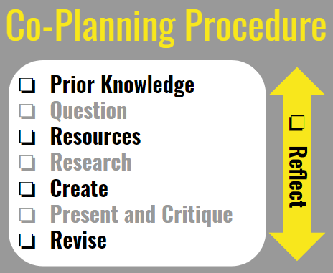
@Ga2019TOTY

Slide 8
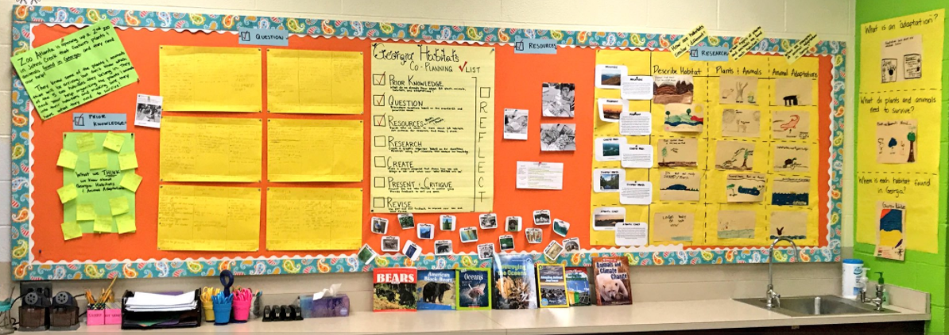
Learning is a process, not a product.
@Ga2019TOTY

Slide 9
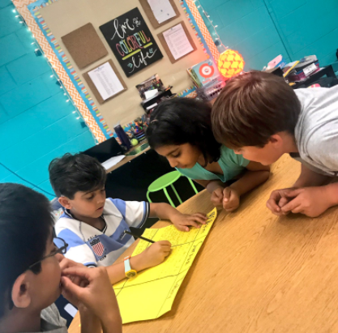
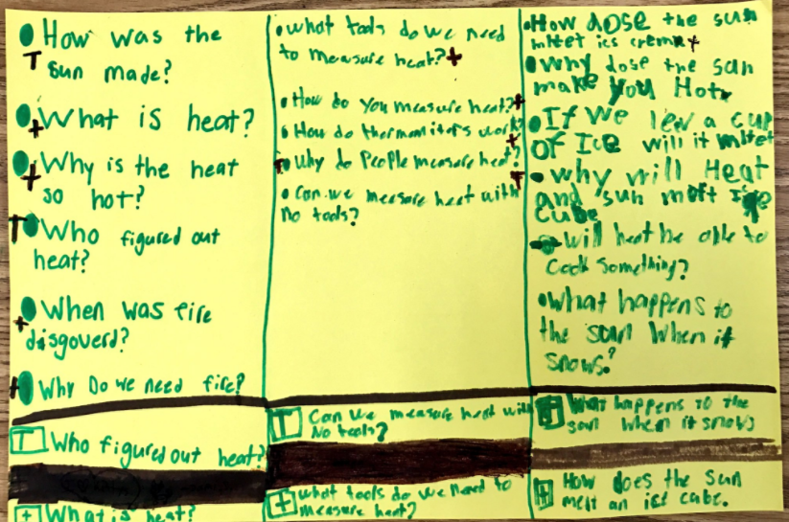
Authentic learning stems
from CURIOSITY.
@Ga2019TOTY

Slide 10
@Ga2019TOTY

Slide 11
Why empower students?
@Ga2019TOTY

Slide 12
@Ga2019TOTY

Slide 13
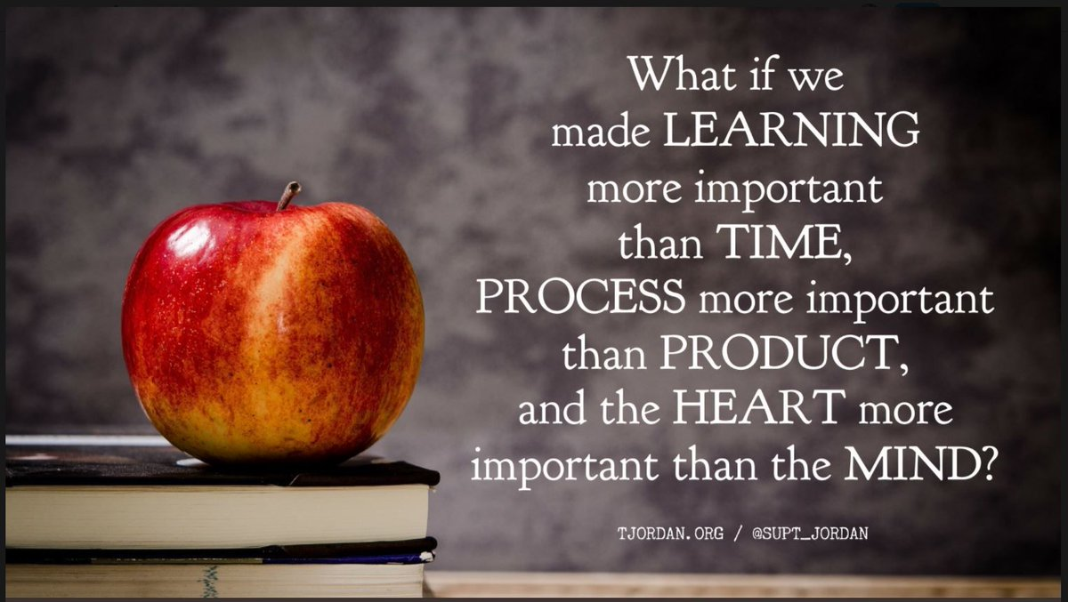

Slide 14
The Power of
EMPOWERMENT
Learn More: bit.ly/coplanninglearning
Allison Townsend
2019 Georgia
Teacher of the Year
Email: 2019toty@gmail.com
Facebook: Georgia Teacher of the Year
Twitter: @Ga2019TOTY

