Slide 1
Spring Bootstrap 2019
Richard Woods
State School Superintendent

Slide 2
Legislative Session Recap
92 education-related bills were filed during the 2019 session
24 education-related bills passed both chambers and will be sent to the Governor
The Governor has 40 days from end of session to veto bills

Slide 3
Bills of Interest
Thank you to Governor Kemp & the legislature – $3,000 teacher pay raises
Extended to certified staff
RESA base grant increase
SB 15: “Keeping Georgia’s Schools Safe Act”
Requires site risk assessment; safe school plans; and other provisions
SB 25: Clarifies changes to school bus passing law (Governor signed)
SB 48: Mandatory dyslexia screening of kindergarten students after three-year pilot
SB 108: Mandatory computer science requirements for middle and high schools
Georgia Virtual School courses available to satisfy requirements

Slide 4
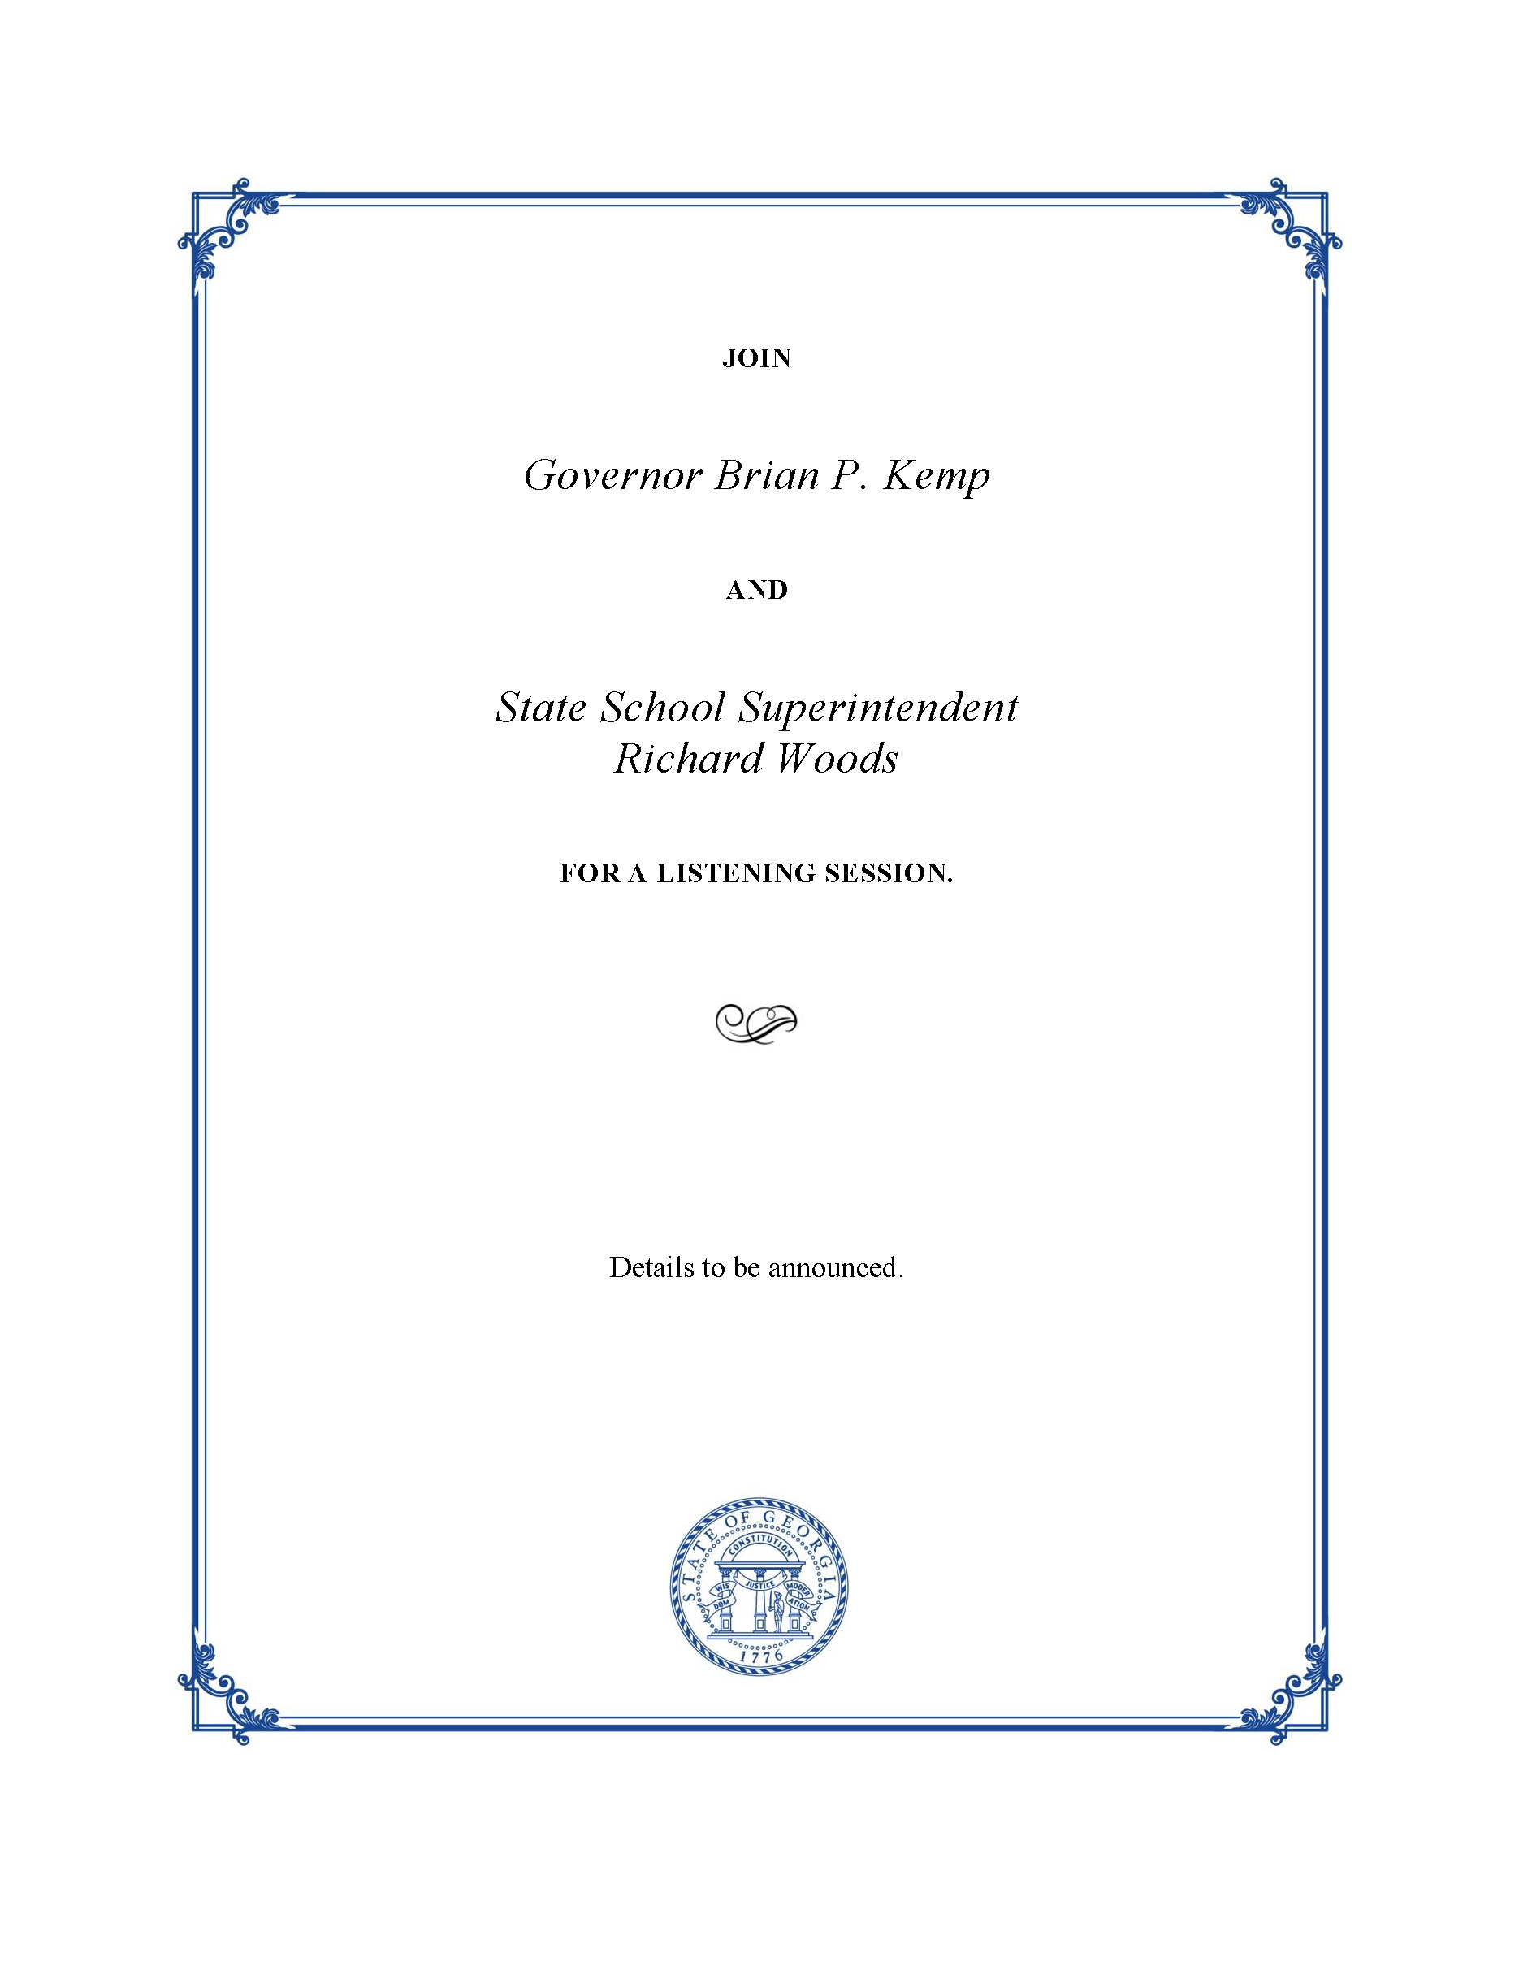
Invitations Forthcoming:
Listening Sessions for Superintendents & Local Board Members
Notes:
Superintendents and local board members will receive invitations soon. You can also contact your RESA for additional details.
Governor Kemp and I are both attending several sessions. Representatives from GOSA and DOEwill attend the other sessions and will relay the feedback to Governor Kemp and myself.
While these sessions are an opportunity to hear from local district leadership (superintendents and board members) we are planning teacher-focused listening events for the fall.

Slide 5
Budget Updates
Ted Beck
Chief Financial Officer

Slide 6
AFY 2019 Appropriations Act
Midterm Adjustment: $131 million
Still seeing marginal growth in FTEs.
Large increase in the number of new state authorized charters.
Fairly typical amount for the midterm.
School Security Grants: $69.4 million
Represents a $30,000 award per school for all districts.
Available for any one-time purchase of goods and/or services related to the district’s school safety assessment and plans.
Application process requires brief budget narrative.
Reimbursement upon receipt of invoice; available through June 30, 2020.

Slide 7
FY 2020 Appropriations Act
Salary Increase: $522 million
Represents a $3,000 increase for all certificated positions beginning July 1, 2019.
Traditionally, salary increases are funded for 10 months in the first year to account for two-month lag time in QBE allotments to districts.
Results in two months of additional funding which will be included in district allocation sheets as “additional funding” under the administration line.
Will “annualize” in FY 2021.
QBE Growth: $198 million
Picks up all FTE growth (very limited) and T/E increases (average teacher tenure is going up! a little).

Slide 8
FY 2020 Appropriations Act
Other Items
Charter school facility grants ($2 million)
Professional development programs for CS ($750k)
Feminine hygiene products grants ($1 million)
Counselor enrichment program ($1 million)
Various CTAE increases

Slide 9
Federal Programs Updates
Craig Geers
Associate Superintendent, Federal Programs

Slide 10
FY 20 Federal Funding Update
Formula Grants
Preliminary allocations are available, for planning purposes, on the
Federal Programs webpage for:
Competitive Grants
There are no preliminary allocations for competitive funding
Title I, Part A
Title II, Part A
IDEA
Title I, Part C
Title III, Part A
Title I, Part D
Title IV, Part A
Title IV, Part B
McKinney-Vento

Slide 11
FY 20 Federal Funding Update
Final Formula Grant Allocations
New! The Department anticipates presenting the formula grant allocations to the State Board for approval on June 13, 2019.
Grant Award Notifications will be loaded to the MyGaDOE Portal on or very soon after July 1, 2019
Competitive Grant Allocations
The Department anticipates presenting the competitive grant allocations to the State Board of Education for approval on July 18, 2019
Grant Award Notifications will be loaded to the MyGaDOE Portal on or soon after July 19, 2019

Slide 12
FY 20 CLIP and Budget Approvals
Consolidated LEA Improvement Plan (CLIP)
FY20 CLIP submission window is March 4, 2019 to July 31, 2019 (118 CLIP online and 18 S-CLIP)
Submit extension requests to federalprograms@doe.k12.ga.us
Team reviews completed in 10 days, unless otherwise notified
Amendments may be created, as needed, during the year
CLIP Aligned Budgets
Formula funds will be loaded into the MyGaDOE Portal for budgeting on or about July 1, 2019
Competitive funds will be loaded for budgeting on or about July 19, 2019
Budget reviews will begin once the FY20 CLIP is approved and the budget is submitted
Program specialist/manager review completed in 10 days, unless otherwise notified

Slide 13
Consolidation of Funds
Consolidated Federal Administrative Funds
Flexibility to consolidate some or all administrative funds under most
Federal ESSA awards
Request form found on Federal Programs webpage due August 1, 2019
Benefits:
Single Cost Objective (annual certification) vs. Multiple Cost Objectives (time sheets)
Ability to work across all contributing grant programs
Consolidation of Federal, State, and Local Funds
4th Cohort (SY 2019-2020) to be finalized April 30, 2019
Benefit:
Consolidated funds lose their identity and create flexibility in local Title I schoolwide programs

Slide 14
Agency Updates
Matt Jones
Chief of Staff

Slide 15
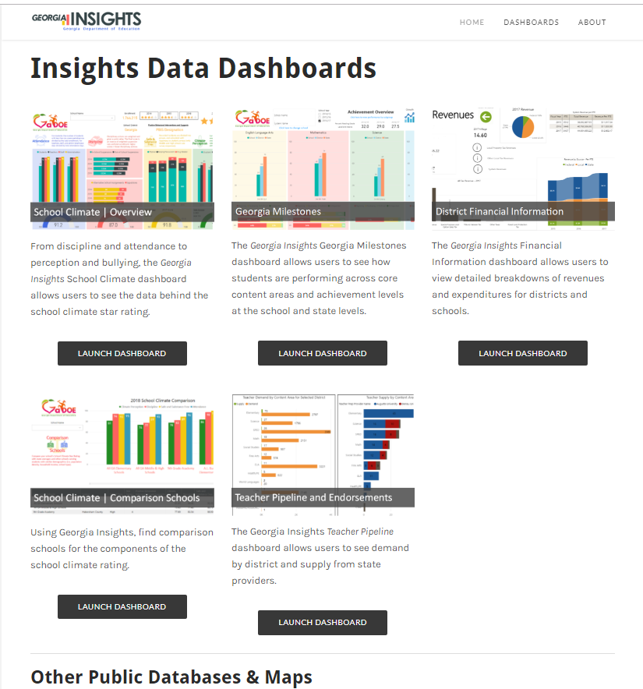
Georgia Insights
GeorgiaInsights.com
Dashboards
GaDOE data (Milestones, school climate, financial, comparison schools)
Data from other state agencies and partners

Slide 16
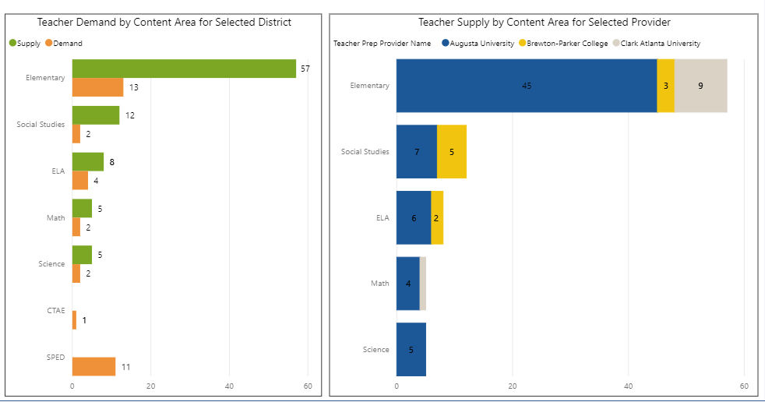
Teacher Pipeline NEW!
Demand – by district
Supply – by selected providers

Slide 17
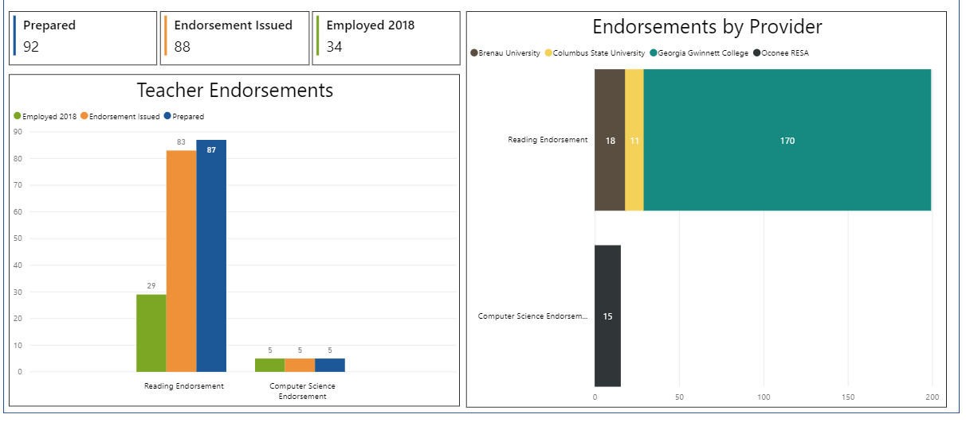
Endorsements NEW!
By endorsement type and provider

Slide 18
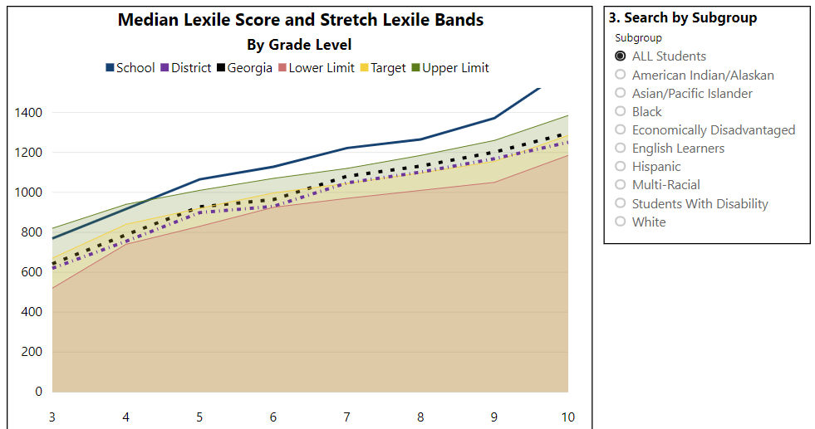
Literacy COMING MAY 1st!
DRAFT
By school and subgroup
…with visualized stretch bands with district/state data

Slide 19
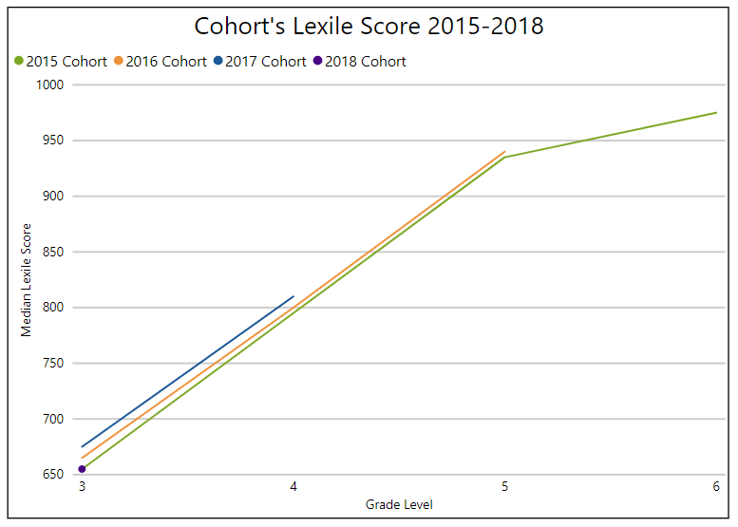
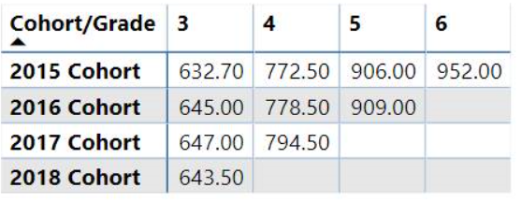
Literacy
Since 2015, each statewide cohort of students have shown an increase in Lexile scores

Slide 20
Partnering with the Governor’s Office
K-3 Literacy
Expanding Growing Readers initiative
+$2 million from GaDOE
Targeted: Federally identified schools
Partnership: GOSA and RESAs
Leadership
Governor’s School Leadership Academy
Partnership: Joint effort between GOSA and GaDOE’s School Improvement Team
Expanding: Teacher Leaders
Committed to coordination and collaboration – new leadership has provided a new opportunity for GOSA and GaDOE to work together

Slide 21
School Improvement
MOUs
Completed; shared responsibility; different tone
Comprehensive Needs Assessment options
GaDOE’s SDE
AdvancED’s Diagnostic Reviews
Recently completed needs assessment (approved by SDE)
Alignment and Cohesion
RESAs & DOE partnering together
Georgia’s Systems framework
CLIP
DIP
SIP
In development… phase out Indistar and embed monitoring/ feedback tools into the SLDS platform; (Optional) Tier I support for all schools

Slide 22
School Improvement
Alternative Schools
Focus groups
Other data sources beyond CCRPI/Milestones to show improvement
Designated support from GaDOE
Promise schools – lowest 5.1%-10%; average 3 year rolling CCRPI score
Purpose: $20k to provide proactive supports/sustain improvement
GaDOE expanding ‘Selecting Evidence-based Interventions’ guidance document for LEAs
Update released May 1st

Slide 23
National Recognition
Comprehensive Needs Assessment
Common framework for improvement with aligned plans and resources
Changing culture of the agency
Continuous Improvement Teams (CITs)
Wraparound support

Slide 24
Prioritizing State-Level Support and Coordination for the Whole Child
Established a state-level director’s position – Director of Whole Child Supports and Strategic Partnerships
Responsibilities:
Coordinate services across the agency
Collaborate with state agencies/nonprofits
Provide support and supervision to regional wraparound coordinators
Notes:
Superintendent Woods

Slide 25
Assessment Updates
GAA 2.0
Spring Window: March 25 – May 3
Georgia Milestones
Spring EOG Window: April 8 – May 17
Spring EOC Window: April 22 – May 31
GKIDS 2.0
GKIDS 2.0 opens in July 2019
District and school training continues through May
Online training modules for teachers available in May
Notes:
We are currently in the middle of two open administration windows. The GAA 2.0 began on March 25 and is open through May 3. This is the first administration of the redesigned GAA 2.0. While there have been some challenges, we are hearing positive feedback from educators about the new assessment. We have completed some observations of the administration and will be seeking additional input from districts and schools about the administration. We will use what we learn to determine if any refinements are needed for future years.
The Georgia Milestones End of Grade window opened on April 8 and runs through May 17. The administration and run smoothly so far. The assessment team is available to assist if you have any questions or concerns or encounter and issues during your administration.
The Georgia Milestones End of Course window opens on April 22 and runs through May 31.
A quick reminder that the new GKIDS 2.0 rolls out statewide for the 2019-2020 school year. This redesigned assessment is based on learning progressions and allows teachers to continually assess student performance throughout the year to determine what they have mastered, where they are now, and where they need to go next. We have received tremendous feedback and support for this new assessment from teachers who participated in this year’s pilot. We are looking forward to the statewide launch this fall. District and school training for this new assessment continues through May and online training modules for teachers will be available in SLDS in May.

Slide 26
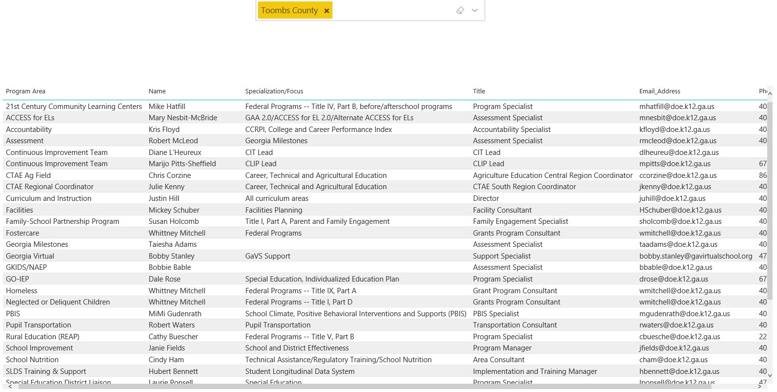
District Support Directory
GaDOE.org/support

Slide 27
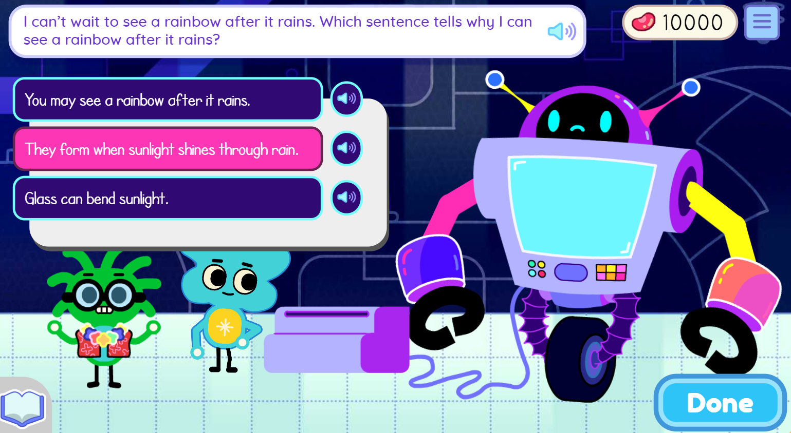
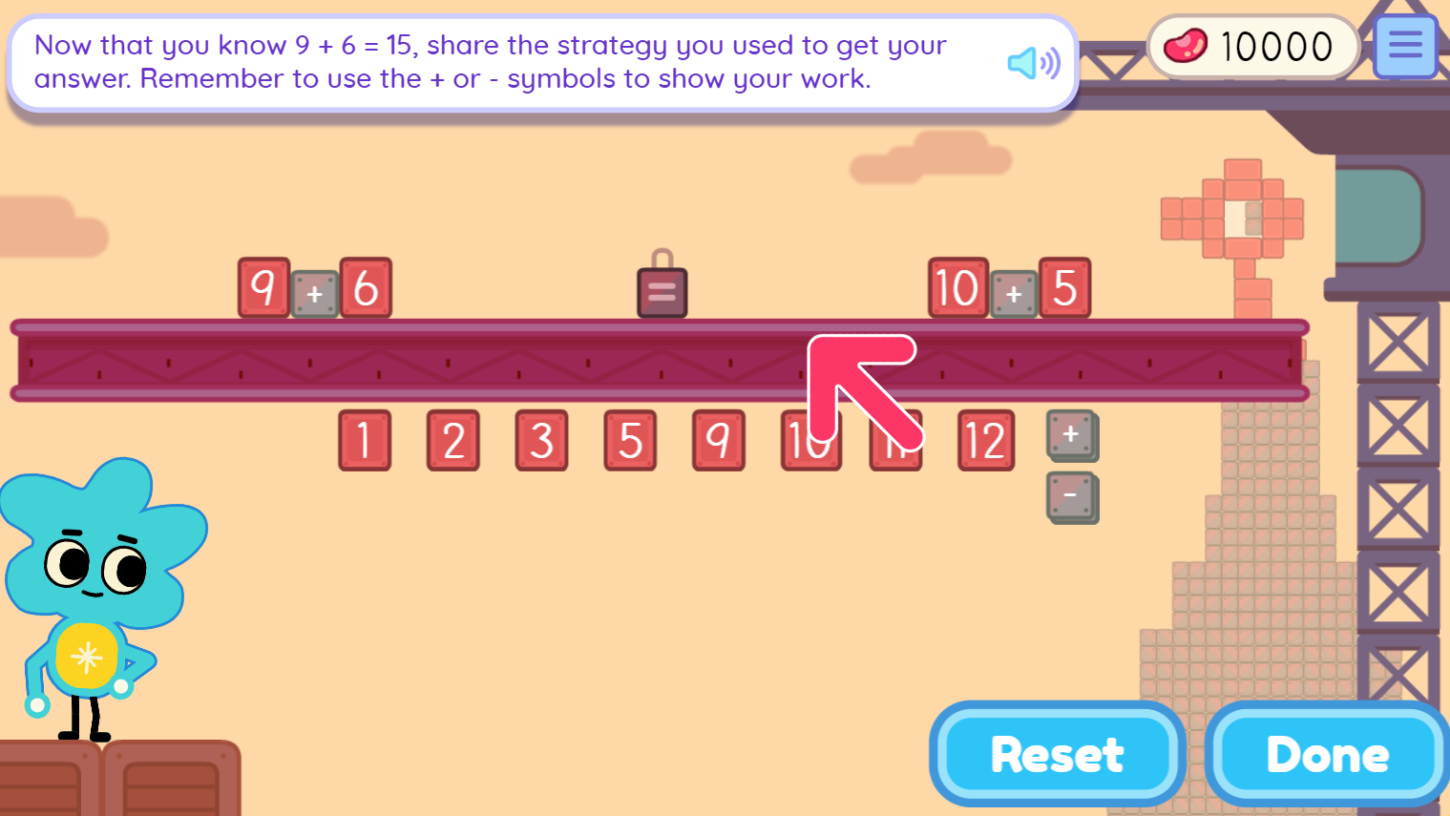
Keenville
Keenville is Georgia’s game-based, formative assessment in literacy and mathematics for grades 1 and 2.
It is accessible via the Statewide Longitudinal Data System (SLDS).
New games and dashboards will arrive this spring and summer.
Keenville will be fully operational for the 2019-2020 school year.
Notes:
We are nearing completion of the development of Keenville, Georgia’s game-based formative assessment in literacy and mathematics for grades 1 and 2. New games and dashboards will arrive this spring and summer. The assessment will be fully operational for the 2019-2020 school year.
We are excited about the new games and have received excellent feedback from the teachers and students who participated in development and testing. Upcoming enhancements to the teacher dashboards include features such as student progress reports, play history, and item-level details. School and district leaders will soon have access to real-time dashboards featuring data for students in their school or district. We appreciate the ongoing feedback we are receiving from your districts to help us make refinements and enhancements to this assessment system.

Slide 28
ESSA Amendment
Seeking amendment to our ESSA plan
Amendment relates to an Alternate Diploma option for students with significant cognitive disabilities assessed using alternate assessment.
These students currently receive a Regular Diploma but U.S. Ed will no longer allow them to count in graduation rate.
U.S. Ed will allow Alternate Diploma graduates to count in the graduation rate.
We will ask to include these students who receive Regular Diplomas in the graduation rate calculation until the first cohort of Alternate Diploma graduates finish (those will then be automatically included)

Slide 29
CCRPI
CCRPI Live Portal Data Available in May
This tool assists districts and schools in checking the accuracy of the data used for CCRPI that are submitted in Student Record and Student Class before superintendent sign-off.
If issues are identified, they can be corrected directly in Student Record and Student Class before those applications close in June.
All issues must be resolved prior to the close of Student Record and Student Class in June.
There will not be a data correction window for CCRPI after the close of these applications.
Notes:
I have just two quick updates regarding CCRPI.
First, the live portal data feature will be available in May. This provides district personnel and school leaders with an opportunity to see how the data they are entering into Student Record and Student Class are used in CCRPI calculations. Specifically, some indicators such as student attendance and beyond the core are run in real-time as you enter and update data.
This tool gives you an opportunity to correct an errors directly in Student Record and Student Class before those applications close. Once they close, there will be no corrections window for CCRPI.
We have seen significant improvement in data accuracy over recent years; however, we still find that some principals are unaware of this feature and do not check their CCRPI data before the applications close. Please ensure that your district staff and principals are aware of this feature and utilize it to check the accuracy of their CCRPI data. Our accountability team is available to answer any questions and provide assistance.

Slide 30
2019 CCRPI Tentative Calendar
Activity | Start | End
GAA Participation Application | December, 2018 | January 17, 2019
Assessment Matching 1 | March 5, 2019 | August
Live Portal Data | Early May | Static when SR and SC close
Student Record and Student Class Close | Ongoing | June
Assessment Matching 2 | August | August
Non-Participation Application | July | August
Summer Graduate Collection | Early July | Early August
Cohort Withdrawal Update | Early July | Early August
Graduation Rate Public Release | - | September
CCRPI Public Release | - | Late October
Notes:
This year’s CCRPI schedule will look similar to previous years. This summer we will open four main applications – assessment matching, non-participation, summer graduate collection, and cohort withdrawal update. These applications are used to provide information needed for CCRPI calculations.
We expect to release graduation rates in September and the full CCRPI in late October. The CSI and TSI lists will follow the CCRPI release.

Slide 31
Innovative Assessment Demonstration Authority (IADA)
GaDOE submitted an IADA application to seek flexibility for the state’s innovative assessment pilot in December 2018
We received an interim feedback letter from the U.S. Department of Education (USED) in March 2019 requesting additional information
We have been working with participating districts to collect additional information to respond to USED
Committed to an open and transparent process
Notes:
Georgia submitted an application for the federal Innovative Assessment Demonstration Authority in December. This application seeks federal flexibility for the implementation of the state’s innovative assessment pilot established by SB 362 last year.
We received an interim feedback letter from the U.S. Department of Education in March requesting additional information.
We have been working with the pilot districts to compile the additional information requested. We will be submitting an addendum to USED this month.
We do not know exactly when we will hear back from USED but they have been responsive throughout the process and we hope the turnaround time will be short.

Slide 32
Accountability Refinements
Lingering Concerns
A-F rating system
Weight of high-stakes testing (still 70-80%)
Financial Efficiency Rating – unfair for schools that are rural, small, or struggling
Competing accountability systems vs. Aligned accountability (CCRPI, Report Cards, Performance Contracts)
Ensuring Equal Opportunities
Dual enrollment – uses students’ course grade in place of Milestones; gives school ‘full credit’, eliminates double-testing
AP – should use students’ course grades in place of Milestones (if they are registered to take AP exam); eliminates double-testing

Slide 33
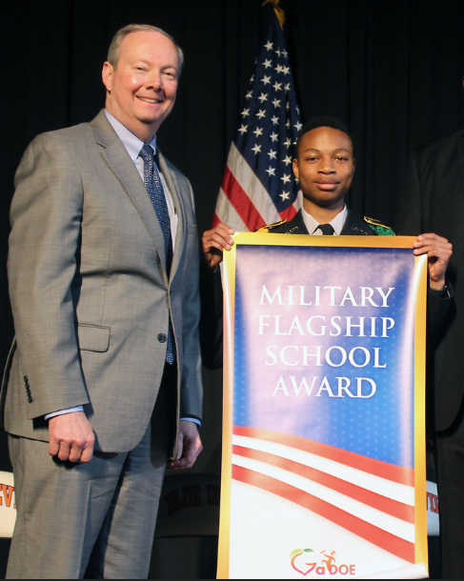
Military Flagship School Recognition
Recognized for a welcoming environment and providing targeted supports for children of military families
6 schools recognized (2018-2019):
Columbus High School, Muscogee County
Crooked River Elementary School, Camden County
Hilltop Elementary School, Houston County
Lowndes High School, Lowndes County
Riverside Elementary School, Columbia County
Snelson-Golden Middle School, Liberty County

Slide 34
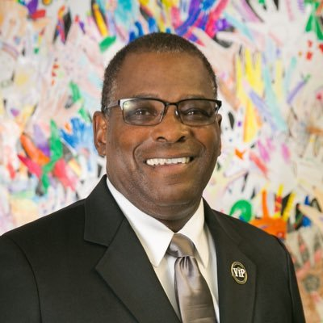
National Superintendent of the Year;
2019 National Superintendent of the Year
Dr. Curtis Jones, Bibb County
2020 Finalists for Georgia Teacher of the Year
Kristen Applebee, Georgia Academy for the Blind, State Schools
Amy Arnold, Colham Ferry Elementary School, Oconee County
Dr. David Bishop Collins, Fernbank Science Center, DeKalb County
Carlos Hernandez, General Ray Davis Middle School, Rockdale County
Lewis Kelly, Newton High School, Newton County
Tracey Nance Pendley, Burgess Peterson Academy, Atlanta Public
Stephanie Peterson, Westside Elementary School, Lowndes County
Teresa Thompson, South Tattnall Middle School, Tattnall County
Francisco “Frank” Zamora, Johnson High School, Hall County

