Slide 1
FALL BOOTSTRAP CONFERENCE October 18, 2018
Phillip l. Hartley
Harben, Hartley & Hawkins, LLP
340 Jesse Jewell parkway, Suite 750
Gainesville, GA 30501
(770) 534-7341
phartley@hhhlawyers.com

Slide 4
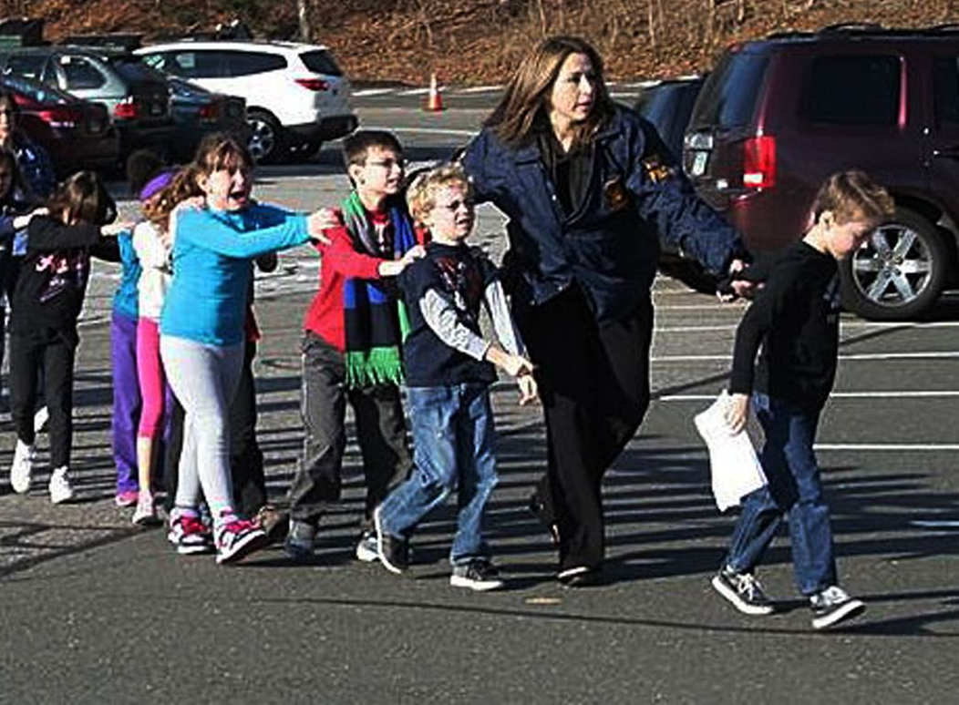
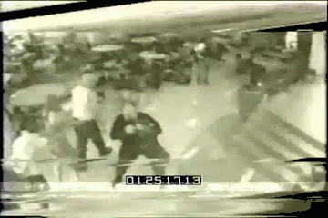
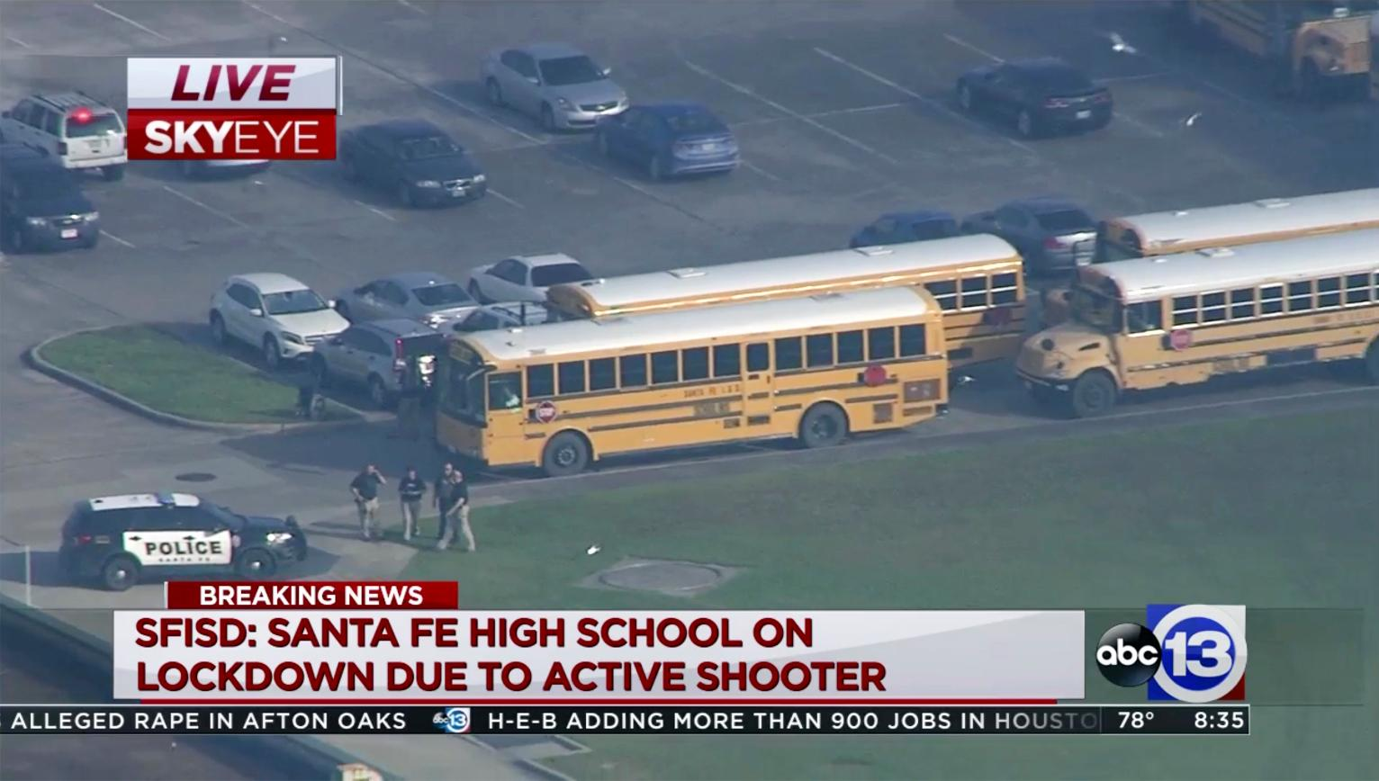
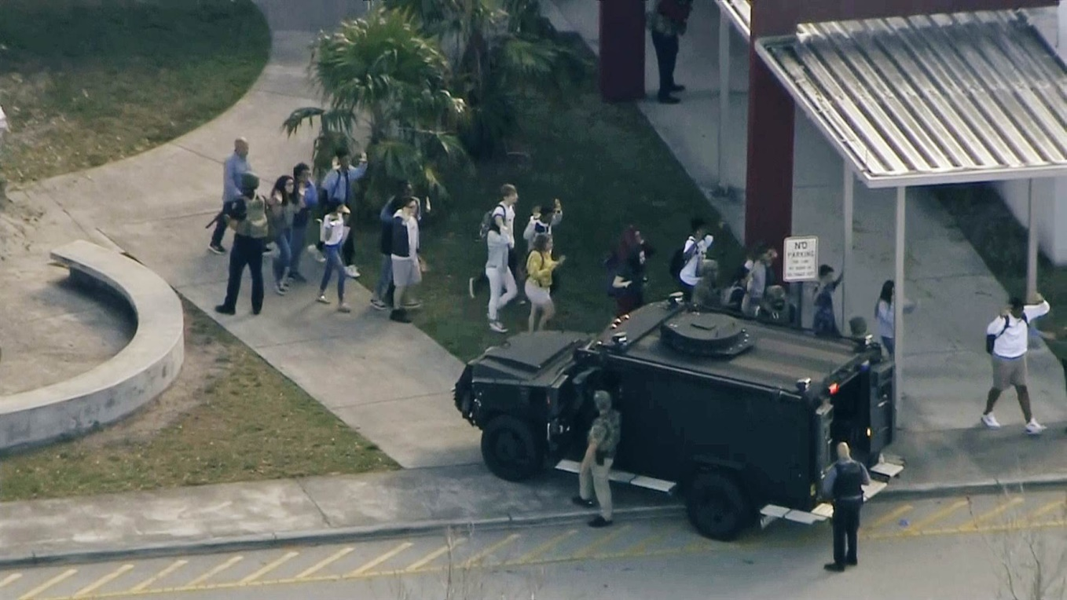

Slide 5
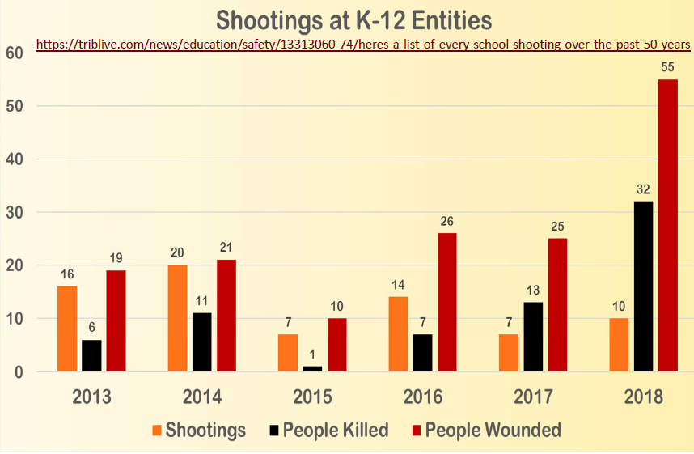

Slide 6
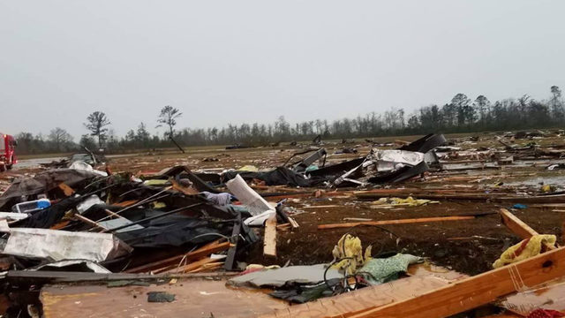
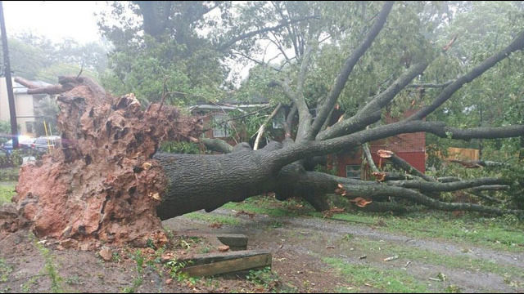
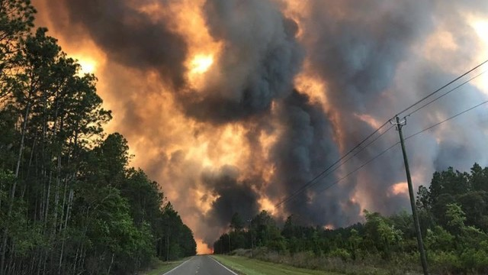
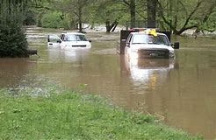
One of the Costliest Years For Weather Disasters in Georgia

Slide 7
Developing a Safety Plan, Policy and Practices, and Keeping It Current

Slide 8
Reviewing the District’s and Each School’s Safety Plan O.C.G.A. § 20-2-1185
Every public school shall prepare a school safety plan to help curb the growing incidence of violence in schools, to respond effectively to such incidents, and to provide a safe learning environment for Georgia's children, teachers, and other school personnel. Such plan shall also address preparedness for natural disasters, hazardous materials or radiological accidents, acts of violence, and acts of terrorism. School safety plans of public schools shall be prepared with input from students…, parents…, teachers…, community leaders…, other school employees…, and local law enforcement, fire service, public safety, and emergency management agencies. … Such plans shall be reviewed and, if necessary, updated annually. Such plans of public schools shall be submitted to the local emergency management agency.

Slide 9
O.C.G.A. § 20-2-1185 School Safety Plans as Revised by HB 763
(a) Every public school shall prepare a school safety plan to help curb the growing incidence of violence in schools, to respond effectively to such incidents, and to provide a safe learning environment for Georgia's children, teachers, and other school personnel. Such plan shall also address preparedness for natural disasters, hazardous materials or radiological accidents, acts of violence, and acts of terrorism. School safety plans of public schools shall be prepared with input from students enrolled in that school, parents or legal guardians of such students, teachers in that school, community leaders, other school employees and school district employees, and local law enforcement, juvenile court, fire service, public safety, and emergency management agencies. As part of such plans, public schools shall provide for the coordination with local law enforcement agencies and local juvenile court system. School safety plans shall include, at a minimum, the following strategy areas:

Slide 10
O.C.G.A. § 20-2-1185 School Safety Plans HB 763 requirements
Training school administrators, teachers, and support staff, including, but not limited to, school resource officers, security officers, secretaries, custodians, and bus drivers, on school violence prevention, school security, school threat assessment, mental health awareness, and school emergency planning best practices;
Evaluating and refining school security measures;
Updating and exercising school emergency preparedness plans;
Strengthening partnerships with public safety officials; and
Creating enhanced crisis communications plans and social media strategies.

Slide 11
O.C.G.A. § 20-2-1185 School Safety Plans HB 763(a) cont’d
Such plans shall be reviewed and, if necessary, updated annually. Such plans of public schools shall be submitted to the local emergency management agency and the local law enforcement agency for approval.

Slide 12
O.C.G.A. § 20-2-1185 School Safety Plans HB 763 cont’d
(b) A public school may request funding assistance from the state for facilities, technology, or other safety improvements or initiatives, such as the installation of safety equipment, including, but not limited to, video surveillance cameras, metal detectors, alarms, communications systems, building access controls, and other similar security devices. The Department of Education shall establish criteria that will be applied in reviewing funding requests pursuant to this subsection which shall take into consideration the physical security needs of the public school in evaluating how the school safety plan and funding request will support such physical security needs. Funding may be provided to a public school in accordance with a school safety plan prepared by the school and approved by the local board of education, the local law enforcement agency, the Department of Education, and the Georgia Emergency Management and Homeland Security Agency; provided, however, that a public school shall be required to match the state funding with local funds unless the school can demonstrate a substantial hardship.

Slide 13
O.C.G.A. § 20-2-1185 School Safety Plans cont’d
(c) School safety plans prepared by public schools shall address security issues in school safety zones as defined in paragraph (1) of subsection (a) of Code Section 16-11-127.1. School safety plans should also address security issues involving the transportation of pupils to and from school and school functions when such transportation is furnished by the school or school system and school functions held during noninstructional hours.
(d) The Georgia Emergency Management and Homeland Security Agency shall provide training and technical assistance to public school systems, and may provide this same training and technical assistance to private school systems, and independent private schools throughout this state in the area of emergency management and safe school operations. This training and technical assistance shall include, but not be limited to, crisis response team development, site surveys and safety audits, crisis management planning, exercise design, safe school planning, emergency operations planning, search and seizure, bomb threat management, and model school safety plans.

Slide 14
Planning is Useless Without Training HB 763 amends O.C.G.A. § 20-2-1185
(e) Every public school shall conduct drills with students, teachers, and other school personnel on the execution of school safety plans in such form and at such intervals based upon guidance from the Georgia Emergency Management and Homeland Security Agency.

Slide 15
Safety Plan Effectiveness
Each school needs its own plan
Put majority of time and emphasis on most likely events
Include representatives of groups responsible for implementing the plan
Should be a living document and not just another notebook on the shelf
Effectiveness comes only with proper training of personnel, coordination with other agencies, and communication with the community

Slide 16
Arming Staff from Teachers to SROs: Options and Best Practices

Slide 17
Exceptions to Weapons Statute: O.C.G.A. § 16-11-127.1
(c)(6) A person who has been authorized in writing to possess a firearm in a school safety zone, at a school function or on a school bus if a local board authorizes such possession in a policy meeting the requirements of O.C.G.A. § 16-11-130.1

Slide 18
O.C.G.A. § 16-11-130.1
(a) [definitions]
(b) Does not “require or otherwise mandate that any board of education or school administrator adopt or implement a practice or program for the approval of personnel to possess or carry weapons” nor does it “create any liability for adopting or declining to adopt” such a practice
If a local board adopts a policy to allow certain personnel to carry weapons, the policy must contain certain requirements

Slide 19
O.C.G.A. § 16-11-130.1 Policy requires
(b)(1) Training of approved personnel prior to their authorization to carry weapons. Must include review of “current laws relating to the use of force for the defense of self and others; provided, however, that the local board… may substitute for certain training requirements the personnel’s prior military or law enforcement service if the approved personnel has previously served as a certified law enforcement officer or has had military service which involved similar weapons training.”

Slide 20
O.C.G.A. § 16-11-130.1 Policy requires
(b)(2) “An approved list of the types of weapons and ammunition and the quantity of weapons and ammunition authorized to be possessed or carried.”
(b)(3) “The exclusion from approval of any personnel who has had employment or other history indicating any type of mental or emotional instability as determined by the local board of education.”

Slide 21
O.C.G.A. § 16-11-130.1 Policy requires
(b)(4) “A mandatory method of securing weapons which shall include at a minimum a requirement that the weapons, if permitted to be carried concealed by personnel, shall be carried on the person and not in a purse, briefcase, bag or similar other accessory which is not secured on the body… and, if maintained separate from the person, shall be maintained in a secured lock safe of similar lock box that cannot be easily accessed by students.”

Slide 22
O.C.G.A. § 16-11-130.1 Arming Staff
(c) Person approved to possess or carry weapons must be a license holder and the local board of education is responsible for conducting a criminal history background check annually to determine whether he or she remains qualified to fulfill these duties
(d) “strictly on a voluntary basis”, employees cannot be terminated or otherwise retaliated against for refusing to carry weapon

Slide 23
O.C.G.A. § 16-11-130.1 Who pays to arm staff?
(e) The local board is responsible for any costs associated with training personnel to carry weapons and the implementation of the policy, although employees are not prohibited from paying all or part of the costs or “using any other funding mechanism available, including donations or grants from private persons or entities.”

Slide 24
O.C.G.A. § 16-11-130.1 - Can the public get a copy of your safety plan?
(f) Documents and meetings pertaining to personnel approved to carry or possess weapons within a school safety zone, at a school function, or on a bus or other transportation furnished by a school shall be considered employment and public safety security records and shall be exempt from disclosure under Article 4 of Chapter 18 of Title 50.

Slide 25
HB 763 Amends Open Records Act
A new exemption in § 50-18-72 (a)
"(25.1) School safety plans prepared pursuant to Code Section 20-2-1185, whether in the possession of a local school system, a local law enforcement agency, a local emergency management agency, the Department of Education, the Georgia Emergency Management and Homeland Security Agency, or any other public entity;"

Slide 26
O.C.G.A. § 50-14-3(b)(4)
Portions of meetings during which that portion of a record made exempt from public inspection or disclosure pursuant to Article 4 of Chapter 18 of this title is to be considered by an agency and there are no reasonable means by which the agency can consider the record without disclosing the exempt portions if the meeting were not closed.

Slide 27
Arming Staff
Think of it only in connection with a safety plan and consult
Legal Counsel
Law Enforcement
Parents
Teachers and Staff
RMF or Insurance Carrier

Slide 28
Arming School Resource Officers O.C.G.A. § 20-8-5
(a) In each public school system in this state, school security personnel employed by the board of education of a county or an independent board of education of a municipality for the various public schools thereof who are certified pursuant to subsection (b) of this Code section and who are authorized by the board of education of that county or the independent board of education of that municipality shall have the same law enforcement powers on school property, including the power of arrest, as law enforcement officers of that respective county or municipality.

Slide 29
O.C.G.A. § 20-8-5 cont’d
(b) As a condition precedent to the exercise of law enforcement powers pursuant to subsection (a) of this Code section, school security personnel must be certified by the Georgia Peace Officer Standards and Training Council as having met the qualifications and having completed the basic training requirements for a peace officer under Chapter 8 of Title 35. The certification of school security personnel by the Georgia Peace Officer Standards and Training Council does not require that such security personnel exercise the powers provided in subsection (a) of this Code section.

Slide 30
O.C.G.A. § 20-8-5 cont’d
(c) The provisions of this Code section shall not prohibit a board of education of a county or an independent board of education of a municipality from employing school security personnel without law enforcement powers.
(d) School security personnel who are certified by the Georgia Peace Officer Standards and Training Council may be authorized by a local board of education to carry a standard issue firearm or weapon generally used for law enforcement purposes for the purpose of carrying out law enforcement duties.

Slide 31
Review Existing MOU or SRO Job Description
Role of the SRO as part of the Safety Plan
Relationship with Law Enforcement
Coordination of SRO with law enforcement and school staff
Does the SRO have training on the specifics of the plan?

Slide 32
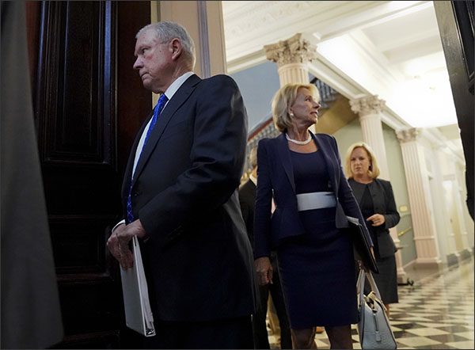
Federal government seeks to address school safety
Notes:
This picture isn’t creative commons/free to use etc
Or use photo of kids exiting building

Slide 33
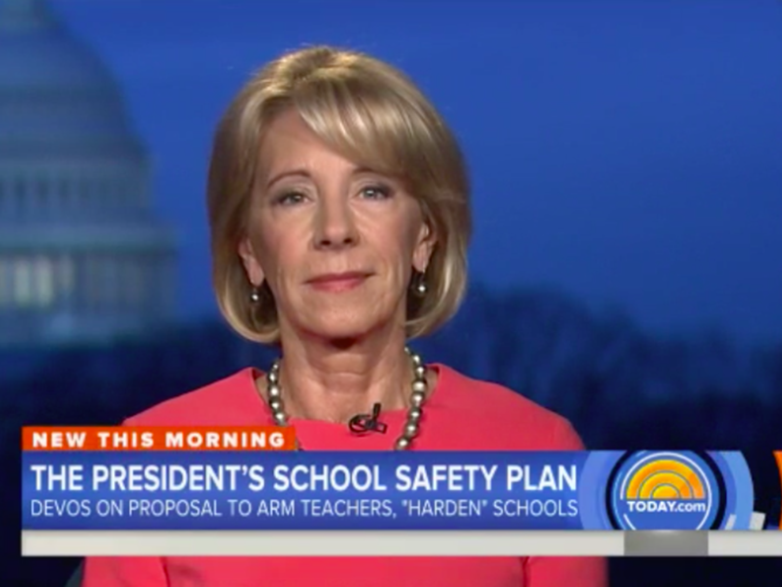
Notes:
Note here that no direct funding provided to arm teachers yet

Slide 34
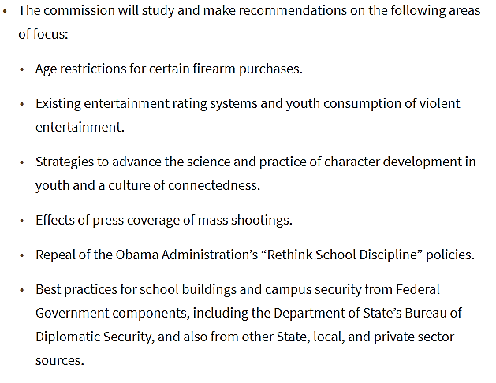
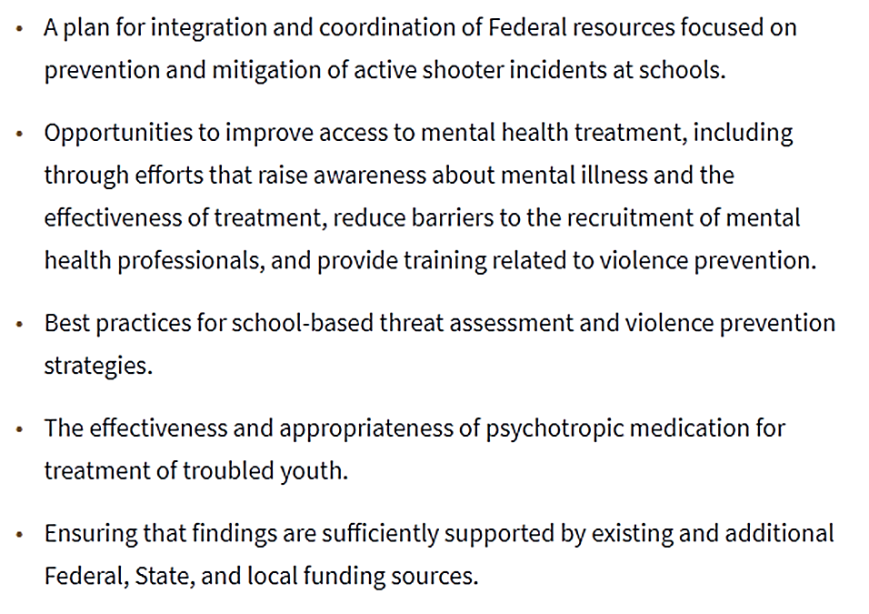
The Commission will study and make recommendations in the following areas:
Notes:
This slide will highlight the curious additions

Slide 35
The Commission will study and make recommendations in the following areas:
Notes:
This slide will highlight the curious additions

Slide 36
Threat assessments
A threat assessment is a process for “identifying, assessing, and managing students who may pose a threat of targeted violence in schools.”
Unlike a discipline investigation, the focus of a threat assessment is not to determine whether a student did or did not make a threat, but whether a student poses a serious and legitimate threat to the school community.
Several states have passed laws requiring school districts to develop threat assessment procedures.

Slide 37
THREAT ASSESSMENTS AND SPECIAL EDUCATION
Neither the IDEA nor Section 504 requires a school district to develop a threat assessment procedure, and the threat assessment process is not explicitly regulated by either law.
Notwithstanding, school districts should be mindful of how the requirements of the IDEA and Section 504 may impact the threat assessment process.

Slide 38
G.H. V. MCDUFFIE COUNTY BOARD OF EDUCATION, SBOE 2018-33
Local boards of education generally do not have jurisdiction over off-campus misconduct
Georgia law, however, requires local boards of education to adopt a policy prohibiting bullying, including cyberbullying, whether on or off-campus. O.C.G.A. § 20-2-751.4
In reviewing the record, the State Board does not find any evidence that the Local Board had such a policy or that the Student was charged with cyberbullying which would have provided the Local Board with jurisdiction of the alleged off-campus behavior

Slide 39
G.H. V. MCDUFFIE COUNTY BOARD OF EDUCATION cont’d
In reviewing the record, the State Board does not find any evidence that the Local Board had such a policy or that the Student was charged with behavior that could result in the student being criminally charged with a felony for off-campus behavior
The State Board finds that the lack of the required “rule or rules allegedly violated” and the lack of the required “date, time, and place” of the violation along with the lack of “the details of the actions that constitute a violation of a rule” prevented the Student from defending against the charges

Slide 40
A New Approach to OCR Complaints
Resolution over investigation
Addressing issues rather than punishment
Some argue no emphasis on enforcement
Clearly less emphasis on advocacy of specific issues
Notes:
Focus on new OCR here

Slide 41
Discipline and Title VI
Based on OCR’s Data Collection, Obama administration issued 2014 Dear Colleague Letter on racial disparities in discipline: urged schools to emphasize positive interventions over more punitive measures, like suspension or expulsion.
Critics claim guidance values statistics over students; schools less safe; restricted ability to maintain order
2 listening sessions with teachers, parents, students, administrators, researchers, advocates and union representatives to hear varying views on whether the DCL should be kept as is, amended or rescinded.
DeVos Holds ‘Listening Sessions’ on Student Discipline as GAO Report Confirms Widespread Racial Disparities
Notes:
Mention repeal of discipline policies from Obama here

Slide 42
Likely changes in title ix sexual harassment guidance
More limited definition of sexual harassment
Limit Title IX responsibility to only incidents that occurred on campus or during a school program
Higher evidentiary standard to substantiate a claim
Reinstate mediation option
Give parties access to evidence
Presumption of innocence for the accused
Emphasis on fairness and due process for both slides

Slide 43
INCREASED EMPHASIS ON DUE PROCESS
Greater focus on the rights of the accused
Interim measures that don’t unduly disadvantage either party
Equal access to evidence
Title IX protects male students too –
must be treated fairly in the investigation
and adjudication process

Slide 44
Aspects of title ix compliance
Policies and Procedures
Prevention Programs
Training for staff and students
Reporting Processes
PROPER INVESTIGATIONS
Effective Responses

Slide 45
What Can Be Disclosed under FERPA now?
Health Emergency
&
Safety Emergency
Law Enforcement Records
Personal Knowledge or Observation
“If the educational agency or institution determines that there is an articulable and significant threat to the health or safety of a student or other individuals…”
“it may disclose information from education records to any person whose knowledge of the information is necessary to protect the health or safety of the student or other individuals.”
Investigative reports and records that are created and maintained by law enforcement units
Information learned through personal knowledge or observation
FERPA only applies to educational records
34 CFR § 99.36(c)
34 CFR § 99.36(c)
34 CFR § 99.8

Slide 46
Funding Provided through STOP School Violence Act
Funding to Bolster School Security
The STOP School Violence Prevention and Mental Health Training Program
The COPS Office School Violence Prevention Program
$70M
$28M
$25M
Training educators to respond to incidents of violence at school
Training on how to respond to crises related to mental health
Training for law enforcement and new technology to help notify law enforcement
Notes:
Grants have been provided via the STOP School Violence Act. Sessions says it’s been signed into law by Trump. https://www.justice.gov/opa/pr/department-justice-announces-more-70-million-support-school-safety-and-64-million-improve

Slide 47
New Department of Homeland Security Materials
Guide to Threat Assessments
School Security Survey

Slide 48
Lozman v. city of Riviera beach
138 S. Ct. 1945 (U.S. 2018)
Plaintiff arrested at city council meeting after speaking off-topic and refusing to leave the podium
Court held that the existence of probable cause for arrest did not defeat a First Amendment claim for retaliatory arrest

Slide 49
Lozman v. city of Riviera beach
Plaintiff has to show that “retaliation was a substantial or motivating factor behind the [arrest], and, if that showing is made, the defendant can prevail only by showing that the [arrest] would have been initiated without respect to retaliation.”
Justice Thomas, dissenting, would have concluded that probable cause for arrest necessarily defeats a claim of retaliatory arrest

Slide 50
KNIGHT FIRST AMENDMENT INSTITUTE V. TRUMP
302 F. Supp. 3d 541 (S.D.N.Y. 2018)
Seven Twitter users filed suit against the President after they were blocked by the @realDonaldTrump Twitter account after Tweeting critical messages about the President or his policies

Slide 51
The Defense stipulated that …
The President blocked the 7 Plaintiffs from the @realDonaldTrump account; and that
The @realDonaldTrump account is presented as being registered to the “45th President of the United States” and that the account has been used in the course of the appointment and removal of officers, including cabinet secretaries, and “the conduct of foreign policy.”

Slide 52
Held:
The interactive portions of the @realDonaldTrump Twitter page were a designated public forum subject to strict scrutiny
Plaintiffs were blocked from speaking based on their viewpoint in violation of their First Amendment Rights

Slide 53
Courts have found First Amendment violations when …
School board members blocked parents on social media, when the social media page was sufficiently linked to the board members’ official capacity
Citizens were blocked for posting complaints about public officials

Slide 54
Public entities have prevailed when…
Social media pages belonging to government officials were purely personal and not affiliated with the individual’s official capacity
The public entity maintained a Social Media Policy prohibiting comments unrelated to posted topics

Slide 55
GAEL Fall Legal Issues Workshop
November 5, 6 and 7, 2018
Georgia Center
Athens, Georgia
ONLY ONE OF THE YEAR!

