Slide 1
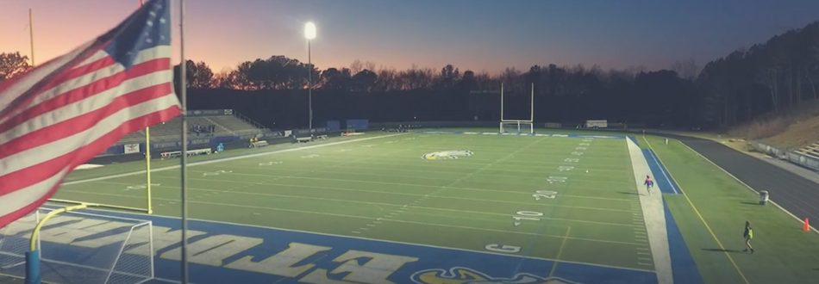
October 18, 2018
Lessons We Can Learn from the
School Attack that Didn’t Happen

Slide 2
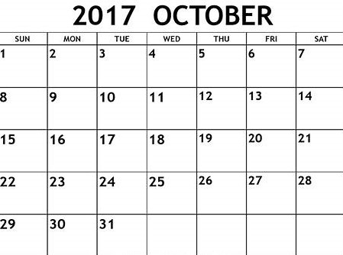
GSSA: Lessons We Can Learn from the School Attack that Didn’t Happen

Slide 3
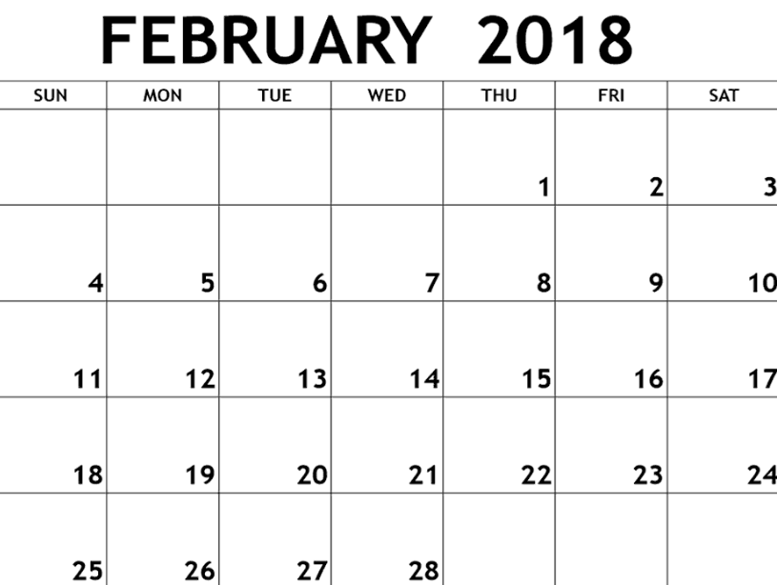
EHS Incident
MSD
HS
GSSA: Lessons We Can Learn from the School Attack that Didn’t Happen

Slide 4
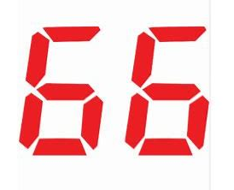

Gained National Attention
MSD
HS
GSSA: Lessons We Can Learn from the School Attack that Didn’t Happen

Slide 5



Gained Local Attention
Gained National Attention
EHS Incident
MSD
HS
GSSA: Lessons We Can Learn from the School Attack that Didn’t Happen

Slide 6
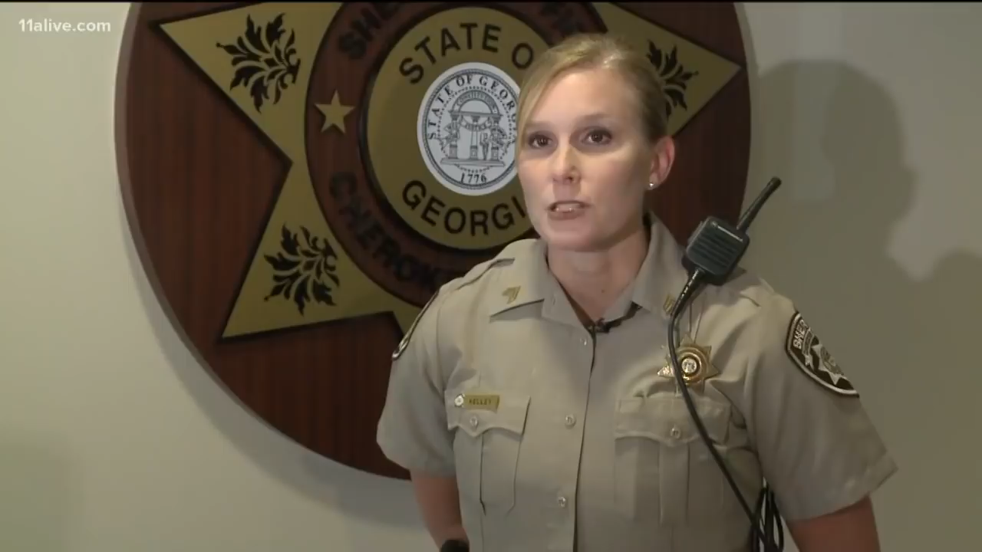
Post Media Clip Here
GSSA: Lessons We Can Learn from the School Attack that Didn’t Happen

Slide 7
Day | Event
SUN, Oct 15 | Woodstock PD receives a tip of potential school violence late evening on a dedicated tip line.
MON, Oct 16 | CCSD Police receive tip from Woodstock PD. Cherokee SO brought in to lead investigation later afternoon. Investigation begins, one student arrested late evening and accomplice sought.
TUE, Oct 17 | Investigation continues, a second student arrested.
WED, Oct 18 | Media begins reporting two students arrested. Cherokee SO conducts press conference and CCSD communication plan w/public completed. In midst of incident, an additional school threat is rumored via social media.
THU, Oct 19 | Arrested students make first court appearance. CCSD investigating additional school threat.
FRI, Oct 20 (homecoming) | Additional school threat is investigated, four students arrested for hoax/threat.
@GSPRA
GSSA: Lessons We Can Learn from the School Attack that Didn’t Happen

Slide 8
Disaster Averted? That’s a Great Day!!!
GSSA: Lessons We Can Learn from the School Attack that Didn’t Happen

Slide 9

PREPAREDNESS
Plans & Protocols
Provisions
Partnerships
AUDIT
Personnel
Physical Plant
GSSA: Lessons We Can Learn from the School Attack that Didn’t Happen

Slide 10

Comprehensive
Plans & Protocols
Partnerships Physical Plant Personnel Provisions
Action-Oriented
Timely
Effective
COMMUNICATION
GSSA: Lessons We Can Learn from the School Attack that Didn’t Happen

Slide 11



Plans & Protocols
WHAT WORKED:
“See Something, Say Something” Reporting
Inter-agency Reporting/Communication
Emergency Planning and Training Practiced and Utilized
Communications (School Board, District Leadership, Principal, Employees, Parents, Media)
GROWTH/IMPROVEMENT CONSIDERATIONS:
Tip-Line Mechanism and Campaign--#SafeCherokee
Quicker communication between LE agencies
Communication to All Parents on Multi-School Campuses
Update of Reunification Plans
GSSA: Lessons We Can Learn from the School Attack that Didn’t Happen

Slide 12


Partnerships
WHAT WORKED:
Great Cooperation and Communication With LE, Judicial and Community Agencies (Serves as “Force Multiplier” for Police Force, Counselors and School Administrators)
GROWTH/IMPROVEMENT CONSIDERATIONS:
Co-Agency PSA Campaign
GSSA: Lessons We Can Learn from the School Attack that Didn’t Happen

Slide 13
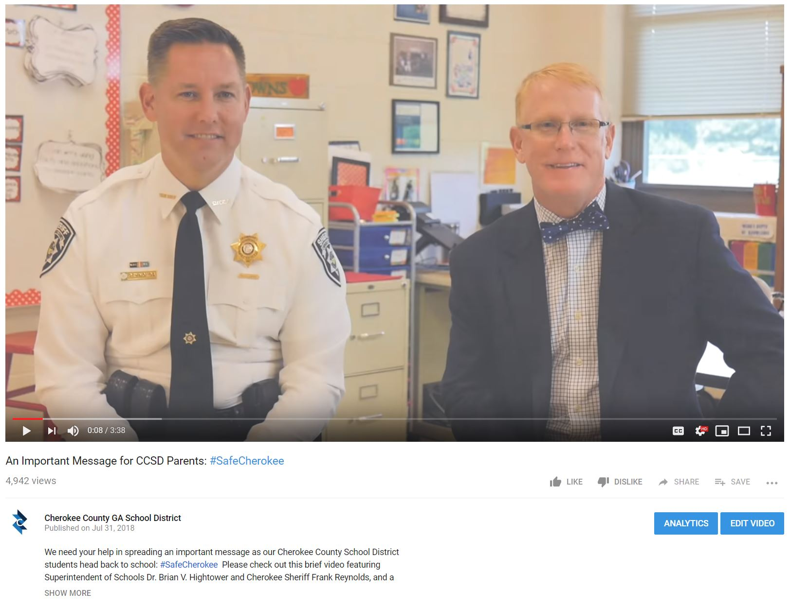
GSSA: Lessons We Can Learn from the School Attack that Didn’t Happen

Slide 14
Physical Plant
GROWTH/IMPROVEMENT CONSIDERATIONS:
Additional Interior/Exterior Camera Coverages
Security Foyer Addition for MS/HS Campuses
Door Security Concerns (Open Campus) and Size of Facility a Concern
GSSA: Lessons We Can Learn from the School Attack that Didn’t Happen

Slide 15
Personnel
WHAT WORKED:
In-House Police Department (Capacity More Robust w/Officers, Investigators and Emergency Manager)
Communications Division
School Operations Division
GROWTH/IMPROVEMENT CONSIDERATIONS:
Potential Additional Officers for Large High Schools
GSSA: Lessons We Can Learn from the School Attack that Didn’t Happen

Slide 16
Provisions
WHAT WORKED:
Presence of Emergency Provisions, Equipped LE and Identified Reunification Site
Student Code of Conduct and School Police Policies Drove Investigations and Consequences
Ad Hoc Study Committee Recommendations
GROWTH/IMPROVEMENT CONSIDERATIONS:
Additional LE equipment and inter-operability of LE agency radios
Support Counselors and Adoption of Intervention Curriculum for All Levels (ES, MS and HS)
In-House Tip Line and Usage Campaign—#SafeCherokee –PSAs, Social Media Stories, Media Coverage, Stickers and Posters
GSSA: Lessons We Can Learn from the School Attack that Didn’t Happen

Slide 17

GSSA: Lessons We Can Learn from the School Attack that Didn’t Happen

Slide 18
October 18, 2018
“A good relationship starts
with good communication”
#SafeCherokee – Thank You!

