Slide 1
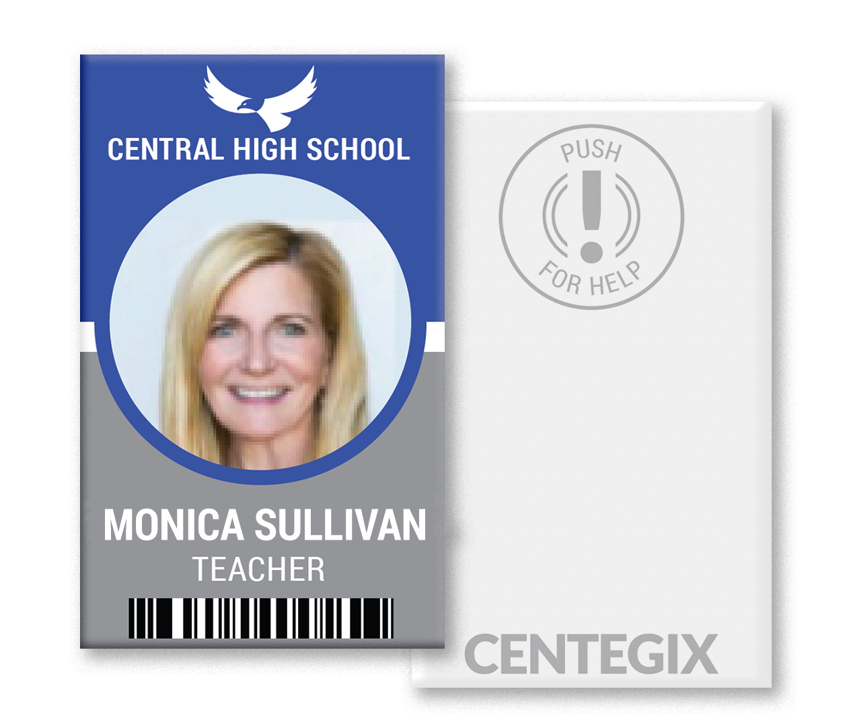
Company Evolution
Invested in Kloud-12
Video Solution
Moved from Reseller to Developer
Acquired
Crisis Alert
Dec. 2015
Mar. 2017
Mar. 2018
Oct. 2018
May 2016
Jan. 2018
July 2018
Launched DES
Reseller
Built Proprietary
Camera
Acquired
Kloud-12
Video Solution
CENTEGIX
Launched
Centegix
Notes:
Many of you have asked about all the different name changes….

Slide 2
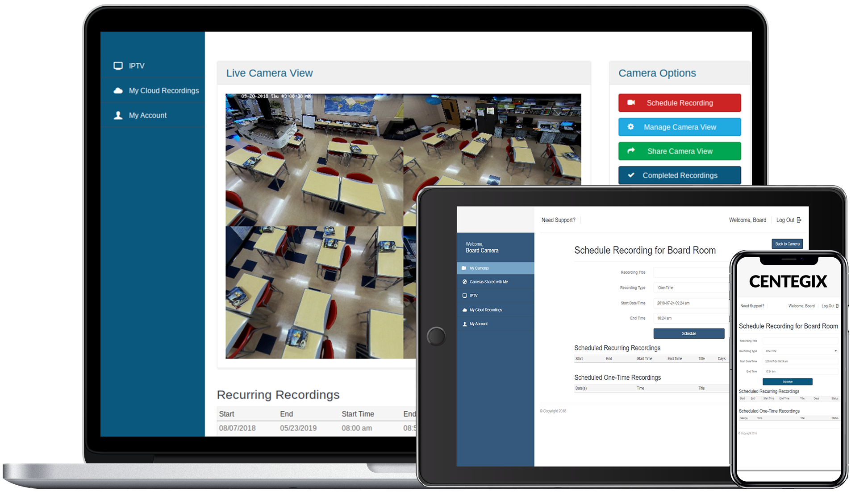
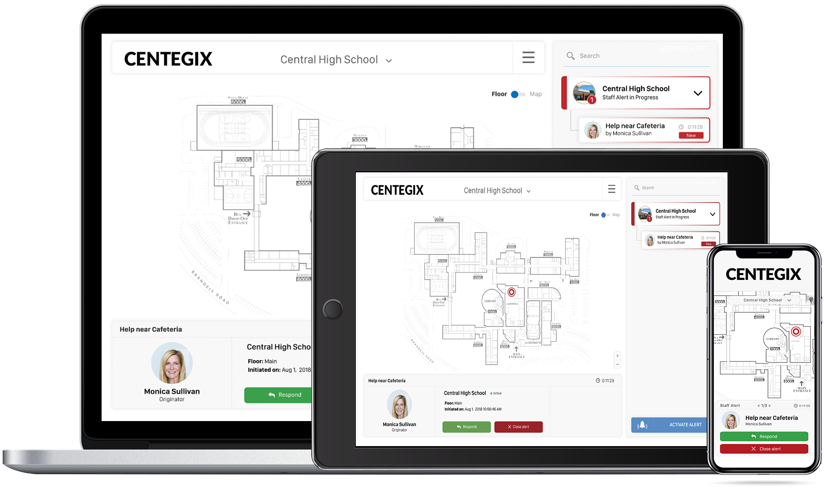
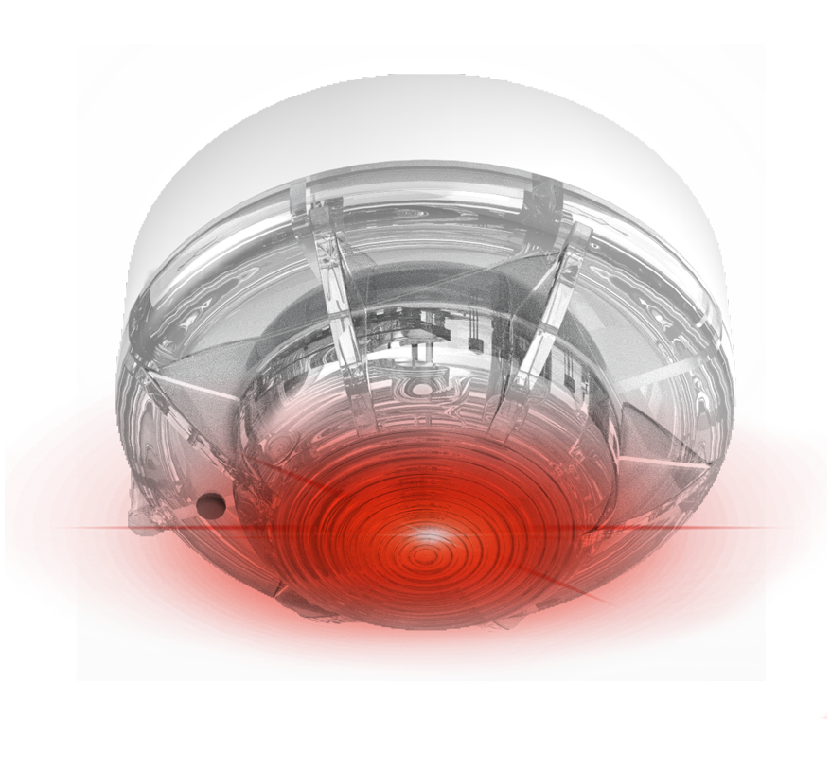
Classroom Video Solution
Crisis Alert Solution
Notes:
We continue to innovate with our Kloud-12 Classroom Video Solution, we now offer a Crisis Alert Solution. Today, we are going to focus on the Crisis Alert Solution.

Slide 3
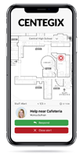
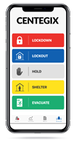
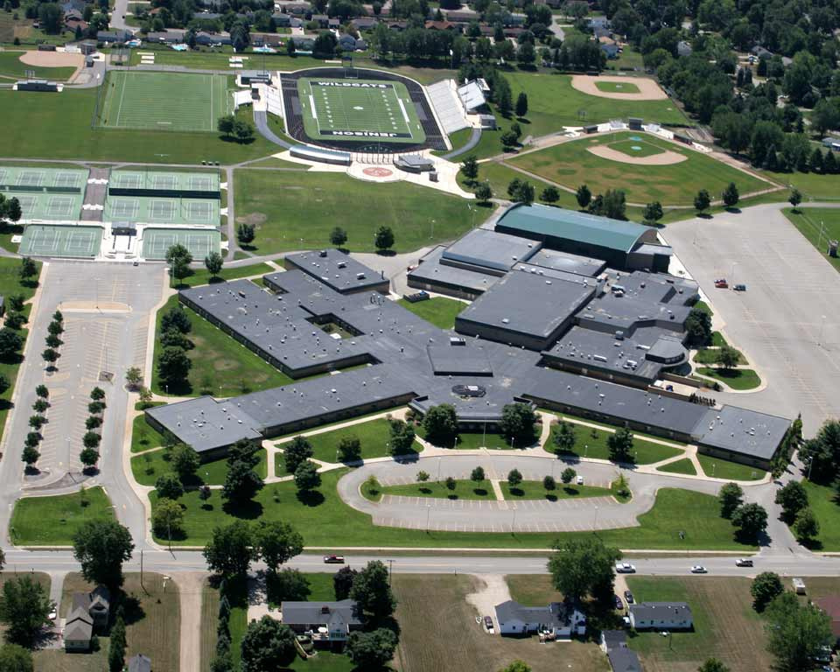
Crisis Alert System
Staff Alert Badge
Campus-wide Protection
Instant Response
Real-Time Locating
District
Protocols
Notes:
Our system -
Alert Badge
Provides campus wide protection
Instant Response with real-time locating
Utilizes district protocols

Slide 4
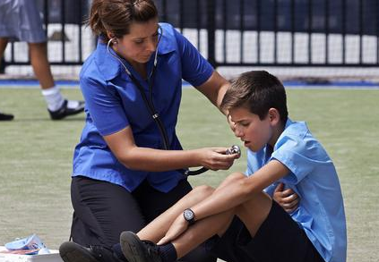
Two Types of Alerts
Campus Alerts
School/Region/District Issue
Individual Staff Alerts
Room/Area Issue
Notes:
Our system can activate 2 types of alerts
Campus - when you want to notify an entire building (or district) to take action.
Visual Cues
Auditory Cues
Instructions Provided
School and District Responders notified
Individual
School Responders notified
First – we are going to discuss Individual Staff Alerts

Slide 5
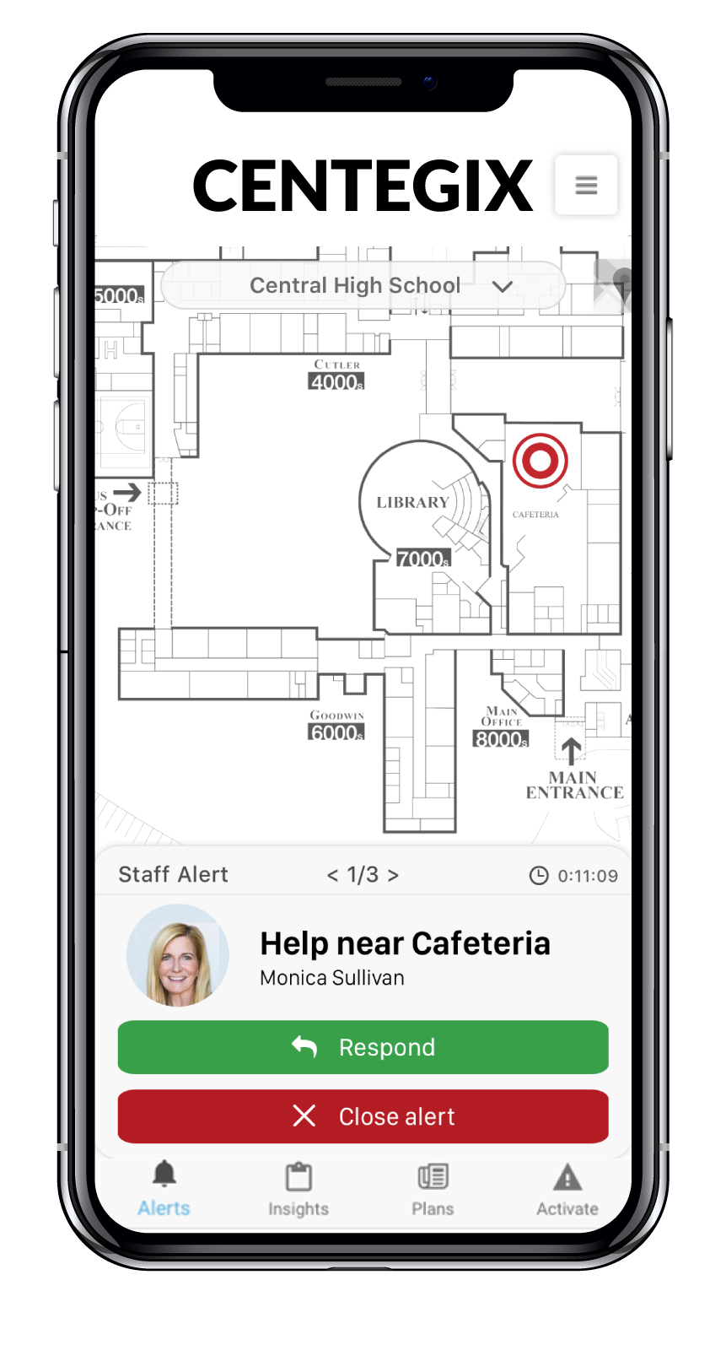
Individual Staff Alerts
Room/Area Issue
Medical Issues
Discipline Issues/Fights
Custody Situations
Staff Alert Badge
School Responders
Notes:
This system will be used EVERY day…for medical issues, discipline issues, etc.
Add stories here - medical/fights/etc.

Slide 6
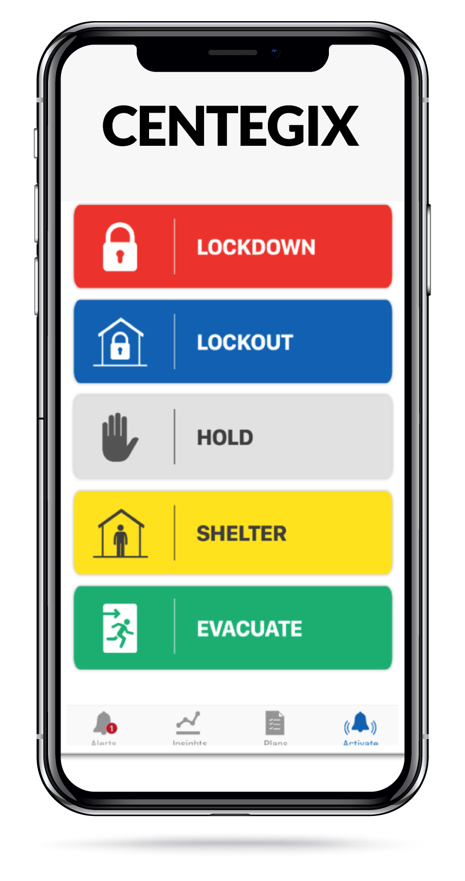
Campus Alerts - School/Region/District Issue
Staff Badge
All Employees
Visual Cues
Alert Beacon
Auditory Cues
Integrated into intercom system
Instruction
Displays on computer and mobile devices
School Responders
Notification on mobile devices
Authorities Notified
Option for integration with communication systems for local authorities
Auditory Cues
Integrated into intercom system
Instruction
Displays on computer and mobile devices
School Responders
Notification on mobile devices
Mobile App
District Leadership
Notes:
In an event of a campus alert (active shooter, law enforcement issue, weather emergency), this is what occurs.
Let’s walk through an example of what happens during a campus alert.
When the badge is pressed (in this example of a lockdown) it can activate the alert beacon, show a message on every computer in the school and notify responders immediately on their mobile phones and computers

Slide 7
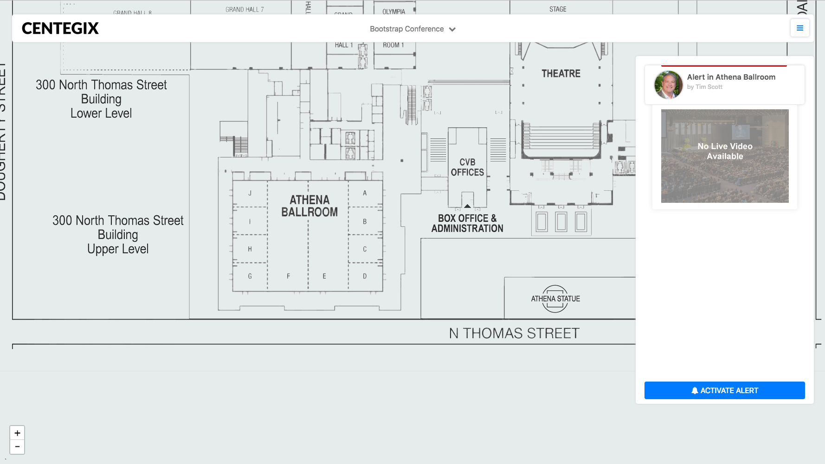
Notes:
As you can see, the beacons are flashing, the siren is sounding,

Slide 8
Notes:
Instructions displayed on devices
displayed school-wide.

Slide 9
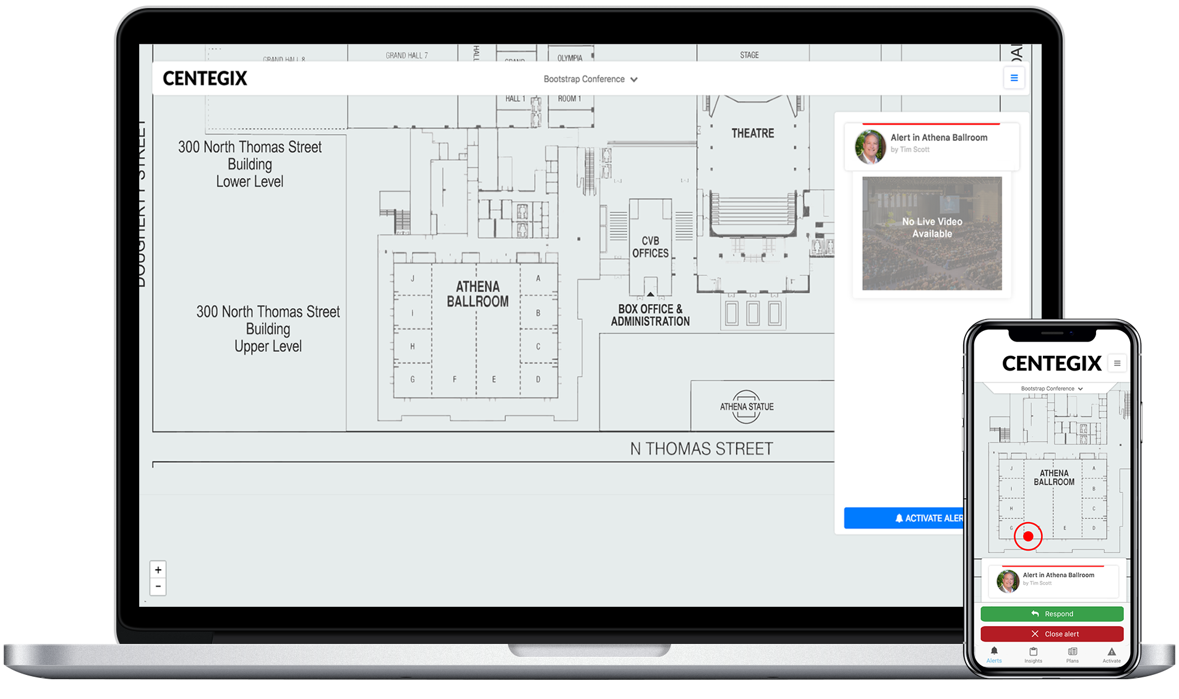
Responders - Notification
Notes:
Moses - Add updated image of Supt Tim Scott to the laptop view
Alysse - get updated image for the cell phone version from Adam
What happens to the responders computer screen?
Responders get a mobile notification - with
Ability to respond
Ability to close alert,
and include comments

Slide 10
Campus Alerts - School/Region/District Issue
Staff Badge
All Employees
Visual Cues
Alert Beacon
Auditory Cues
Integrated into intercom system
Instruction
Displays on computer and mobile devices
School Responders
Notification on mobile devices
Authorities Notified
Option for integration with communication systems for local authorities
Mobile App
District Leadership
Notes:
In an event of a campus alert (active shooter, law enforcement issue, weather emergency), this is what occurs.
Let’s walk through an example of what happens during a campus alert.
When the badge is pressed (in this example of a lockdown) it can activate the alert beacon, show a message on every computer in the school and notify responders immediately on their mobile phones and computers

Slide 11
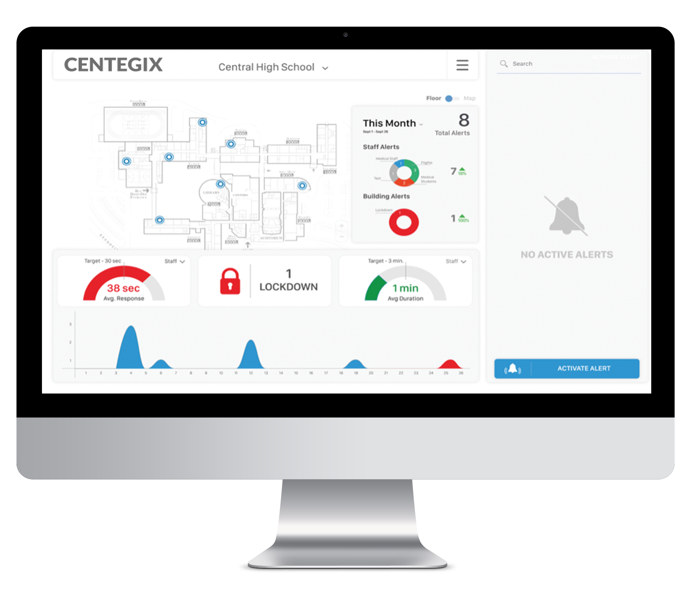
Data and Analytics
Automatically Capture Incident Data
Trend Data
District Benchmarks
Notes:
For both types of alerts, you will have data and analytics that roll up and are provided to you.
Hillsborough example - 4 drills per year, this data would help improve/reassign/reallocate staff, etc.
Columbus example - every 6 seconds
Automatically capture incident data:
Who, what, when, where, why - including who responded, how long it took, etc. All of this is rolled into an Alert Summary
Trend data
Able to compare school to school - to improve response times, and adjust number of responders, location of responders, etc.
District Benchmarks
Inform stakeholders of your district goals, and actual metrics - frequency of alerts, types of alerts, response times, etc.
After every event, whether building or staff level - all of the data is provided:
What type of event
Who responded
How long did it take to respond?
How long did it take to close?
This can be useful information to continue to improve response time/communication for safety drills and actual events. And to be able to drill down into the analytics - are responses taking longer in Bldg 12 versus Bldg 9? 5th grade hall verus K hall? Do we have enough responders? Do we have the right responders?

Slide 12
“As Superintendents, we are charged with doing everything we can possibly do to keep students safe.”
Dr. Mike Newton,
Jasper County Superintendent
Fall Bootstrap Conference
Notes:
https://www.forbes.com/sites/forbestechcouncil/2018/09/06/how-new-innovations-can-make-schools-safer/#9626f9d736b3
The Captain is a 10 year veteran and ensures the safety and security of 63 public schools serving 67 K students and 10K employees
told to the told the Texas House of Representatives Committee on Public Education.
The Need For School Safety Innovations
The increasing frequency of school shootings in the United States has placed security in the forefront of the minds of parents, teachers, administrators and community leaders. Some find comfort in statistics, pointing out that school shootings are comparatively rare when measured against the number of students in our schools. To do so, however, is a mistake. “Those things don’t happen here” is a myth. School shootings have happened everywhere -- in rural, suburban and urban school districts; in elementary, middle, and high schools; in our colleges and universities. During the last half of the 2018 school year, there was a shooting somewhere in America on average every week. In Santa Fe, Texas, and Parkland, Florida, major losses of life and mass casualties resulted, devastating those communities. Since the Columbine High School massacre, statistics show the frequency of school shootings has steadily increased.

