Slide 1
School Safety
Georgia Department
of Education
Garry McGiboney

Slide 2

He is most free from danger, who, even when safe, is on his guard.
-Publilius Syrus (85 BC-43 BC)

Slide 3

“Workplace safety begins and ends with attention to all aspects of the climate. Workplace climate is safety.”
-RAND CORPORATION RESEARCH

Slide 4

  According to Harvard Business Review Research, the Best and Safest Organizations Are…
  A place where individual differences are nurtured.
  A place where information is not suppressed.
  A place where the organization adds value to employees, rather than taking value from them.
  A place that has a purpose.
  A place where the work is meaningful and is recognized.
  There are no stupid rules.

Slide 5
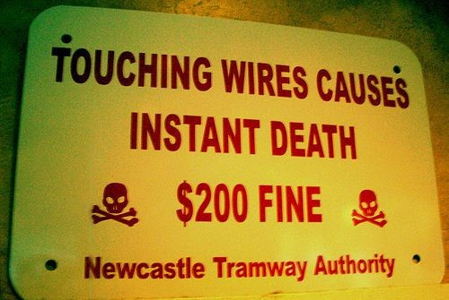
  There are no stupid rules.

Slide 6
Harvard Business Review
Organizations with a positive and safe workplace are more successful because the climate:
  Increases positive emotions and well-being
  Improves people’s relationships with each other and amplifies creativity
  Buffers against negative experiences such as stress, thus improving employees’ ability to bounce back from challenges and difficulties while bolstering their health
  Attracts and retains employees, making them more loyal to the leader and to the organization as well as bringing out their best strengths

Slide 7
  Harvard Business Review Conclusion
  When organizations have a positive climate they achieve significantly higher levels of organizational effectiveness — including safety, financial performance, customer satisfaction, productivity, and employee engagement and retention, and experience fewer safety crisis situations.

Slide 8
  Harvard Business Review Conclusion
  “Well-being and safety come from one place, and one place only – a positive workplace climate.”

Slide 9

United States Army Climate Indicators
Positive and Safe Command Climate Indicators:
  Trust exists in the command
  Teamwork, fair play, and information sharing
  Open, candid communications
  Soldier job satisfaction
  Soldiers & families attend unit social/sports activities
  Reenlistment rate is high (retention)
Reference: FM 22-100

Slide 10

United States Navy Command
Climate Assessment
Both Active and Reserve Commanders, Commanding Officers and Officers-in-Charge are required to complete a Command Climate Assessment within 90 days after assumption of command and every 9-12 months as follow-up during their command tenure.
Safety and productivity increase as climate improves.
Reference: OPNAVINST 5354.1F

Slide 11

Gallop Poll
A Gallup Poll of employees showed that, even when companies offered benefits, employees preferred workplace well-being to material benefits.
Notes:
https://www.nova.edu/ie/ice/forms/engagement_drives_results.pdf

Slide 12
Research indicates that a positive school climate is critical to overall school safety (RAND Corporation; M. C. Wang, Haertel, and Walberg)
“A negative school climate is the only school characteristic that consistently correlates with school violence after taking into account other school features and factors.”
RAND Corporation

Slide 13
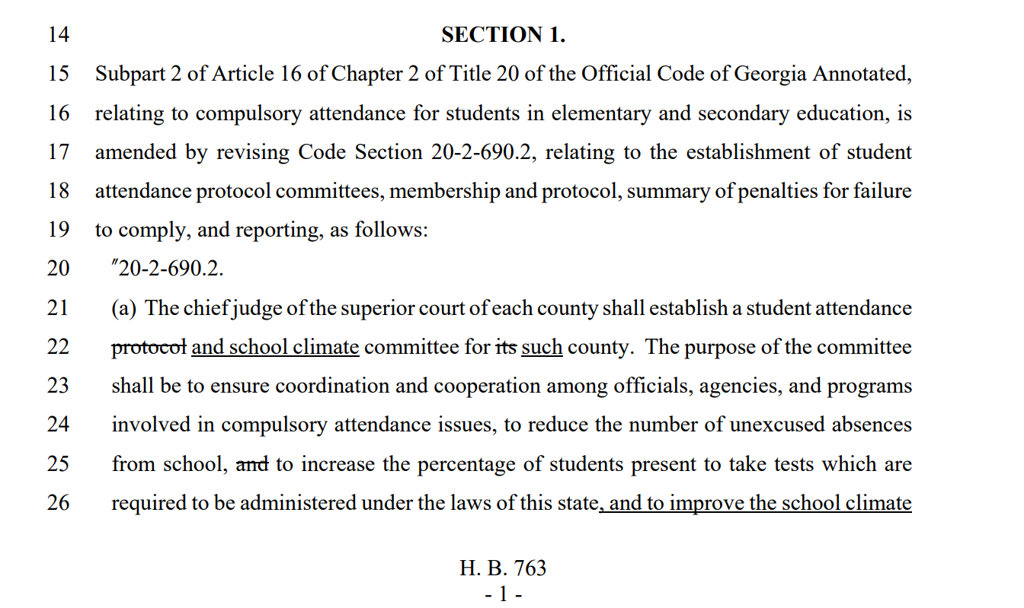
HB 763
Adds school climate to the Student Attendance Protocol Committee

Slide 14
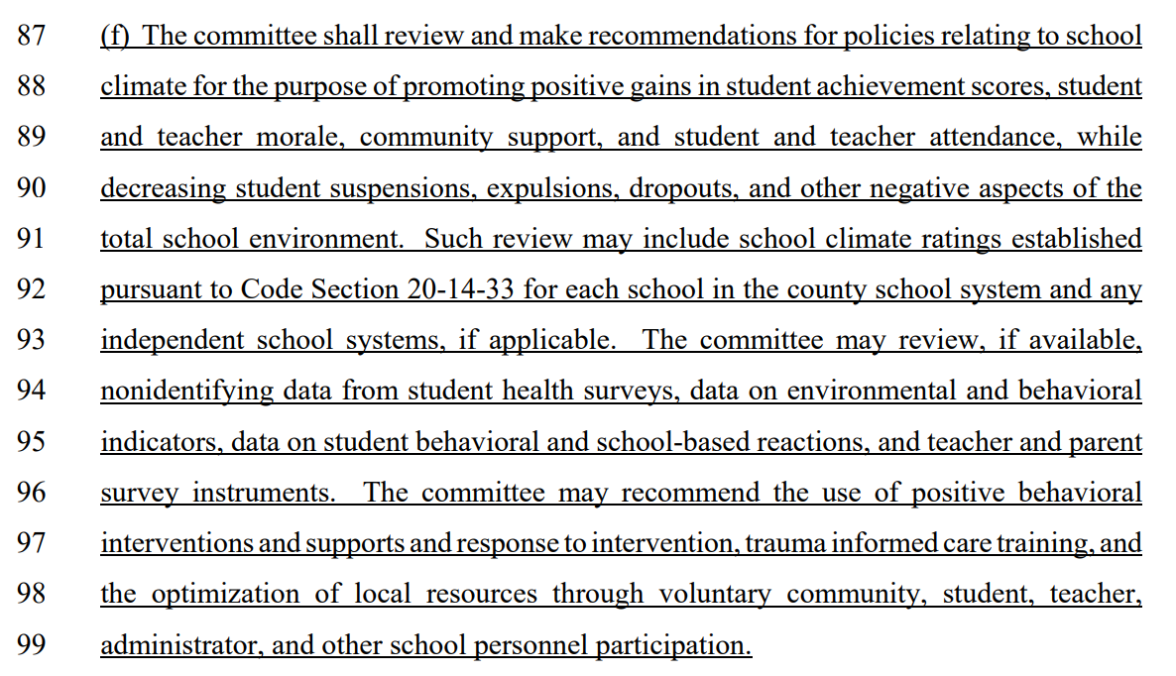

Slide 15

State statute requires a School Climate Rating for each school
Official Code of Georgia Annotated 20-14-33
School Climate Rating

Slide 16
Georgia Student Health Survey

Slide 17
School Climate is the experience of school life and reflects norms, goals, values, social interactions, access, engagement, connections, teaching and learning practices, building quality, safety, and organizational practices. Positive Behavioral Interventions and Supports (PBIS) has proven to improve school climate and safety.
-National School Climate Center

Slide 18
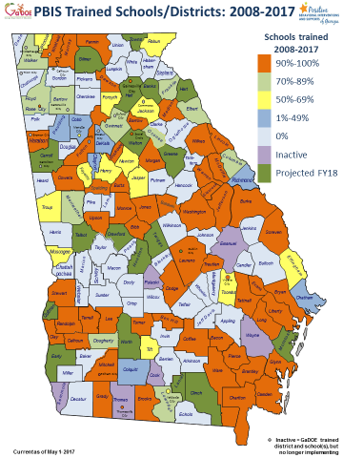
PBIS

Slide 19
2009 = 80 schools
2018 = 1,361 schools in 115 school
districts

Slide 20
165,000
Number of Schools Implementing PBIS
1,361
34% Reduction of OSS
113,000
80

Slide 21
1
2
3
4
5

Slide 22
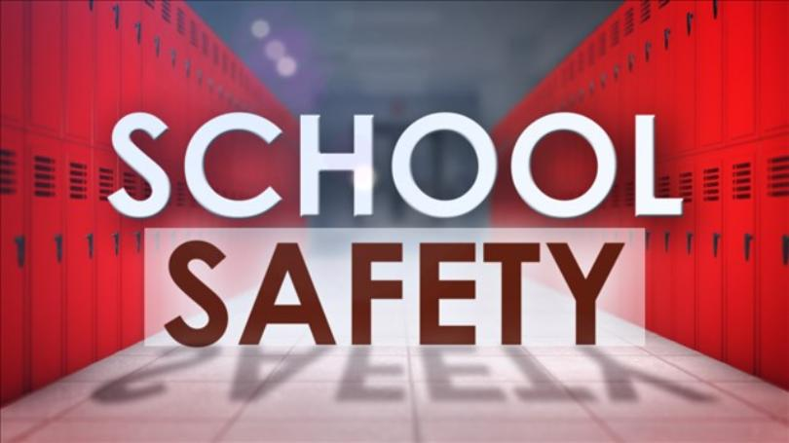
School Safety Plan

Slide 23
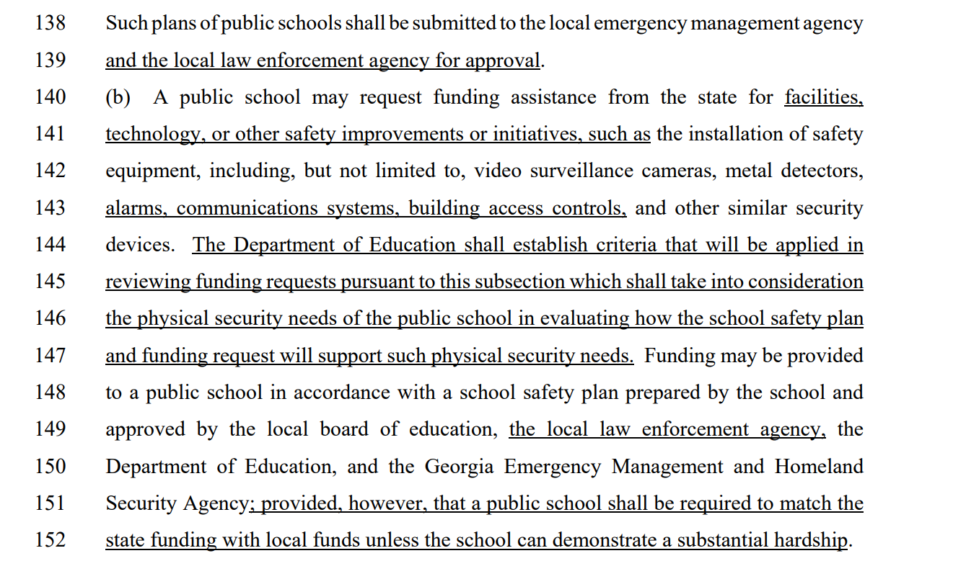
HB 763
“…shall be submitted to the local emergency management agency and the local law enforcement agency for approval.”

Slide 24
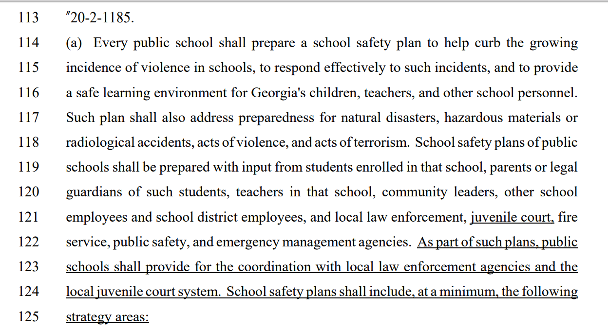
HB 763

Slide 25
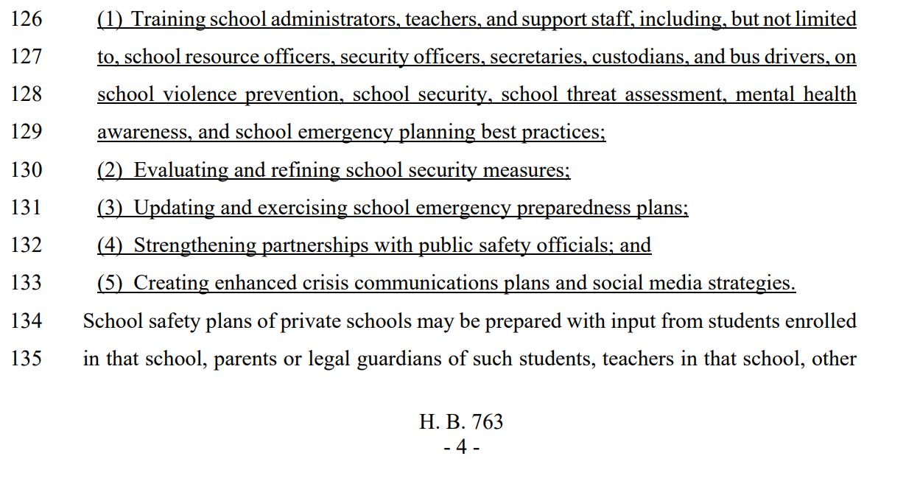
HB 763

Slide 26
Mental illness is one of the top five health conditions for children in the United States.
(Zupp)
26% of children in the United States will witness or experience a traumatic event before they turn age four.
(National Center for Mental Health Promotion and Youth Violence Prevention)

Slide 27
Students’ unmet mental health needs can be a significant obstacle to student academic, career and social/emotional development and can compromise school safety. (Froeschle and Meyers)

Slide 28
Prevention and Intervention Resources
PBIS
Mental Health Awareness Training (National Alliance on Mental Illness and Mental Health America)
APEX Project (GaDBHDD)
Suicide Prevention (GaDOE, NAMI, MHA, BHDD, DPH, GBI, American Academy of Pediatrics, SPAN-GA)
Trauma-Informed Schools (State Collaborative and DECAL)
2nd Step Violence Prevention (State DFCS grants)
U.S. Department of Education Title IV – Part A
(drug education, school-based mental health services, mental health awareness training, safety, school climate)

Slide 29
School Safety
Resources

Slide 30


Slide 31



Monitored 24/7 by the Georgia Department of Education and the Georgia Department of Public Safety

Slide 32
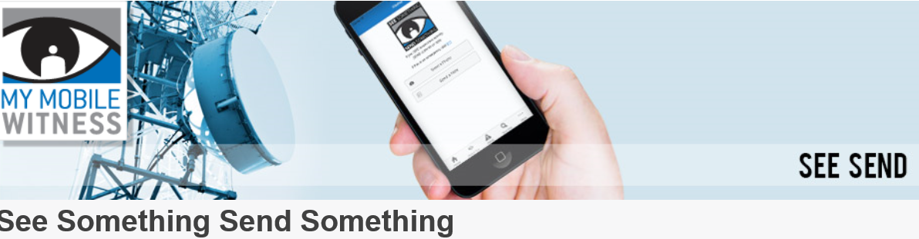
April 25, 2018
ATLANTA—Gov. Nathan Deal announced the launch of See Something, Send Something, a smartphone app that directs citizen concerns to local law enforcement. See Something, Send Something operates statewide and nationwide, allowing citizens to report suspicious activity and concerns about safety and security.

Slide 33
HB 763

Slide 34
Georgia Department of Education School Safety and Health Resources
Crisis Management and Prevention in Georgia Public Schools​
Guide for Developing High-Quality School Emergency Operations Plans
School Safety Checklist
School Safety Hotline
Responding to a School Crisis
Trauma's Impact on Children Exposed to Violence​
School Emergency Management Tool Box
Bullying Prevention Toolkit​
Anti-Cyberbullying Toolkit
Suicide Prevention Resources​
Human Trafficking Prevention/Intervention Toolkit
Complex Trauma - Resource Guide for Youth​

Slide 35
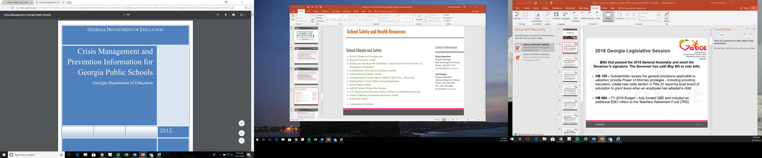
Crisis Management and Prevention in Georgia Public Schools​
Prevention/Mitigation is the action schools take to prevent a threatened or actual incident from occurring or reducing the likelihood that an incident will happen.
Preparedness focuses on ongoing actions that protect students, teachers, staff, visitors, networks, and property from a threat or hazard.
Response is the capability necessary to stabilize a crisis once it has already happened or is certain to happen in an unpreventable way; establish a safe and secure environment; save lives and property; and facilitate the transition to recovery.
Recovery the capability necessary to assist schools affected by a crisis in restoring the learning environment.

Slide 36
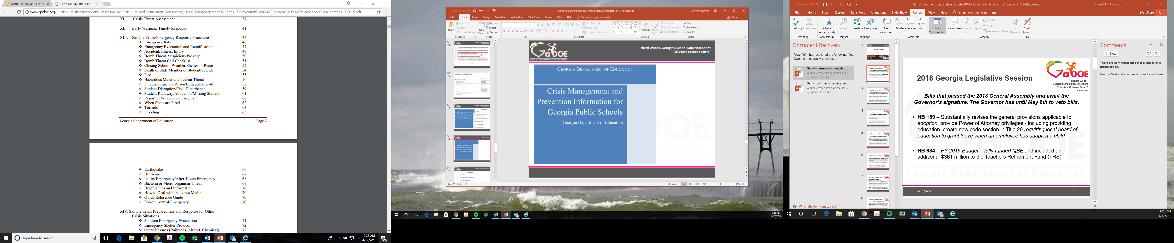
Crisis Management and Prevention in Georgia Public Schools​

Slide 37
Crisis Management and Prevention in Georgia Public Schools​

Slide 38
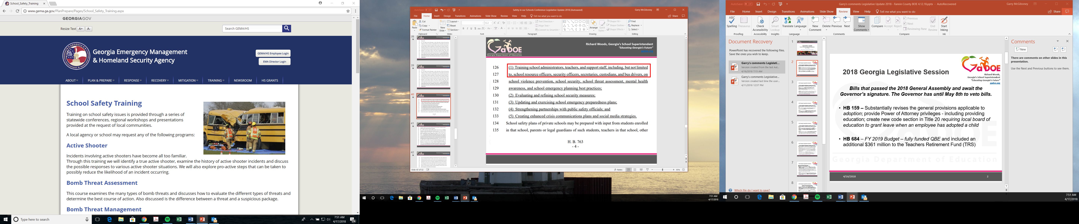

Slide 39
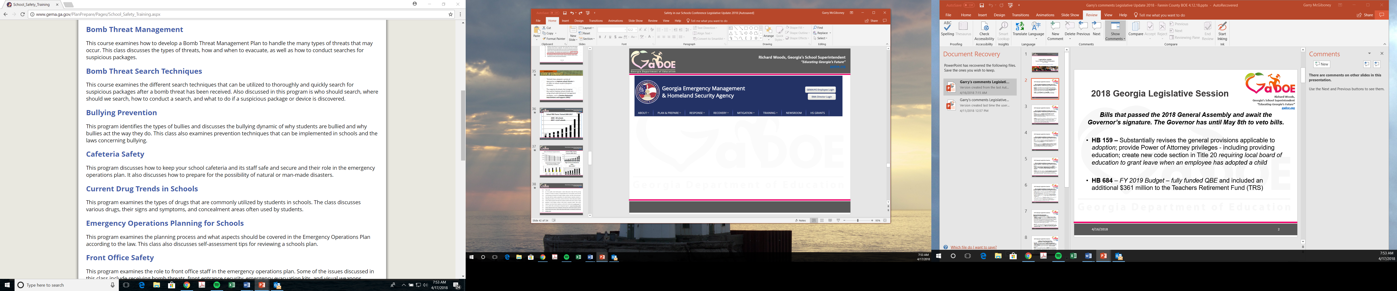

Slide 41
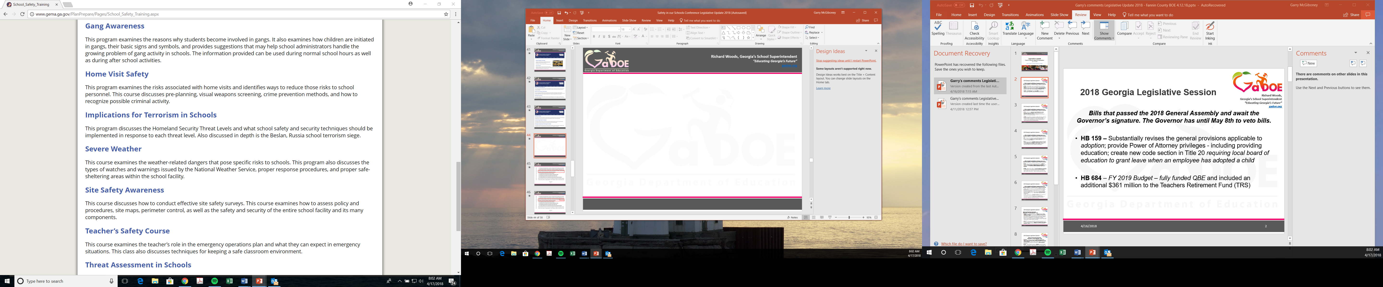

Slide 42
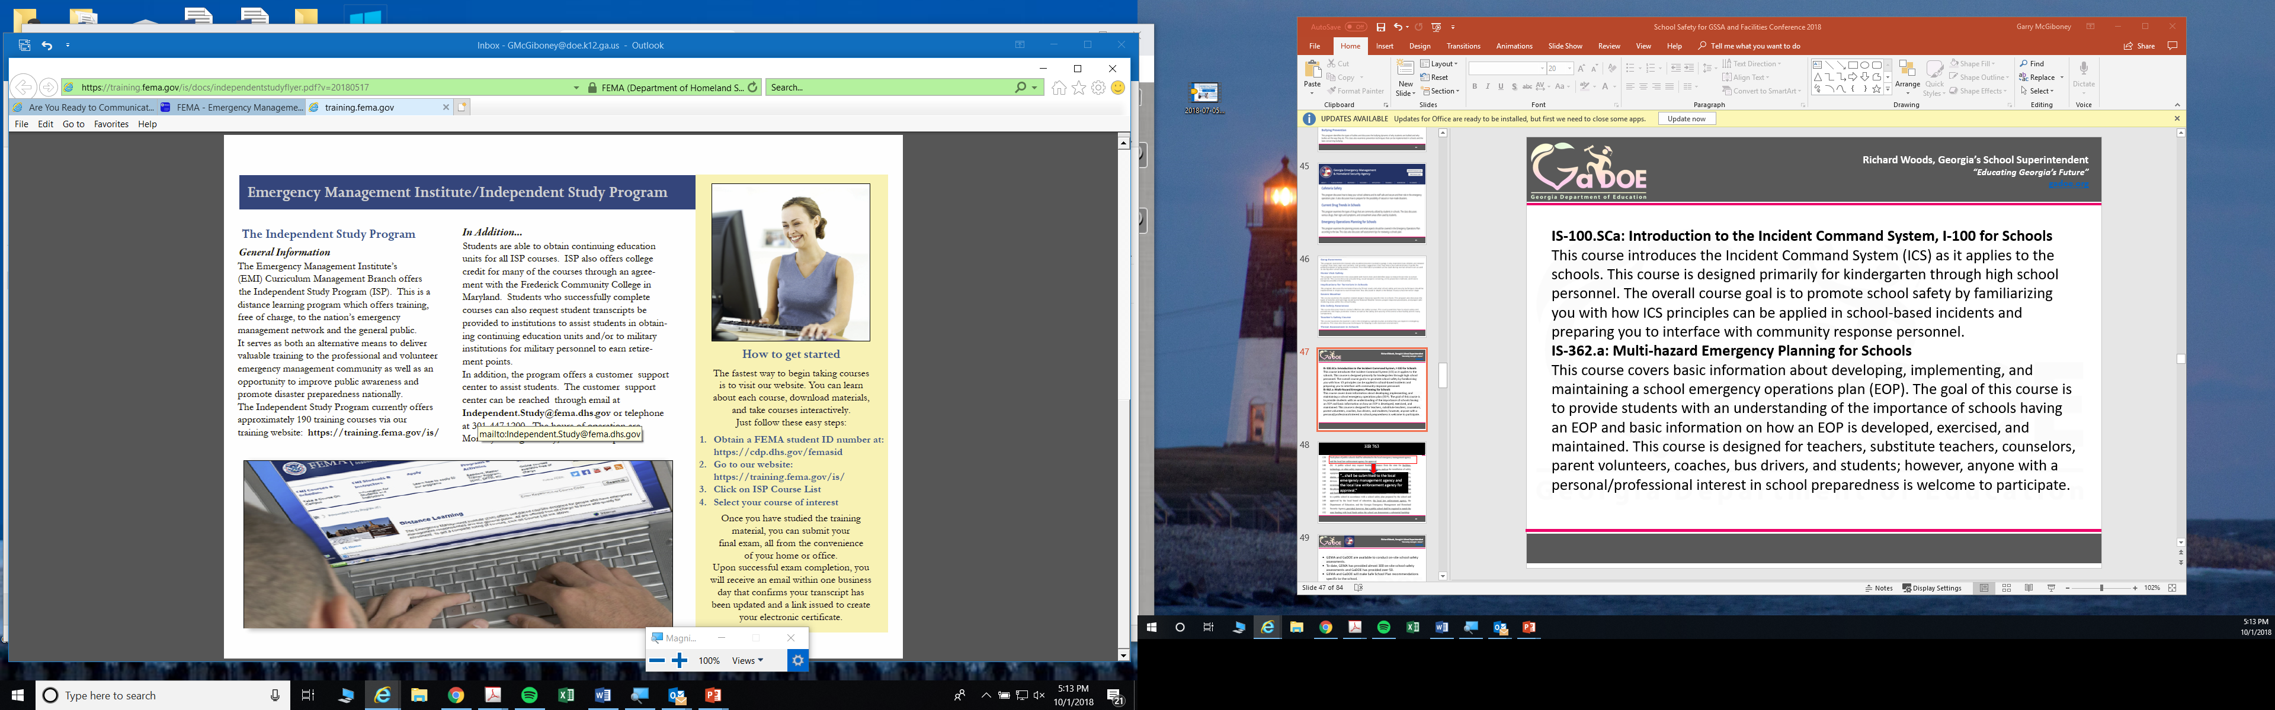
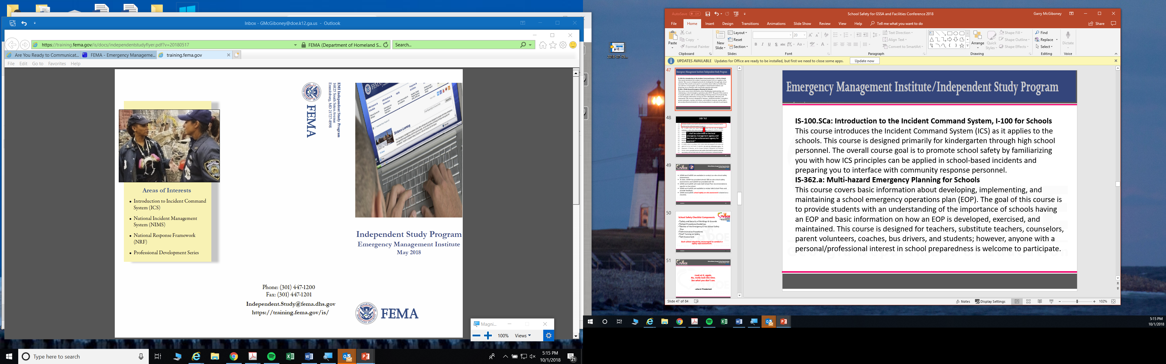
IS-100.SCa: Introduction to the Incident Command System (ICS), I-100 for Schools
The overall course goal is to promote school safety by familiarizing you with how ICS principles can be applied in school-based incidents and preparing you to interface with community response personnel.
IS-362.a: Multi-hazard Emergency Planning for Schools
This course covers basic information about developing, implementing, exercising, and maintaining a school emergency operations plan (EOP).

Slide 43
GEMA and GaDOE are available to conduct on-site school safety assessments.
To date, GEMA has provided almost 300 on-site school safety assessments and GaDOE has provided over 50.
GEMA and GaDOE make Safe School Plan recommendations specific to the school.
GEMA and GaDOE are also available to review Safe School Plans and provide feedback.
GEMA and GaDOE school safety on-site assessments are centered on a research-based checklist.

Slide 44
Examples of School Safety Site Assessment
Checklist Items

Slide 45
School Interior
The designated entrance door has clearly visible signs showing the location of the main office and advising visitors to report to the office.
The entrance lobby is visible from the main office. If not, secure the area.
Staff members, volunteer personnel, or a security camera monitor the main entrance lobby.
Visitors are required to sign in at the main office.
Hallways are free of travel impediments.
Hallways leading to required exit doors are kept clear and unencumbered with rugs or furniture which might impede traffic flow from building in an emergency.
Blind spots in hallways and stairwells are equipped with parabolic mirrors (or similar surveillance device).
Remote and isolated hallways are monitored by security cameras or other monitoring methods.
Stairwells are monitored.

Slide 46

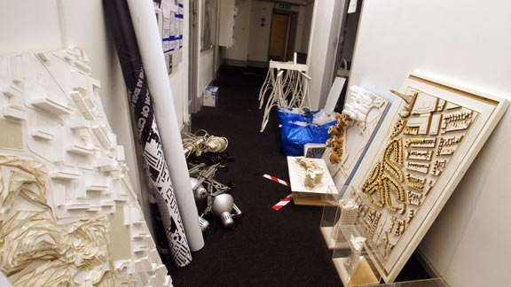
Dark or Isolated Stairwells
Cluttered Hallways

Slide 47
School Interior
Restrooms are inspected for cleanliness and safety on a regular basis.
Restroom walls and stalls are free of graffiti.
Restrooms have a smoke detector.
All cafeteria food and perishables are stored properly.
Choking guidelines are clearly posted in cafeteria dining area.
Cafeteria staff can hear school alarms and announcements.
A staff member is assigned to make sure the cafeteria staff are contacted in the event of a lockdown or severe weather threat.
If a classroom is vacant, students are restricted from entering unsupervised.
Clear and precise emergency evacuation routes are posted at critical locations, including classrooms.
Surveillance cameras and monitors are installed in strategic locations, with monitors in locations visible to staff.

Slide 48
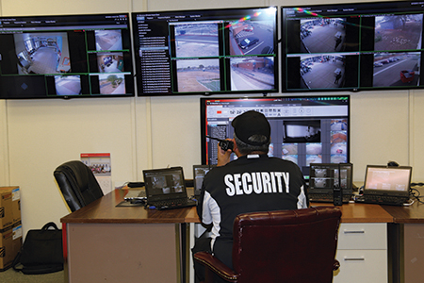
Are surveillance cameras and monitors installed in strategic locations with monitors in locations visible to staff?

Slide 49
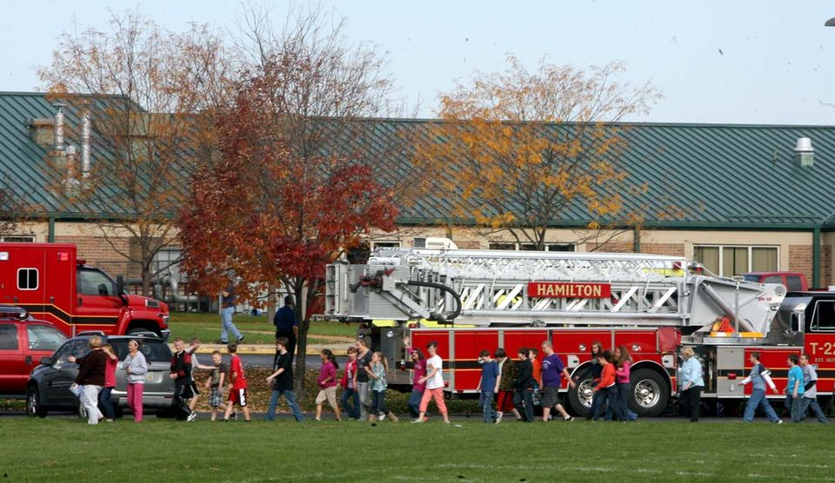
What’s wrong with this picture?

Slide 50
Clear and precise emergency evacuation routes are posted in each classroom and teachers have rosters to take with them to evacuation reunification sites.
Posted evacuation routes must include primary and secondary routes, and evacuation routes must be clear of impediments.

Slide 51
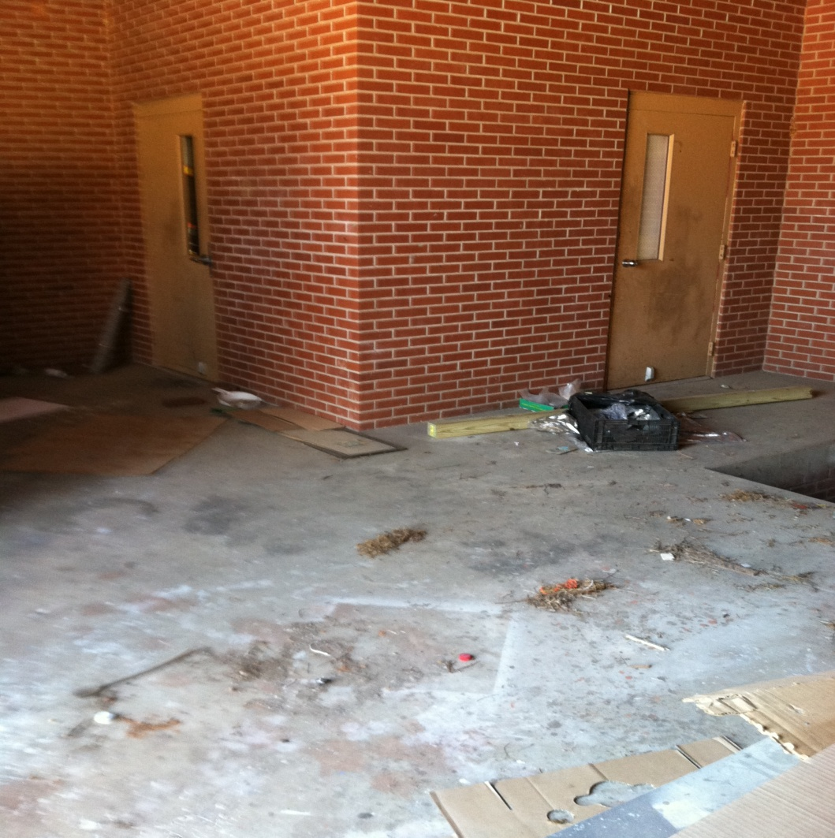
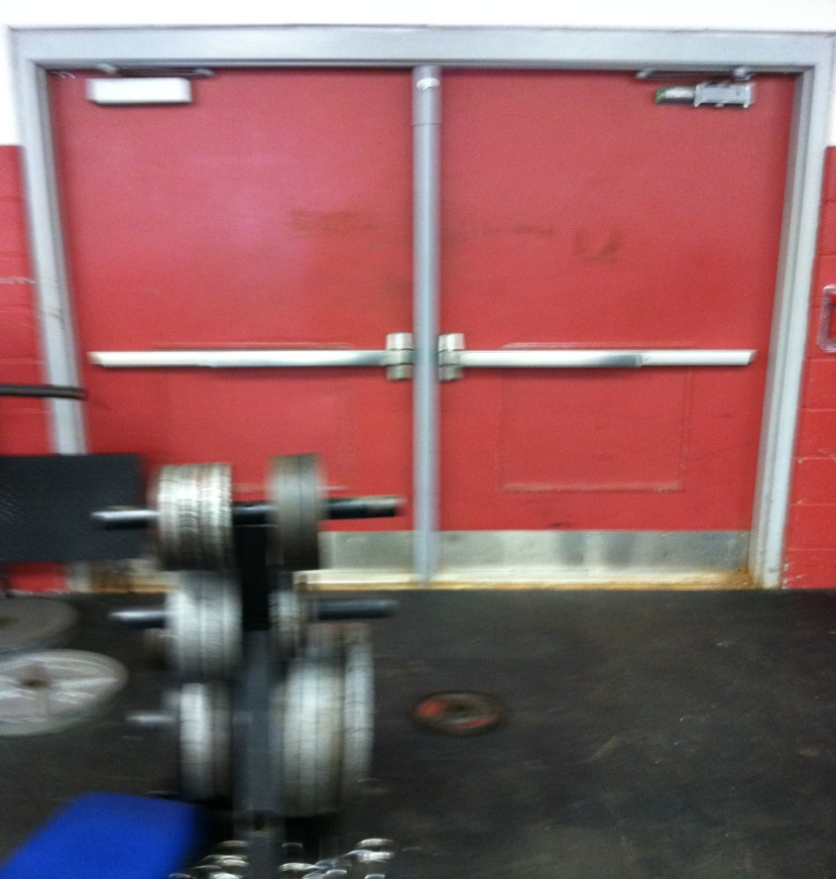
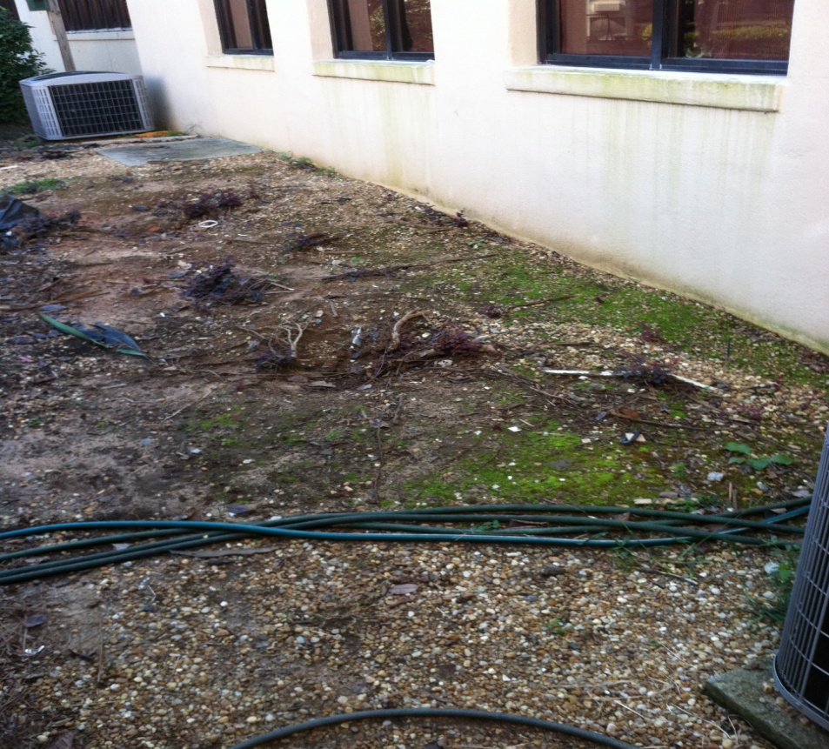
Are evacuation routes clear?

Slide 52
School Interior
Fire extinguisher locations are clearly marked and inspected.
School staff is trained on the use of fire extinguishers.
Access to catwalk and prop areas is restricted.
Access to electrical panels is restricted.
Hallways have emergency lighting and are tested.
Main lobby is properly lighted.
Hallways, bathrooms, and classrooms are properly lighted.
Faculty members are required to lock classrooms upon leaving.
Multiple entries to the building are controlled and supervised.
Areas accessible to intruders are secure.
All doors are properly labeled and numbered.
Electrical and maintenance areas are clutter free and are inspected.

Slide 53
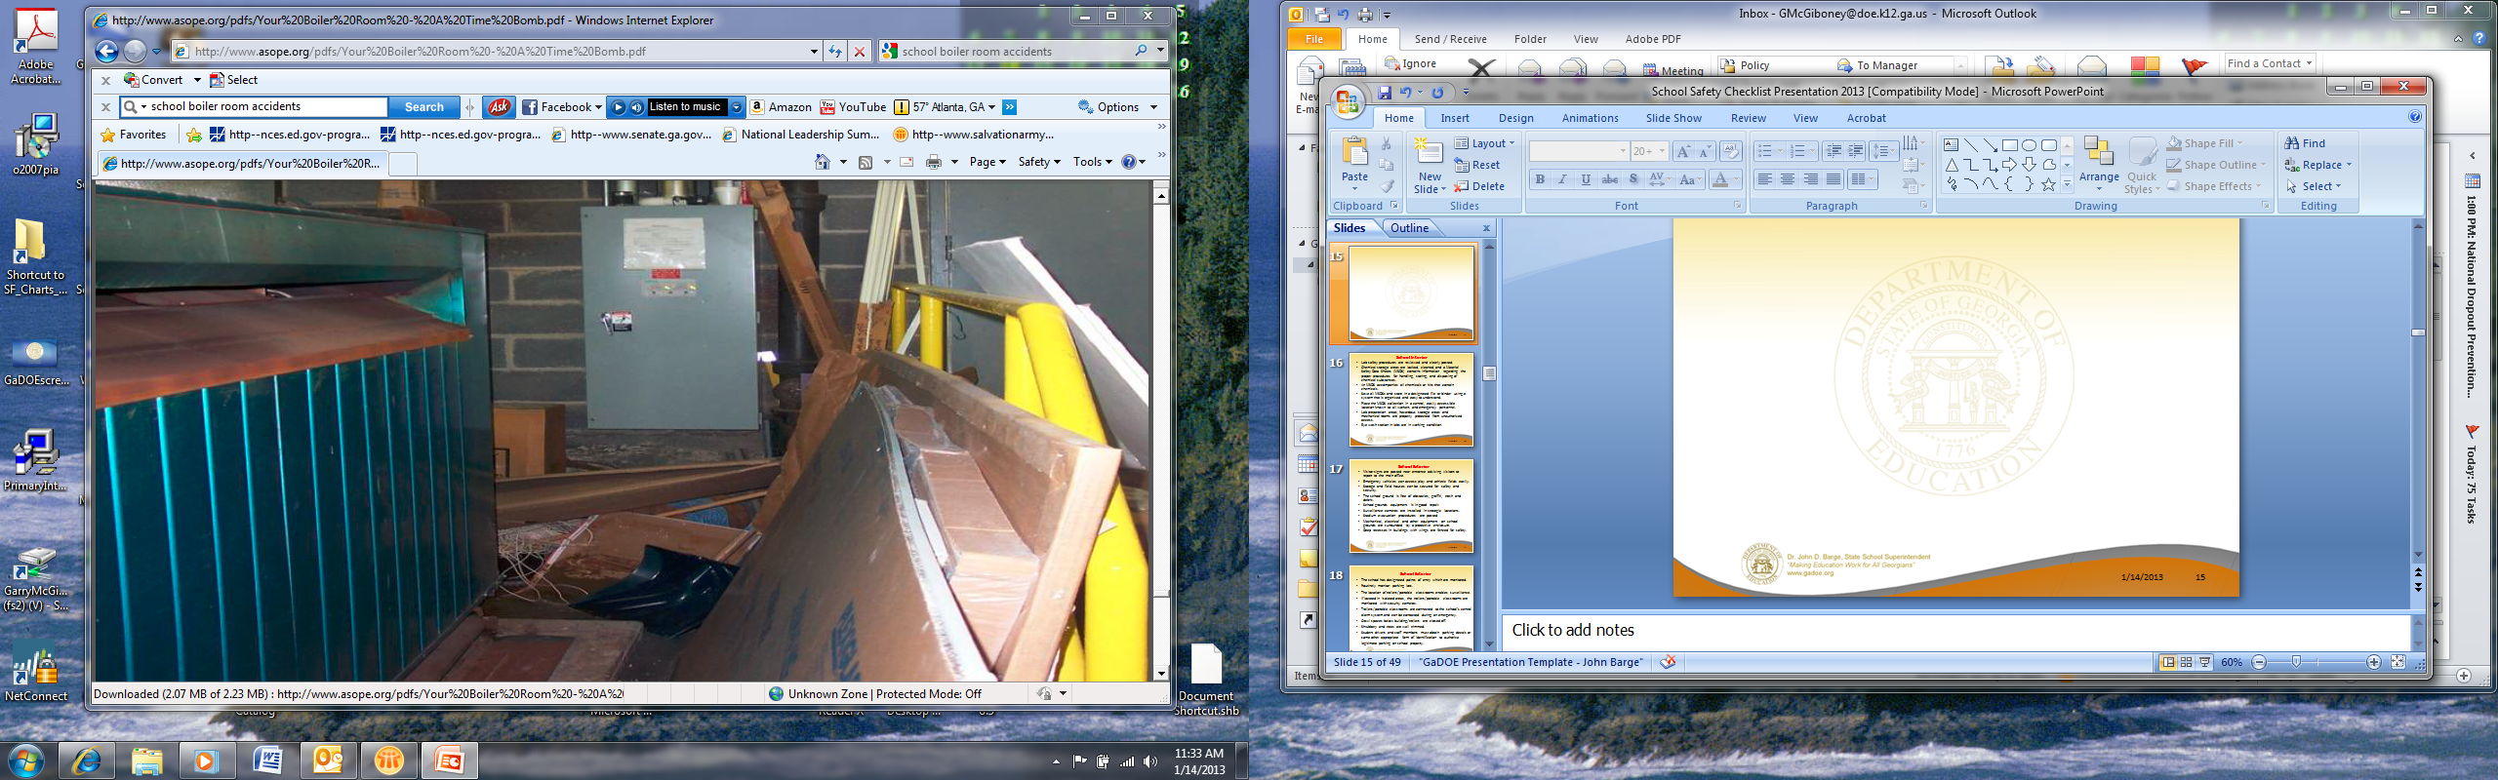
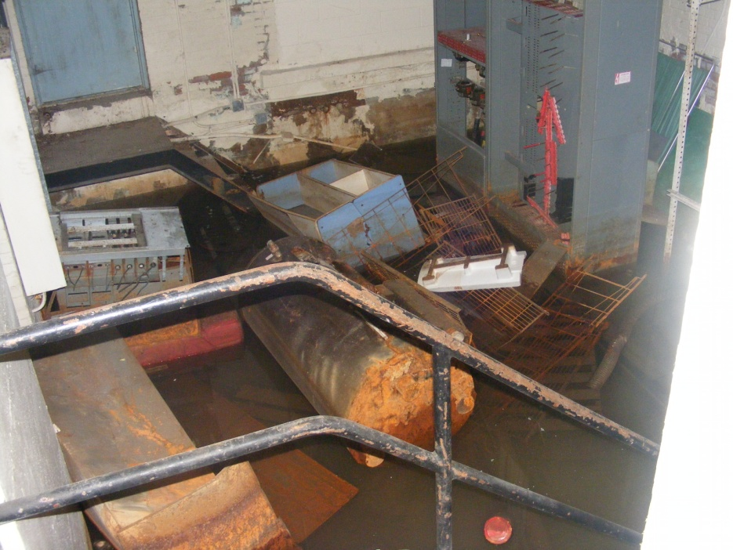
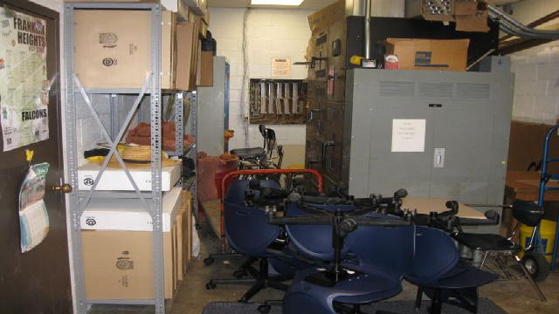
Electrical, maintenance, and storage areas are clutter free and are inspected.

Slide 54
School Interior
Lab safety procedures are reviewed and clearly posted.
Chemical storage areas are locked, cleaned, and Material Safety Data Sheets (MSDS) contain information regarding the proper procedures for handling, storing, and disposing of chemical substances.
An MSDS accompanies all chemicals or kits that contain chemicals.
Save all MSDS and store in a designated file or binder using a system that is organized and easy to understand.
Place the MSDS collection in a central, easily accessible location known to all workers and emergency personnel.
Know what chemicals cannot be stored together (e.g., store mineral oxidizing chemicals separate from organic acids).
Lab preparation areas, hazardous storage areas and mechanical rooms are properly protected from unauthorized access.
Eye wash station in labs are in working condition.

Slide 55
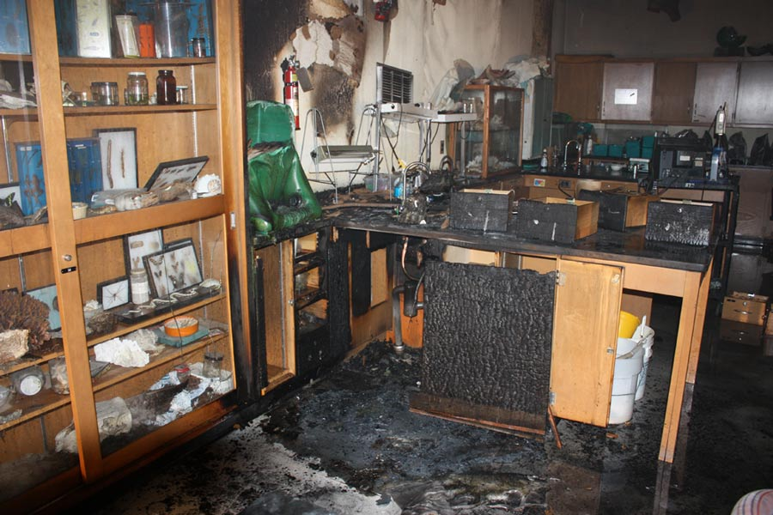

Slide 57
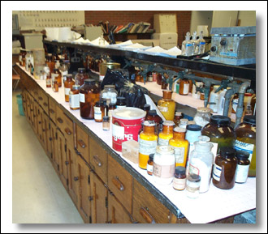

Slide 58
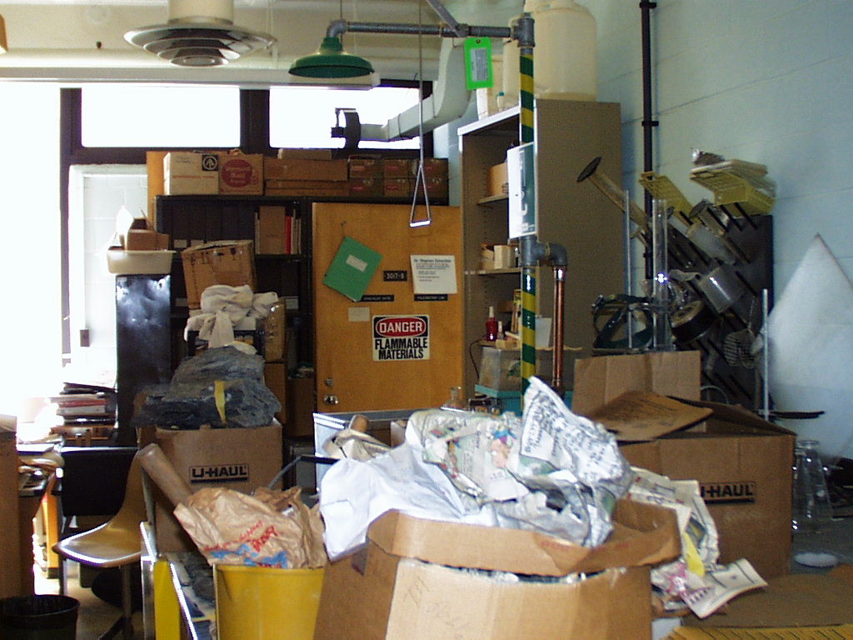
An unkept school is a signal to students and teachers that they are not important – it’s a school climate and safety element.
-School Buildings Coalition

Slide 59
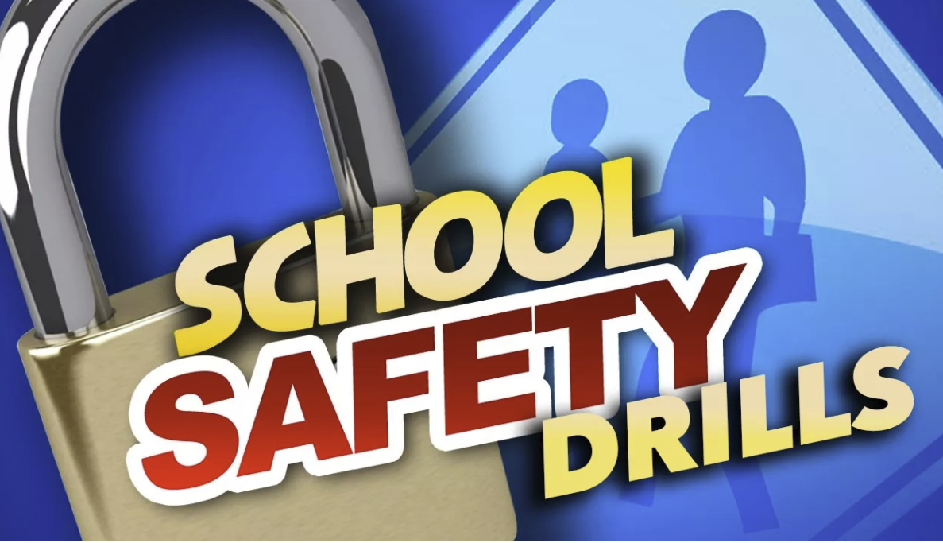
DOCUMENT SAFETY DRILLS

Slide 60
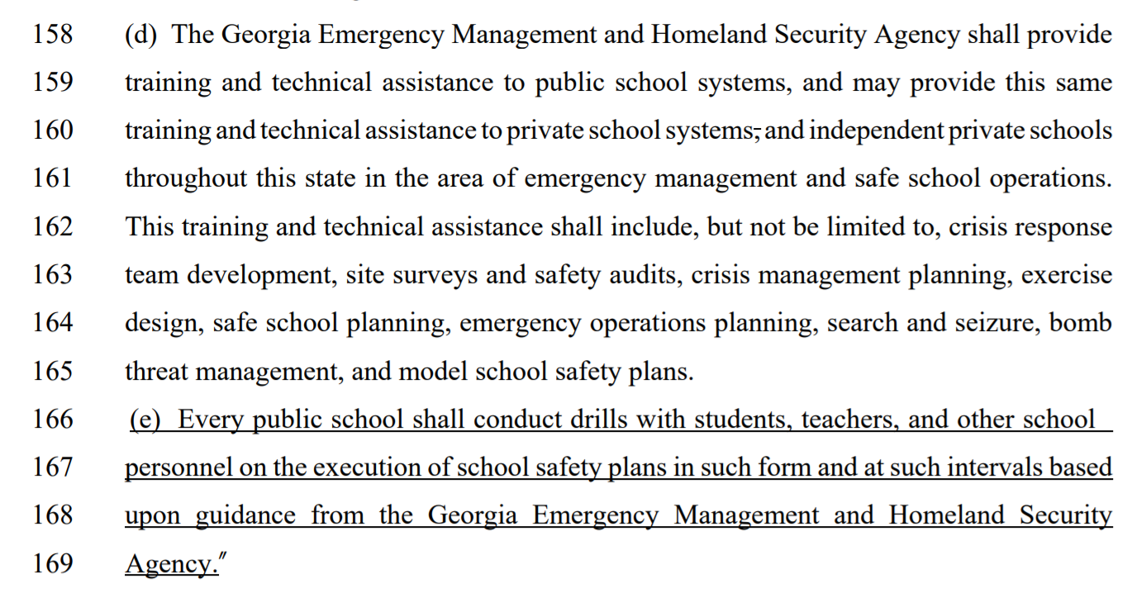
HB 763

Slide 61
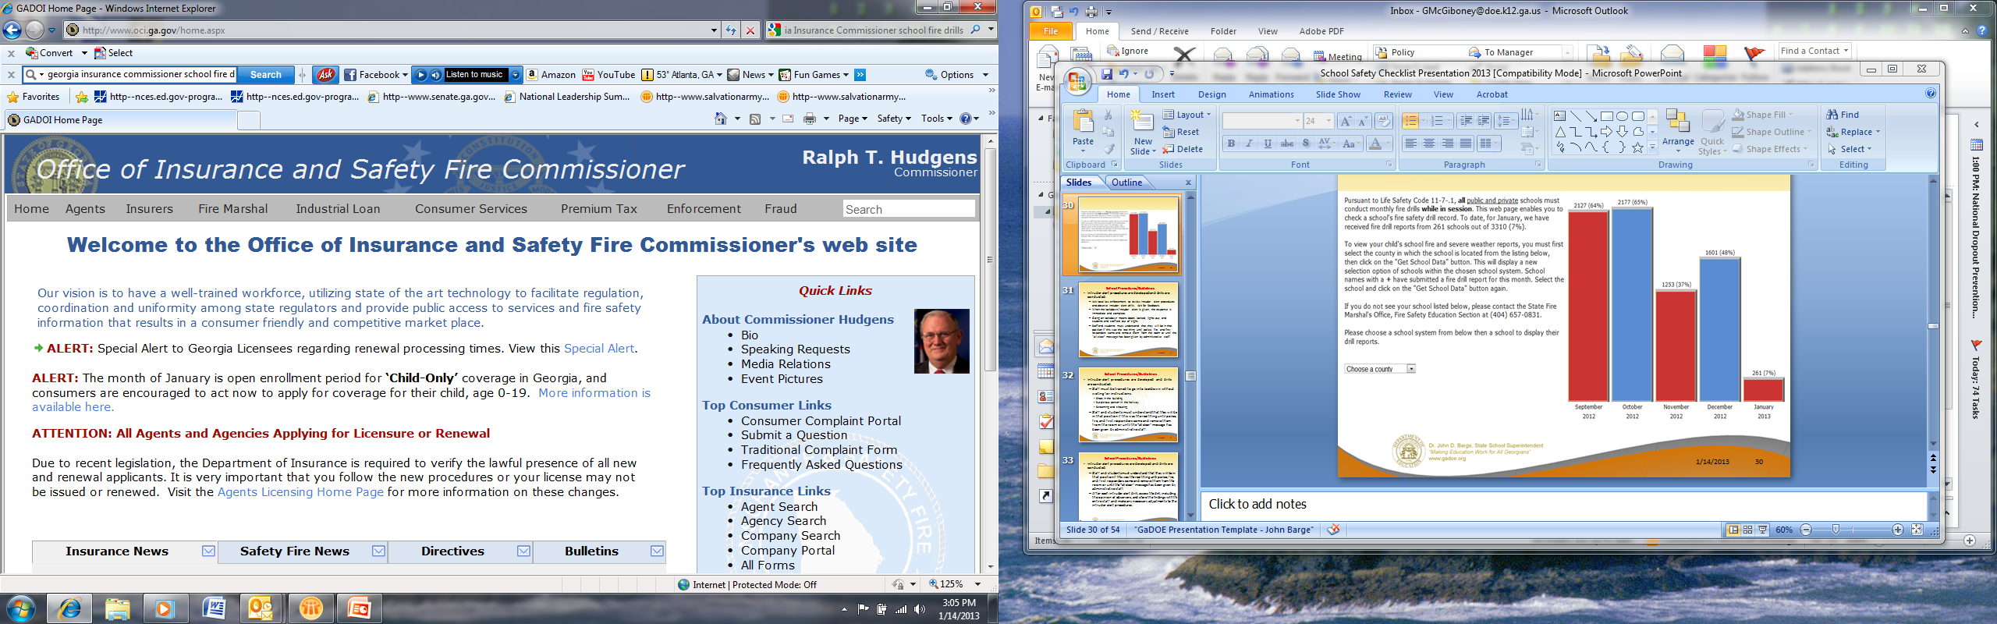
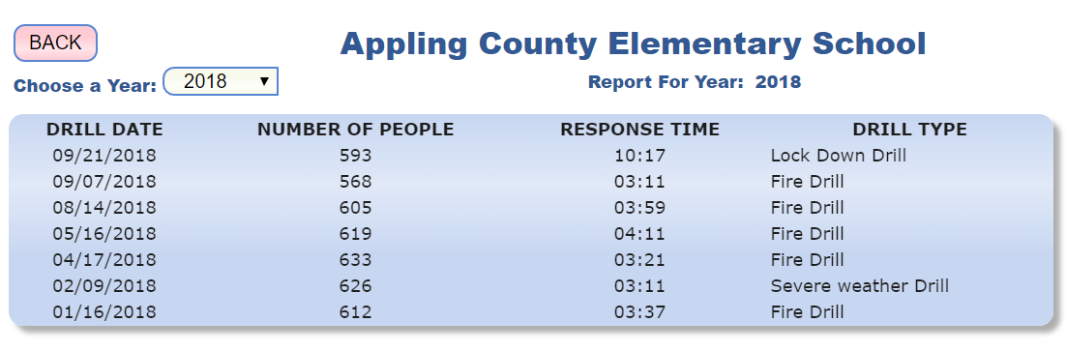
Working with GEMA and the Office of Insurance and Safety Fire Commissioner to add “School Safety Plan Drills” to the online reporting system.

Slide 62
2017-2018 Regular Session - HR 1414
House Study Committee on School Security
2017-2018 Regular Session - SR 935
Senate School Safety Study Committee

Slide 63
State Laws - School Safety/Discipline
Bullying: O.C.G.A. § 20-2-751.4
Conflict Management: O.C.G.A. § 20-2-739
Disrupting a Public School: O.C.G.A. § 20-2-1181 – 20-2-1182
Designated felony acts: O.C.G.A. § 15-11-63
Off-campus behavior resulting in felony charge:
O.C.G.A. § 20-2-751.5
School principal must be notified when a child commits certain acts: O.C.G.A. §15-11-83
Carrying and possession within school zones:
O.C.G.A. § 16-11-127.1
Allowing school personnel to carry weapons within school safety zones: O.C.G.A. § 16-11-130.1
Expulsion of students who bring or possess firearms at school: O.C.G.A. § 20-2-751.1

Slide 64
State Laws - School Safety/Discipline
Loitering on school property: O.C.G.A. § 20-2-1180
Mandatory Reporting
  Student crimes reported to law enforcement:
  O.C.G.A. § 20-2-1184
  Report juvenile drug use: O.C.G.A. § 19-7-6
  Child Abuse: reporting child abuse; failure to report:
  O.C.G.A. § 19-7-5
Student Personal Safety: O.C.G.A. § 20-2-314
School Safety Plans: O.C.G.A. § 20-2-1185
School Safety Zones
  Defined: O.C.G.A. § 16-11-127.1
  Weapons in: O.C.G.A. § 16-11-127.1

Slide 65
State Laws - School Safety/Discipline
Alcohol and Drug Use
  Development and dissemination of instructional materials; mandatory instruction: O.C.G.A. § 20-2-142
  Mandatory instruction/prevention: O.C.G.A. § 20-2-144
  Reporting juvenile drug use: O.C.G.A. § 19-7-6
  Alcohol sales near school zones: O.C.G.A. § 3-3-21
Suicide Prevention: O.C.G.A. § 20-2-779.1
School security personnel authorized to carry: O.C.G.A. § 20-8-5
School Climate Management Program for Improving School Climate: O.C.G.A. § 20-2-155 – Positive Behavioral Interventions and Supports (PBIS)
School Climate Rating System: O.C.G.A. § 20-14-34
School Climate Positive Behavioral Intervention: O.C.G.A. § 20-2-741 – implementation of PBIS for schools with low School Climate Ratings

Slide 66
State Laws - School Safety/Discipline
Discipline
  Annual Discipline Reports: O.C.G.A. § 20-2-740
  Authority of teacher over classroom: O.C.G.A. § 20-2-738
  Chronic Disciplinary Problem Students: O.C.G.A. § 20-2-764 –
  § 20-2-768
  Model Code of Behavior and Discipline: O.C.G.A. § 20-2-155
  Corporal Punishment: O.C.G.A. § 20-2-730 – §20-2-732
  Disciplinary tribunals: O.C.G.A. § 20-2-750 – §20-2-759
  In-School Suspension: O.C.G.A. § 20-2-155, § 20-2-738
  Liability of educators: O.C.G.A. § 20-2-1000
  Out-of-School Suspension: O.C.G.A. § 20-2-738
  Reciprocal expulsion by other school systems: O.C.G.A. § 20-2-751.2
  Student Code of Conduct: O.C.G.A. § 20-2-735 - § 20-2-738
  Student conduct to be addressed in codes: O.C.G.A. 20-2-751.5
  Student expulsion for felony conviction: O.C.G.A. § 20-2-767 –
  § 20-2-768
  Violence against teachers: O.C.G.A. § 20-2-751.6

Slide 67
State Laws - School Safety/Discipline
Discipline
  Annual Discipline Reports: O.C.G.A. § 20-2-740
  Authority of teacher over classroom: O.C.G.A. § 20-2-738
  Chronic Disciplinary Problem Students: O.C.G.A. § 20-2-764 –
  § 20-2-768
  Model Code of Behavior and Discipline: O.C.G.A. § 20-2-155
  Corporal Punishment: O.C.G.A. § 20-2-730 – §20-2-732
  Disciplinary tribunals: O.C.G.A. § 20-2-750 – §20-2-759
  In-School Suspension: O.C.G.A. § 20-2-155, § 20-2-738
  Liability of educators: O.C.G.A. § 20-2-1000
  Out-of-School Suspension: O.C.G.A. § 20-2-738
  Reciprocal expulsion by other school systems: O.C.G.A. § 20-2-751.2
  Student Code of Conduct: O.C.G.A. § 20-2-735 - § 20-2-738
  Student conduct to be addressed in codes: O.C.G.A. 20-2-751.5
  Student expulsion for felony conviction: O.C.G.A. § 20-2-767 –
  § 20-2-768
  Violence against teachers: O.C.G.A. § 20-2-751.6
43 statutes

Slide 68
Recommendations
Ensure that current funding continues and enhance funding to allow school systems and communities to identify and address the physical and mental health needs of all children:
  Expand PBIS to focus on the importance of school climate and the link to school safety
  Expand APEX to provide mental health evaluations and interventions for students in distress
  Expand mental health awareness training for educators, SROs, parents, volunteers, and communities
  Expand suicide prevention training for educators, SROs, parents, volunteers, and communities
  Expand trauma-informed training for schools (e.g. Haralson County School System WATCH/Handle with Care program)
  Expand drug education to confront the opioid crisis
  Expand 2nd Step Violence Prevention program (in conjunction with PBIS)

Slide 69
Recommendations
Expand bond funding and/or provide grants or other funding to allow local school systems to enhance safety:
  Renovate all main entrances to secure and control access into the school (e.g., safety vestibule/double entry door system)
  Renovate and ensure that all exterior doors can be locked from the inside and integrated into the school’s alarm system in the event an attempt is made to pry open the door or a door is left ajar for a brief period of time
  Renovate to equip all classrooms with doors that can be locked from the inside by the classroom teacher
  Renovate to equip all classrooms with duress/panic button that signals the school front office, SRO, and alerts 9-1-1
  Renovate to equip main office and administration areas with duress/panic buttons that signals the SRO and alerts 9-1-1
  Employee ID system with high visibility features and employee photographs

Slide 70
Recommendations
Expand bond funding and/or provide grants or other funding to allow local school systems to enhance safety:
  Visitor ID system that provides temporary visitor ID badge, picture, and records the name, time, and date of the visit
  New or updated surveillance (camera) systems that include mobile surveillance which allows off-site monitor for prevention, intervention, and law enforcement response, as deemed appropriate and necessary by the school system
  Communication systems that intersect school system and law enforcement communications
  Card Access Systems that can be programmed for certain areas of the school, activated at certain times, and for certain events
  School safety architectural experts review architectural plans for new schools and renovations using Crime Prevention through Environmental Design (CPTED) standards

Slide 71
Recommendations
Expand bond funding and/or provide grants or other funding to allow local school systems to enhance safety:
  To allow schools the resources to record, document, and practice Safe School Plans
  Add flexibility to ESPLOST to allow a certain percent for school safety equipment and/or personnel
  Provide funding that provides a school safety expert at each of the 16 RESAs to (1) conduct continuous on-site school safety assessments; (2) assist schools in the development, review, and practice of safe school plans; (3) coordinate school safety training for school personnel, including Active Shooter training; (4) work with local emergency management and law enforcement to coordinate cross training, school safety planning, and crisis response and recovery; (5) work with the school climate specialists to ensure safe climates in schools

Slide 72
Recommendations
Additional recommendations for funding:
  Explore the availability and credibility of school safety social network alert systems that combine technology along with trained professionals to reveal threats to schools in emails, documents, shared files, images, photos and more

Slide 73
Trusting relationships and a positive school climate are the most effective means of ensuring school safety, much more so than metal detectors.
-National Association of Secondary School Principals

Slide 74
Georgia Department
of Education
Garry McGiboney
Cell Phone: 678-637-1261

