Slide 1
Reducing Discipline Through Culture Change
Dr. Michael Duncan, Superintendent
Mrs. Ashley Marratt, Interquest K9

Slide 2
Comprehensive Safety & Security Program
Student Engagement
Safe Contact for Every Student
Intentionally Developed
Opiate Awareness
Anonymous Tip Line
Reasonable Hardening
Double Entry Vestibule
Electronic Monitoring & Alerts
Secure Perimeter & Parking Lot
Presence
SRO at Every School
Interquest K9

Slide 3
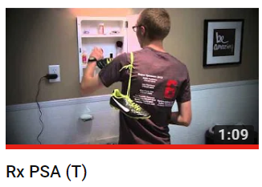
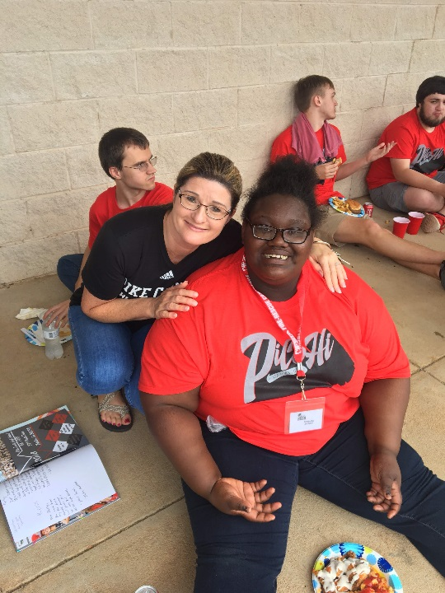
Engagement

Slide 4
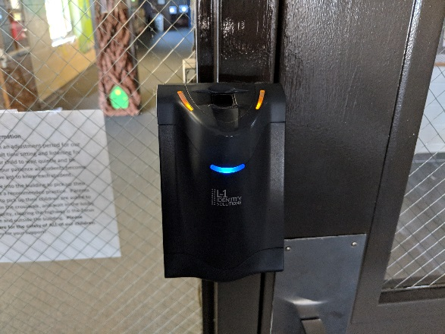
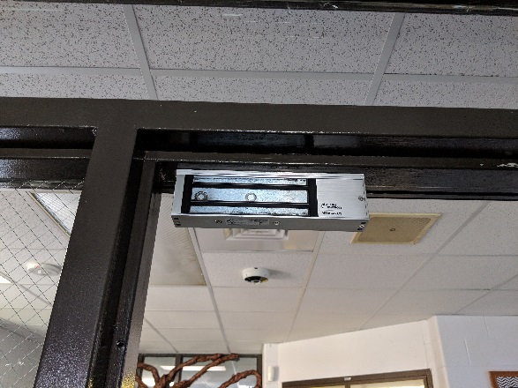
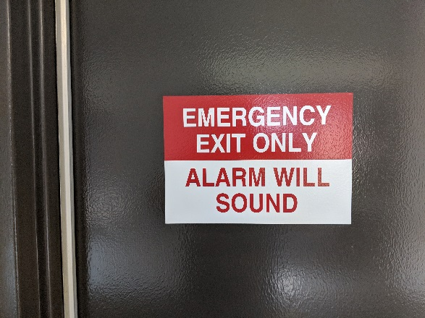
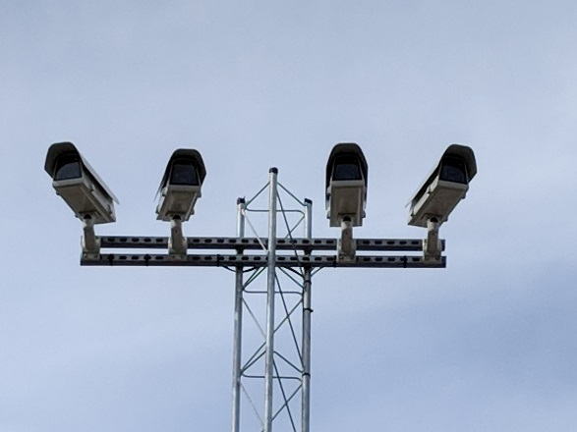
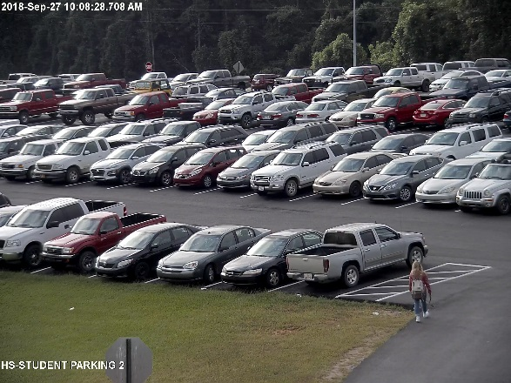
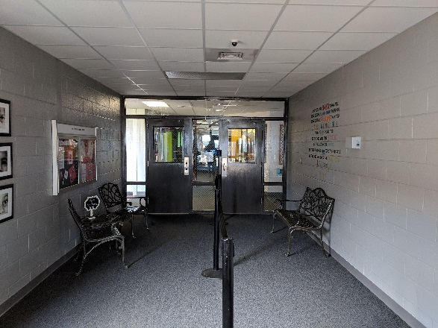
Hardening

Slide 5
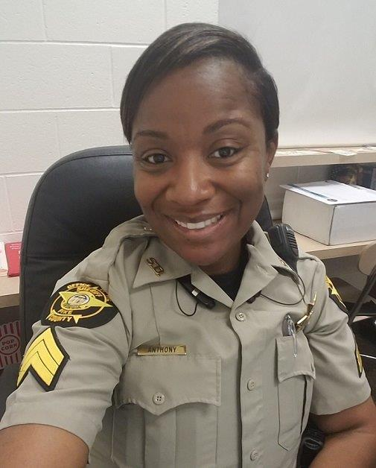
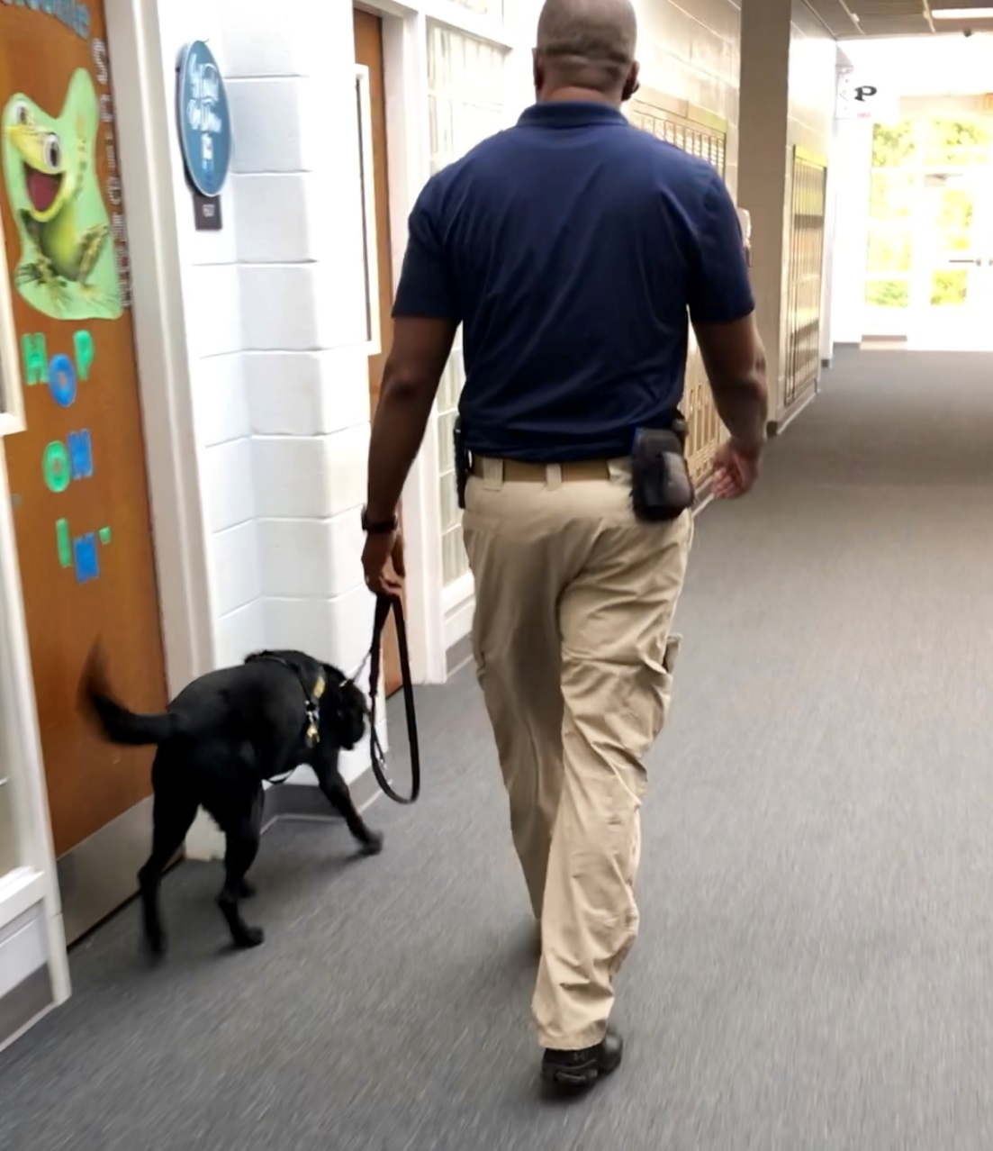
Presence

Slide 6
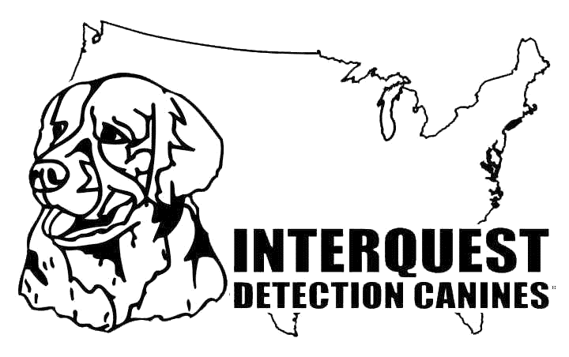
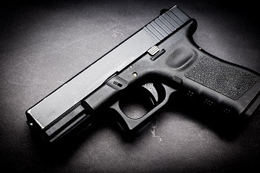
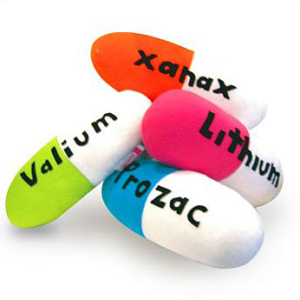
Deterrence Not Enforcement
Structure
Benefits
Collaborative Orientation Assembly for Students & Parents
Full Day Visits, No Lockdown
Random & Unannounced
Reasonable Suspicion Standard, not Probable Cause
K9 Trained on:
Drugs
Alcohol
Medication
GUNS!
Keeping ALL Safe – Students, Teachers & Administration
PR – Positive tone, control of the narrative, parent endorsed
Administration in control of outcomes & discipline
Decreases chatter & background noise; Better tips, blamed on dog
Operational reduction in discipline, investigations, tribunals & appeals = Time Savings for Administration & BOE

Slide 7
Reducing Discipline Incidences
Pike County Schools
Un-Named School System

Slide 8
Engaging Local Law Enforcement
Structure
Benefits
Superintendent, Interquest & LE Pre-meeting
Complimentary, supplemental resources, Not Replacement
Is the Local LE K9 frequency reasonable deterrence for your students?
Eliminates minor offense paperwork and follow up for LE
Frees up LE for public safety concerns
Always on stand by for escalation

Slide 9
Dr. Michael Duncan
Pike County Schools
DuncanS@pike.k12.ga.us
770-567-8489
Mrs. Ashley Marratt
Interquest K9 of Georgia
amarratt@interquestga.com
404-891-1432

