Slide 1
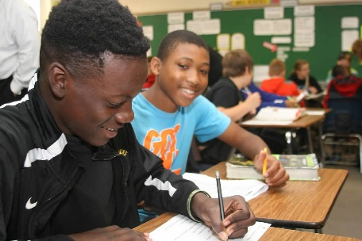
Fall Bootstrap 2018
Richard Woods State School Superintendent
Notes:
Quick greetings
A lot has happened since I last saw you at spring Bootstrap. Here’s a look at some of the good news we’ve gotten to share over the last several months, all thanks to you and your teachers and students…

Slide 2
Thanks to you and your teachers & students…
2018 ACT: beating national average for third year in a row, and third time in state history
2018 ACT: beating national average for third year in a row, and third time in state history
Georgia’s public schools are on the move.
Notes:
Yesterday we announced Georgia’s 2018 ACT scores – we are beating the national average for the third year in a row and the third time in state history.

Slide 3
Thanks to you and your teachers & students…
2018 ACT: beating national average for third year in a row, and third time in state history
2018 ACT: beating national average for third year in a row, and third time in state history
2018 Graduation Rate: all-time high of 81.6%; 74 districts at or above 90%
Georgia’s public schools are on the move.
Notes:
The 2018 graduation rate hit an all-time high of 81.6%, a full-point increase over 2017 and the highest ever under the adjusted cohort rate. Additionally, 74 districts have graduation rates at or above 90%.

Slide 4
Thanks to you and your teachers & students…
2018 ACT: beating national average for third year in a row, and third time in state history
2018 ACT: beating national average for third year in a row, and third time in state history
2018 Graduation Rate: all-time high of 81.6%; 74 districts at or above 90%
Quality Counts 2018: Georgia 11th in the nation for K-12 Achievement
(based on NAEP scores)
Georgia’s public schools are on the move.
Notes:
On Education Week’s Quality Counts report, Georgia ranked 11th in the nation on the “K-12 Achievement” indicator – which is based on NAEP scores.
So the next time someone tries to tell you Georgia is “last in the nation” for education – you may want to point out that’s not the case!

Slide 5
Moving forward…
CCRPI: For students and schools, a fair measure of success.
Urging the legislature to remove the 100-point scale for CCRPI
Pushing for flexibility & authority to reduce the weight of testing in the CCRPI
Getting assessment in line with the federal minimum
Funding: A 21st-century formula for a 21st-century education.
Keeping our constitutional & moral obligation to fully fund public education
Updating the formula & ensuring districts aren’t picking up the tab for rising costs
Supports: Connecting students & families with resources to support & improve achievement.
Provided $1 million for wraparound services – requested additional $1 million for state match
Goal is to scale the pilot up to impact more schools in future years
Notes:
Moving forward, we’re committed to making sure your districts and schools have the resources you need to continue the forward motion we’re seeing in K-12 education.
Here are a few of our top priorities for the next year:
-GETTING RID OF THE 100-POINT SCALE AND LETTER GRADES FOR CCRPI. When we developed our ESSA state plan, we worked with districts and other stakeholders to make positive improvements to the CCRPI – and I’m proud of what they accomplished. But as you may know, the Georgia Department of Education is not the sole decision-maker regarding CCRPI – and that restricted the improvements that could be made.
Even though ESSA doesn’t mandate it, and no top-ranking NAEP state uses it, state law requires a 100-point scale. We’re also held to an accountability metric that gives roughly 80% of its weight to high-stakes tests.
I believe this is holding Georgia back. I believe this is not a full measure of how your districts and schools are performing.
So I’m committed to urging the legislature to remove the 100-point scale requirement, pushing for the flexibility and authority to reduce the weight of testing in the CCRPI, and getting assessment in line with the federal minimum so we can have a system that truly informs teaching and learning.
-UPDATED FUNDING FORMULA. I remain grateful for a fully-funded QBE in 2018 – we must continue to keep our constitutional & moral obligation to fully fund public education. And we can’t be satisfied with a fully funded, but outdated formula: we need a 21st-century formula to support the 21st-century education you’re being asked to provide, and we need to make sure districts aren’t picking up the tab for the rising costs of transportation and benefits.
-WRAPAROUND SERVICES & EDUCATING THE WHOLE CHILD. We know our responsibility to students doesn’t end when the school bell rings. This year, we were able to provide $1 million to fund a wraparound coordinator in every RESA – those coordinators will work with school improvement-identified schools to create wraparound centers where students and families can access community resources like food pantries, clothes closets, mental health counseling, tutoring & academic support, and help connecting with local job opportunities.
In the budget enhancement request we submitted to OPB, we requested an additional $1 million to double our investment in this program, and our goal is to scale the pilot up to impact more schools in future years.

Slide 6
New: Partnership for Rural Growth
Notes:
Something I’m very excited about – and you’ll see more information about this today – is our new initiative to support rural districts and schools, the Partnership for Rural Growth.
More and more Georgians are recognizing the importance of a ‘rural renaissance’ to the future of our state – and K-12 education must be a driver of that renaissance.
Through the Partnership for Rural Growth, we’re working to eliminate the resource gaps our rural schools and districts often face, and making sure all students have access to opportunities that will prepare them for a successful future.

Slide 7
New: Partnership for Rural Growth
Grants to establish or expand fine arts programs
Notes:
That includes…
-35 $10,000 grants to establish or expand fine arts programs

Slide 8
New: Partnership for Rural Growth
Grants to establish or expand fine arts programs
STEM/STEAM coordinators in Southwest and Southeast Georgia
Notes:
-New STEM and STEAM coordinators in Southwest and Southeast Georgia

Slide 9
New: Partnership for Rural Growth
Grants to establish or expand fine arts programs
STEM/STEAM coordinators in Southwest and Southeast Georgia
Workshops to increase access to AP, Dual Enrollment & Gifted coursework
Notes:
-Free workshops in 14 rural districts that will help teachers prepare their students for accelerated opportunities (like AP, Dual Enrollment, and Gifted courses)

Slide 10
New: Partnership for Rural Growth
Grants to establish or expand fine arts programs
STEM/STEAM coordinators in Southwest and Southeast Georgia
Workshops to increase access to AP, Dual Enrollment & Gifted coursework
Grants to help schools teach entrepreneurship
Notes:
-And 40 $11,000 Entrepreneurship, Enterprise & Education grants to support entrepreneurship education in rural districts
We are committed to making sure EVERY student in EVERY part of our state has access to a well-rounded education, including opportunities like fine arts, STEM and STEAM, advanced coursework and career tech.
I’m going to turn it over to my Chief of Staff, Matt Jones, to share more about the Partnership for Rural Growth.
Thank you for the opportunity to speak with you today, and the hard work you’re doing each day on behalf of Georgia’s students – your efforts ARE making a difference.
[turn it over to Matt]

Slide 11
Updates: Matt Jones
Chief of Staff

Slide 12
Partnership for Rural Growth
Over $1.6 million to support rural education in Georgia
$300k -- STEM/STEAM: 2 regional coordinators to work with southeast and southwest Georgia; Incubator to assist schools with getting STEM/STEAM off the ground
$400k -- Fine Arts: $10k stART grants to expand opportunities
$200k -- Post-secondary pipeline: Pre-AP institutes for 8th and 9th grade teachers; expand dual enrollment, AP, and gifted
$440k -- Entrepreneurship: Support CTAE teachers; small business training; producing and marketing student-created products; partnering with Georgia Grown and Chamber
$260k -- Rural Education Leadership Network: Collaborative with dedicated resources to support the needs of identified districts

Slide 13
Assessment
Focus: Not only the purpose/role but also the weight/emphasis
87% weight in CCRPI; 100-pt scale/Letter grades
Paper/Pencil options -- $1.1 million for 5%
Keenville – grades 1 & 2 literacy and numeracy; http://keenville.gadoe.org
Georgia’s Innovative Assessment Pilot (SB 362)
3 applications approved by SBOE
Putnam consortia, Cobb Metrics, Georgia MAP consortia
Innovative Demonstration Authority
Superintendent sent Intent to Apply; SBOE resolution
Working with PennHill Group; Submit application Dec 2018

Slide 14
School Improvement
Events: CCRPI scores releases -> Schools Identified -> MOAs -> 1003 funds -> District/School Reviews -> Improvement Plans
Alternative schools: eligible to be identified (per ESSA statute); developing new service model & method to judge progress
Existing plans & improvement: Districts/schools who have plans in place and are showing improvement will not be required to produce new plans
Finalizing Options: DOE District Review or AdvancED Diagnostic Reviews (can utilize 1003)
Tiered System of Supports: Tier 1: Universal, Tier 2: Targeted, Tier 3: Comprehensive, Tier 4: Turnaround

Slide 15
Whole Child Tool Kit: Research, Resources, & Partners
gadoe.org/wholechild

Slide 16
Leveraging Evidence-based Practices
gadoe.org/evidencebasedguide

Slide 17
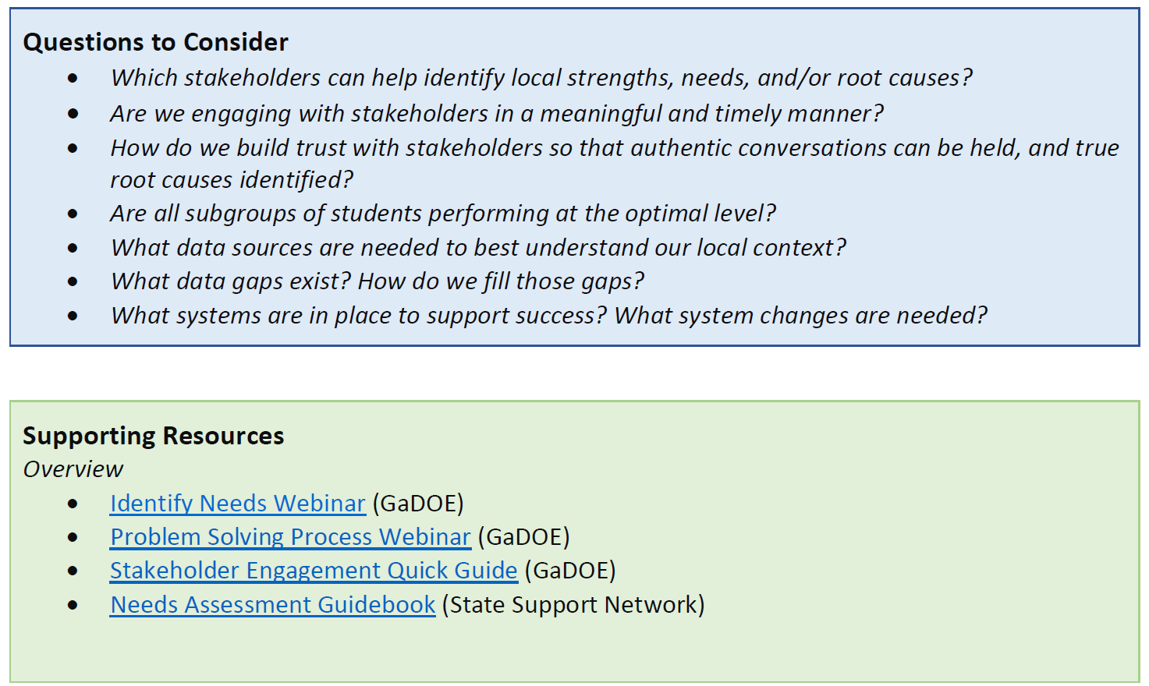
Leveraging Evidence-based Practices
This GaDOE guidance document helps LEAs identify and leverage EBPs throughout the problem-solving cycle.
gadoe.org/evidencebasedguide
Educating Georgia’s Future: Georgia’s State ESSA Plan

Slide 18
Support Directory
gadoe.org/support

Slide 19
Updates: Ted Beck
Chief Financial Officer

Slide 20
AFY19 / FY20 Budget Request
Governor’s budget instructions:
Agencies permitted to request a 2% enhancement to their operational budgets (!)
Specific allowances for known growth areas:
K12/QBE, Medicaid, higher education/scholarship programs, etc.
GaDOE has not historically submitted a QBE request due to timing of FTE counts and other required data
Governor’s Office of Planning and Budget asked GaDOE to submit “placeholder” request for this cycle

Slide 21
AFY19 / FY20 Budget Request
All QBE request items are “placeholders”
Actual QBE will reflect data submitted by districts the and results of the formula
AFY 2019: No enhancement request
FY 2020
$5,800,000 enhancement request
$2,000,000 – exemplary curriculum and TRL design/resources
$2,000,000 – IT infrastructure and support
$1,040,000 – wraparound coordinators
$480,000 – Innovative Assessment Pilot support
$140,000 – STEM/STEAM coordinator
$140,000 – Military affairs coordinator

Slide 22
Other Finance Items
Year-end (FY18) financial reporting
School construction/financing study committee
School safety study committees
School financial transparency act (HB 139)
GaDOE enterprise financial systems study
New board member financial training dates/location changes
Disaster recovery

