Slide 1
Summer Inspiration and Innovation Center
Mr. Eric Arena Superintendent
October 18, 2017

Slide 2
Summer Inspiration
Year-Round Learning
Learning is Fun (Students and Teachers)
Summer Nutrition
Summer Innovation Center
Instructor Flexibility Training
Incubator (Unmanned Systems, Industry)
Experiential Learning
Community Involvement

Slide 3
Summer Inspiration and Innovation Center
Dr. Christopher Lawton Director, Experiential Learning
October 18, 2017

Slide 4
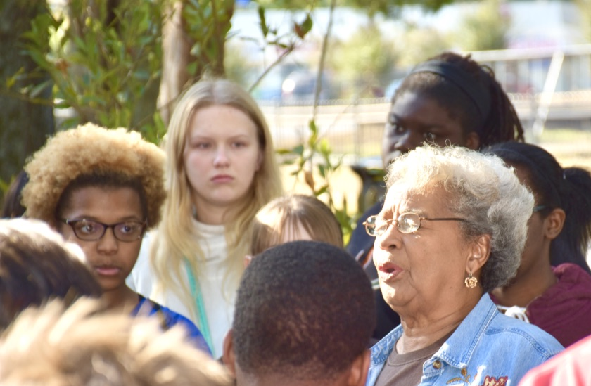
Anna Adams

Slide 5
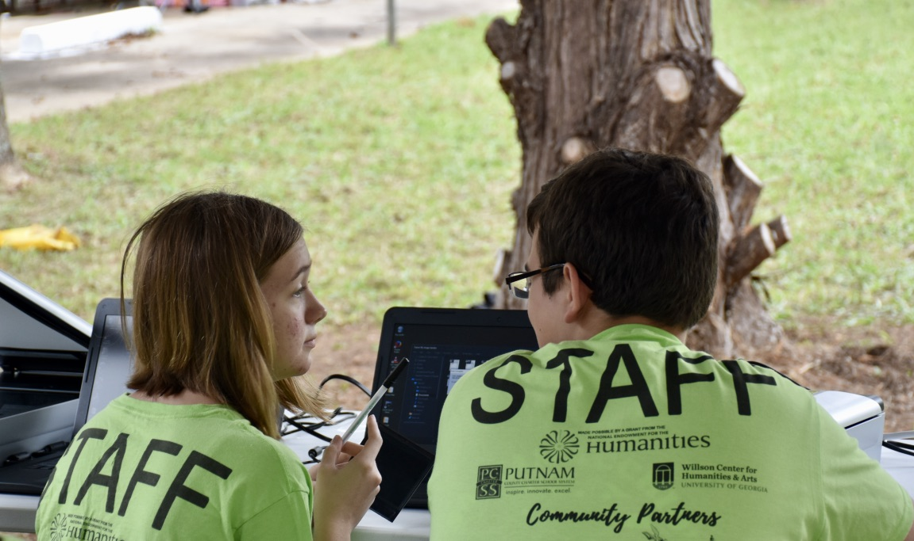
Annabell Sapp

Slide 6
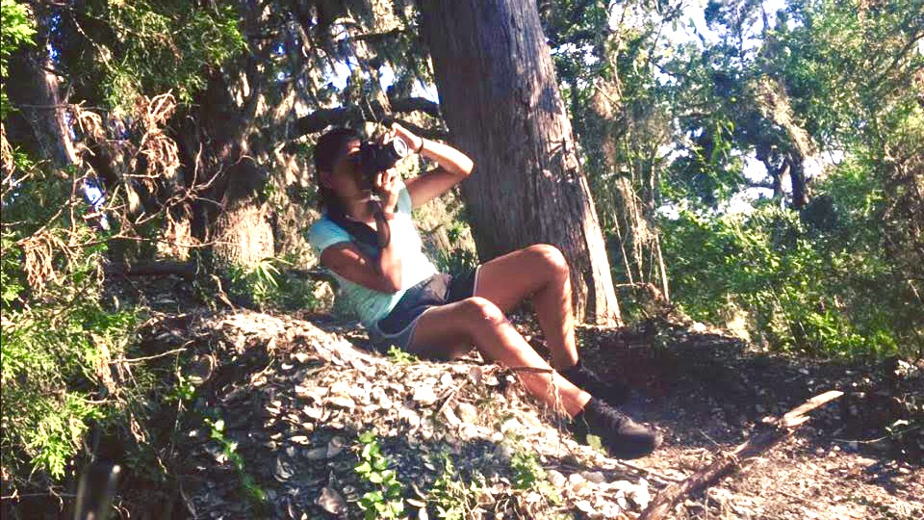
Angie Monroy

Slide 7
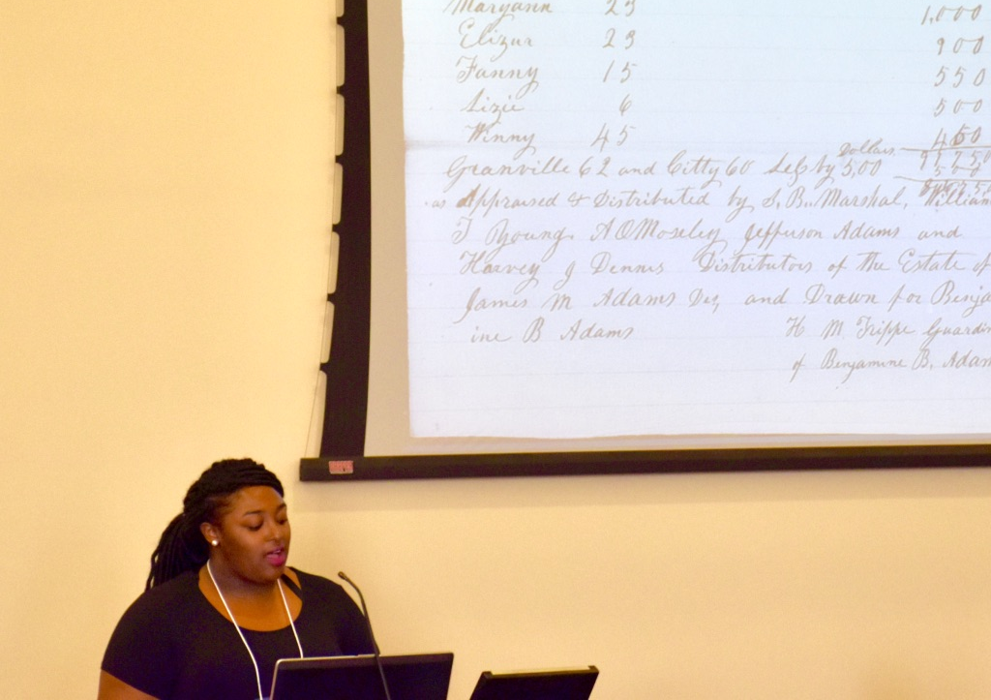
Kacie Ruff

Slide 8
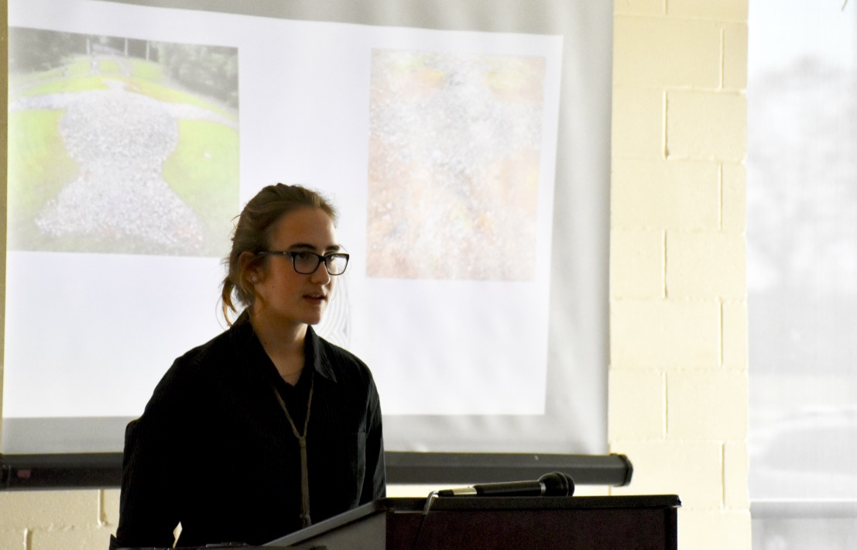
Mary Mead

Slide 9
Jake Morris

Slide 10
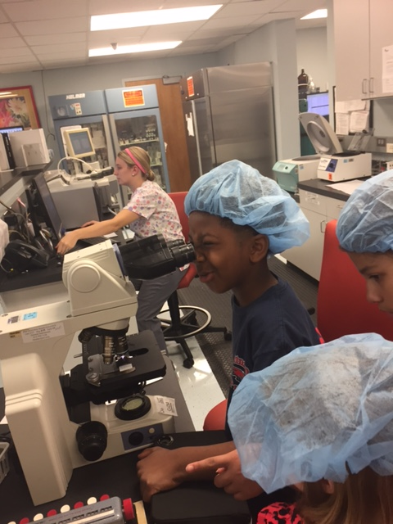
Summer Inspiration

Slide 15
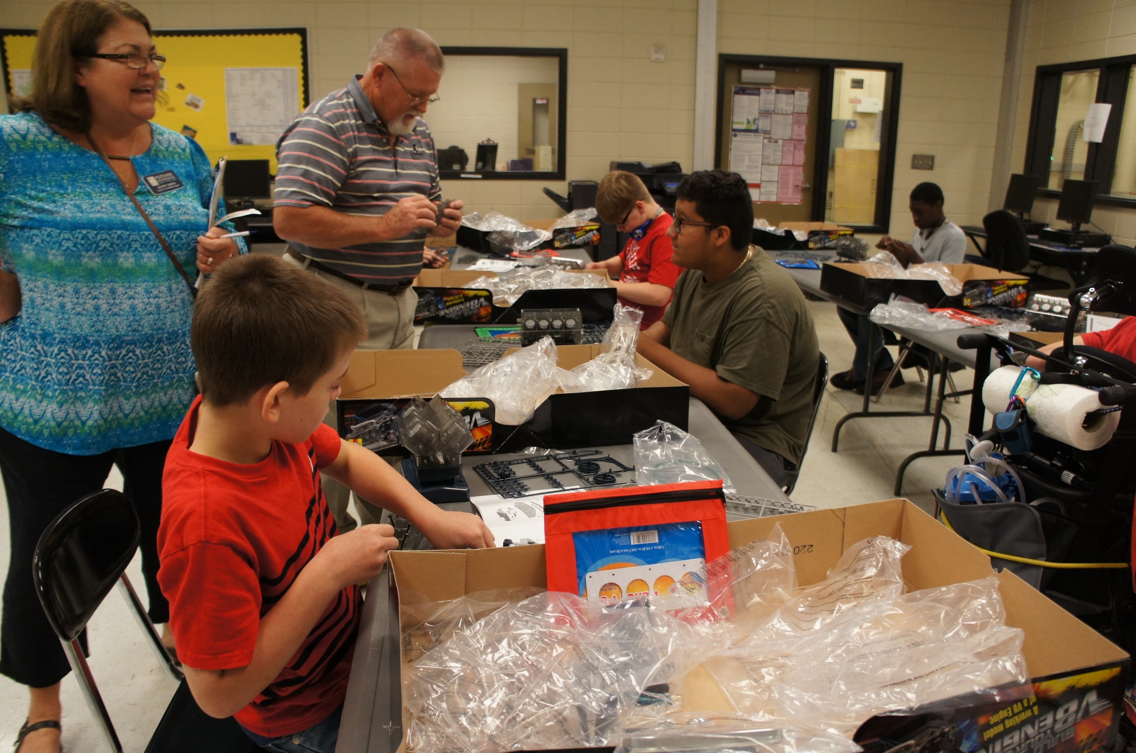

Slide 16
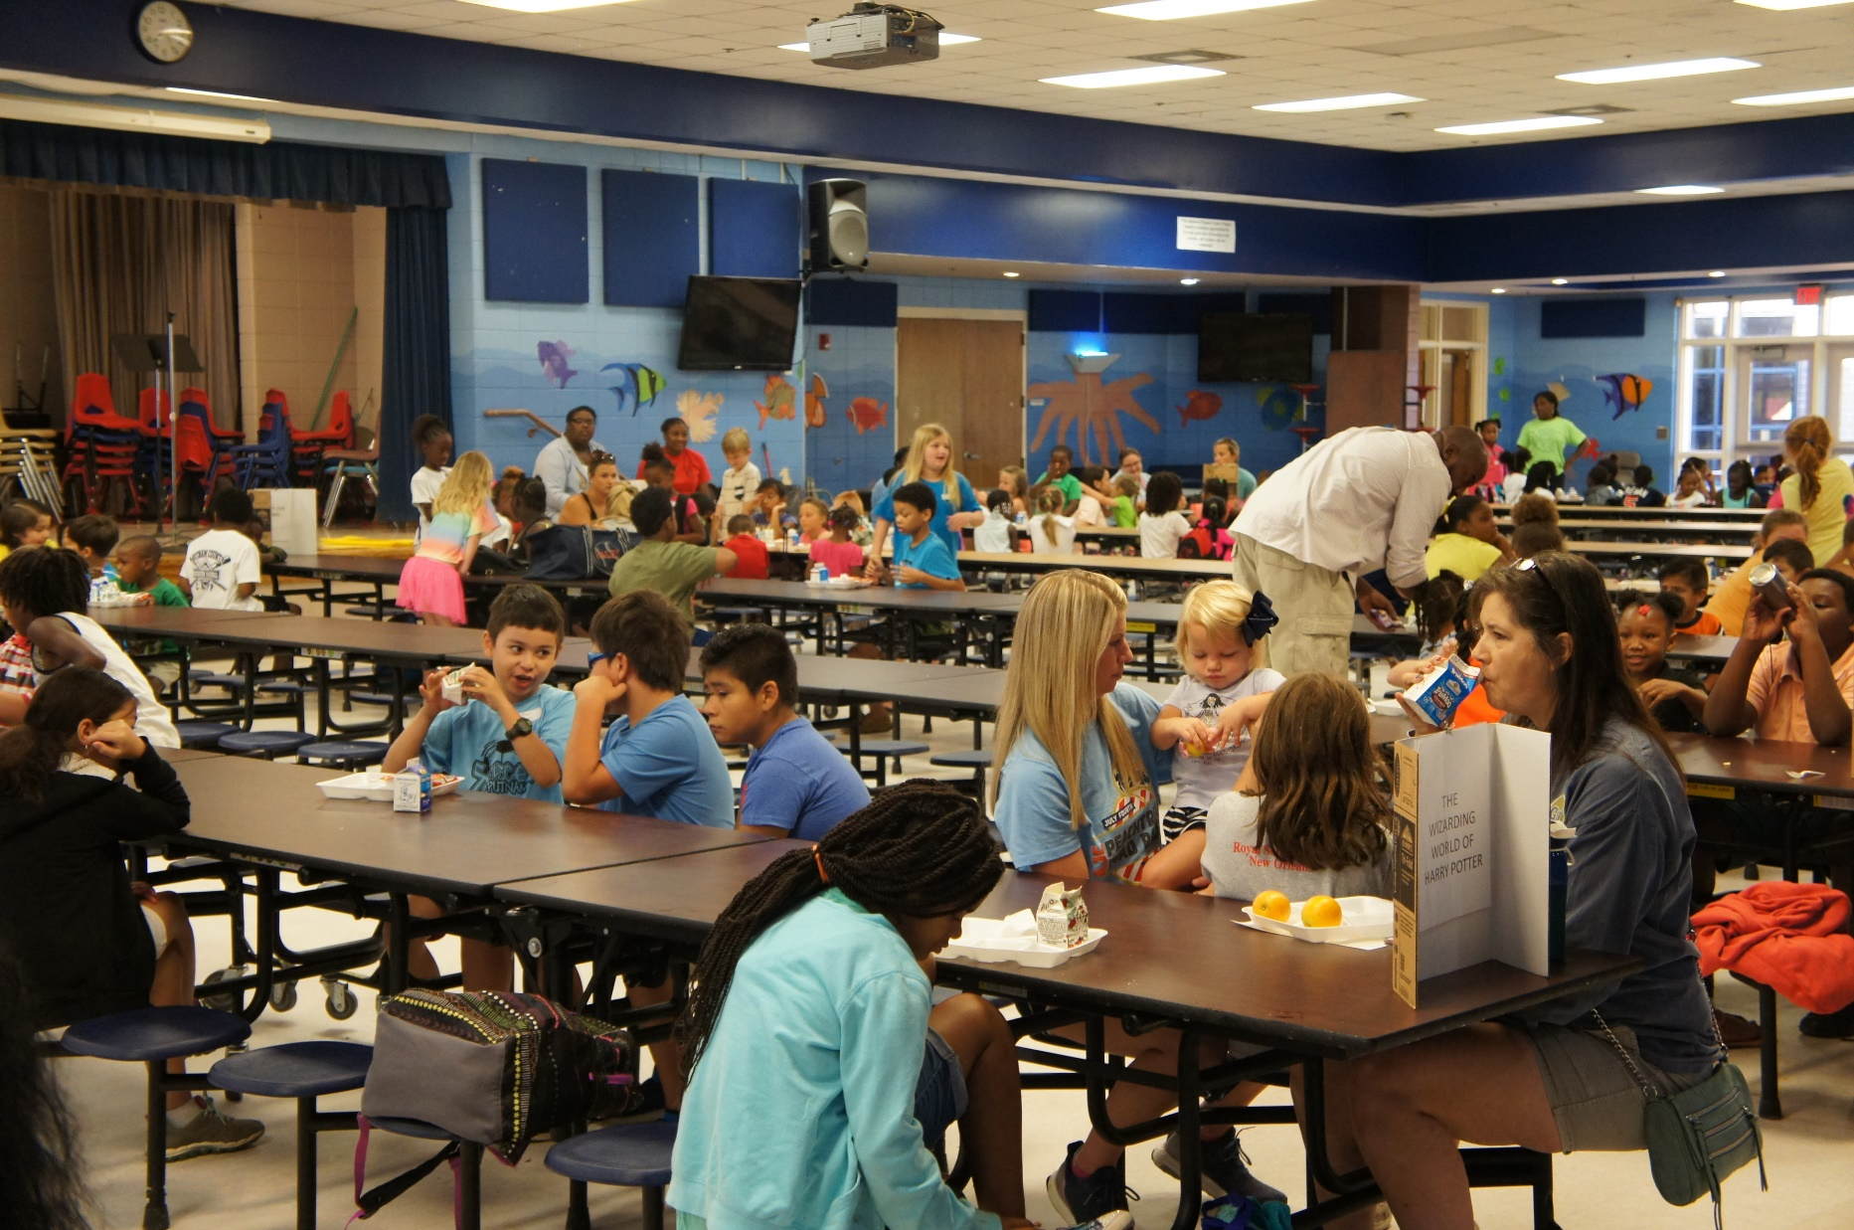

Slide 17
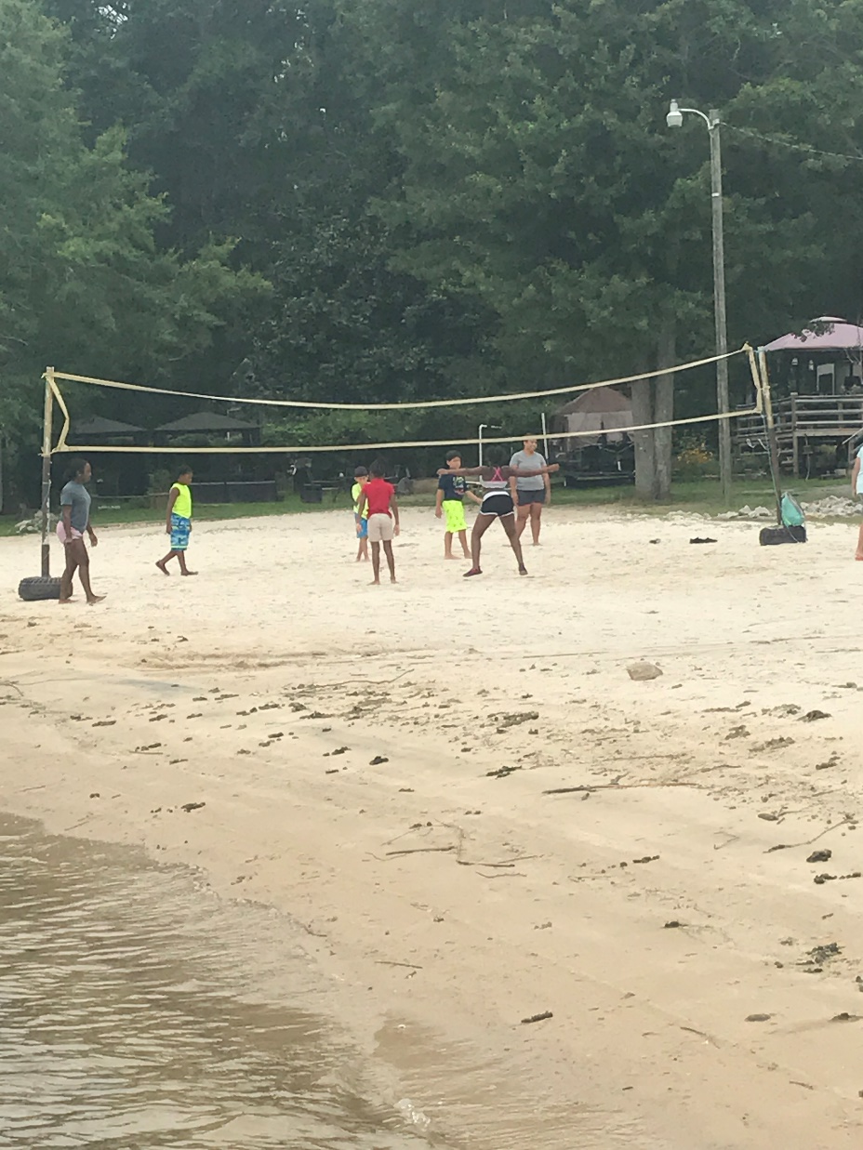

Slide 18
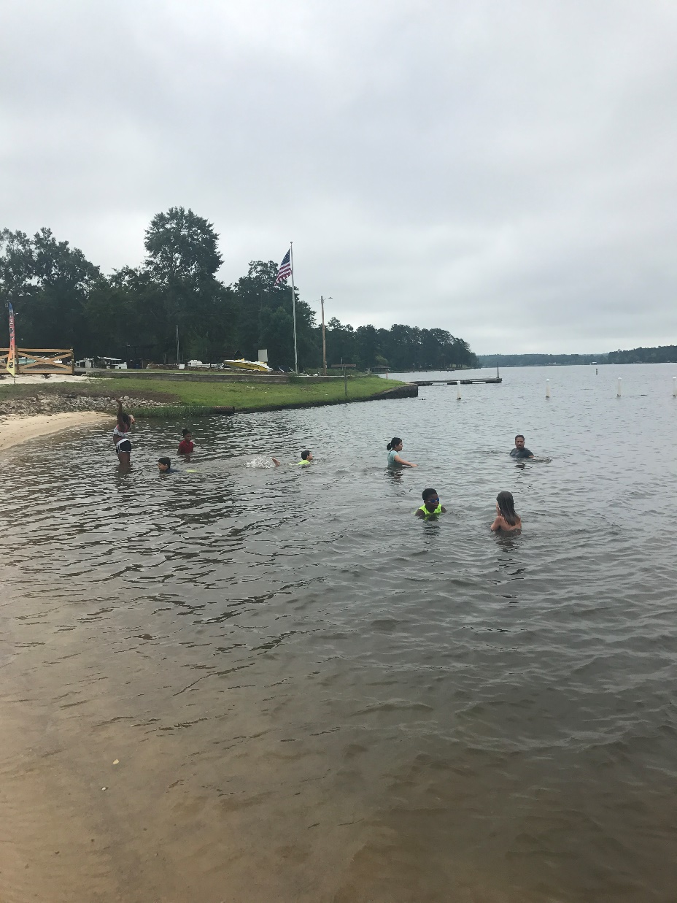

Slide 19
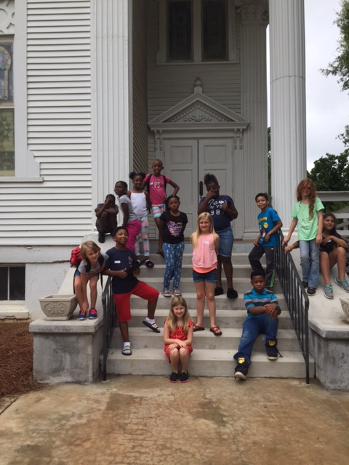

Slide 20
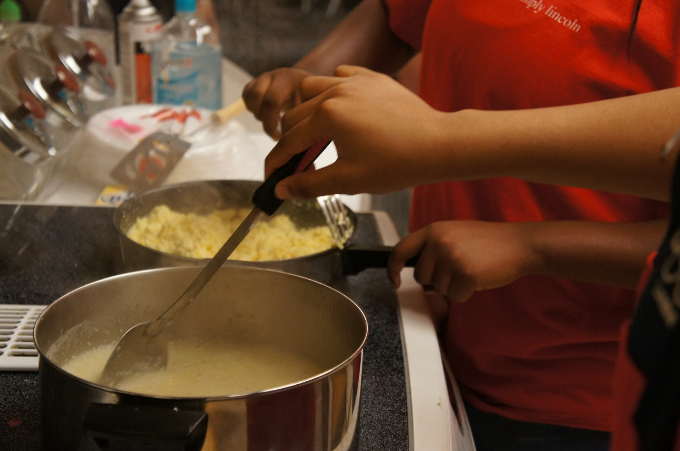

Slide 21
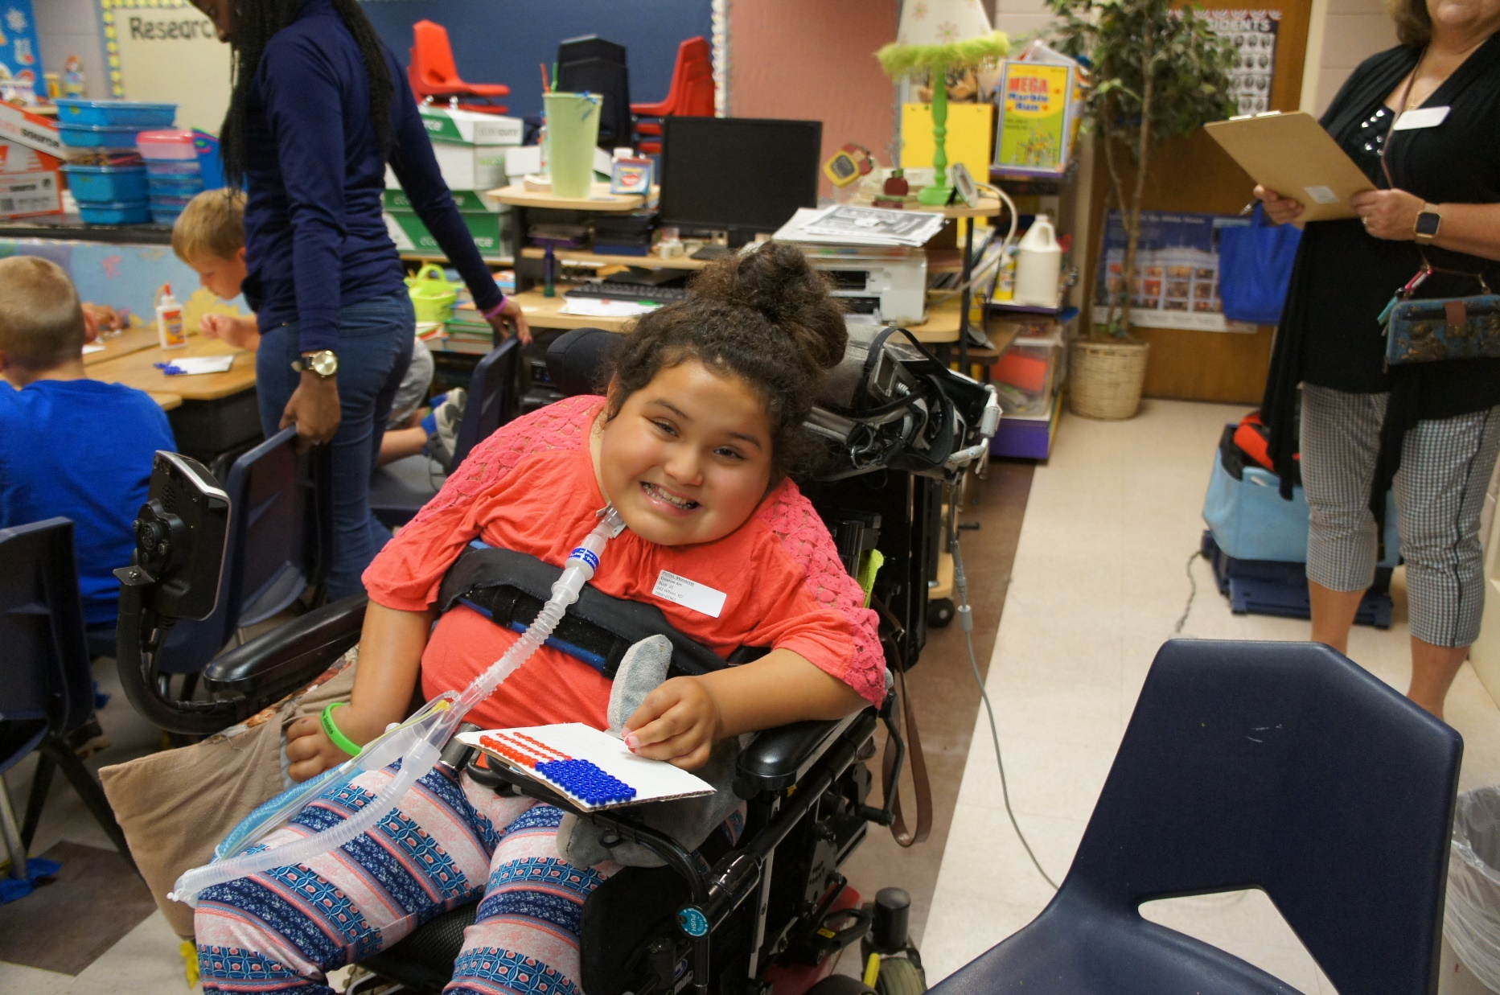

Slide 22
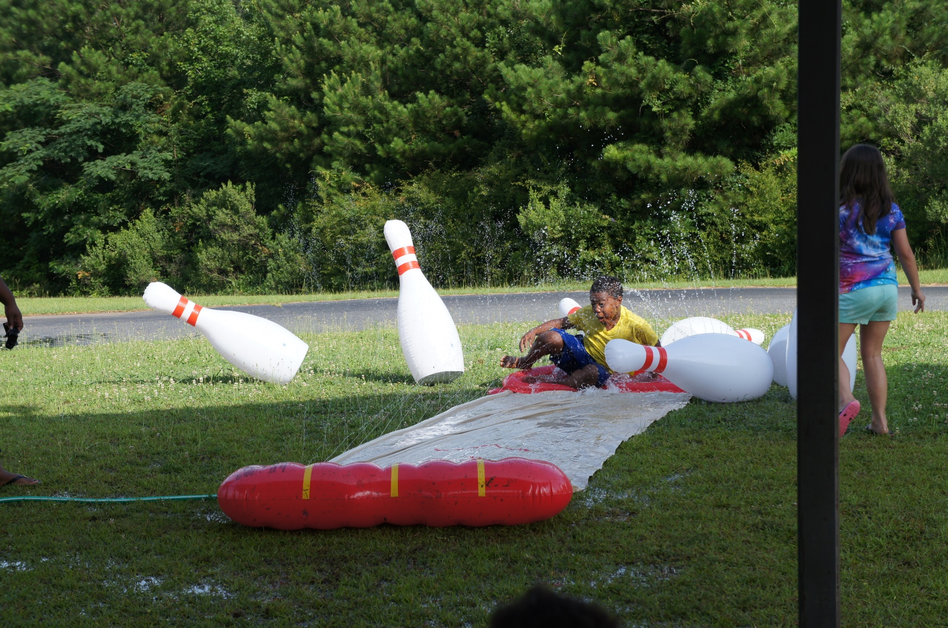

Slide 23
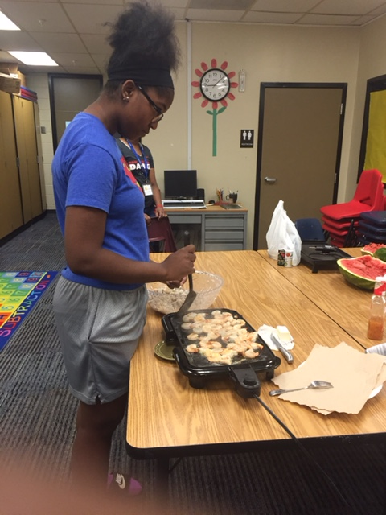

Slide 24
