Slide 1
2017 Fall Bootstrap Conference
Cory O. Kirby
Hieu M. Nguyen
Harben, Hartley & Hawkins, LLP

Slide 2
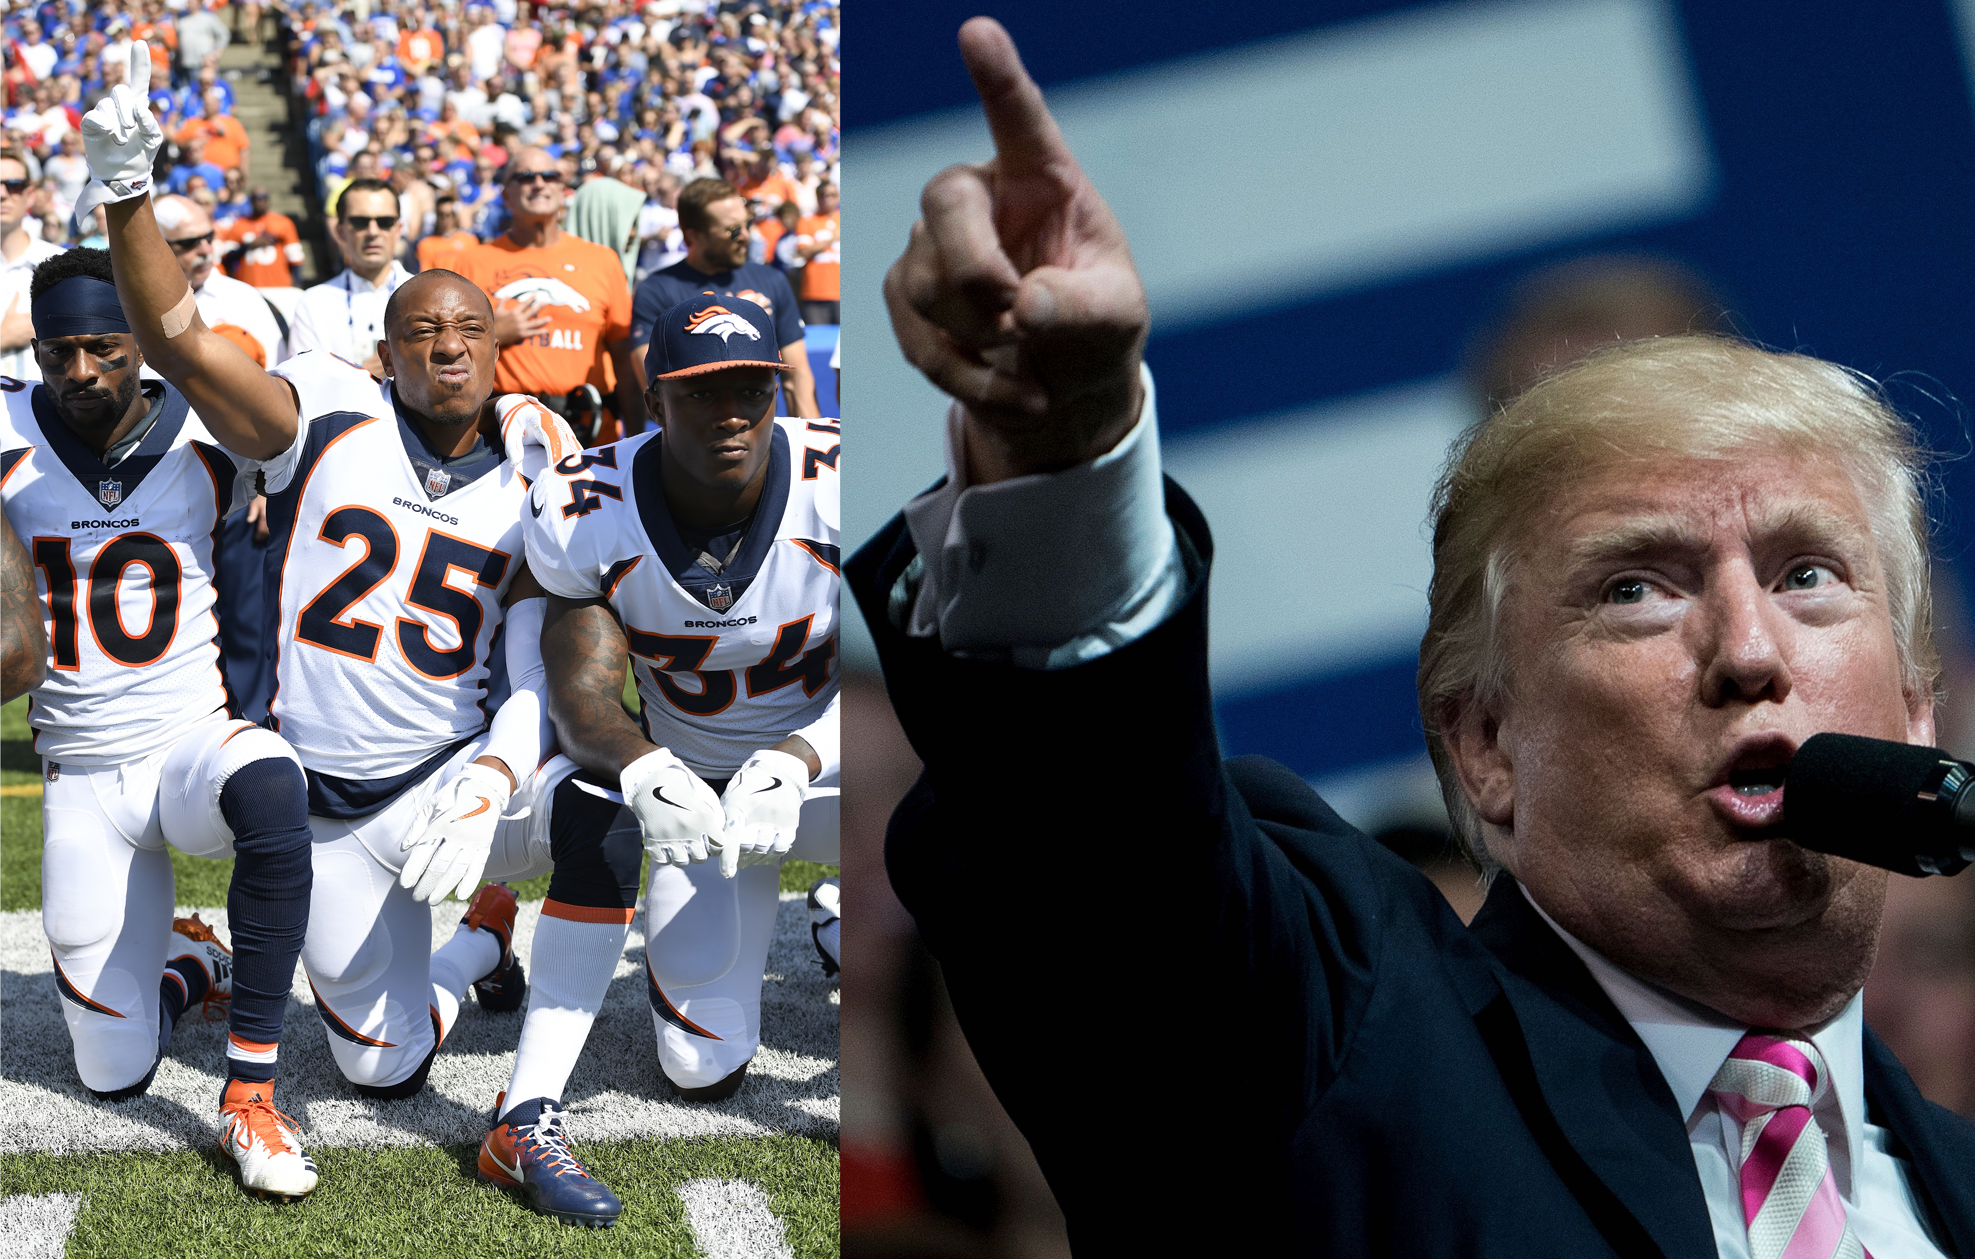
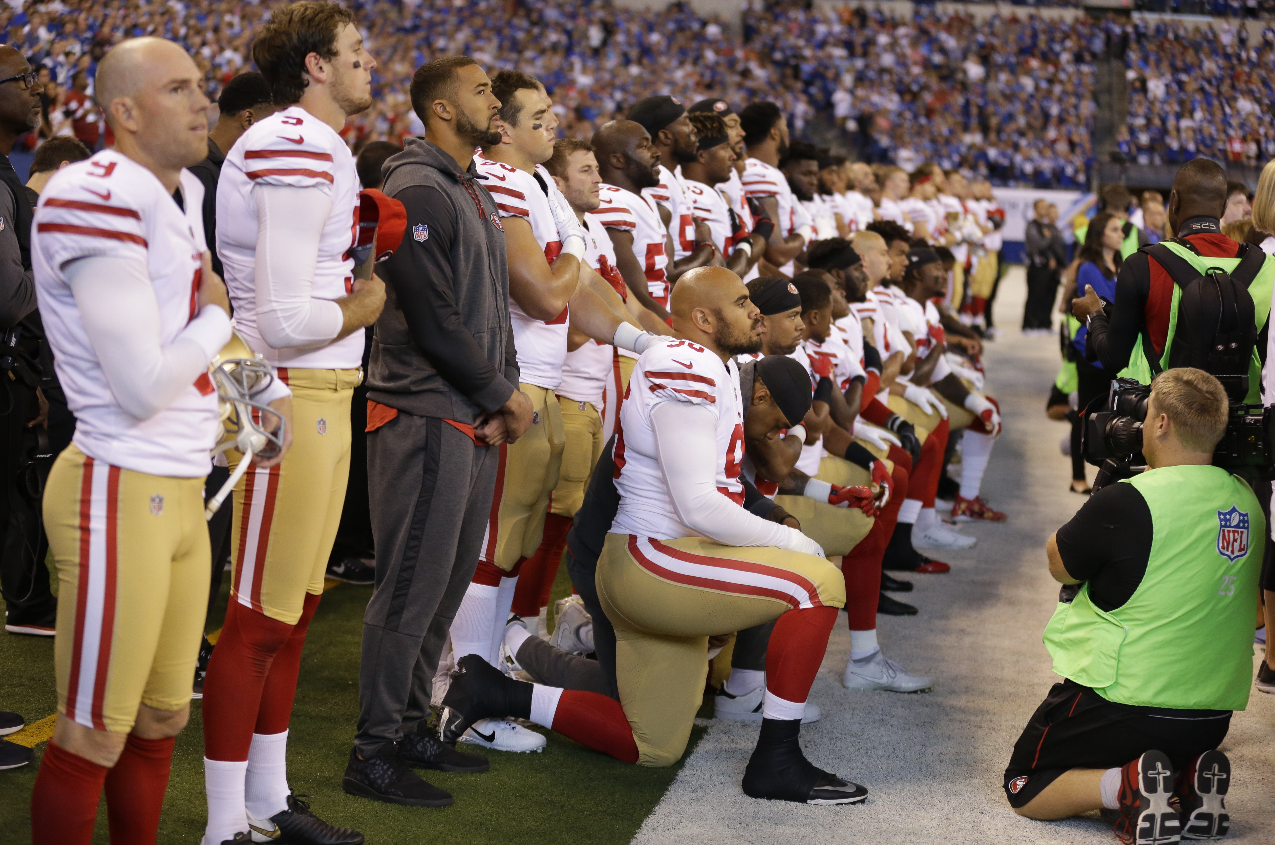
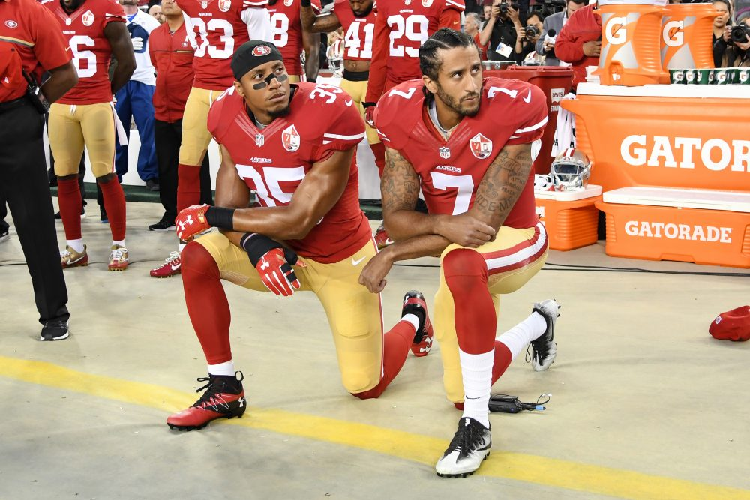
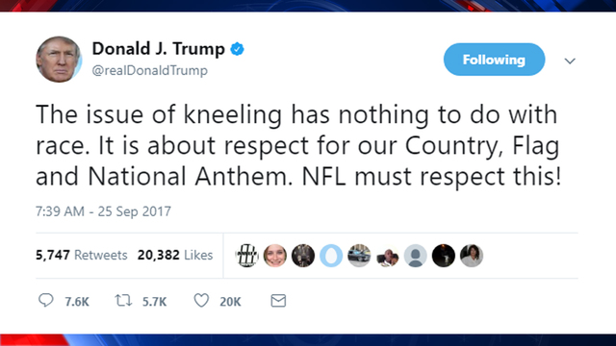
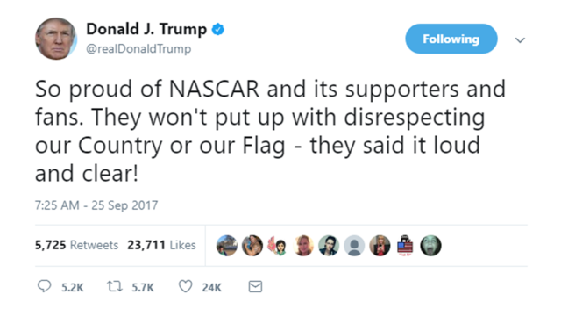
Visit gsba.com
® GSBA, Georgia School Boards Association. All rights reserved 2016.

Slide 3
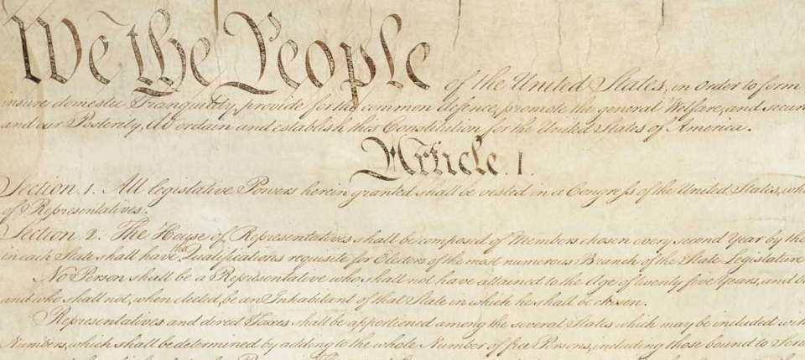
Free Speech
Congress shall make no law… abridging the freedom of speech
U.S. Const. Amend. I

Slide 4
The Free Speech “Rule”
Students do not “shed their constitutional rights to freedom of speech or expression at the schoolhouse gate.”
  Tinker v. Des Moines Ind. Community Sch. Dist., 393 U.S. 503, 506 (1969)

Slide 5
Except When Their Speech…
Will materially and substantially disrupt the work and discipline of the school - Id., at 513.
Is lewd and indecent - Bethel School District v. Fraser, 478 U.S. 675 (1986)
Bears the imprimatur of the school - Hazelwood Sch. Dist. V. Kuhlmeier, 484 US 260 (1988)
Has a pro-drug message - Morse v. Frederick, 551 U.S. 393 (2007)

Slide 6
What about the Pledge of Allegiance?
O.C.G.A. § 20-2-142 (a)(1):
“All elementary and secondary schools which receive in any manner funds from the state shall provide the following course offerings … A course of study in the history of the United States and in the history of Georgia … which shall include a study of the Pledge of Allegiance to the flag of the United States and the Georgia flag in addition to other institutions and ideals.”
O.C.G.A. § 20-2-310 (c)(1): “Each student in the public schools of this state shall be afforded the opportunity to recite the Pledge of Allegiance to the flag of the United States of America during each school day. It shall be the duty of each local board of education to establish a policy setting the time and manner for recitation of the Pledge of Allegiance. Such policy shall be established in writing and shall be distributed to each teacher within the school.”

Slide 7
Holloman v. Harland, 11th Circuit, 2004
During the flag salute on the day after the Hutto incident, Holloman stood with the other students. but did not recite the Pledge of Allegiance. Instead, he silently raised his fist in the air while the rest of the class recited the pledge; once the pledge was over, he sat down like everyone else. He did not say anything, touch any other students, disrupt the class, or obstruct anyone's view of the flag.
Barnette (USSC, Jehovah’s Witness case) clearly and specifically established that school children have the right to refuse to say the Pledge of Allegiance.

Slide 8
What about the Pledge of Allegiance?
Frazier v. Winn, Eleventh Circuit Court of Appeals (2008):
Florida state statute requiring all students to participate in the pledge of allegiance to the flag each day, unless the parent of the student has, in writing, requested that the student be excused. The statute further required that “all civilians” must stand when the pledge is recited.
Court overturned the requirement to stand portion of the statute, concluding that students have a constitutional right to remain seated during the Pledge.

Slide 9
Employee’s Free Speech Analysis and Social Media

Slide 10
Typical Analysis
Was speech “pursuant to” or “in the scope of” employee’s duties?
Was speech a “matter of public concern” or of personal interest?
If speech is a matter of public concern, how does the District’s interest balance against the employee’s interest?

Slide 11
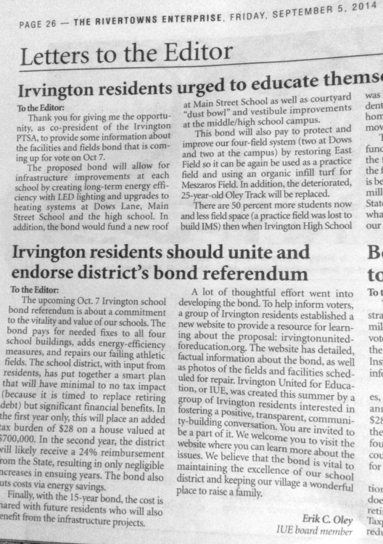
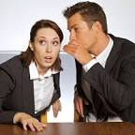

How should social media speech be treated?

Slide 12
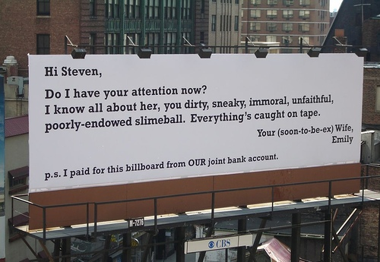

Slide 13

Denver math teacher tweets about her hot students and how she likes to smoke weed
Reported by Jordan Yerman, examiner.com

Slide 14
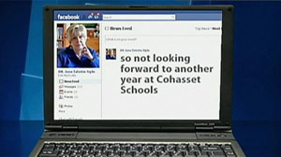
Teacher Loses Job After Commenting About
Students, Parents on Facebook
ABC News Aug. 19, 2010 By KI MAE HEUSSNER and DALIA FAHMY

Slide 15
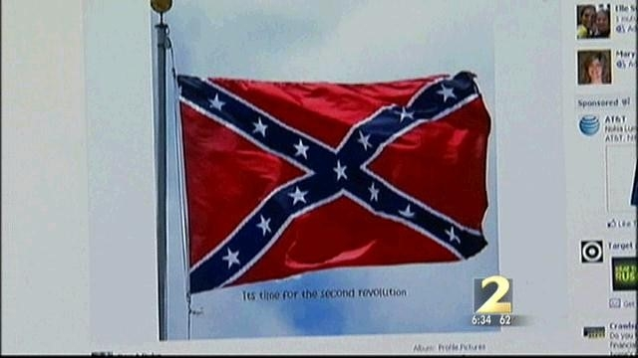
Speech About Public Matters
Duke v. Hamil, 997 F. Supp. 2d 1291 (N.D. Ga. 2014)

Slide 16
Duke v. Hamil (cont’d)
Personal Facebook page, accessible only by “close friends and family”
Facebook profile did not reference his employment at the Clayton State University Police Department or his job as a assistant chief
Took down the post within an hour but before he did, someone provided an image of the post to local TV station

Slide 17
The Court’s Decision and Advice
“In addition to possible internal disruption, the public attention the speech received also implicated the Department's reputation and the public's trust.”
“Yet despite his intentions and his quick removal of it, the post became public after someone provided the image to a television station. This illustrates the very gamble individuals take in posting content on the Internet and the frequent lack of control one has over its further dissemination.”

Slide 18
SOCIAL MEDIA LESSONS
FROM THE COURT
You are responsible for the consequences of what you post
There is no privacy on the Internet

Slide 19
Fighting and
Self-defense

Slide 20
Students have a right to defend themselves from attack.
Relying on “zero tolerance” for fighting is not enough. Have evidence of initiation of fight or becoming aggressor.

Slide 21
O.C.G.A. § 16-3-21
(a) A person is justified in threatening or using force against another when and to the extent that he or she reasonably believes that such threat or force is necessary to defend himself or herself or a third person against such other's imminent use of unlawful force…

Slide 22
O.C.G.A. § 16-3-21
(b) A person is not justified in using force under the circumstances specified in subsection (a) of this Code section if he:
(1) Initially provokes the use of force against himself with the intent to use such force as an excuse to inflict bodily harm upon the assailant;
(2) Is attempting to commit, committing, or fleeing after the commission or attempted commission of a felony; or
(3) Was the aggressor or was engaged in a combat by agreement unless he withdraws from the encounter and effectively communicates to such other person his intent to do so and the other, notwithstanding, continues or threatens to continue the use of unlawful force.

Slide 23
O.C.G.A. § 16-3-21
(c) Any rule, regulation, or policy of any agency of the state or any ordinance, resolution, rule, regulation, or policy of any county, municipality, or other political subdivision of the state which is in conflict with this Code section shall be null, void, and of no force and effect.

Slide 24
B.B. v. Polk County Board of Education, Case No. 2016-29
“The Student contends that the decision of the Local Board is in error because the policy defining fighting is null and void….
The Local Board policy defines “fighting” as follows:
A physical altercation between two or more individuals. A student under attach should detach himself/herself from the situation and get an adult to help; this action would constitute ‘self defense’ on the attached student’s part. A fight occurs when the student strikes back and actively engages in the altercation. Disciplinary consequences may be different for an aggressor than for a victim.
This Board concludes that the self-defense portion of this policy is contrary to the Georgia self-defense statute.

Slide 25
B.B. v. Polk County Board of Education, Case No. 2016-29
“Thus, this Board concludes that the Local Board’s definition is contrary to Georgia Law, and therefore, null and void.”

Slide 26
Georgia Court of Appeals:
Henry County Bd. of Educ. v. S.G. (2016)
“The testimony of the only people who testified they actually witnessed the fight—the school secretary, S.G., and her mother—is uniform and largely corroborated by the video recording, which undisputedly shows S.G. walking towards the building (camera), followed quickly by the other student, and S.G. stopping with her back to a pillar, at which time the other girl comes within inches of S.G.'s face. The undisputed evidence also reveals that S.G. hit the other student first, took her to the ground, and repeatedly hit her while sitting on top of her. Even after S.G. repeatedly punched the other student, the student again went after S.G. when the girls were first separated.
When considering the prior difficulties between S.G. and the other student, which the Local Board acknowledges, the corroborated testimony that the other student was the aggressor, and the other student's attempt to attack S.G. after being separated, there is sufficient evidence to support a claim that S.G. reasonably believed that she had to use force to protect herself from the other student. Because there is credible evidence to support a justification defense, it was for the Local Board to disprove that defense….It failed to do so.”

Slide 27
Georgia Court of Appeals:
Henry County Bd. of Educ. v. S.G. (2016)
Local Board’s “Factual Findings:”
  “[S.G.] was involved in a fight on school grounds. The other female moved towards [S.G.] and [S.G.] hit the girl and the fight ensued. [S.G.] threw the other student to the ground and began hitting her in the face numerous times. The fight was broken up and the other female walked toward [S.G.] and the fight continued. The other student received a busted lip and blood on her face. The SRO charged [S.G.] with a misdemeanor under Georgia law. Based on S.G.'s involvement in the fight, the Local Board concluded that S.G. committed two “Section 2 Offenses” from the Secondary Student Handbook—for physically abusing others and for violations that constitute a misdemeanor. The Local Board expelled S.G. from her high school and allowed her to attend an alternative school.”

Slide 28
Georgia Court of Appeals:
Henry County Bd. of Educ. v. S.G. (2016)
“The limited factual findings made by the Local Board, while supported by the evidence, do not support the Local Board's argument that it properly applied self-defense laws in expelling S.G. The Local Board expressly found that the fight started when the S.G. hit the other student after the student moved toward S.G. One could read this express finding as supporting an implicit finding that S.G. did act in self-defense. Such a finding would be supported by the record, because an eyewitness testified that the other student was the aggressor and the video undisputedly shows that the other student followed S.G. before coming within inches of S.G. Although an implicit finding that S.G. acted in self-defense is the most natural reading of the Local Board's express findings, this would be at odds with the Local Board's ultimate conclusion to expel S.G., leaving us to wonder whether the Local Board actually considered S.G.'s self-defense claim.”

Slide 29
Georgia Court of Appeals:
Henry County Bd. of Educ. v. S.G. (2016)
“…the evidence shows that S.G. was not the aggressor. As a result, she had no duty to retreat before being justified in using force to protect herself. Although the other student had stepped back before S.G. threw the first punch, this was preceded by the other student's aggressive behavior. [Georgia law] did not require S.G. to be hit first before defending herself; nor was S.G. required to have lost the fight in order to claim self-defense. That an individual prevails in standing their ground against an aggressor does not make her actions unlawful. Thus, the evidence does not support the Local Board's reasons for ‘implicitly rejecting’ S.G.'s justification defense on the basis that she was engaged in mutual combat and did not retreat.”

Slide 30
Georgia Court of Appeals:
Henry County Bd. of Educ. v. S.G. (2016)
“The Local Board, through its actions and arguments, has demonstrated a policy of expelling students for fighting on school grounds regardless of whether the student was acting in self-defense. The Local Board's rejection of S.G.'s justification defense is consistent with that zero-tolerance policy, is inconsistent with the requirements of OCGA § 16–3–21(c), is not supported by the record, and, therefore, amounted to an abuse of discretion. Accordingly, we affirm the superior court's reversal of the Local Board's ruling.”

Slide 31
Georgia Supreme Court:
Henry County Bd. of Educ. v. S.G. (2017)
Reversed Court of Appeals decision that the burden of proof was with the school
Student had to establish that she was acting in self-defense
Sent back to local board for further review
Did not apply the “any evidence” rule in reversing LBOE or addressing self-defense

Slide 32
Georgia Supreme Court:
Henry County Bd. of Educ. v. S.G. (2017)
The Bottom Line
“It is certainly true in criminal proceedings that, once a defendant presents sufficient evidence to raise a claim of self-defense, the State must disprove that defense beyond a reasonable doubt. See Mosby v. State, 300 Ga. 450, 451 (1) (796 SE2d 277) (2017). But a local school board disciplinary proceeding is a civil, and not a criminal, proceeding. Thus, while self-defense may be asserted as a defense to disciplinary charges, that does not change the rule that the burden of proof with respect to an affirmative defense in a civil case is upon the party asserting it.”

Slide 33
Georgia Supreme Court:
Henry County Bd. of Educ. v. S.G. (2017)
Implications for Codes of Conduct
Court did not require inclusion of specific self-defense provision
  Why that may not be a good idea?
Are terms such as “fighting” defined in such a way that self-defense would not be recognized?

Slide 34
What Do We Do?
Review Codes of Conduct thoroughly to ensure any suggestion of “zero tolerance” or inconsistency with self-defense statute is removed
In tribunals – be prepared to demonstrate and argue why a self-defense claim is not applicable
If self-defense is raised, the tribunal should be explicit in rejecting the claim
  i.e., “The tribunal has considered the student’s claim of self- defense and rejects that claim in determining the student committed the offense(s) alleged in the charge letter.”

Slide 35
SB 211- Valedictorian/Salutatorian
O.C.G.A. § 20-2-161.3
Move On When Ready
(4) No local school system that received funding under this article shall exclude eligible high school students taking one or more dual credit courses pursuant to this Code section from eligibility determinations for valedictorian and salutatorian of a participating eligible high school; provided, however, that this shall not apply to a high school student who moves into the local school system after his or her sophomore year and has not taken any courses on site at the participating eligible high school.

Slide 36
  Valedictorian and Salutatorian
  Do you have a policy or procedure?
  What are the selection criteria?
  How are students/parents informed?
  Legal concerns
    Is there a constitutional right?

Slide 37
SB 186: O.C.G.A. § 20-1-15
Caregiver Educational Consent Act
(3) Kinship caregiver- grandparent (or great), aunt, uncle, (or great), cousin, sibling, or fictive kin who has assumed responsibility for raising child in informal, noncustodial, or guardianship capacity for specific reasons
(2) Fictive kin- individual known to child as relative, but not related by blood or marriage and with whom child has resided or had significant contact

Slide 38
Caregiver Educational Consent Act
  Authorizes kinship caregiver to give legal consent by executing affidavit for child not in DFCS custody to
  receive educational services
  receive medical services directly related to academic enrollment, or
  participate in extracurricular activities
  Affidavit in O.C.G.A. § 20-1-18; valid for one year
    Does not supersede grandparent power of attorney in O.C.G.A. § 19-9-129

Slide 39
What Remains Alive for Next Year?
HB 32, making it a crime for any district employee to have sexual contact with students
HB 61, trying to find a way to collect sales tax on e-retail purchases
HB 217, increasing cap on income tax credits for donations to student scholarship organizations
HB 273, recess bill
SB 152, limiting amount of time student can be assigned to alternative school
Changes in nepotism law

