Slide 1
Bootstrap
Matt Jones, Chief of Staff
mattjones@doe.k12.ga.us
Georgia Department of Education

Slide 2
What We Are Accomplishing Together Good News
80% graduation rate; 50 districts with grad rate at 90% or above
ACT scores above the national average across all subject areas
SAT scores above the national average in reading/writing
$65 million to support literacy – Rewarded second round of Striving Readers (1 of 3 states)

Slide 3
Committed to Service, Support, and Innovation What’s New?
New Leadership
Meghan Frick, Communications Director
Nakeba Rahming, Deputy Superintendent of Federal Programs
Stephanie Johnson, Deputy Superintendent of School Improvement
Service & Support
Keenville – grades 1 & 2 formative assessments (keenville.gadoe.org)
CCRPI redesign (rolling out with new CCRPI)
GeorgiaInsights.com – data dashboards (regular releases)
CNA/DIP/SIP – SLDS application (Jan 2018)
Teacher Resource Link redesign (K-5 ELA & Math)

Slide 4
Georgia’s State ESSA Plan
Current Status: Submitted to USED
& under review
GaDOE.org/ESSA

Slide 5
Georgia’s State ESSA Plan Development Process
Developed by Georgians, For Georgians
Approx. 2 years of work
8 statewide meetings
Hundreds of students, parents, teachers, and superintendents through our advisory councils
6 working committees representing over 120 Georgians
40 Georgians represented on our State Advisory Committee
3rd party facilitation
45 state organizations, nonprofits, and agencies involved
30 day public review
Georgia’s ESSA Accountability Working Committee
13 – meetings
47 – hours

Slide 6
Governor’s Representation Throughout the Development Process:
Over a dozen representatives from appointed agencies
Representation on committees: State Advisory Committee; Accountability and Federal Program to Support School Improvement Working Committees
Regular updates: Rules Committee and Committee of the Whole
Requested meeting with the SBOE Chair and GOSA Executive Director
30-day review by the Governor

Slide 7
A Truly Georgia Plan
We must recognize and respect the efforts and insights of Georgians.

Slide 8
Georgia’s State ESSA Plan Reflects Our Priorities
Georgians are demanding more from their education system – we must deliver.

Slide 9
Georgia’s State ESSA Plan Keeps Us at the Forefront
Like a budget, the CCRPI reflects what’s important and what’s our priorities
National recognition – indicators, CTAE pathways, Fine Arts, AP
AYP -> CCRPI -> CCRPI 2.0 (under ESSA)

Slide 10
Georgia’s State ESSA Plan Keeps Us at the Forefront
NCLB -> ESSA: Federal shift away from heavy emphasis on high-stakes testing
Attendance
Pathways (advanced academics, arts, CTAE)
AP/IB enrollment
Enrichment (arts, physical education, world languages)
Closing the Gaps (ED, EL, and SWD)
Despite recent pushback from the SBOE, they has shown strong, consistent support in the past for these indicators (in blue) by voting in approval 6 times.

Slide 11
Georgia’s State ESSA Plan Keeps Us at the Forefront
Attendance:
Alaska, Arkansas, California, Colorado, Connecticut, Delaware, D.C., Hawaii, Illinois, Indiana, Kentucky, Maine, Massachusetts, Michigan, Minnesota, Missouri, Montana, Nebraska, New Jersey, New Mexico, New York, Ohio, Oklahoma, Oregon, Pennsylvania, Rhode Island, South Dakota, Tennessee, Virginia, Washington, West Virginia, Wisconsin
AP/IB Enrollment:
Arkansas, D.C., Maryland, Massachusetts, Michigan, Montana, Ohio*, Oklahoma, South Dakota, Utah, West Virginia
Without these indicators, points will add additional weight to
high-stakes testing

Slide 12
Georgia’s State ESSA Plan Keeps Us at the Forefront
Career Pathways:
Arkansas, California, Delaware, Idaho, Illinois, Indiana, Kentucky, Maryland, Mississippi, Montana, Nevada, New Hampshire, New Mexico, New York, North Carolina, North Dakota, Ohio, Oklahoma, Pennsylvania, Rhode Island, South Dakota, Tennessee, Vermont, West Virginia, Wyoming
Arts, PE, World Language:
Connecticut, Illinois, Kentucky, Louisiana, Maryland, Michigan, Vermont, Wyoming
Without these indicators, points will add additional weight to
high-stakes testing

Slide 13
Georgia’s State ESSA Plan Supports Increased Outcomes & Opportunities
Outcomes:
Content Mastery
Progress
Lexile
Non-Milestones assessments
Opportunities:
Beyond the Core
CTAE Pathways
AP/IB
Dual enrollment

Slide 14
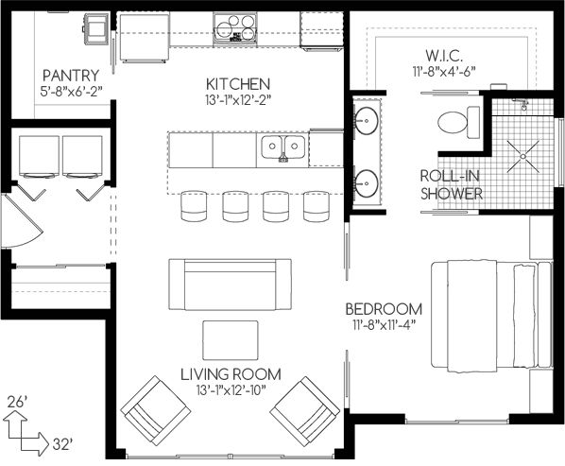
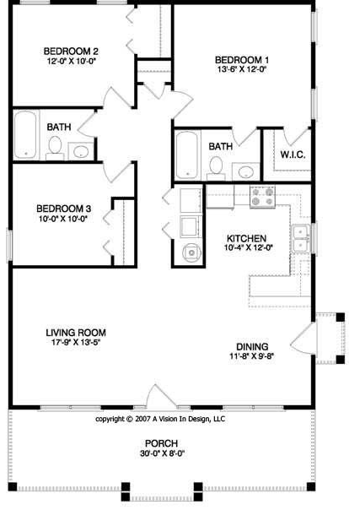
Georgia’s Accountability Model What’s Really Wrong?
…with a house containing…
Bedrooms
Kitchen
Living room
Dining room

Slide 15
Georgia’s Accountability Model Not Setting Our Schools Up for Failure
Which is better?
Gator Elementary School (FL) – rated an “A”
Sweet Onion Elementary School (GA) – rated a “B”
Letter Grade | Georgia | Louisiana | Florida
A | 82% or greater | 67% or greater | 62% or greater
B | 72% - 81% | 57% - 66% | 54% - 61%
C | 64% - 71% | 47% - 56% | 41% - 53%
D | 54% - 63% | 33% - 46% | 32% - 40%
F | 53% or less | 32% or less | 31% or less
Note. Percentages are based on the available points on the state’s scale. In other words, what proportion of the available points is needed to obtain the letter grade. Georgia has a 0-110 scale, Louisiana has a 0-150 scale and Florida scales ranged from 800 -1000 depending on schooling levels

Slide 16
Georgia’s Accountability Model Not Setting Our Schools Up for Failure
None of the top performing NAEP states use a 100 scale
Several states are moving away from 100 pt scales and ‘grading schools’
We must be champions of flexiblity and innovation in this area
UGA study (Welsh, 2017) findings:
Georgia has a harsher grading scale than other Southeastern states
Massachusetts uses a five-level scale (Level 1 is the highest performing and Level 5 is the lowest performing). An A school needs 75 or higher on the cumulative performance index. If this was analogous to a letter grade rating system, it would be less stringent than Georgia.
Source: tinyurl.com/welsh-ccrpi

Slide 18
Keenville
Grades 1 & 2 literacy and numeracy formative assessments
Gamification
Mobile friendly & compatible across platforms
Connects with SLDS
keenville.gadoe.org
Superintendent Woods does not support the expansion of high-stakes testing in grades 1 & 2

Slide 19
Assessment
Letter to Secretary DeVos – intent to apply for participation in pilot; expressed desire for additional federal flexiblity
Assessment Innovation and Flexiblity Task Force – comprehensive review and discussion of our state assessment system; interim, formative-type features; more detailed reporting; competency-based
Assessment Innovation Fund -- $$ for 3 focus areas: (1) analysis and reduction of local assessments; (2) innovative practices; (3) planning/scaling for pilot

