Slide 1
Redesigned CCRPI Under ESSA
GSSA Fall Bootstrap Conference
October 19, 2017

Slide 2
Background
ESSA provided an opportunity to reflect on several years of CCRPI implementation, and, in consultation with stakeholders across the state, to revise CCRPI to expand upon its successes and address its shortcomings.
The redesigned CCRPI is simplified, streamlined, and reflects statewide stakeholder feedback and the recommendations of the Accountability Working Committee.
Accountability should play a supporting role in assisting our state to reach its mission of offering a holistic education to every child and preparing them for college, career, and life.
Accountability should not be the driving force behind decisions about educating children.
The purpose of CCRPI is to provide an objective measure of the extent to which schools, districts, and the state are succeeding in providing high-quality opportunities and outcomes for students that can be used for communication and continuous improvement.

Slide 3
Redesigned CCRPI
Content Mastery
Are students achieving at the level necessary to be prepared for the next grade, college, or career?
English Language Arts achievement
Mathematics achievement
Science achievement
Social studies achievement
How much growth are students demonstrating relative to academically-similar students?
English Language Arts growth
Mathematics growth
Progress towards English language proficiency (EL students)
School climate star rating
Progress
Financial efficiency star rating
CCRPI
Score
Closing
Gaps
Are all students and all student subgroups making improvements in achievement rates?
Meeting achievement improvement targets
Are students participating in activities preparing them for and demonstrating readiness for the next level, college, or career?
Elementary: Literacy, student attendance, beyond the core
Middle: Literacy, student attendance, beyond the core
High: Literacy, student attendance, accelerated enrollment, pathway completion, college and career readiness
Readiness
Graduation Rate
Are students graduating from high school with a regular diploma in four or five years? (high school only)
4-year adjusted cohort graduation rate
5-year adjusted cohort graduation rate
Draft 2018 CCRPI based on ESSA Plan submitted to USED for review.

Slide 4
Highlights of the Redesigned CCRPI
In addition to content mastery and high school graduation, CCRPI includes multiple measures of college and career readiness and values multiple pathways to success.
Literacy
Student Attendance
Accelerated Enrollment
Pathway Completion
College and Career Readiness
Entering TCSG/USG without remediation
ACT, SAT, AP, IB
National or state credential (end of pathway assessment)
Work-based learning
College and Career Readiness
Draft 2018 CCRPI based on ESSA Plan submitted to USED for review.

Slide 5
Highlights of the Redesigned CCRPI
The redesigned CCRPI maximizes local flexibility to determine the programs and policies that best meet the needs of students.
CCRPI values educating the whole child.
Exposure to a well rounded curriculum (Beyond the Core)
Engagement/climate and skills for success (Student Attendance)
Relevance and in-depth study (Pathway Completion)
Accelerated enrollment opportunities (AP, IB, Dual Enrollment)
Postsecondary readiness (College and Career Readiness – multiple opportunities to demonstrate readiness)
CCRPI is designed to award points where possible as opposed to denying points when expectations are not met.
Partial points when progress is made but targets are not met
Extra points when targets are exceeded
Progress and Closing Gaps capture growth and improvement
Draft 2018 CCRPI based on ESSA Plan submitted to USED for review.

Slide 6
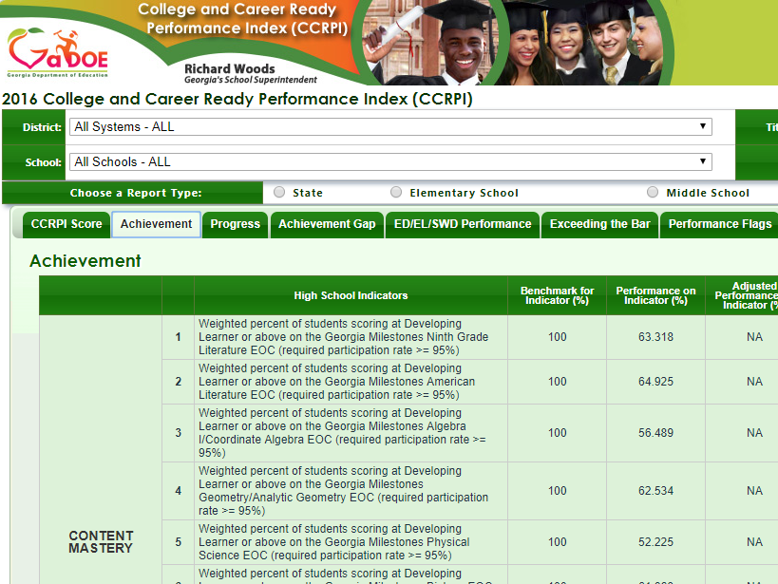
Designing New CCRPI Reports
Prior to and throughout the ESSA process, we received feedback that the current CCRPI online reports are too complicated, difficult to navigate, and do not provide enough context.
While the redesigned CCRPI itself is simplified and streamlined, new online reports are needed to improve communication and utilization of data.

Slide 7
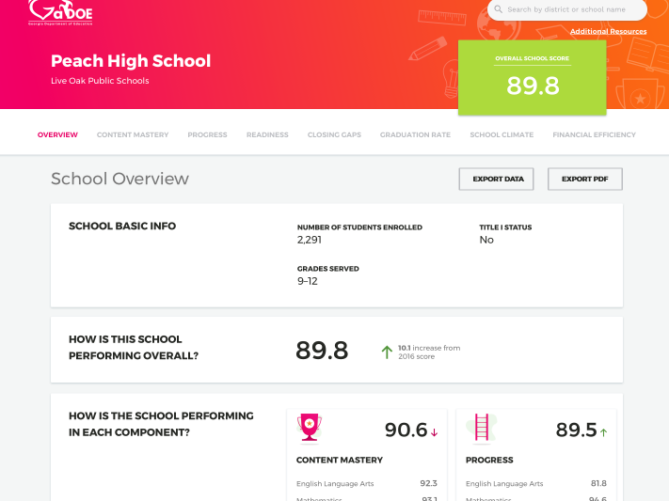
Designing New CCRPI Reports
We are pleased to present a prototype of the new CCRPI online reports.
We need feedback to finalize the design to ensure it meets the needs of educators and the public.
Please watch a video overview, tour the prototype, and submit feedback at accountability.gadoe.org.

Slide 8
Moving Forward
While the redesigned CCRPI will be a significantly improved accountability system for Georgia, the most critical piece is changing the conversation about student performance in our state.
CCRPI can shine a light on the great work schools are doing and areas in need of improvement, but it must be used as a tool by communities and other stakeholders to engage in meaningful conversations around how to improve student opportunities, outcomes, and preparedness for college, career, and life.

