Slide 1
Georgia School Superintendents Association
2017 Spring Bootstrap Conference
Casey M. Bethel | Georgia Teacher of the Year
Email: 2017gatoty@gmail.com
Facebook: GATeacher
Twitter: 2017GATOTY

Slide 2
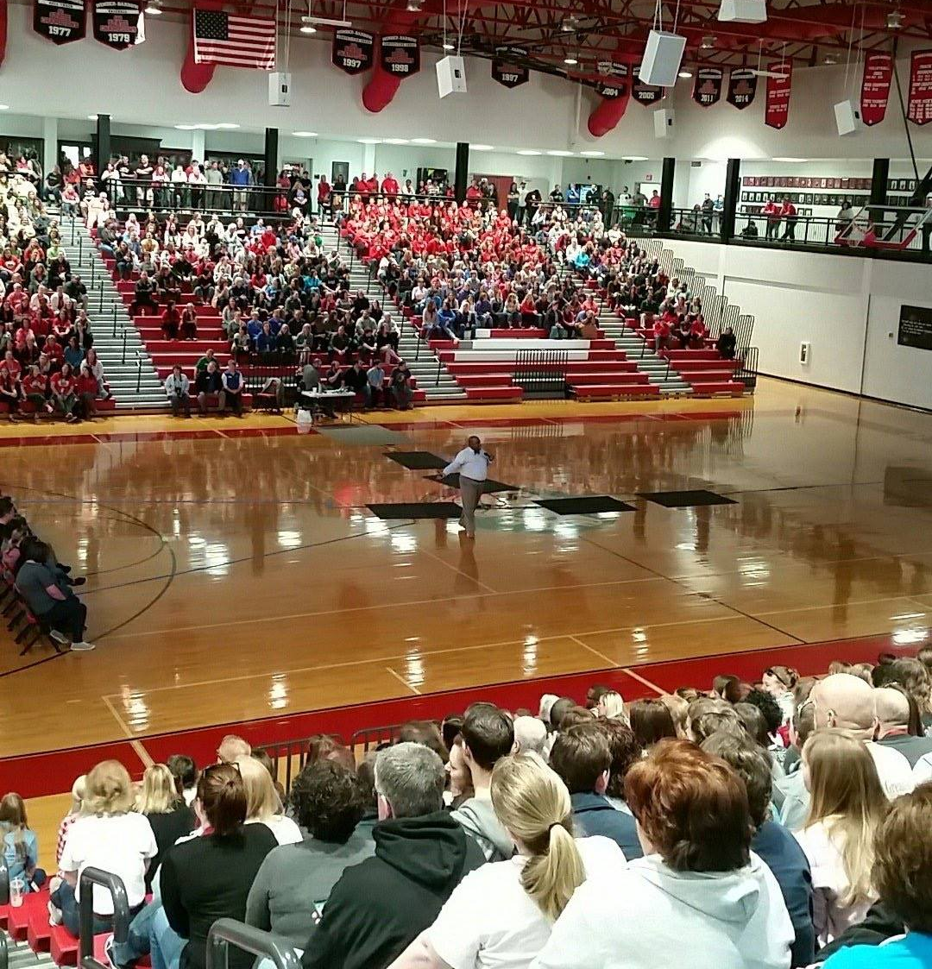
My
Deepest
Gratitude

Slide 3
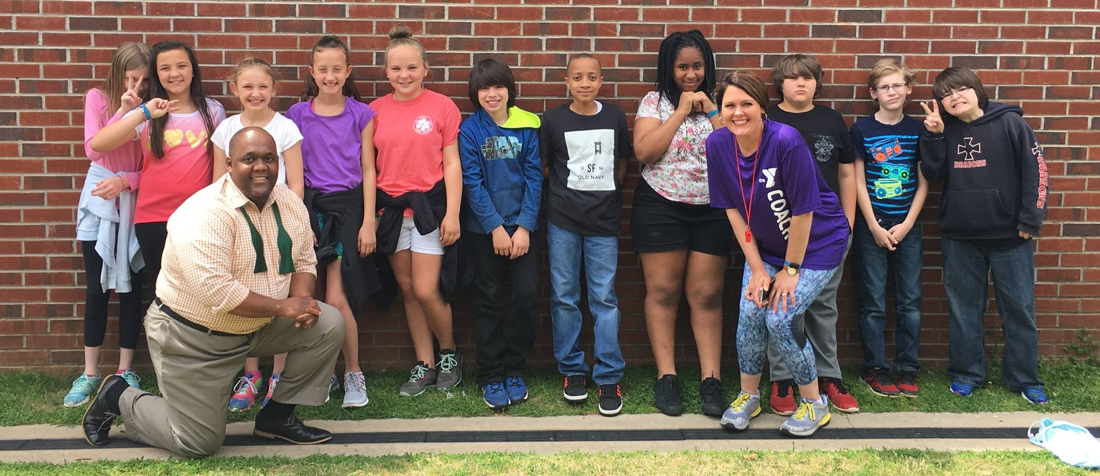
My Heartfelt Thanks

Slide 4
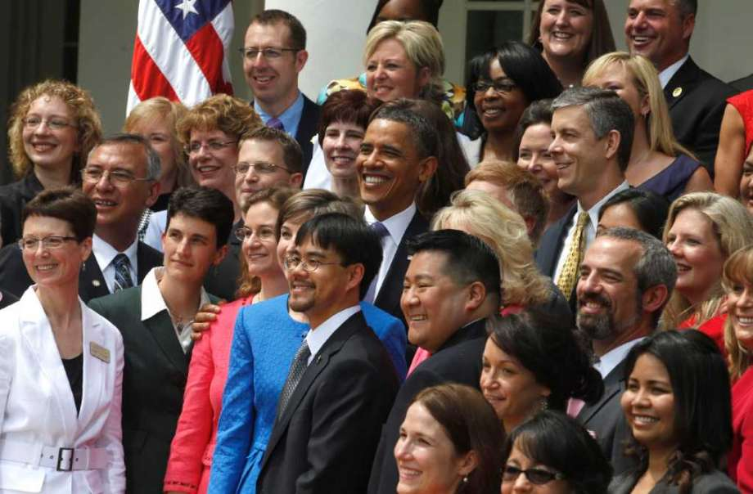

Slide 5
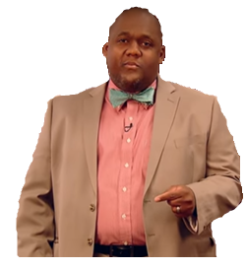

Slide 6
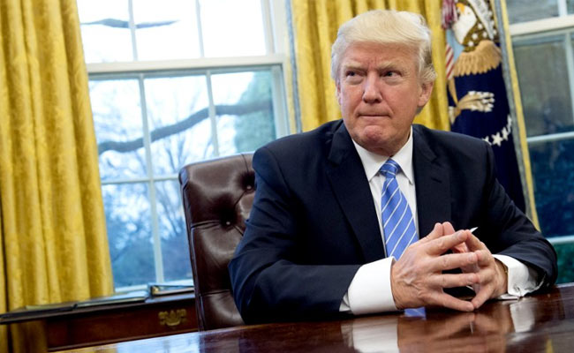

Slide 8
Two Favors

Slide 9
Continue helping us to change the narrative.
Promote positive conversations about education.

Slide 10
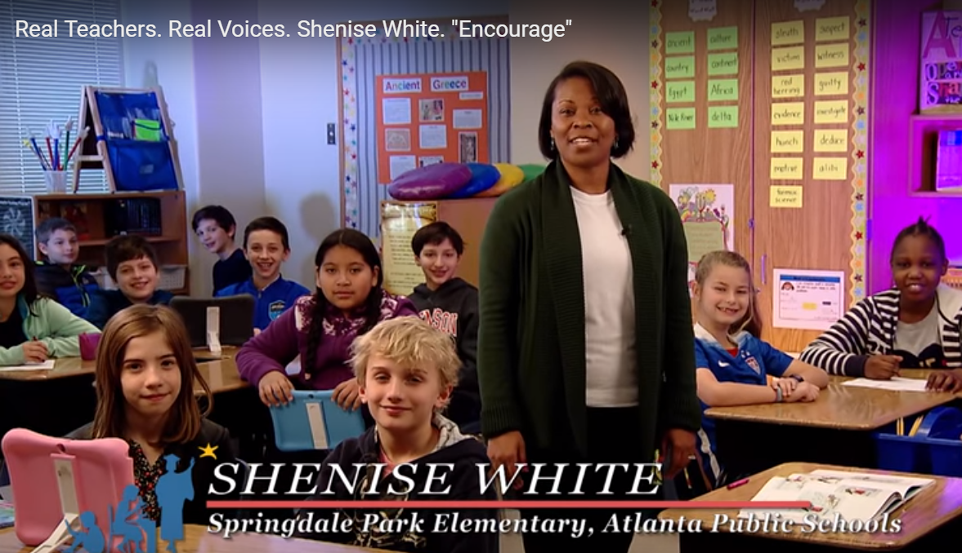
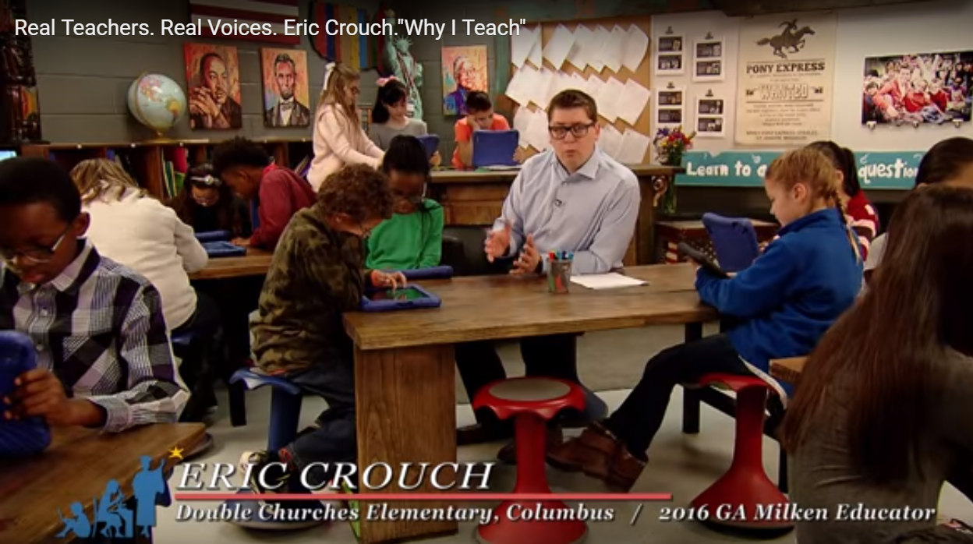

Slide 11
Harness the Power of School, University & Industry Partnerships to Improve Education

Slide 13
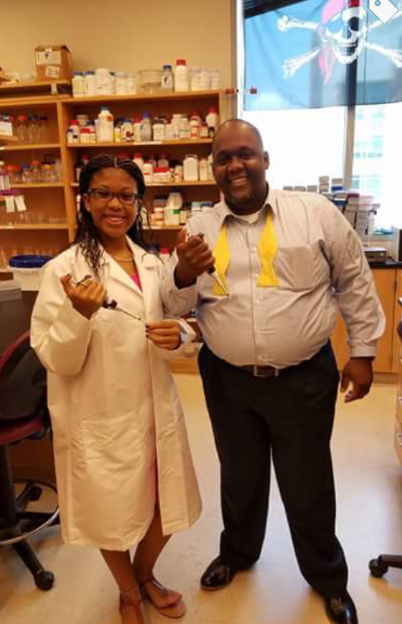
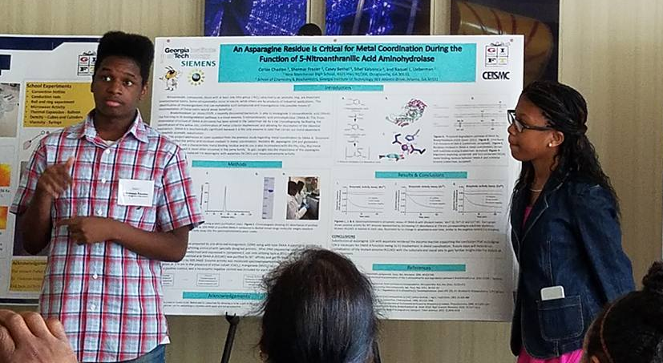
Students Are Exposed

Slide 14
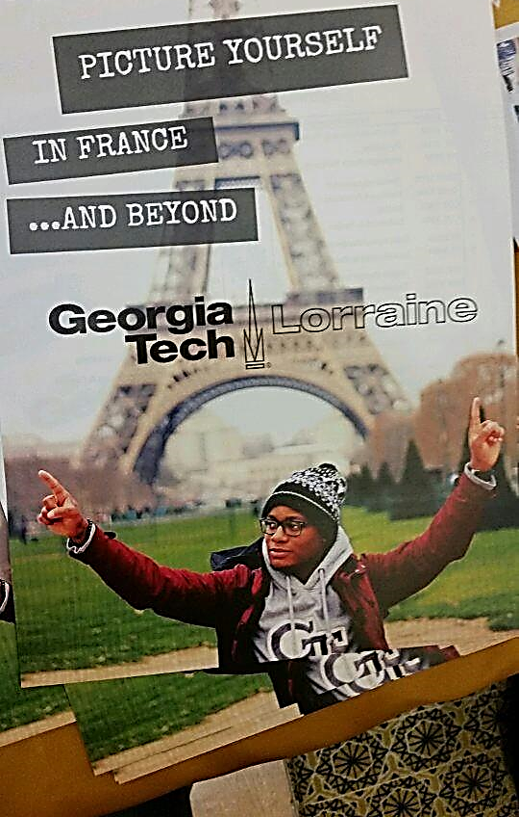
The Best Part

Slide 15
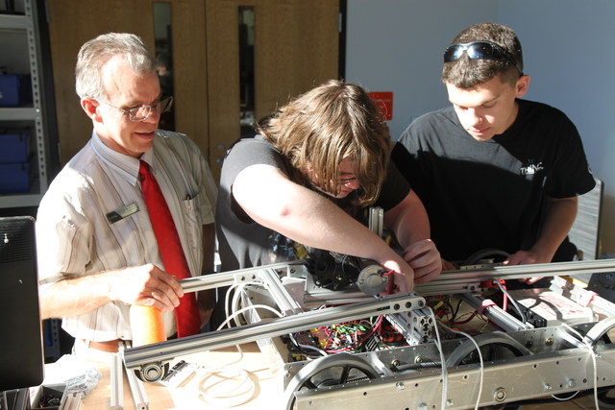
Career Academies ✓
STEM Certified Schools ✓

Slide 16
Expand
Initiate
Meaningful Interaction
Every Area
Encouragement Comes From Leadership

Slide 17
The Power of Collaboration
In our school improvement efforts, let’s invite even more stakeholders to the table.

Slide 18
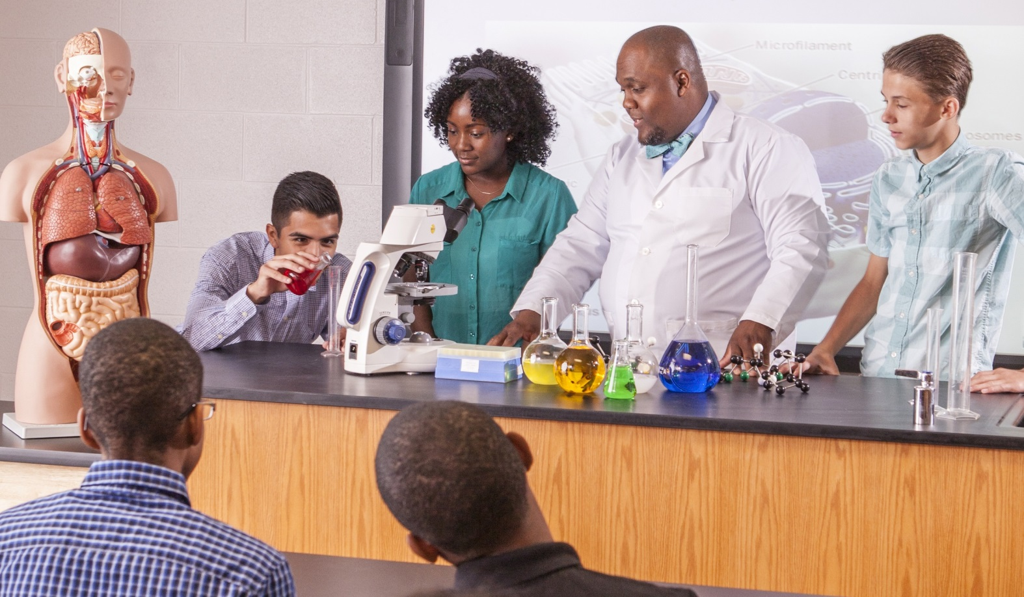
2017 Georgia Teacher of the Year
Email: 2017gatoty@gmail.com
Facebook: GATeacher
Twitter: 2017GATOTY

