Slide 1

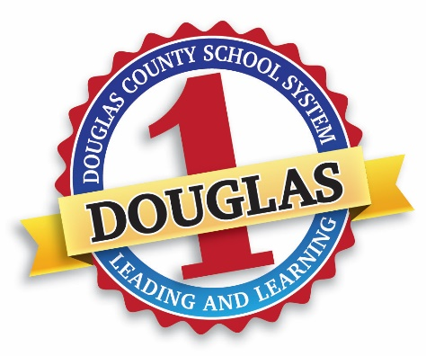
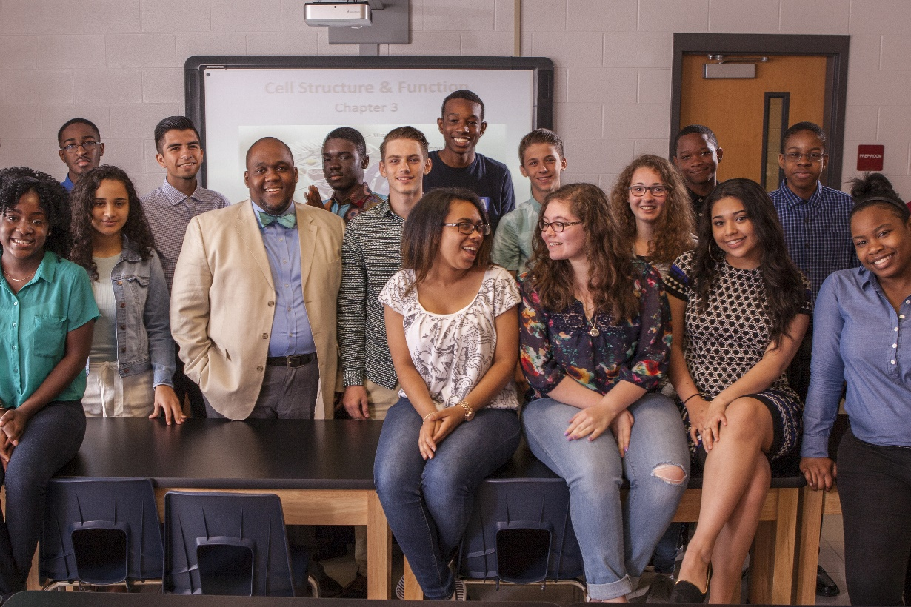
Dr. Gordon Pritz - Douglas County School System
2017 GAEL Spring Bootstrap
Successful Community Engagement

Slide 2


Components of Community Engagement
Build Relationships
Listen To and Tell Stories
Share Success

Slide 3

Begin With Students and Staff
Be Visible
Establish Collaborative Groups for Students, Teachers, Principals and Community
Provide Inspirational Speakers for Meetings to Promote Growth and New Perspectives

Slide 4


Connect With Parents
Be Visible
Be Communicative
Be Reachable

Slide 5
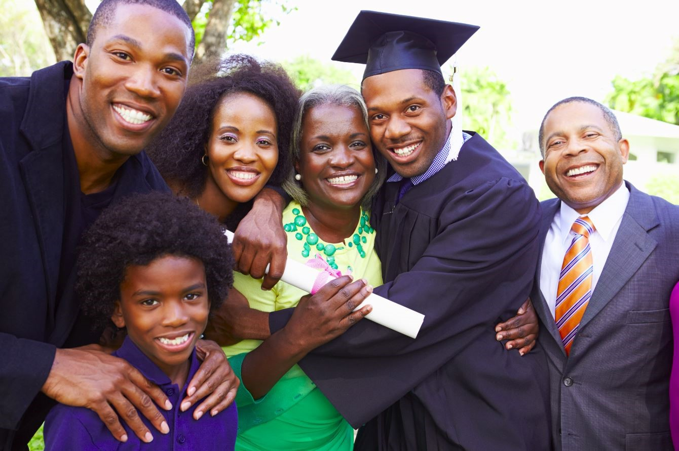
Engage the Community
Partners in Education
Business Commitments to District
Chamber of Commerce

Slide 6
Engage the Community
Civic Clubs/Boards
Church/Faith Based Organizations
Other Groups in Your Community

Slide 7
Tips for Success
Don’t Be Afraid to Apologize for Mistakes
Recruit and Engage Cheerleaders for Your District
Win over the “Fear Leaders” or Let Them Go!
Engage Your Community
Build Relationships
Listen To and Tell Stories
Share Success

