Slide 1
Georgia School Superintendents Association Spring Bootstrap Conference Legal Issues Update April 19, 2017
Phillip L. Hartley Harben, Hartley & Hawkins, LLP

Slide 2
ISSUES FROM THE GENERAL ASSEMBLY

Slide 3
HB 338 – Turnaround Schools
CTO gets all the press, but watch for the “third party specialists” approved by SBOE through RFP process and turnaround coaches
State to pay for approved TPS as incentive
ESSA plan to allow “maximum flexibility to implement” HB 338 and plan will define accountability system from which schools are chosen

Slide 4
HB 338 – Turnaround Schools
Elaborate and detailed process for “diagnostic review” of “root causes” to be accomplished in 90 days leading to intensive school improvement plan
Interventions start after 3 years “unless the school is in substantial compliance with … plan”
Continue the plan, remove personnel or reconstitute staff, state charter, private nonprofit operator, parental intradistrict choice, restructure governance, another district take over, anything else CTO wants
Right to hearing before SBOE?
If ½ of schools are turnaround eligible for 5 or more years, hearing to remove LBOE

Slide 5
HB 338 – State Accreditation Process
Study Commission report by 12/1/17
Align accreditation with charter and SWS review?
School Board Review Commission?
Consequences such as removal of board or losing flexibility contract

Slide 6
Powers of Attorney
HB 359 – parent may delegate temporary caregiving authority to resident relatives or approved agents of child placement agencies, shall not exceed one year, except for grandparents and active duty military
SB 186 – Caregiver Educational Consent Act – kinship caregiver (includes fictive kin) shall exercise parental authority when parents unable to for specific reasons, not more than a year, but specific to schools
Both require very specific forms set forth in statue

Slide 7
Testing Opt-out
“Strongly encouraged” to allow paper and pencil assessment at parental choice
State quidelines by 9/1/17 that identify appropriate policies which local systems are “strongly encouraged” to adopt for students who opt out, no punitive action, no sit and stare

Slide 8
Val and Sal Selections
Was HB 114 and then SB 211 - No local system shall exclude eligible students taking one or more dual credit courses … providing that this shall not apply to student who moves in after sophomore years and has not taken any courses on site at the participating school.

Slide 9
Military Families
HB 139 – unique identifier for children of military
HB 224 – intradistrict choice for students living on a base or in military housing, if room available, work into HB 251 universal, streamlined process
HB 245 – By 7/1/18, PSC shall provide for temporary certificates, endorsement or expedited treatment for military spouses moving to Georgia or transitioning spouse

Slide 10
Governance Issues
HB 430 – DOE to implement procedures as to charters receiving proportionate federal funds and facilities grants for charters
unused facilities (for any purpose and not on five year plan) for last two years have to be provided to charters
Develop charter authorizer standards and review, charters in LBOEs that don’t meet standards can become state standard
SR 95 – SPLOST when county has one or more independent districts, district or combination of districts with majority of students can pass referendum and if not agreement reached, FTE % controls

Slide 11
Medical Marijuana
SB 16 adds Tourette’s, autism, AIDS and other conditions
No specific rule change that affects schools

Slide 12
SRO’s and SB 149
Best practice for SRO’s to complete training course, 40 hours of training to be developed by POST

Slide 13
Issues from the Federal Government

Slide 14
What does it mean?
52

Slide 15
What does it mean?
Changes at the DOJ, OCR, EEOC likely reflect new priorities
But it will take a while
Not safe to predict what a new administration will do or be able to do
Not safe to predict what a Supreme Court will do
53

Slide 16
Emerging Themes
First Theme – Choice: See Staff and Budget
Second Theme - Less Regulation?
Withdrawal of ESSA regulations and minimizing of plan requirements – implementation delayed another year
Georgia plan in development – check out website and especially issues with CCRPI
Delay in submission from April to September, at least
DOJ/DOE and the use of litigation
Remaining Desegregation Orders
The Status of the GNETS litigation
NC and Transgender issues

Slide 17
What is the status?

Slide 18
A New DOJ/DOE DCL – February 22, 2017
The interpretation in the previous letters “has given rise to significant litigation regarding school restrooms and locker rooms ... There must be due regard for the primary role of the States and local school districts in establishing educational policy. In these circumstances, the Department of Education and the Department of Justice have decided to withdraw and rescind the above-referenced guidance documents in order to further and more completely consider the legal issues involved. The Departments thus will not rely on the views expressed within them…. The withdrawal of the guidance document does not leave students without protections from discrimination, bullying or harassment."

Slide 19
Secretary DeVos’ statement
The responsibility to protect students and to ensure safe learning environments is "not merely a federal mandate, but a moral obligation no individual, school, district or state can abdicate." She said she is directing the Department of Education's Office for Civil Rights to remain "committed to investigating all claims of discrimination, bullying and harassment against those who are most vulnerable in our schools."

Slide 20
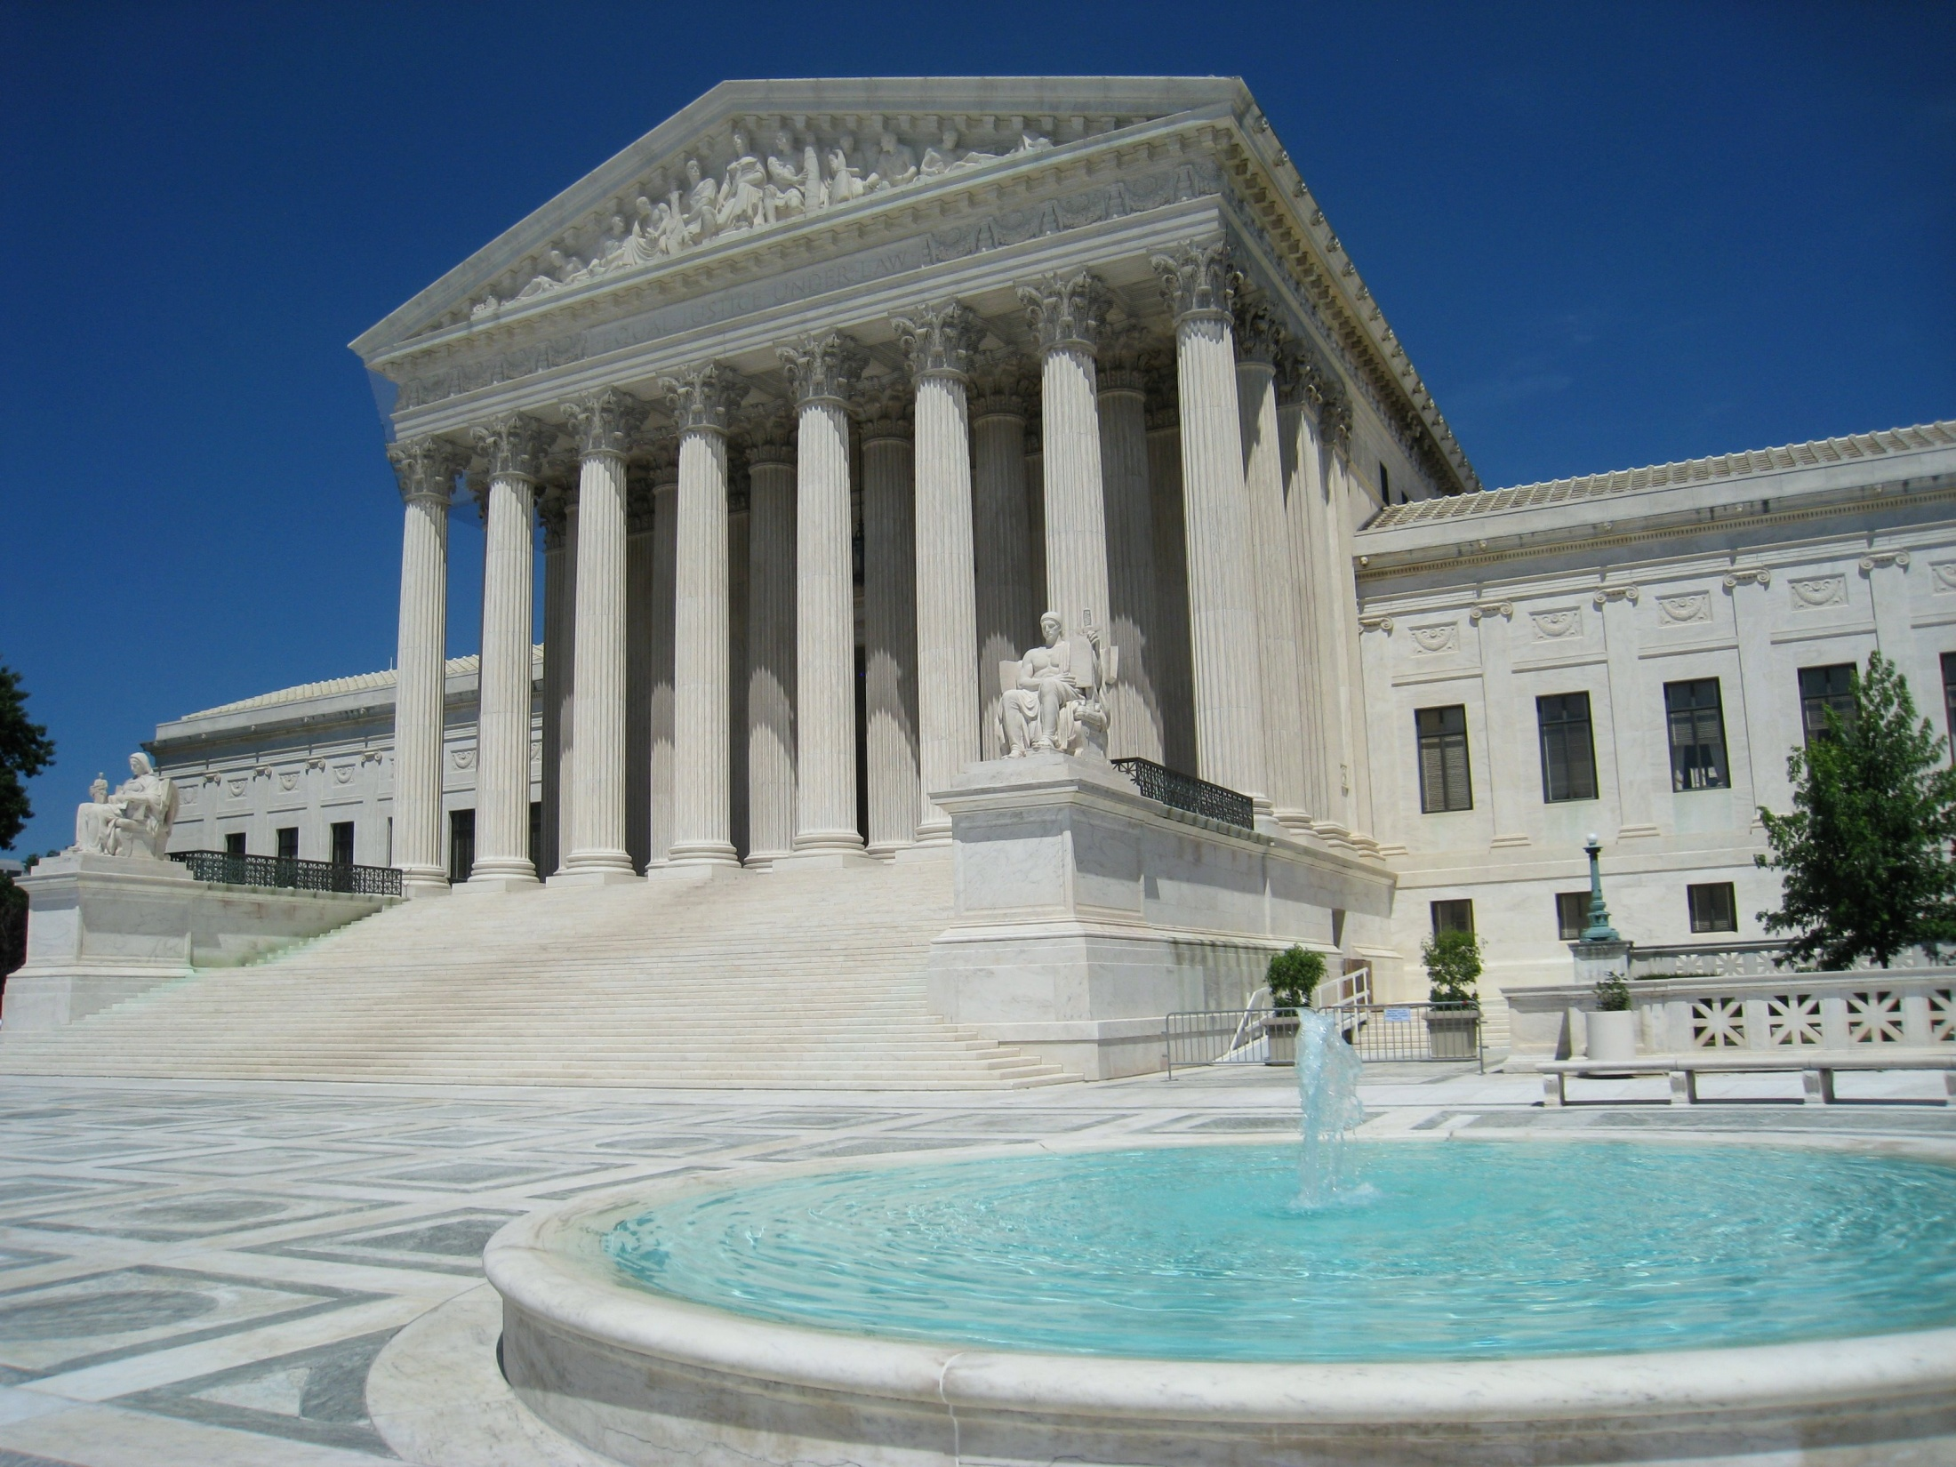
Issues from the Courts

Slide 21
Gloucester County School Board v. G.G.
Approval of cert petition by USSC withdrawn and case remanded to the 4th Circuit
4th Circuit says: “What’s the hurry?”
Most, but not all, courts hearing such cases issue injunction in favor of transgender students suing privately, but no additional appellate court decisions
No decision addressing ultimate 14th Amendment Equal Protection Claim

Slide 22
Recommendations
Make sure nondiscrimination procedures are in place and coordinators identified
Train administrators and staff
Strive for positive, harassment-free atmosphere for all students
Be alert to gender stereotyping, bullying and investigate immediately
Work with legal counsel on specific questions and issues, before you’re out on a limb

Slide 23
Endrew F. v. Douglas County School District
The student is a child with autism. He attended the School District’s preschool program, kindergarten, first, and second grade. During first and second grade, he received approximately twenty hours a week of specialized services and was assigned a full-time paraprofessional to keep him on task and to deescalate his disruptive behaviors.
According to the Court, he progressed academically and socially, but continued to exhibit problem behaviors such as tantrums, yelling, elopements, and unplanned urinations.

Slide 24
The Facts:
Endrew transferred to his neighborhood school for his third grade year. His maladaptive behaviors continued, but the data showed he progressed academically. The following year his problem behaviors increased, but he continued to progress toward his academic and functional goals.
When a new IEP was created the goals were nearly identical to the previous year’s goals. While the goals remained the same, the objectives were changed to reflect higher expectations.
The next month, Endrew’s parents notified the District that they intended to enroll Endrew in a private school, expressing concern about his academic and social progress.
At the private school, Endrew’s behavior improved under their strategies and the school established more challenging educational goals for Endrew.
Endrew’s parents initiated an action under the IDEA seeking reimbursement for the cost of Endrew’s private school.

Slide 25
Proceedings in Endrew
An administrative law judge ruled in favor of the School District. The ALJ found that the IEP meets the requirements of the IDEA if it is reasonably calculated to enable the child to receive educational benefit by furnishing a basic opportunity for an individually structured education.
The parents filed an action for review in federal court. The district court affirmed the ALJ’s decision, stating that the parents failed to prove that the District’s IEP “was not reasonably calculated to provide some educational benefit.”

Slide 26
Appeal to the 10th Circuit
The Tenth Circuit held that Endrew F.’s parents were not entitled to private school tuition reimbursement because the school district established he received “some benefit” from his special education program.
The Family appealed to the Supreme Court of the United States
On March 22, 2017, the Court ruled

Slide 27
The Decision
In the Tenth Circuit, where Endrew F. lives, the court held that an IEP provides FAPE if “it is calculated to confer an ‘educational benefit [that is] merely … more than de minimis.” But, the Supreme Court disagreed.
The Court reiterated that the purpose of adopting the Individuals with Disabilities Education Act (IDEA) was to address the fact that children with disabilities were receiving little to no education.

Slide 28
The Decision
The Court focused on the requirement for a student by student analysis: “To meet its substantive obligation under the IDEA, a school must offer an IEP reasonably calculated to enable a child to make progress appropriate in light of the child’s circumstances.”
But there is still no guaranteed outcome:
“… his IEP need not aim for grade-level advancement. But his educational program must be appropriately ambitious in light of his circumstances, just as advancement from grade to grade is appropriately ambitious for most children in the regular classroom. The goals may differ, but every child should have a chance to meet challenging objectives. “

Slide 29
What does this mean?
It is clear that the “de minimus” standard is put to rest:
“When all is said and done, a student offered an educational program providing ‘merely more than de minimis’ progress from year to year can hardly be said to have been offered an education at all.”
And while the Court declined to second guess decisions made by the educators, it is clear that a school district must “be able to offer a cogent and responsive explanation for their decisions” that meets the standard enunciated in this case.

Slide 30
What does this mean? What happens next?
It remains to be seen how lower courts will interpret this new decision BUT it is clear that we must pay particular attention to what progress will look like for those students who do not progress in the general curriculum;
We can expect a push for “appropriately ambitious” IEPs
This case could spur the Congress to amend IDEA – to clarify the standard and their intentions; and
It could give more clarity as to what education benefit is when looking at a student with a disability.

Slide 31
Fry v. Napoleon Community Schools, USSC (2017)
Question Presented: May parents of a disabled child bypass IDEA procedures to bring directly a suit for damages under the Americans with Disabilities Act and the Rehabilitation Act, as damages are not available under the IDEA?

Slide 32
Facts …
Parents of a child with cerebral palsy requested school district allow service dog to accompany the child to kindergarten to enhance her independence.
School’s IEP team determined the human aide already assisting the child as part of her IEP sufficiently met her needs, and denied the request.

Slide 33
Exhibit A: The dog, Wonder

Slide 34
Exhibit B: Wonder & Ehlena

Slide 35
Facts, continued …
Instead of using IDEA dispute resolution procedures to resolve the disagreement, the parents home schooled Ehlena and filed a complaint with the U.S. Department of Education’s Office for Civil Rights (OCR).
After two-year OCR investigation, district agreed to let the service dog accompany the child, but the parents instead enrolled her in another district.

Slide 36
The Lawsuit below: Courts rule Parents must exhaust IDEA procedures before filing suit
Parents brought a suit seeking monetary damages under Section 504 and the ADA for the first school district’s failure to accommodate the presence of the service dog.
Both the trial court and the Sixth Circuit agreed that the case should be dismissed, because when the injuries alleged can be remedied through IDEA procedures or they relate to the specific educational purpose of the IDEA, parents must exhaust IDEA procedures before seeking relief in court.

Slide 37
The Decision – What does this have to do with FAPE?
Supreme Court held:
IDEA’s “exhaustion rule hinges on whether a lawsuit seeks relief for the denial of FAPE. If a lawsuit charges such a denial, the plaintiff cannot escape § 1415(l) merely by bringing her suit under a statute other than IDEA…But if, in a suit brought under a different statute, the remedy sought is not for the denial of a FAPE, then exhaustion of the IDEA’s procedures is not required.”
“The Frys’ complaint alleges only disability-based discrimination. This case is remanded…for a proper analysis of whether the gravamen of E.F.’s complaint charges, and seeks relief for, the denial of a FAPE.”

Slide 38
Other Cases to Watch
USSC - Trinity Lutheran Church v. Pauley. Church denied Dept of Natural Resources grant for recycled tires for Pre-K playground – are state Blaine Amendments in violation of the federal 1st A.
Ga SCt - Gaddy v. Georgia Department of Revenue - Blaine A. challenge to state tax credit law
Ga SCt - Henry County Bd. of Educ. v. S.G. – Self-defense statute and the student code of conduct

Slide 39
Questions

