Slide 1
Hugh Kight, Superintendent
Eagle Express Mobile Classroom

Slide 2
System Demographics
Total Enrollment
Elementary School 442
Middle School 200
High School 278
Percentage of Students by Ethnicity
48% White
35% Black or African American
11% Hispanic/Latino of any race
4% Two or More Races
1% American Indian or Alaskan Native
1% Asian
72% Percentage of Students Qualifying for Free and Reduced Lunch

Slide 3
The Big Idea….
Our data has shown a need for earlier literacy interventions for our pre-k and kindergarten students.
Literacy Research – Vocabulary Development –Million Word Gap
“Some children come to school knowing far fewer words than others. Hart and Risley (1995) studied young children’s vocabulary development and found that when children from families with low incomes were 3 years old, they knew 600 fewer words than children the same age from families with upper incomes. By grade 2, the gap widens to about 4,000 words (Biemiller & Slonim 2001). These facts heighten the need to purposefully teach vocabulary in early childhood, especially in programs serving children from low-income households.” --Christ and Wang

Slide 4
Goals
Increase the vocabulary and literacy exposure for our students entering Pre-K
Allow under privileged kids the same opportunities
Exposure to numerous words everyday
Socialization with other children their age
Model appropriate vocabulary/literacy strategies for parents

Slide 5
Montgomery County
Montgomery County is made up of several small communities.
Mount Vernon (Montgomery Co. Schools location)
Uvalda (15 miles)
Alston (11 miles)
Ailey (1 mile)
Higgston (10 miles)
Petross (8 miles)
Tarrytown (18 miles)

Slide 6
Daily Schedule
The daily hours will be 9:00am-10:30am.
Monday = Dead River/Uvalda
Tuesday = Tarrytown
Wednesday = Mount Vernon/Ailey
Thursday = Petross
Friday = Alston

Slide 7
Daily Learning Stations
20 minute stations
Listening Center – This center will consist of age appropriate audiobooks using a CD based listening center with headphones.
Whole Group Center – The certified teacher will use age appropriate trade books to present read alouds. During this time, she will model to parents the importance of asking questions during reading. These questions will relate to visualizing, predicting, summarizing, connecting, and inferring. She/he will highlight good vocabulary throughout the book, point out the characters, setting, etc. Portions of the OWL Curriculum will be used.
I-Pad Center – The I-Pad Center will be available for learning games. Parts of the OWL Curriculum will be incorporated. Other possible curriculum purchased will be ABC mouse (abcmouse.com) and Square Panda (squarepanda.com). Free apps will also be loaded on the I-pads.
Book/ Flashcard Check Out Station – Children and parents will be able to check out children’s books as well as parent resources to use at home.

Slide 8
Evaluation
Screening for Pre-K
Peabody- PPVT
Bracken Test

Slide 9
Budget
Equipment Needs/Funding:
Bus $10,000
5 I-pads/With Case $1500
5 Chrome Books/With Case $1125
10 Head Phones $175
Rocking Chair $150
Rug for children listening Center $200
Book Shelf with Doors $200
Books $5000
15 Stools $450
3 Plastic Storage Boxes $30
1 Broom with Dustpan $10
Generator $900
Funding Equipment Total Needed = $19,740

Slide 10
Budget
Funding Need for Staff:
Part-time Retired/49% Teacher @ $30 hour Rate (10 hrs. weekly) = $300
Based on 45 weeks = $13,500

Slide 11
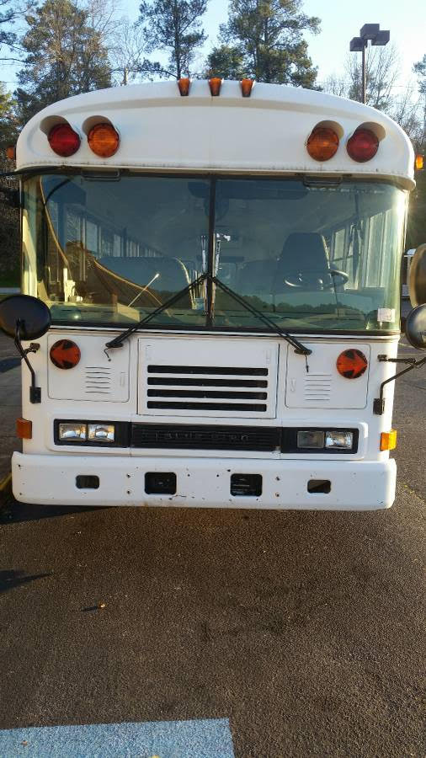
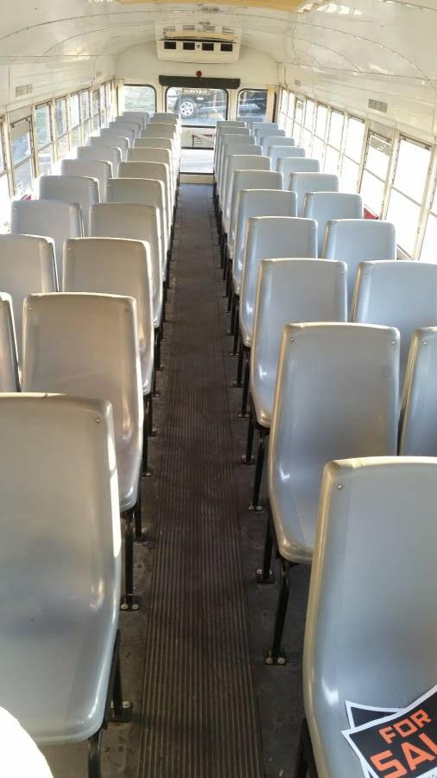
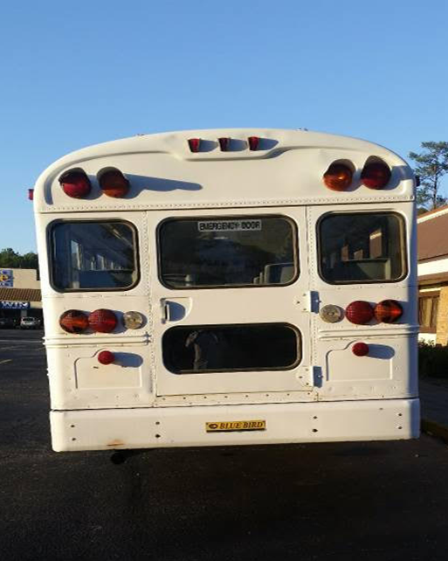
The Eagle express comes to life.
The Eagle Express Mobile Classroom
Before Renovation

Slide 12
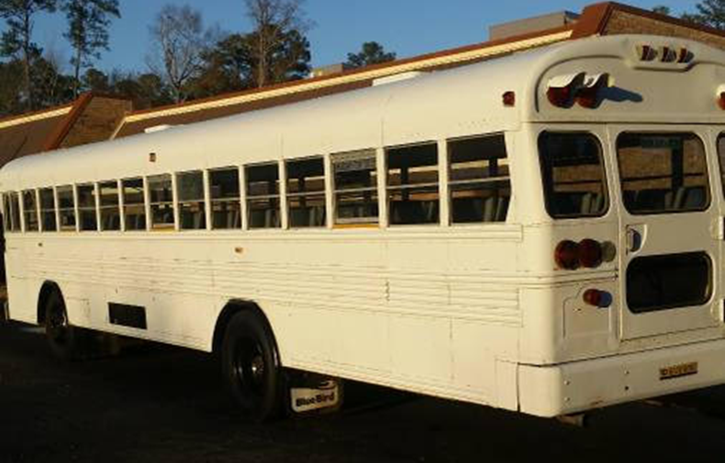
The Eagle Express Mobile Classroom
Renovations
Remove Seats
Add New Flooring
Cover the Windows
Add a Generator
Exterior/ Interior Decals

Slide 13
Eagle Express Mobile Classroom
Table = 18 inches X 12 feet
Interactive TV
Listening
Center
seat
Driver
Seat
Rug
Exit Door
table
seat
Seat
seat
seat
50 amp breaker box
Entrance Door
= Power Outlet

Slide 14
Donations
Georgia Power
EMC
Holland-Underwood Foundation
Local Citizens
Tiny Grant (GOSA)
Tri-County
Dr. Joseph Brogdon
TBO Trucking
Paul Thigpen Chevrolet
Paul Leonard Elite Events

Slide 15
Questions

Slide 16
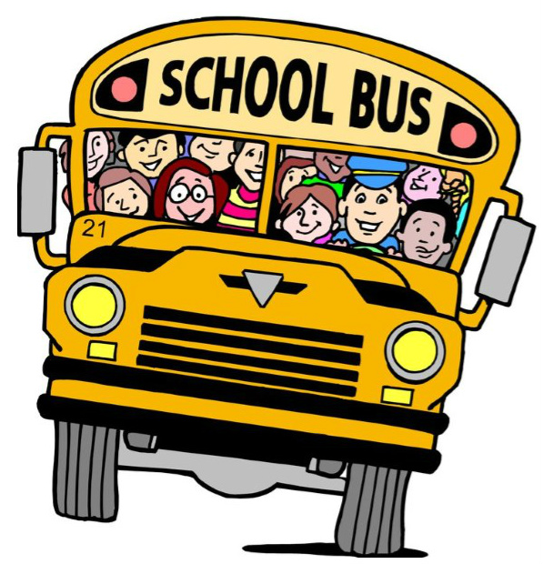
Montgomery County Schools … Making it happen

