Slide 1
Federal advocacy update
Noelle Ellerson Ng
Georgia School Superintendents Association
April 2017

Slide 2
What’s an advocate?
A person who publicly supports or recommends a particular cause or policy
YOU are an advocate. It is one of the many ‘hats’ you wear as a superintendent.
Your voice matters. No one is better positioned to tell your district’s story.
Weigh in early, weigh in often.
Relationships matter. It is a marathon, not a sprint.
Are you Pollyanna? Chicken Little? Other?

Slide 3
Georgia Congressional Contacts
StaffName | staffEmail | Title | First | Last | Chamber | Party | District
Brett Layson | brett_layson@isakson.senate.gov | Sen | Johnny | Isakson | S | R | 1
John Eunice | john_eunice@perdue.senate.gov | Sen | David | Perdue | S | R | 2
Hart Thompson | hart.thompson@mail.house.gov | Rep | Earl | Carter | H | R | 1
Adilene Rosales | adilene.rosales@mail.house.gov | Rep | Sanford D. | Bishop | H | D | 2
Mary Christina Riley | marychristina.riley@mail.house.gov | Rep | Drew | Ferguson | H | R | 3
Brian Duckworth | brian.duckworth@mail.house.gov | Rep | Henry C. | Johnson | H | D | 4
Robert Stephens | robert.stephens@mail.house.gov | Rep | John | Lewis | H | D | 5
 |  | Rep |  |  | H |  | 6
Tripp Cofield | tripp.cofield@mail.house.gov | Rep | Rob | Woodall | H | R | 7
Mark Sanders | mark.sanders@mail.house.gov | Rep | Austin | Scott | H | R | 8
Robert Burkett | robert.burkett@mail.house.gov | Rep | Doug | Collins | H | R | 9
Tim Reitz | tim.reitz@mail.house.gov | Rep | Jody | Hice | H | R | 10
Aubrey Neal | aubrey.neal@mail.house.gov | Rep | Barry | Loudermilk | H | R | 11
Katie Hunter | katie.hunter@mail.house.gov | Rep | Rick | Allen | H | R | 12
Seema Ibrahim | seema.ibrahim@mail.house.gov | Rep | David A. | Scott | H | D | 13
Alicia Stafford | alicia.stafford@mail.house.gov | Rep | Tom | Graves | H | R | 14

Slide 4
2017: The Year of Superintendent Advocacy
Can you commit to 5 minutes a week?
YOU know your story. A little lobbying secret: Everything you need to know to lobby, you learned in kindergarten: CUT & PASTE
Identify one theme/topic per month, and share the same information with your full delegation
As you do more direct advocacy, rely on your membership benefits of belonging to both your state association and AASA
Topic summaries, one pagers, talking points, contact information

Slide 5
Of Trump and Education
Question used to be: How will he treat the department of education?
How do the promises of the candidate compare to the policies of the President?
Top Three Proposals:
Fed govt out of higher ed loans
Early ed (child care) – mostly through tax credits
K12 choice
$20 b for vouchers: Convert IDEA or Title I? Bully pulpit for state dollars?
Just as concerning: Who is head of FCC?
Funding, funding, funding.

Slide 6
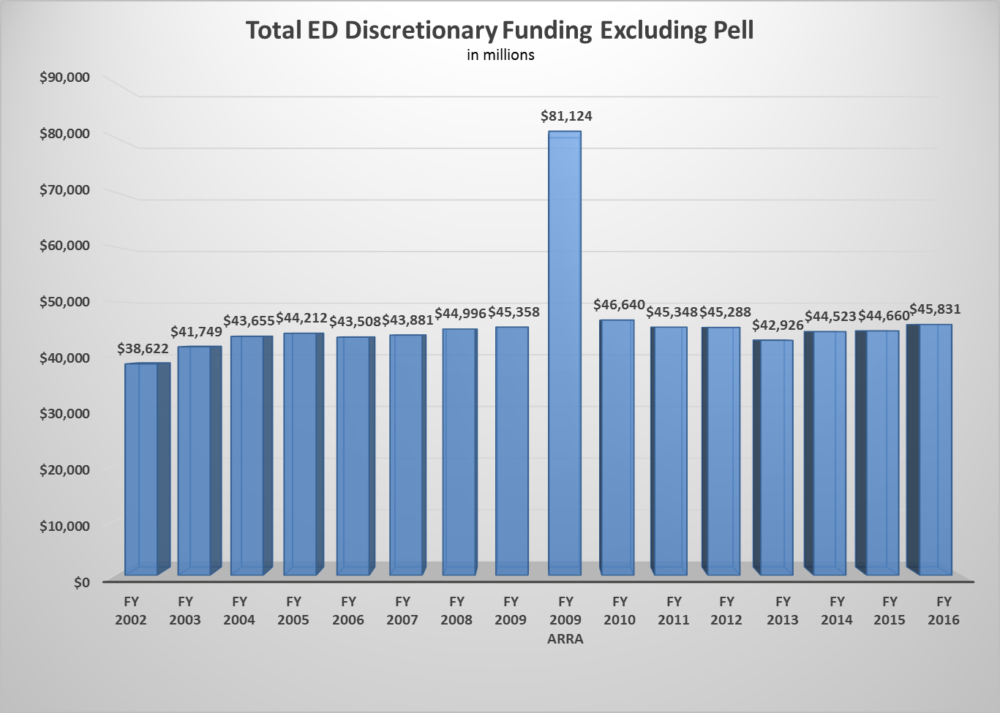
FUNDING

Slide 7
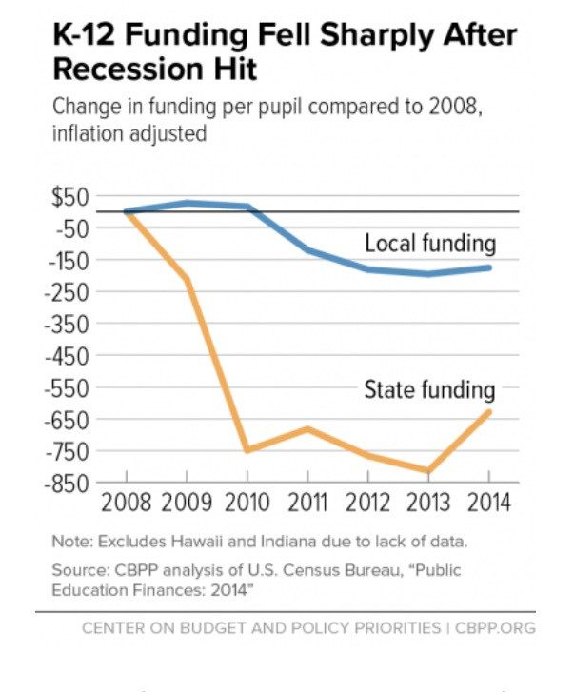
FUNDING
35 states provided less overall state funding per student in 2014 school year than in 2008 the year the recession took hold
In 27 states, local government funding per student fell over the same period, adding to the damage of state cuts

Slide 8
FY17 & FY18: Tale of Two Budgets
FY17 CR through April 28
In CR, we need conforming language for Title I/SIG money and for Title IV
FY17 Priority:
Title I must be funded at level to meet state set aside and preserve LEA allocations and avoid $200m shortfall for LEAs
IDEA: Level funding of IDEA puts the federal share at 16%, below the 2005 level, when federal share was 18%
Title IV: Fund Title IV at a level that supports local formula allocation

Slide 9
FY17 & FY18: Tale of Two Budgets
FY18 Priority:
Very real threat of deep cuts.
Parity between defense/non-defense discretionary
$54b increase for defense discretionary; paid for with $54 b cut to NDD
$9 b (13%) cut to USED
$1.4 b increase for school choice/privatization
$1b for Title I portability; $250 m for vouchers; $168 m for charters
Level funds IDEA
Eliminates Title IIA and 21st Century Community Learning grants
Eliminate 20 other categorical grants
Full budget mid May?!

Slide 10
Cuts to School-Based Medicaid on the Horizon
GOP Goal: Reduce federal expenditures by 30%
GOP Plan: Institute a block-grant or per-capita cap on Medicaid
GOP Legislative Vehicle: Budget Reconciliation
Since 1968, districts can provide EPSDT services for Medically eligible children and be reimbursed.
Since 1988, districts can bill for medically-necessary services related to IEP
Is it easy to bill? NO. Is it worth it for some districts? ABSOLUTELY.
1% of all federal Medicaid dollars go to schools
46% of Medicaid beneficiaries are children
19% of the costs of Medicaid are incurred by children.

Slide 11
Findings from AASA Medicaid Report

Slide 12
Findings from Medicaid Cuts: A Prescription to Hurt the Neediest Children
50% of districts have taken steps recently to increase Medicaid enrollment in their districts
Economic consequences for Medicaid cuts: furlough or lay-offs for personnel; higher taxes
IDEA compliance may be jeopardized if professionals can’t or won’t work in your district

Slide 13
Types of Vouchers
Traditional Vouchers
Backdoor Vouchers
Portability
Tuition Tax Credits
Education Savings Accounts
A Step Towards Vouchers
All Students
Targeted
Military
Disabilities
Poverty
Poor Performing Schools
Foster Child
Title I funds “follow the student”
Notes:
Sarah

Slide 14
ESSA
Implementation is full steam ahead, and starts for the 2017-18 school year.
Congressional Review Act rescinds the accountability regulations. For you, that means write your state accountability plans to the statute.
Implementation of ESSA will hinge on how much your state makes significant changes to the accountability workbook AND funding.
In light of the CRA, its important for Congress to be diligent in its ESSA oversight.
Funding will be important part of initial roll out of ESSA.

Slide 15
Perkins CTE Reauthorization
House passed bipartisan legislation in July 405-5 to reauthorize Perkins
Senate didn’t take action
House expected to re-introduce legislation soon– should be very similar.
Senate is a big ?
AASA supported the House bill

Slide 16
Things to Watch
CRA: ESSA and Teacher Prep Regs
Immigration (DACA)
Vouchers/Charters/Portability
Sen Scott proposal introduced this week
ACA Repeal and Replace:
Impact for Medicaid block grant
30 v 40 hr work week; Excise (Cadillac) Tax; Employer Mandate
Infrastructure Plan
Offset by negating ability of state/local taxes to be deducted from federal income taxes
E-Rate/Lifeline
Net neutrality
Reduction of funding increase provided in 2014
Supreme Court Decisions

Slide 17
Get Involved, Stay Engaged
AASA Advocacy Conference July 10-12
AASA Policy Blog The Leading Edge
AASA Advocacy on Twitter (@AASAhq)
Weekly & Monthly Updates
Websites & Newsletters
EdWeek
Politics K12
Morning Education (Politico)
Real Clear Education
Cabinet Report

Slide 18
AASA Policy & Advocacy Team
Noelle Ellerson Ng
nellerson@aasa.org
@Noellerson
Sasha Pudelski
spudelski@aasa.org
@Spudelski
Leslie Finnan
lfinnan@aasa.org
@LeslieFinnan

Slide 19
Questions?

