Slide 1
Spring Bootstrap April 19, 2017
Richard Woods, Georgia’s School Superintendent

Slide 2
Good News
74 schools removed from Priority and Focus lists
First STEAM certified school
Career Pipeline tool – gacareerpipeline.gadoe.org
AP: 16th highest pass rate in the nation
Accuplacer – Milestones ELA; pursuing Math
Solutions Summit – May 5th

Slide 3
Our Shifting Role
Compliance
<
Support
<
flexibility
Accountability
(CCRPI, TEMs/LEMs, Performance Contracts, etc.)
Expectations
(standards, targets, goals, etc.)
Local Control
True
<
‘Achievement’ Gap

Slide 4
Our Shifting Role
Changing the culture at the Department
Service & support rather than purely compliance
Recognizing and honoring local control by empowering districts and schools with true flexibility

Slide 5
ESSA Georgia’s State Plan: A Plan for Georgians, By Georgians

Slide 6
Key Dates
June 15 – 30 day public review period (post for comments)
July 14-July 24 – ESSA team makes revisions based on 30-day feedback
Aug 4-Sept 10 – Governor’s review period
Sept 11-Sept 18 – Finalize plan for submission
Sept 18, 2017 – Georgia’s State Plan is submitted
GaDOE.org/ESSA

Slide 7
ESSA
An opportunity to:
Capture the GaDOE’s shift to service and support
Reflect and refine on previous reforms
Align educational efforts in a more cohesive way
Focus on implementation and sustainability
Engage stakeholders in a meaningful way
Foster flexibility and innovation
Re-examine state laws

Slide 8
Long-term Goals
Aligned with the targets of the performance contract
Ambitious, but attainable
Differentiated by school and by subgroup
Resets after period of time

Slide 9
Accountability

Slide 10
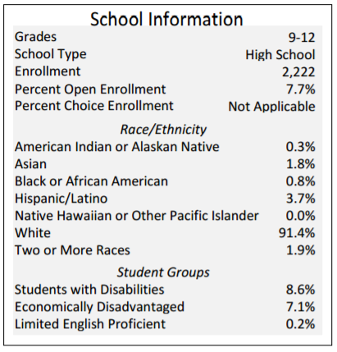
Accountability
Context – demographics and comparison schools
Help public understand what data means
Trends
WI Report Card
Louisiana Report Card

Slide 11
Accountability
Balancing stable indicators with flexibility
Easier-to-understand reporting
Balancing the 100-point scale
Easier to understand weights & calculations
00
00
00
Ohio Report Card

Slide 12
Accountability
Indicator to capture a more well-rounded education
Revised Achievement Gap calculation; Performance Flags

Slide 13
Accountability
State law is restricting federal flexibility
Next legislative session, will push hard to repeal the 100-pt scale requirement
Across the nation, other states are taking advantage of federal flexibility
Louisiana and Florida use a scaled score
Ohio and Michigan going to use a dashboard
California and Kentucky pushing to use dashboards
Highest performing NAEP states don’t use 100-pt scale

Slide 14
Assessment

Slide 15
Assessment
Focus: Appropriate role of assessment, including its use in accountability and related unintended consequences (driving instruction versus informing instruction)
Testing pressure; fatigue
Georgia’s testing requirements still above the federal minimum

Slide 16
Assessment (cont.)
Area with the most limited flexibility from the feds
Possible flexibility allowed with ESSA:
Possibility of a nationally-recognized high school assessment if comparability can be established, and as outlined in Senate Bill 211
Discussion surrounding the innovative assessment pilot opportunity has also been discussed

Slide 17
Educator & Leader Development

Slide 18
Educator & Leader Development
Focus on leadership
Building capacity
Personalized support
Expanded definition and support of leadership (teacher, parent, student, community)
Personalized professional learning
Delivering support in different ways: online communities, face-to-face, self-paced, blended, etc.
Not just measuring effectiveness, but providing support throughout a professional’s development

Slide 19
Federal Programs to Support School Improvement

Slide 20
Tiered System of Supports
Reactive
(service & support…
once on list)
Monitoring Status
Tiered Supports
Proactive
Tier I “Core” supports for all schools

Slide 21
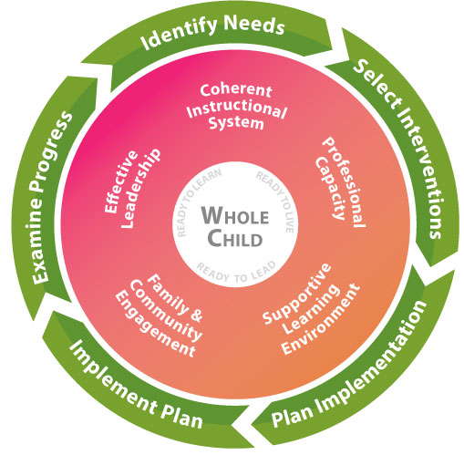
Georgia’s Systems of Continuous Improvement
How
What
Who

Slide 22
Moving from This Approach

Slide 23
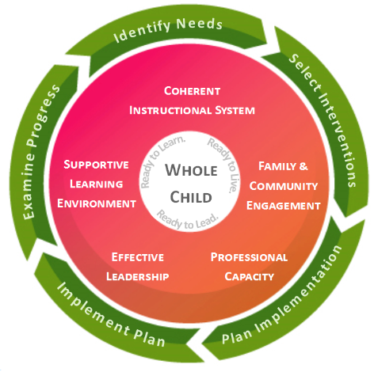
Moving to This Approach
Notes:
Everything aligns for our districts and school leaders
Leaders see how programs and initiatives work together to support a continuous system of improvement

Slide 24
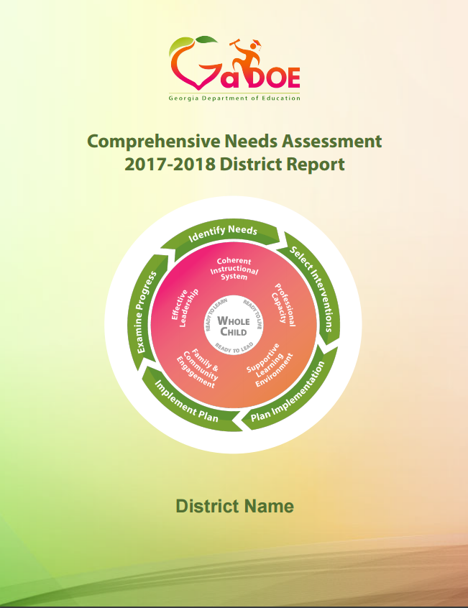
Comprehensive Needs Assessment
Aligned to the shared framework
Prepopulated with data
Supported by tools and resources that are being developed by GaDOE

Slide 25
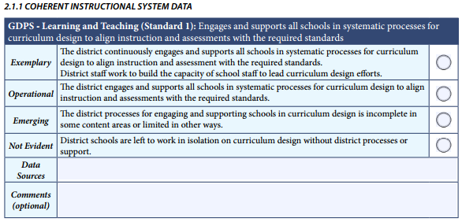
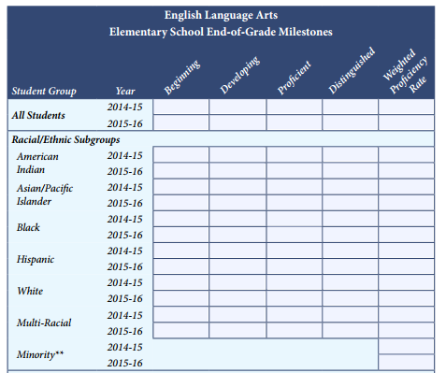
Comprehensive Needs Assessment (cont)
Satisfies all federal requirements that, in the past, were satisfied by multiple needs assessments
Reflected and refined based on new data and identified needs; not required to be redone each year

Slide 26
Consolidated Funds Pilot
Ensuring flexibility of funds by empowering districts to utilize funds more effectively
Positioning funds around school improvement goals rather than programmatic requirements
$500,000 allocated to GaDOE to assess our financial systems
Summer 2017: Easier access to financial data; greater transparency

Slide 27
Education of the Whole Child

Slide 28
Georgia’s Systems of Continuous Improvement
Who

Slide 29
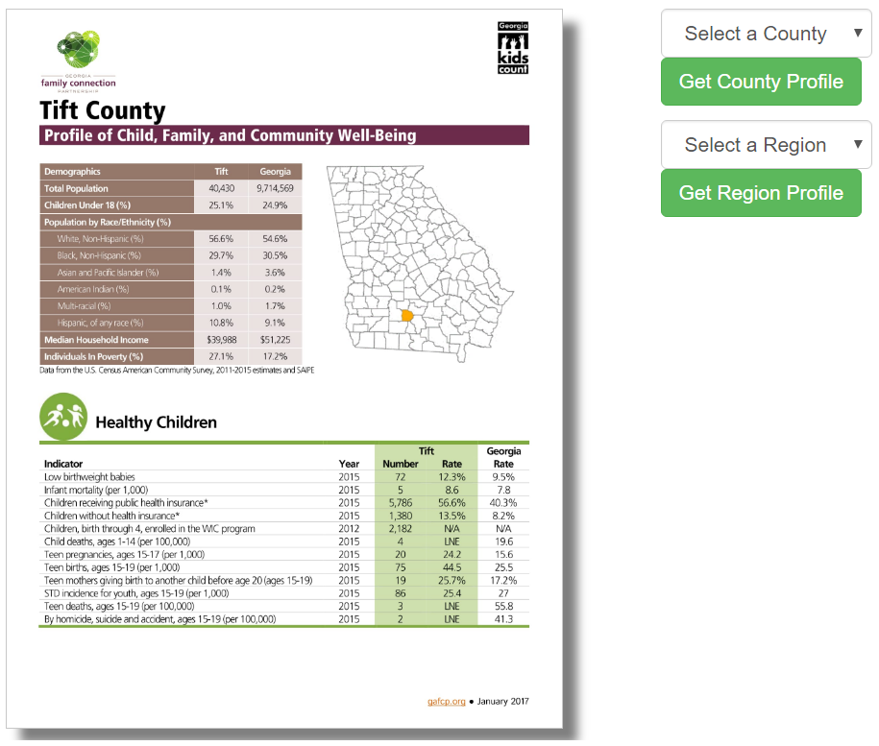
Education of the Whole Child
Access to ‘whole data’
Ability to use federal funds to support well rounded education and well being of the child
Address non-academic factors that impact academic achievement
Organizing evidence-based tools and resources

Slide 30
Coming Soon
Economic Development Partnership
Counselor Companion
Re-designed Teacher Resource Link
Comprehensive Needs Assessment – in LDS with dynamic data, guiding questions, and interventions all in one place
Development of Tier 1 supports for all schools

Slide 31
Ted Beck, Chief Financial Officer

