Slide 1
Albany Area Primary Health Care, Inc. SBHC success in our community
Shelley Spires, CEO
Clifton Bush, COO

Slide 2
AAPHC History
Corporation initially established in 1978 and current institution was incorporated in 1979.
Grant to develop clinic in Lee County was based on thesis project regarding lack of care for women and babies in the community, particularly prenatal care. AAPHC did not implement OB services until 2009…thirty years later.
AAPHC had three locations in 1982 and has grown to include 14 clinical locations, 6 SBHC sites, 3 adjunct facilities, 1 laboratory, and 1 administrative site

Slide 3
The 4 A’s for Health Centers
Available - We have services and support services for the community we are trying to serve.
Affordable - We have fees comparable to the area; acceptance too of Medicare, Medicaid, and other third party insurance, as well as offering reduced fees for eligible patients.
Acceptable - The services we provide are needed and meet the perceived needs of the area. The community is willing to utilize the services.
Accessible - We are located in the service area and there are adequate means for the service population to avail themselves of our services. Some examples which can readily be identified are the bus service for patients in Albany, as well as, our proximity to the patients in the census tracts to be served.

Slide 4
AAPHC Growth
AAPHC has seen significant growth since 2008, opening and/or expanding 7 locations during this time; including the addition of three new service models (OB/GYN, Dentistry, & Podiatry)
To facilitate this growth, AAPHC has a well defined implementation model to help ensure successful launches.
AAPHC opened the doors to it’s inaugural School-Based Health Center in March 2013.

Slide 5
School Statistics
Georgia ranks 42nd in the nation overall for child well-being
2nd highest childhood obesity rate in the country and 29% of adolescents had significant episodes of depression during the past 12 months
25% of Georgia children live in poverty
Georgia has the 3rd highest school drop out rates in the county

Slide 6
Statistical Objectives of a SBHC
School-based health clinics effectively address the needs of the underserved through:
Increased access to quality health care
Improved health outcomes
Decreased health care costs
Improved school attendance
Improved academic performance

Slide 7
Turner Elementary SBHC
Approximately 500 students
Approximately 50 Faculty & Staff
Grades K-5
99% free and reduced lunch
Over 90% African American
Less than 5% utilize English as a Second Language

Slide 8
SBHC Program Access
Sites
Turner Elementary
Alice Coachman Elementary
Albany Middle School (Dental only)
Crisp County School System
Dooly County School System
Terrell County School System
Services
Medical
Dental
Behavioral Health
Notes:
We will be expanding to another Elementary School next school term along with a Middle School which will provide Dental services. We have expanded services at our current site to include a Licensed Clinical Social Worker and Dental Services.

Slide 9
SBHC Sustainability (Relationships)
Consent forms distributed prior to start-up
Promotional activities (i.e. Adult Health Month)
Wellness Campaigns (Flu Vaccinations)
Focus on Well Child Exams for all engaged students
Poster Contests & Prizes for Students
School Activity Involvement (PTO, etc.)
Relationship with School Administrator(s)
Faculty/Staff Engagement
Hallways to Health Grant
Other Opportunities (SHAPE Grant)
Annual Health Fair Event
Notes:
We sent Consent Forms home before the SBHC site opened March 2013. After receiving the forms back we were very proactive to go ahead and schedule appointments with the consent forms that were returned.
We have declared the months of January and May of each school year as Adult Health Month for the Faculty and Staff at the school.
We host a Flu Campaign for the entire school starting September of each year to vaccinate everyone that gives consent for a flu vaccine.
We send “Does Your Child Need a Well Child Exam” Forms home at the beginning of every year.
We have done various poster contest with education done by the SBHC on the poster contest topics and gave prizes to the students.
Attended PTO, Faculty and Staff meetings, meet with the principal and assistant principal at the beginning of each year.
We host a Health Fair every August during the beginning of the school year.
Spirometry Days
We also do various employee wellness activities for the faculty and staff to keep them engaged in the SBHC.

Slide 10
SBHC Sustainability (Engagement)
District Wellness Committee – Dougherty County
Committee resurrected and is chaired by Physician Assistant with AAPHC that is provider at Turner Elementary SBHC
Campaigned to get 20 minutes of recess per day for students in grade K-5
Data Extraction
School system provides attendance data and other relevant data to evaluate success of programs
Encounter data can help estimate attendance improvement
Notes:
We sent Consent Forms home before the SBHC site opened March 2013. After receiving the forms back we were very proactive to go ahead and schedule appointments with the consent forms that were returned.
We have declared the months of January and May of each school year as Adult Health Month for the Faculty and Staff at the school.
We host a Flu Campaign for the entire school starting September of each year to vaccinate everyone that gives consent for a flu vaccine.
We send “Does Your Child Need a Well Child Exam” Forms home at the beginning of every year.
We have done various poster contest with education done by the SBHC on the poster contest topics and gave prizes to the students.
Attended PTO, Faculty and Staff meetings, meet with the principal and assistant principal at the beginning of each year.
We host a Health Fair every August during the beginning of the school year.
Spirometry Days
We also do various employee wellness activities for the faculty and staff to keep them engaged in the SBHC.

Slide 11
SBHC Quality and Sustainability
Establishing Health Outcomes Benchmarks
Asthma
Asthma Severity
Asthma Assessment
Asthma Action Plan
Pharmacological Therapy
Annual Flu Vaccine
Obesity
BMI
Blood Pressure
Lipid Profile
Hemoglobin A1c
Health Maintenance
# Health Checks
Screenings for Behavioral Health/Development
Immunizations
Notes:
We sent Consent Forms home before the SBHC site opened March 2013. After receiving the forms back we were very proactive to go ahead and schedule appointments with the consent forms that were returned.
We have declared the months of January and May of each school year as Adult Health Month for the Faculty and Staff at the school.
We host a Flu Campaign for the entire school starting September of each year to vaccinate everyone that gives consent for a flu vaccine.
We send “Does Your Child Need a Well Child Exam” Forms home at the beginning of every year.
We have done various poster contest with education done by the SBHC on the poster contest topics and gave prizes to the students.
Attended PTO, Faculty and Staff meetings, meet with the principal and assistant principal at the beginning of each year.
We host a Health Fair every August during the beginning of the school year.
Spirometry Days
We also do various employee wellness activities for the faculty and staff to keep them engaged in the SBHC.

Slide 12
Current Statistics for
Turner Elementary
SBHC
(Opened March 2013)

Slide 13
SBHC – User & Encounter Data

Slide 14
Asthma Quality Data – 2015-2016

Slide 15
Asthma Quality Data – 2015-2016

Slide 16
Health Maintenance Quality Data

Slide 17
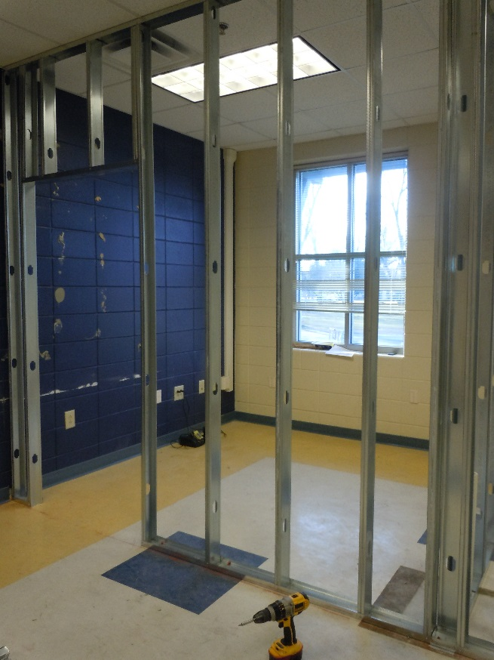
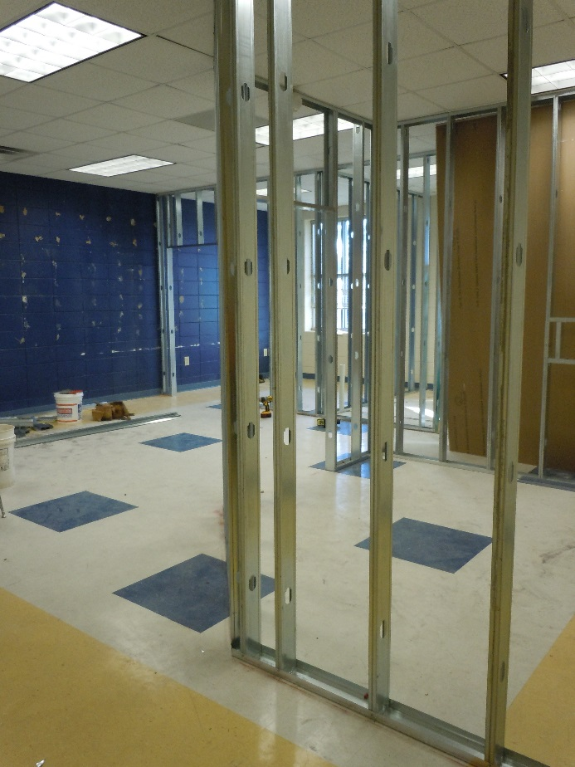
Construction
to
Completion
Turner Elementary SBHC

Slide 18
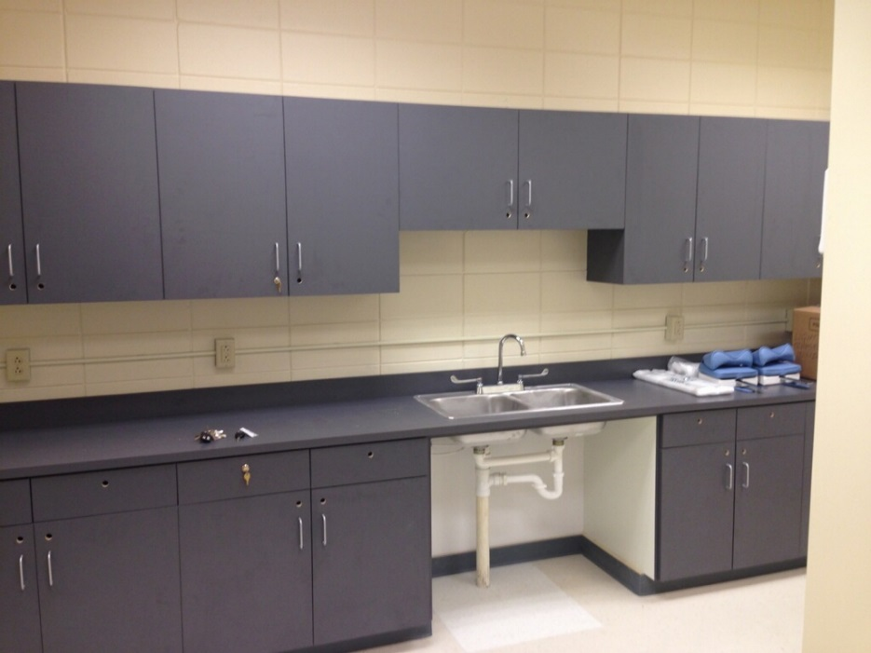
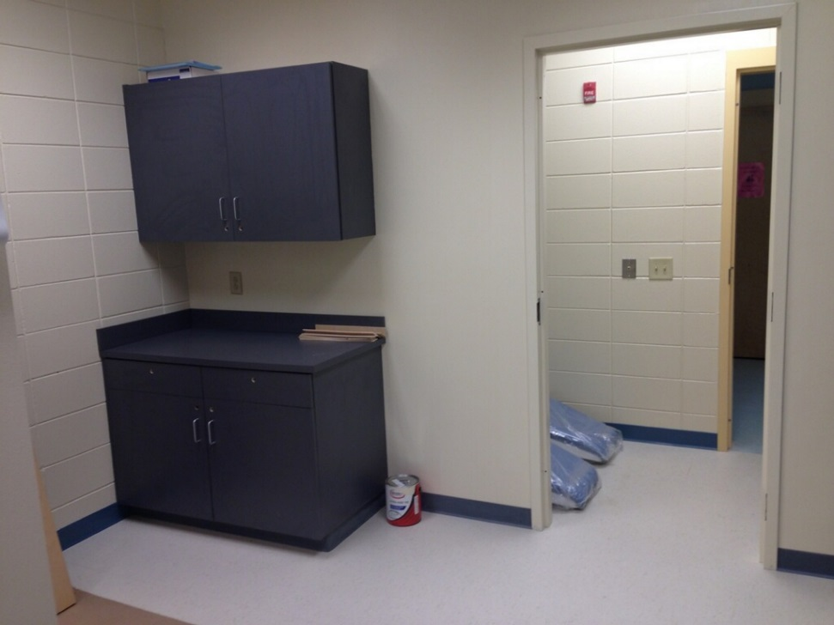
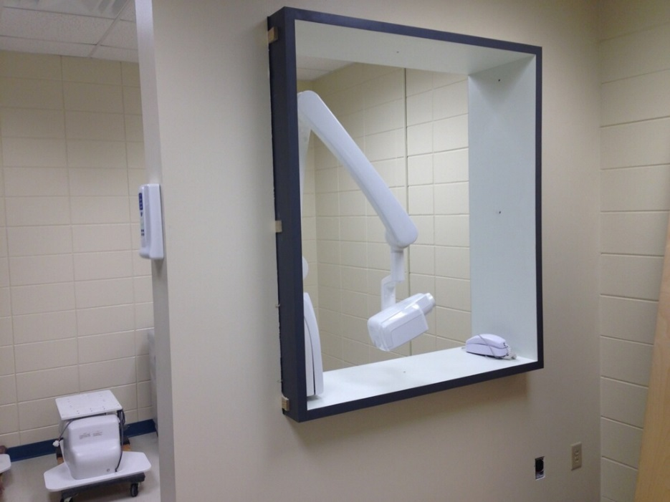
Renovated Space for Dental Services at
Turner Elementary

Slide 19
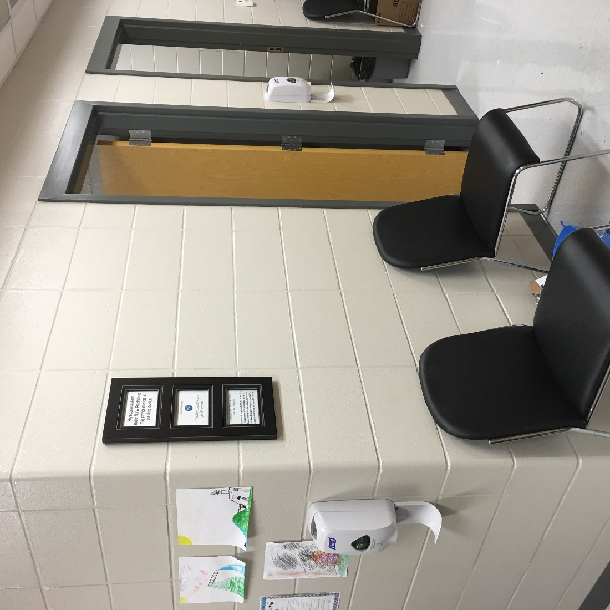
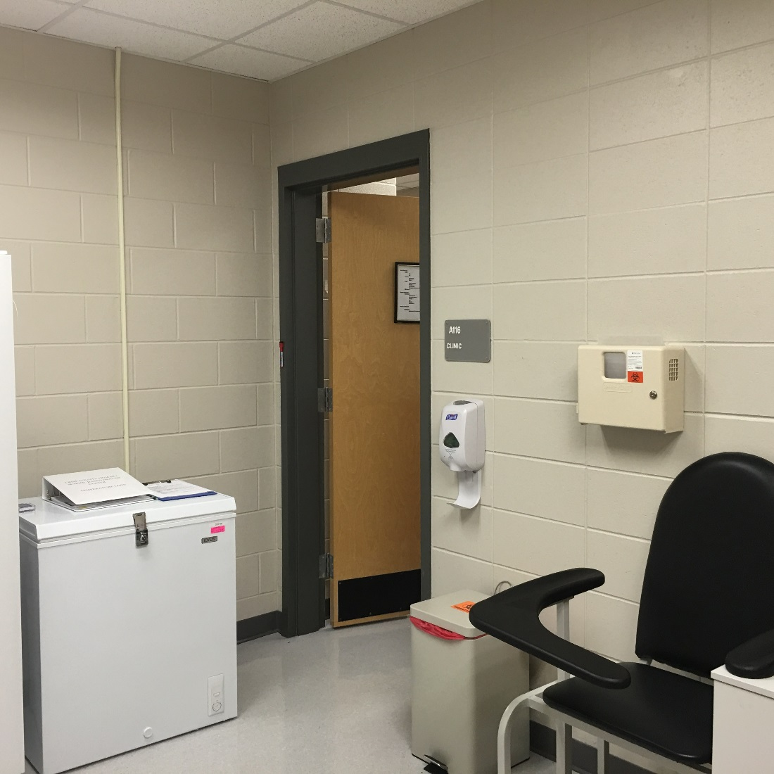
Waiting Area
Laboratory
Crisp SBHC

Slide 20
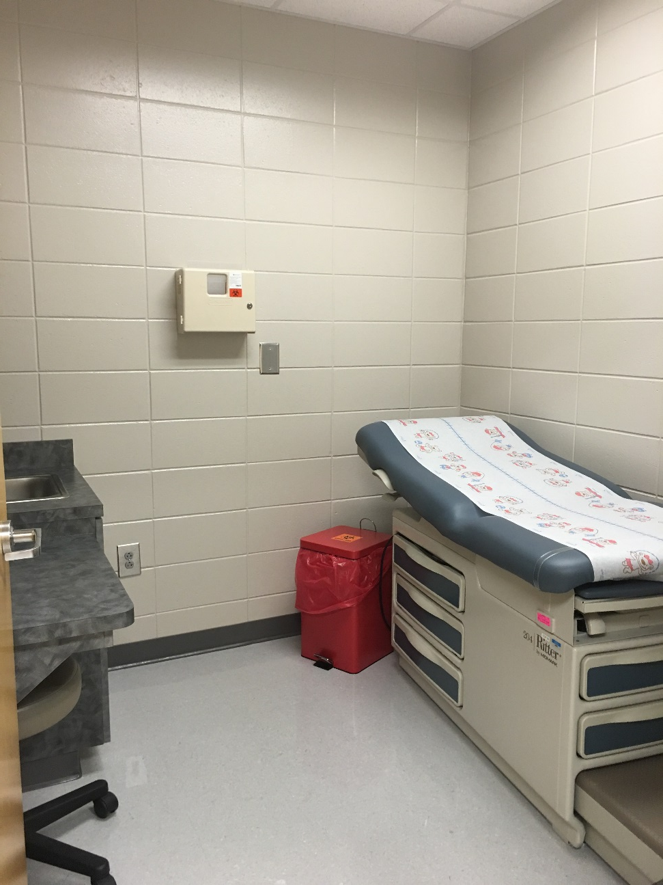
Exam Rooms
Crisp SBHC

Slide 21
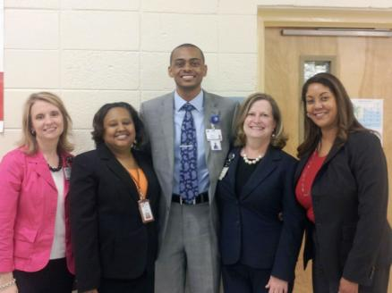
Turner Elementary SBHC Open House

Slide 22
“What Healthy Means to ME” – Art Contest

Slide 23
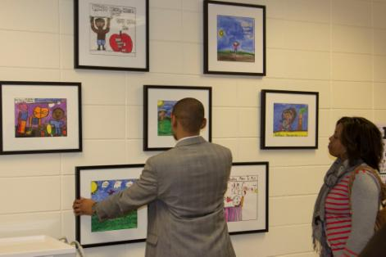
Contest Winners Art Display

Slide 24
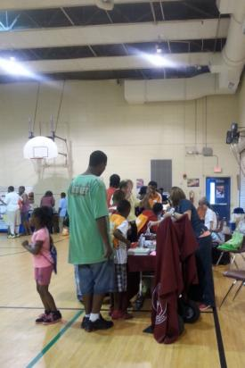
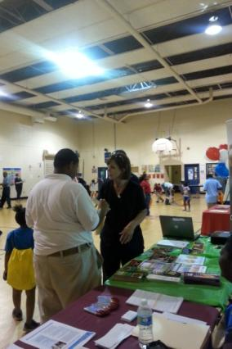
SBHC Health Fair

Slide 25
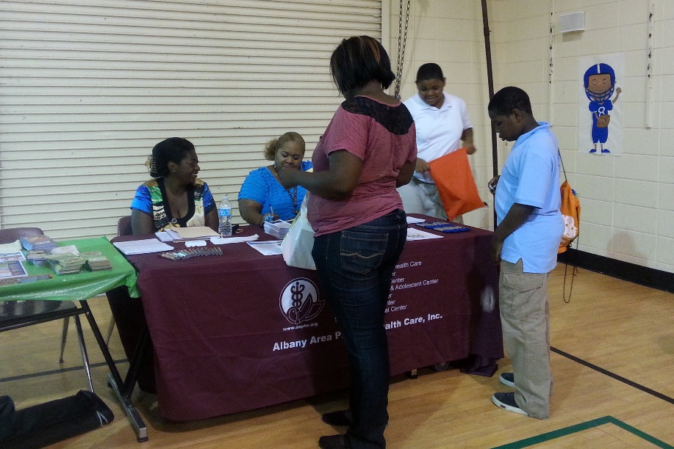
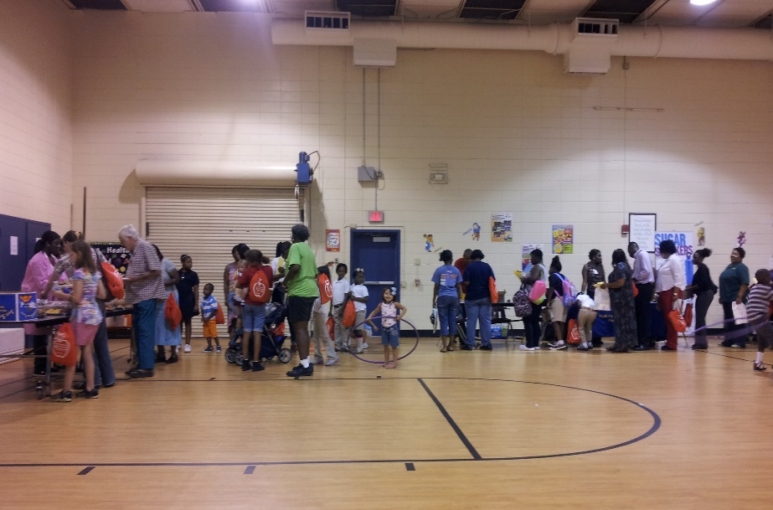
SBHC Health Fair

Slide 26
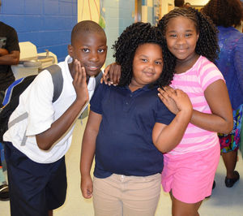
SBHC Health Fair

Slide 27
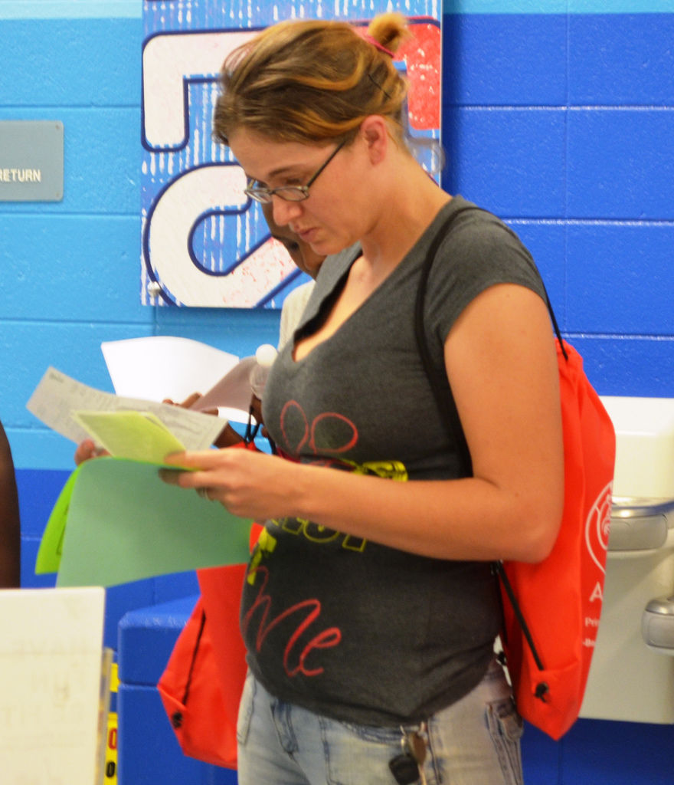
SBHC Health Fair

Slide 28
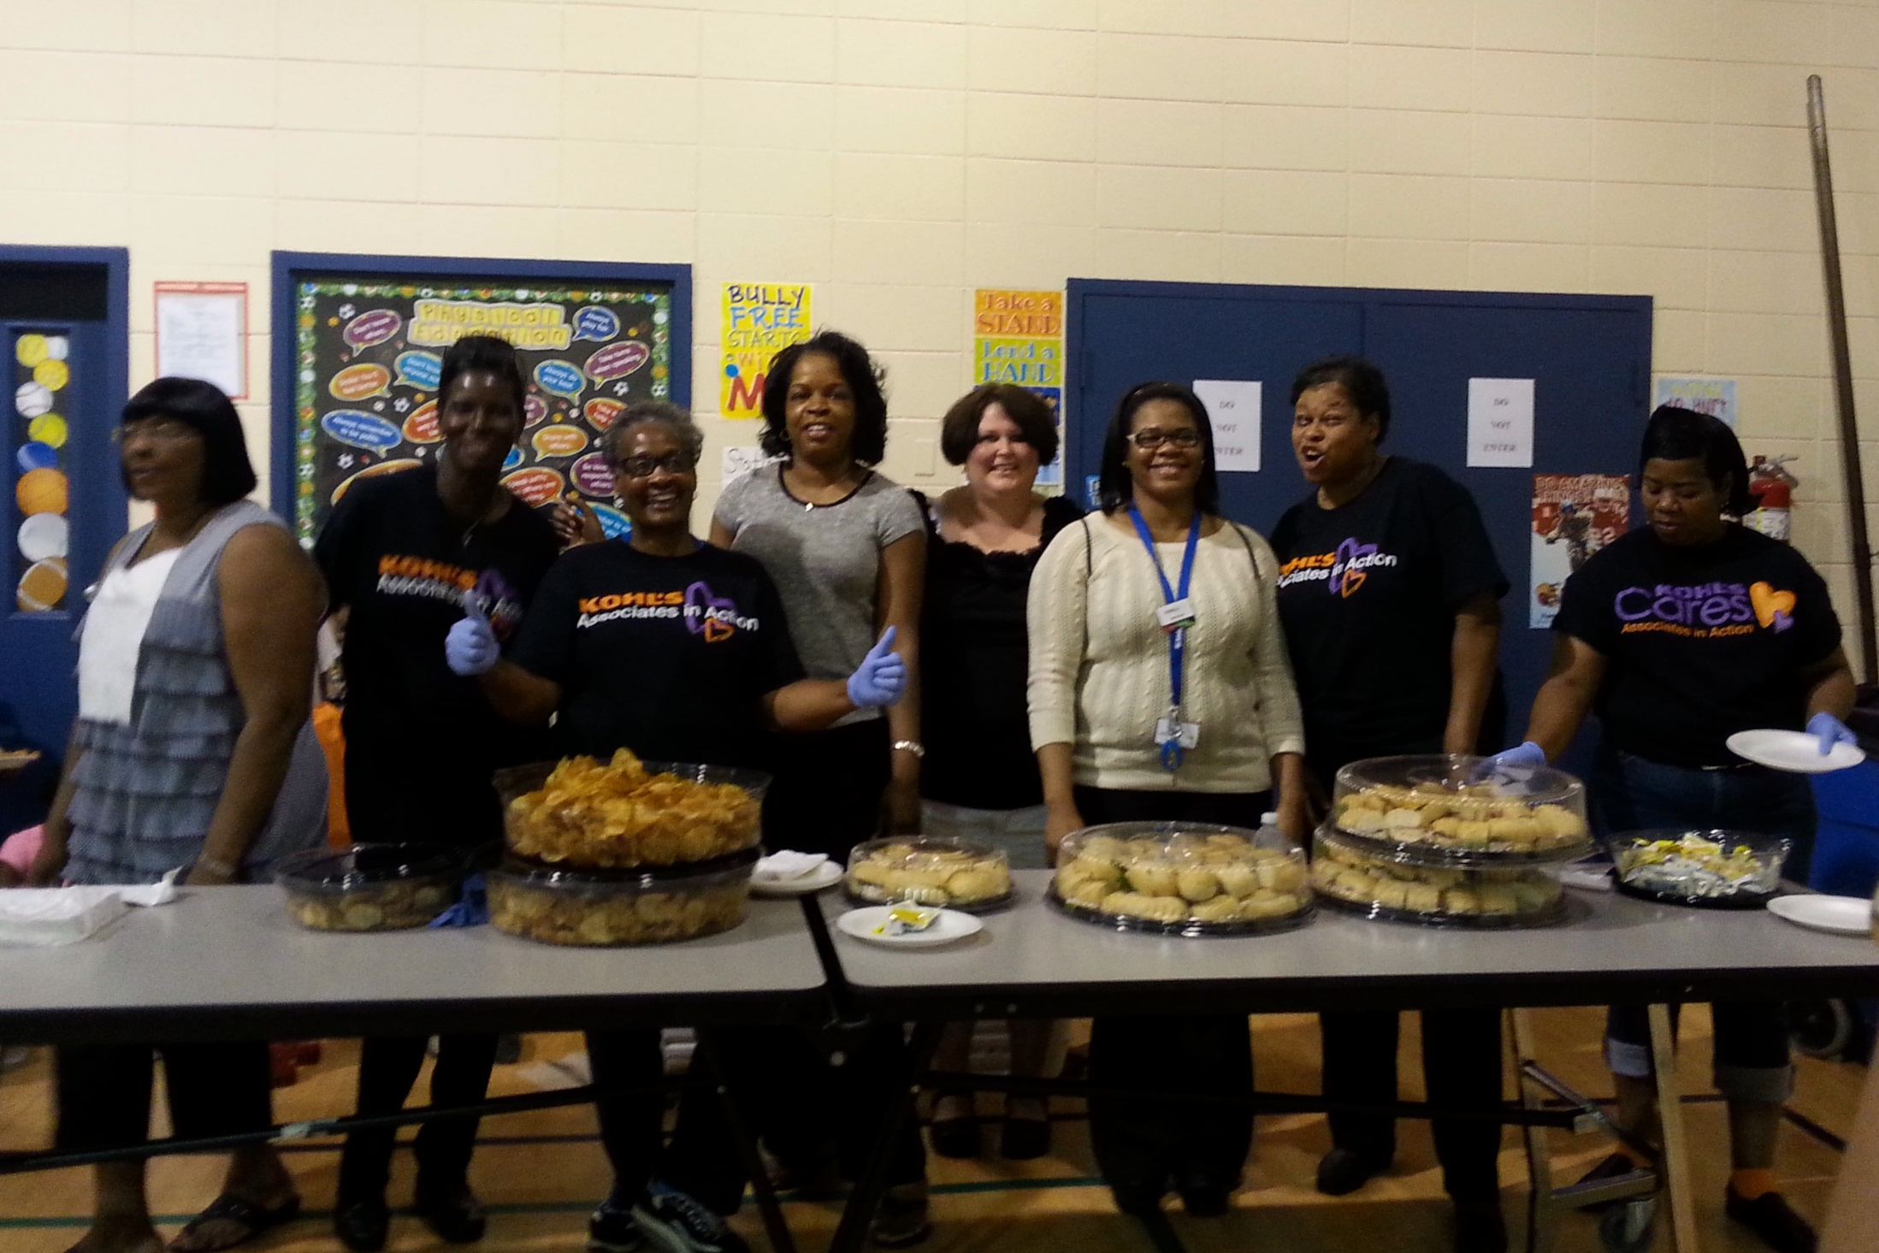
SBHC Health Fair

Slide 29
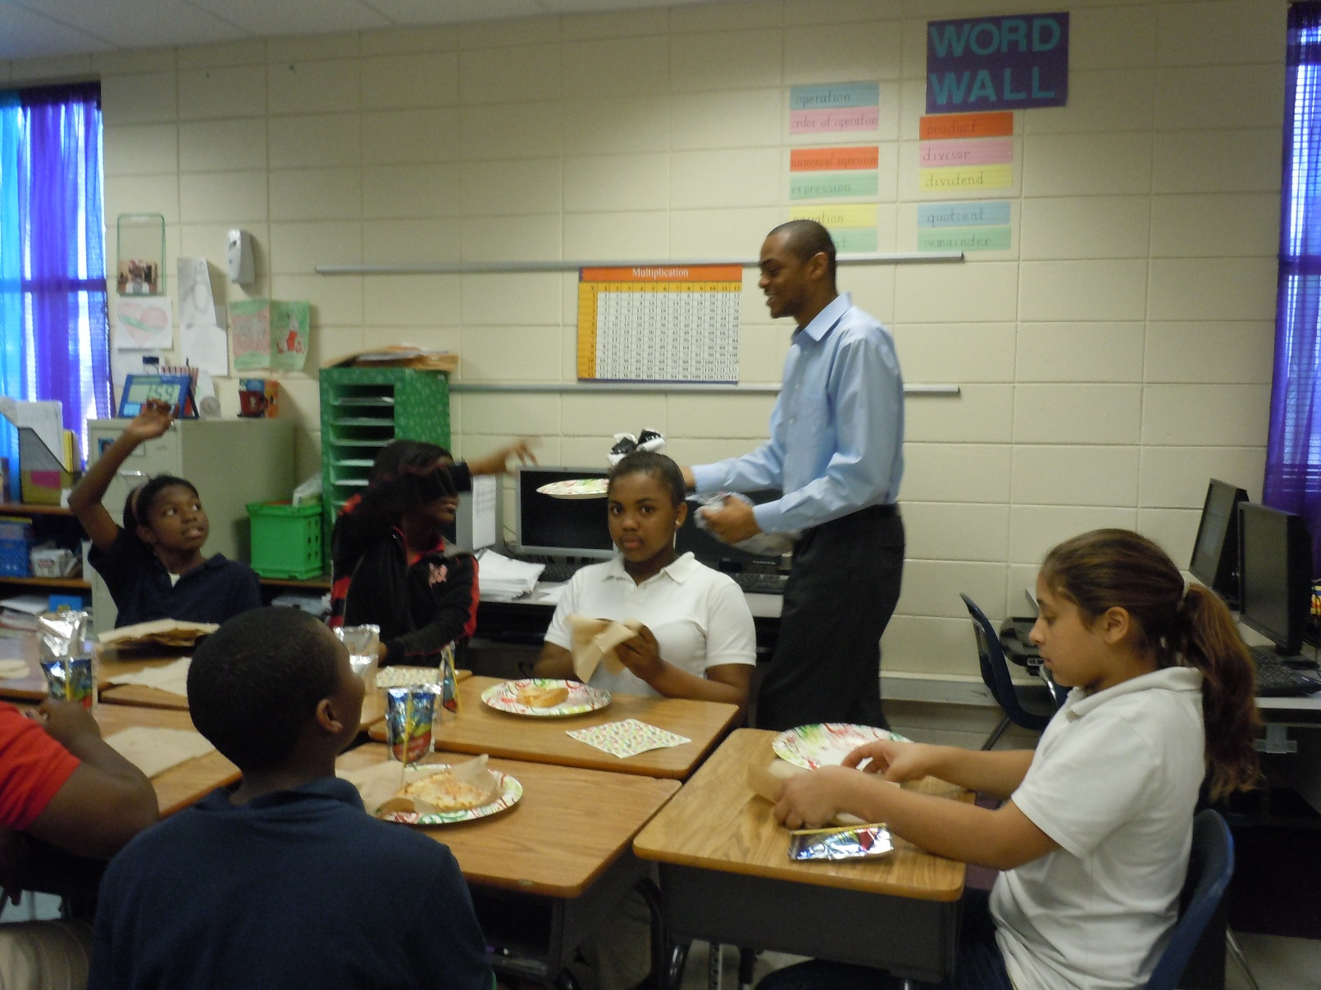
Promotional Activities

Slide 30
Current Utilization Statistics
for all AAPHC SBHC Sites

Slide 31
SBHC Utilization Report – CY16
 | Turner | Turner Dental | Alice Coachman | Albany Middle - Dental | Terrell | Crisp | Dooly
January | 219 | 38 | 136 | 55
February | 261 | 59 | 160 | 61
March | 210 | 62 | 160 | 59 | 18
April | 236 | 66 | 174 | 50 | 80 | 59 | 35
May | 218 | 79 | 175 | 43 | 86 | 49 | 62
June | 0 | 0 | 0 | 0 | 0 | 0 | 0
July | 0 | 0 | 34 | 0 | 37 | 0 | 29
August | 305 | 0 | 244 | 19 | 162 | 79 | 185
September | 275 | 66 | 225 | 62 | 161 | 104 | 155
Total YTD | 1,724 | 370 | 1,308 | 349 | 544 | 291 | 466

Slide 32
For More Information: Shelley Spires, CEO shelley.spires@aaphc.org Clifton Bush, COO clifton.bush@aaphc.org (229) 888-6559

