Slide 1
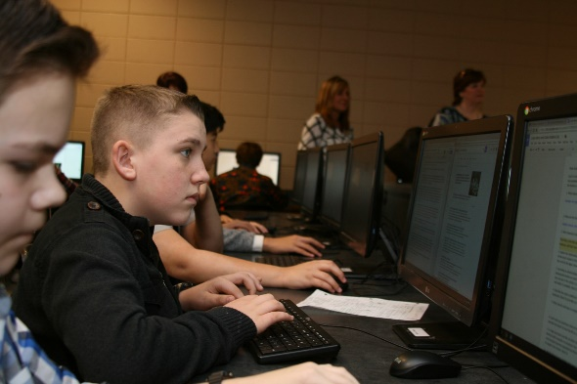
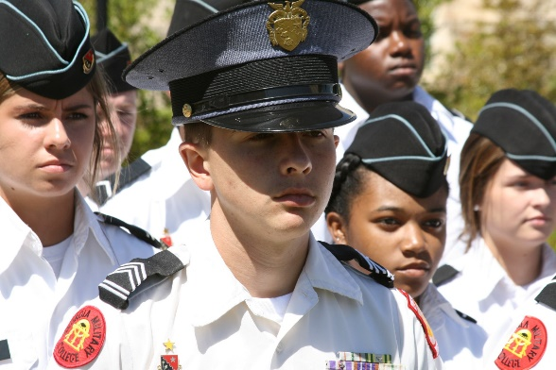
Fall Bootstrap October 20, 2016
Richard Woods, State School Superintendent

Slide 2
ESSA Update
STAKEHOLDER FEEDBACK
8 stakeholder sessions held statewide
Advisory councils
Electronic survey, social media, email (essa@doe.k12.ga.us)
MEETINGS
State Advisory – Guiding Principles & Focus Areas; Lindsay Fryor and Ann Duffy presented
Working Committees – meet regularly
STAY UPDATED
GaDOE.org/ESSA

Slide 3
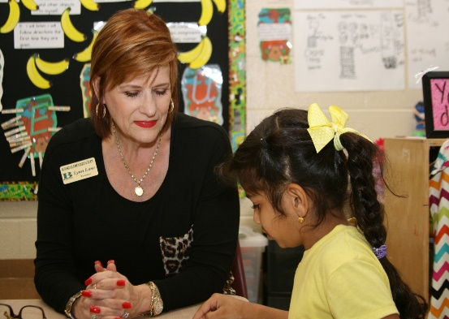
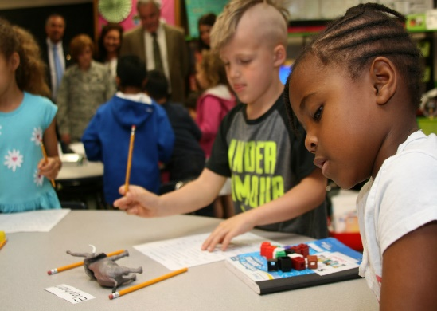
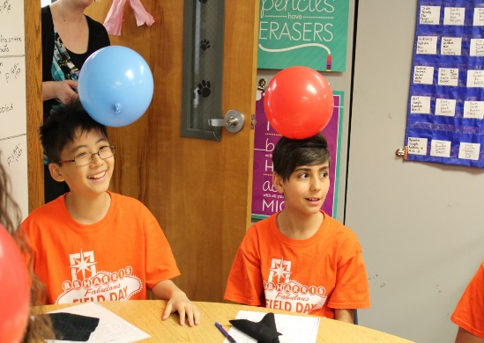
VISION 2020
Educating Georgia’s Future

Slide 4
Every child will have access to Georgia-owned and Georgia-grown academic standards, and teachers will have access to high-quality instructional resources.
VISION 2020
Science and Social Studies standards rollout
Tiered professional learning
Teacher Resource Link (TRL) re-design

Slide 5
Every child in Georgia will be on a path to proficiency in reading (on grade level by third grade) and proficiency in math (on grade level by fifth grade).
VISION 2020
Striving Readers and the LEARN Act
Literacy Think Tank
15 Community Meetings
Using the Get Georgia Reading framework
6 building blocks for the statewide literacy plan
Partnering with public libraries; strengthening support for media centers
Literacy and numeracy diagnostics for grades 1 & 2

Slide 6
Georgia will exceed the national average graduation rate.
VISION 2020
Eliminating unnecessary tests
Expanding core credit flexibility
Providing supports for students with disabilities
Recognizing success with diploma seals

Slide 7
Students who complete a CTAE career pathway have a 94.9% graduation rate – almost 16 points higher than the state average!
CTAE
Graduation Rate
94.9%

Slide 8
* For students who take just one AP course.

Slide 10
Every child in Georgia will earn college and/or career credit before they graduate high school.
VISION 2020
EVERY STUDENT WILL OBTAIN ONE OF THE FOLLOWING:
Move On When Ready
Articulated credit
AP/IB
Complete a CTAE career pathway
Industry-recognized credential
Work-based Learning/Apprenticeship program
Career Academy Program

Slide 11
Every child in Georgia will earn college and/or career credit before they graduate high school.
VISION 2020
PROVIDING SUPPORT THROUGH OUR ‘EDUCATING GEORGIA’S FUTURE WORKFORCE’ INITIATIVE
Career Coach pilot
Counseling Companion
Career Technical Student Organizations
Diploma Seals
Economic Development Ready Certified districts
Economic Development Regional Meetings

Slide 12
The number of high-stakes tests will be reduced to the federal minimum while support for diagnostic tools in all core content areas will be provided.
VISION 2020
MUST CHANGE THE CULTURE AND PURPOSE OF TESTING
Assessments should inform, rather than drive instruction
SB 364: Eliminated 8 high-stakes tests
Opportunity with Grades 1 and 2 diagnostics
Proposed MOWR SBOE rule
Strengthen and expand tools like FIP and GOFAR
Assessment Innovation Fund

Slide 13
Every teacher and leader in Georgia will have access to high-quality, relevant, personalized professional learning.
VISION 2020
Shift from seat-time and one-size-fits-all to open access and personalized approach (aligns with PSC)
Professional growth component in TKES
Partnering with RESAs
Changing the way GaDOE delivers PL

Slide 14
Streamline and integrate state and federal processes, procedures, and policies in order to provide maximum flexibility to districts while ensuring transparency to taxpayers.
VISION 2020
Shift from compliance and control to service and support
Re-organization; creation of Federal Programs
Federal Funds Consolidation pilot
Common Needs Assessment

Slide 15
Increase the number of Georgia districts that meet or exceed the goals of their performance contracts through innovative practices, academic growth, and stakeholder engagement.
VISION 2020
Spotlighting best practices
Guiding and supporting districts
Facilitating partnerships
Organizing data so districts and schools see the entire picture

Slide 16
70% of public schools will achieve a 4 or 5 star climate rating.
VISION 2020
PBIS
RESA School Climate Specialists
Social-emotional needs of students
Increasing support for school nurses, school counselors, school psychologists, and school social workers

Slide 17
Connect with us
FB.com/georgiadeptofed @georgiadeptofed georgiadeptofed
gadoe.org/Pages/Newsletter-Signup.aspx

