Slide 1
Georgia School Superintendents Association Spring Bootstrap Conference Legal Issues Update March 30, 2016
Phillip L. Hartley
Harben, Hartley & Hawkins, LLP
340 Jesse Jewell Parkway, Suite 750
Gainesville, Georgia 30501
phartley@hhhlawyers.com
Telephone: (770) 534-7341
Facsimile: (770) 532-0399

Slide 2
ISSUES FROM THE GENERAL ASSEMBLY

Slide 3
SB 364 – O.C.G.A. § 20-2-210
“(b)(1) … For purposes of the evaluation system established …, the state board shall define and designate teachers of record, assistant principals, and principals; provided, however, that growth in student achievement shall not include the test scores of any student who has not been in attendance for a specific course for at least 90 percent of the instructional days for such course.”

Slide 4
SB 364 – O.C.G.A. § 20-2-210 cont’d
“(3) Teachers of record, assistant principals, and principals shall be evaluated using multiple, rigorous, and transparent measures. …shall be given written notice…Beginning with the 2016-2017 school year, evaluation measures shall include the following elements:
(A) For … courses that are subject to annual state assessments …:
(i) Student growth,… shall count for 30 percent of the evaluation;
(ii) Professional growth shall count for 20 percent… shall be measured by progress toward or attainment of professional growth goals …. Professional growth goals may include measurements based on multiple student growth indicators, evaluations and observations, standards of practice, and any additional professional growth measures allowed by the local school system's or charter school's flexibility contract or other agreement with the State Board of Education for local school systems that are not under a flexibility contract; and
(iii) Teacher evaluations and observations … shall count for 50 percent….”

Slide 5
SB 364 – O.C.G.A. § 20-2-210 cont’d
“(B) For teachers … who teach courses not subject to annual state assessments…:
(i) Student growth … shall include at least one student growth measure and may utilize other student growth indicators, including the school or local school system total score on the annual state assessments…. This provision shall not be construed to require the measurement of student growth for every student taking courses that are not subject to annual state assessments aligned with state standards;

Slide 6
SB 364 – O.C.G.A. § 20-2-210 cont’d
(C) For principals and assistant principals, the evaluation shall be composed of the following:
(i) Student growth, based on the school score on annual state assessments, shall count for 40 percent of the evaluation;
(ii) School climate shall count for 10 percent of the evaluation;
(iii) A combination of achievement gap closure, Beat the Odds, and College and Career Readiness Performance Index data, as allowed by the flexibility contract or other agreement with the State Board of Education for local school systems that are not under a flexibility contract, shall count for 20 percent of the evaluation; and
(iv) The results of evaluations, observations, and standards of practice shall count for 30 percent of the evaluation.

Slide 7
SB 364 – O.C.G.A. § 20-2-210 cont’d
“(3)(4) …neither the State Board of Education, a local school system, … shall impose or require any quota system or predetermined distribution of ratings ….
(4)(5) … the annual evaluation shall include multiple classroom observations conducted each year by appropriately trained and credentialed evaluators, using clear, consistent observation rubrics, and supplemented by other measures aligned with student achievement and professional growth. A… local school system may include in its flexibility contract … a provision for a tiered evaluation system, in which reduced observations of certain teachers may be conducted to provide additional time to coach and mentor new teachers and teachers with 'Needs Development' or 'Ineffective' … teachers with a minimum of three years' … and a 'Proficient' or 'Exemplary' …in the previous school year, the local school system … in its discretion, shall require no less than two classroom observations and one summative evaluation for the school year.”

Slide 8
SB 364 – O.C.G.A. § 20-2-281
(a) … The student assessment program shall include a comprehensive summative assessment program for grades three through 12. In addition, each local school system shall administer, with state funding, a research based formative assessment with a summative component that is tied to performance indicators in English, language arts/reading, and mathematics in grades one and two, subject to available appropriations. ...
(r) In order to maximize classroom instruction time, the State Board of Education shall study and adopt policies beginning with the 2017-2018 school year that will move the end-of-grade and end-of-course assessment testing windows as close to the end of the school year or semester as possible. …

Slide 9
SB 364 – O.C.G.A. § 20-2-989.7
"(a) The performance ratings contained in personnel evaluations conducted pursuant to Code Section 20-2-210, professional development plans, and job performance shall not be subject to complaint under the provisions of this part; provided, however, this shall not apply to procedural deficiencies on the part of the local school system or charter school in conducting an evaluation pursuant to Code Section 20-2-210. The termination, nonrenewal, demotion, suspension, or reprimand of any employee, as set forth in Code Section 20-2-940, and the revocation, suspension, or denial of certificates of any employee, as set forth in Code Section 20-2-984.5, shall not be subject to complaint under the provisions of this part."

Slide 10
Remember SB 84 The Individual Member and the Board
LBOE members should work together with the entire LBOE and shall not have authority as independent elected officials but shall only be authorized to take official action as members of the board as a whole.
10

Slide 11
The BOE Code of Ethics : Board Meetings
Be informed and prepared to discuss issues to be considered on the Board agenda.
Work with other Board members in a spirit of harmony and cooperation in spite of differences of opinion that may arise during the discussion and resolution of issues at Board meetings.
Maintain the confidentiality of all discussions and other matters pertaining to the Board and the school system, during executive session of the Board.
Make decisions in accordance with the interests of the school system as a whole and not any particular segment thereof.
7. Express opinions before votes are cast, abide by and support all majority decisions of the Board after the Board vote.

Slide 12
O.C.G.A. § 20-2-49
Given the specialized nature and unique role of membership on a local board of education, this elected office should be characterized and treated differently from other elected offices where the primary duty is independently to represent constituent views. Local board of education members should abide by a code of conduct and conflict of interest policy modeled for their unique roles and responsibilities. And although there are many measures of the success of a local board of education, one is clearly essential: maintaining accreditation and the opportunities it allows the school system’s students.

Slide 13
SB 275
36-80-1
“A local board of education shall not adopt or follow any code of ethics which prevents the members of such board from discussing freely the policies and actions of such board outside of a board meeting. This Code section shall not apply to any matter or matters discussed in executive session as defined in subsection (a) of Code Section 50-14-1 or which are exempt from disclosure under Code Section 50-18-72.”

Slide 14
HB 959
“(6) No local board of education member shall be prohibited from:
(A) Making an inquiry for information on behalf of a constituent if no fee, reward, or other thing of value is promised to, given to, or accepted by the local board of education member or his or her immediate family member in return therefor;
(B) Discussing any nonconfidential matters with a constituent;
(C) Attending or conducting a town hall meeting; or
(D) Discussing any nonconfidential matter with representatives of the media.”

Slide 15
HB 659
“where the primary duty is independently to represent constituent views. Local board of education members should abide by a code of conduct and conflict of interest policy modeled for their unique roles and responsibilities. And although there are many measures of the success of a local board of education, one is clearly essential: maintaining accreditation and the opportunities it allows the school system's students.”

Slide 16
HB 959 – O.C.G.A. § 20-4-37
(b)(5) 'College and career academy' means a specialized charter school established by as a charter school or pursuant to a contract for a strategic waivers school system or charter system, which formalizes a partnership which that demonstrates a collaboration between business, industry, and community stakeholders to advance workforce work force development… A charter school, charter system, or strategic waivers school system contract establishing a college and career academy shall include provisions requiring that the college and career academy have a governing board reflective of the school community and the partnership with decision-making authority and requiring that governing board members complete initial and annual governance training, including, but not limited to, best practices on school governance, the constitutional and statutory requirements relating to public records and meetings, and the requirements of applicable statutes and rules and regulations.

Slide 17
SB 355 – O.C.G.A. § 20-2-281
"(r) With respect to any standardized assessments…,may administer in a paper-and-pencil format to any student whose parent or guardian requests…
(s) The State … shall develop guidelines…, by September 1, 2016, that identify a range of appropriate policies that may be adopted by a school system when considering how students … will be supervised and what, if any, alternative to the assessment will be provided to them during the test administration. The guidelines should prohibit a school system from taking punitive action against a student, including,… the adoption of sit and stare policies, in response to a student's refusal to participate…. The guidelines shall offer positive learning opportunities for students and not be undirected free time. The guidelines shall also address how and when the school system's policy will be communicated to parents, students, and school system staff. As used in this subsection, the term 'sit and stare' means any policy that requires a student whose parent or guardian has given written instructions for such student not to participate …to remain … in the test room or in another location without any alternate instructional activity provided."

Slide 18
SB 355 – O.C.G.A. § 20-2-281.2
“(a) State mandated tests … shall be mandatory for school systems… but optional for students, …under the following conditions:
(1) A parent's written request to school officials to excuse his or her child from any or all parts of the state mandated assessments … shall be granted if the child is diagnosed with a life-threatening or serious health condition; and
(2) A licensed therapist's order or a physician's order to excuse a child from any or all parts of the state mandated assessments … shall be granted.
(b) A student who is absent or otherwise unable to take any … mandated assessment … may take the assessment on the second administration day or … may take an alternative to the assessment as specified by the State Board of Education or the local board of education…. local school systems shall not be subject to any penalties due to any student's nonparticipation.”

Slide 19
SB 355 – O.C.G.A. § 20-2-281.2 cont’d
“(c) If the rating on a school performance report is affected by the number of students excused or otherwise not taking the standardized assessments, the Department of Education shall include on the school performance report:
(1) An indication that the rating was affected by a federal law requirement;
(2) A brief explanation of the federal law requirement that affected the rating; and
(3) The rating the school would have received if not for the federal law requirement of the 95 percent participation threshold.
A teacher, principal, assistant principal, school, or local school system shall not be penalized for any such child who does not participate in such assessments."

Slide 20
SB 3 – O.C.G.A. § 19-9-141
“(4) ‘Kinship caregiver’ means a grandparent, step-grandparent, aunt, uncle, great aunt, great uncle, cousin, or sibling of a child or a fictive kin who resides in this state.”

Slide 21
SB 3 – O.C.G.A. § 19-9-142
“(a) A parent, guardian, or legal custodian of a child may delegate caregiving authority regarding such child to a kinship caregiver for a period not to exceed one year, …, by executing a power of attorney …Such power and authority may be delegated without the approval of a court, …
(e)(1) The agent under a power of attorney shall have the right to enroll the child in a public school serving the area where the agent resides ….

Slide 22
SB 3 – O.C.G.A. § 19-9-145
“(a) Except as may be permitted by the federal Every Student Succeeds Act (P.L. 114-95), an individual executing a power of attorney under this article shall swear or affirm under penalty of law that such action is not being taken for the purpose of enrolling the child in a school to participate in the academic or interscholastic athletic programs provided by that school or for any other unlawful purpose. …”

Slide 23
HB 792 – O.C.G.A. § 16-11-127.1
(c)“(19) Any person who is 18 years of age or older or currently enrolled in classes on the campus in question and carrying, possessing, or having under such person's control an electroshock weapon while in or on any building or real property owned by or leased to such public technical school, vocational school, college or university or other public institution of postsecondary education;

Slide 24
SB 367 – O.C.G.A. § 20-2-759
“The State Board of Education shall promulgate rules and regulations to require minimum qualifications for hearing officers, disciplinary hearing officers, tribunals, and panels that are tasked with hearing matters in this subpart. The State Board of Education shall promulgate rules and regulations to ensure that such individuals have initial training prior to serving as a hearing officer or disciplinary hearing officer or on a tribunal or panel, undergo continuing education so as to continue to serve in such capacity, and function as independent, neutral arbiters.”

Slide 25
SB 367 – O.C.G.A. § 20-2-1183
“When a local school system assigns or employs law enforcement officers in schools, the local board of education shall have a collaborative written agreement with law enforcement officials to establish the role of law enforcement and school employees in school disciplinary matters and ensure coordination and cooperation among officials, agencies, and programs involved in school discipline and public protection.”

Slide 26
HB 59 – O.C.G.A. § 50-21-50
(a) The defense of sovereign immunity is waived as to any claim … by an aggrieved person seeking a declaratory judgment or injunctive relief … to remedy an injury in fact caused by the … political subdivision thereof acting without lawful authority and beyond the scope of official power in violation of a provision of the Georgia Constitution, a state law, or a local ordinance; provided, however, that sovereign immunity is not waived:
(1) When a state law explicitly prohibits such waiver;
(2) As to any claim for monetary relief, attorney's fees, or expenses
(3) As to any claim… related to a contract

Slide 27
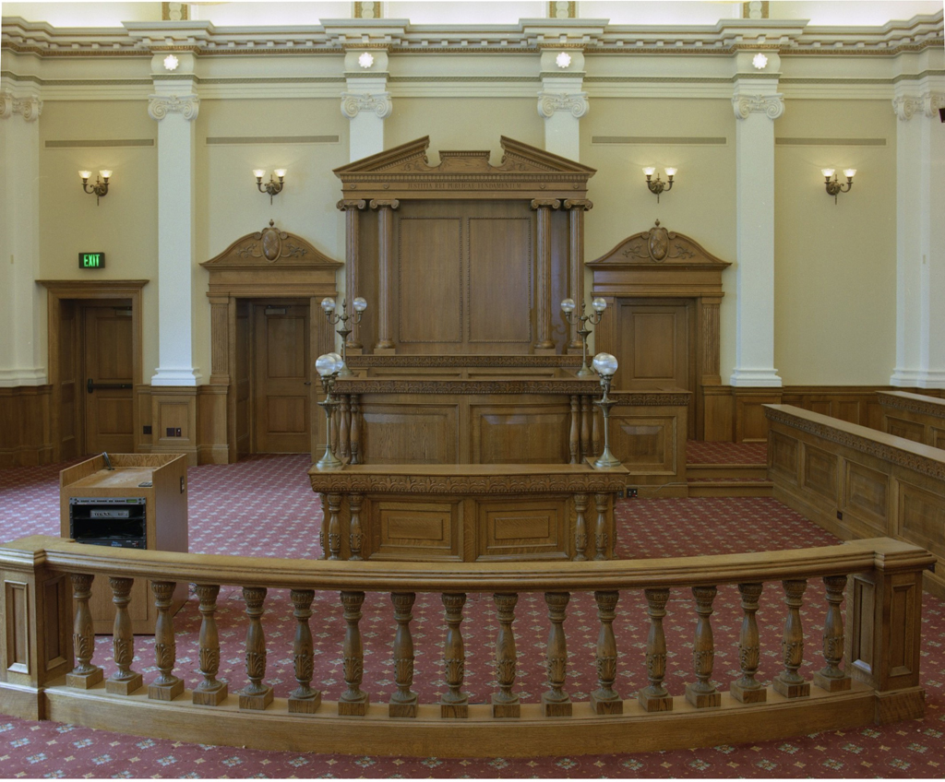
Issues from the Courts

Slide 28
Boatright v. Copeland
Ga Court of Appeals attacks immunity again
Suit first against School District dismissed based on sovereign immunity
Suit then filed against board members and superintendent individually
Superior Court dismisses based on immunity
Court of Appeals reverses

Slide 29
Confusion or Conflation?
“the school district violated its ministerial duty” to comply with a criminal statute.
the next sentence refers to “a discretionary act” of the “school board.”
“it is at least conceivable that Defendants may have had the cannon within their individual control” because “at least some of [the Defendants] together manage and control the school district.”

Slide 30
Issues from the Federal Government

Slide 31
EVERY STUDENT SUCCEEDS ACT
Existing waivers of NCLB end 8/16
New accountability plan developed by the State for 17-18
More flexibility on goals to address both student achievement based on tests and other academic indicators (at least 3) and at least one of another kind (think school climate issues) – think CCRPI
95% participation on tests still counts but State decides how – see above
Intervention requirements for bottom 5% of schools, schools where subgroups are not succeeding and high schools with 67% or less graduation rate – think OSD

Slide 32
EVERY STUDENT SUCCEEDS ACT
Testing still required at 3-8 and at high school but number reduced
Disaggregation of subgroups still required
Must have “challenging” standards, but no requirement for uniformity or Common Core
May allow opt-out by parents as determined by State – is SB 355 it or is there more to come?

Slide 33
EVERY STUDENT SUCCEEDS ACT
No requirement that teacher evaluations be based on student outcomes – is SB 364 it?
No more highly qualified requirements in federal law – but see PSC certification requirements, unless waived

Slide 34
Data Privacy: the national conversation
Privacy groups fear “permanent record,” breach, government eyes on “big data,” corporate eyes on marketing opportunities
Ed/Data/Research groups tout individualized learning, closing achievement gaps, creating digital citizens
Many groups putting out resources, training, seals of approval
Watch for federal legislation governing school districts (FERPA), vendors or both

Slide 35
Everyone who has access to students’ personal information should be trained and know how to effectively and ethically use, protect, and secure it.
Schools should have governance system for data, notification/remedy policy for breach, security process, designated contact for data rights and access questions.

Slide 36
Technology
SB 89 – Student Data Privacy – 2015
Implementation ongoing – State Chief Privacy Officer, state rules, local model policies, local privacy officer, complaint procedures

Slide 37
Other Issues from Atlanta

Slide 38
Charter School Law O.C.G.A. § 20-2-2065
(a) Except as provided in this article or in a charter, a charter school, or for charter systems, each school within the system, shall not be subject to the provisions of this title or any state or local rule, regulation, policy, or procedure relating to schools within an applicable school system regardless of whether such rule, regulation, policy, or procedure is established by the local board, the state board, or the Department of Education;

Slide 39
IE² Law O.C.G.A. § 20-2-82
(e) The state board shall be authorized to approve a waiver or variance request of specifically identified state rules, regulations, policies, and procedures or provisions of this chapter upon the inclusion of such request in the local school system's proposed contract and in accordance with subsection (b) of Code Section 20-2-84.

Slide 40
What Are We All Waiving?
Salary Schedules?
Contracts for teachers?
Tenure?
Hearing process for termination during a contract?
Hearing process for teachers with tenure?
Notice requirements by May 15?
Suspensions and reprimands?

Slide 41
How does this affect contracts, salary schedules and policies?
Most form contracts still based on state salary schedule and state laws that have been waived
Responsibility for salary decisions rest with local district
What about teacher expectations?
Making the decision to change practices – When? How? Why?

Slide 42
Questions

