Slide 1
Technology Service Update

Slide 2
LDS
60,000,000
Information Requests

Slide 3
LDS
Longitudinal Data – 8 Years
Digital Resources – 27,665
Full Virtual Course From GAVS – 55
Formative Testing with 20,848 item bank
IEP System
Parent Portal
Gifted System
Growth Models
Analytic Tools with data to compare to other districts

Slide 4
Bandwidth
100 MBPS for every public school in Georgia
$9MM per year – 5MM State, 4MM eRate

Slide 5
Bandwidth Utilization
Gold – 41 & Up
Blue – 26-40
Green – 10-25
Red – 0-9
eRate funding is at risk!

Slide 6
Bandwidth Utilization

Slide 7
Dependency on Technology
Increases in 1 to 1 initiatives
Increases in BYOD
Increases in online testing
Increases in wireless networks
Has your technology budget increased to support these initiatives?

Slide 8
Number of Technology Staff
2013 - 1400
Today – 1533
Staff increased by 9%
Online testing increased more than 50%.
This spring over 70% will be online.

Slide 9
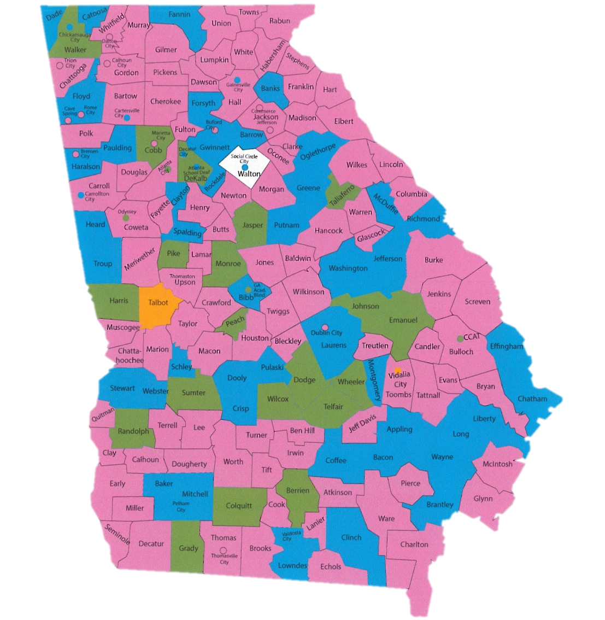
Online Testing Growth
Purple – 76%-100%
Blue – 51%-75%
Green – 26%-50%
Orange – 0%-25%
White – No Data

Slide 10
2016 Legislative Update

Slide 11
AGENDA
Amended FY 16 Budget
FY 17 Initial Budget
2016 Legislative Session

Slide 12
AFY 2016
Funded enrollment growth - $92,048,452
Funded Hold Harmless - $16,404,407
Initial FTE – 1,725,961
Mid-Term FTE – 1,736,628
Charter System Supplement Enrollment Growth and New Charters - $2,341,908 (Charters approved by July 1, 2015 – Candler, Colquitt, Fannin, Liberty)
State Commission Charters - $665,045 (DuBois, Foothills, Ga School Innovations, Scintilla and International)
Transportation Allotment – added additional distribution $1,359,733
Notes:
Charter System grant increased due to all charter systems approved by July 1, 2015.

Slide 13
AFY 2016
Sparsity –
Did not update. Amount remains the same as Initial Allotment
Cut Off FTE Counts
High – 485
Elementary/Middle – 450
K-12 – 935
$1,688.18 per FTE
Funded as appropriated
Notes:
Currently only funded at 27% of what the calculation determines.

Slide 14
AFY 2016
No Adjustments for:
Health Insurance – Certified Employees
Training and Experience
Reduced FTEs
Notes:
Only changes to FY 2016 were for funding growth. Enrollment increased statewide. Districts were held harmless for decreased enrollment. The Charter system supplement was increased due to the enrollment growth. The transportation allotment was amended for part of the initial allotment that was withheld pending the transportation survey.

Slide 15
FY 2017 QBE and Other State Grants

Slide 16
Initial FY 2017 QBE
Funded enrollment growth and T&E increase - $124,057,498
Nurses Increase (based on enrollment increases) - $220,798
TRS remains at 14.27%
Initial FTE – 1,736,628
Reduced Austerity $300,000,000 – down to 2.08%
Charter System Supplement - $2,999,129
Adjusted for Increased FTEs
Charter Systems approved after July 1, 2015 will see supplement as appropriated at the FY 17 Mid-Term
State Commission Charter Schools - $8,021,294
Math and Science Supplement - $307,704
Notes:
Increase in T&E is NOT an increase in the state salary scale. This is simply to fund the increase cost due to the increase in certificate levels and years of experience.
Charter Systems – If recently approved or approved by July 1, 2015, the charter system supplement will be added at the mid-term.

Slide 17
FY 2017 Other Categorical Grants
Math & Science Supplement
Funded for those teachers reported as eligible on the October 2015 report (CPI 2016 – 1) report. Program was only funded to pay teachers that were eligible up to Step 4 (Year 6). If they attained that level, they were no longer eligible. Also funded those K – 5 teachers that were eligible and REPORTED CORRECTLY for the Stipend
Only fringes will be TRS (14.27%) and Medicare (1.45%)
Hope to provide funding early in FY2017
NOTE: Districts were not and are not to move these teachers up on the salary schedule based on this bill
Notes:
The new PSC teaching requirements for the induction pathways were not originally considered. The error was discovered and there are an additional 44 employees at 26 school districts will receive funding. Mr. Gary Wenzel, the Program Director the grant should have contacted those 26 districts regarding the additional eligible employees.

Slide 18
Nursing – FY 17
Provided for 3% salary increase for nursing
Funding for FY2017 increased by $912,932
Raised pay for RN in formula from $45,000 to $46,350
Raised pay for LPN in formula from $32,000 to $32,960
(Note: Does not mean you have to pay at that rate)
Salary is earned based on FTEs reported. You earn positions.
Notes:
Nurses: RN - Base salary is $45,000, with Retirement (14.27%) and FICA (1.45%) to total $52.074.00. The funding ratios are 1 RN for every 4500 elementary FTE, 1 RN for every 9000 other FTE.
LPN – Base salary is $32,000, with Retirement (14.27%) and FICA (1.45%) to total $37,030.40. The funding rations are 1 LPN for every 900 elementary FTEs, and 1 LPN for every 1,800 other FTE.
The allotment then funds 50% of the calculated nursing costs as the state’s obligation. After the nursing salaries are calculated, a supply cost is calculated at $500,000 in supplies, proportionally distributed among the FTEs statewide.
For APS: $52,074/4,500 X 25,731 elementary FTEs = $297,759. $52,074/ 9,000 X 25,060 other FTEs = $144,997. Total of $442,756 in RN allotments.
$37,030.40/900*25,731 elementary FTEs = $1,058,699. $37,030.40/1800*25,060 other FTEs = $515,545. Total of $1,574,244 in LPN allotments.
Total Nursing Salary Costs = $2,018,293 multiplied by 50% = $1,008,500
$500,000/1,736,467 FTEs per state*50,791 = $14,625 for supplies.
Total estimated nursing allotment for APS in FY 17 = $1,023,125

Slide 19
2017 Transportation Funds
Categorical Grant
Funding increases based on 3% increase for salaries
Salary allotment per bus increases from $9,574.16 to $9,864.19
Recalculated based on formula
Remember, you earn funding for salaries of individuals to drive the buses you qualify for based on mileage reported
Notes:
Our transportation director is in the field today, so I am not positive on the actual salary increase. The $9,574.16 is combined of salaries and benefits, so it appears current funding is $9,440 salaries plus FICA (1.45%). The 3% salary increase for bus drivers would land somewhere around $9,864.19 with FICA. Based on the Budget Specialist calculation, APS calculation for transportation increases $57,455.

Slide 20
2017 Transportation Funds
Bonds for Buses
Remember you still have to submit copies of invoices to get reimbursed (Invoice Application in the Portal)
There will be $14.285 million in Bus Bonds in FY17
Unspent $154K from FY 15 Bonds
Funding $77,216.250 per bus.
Funding for 187 buses Announcement for FY17 allocation expected in Mid-July 2016 (after bonds are sold)

Slide 21
2017 Nutrition
“Provide funds for a 3% salary adjustment for lunchroom workers effective July 1, 2016”
Appropriations increased for a 3% salary adjustment based on current manager and non-manager staffing and estimated lunches served in FY 17
State Board Rule stipulates the amount of lunches to be served in an 8 hour day by each employee as 85
Formula calculates the amount of employees needed
Divides number of employees needed by amount of funding appropriated to determine base salary

Slide 22
2017 Nutrition
State Nutrition allotment - $25,602,086
Administrative matching (roughly $300K maintained at state level)
Manager’s Supplement - $400 (for every manager reported in April)
Sick Leave for 2 days
Manager Daily Rate - $58
Non-Manager Daily Rate - $37

Slide 23
2017 Equalization
Fully Funded for FY2017
Formula Calculated a total amount of $498,729,036
The Equalization Benchmark (statewide system average of wealth) for the state increased from $135,047 per FTE in FY 2016 to $135,782 per FTE in FY 2017.
If District’s digest per weighted FTE did not decline, or remain constant, then the equalization would have declined.
For funding to have increased, the wealth digest per district would have had to decrease.

Slide 24
2017 Equalization
46 districts decreased equalization funding
60 districts had no change (i.e., no funding in either year)
74 districts increased equalization funding
Above the benchmark, did not receive funding
Below the benchmark, received funding

Slide 25
2017 Austerity
FY 2017 - $166,769,851
FY 2016 - $466,769,851
Decreased - $300,000,000
Adjusted to 2.08% of QBE Earnings (less local 5 mills) for each district
Survey Requested (surprise)
Budgetary impact reported on survey should equal the increase in funding, due to Austerity reduction

Slide 26
2017 Austerity
What if we provide a 3% one-time bonus?
Per TRS, earnings, including several types of supplements, in a member’s contract for normal duties/hours are earnable compensation for TRS purposes. Bonuses, which are normally awarded to certain employees only based on performance, are not considered earnable compensation. However, a salary adjustment paid to all employees is considered earnable compensation. For example, an employer may decide to pay all permanent status employees employed as of a specific date a one-time 2% adjustment.
Contact TRS before awarding any type of compensation supplement to ensure it is handled correctly.

Slide 27
State Health Benefit Plan
Employer Contributions
Certified Employees - $945 PMPM
Non-certified Employees - $846.20 PMPM
Increase from $746.20 PMPM
Effective January 1, 2017
Authorize a pilot program for non-certificated system-directed health care coverage for a 24-month pilot effective for coverage year January 1, 2017, at the end of which the participating systems may opt to return to the state plan without penalty.

Slide 28
TRS
Employer Rates
FY 2016 – 14.27%
FY 2017 – 14.27%
Employee Rates
FY 2016 – 6%
FY 2017 – 6%

Slide 29
HB 65 – Budget Hearings - passed
Intent – to require local boards of education and certain charter schools to hold at least two public meetings on the proposed annual operating budget; to require that a summary of the proposed and adopted annual operating budget be posted on the Internet; to require that the detailed annual operating budget be made available upon request; to provide for related matters; to repeal conflicting laws; etc.

Slide 30
HB 65 – Budget Hearings
Includes school districts and state charter schools
Excludes:
College and Career Academies
Conversion Charter Schools
System Charter Schools

Slide 31
HB 65 – Budget Hearings
Requires at least two public hearings before adopting any budget
Two public hearings cannot be held within the same week
Any other public meetings or hearings related to the budget shall satisfy all or a portion of such requirement

Slide 32
HB 659 – Transparency of local school systems and schools
Required School Level Information:
Budget and Cost of all materials, equipment, and other non-staff support
Budget and Cost Salary and benefit expenditures for all staff
Budget and Cost of all professional development, including training, materials, and tuition provided for instructional staff on an annual basis
Budget and Cost of facility maintenance and small capital projects
Budget and Cost of new construction or major renovation reported on a cost-per-square-foot basis, based on the school system facility plan

Slide 33
HB 659 – Transparency of local school systems and schools
Required School District Information:
Annual budget of the local board of education
Annual audits conducted on the finances of the local board of education
Ratios of expenditures to revenues
Total dollar amount of local property tax revenue the school system is authorized to collect in addition to the total program mill levy
Total dollar amount of all other tax revenue that is collected by the school system

Slide 34
HB 659 – Transparency of local school systems and schools
Required Links to Other Information on School District’s webpage:
Annual budget submitted to the State Board of Education
Annual personnel report prepared by the state auditor
Most recent audit
Any findings of irregularities or budget deficits reported by DOAA
Annual SPLOST Schedule as required to be provided to DOAA

Slide 35
HB 659 – Transparency of local school systems and schools
WHEN?
GaDOE must have rules and regulations developed by January 1, 2017. Must include a template and definitions of budget and expenditure categories and line items.
School Districts and State Charter Schools shall comply by October 31, 2017.

