Slide 1
Georgia School Superintendents Association Fall Bootstrap Conference Legal Issues Update October 15, 2015
Phillip L. Hartley
Harben, Hartley & Hawkins, LLP
340 Jesse Jewell Parkway, Suite 750
Gainesville, Georgia 30501
phartley@hhhlawyers.com
Telephone: (770) 534-7341
Facsimile: (770) 532-0399

Slide 2
Issues from the Federal Government

Slide 3
Obergefell v. Hodges 576 U.S.__(2015)
“the Fourteenth Amendment requires a State to license a marriage between two people of the same sex.”
“there is no lawful basis for a State to refuse to recognize a lawful same-sex marriage performed in another State on the ground of its same-sex character.”

Slide 4
What does the same-sex decision mean for school districts?
Same-sex spouses have right to receive same benefits as opposite-sex spouses under federal, state, and local laws or policies
What changes are needed in all aspects of personnel operations?
Review “spouse” definition policies, forms or handbooks, particularly FMLA policy
Practically speaking, references to spouses or being married will be viewed more broadly rather than requiring extensive re-writing

Slide 5
Discrimination and Harassment under Federal Law
OCR jurisdiction includes:
Title VI
Title IX
Section 504
Title II of the ADA
But, DOJ can investigate14th amendment issues:
Religion
Compliance with Desegregation Orders
And sometimes, they team up!

Slide 6
Who Wants to Be Title IX Coordinator?
Dear Colleague Letter issued April 24, 2015
To Be Effective Must Be:
Senior Official with Independence and Full Support of District
Full Time, possibly even multiple coordinators needed
Be Well Trained
Be Visible
Separate letter attached directly to Coordinators
Remember you also need one for Title VI and Section 504

Slide 7
June 14, 2011 Dear Colleague Letter on Equal Access
“Harassment and bullying are serious problems in our schools, and lesbian, gay, bisexual, and transgender (LGBT) students are the targets of disproportionate shares of these problems.”
“According to a recent survey, more than 90 percent of LGBT students in grades 6 through 12 reported being verbally harassed — and almost half reported being physically harassed.”

Slide 8
Complaints involving gender issues
“… the actual or perceived sexual orientation or gender identity of the parties does not change a school’s obligations. Indeed, lesbian, gay, bisexual, and transgender (LGBT) youth report high rates of sexual harassment and sexual violence. A school should investigate and resolve allegations of sexual violence regarding LGBT students using the same procedures and standards that it uses in all complaints involving sexual [harassment].”

Slide 9
Bathrooms and Locker Rooms

Slide 10
Should transgender students have a 504 Plan?
No, being transgender is not a disability
Accommodation and common sense planning is good idea, but getting together a team could involve too many people with no need to know
Handle on case by case basis with attorney advice as needed

Slide 11
Recommendations
Make sure nondiscrimination procedures are in place and coordinators identified
Train administrators and staff
Strive for positive, harassment-free atmosphere for all students
Be alert to gender stereotyping, bullying and investigate immediately
Work with legal counsel on specific questions and issues, before you’re out on a limb

Slide 12
Coming soon: The Latest DCL
OCR/maybe DOJ address transgender students in the school setting
Will it address employment issues?
Will it have any effect on the courts?
Will it have any effect on public opinion?
What is its effect on school districts?

Slide 13
G.G. v. Gloucester Cnty. Sch. Bd., No. 15-54 (E.D.Va. Sept. 17, 2015)
The court dismissed the student’s claim that the school board’s policy excluding him from using the boys’ restroom based on his gender identity amounts to sex discrimination in violation of Title IX.
“The Title IX claim is precluded by Department of Education [(ED)] regulations.” Specifically, it pointed out that ED regulation 34 C.F.R. § 106.33 expressly “allows schools to provide separate bathroom facilities based upon sex, so long as the bathrooms are comparable.”

Slide 14
What the courts say…..
“under any fair reading, sex in Section 106.33 clearly includes biological sex.”
“Because the School Board’s policy of providing separate bathrooms on the basis of biological sex is permissible under the regulation, the Court need not decide whether sex in the Section 106.33 also includes gender identity.”

Slide 15
What the courts say…
G.G. fails to allege that the bathrooms to which he is allowed access by the School Board—the girls’ restrooms and the single-stall restrooms—are incomparable to those provided for individuals who are biologically male.
ED’s “interpretation does not stand up to scrutiny” because “[u]nlike regulations, interpretations in opinion letters, policy statements, agency manuals, and enforcement guidelines ‘do not warrant … deference’ with regard to statutes.”

Slide 16
STATE LEGISLATIVE ISSUES

Slide 17
It was a busy Session…
Cyberbullying – it may be more about the change in jurisdiction and responsibility
Privacy Compliance Officer – Another Full time position?
Suicide Prevention – SDOE issued resource manual; training more important than policy
Medical Interventions – epipens, inhalers, defibrillators, what’s next?
OSD – If it survives the voters, will it survive the implementation? And what will it mean for everyone else?

Slide 18
Another one to come…
OSD – Are they through tinkering?
180 different salary scales: How will GA react to the flexibility of Charter Systems and SWS’s
Tenure – Can the Court do what a former Governor could not?
And there will be surprises?

Slide 19
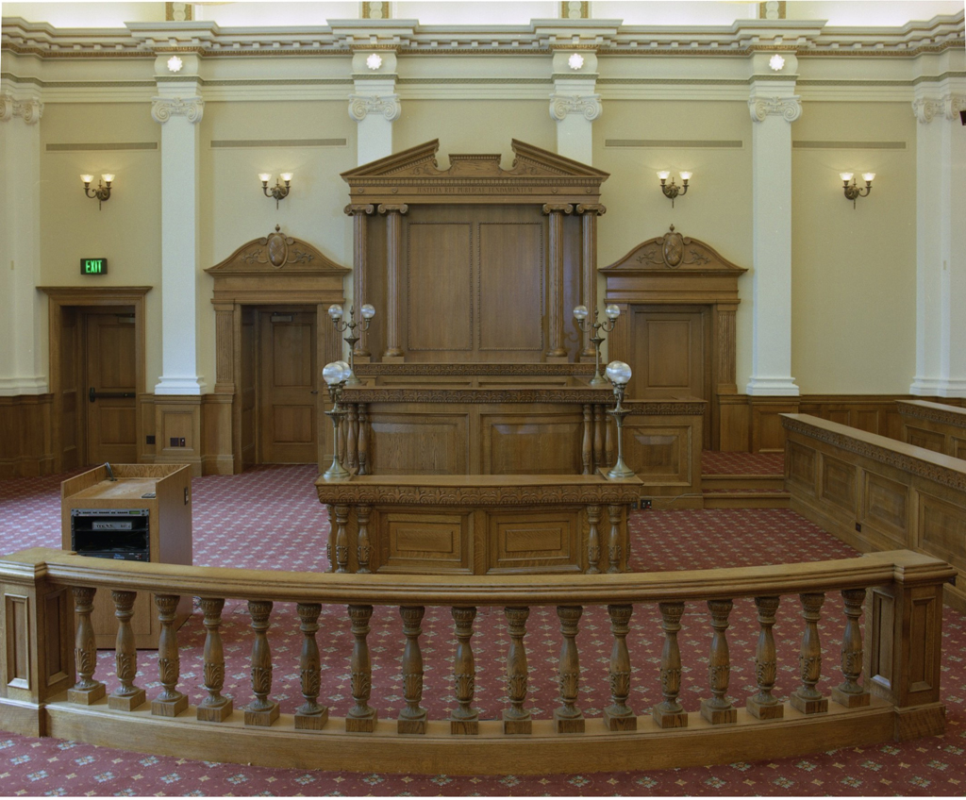
Issues from the Courts

Slide 20
Speech About Public Matters
Duke v. Hamil, 997 F. Supp. 2d 1291 (N.D. Ga. 2014)

Slide 21
Duke v. Hamil (cont’d)
Personal Facebook page, accessible only by “close friends and family”
Facebook profile did not reference his employment at the Clayton State University Police Department or his job as a assistant chief
Took down the post within an hour but before he did, someone provided an image of the post to local TV station

Slide 22
The Court’s Decision and Advice
“In addition to possible internal disruption, the public attention the speech received also implicated the Department's reputation and the public's trust.”
“Yet despite his intentions and his quick removal of it, the post became public after someone provided the image to a television station. This illustrates the very gamble individuals take in posting content on the Internet and the frequent lack of control one has over its further dissemination.”

Slide 23
CHANEY V. FAYETTE COUNTY PUBLIC SCHOOL dISTRICT U.S.D.C. NORTHERN DISTRICT OF GEORGIA
“Chaney not only voluntarily turned over the picture to her Facebook friends, but she also chose to share the picture with an additional audience of unknown size, likely comprised of people Chaney did not know, subject to continuous expansion without Chaney’s approval. … By doing so, Chaney surrendered any reasonable expectation of privacy when she posted a picture to her Facebook profile, which she chose to share with the broadest audience available to her. Thus, Chaney cannot show that society would be willing to recognize her expectation of privacy as legitimate.”

Slide 24
Social Media Lessons from the court
You are responsible for the consequences of what you post
There is no privacy on the internet

Slide 25
Day v. Floyd County BOE, Ga. Court of Appeals
“Because [the] FDA … is among the provisions of Title 20 generally waived, a charter system is not subject to the FDA unless the system’s charter so provides or unless an exception to the general waiver contained within Title 20 applies. This is the plain and unambiguous import of the statute.”
“Having accepted employment with a charter system that was not subject to the FDA, Day had no tenure or right to continued employment with that charter system; consequently, she was not entitled to any of the procedural rights afforded to tenured employees under the FDA prior to the nonrenewal of her employment contract.”

Slide 26
What will this mean
What will the Supreme Court do?
Blanket waiver for all charters and charter systems will include the FDA
SWS can request waiver of FDA
What are the options after the waiver?
Continue to use the same procedures
Modify the procedures and provide due process for terminations
What about tenure?
No contracts at all – at will employment?

Slide 27
Other Issues from Atlanta

Slide 28
Criminal Background Checks
Fingerprint checks and authorization to use the GCIC and NCIS
The Changes in O.C.G.A. §20-2-211.1 to issue clearance certificates
At will employees, volunteers and O.C.G.A. §35-3-34.2
The GBI gets into the auditing, monitoring business

Slide 29
The Role of the BOE
GBI says that LBOE is not part of the agency and has no authority to access information from the CBC
But what about 20-2-211: All personnel “shall be employed and assigned by its governing board on the recommendation of its executive officer”
GBI changes its position but still has rules

Slide 30
New Rules from the GBI
These rules only apply to fingerprint criminal background checks through the GBI that access the FBI’s national database.
Boards and superintendents can be given access to information from the background check, but every individual who will be given such access (for instance, every board member) must go through the computer training and sign off
This does not change in any way other basic requirements, such as the importance of keeping the document itself separate and confidential. Thus, it is probably not a good idea to share the document with board members as opposed to information from the document.
GBI may be sending out information to you and to its auditors

Slide 31
Applying the New Rules
Set parameters. Within the parameters that everyone agrees to, the board would know that anyone recommended had been screened against those parameters.
If applicant has information on a criminal background check that would not immediately bar him based on the parameters set, the superintendent would make the first determination as to whether to recommend this person. Obviously, if she is not going to recommend the person, the board has no need for any information.

Slide 32
Applying the New Rules
If there are issues on the background check not covered by the parameters and the superintendent chooses to recommend the individual, in an executive session the relevant information can be shared with the board. If the board votes against the recommendation, under no circumstances should the criminal background check information be made public, or the fact that it was considered be made public.
If one board member refuses to get training required, those board members would be excused only for the portion of executive session that specifically involving the criminal background check of the nominee.

Slide 33
FALL LEGAL ISSUES WORKSHOP NOVEMBER 11, 12 AND 13, 2015
CONTINUING EDUCATION CENTER
ATHENS, GA

Slide 34
Questions

