Slide 1

Facing Facts:
Separating Fact from Fiction about Public Education
Georgia School Superintendents Association
Fall Bootstrap Conference
October 14 - 15, 2015
Classic Center, Athens, Georgia
David C. Berliner
Regents’ Professor Emeritus
Mary Lou Fulton Teachers College, Arizona State University, USA

Slide 2


Slide 3
Ridicule is the only weapon which can be used against unintelligible propositions.
- Thomas Jefferson 30 July, 1816
“You are entitled, sir, to your own opinions, but not your own facts”
- Senator Daniel Patrick Moynihan, at a Senate hearing.
QUOD GRATIS ASSERITUR, GRATIS NEGATUR
(That which is alleged without proof may be dismissed without explanation.)
Facts do not cease to exist because they are ignored
-Aldous Huxley
“Educational reform is a euphemism for the destruction of public education.”
Noam Chomsky

Slide 4
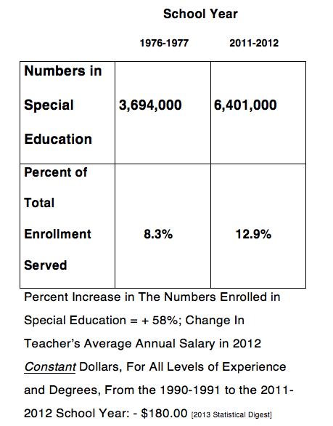

Slide 5
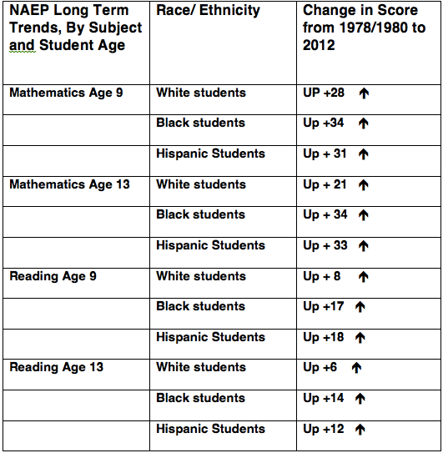

Slide 6
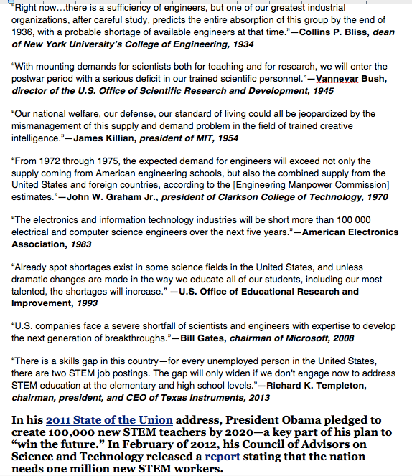

Slide 7
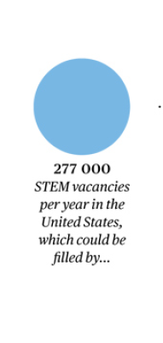

Slide 8
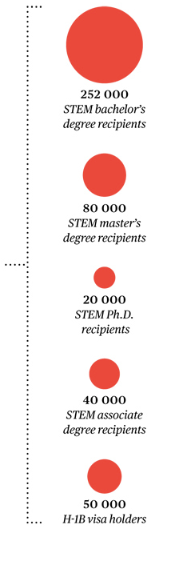
I wonder: Can anyone in our government and among our industrial leaders still add?
442,000 new stem graduates a year, for 277,000 jobs a year equals a surplus of 165,000 STEM grads a year.

Slide 9
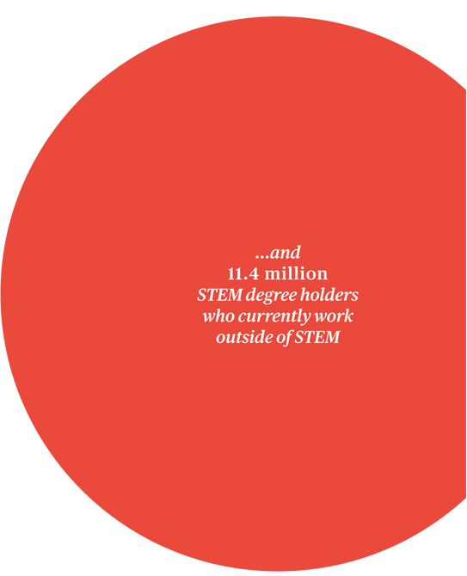

Slide 10
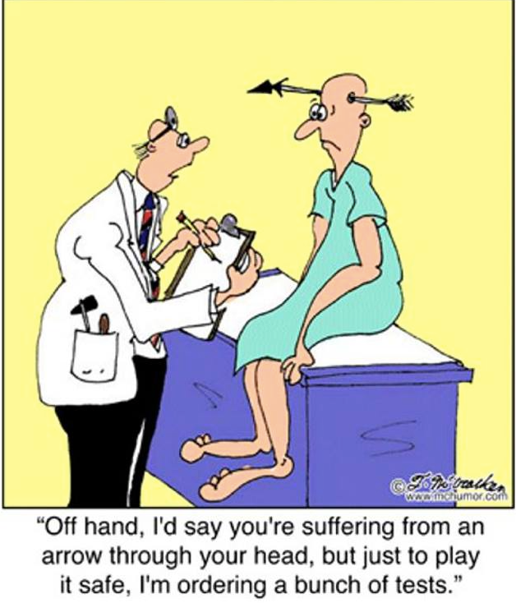
An obsession with metrics forces us to be less trusting of our observational skills and to put too much faith in metrics that appear to be “objective,” “ hard,” or “quantifiable.”

Slide 11
Will County School District 92, , Lockport, IL. continues to improve teaching and learning for
all students. We are pleased to announce that District 92 will implement a new
standards-based report card for kindergarten students.
General English Language Arts Kindergarten Expectations:
Follow words left to right, top to bottom, and page by page. Recognize how spoken words are
represented in written language. Understand that words are separated by spaces. Recognize
and name upper and lower case letters. Recognize and produce rhyming words.
Count, pronounce, blend, and segment syllables. Blend and segment onsets and rhyming words.
Isolate and pronounce the phonemes in CVC words. Demonstrate knowledge of one-to-one
letter-sound correspondence. Associate the long and short sounds with the five major vowels.
Distinguish between similarly spelled words by identifying the sounds of the letters that differ.
Read grade level high-frequency sight words with automaticity. Read emergent-reader text with
purpose and understanding.
For Reading Informational Texts:
Determine the meaning of unknown words. Determine the meaning of multiple-meaning words
and phrases. Uses sight words, letter/sounds, onset/rhymes, and connections to other words.
Chunks words. Uses context/pictures. Asks and answers questions about unknown words. Uses
multiple sources of information (visual, syntax, meaning). Remembers and uses details when
discussing text. Identifies the main idea and retells key details. Make predictions using
information from pictures/text features. Make predictions based on information gained through
reading. Describes the relationship between illustrations/pictures and the text.

Slide 12
Reading Literature: Determine the meaning of unknown words. Determine the meaning of
multiple-meaning words and phrases. Uses sight words, letter/sounds, onset/rhymes,
and connections to other words. Chunks words. Uses context/pictures. Asks and answers
questions about unknown words. Use multiple sources of information (visual, syntax,
meaning). Identify parts of a book and parts of a text. Remember and use details when
discussing text. Name and understand the role of the author and illustrator of a story.
Thinking Beyond the Text: Recognize attributes of recurring characters, Recognize common
types of text, Make connections between the illustrations and the text. Compare and contrast
characters in familiar stories. Acquire and report new information. Talk about prior
knowledge. Infer and talk about characters’ feelings, motives, and attributes.
Show evidence to support inferences.
Thinking About the Text: Notice how the writer has made the story funny or surprising.
Identify and appreciate humor. Understand that a story has a beginning, a series of events,
and an end. Discuss how writers use interesting characters. Ask and answer questions about
key details. Point out connections between text and pictures. Express opinions about the
quality of text .
It looks like this for Writing and Mathematics as well………
And In Ohio: Kindergarten students are tested 11.3 hours, on average, and grade 1 students
Are tested 11.6 hours, on average. Test preparation time = 26.3 hours
and 26. 6 hours respectively. This is more time for testing than used to be
Allocated for elementary school instruction in the visual arts before NCLB!

Slide 13
Here’s what kindergarteners in Florida are going to be subjected to this year, according to Valerie Strauss of the Washington Post:
From August 10-September 30 they will take the Florida Kindergarten Readiness Screener
(Work Sampling System and Florida Assessments for Instruction in Reading).
From March 2-April 3, they’ll take the Comprehensive English Language Learning Assessment.
From April 13-17, they’ll take the Stanford Achievement Test, Tenth Edition
for Reading and Mathematics.
From April 13-May 29 they’ll take the Florida Assessments for Instruction
in Reading Assessment Period 3 (AP3)
From May 11-June 5, they will take the District-Designated End-of-Course Assessment
And, just in case they haven’t had enough by that point, Florida kindergarteners also have the option of taking these two tests:
1. To see if they are “gifted:” ”The Iowa Tests (Iowa Tests of Basic Skills and Iowa Tests of Educational Development), either the English or English Language Learners (ELL) version.
2. To decide about placement for English to Speakers of Other Languages (ESOL):
Miami-Dade County Oral Language Proficiency Scale Revised

Slide 14


Slide 15
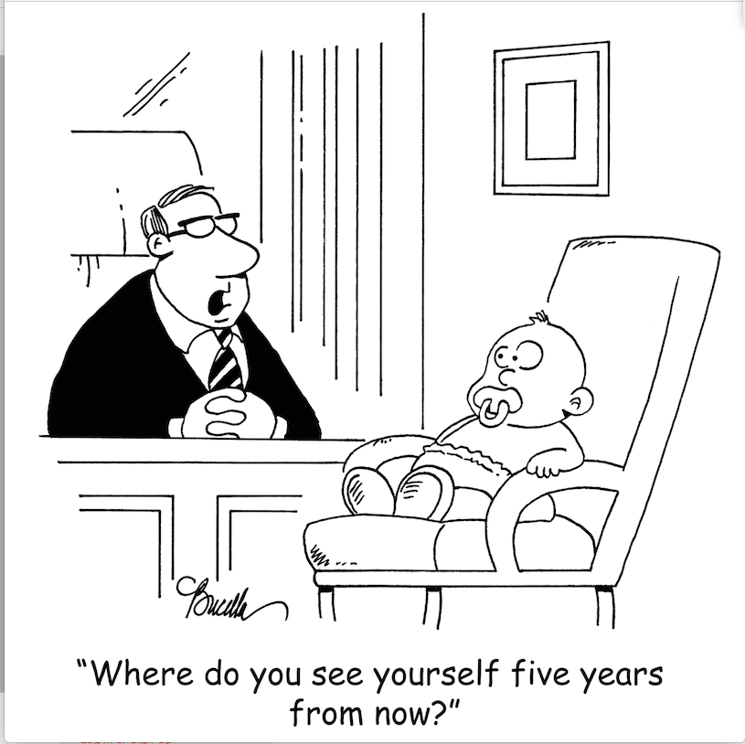

Slide 16


Slide 17
In 2014 the World Global Entrepreneurship and
Development Index (The GEDI) was released.
120 countries were assessed and ranked by researchers associated with the Imperial
College Business School, the London School of Economics and Political Science,
University of Pécs, and George Mason University.
The number 1 country in the world was: Ta Da!..............................................The USA!
The authors say: “Entrepreneurship plays a crucial role in the US economy and as result,
policy initiatives are created to encourage entrepreneurial behavior. This, coupled with
the culture of determination and motivation, makes the US a great place to be an entrepreneur.
[Moreover,] the gulf between the United States and other countries is large
and appears to be widening,…. not narrowing.”
Furthermore, “this year's Index compared the experience of male and female entrepreneurs
for the first time, to reflect the increasing participation and importance of women in
entrepreneurship around the world.
The researchers determined that the US is………….Ta Da! The worlds leader in female entrepreneurship.”
Source: http://www.thegedi.org/research/gedi-index/

Slide 18
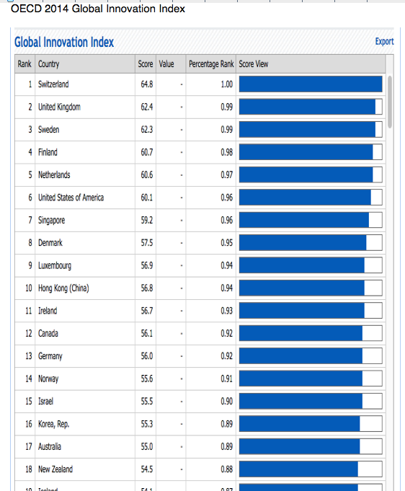
Number
Six➔

Slide 19
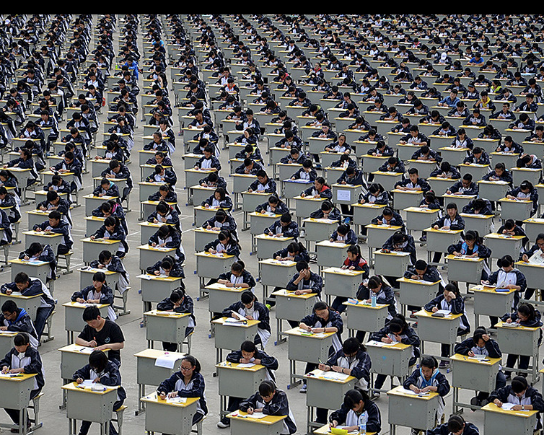

Slide 20
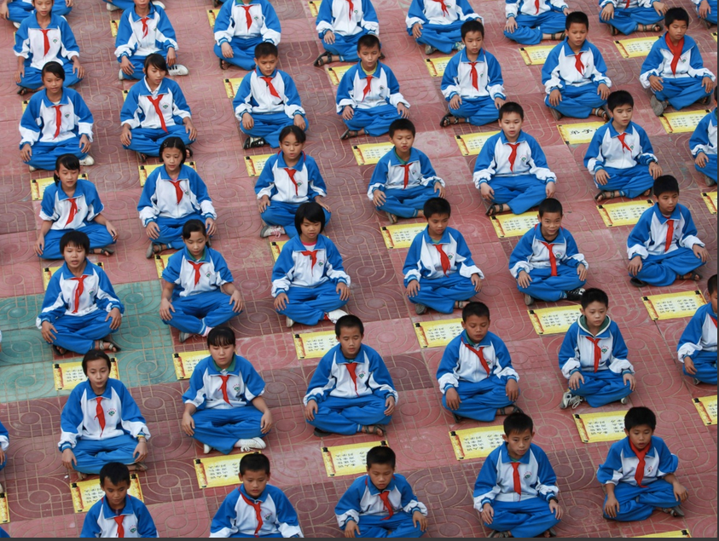
Pupils recite Di Zi Gui, which translates as 'standards for being a good student and child', in the playground of Jiale Centre primary school in Hainan province, China.

Slide 21
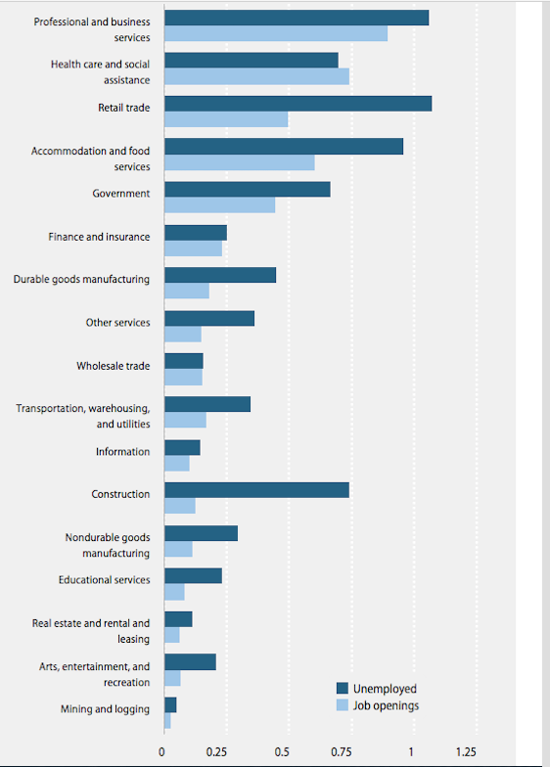
Number of jobs
available, 2014,
and
number
unemployed in
that sector:
Economic Policy
Institute.

Slide 22
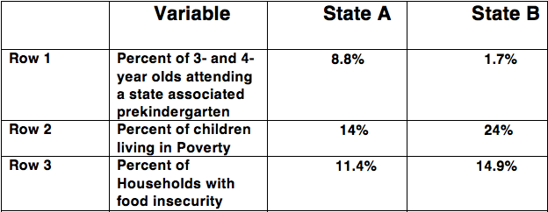

Slide 23
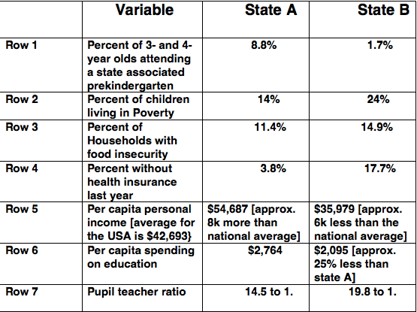

Slide 24
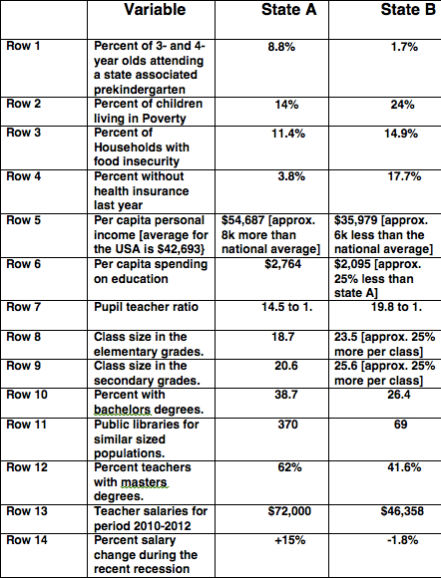

Slide 25
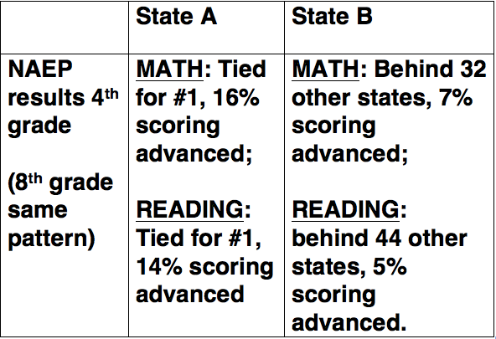
RESULTS

Slide 26
2012 PISA Results
Mean/Average Scores
No examination of variation
Reading
Singapore Japan Korea Finland Canada Ireland Poland Estonia Lichtenstein Australia Etc.
US is #21
Mathematics Singapore Korea Japan Lichtenstein Switzerland Netherlands Estonia Finland Canada Poland Etc.
US is # 32
Science
Singapore Japan Finland Estonia
Korea
Vietnam
Poland Canada Lichtenstein Germany Etc.
US is #23

Slide 27

15 year-old students in public schools with half or more of students eligible for free or reduced-price lunch had lower average MATHEMATICS literacy scores than both the U.S. and OECD averages—These are the bottom 2 bars. But look again at the top two bars and even the third bar. Same trend as in 2009
1000
Score
* Significantly different from U.S. average
**Significantly different from OECD average
Note: The National School Lunch Program provides free or reduced-price lunch for students meeting certain income guidelines. The percentage of students receiving such lunch is an indicator of the socioeconomic level of families served by the school. Estimates of the percentage of students eligible for free or reduced-price lunch are based on principals’ reports.
Notes:
Shanghai-China 613
Singapore 573
Hong Kong-China 561
Chinese Taipei 560
Korea, Republic of 554
BUT EVEN IN MATH—OUR WEAKEST SUBJECT, THOSE KIDS IN SCHOOLS WHERE POVERTY RARELY IS SEE—THE FIRST BAR IN THIS GRAPH-- THESE KIDS PLACED 6th in world-- higher than Japan.
THE NEXT GROUP—WITH UNDER 25% OF THE KIDS WERE IN POVERTY-- WERE 17th in world, well above most of the countries in OECD.
And Massachusetts kids tied with Germany.

Slide 28
15-year-old students in public schools in which half or more of students were eligible for free or reduced-price lunch had lower average SCIENCE literacy scores than both U.S. and OECD averages
OECD average
U.S. average
1000
Score
* Significantly different from U.S. average
**Significantly different from OECD average
Note: The National School Lunch Program provides free or reduced-price lunch for students meeting certain income guidelines. The percentage of students receiving such lunch is an indicator of the socioeconomic level of families served by the school. Estimates of the percentage of students eligible for free or reduced-price lunch are based on principals’ reports.
Notes:
THE first bar in this graph dealing with PISA science scores shows that kids in schools with under 10% of their classmates in poverty WERE beaten by only one country—shanghai—which is not a country at all, and won’t test around 200 thousand kids of immigrants. AND IT IS THE ONE CITY IN CHINA WITH THE HIGHEST % OF COLLEGE GRADUATES. Like testing in siliconvalley, without the hispanics.
The second group, where under —under 25%of the kids in a school are in poverty—tied for 8th in the world in science.

Slide 29
Students in public schools in which half or more of students were eligible for free or reduced-price lunch had lower average READING LITERACY scores than both the U.S. and OECD averages
1000
Score
* Significantly different from U.S. average
**Significantly different from OECD average
Note: The National School Lunch Program provides free or reduced-price lunch for students meeting certain income guidelines. The percentage of students receiving such lunch is an indicator of the socioeconomic level of families served by the school. Estimates of the percentage of students eligible for free or reduced-price lunch are based on principals’ reports.
Notes:
As PIRLS taught us, reading is an area of US strength, and we see that again in PISA.
For US kids in schools with under 10% of the students in poverty, they were 2nd in the world
In the group where under 25%of the kids were in poverty their place was 6th in the world—tied with Finland. So 15 million kids did great ,
But if we add the third bar here, the one showing kids in schools with less than 50% of the kids in poverty, they came in 10th. Meaning that soemhwere about half of all US kids are doing pretty damn good.
It’s the other half of our school population—those in schools where over 50% of the kids are in poverty that are doing poorly.
And our mots progressive states did well—Massachusetts placed 6th in the world, and conecticutt placed 10th in world. Our problem is states that are high in poverty like Alabama and Missisipi.

Slide 30
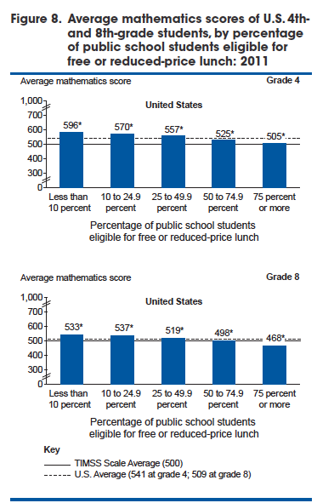
TIMSS 4TH
GRADE SCORES BY SCHOOL POVERTY LEVEL:
MATH
TIMSS 8TH
GRADE SCORES BY SCHOOL POVERTY LEVEL:
MATH

Slide 31
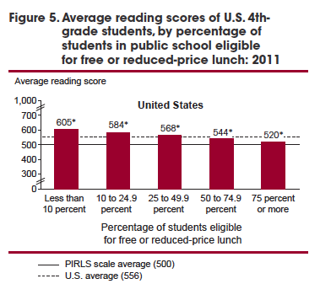
PIRLS
READING AT
4TH GRADE:
USA DID FINE
OVERALL BUT
SAME PATTERN

Slide 32
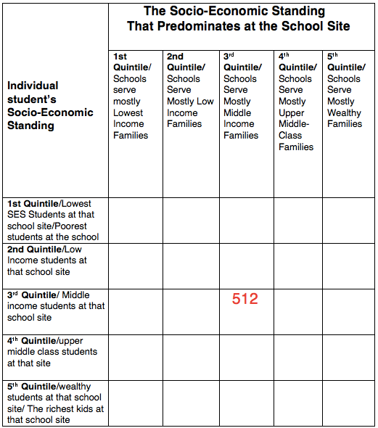

Slide 33
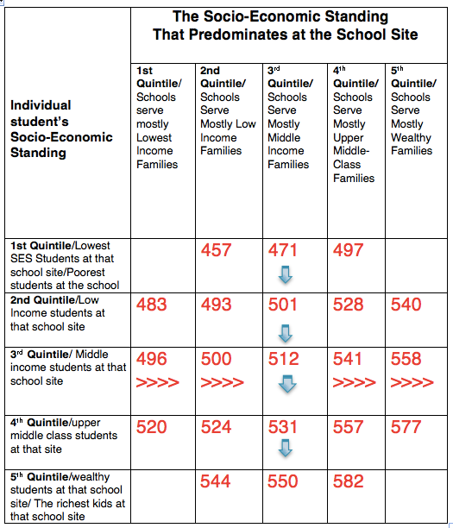

Slide 34
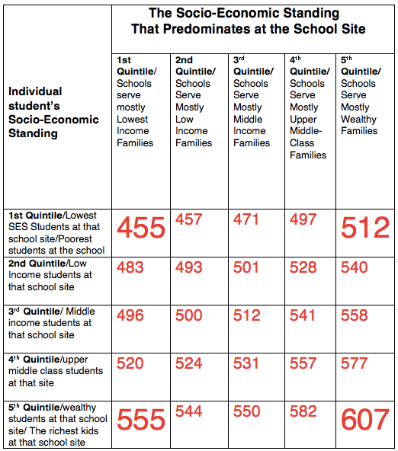

Slide 35
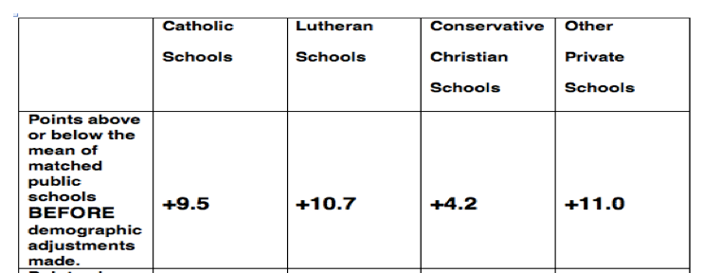

Slide 36
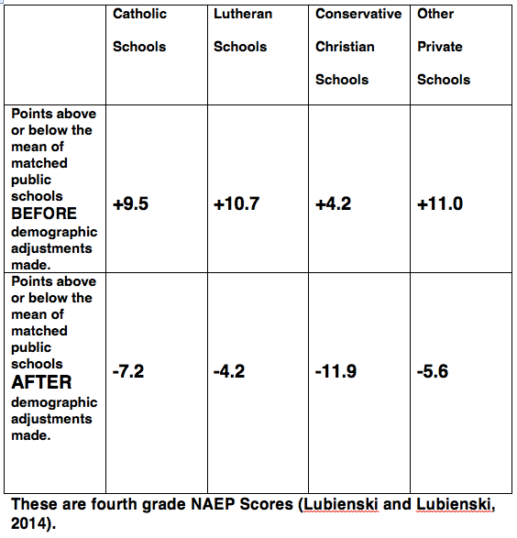

Slide 37
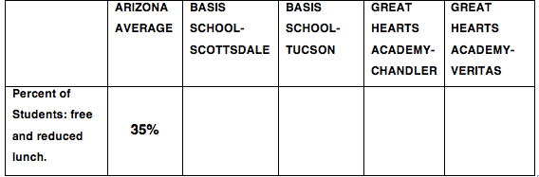
Four of the best high schools in the USA,
according to US News and World Report

Slide 38
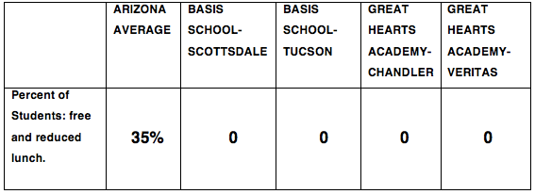
Four of the best high schools in the USA,
according to US News and World Report

Slide 39
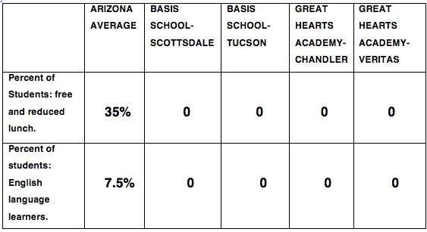
Four of the best high schools in the USA
according to US News and World Report

Slide 40
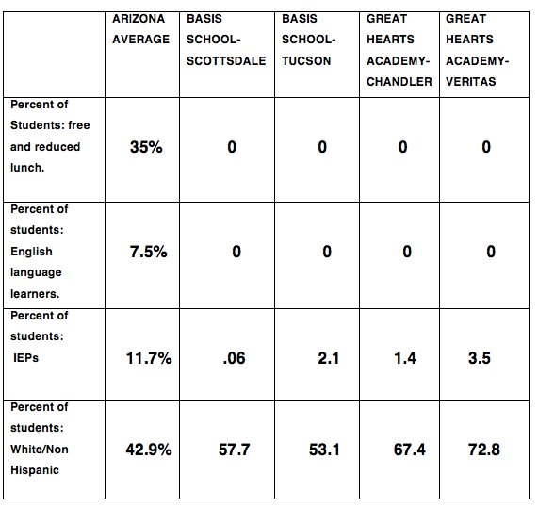
Looks a lot like skimming and creaming going on to me!!!!!
These schools simply will not take all who apply or they kick out those that they don’t want to educate or are unable to educate.

Slide 41
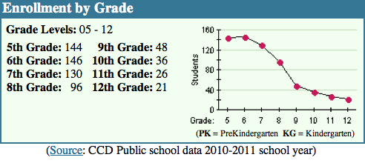
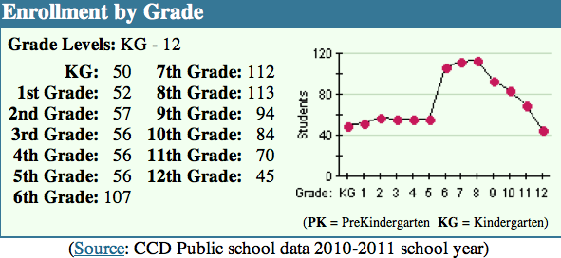
Basis school-Scottsdale: 146 to 21
Great Hearts-Chandler: 113 to 45

Slide 42


Slide 43
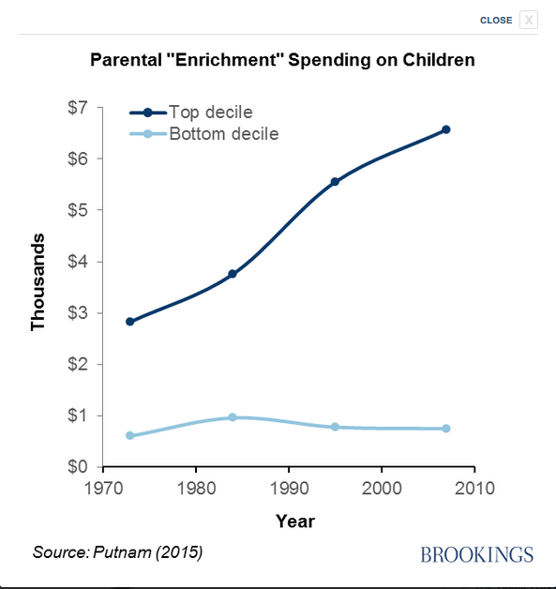

Slide 44
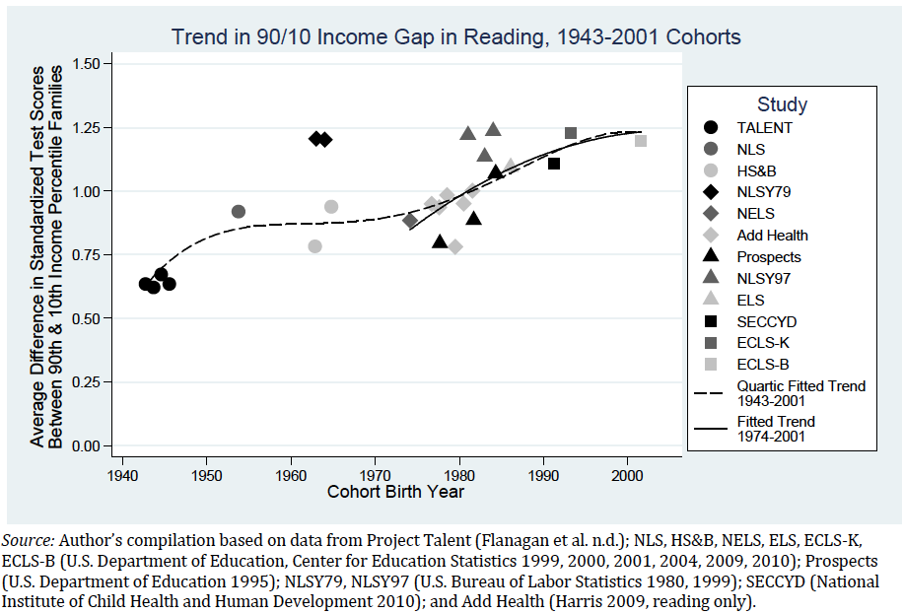
Notes:
This is a plot of the gaps in school achievement scores in reading from 1943 to the present. Kids whose family income was at the 90th percentile had over a half standard deviation higher score than kids at the 10th percentile in family income. Not surprising. EXPLAIN OVERLAP
But look at the trend line: By the mid 2000’s the gap in reading achievement associated with income differences had changed dramatically. Kids in 90th percentile families now exceed kids in 10th percentile families by 1.25 standard deviations—a huge difference. The great land of opportunity was closing down from the 1970s on, greed was good, —the rich got richer and better educated than ever before, perpetuating the advantages they already enjoyed. The math data shows the same trends. The children of the wealthy separated from the children of the poor in terms of educational level and quality of education at rates that are quite remarkable and they have that advantage right now when the country only seems to have good jobs for the better educated.
Quote Riordan
"The income-achievement gap is now more than twice as large as the black-white achievement gap. Fifty years ago, in contrast, the black-white gap was twice as large as the income gap. . . .At the same time that family income has become more predictive of children's academic achievement, so have educational attainment and cognitive skills become more predictive of adults' earnings. The combination of these trends creates a feedback mechanism that may decrease intergenerational mobility. As the children of the rich do better in school, and those who do better in school are more likely to become rich, we risk producing an even more unequal and economically polarized society."

Slide 45
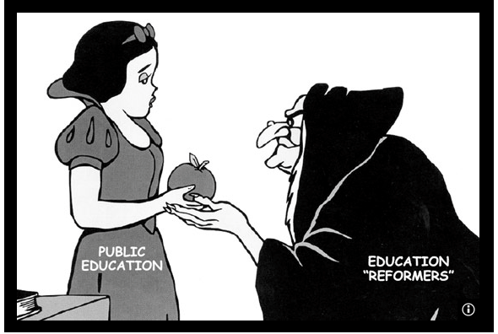

Slide 46


Slide 47
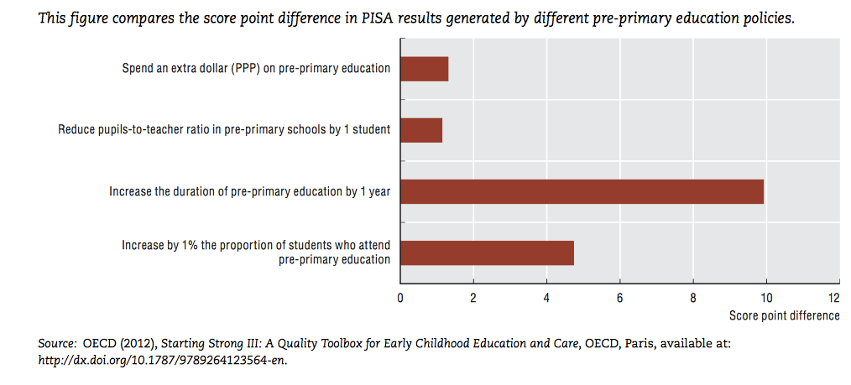

Slide 48
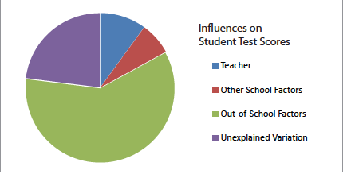
Teachers account for about 10%
Schools account for about 10%
Out of school factors account for about 60%
Vs.

Slide 49
OUTSIDE-OF-SCHOOL FACTORS AFFECTING WHAT OCCURS INSIDE-THE-SCHOOL AND INSIDE-THE-CLASSROOM.
Percent of low birth-weight children in the neighborhood.
Inadequate medical, dental and vision care in family and neighborhood.
Food insecurity in family.
Environmental pollutants in home and neighborhood.
Family relations and family stress.
Percent of mothers at the school site that are single and/or teens.
Percent of mothers at the school site that do not possess a high school degree.
Language spoken at home.
Family income.
Neighborhood characteristics [including sense of collective efficacy]
Rate of violence in the neighborhood.
Drug use in the neighborhood.
Mental health in the neighborhood.
Average income in neighborhood.
Mobility rates of families in the neighborhood.
Availability of positive Role models in the community.
Availability of high quality early education.
Transportation to get to jobs.
Etc.
Notes:
If you don’t include these in the VAM equations, the equations cannot predict.
Exogneous

Slide 50
INSIDE THE SCHOOL FACTORS AFFECTING WHAT OCCURS INSIDE THE CLASSROOM
Class size.
Quality of the principal and other administrators.
Collective efficacy of the faculty.
Teacher turnover or school churn rates.
Quality of the school facilities.
Quality and Frequency of Professional Development Opportunities.
Curriculum.
Availability of counseling and special education services.
Availability of librarians and school nurses.
Integration of music, art, and sports programs.
Provision of after school programs.
School finances from state and district funds.
School funding from parents and community.
Parent involvement.
Notes:
This is why Vergara is a farce. These are all variables with 3 or 6 times the power to affect the aggregaete scores.
Agg vs individual
It happees, but not usually
Exceptions no good. Smoking

Slide 51
U.S. Asian and White students had higher average scores than both the U.S. and OECD averages in mathematics literacy
OECD average
Score
* Significantly different from U.S. average
**Significantly different from OECD average
Notes:
Culture impt: American Asians above japan and probably statistically tied with Korea.. They beat all other Americans handily.

Slide 52
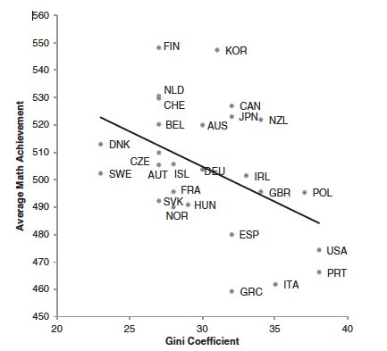
Relationship between a nations inequality in income (Gini Coefficient, high being more unequal) and Average PISA (2006) mathematics score just among the wealthy nations (Condron, 2011). Relationships for science and reading scores are similar.
Notes:
Here you see that, at the level of nations, national inequality predicts average PISA scores quite well.
But this analysis by Condron tells us something else---We can estimate that if the USA put into place policies that gave us the same level of inequality as Finland, the US average score would likely be 509, not around 475.
And if Finland were to become as unequal in income as the US, its score would be about 487, and they would no longer be the the worlds leader at 548.........
If you believe that there is some causal relationship between poverty and income inequality on the one hand, and the performance of a nation’s schools on the other hand, then a nations social and taxation policies are expected to have a huge impact on school performance. I believe that these relationships are, indeed, causal...... The President of the United States of America and his Secretary of Education, the Republican and Democratic leadership, are all looking at school policies related to testing, curriculum and teacher quality, while it is the social policies about income and taxes that need to be changed. Here are two other graphs to make this point quite vividly, I hope.
NEXT
Relationship between a nations inequality in income (Gini Coefficient, high being more unequal) and Average PISA (2006) mathematics score just among the wealthy nations (Condron, 2011). Relationships for science and reading scores are similar.

Slide 53
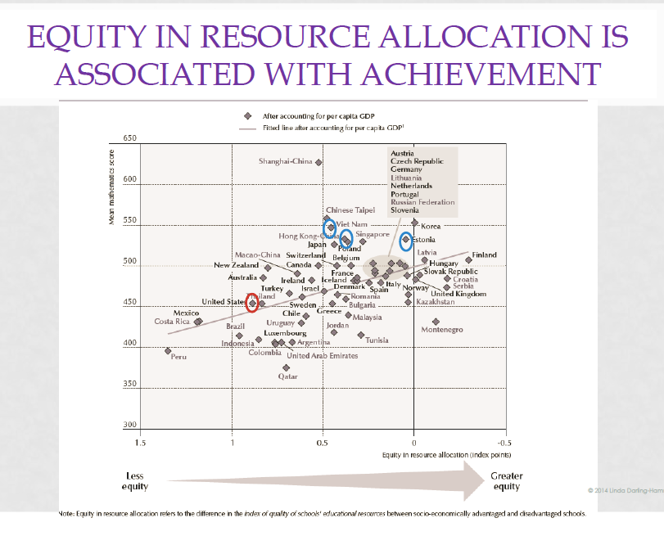

Slide 54
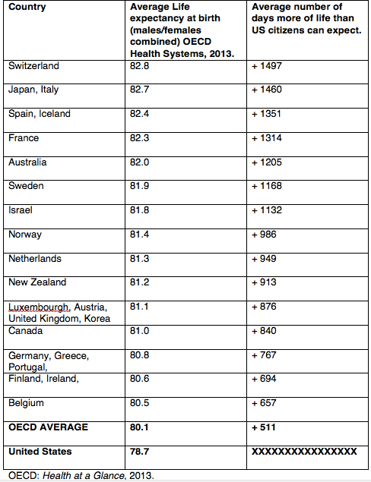

Slide 55
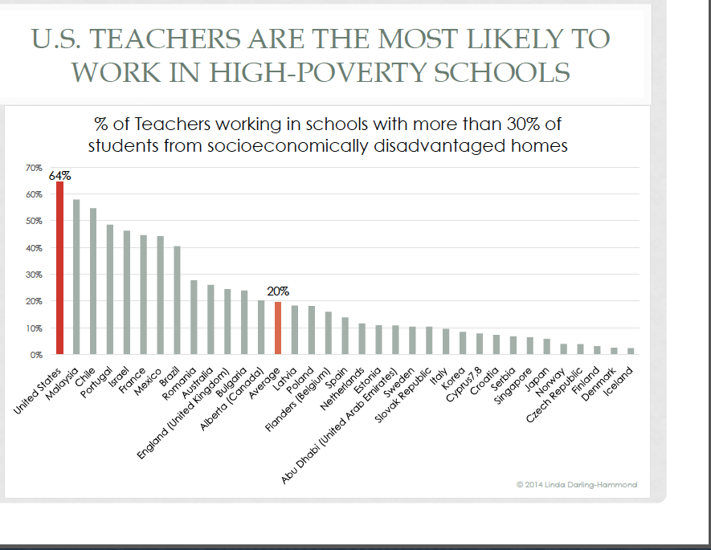

Slide 56
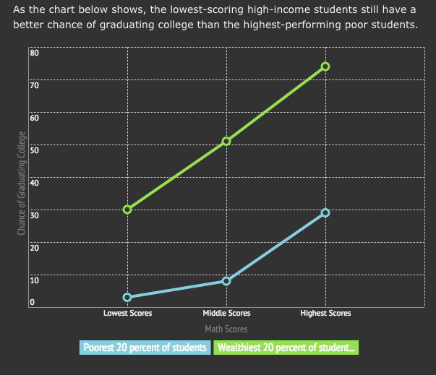

Slide 57
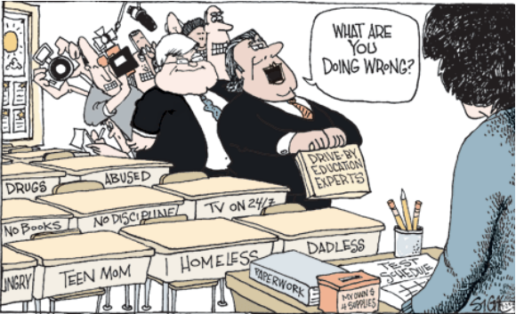

Slide 58
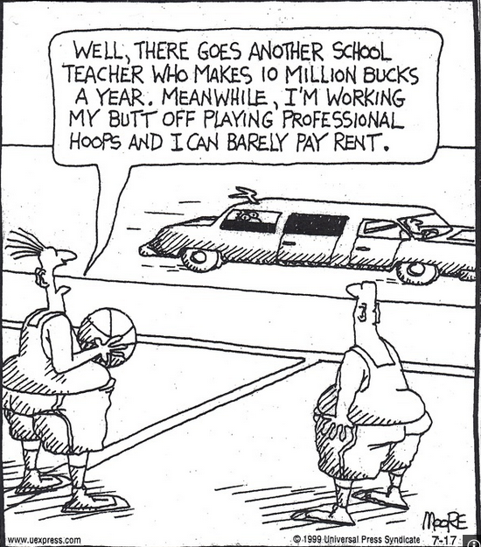

Slide 59
