Slide 1
Assessment & Accountability Update
Melissa Fincher, Ph.D.
Deputy Superintendent for Assessment & Accountability

Slide 2
Georgia Milestones
Online Testing 2014-2015 by the Numbers….
Online Administrations
  Spring EOG: ~233,000 (30%)
  Winter EOC: ~129,000 (73%)
  Spring EOC: ~557,000 (71%)
Grand Total 2014-2015 School Year
  Online Administrations: 919,636
  Paper-Pencil Administrations: 819,078
  Grand Total: 1,738,714
  Overall % Online: 53%

Slide 3
Feedback Surveys
Survey Participation
  EOG Online Students: 83,557 192 districts
  EOC Online Students: 13,007 199 districts
  EOG/EOC Teachers: 16,446 175 districts

Slide 4
Spring 2015
Online interruptions and delays, particularly – but not exclusively – for students using screen reader application
So what is being done to address this?
To investigate the impact of these delays, a forensic analysis is being completed by an independent third party.
A mode comparability study is also being conducted to ensure students were not advantaged or disadvantaged by the mode of administration (online/paper-pencil).

Slide 5
Achievement Levels
Beginning Learners do not yet demonstrate proficiency in the knowledge and skills necessary at this grade level/course of learning, as specified in Georgia’s content standards. The students need substantial academic support to be prepared for the next grade level or course and to be on track for college and career readiness.
Developing Learners demonstrate partial proficiency in the knowledge and skills necessary at this grade level/course of learning, as specified by in Georgia’s content standards. The students need additional academic support to ensure success in the next grade level or course and to be on track for college and career readiness.
Proficient Learners demonstrate proficiency in the knowledge and skills necessary at this grade level/course of learning, as specified in Georgia’s content standards. The students are prepared for the next grade level or course and are on track for college and career readiness.
Distinguished Learners demonstrate advanced proficiency in the knowledge and skills necessary at this grade level/course of learning, as specified in Georgia’s content standards. The students are well prepared for the next grade level or course and are well prepared for college and career readiness.

Slide 6
Norm-Referenced Scores
Supplemental Information:
National Percentile Rank (NPR)
  NPR Range (based on SEM)
Norm Curve Equivalencies (NCE)
  Provided on summary reports only
Remember:
  A sample of norm-referenced items were administered, not an intact form.
  Norm-referenced Testing (NRT) data should be utilized as an indicator or barometer of student performance relative to their peers nationally.
  NPRs from Georgia Milestones may not be used for gifted program identification.

Slide 7
CCRPI Update
At its September meeting, the SBOE approved revisions to the indicators and calculations for the 2015 and 2016 CCRPI given the implementation of Georgia Milestones.
These revisions were designed to give schools credit for the progress they are making towards the increased expectations for student achievement.
The Summary of Changes as well as the 2015 and 2016 Indicators can be found on the Accountability Webpage – second, third, and fourth links under Resources.
http://www.gadoe.org/Curriculum-Instruction-and-Assessment/Accountability/Pages/default.aspx

Slide 8
CCRPI Update
The two most significant changes were made to Content Mastery and the CCRPI Component Weights.
Content Mastery
Students achieving the Developing Learners level will earn 0.5 (one-half) point.
Students achieving the Proficient Learners level will earn 1.0 (one) point.
Students achieving the Distinguished Learners level will earn 1.5 (one and one-half) points.
CCRPI Component Weights
Increasing the contribution of Progress recognizes the work districts and schools are making toward the increased expectations for student achievement. Remember, growth is independent of proficiency classifications.
Previous Weights:
Achievement | 60%
Content Mastery | 40%
Post Readiness | 30%
Graduation Rate | 30%
Progress | 25%
Achievement Gap | 15%
New Weights:
Achievement | 50%
Content Mastery | 40%
Post Readiness | 30%
Graduation Rate | 30%
Progress | 40%
Achievement Gap | 10%

Slide 9
CCRPI Update
Other changes include:
Giving credit for both Proficient Learner and Distinguished Learner in the Post High School Readiness and Predictor for High School Graduation areas.
Benchmarking at the 95th percentile the following:
  Attendance
  Progress
Removing the redundant indicator for fifth and eighth grade students passing four courses in core content areas and scoring Exceeds.

Slide 10
CCRPI Update
In the works…..
Improve communications
  District Accountability Point of Contact
  Additional informational webinars
    Prior to applications opening
    Understanding data calculations and uses
    Best practices – which indicators yield highest returns
    Identification and exit criteria for Priority and Focus Schools
    Informal Q and A’s
Publish annual CCRPI calendar
  Key dates for application opening and closing
  Dates for releases to MyGaDOE portal and public
  Priority and Focus School exit calculations and status

Slide 11
Curriculum and Instruction
Update
October 15, 2015

Slide 12
Science and Social Studies
Revision Process

Slide 13
Educator Survey
Open April 16 - June 15, 2015
Total respondents: 18,268
  9,237 science
  9,031 social studies

Slide 14
Educator Survey
Quantitative feedback:
  content, wording, or sequence of standards & elements
  professional learning preferences
Qualitative feedback: recommendations

Slide 15
Stakeholder Survey
Open August 10 - September 15, 2015
Total respondents: 2,013
1,044 (51.9%) included comments
Separate surveys for each grade level or course for each content area
Most respondents were Georgia educators, parents, and students

Slide 16
Science and Social Studies
Projected Timeline
October 2015:
Working Committees use survey analysis to guide revision
November 2015:
  Advisory Committees review recommendations of Working Committees
  Academic Review Committees review recommendations of Advisory Committees
January 2016: Draft revisions submitted to SBOE for approval to post for 60 days for public review/comment
April 2016: Draft standards submitted to SBOE for review and consideration for approval

Slide 17
Science and Social Studies
Projected Timeline
April 2016: Pending SBOE approval, initial communication and resource development
May - December 2016: Initial professional learning; Current resources revised and new resources developed to tag for SLDS
January - May 2017: Professional learning; New resources developed, tagged, and loaded into the SLDS; Field Test of assessment items
June - July 2017: Data review of Field Test items
2017-2018 School Year: First year of Implementation of Georgia Standards of Excellence for Science and Social Studies

Slide 18
Working Committees
Science: (11 Committees)
K-3 grades
3-5 grades
6th grade – Earth Science
7th grade - Life Science
8th grade - Physical Science
Biology
Chemistry
Earth Systems
Environmental Science
Physical Science
Physics

Slide 19
Working Committees
Social Studies: 10 Committees
K-3 grades
4-5 grades
6th grade - Latin America, Caribbean, Canada, Europe, Australia and
7th grade - Africa, Southwest Asia (Middle East), Southern and Eastern Asia
8th grade – Georgia Studies
American Government and Civics
Economics
Psychology and Sociology
United States History
World Geography
World History

Slide 20
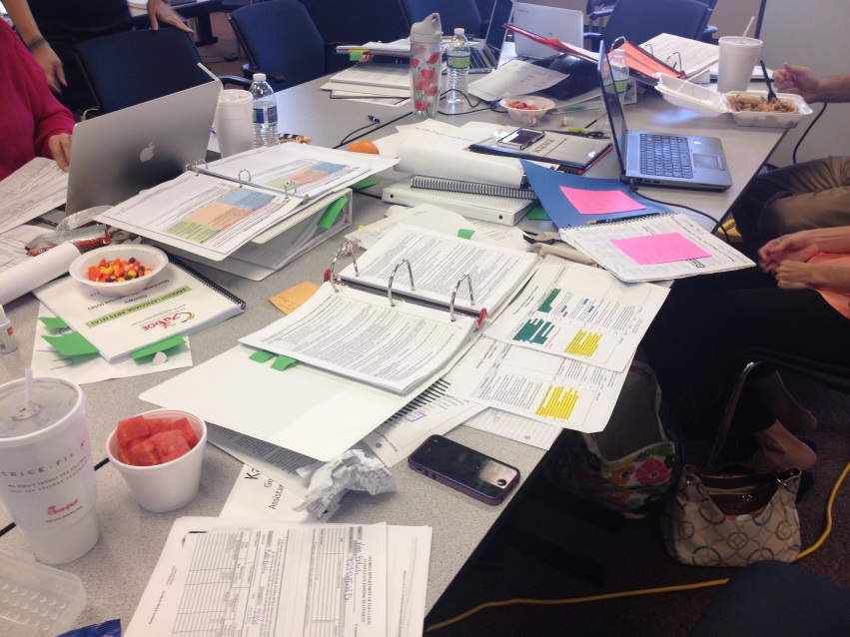
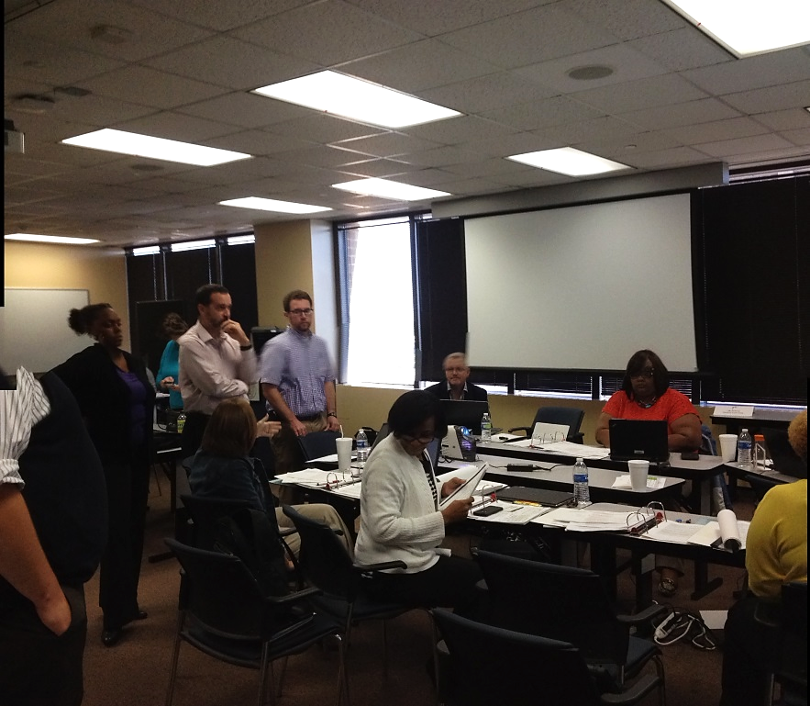
Teachers at Work

Slide 21
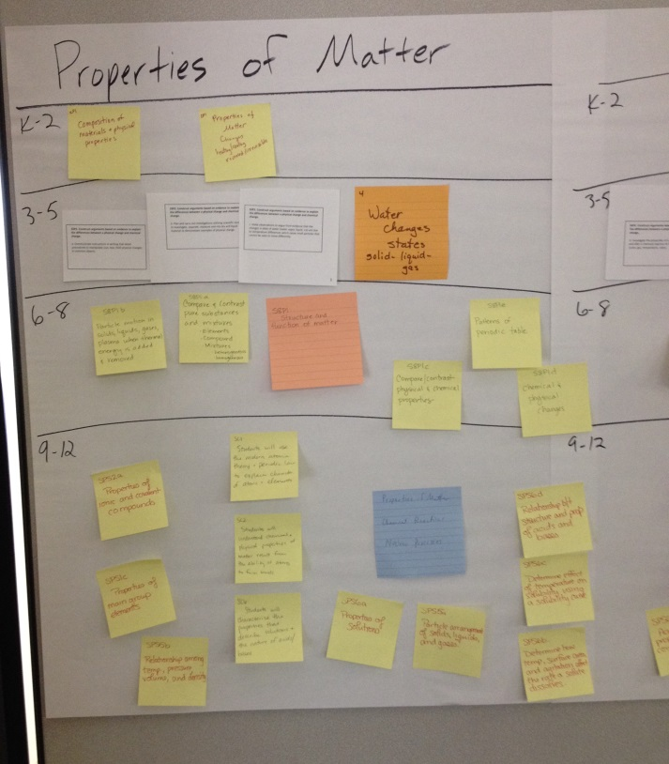
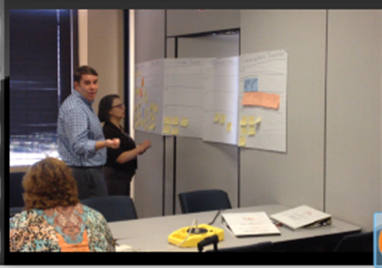
Teachers at Work
Notes:
Teachers created concept maps towards the end of the process to visualize how different core ideas grew in complexity from Kindergarten to high school and where we could have gaps.

Slide 22
Rationales
  Any modification or deletion of standards or elements must be justified by
    A significant amount of feedback from stakeholder comments
    Agreed to by a consensus of the committee.
  Rationale must be included for each modification

Slide 23
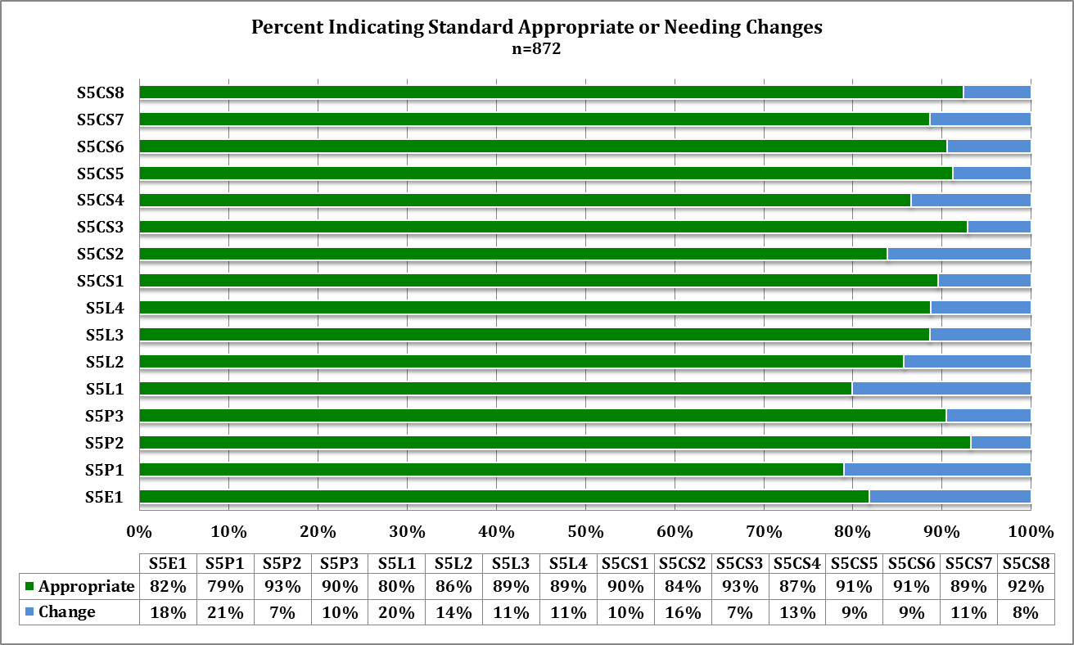
Science: Ranges of Percent Appropriate Ratings for Standards
Notes:
Percent recommending changes in content, wording, or sequence

Slide 24
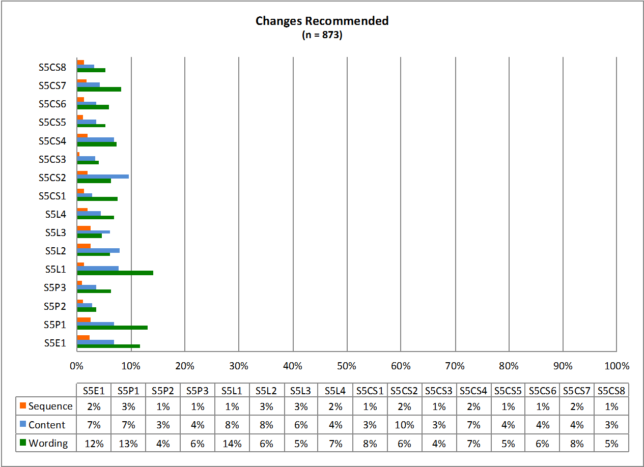
Science: Areas recommended for Change

Slide 25
Survey Question:
Areas Recommended for Change: Sequence, Content, Wording
(Check all that apply.)

Slide 26
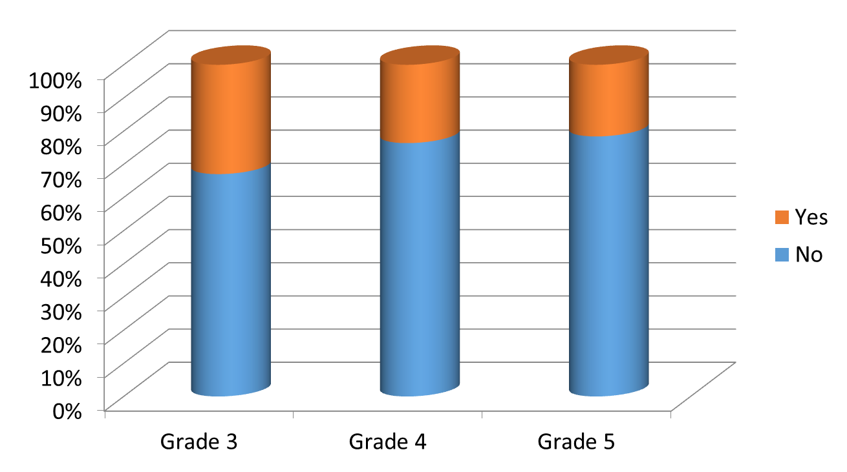
Social Studies: Do you have enough time to teach the standards and elements?

Slide 27
Social Studies (SS): Ranges of Percent Appropriate Ratings for Standards

Slide 28
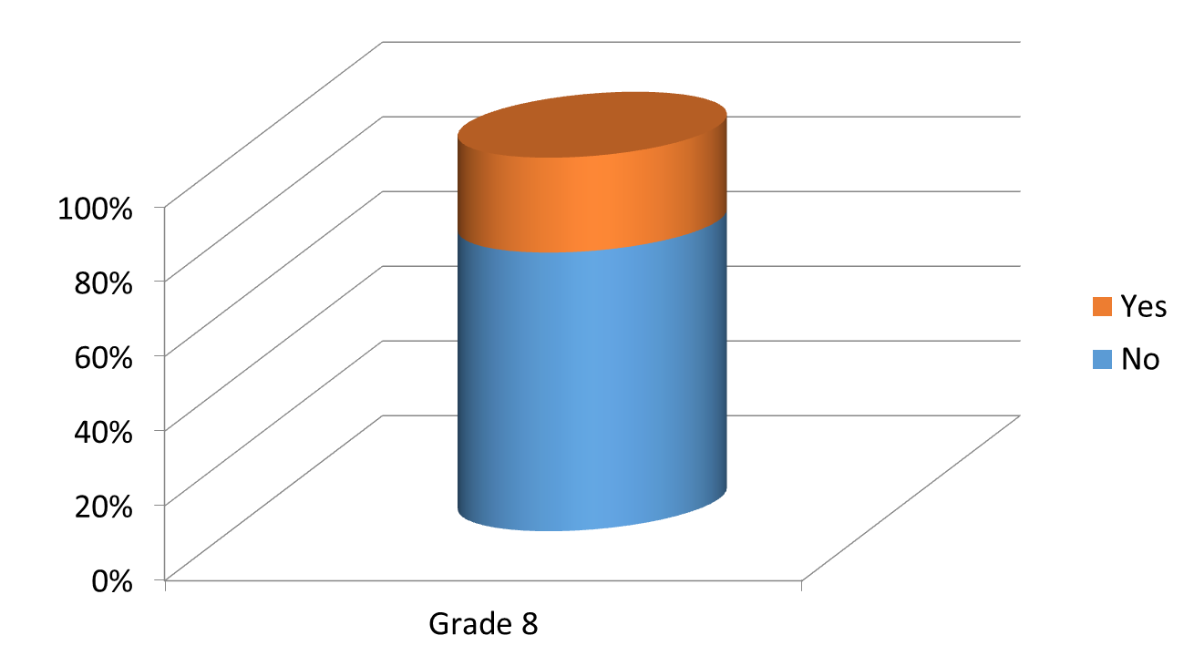
Social Studies: Do you have enough time to teach the standards and elements?

Slide 29
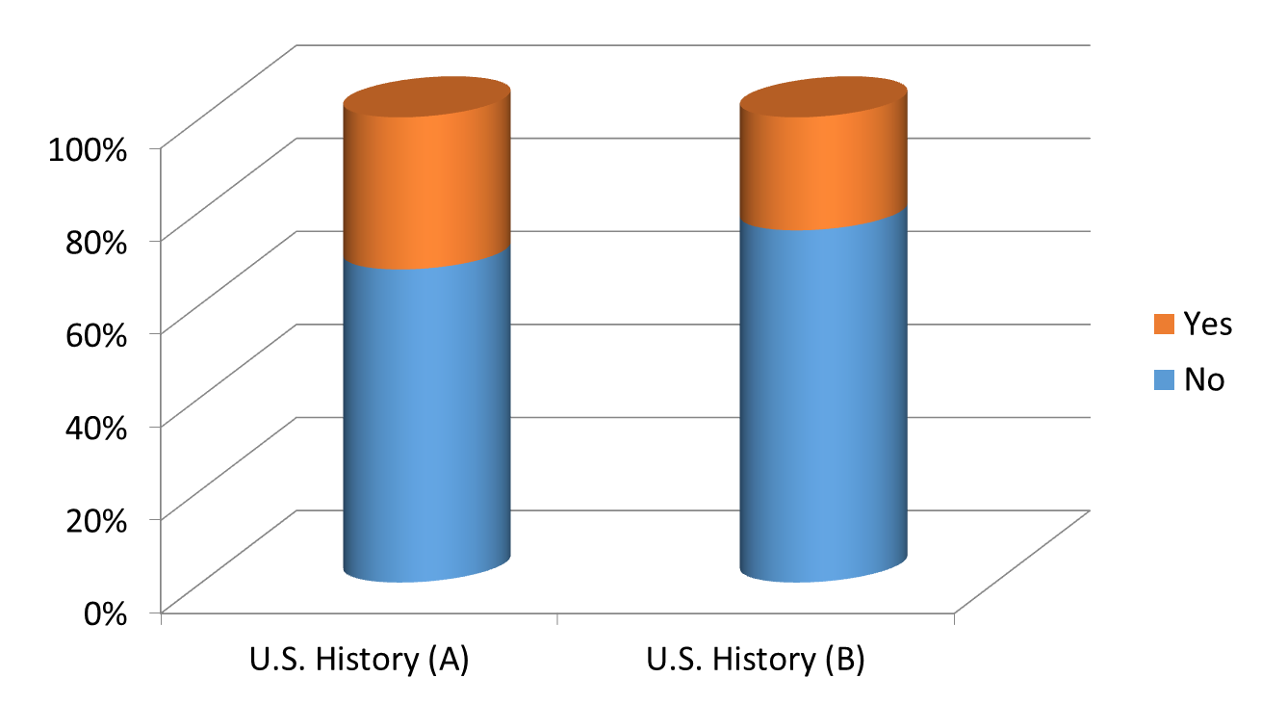
Social Studies:
A. Do you have enough time to teach the standards and elements?
B. Do you have enough time to integrate literacy, have classroom discussions, etc.?

Slide 30
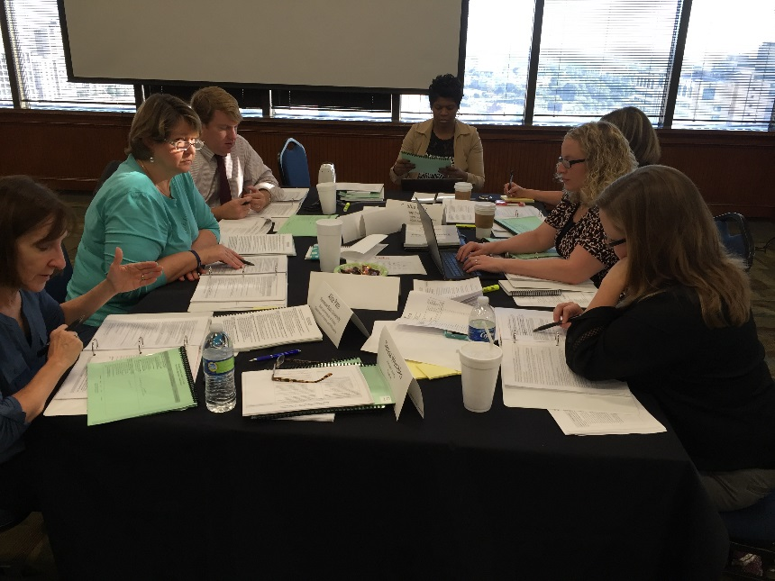
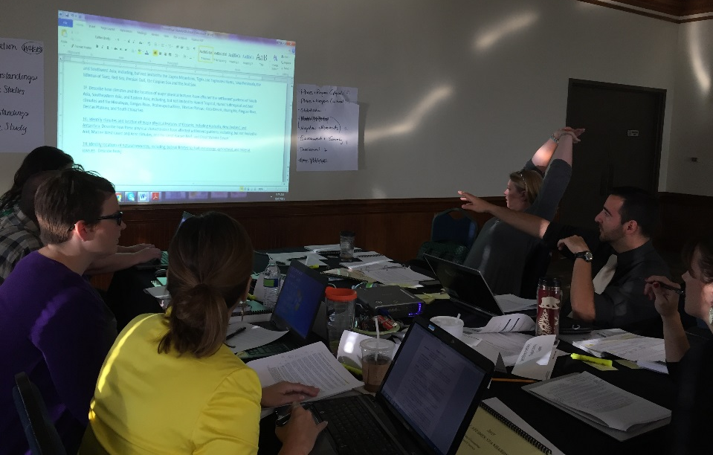
Teachers at Work
Notes:
Teachers were divided into 10 groups between 2 rooms. This setup allowed each group to have an adequate amount of working space and privacy.

Slide 31
Social Studies Committee Work
Vertical alignment meetings arranged between committees
Integrated map & globe skills, information processing skills, literacy skills, and conceptual teaching
Legal Requirements: e.g., GA Pledge (8th grade) and Pledge of Allegiance (Amer Govt) (SB 518)
Notes:
Example- if 3rd grade decides the branches AND the levels of government are too difficult for 3rd graders, we cannot just delete and not teach that information. It has to be included at another grade level.

Slide 32
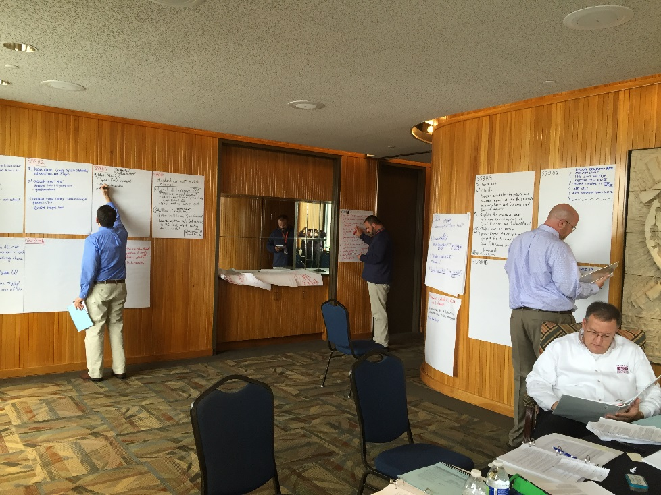
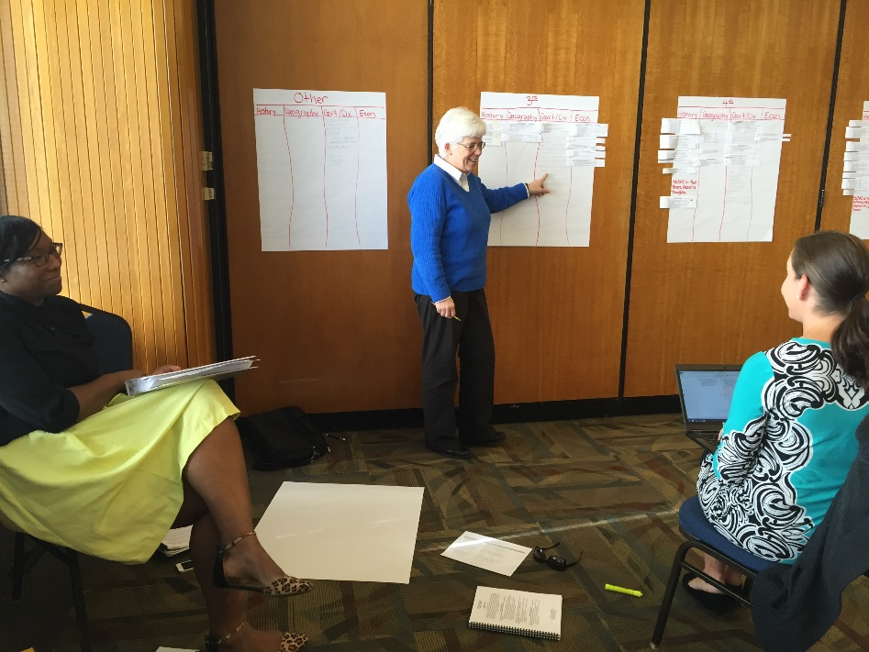
Teachers at Work
Several Groups created Visual Aids and Concept Maps to keep track of changes, and to reference data from the resource booklets.
Pictured above is 8th Grade and 3rd-5th Grade Pictured on the right

Slide 33
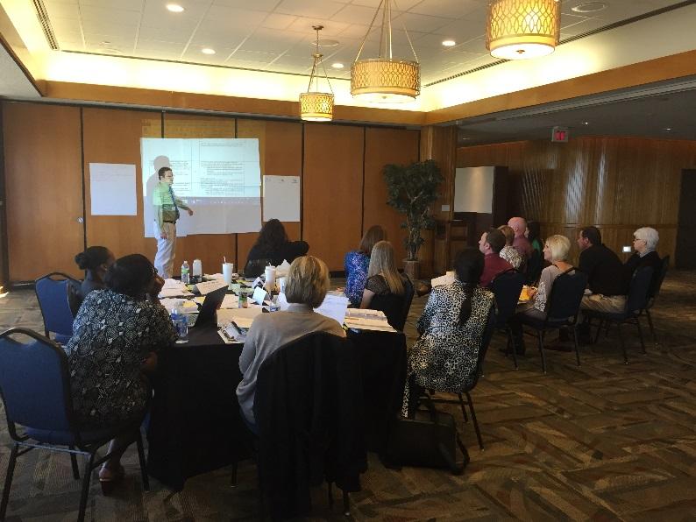
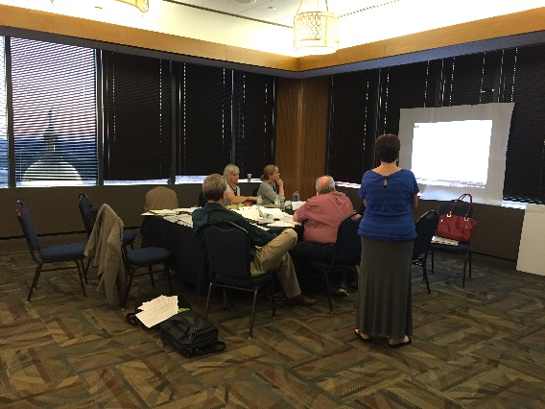
Teachers at Work

